Slide 2
Experiment 1: Noise Removal

Slide 3
Experiment 1: Noise Removal (cont’d)

Slide 4
Experiment 1: Noise Removal (cont’d)

Slide 5
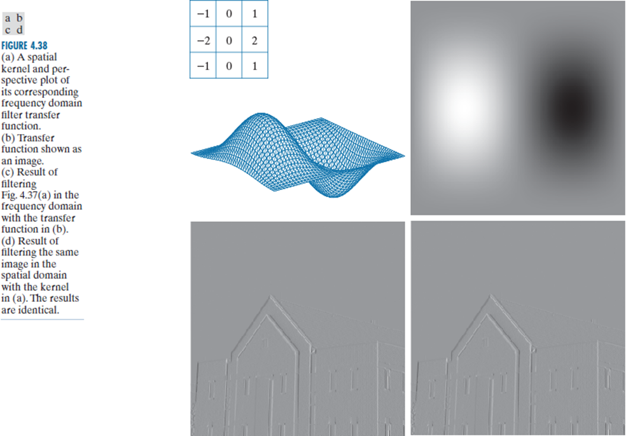
Experiment 2: Convolution in the frequency domain

Slide 6
Experiment 3: Homomorphic Filtering

Slide 7
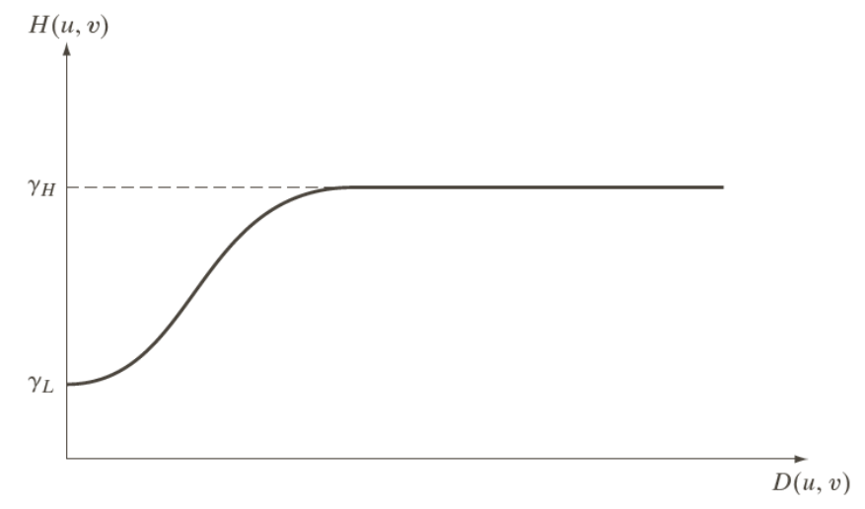
Experiment 3: Homomorphic Filtering

Slide 8
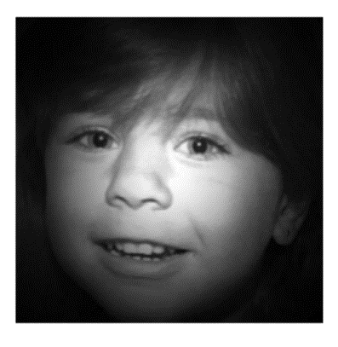
Experiment 3: Homomorphic Filtering

