Slide 1
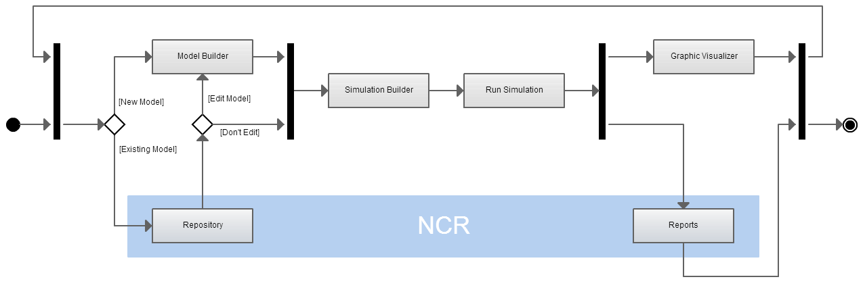
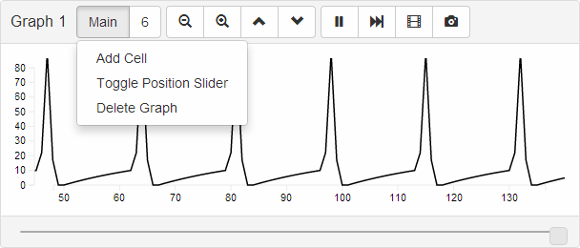
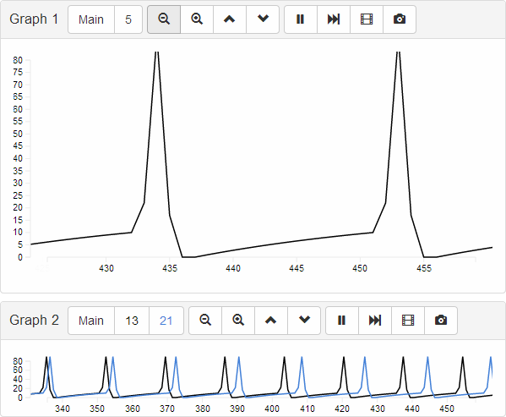
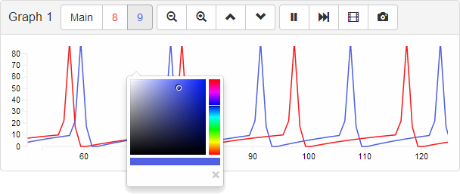
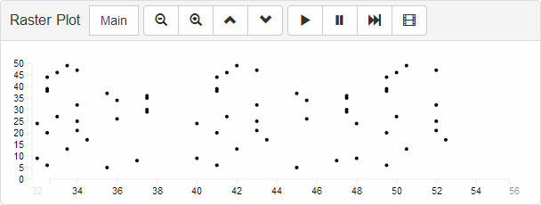
Neo - Cortical Repository/Reports
Edson Almachar | Alex Falconi | Katie Gilgen | CSE Department, UNR
Instructor: Dr. Sergiu Dascalu | Advisors: Dr. Frederick Harris, Jr., Devyani Tanna
Abstract
User Interface
Project Goals
Neo Cortical Repository/Reports (NCR) consists of two tabs of a web application to make Neo Cortical Simulator (NCS) more accessible. NCS is a brain simulator used in the field of neuroscience which uses brain models for simulation input, and outputs report data to the user. The web application aims to make interactions with the simulator more intuitive. NCR’s work is divided between the repository tab that allows users to view and search through brain models, and the reports tab with functionality to view graphical representations of the simulation data. The project includes additional work to create the brain model database and manage user accounts.
Repository Tab
The goal of NCR is to expand the use of computational neuroscience by making the use of the Neo Cortical Simulator more accessible. The components are designed for the neuroscience community, meaning that the usage will not require the users to learn how to code or spend valuable time creating graphs from raw data.
Selecting a model opens the detail view seen in Figure 3
Figure 2 – Repository tab with filtered model list
Future Work
The left search panel contains collapsible search filters for model types and parameter values
Model list changes as filters are applied
Figure 3 – Detailed view of selected model
Future work for the project includes modifications that allow the application to be more accessible on mobile devices. The database may also be modified so that it supports a wider variety of model types, meaning that the interface supports the variety as well.
Activity Diagram
The repository and reports are a part of NCS. The diagram (right) shows their relationship to each other and the other components
Application Architecture
Conclusion
The web application is made up of multiple tabs, which work together for completeness in functionality. Figure 1 shows the various components that make up the overall application. The activity diagram in Figure 4 gives more detail into the flow of control throughout the components.
Figure 4 – NCR Activity Diagram
The NCR project is a necessary component of the web application because it allows users to see the available models, collaborate with users around the world, and intuitively view the simulation output. NCR follows a fundamental principle: Fluid harmony between the powerful back end simulator and the intuitive front end array of tools is essential to the human paradigm of easy to use, easy to share, and easy to understand. Combining the various application components will encourage the desired flow of user control throughout the application.
Reports Tab
Figure 6 – A Line Graph with the graph menu clicked. Change position via the position slider (visible on the bottom).
Figure 7 - View multiple cells and change their line color. Save the graph as an SVG or an animated GIF.
Web Application
Brain Builder (NCB)
Robot Visualizer
Simulation Builder (NCB)
Reports (NCR)
Repository (NCR)
Simulator
(NCS)
Figure 8 - View firing neurons via Raster Plot. Pause the graph to get a better look.
Figure 1 – NCS Web application components
Figure 5 - Zoom in and expand the graph, or Zoom out and contract the graph
This project was developed in Spring 2014 as part of the course CS 426 Senior Projects in Computer Science
For more information about the NCR project, visit http://www.surukenza.com/Brainlab
To learn about the Brain Computation Lab, visit http://www.cse.unr.edu/brain
University of Nevada Reno
Department of Computer Science & Engineering

