Slide 1
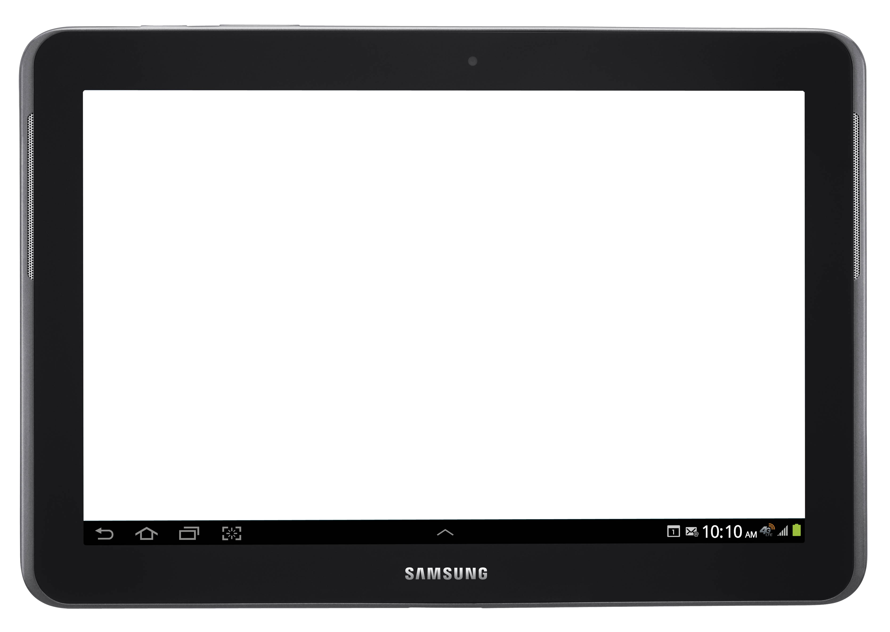
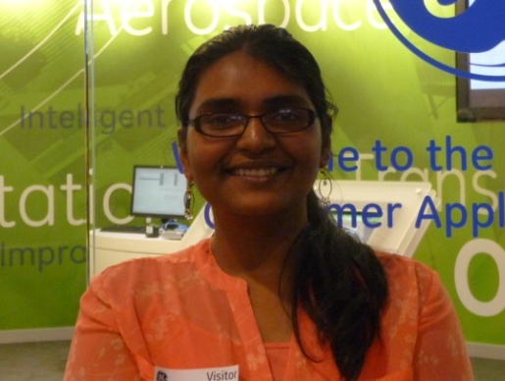
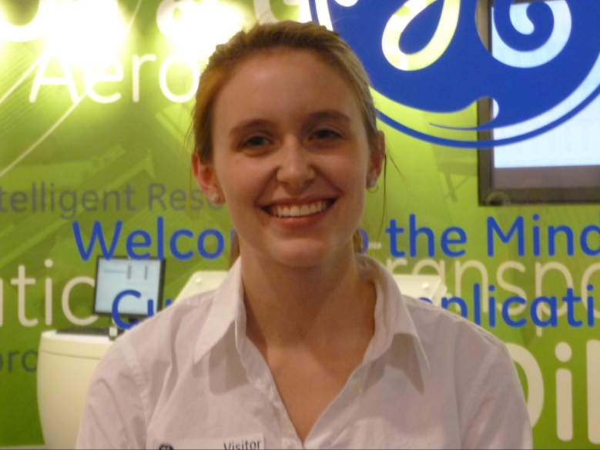
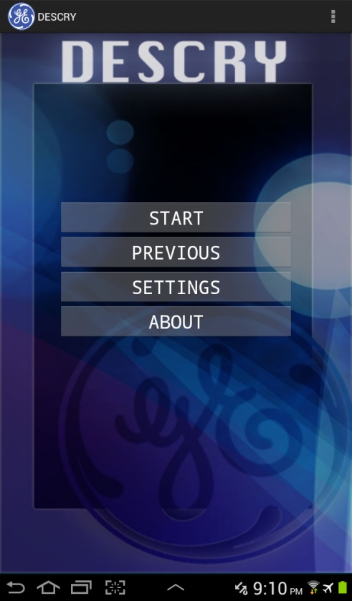
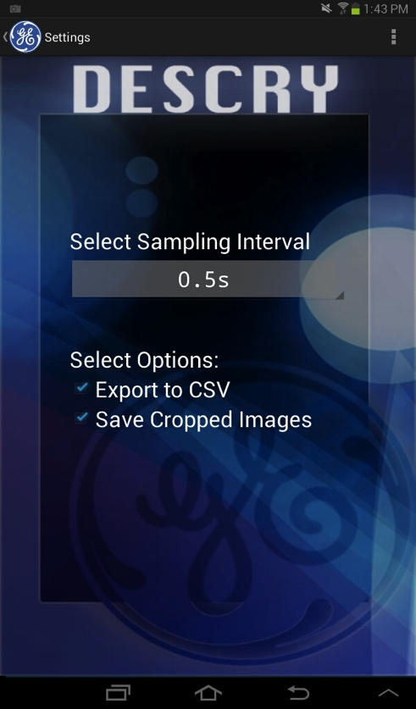
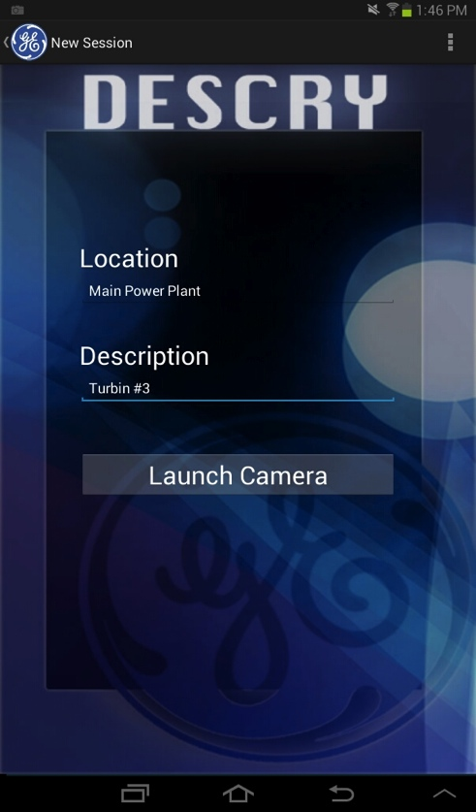
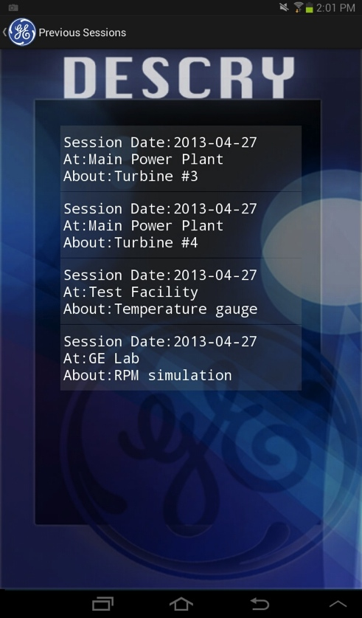
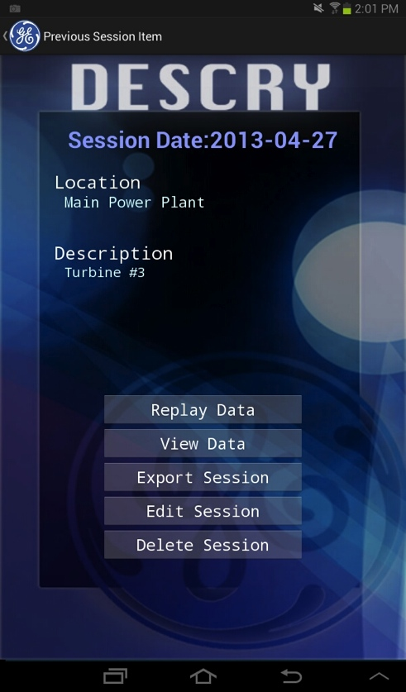
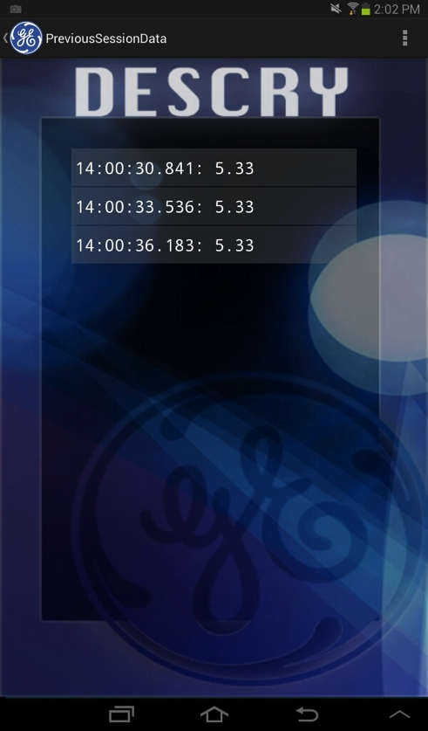
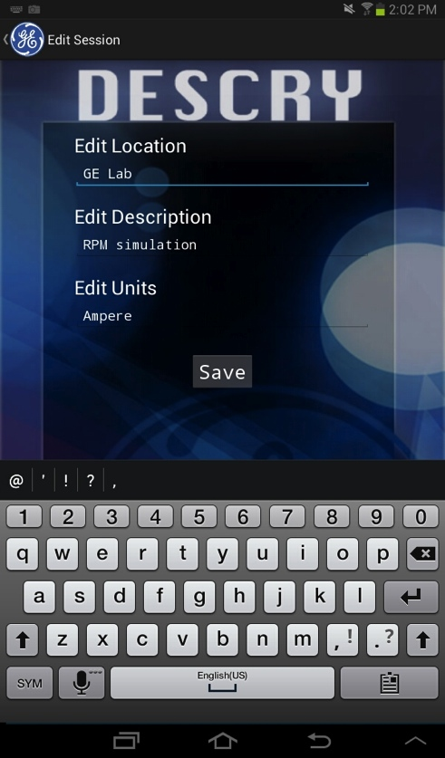
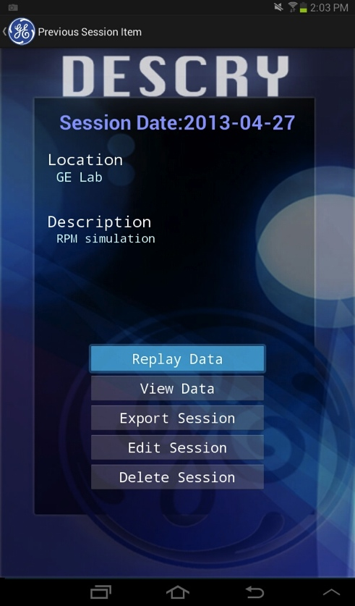
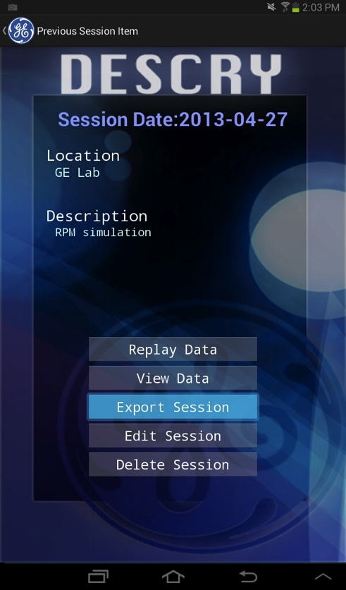
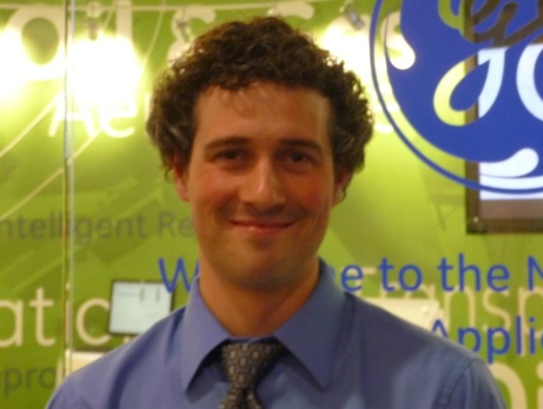
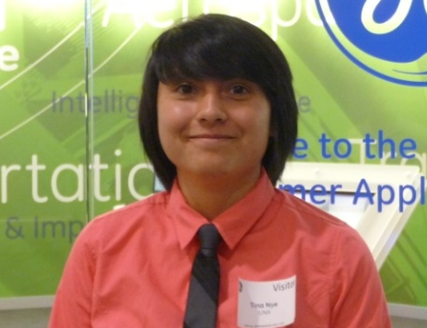
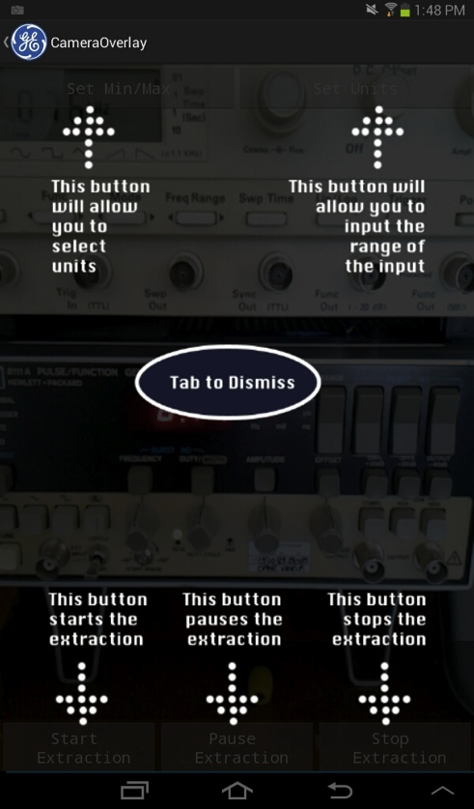
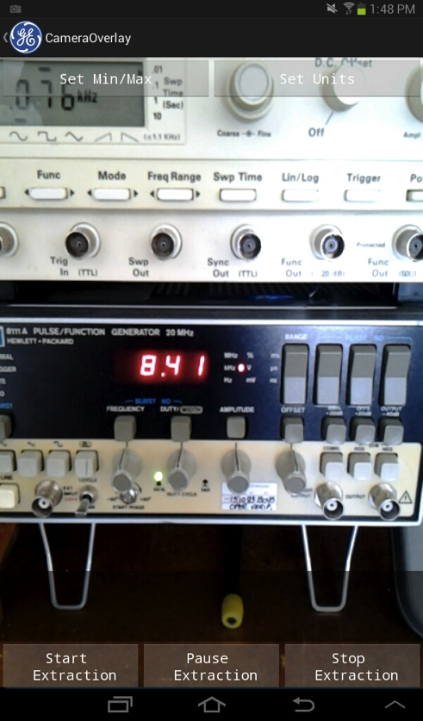
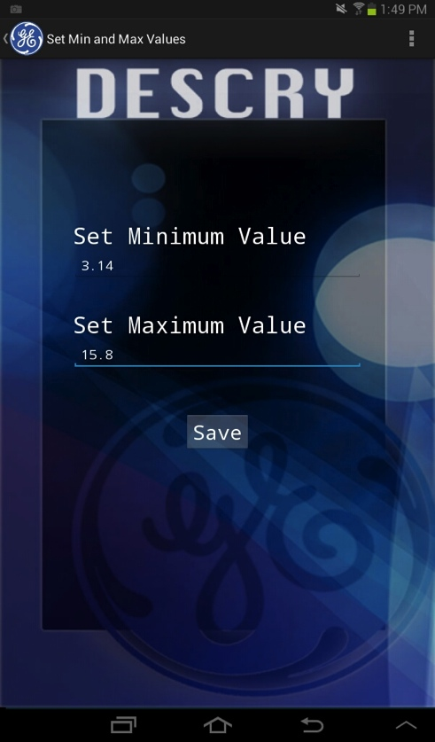
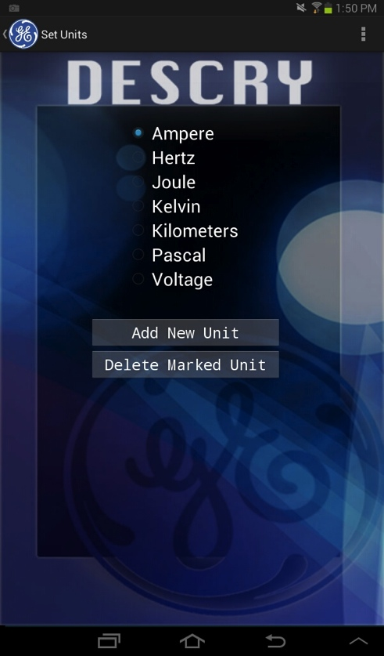
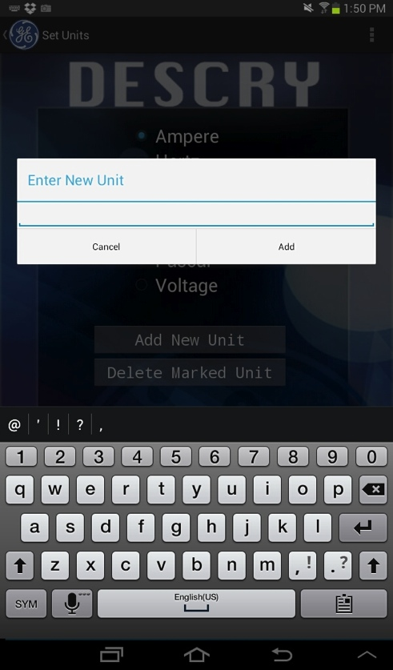
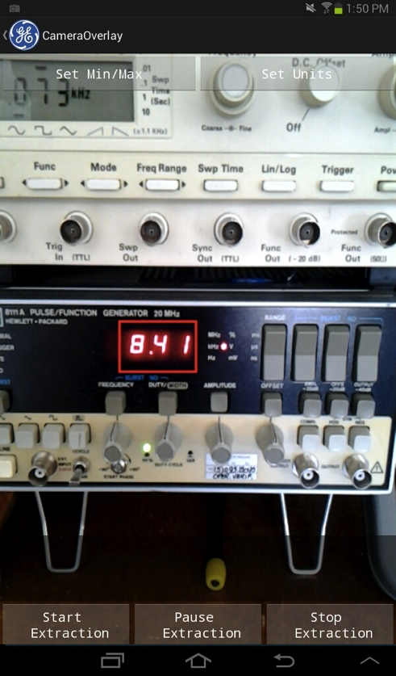
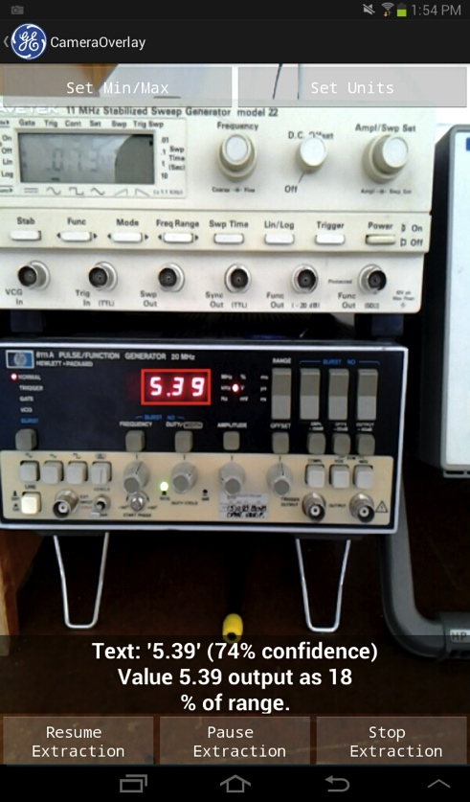
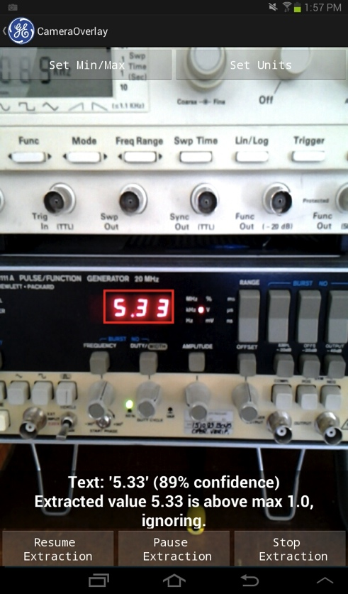
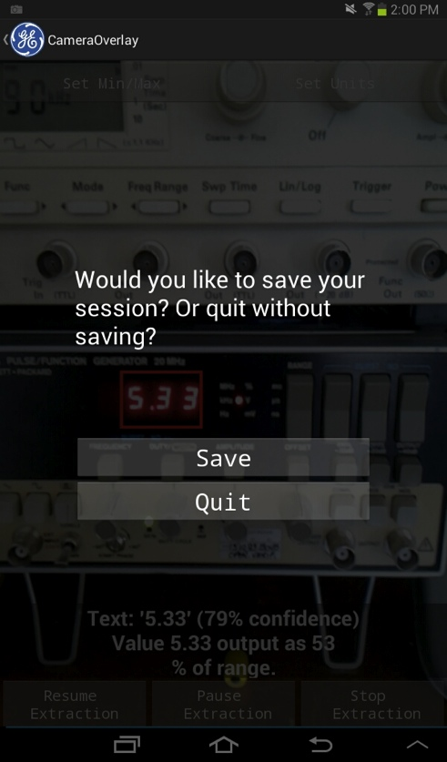
DESCRY: Design for Electrical Sensor Character Recognition Yoking
Emily Hand ● Tina Nye ● Greg Patterson ● Qandeel Sajid
Department of Computer Science and Engineering, University of Nevada, Reno
Dr. Sergiu Dascalu, UNR CSE Department ● Mr. Roy Francis, Sr. QA Engineer, GE Energy ● Mr. Ray Jensen, Applications Engineer, GE Energy
https://sites.google.com/descry2013/
Abstract
Interface
The Measurement and Control division of General Electric in Minden, NV provides products and services that prevent large systems from failing. Often, representatives from GE will audit existing systems at other facilities and need to record data. However, due to security restrictions and limitations of legacy technology, they sometimes must record values from equipment displays by hand and enter the data into a separate machine later for analysis. To remove this middle step, we created a mobile application that uses a tablet's camera to record an image of the equipment's digital readout and performs optical character recognition to extract and record the numerical values, optionally outputting them to a separate data acquisition system using tone modulation through the tablet's headphone jack.
Starting a Session
Accessing Previous Sessions
Qandeel Sajid
Emily Hand
Extraction Process
Main Goals
Greg Patterson
Tina Nye
DESCRY is an Android application intended for the Samsung Galaxy Tab 2 7.0 that allows a user to extract data from digital gauges, records it to a database, and outputs it via tone modulations. The user can view a live preview of the tablet’s camera and select a region of the image where a desired value is being displayed. When the user is ready, DESCRY then continuously samples the value at a specified interval by performing OCR on the image. The values are written to a database with timestamps, and the volume of a 1KHz tone is modulated based on where the value lies within a user-defined range. This allows a separate data acquisition device, such as GE’s ADRE 408 DSPi, to accept the values as an analog input. After setup, DESCRY can be left unattended for continuous, automated data collection. The user can then pause or stop the extraction when desired. Extracted values are displayed on the tablet in real time, along with a confidence value and other information. Values that cannot be recognized accurately or fall outside of the specified range are discarded. Previous sets of extracted values, called sessions, can be later “replayed” to the ADRE via tone modulation, exported to a comma-separated values (CSV) file, or emailed. In addition to the extracted values, a stored session may also contain the location and description of the sampled gauge, the minimum and maximum of the user-defined range, the units of the value, and the date recorded.
Conclusion
Future Work
DESCRY is a mobile application designed to aid GE field technicians as they collect data from equipment at remote facilities. This automated process is more efficient and accurate than the current methods used for collecting data. Using DESCRY, fewer technicians are needed to record the same amount of data, greatly reducing labor costs. The improved accuracy also allows for more effective analysis of the data. GE has expressed interest in developing DESCRY into a fully featured commercial product.
DESCRY could be extended to allow extraction of multiple areas within the camera's field of view and automatic detection of value locations. It could also be adapted to recognize and extract values from analog gauges. A stabilization layer could also be added to allow handheld operation of the application without loss of data. The application could also be ported to other popular mobile platforms, including iOS and Windows Phone.
This project was developed in Spring 2013 as part of the course CS 426 Senior Projects.

