Slide 1
Autonomous Mobile Robots
CPE 470/670
Lecture 3
Instructor: Monica Nicolescu

Slide 2
Review
Spectrum of robot control
  Reactive
  Deliberative
  Hybrid
  Behavior-based control
Brief history of robotics
  Control theory, cybernetics, AI

Slide 3
AI and Robotics
AI influence to robotics:
  Knowledge and knowledge representation are central to intelligence
Perception and action are more central to robotics
New solutions developed: behavior-based systems
  “Planning is just a way of avoiding figuring out what to do next” (Rodney Brooks, 1987)
Distributed AI (DAI)
  Society of Mind (Marvin Minsky, 1986): simple, multiple agents can generate highly complex intelligence
First robots were mostly influenced by AI (deliberative)

Slide 4
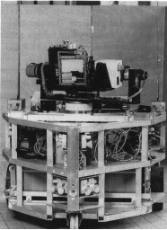
Early AI Robots: HILARE
Late 1970s
At LAAS in Toulouse
Video, ultrasound, laser rangefinder
Was in use for almost 2 decades
One of the earliest hybrid architectures
Multi-level spatial representations

Slide 5
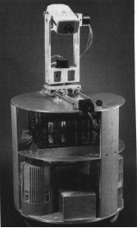
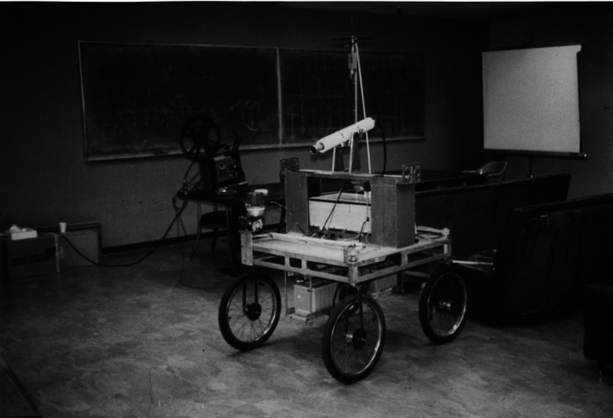
Early Robots: CART/Rover
Hans Moravec’s early robots
Stanford Cart (1977) followed by CMU rover (1983)
Sonar and vision

Slide 6
Lessons Learned
Move faster, more robustly
Think in such a way as to allow this action
New types of robot control:
  Reactive, hybrid, behavior-based
Control theory
  Continues to thrive in numerous applications
Cybernetics
  Biologically inspired robot control
AI
  Non-physical, “disembodied thinking”

Slide 7
Challenges
Perception
  Limited, noisy sensors, symbol grounding
Actuation
  Limited capabilities of robot effectors
Thinking
  Time consuming in large state spaces
Environments
  Dynamic, impose fast reaction times

Slide 8
Key Issues of Behavior-Based Control
Situatedness
  Robot is entirely situated in the real world
Embodiment
  Robot has a physical body
Emergence
  Intelligence from the interaction with the environment
Grounding in reality
  Correlation of symbols with the reality
Scalability
  Reaching high-level of intelligence

Slide 9
Effectors & Actuators
Effector
  Any device robot that has an impact on the environment
  Effectors must match a robot’s task
  Controllers command the effectors to achieve the desired task
Actuator
  A robot mechanism that enables the effector to execute an action
Robot effectors are very different than biological ones
  Robots: wheels, tracks, legs, grippers
Robot actuators:
  Motors of various types

Slide 10
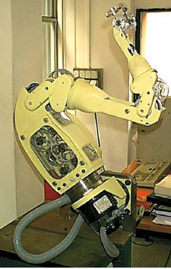
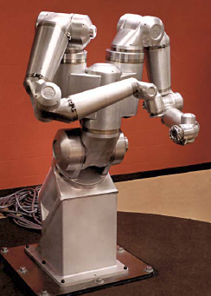
Robot Types - Manipulators
Kinematic redundancy: more degrees of freedom than necessary to solve the task
7-DOF Mitsubishi PA10
8-DOF Scienzia Machinale
Snake design
Robotics Research Corporation
NASA dexterous manipulator

Slide 11
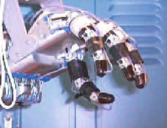
Robot Types - Hands
Mechanical constraints: placement of motors and sensors
Utah/MIT robot hand
Stanford/JPL hand
UB hand 3
NASA robonaut
http://www.youtube.com/watch?v=g3u48T4Vx7k

Slide 12
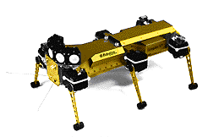
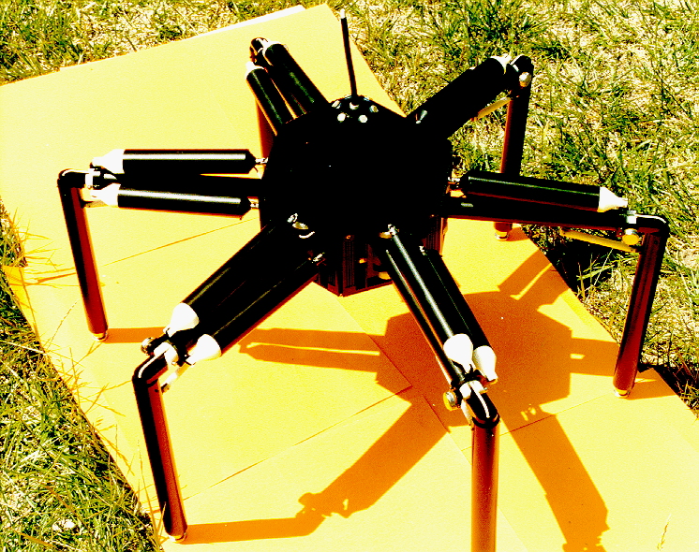
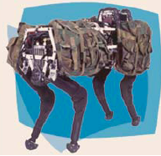
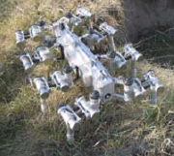
Robot Types – Legged Robots
Inspired from biological systems: insects, mammals

Slide 13
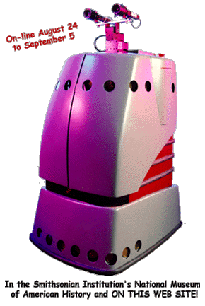
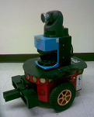
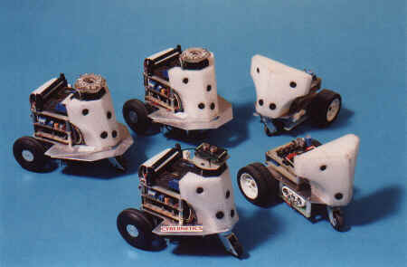
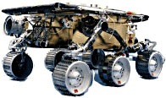
Robot Types - Wheeled

Slide 14
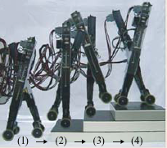
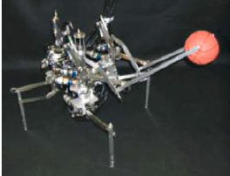
Robot Types - Hybrid
Leg – wheel
Leg – arm
Wall-climbing

Slide 15
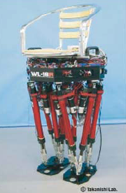
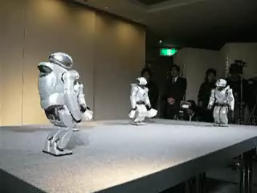
Robot Types – Legged/Humanoid Robots
Biped robots
Hopping robots

Slide 16
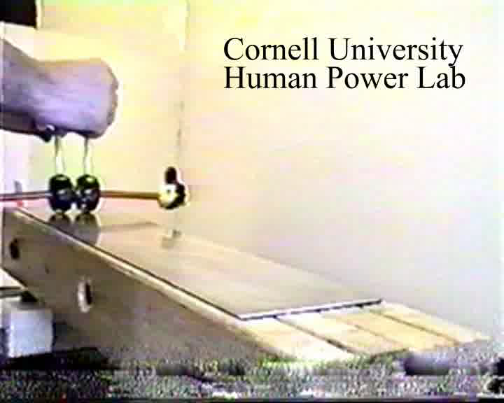
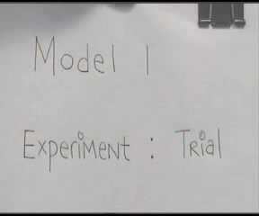
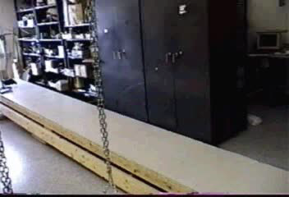
Passive Actuation
Use potential energy and interaction with the environment
  E.g.: gliding (flying squirrels)
Robotics examples:
  Tad McGeer’s passive walker
  Actuated by gravity

Slide 17
Types of Actuators
Electric motors
Hydraulics
Pneumatics
Photo-reactive materials
Chemically reactive materials
Thermally reactive materials
Piezoelectric materials

Slide 18
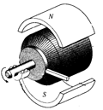
DC Motors
DC (direct current) motors
  Convert electrical energy into mechanical energy
  Small, cheap, reasonably efficient, easy to use
How do they work?
  Electrical current through loops of wires mounted on a rotating shaft
  When current is flowing, loops of wire generate a magnetic field, which reacts against the magnetic fields of permanent magnets positioned around the wire loops
  These magnetic fields push against one another and the armature turns

Slide 19
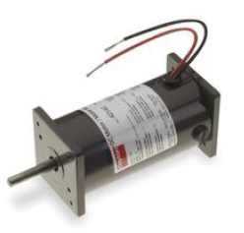
Motor Efficiency
DC motors are not perfectly efficient
Some limitations (mechanical friction)
of motors
  Some energy is wasted as heat
Industrial-grade motors (good quality): 90%
Toy motors (cheap): efficiencies of 50%
Electrostatic micro-motors for miniature robots: ≤50%

Slide 20
Operating Voltage
Making the motor run requires electrical power in the right voltage range
Most motors will run fine at lower voltages, though they will be less powerful
Can operate at higher voltages at expense of operating life

Slide 21
Operating/Stall Current
When provided with a constant voltage, a DC motor draws current proportional to how much work it is doing Work = Force * Distance
When there is no resistance to its motion, the motor draws the least amount of current
  Moving in free space ⇒ less current
If the resistance becomes very high the motor stalls and draws the maximum amount of current at its specified voltage (stall current)
  Pushing against an obstacle (wall) ⇒ drain more current

Slide 22
Torque
Torque: rotational force that a motor can deliver at a certain distance from the shaft
Strength of magnetic field generated in loops of wire is directly proportional to amount of current flowing through them and thus the torque produced on motor’s shaft
The more current through a motor, the more torque at the motor’s shaft

Slide 23
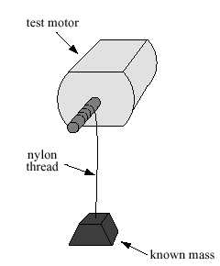
Stall Torque
Stall torque: the amount of rotational force produced when the motor is stalled at its recommended operating voltage, drawing the maximal stall current at this voltage
Typical torque units: ounce-inches
  5 oz.-in. torque means motor can pull weight of 5 oz up through a pulley 1 inch away from the shaft

Slide 24
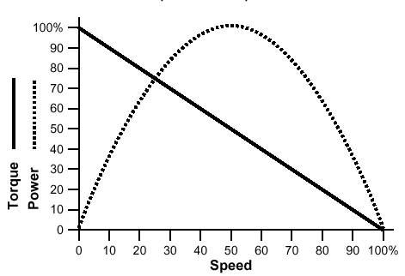
Power of a Motor
Power: product of the output
shaft’s rotational velocity and
torque
No load on the shaft
  Rotational velocity is at its highest, but the torque is zero
  The motor is spinning freely (it is not driving any mechanism)
Motor is stalled
  It is producing its maximal torque
  Rotational velocity is zero
P=0
A motor produces the most power in the middle of its performance range.
P=0

Slide 25
How Fast do Motors Turn?
Free spinning speeds (most motors):
  3000-9000 RPM (revolutions per minute) [50-150 RPS]
High-speed, low torque
  Drive light things that rotate very fast
What about driving a heavy robot body or lifting a heavy manipulator?
  Need more torque and less speed
  How can we do this?

Slide 26
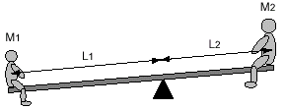
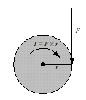
Gearing
Tradeoff high speed for more torque
Seesaw physics
  Downward force is equal to weight
  times their distance from the fulcrum.
Torque: T = F x r
  rotational force generated at the center of a
  gear is equal to the gear’s radius times the
  force applied tangential at the circumference

Slide 27
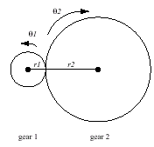
Meshing Gears
By combining gears with different ratios we can control the amount of force and torque generated
  Work = force x distance
  Work = torque x angular movement
Example: r₂ = 3r₁
  Gear 1 turns three times (1080 degrees)
  while gear 2 turns only once (360 degrees)
  T_{output} x 360 = T_{input} x 1080
  T_{output} = 3 T_{input} = T_{input} x r₂/r₁
Gear 1 with radius r1 turns an angular distance of Θ₁ while Gear 2 with radius
r2 turns an angular distance of Θ₂.

Slide 28
Torque – Gearing Law
T_{output} = T_{input} x r_{output}/r_{input}
The torque generated at the output gear is proportional to the torque on the input gear and the ratio of the two gear's radii
If the output gear is larger than the input gear (small gear driving a large gear) ⇒ torque increases
If the output gear is smaller than the input gear (large gear driving a small gear) ⇒ torque decreases

Slide 29
Gearing Effect on Speed
Combining gears has a corresponding effect on speed
A gear with a small radius has to turn faster to keep up with a larger gear
If the circumference of gear 2 is three
times that of gear 1, then gear 1 must
turn three times for each full rotation
of gear 2.
Increasing the gear radius reduces the speed.
Decreasing the gear radius increases the speed.

Slide 30
Torque – Speed Tradeoff
When a small gear drives a large one, torque is increased and speed is decreased
Analogously, when a large gear drives a small one, torque is decreased and speed is increased

Slide 31
Designing Gear Teeth
Reduced backlash
  The play/looseness between mashing gear teeth
Tight meshing between gears
  Increases friction
Proportionally sized gears
  A 24-tooth gear must have a radius three times the size of an 8-tooth gear

Slide 32
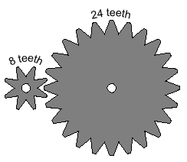
Gearing Examples
3 to 1 Gear Reduction
Input (driving) gear: 8 teeth
Output (driven) gear: 24 teeth
Effect:
  1/3 reduction in speed and 3 times increase in torque at 24-tooth gear
3 turns of left gear (8 teeth) cause 1 turn of right gear (24 teeth)

Slide 33
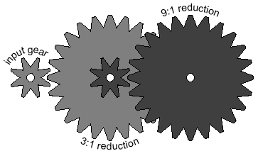
Gear Reduction in Series
By putting two 3:1 gear reductions in series (“ganging”) a 9:1 gear reduction is created
  The effect of each pair of reductions is multiplied
  Key to achieving useful power from a DC motor
With such reductions, high speeds and low torques are transformed into usable speeds and powerful torques
8-tooth gear on left; 24-tooth gear on right

Slide 34
Servo Motors
Specialized motors that can move their shaft to a specific position
DC motors can only move in one direction
“Servo”
  capability to self-regulate its behavior, i.e., to measure its own position and compensate for external loads when responding to a control signal
Hobby radio control applications:
  Radio-controlled cars: front wheel steering
  RC airplanes: control the orientation of the wing flaps and rudders

Slide 35
Servo Motors
Servo motors are built from DC motors by adding:
  Gear reduction
  Position sensor for the motor shaft
  Electronics that tell the motor how much to turn and in what direction
Movement limitations
  Shaft travel is restricted to 180 degrees
  Sufficient for most applications

Slide 36
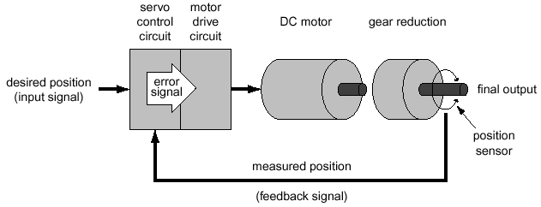
Operation of Servo Motors
The input to the servo motor is desired position of the output shaft.
This signal is compared with a feedback signal indicating the actual position of the shaft (as measured by position sensor).
An “error signal” is generated that directs the motor drive circuit to power the motor
The servo’s gear reduction drives the final output.

Slide 37
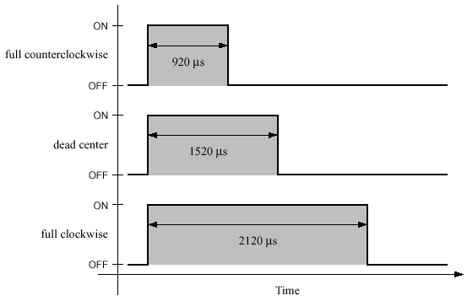
Control of Servo Motors
Input is given as an electronic signal, as a series of pulses
  length of the pulse is interpreted to signify control value: pulse-width modulation
Width of pulse must be accurate (μs)
  Otherwise the motor could jitter or go over its mechanical limits
The duration between pulses is not as important (ms variations)
  When no pulse arrives the motor stops
Three sample waveforms for controlling a servo motor

Slide 38
Effectors
Effector: any robot device that has an effect on the environment
Robot effectors
  Wheels, tracks, arms grippers
The role of the controller
  get the effectors to produce the desired effect on the environment, based on the robot’s task

Slide 39
Degrees of Freedom (DOF)
DOF: any direction in which motion can be made
The number of a robot’s DOFs influences its performance of a task
Most simple actuators (motors) control a single DOF
  Left-right, up-down, in-out
Wheels for example have only one degree of freedom
Robotic arms have many more DOFs

Slide 40
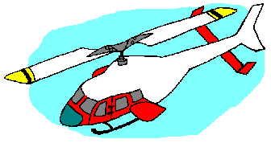
DOFs of a Free Body
Any unattached body in 3D space has a total of 6 DOFs
  3 for translation: x, y, z
  3 for rotation: roll, pitch, yaw
These are all the possible ways a helicopter can move
If a robot has an actuator for every DOF then all DOF are controllable
In practice, not all DOF are controllable
roll
pitch
yaw

Slide 41
A Car DOF
A car has 3 DOF
  Translation in two directions
  Rotation in one direction
How many of these are controllable?
Only two can be controlled
  Forward/reverse direction
  Rotation through the steering wheel
Some motions cannot be done
  Moving sideways
The two available degrees of freedom can get to any position and orientation in 2D

Slide 42
Holonomicity
A robot is holonomic if the number of controllable DOF is equal to the number of DOF of the robot
A robot is non-holonomic if the number of controllable DOF is smaller than the number of DOF of the robot
A robot is redundant if the number of controllable DOF is larger than the number of DOF of the robot

Slide 43
Redundancy Example
A human arm has 7 degrees of freedom
  3 in the shoulder (up-down, side-to-side, rotation)
  1 in elbow (open-close)
  3 in wrist (up-down, side-to-side, rotation)
How can that be possible?
The arm still moves in 3D, but there are multiple ways of moving it to a position in space
This is why controlling complex robotic arms is a hard problem
3 DOF
1 DOF

Slide 44
Uses of Effectors
Locomotion
  Moving a robot around
Manipulation
  Moving objects around
Effectors for locomotion
  Legs: walking/crawling/climbing/jumping/hopping
  Wheels: rolling
  Arms: swinging/crawling/climbing
  Flippers: swimming
Most robots use wheels for locomotion

Slide 45
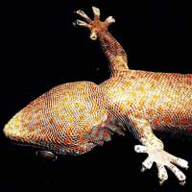
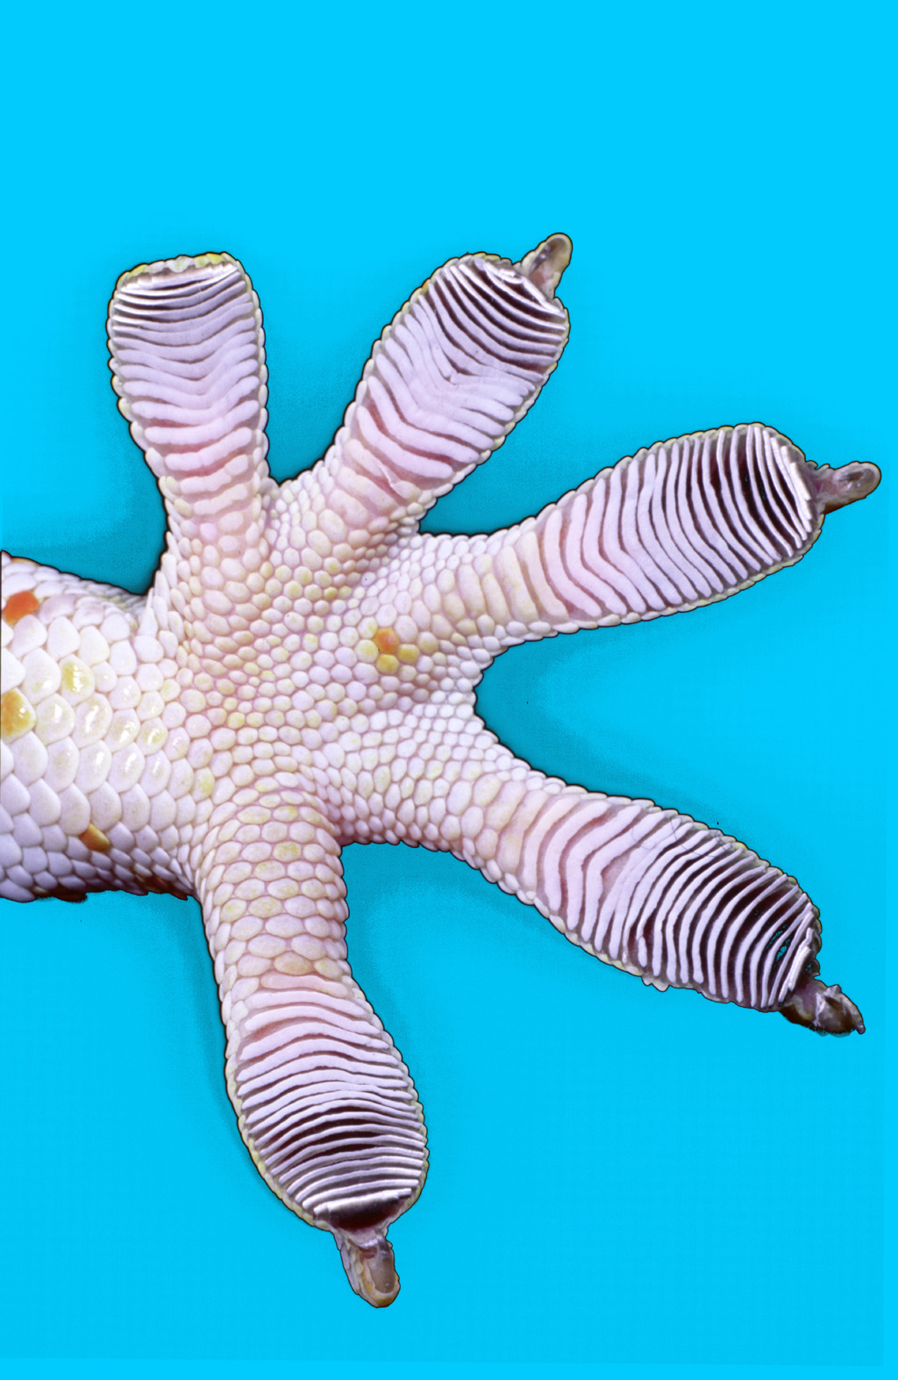
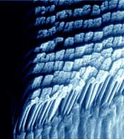
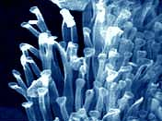
Biologically Inspired Effectors
Bob Full – Berkley: Geckos
The structure of a gecko foot has millions of microscopic hairs (called setae) on its bottom
Setae span just two diameters of a human hair, or 100 millionth of a meter
Each seta ends with 1,000 even smaller pads at the tip.
Intermolecular
forces

Slide 46
Stability
Robots need to be stable to get their job done
Stability can be
  Static: the robot can stand still without falling over
  Dynamic: the body must actively balance or move to remain stable
Static stability is achieved through the mechanical design of the robot
Dynamic stability is achieved through control

Slide 47
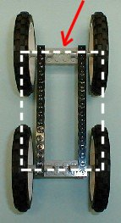
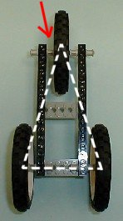
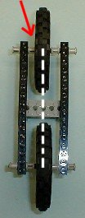
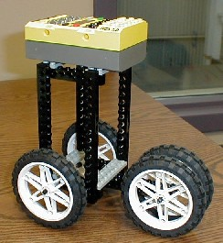
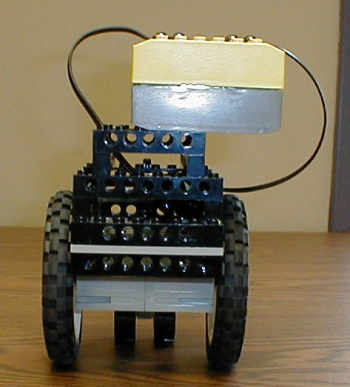
Stability
What do you think about people?
  Humans are not statically stable
  Active control of the brain is needed, although it is largely unconscious
Stability becomes easier if you would have more legs
For stability, the center of gravity (COG) of the body needs to be above the polygon of support (area covered by the ground points)
Bad designs

Slide 48
Readings
M. Matarić: Chapters 5, 6

