Slide 1
Artificial Intelligence
CS482, CS682, MW 1 – 2:15, SEM 201, MS 227
Prerequisites: 302, 365
Instructor: Sushil Louis, sushil@cse.unr.edu, http://www.cse.unr.edu/~sushil

Slide 2
Questions
Rational agents and performance metrics
  Suppose that the performance measure is concerned with just the first T time steps of the environment and ignores everything thereafter. Show that a rational agent’s action may depend not just on the state of the environment but also on the time step it has reached

Slide 3
Questions (True or False)
An agent that senses only partial information about the state cannot be perfectly rational
There exist task environments in which no pure reflex agent can behave rationally
There exists a task environment in which every agent is rational
The input to an agent program is the same as the input to the agent function
Every agent function is implementable by some program/machine combination
Suppose an agent selects its action uniformly at random from the set of possible actions. There exists a deterministic task environment in which this agent is rational

Slide 4
True or False
It is possible for a given agent to be perfectly rational in two distinct task environments
Every agent is rational in an unobservable environment
A perfectly rational poker-playing agent never loses

Slide 5
Types of task environments
Task Env | Observable | Agents | Deterministic | Episodic | Static | Discrete
Soccer
Exploring the subsurface oceans of Titan
Shopping for used AI books on the net
Playing a tennis match
Practicing tennis against a wall
Performing a high jump
Knitting a sweater
Bidding on an item at anauction

Slide 6
Types of task environments
Task Env | Observable | Agents | Deterministic | Episodic | Static | Discrete
Soccer | Partial | Multi | Stochastic | Sequential | Dynamic | Continuous
Exploring the subsurface oceans of Titan | Partial | Single? | Stochastic | Sequential | Dynamic | Continuous
Shopping for used AI books on the net | Partial | Single ? | Deterministic | Sequential | Static | Discrete
Playing a tennis match | Fully | Multi | Stochastic | Episodic/Seq | Dynamic | Continuous
Practicing tennis against a wall | Fully | Single | Stochastic | Episodic/seq | Dynamic | Continuous
Performing a high jump | Fully | Single | Stochastic | Sequential | Static | Continuous
Knitting a sweater | Fully | Single | Deterministic | Sequential | Static | Continuous
Bidding on an item at an auction | Fully | Multi | Stochastic/ Strategic | Sequential | Static | Discrete

Slide 7
Quotes
MURPHY'S LAWS
  Nothing is as easy as it looks.
  Everything takes longer than you think.
  Anything that can go wrong will go wrong.
  If there is a possibility of several things going wrong, the one that will cause the most damage will be the one to go wrong. Corollary: If there is a worse time for something to go wrong, it will happen then.
  If anything simply cannot go wrong, it will anyway.
  If you perceive that there are four possible ways in which a procedure can go wrong, and circumvent these, then a fifth way, unprepared for, will promptly develop.
  Every solution breeds new problems.
The Murphy Philosophy
  Smile . . . tomorrow will be worse.

Slide 8
Arthur C. Clarke
Any sufficiently advanced technology is indistinguishable from magic.

Slide 9
Outline
Problem solving agents
Problem types
Problem formulation
Example Problems
Basic Search Algorithms

Slide 10
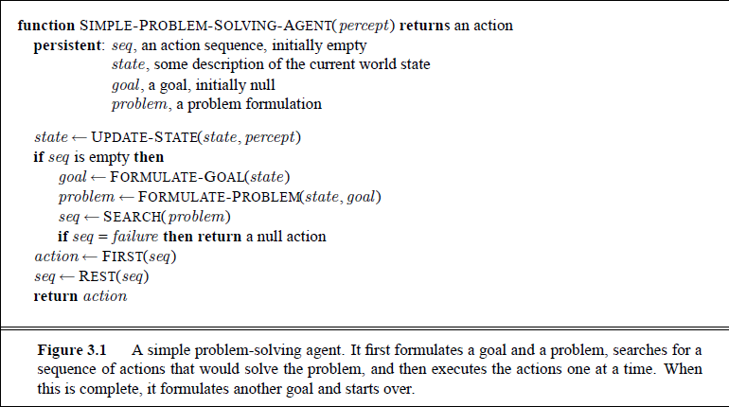
Problem Solving Agents
Restricted form of general agent
This is offline problem solving. Search for solution, then execute. During execution we are not using subsequent percepts

Slide 11
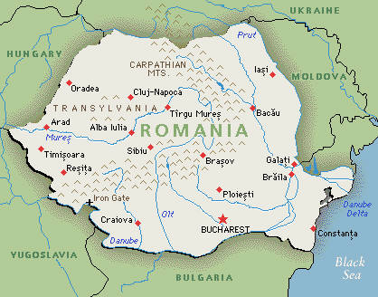
Problem solving agent example
Consider a holiday in Romantic Romania
  You are an agent, holiday touring in Arad, Romania
  What are your performance measures?
    Improve suntan, look at the sights, check out Transylvania, enjoy the nightlife, become one of the undead, avoid hangovers, …
    The action sequence to do this is long and complicated and you need to read guidebooks, books, talk to people, make tradeoffs
    Very complex, let us simplify
  You have a non-refundable ticket to get home from Bucharest tomorrow
  Now you have a goal: Get to Bucharest in time to catch your flight tomorrow

Slide 12
Romantic Romania
Goal: Get to Bucharest
Formulate Problem:
  States: Cities
  Actions: Drive to city
What level of abstraction?
  Turn wheel or Drive to Bucharest
  What is a state?
  What is an action?
Goal: Set of states, specifically: {Bucharest}
Solution: Sequence of actions that results in a goal state

Slide 13
What type of task environment?
Task Env | Observable | Agents | Deterministic | Episodic | Static | Discrete
Romantic Romania
Task Env | Observable | Agents | Deterministic | Episodic | Static | Discrete
Romantic Romania | Yes | Single | Yes | Sequential | Static | Discrete

Slide 14
Problem solution
A fixed sequence of actions
Agent searches for a sequence of actions that will lead to a goal state
So we :
  Formulate the problem,
  Search for a solution,
  Execute the action sequence
Execution phase does NOT consider percepts in this simple example. In control theory: Open-Loop system

Slide 15
Back to Romanian problem formulation
Initial State, S_0
  In(Arad)
Actions
  Actions(S) returns set of actions possible in state S
  {Go(Sibiu), Go(Timisoara), Go(Zerind)}
Transition Model: What does an action do?
  Result (In(Arad), Go(Zerind)) = In(Zerind)
State space is a directed graph
A Path in the state space is a sequence of states connected by a sequence of actions
Goal State(s) → In(Bucharest)
Path COST function
  Some agents are better than others → lower cost
  Path costs are non-negative (>= 0)
State
Space
of our problem
A solution is a sequence of actions leading from the initial state to a goal state

Slide 16
Abstraction
The real world is absurdly complex so state space must be abstracted for problem solving
In(Arad) means somewhere in Arad but where
Result(In (Arad), Go(Zerind)) = In (Zerind). Yay but how do you find the highway out and what side do you drive on and where’s the gas station, and …..
  In a more expressive, less abstract representation of the world, In(Arad) must correspond to some real location in Arad (Hotel Phoenix perhaps)
Similarly a solution, a sequence of actions, must correspond to real actions in the less abstract real-world. A Solution Path must correspond to a real path
Our abstraction should make the original problem easier while at the same time enabling a correspondence with a more expressive representation

Slide 17
Vacuum world. States and transitions

Slide 18
Vacuum world
States
  ?
Actions
  ?
Transition model (see figure)
Goal test
  ?
Path cost
  ?

Slide 19
Vacuum world
States
  Dirt location (0, 1), Robot location (0, 1)
  Initial state can be any state →
Actions
  Left, Right, Suck, NoOp
Transition model →
Goal test
  No Dirt. All squares are clean
Path cost
  1 per action, 0 for NoOp

Slide 20
8 puzzle
States
  Location of every tile and blank
Initial state
  Any state
Actions
  Movement of blank
    Up, down, left, right
Transition model
  New state after blank move
Goal Test
  Test if configuration matches figure
Path cost
  1 per blank move

Slide 21
8 Queens
States
  ?
Initial State
  ?
Actions
  ?
Transition model
  ?
Goal Test
  ?
Path cost
  ?

Slide 22
Real world problems
Route finding
TSP
VLSI
Robot Navigation
Automatic assembly sequencing

Slide 23
Solving Romania

Slide 24
Romanian problem formulation
Initial State, S_0
  In(Arad)
Actions
  Actions(S) returns set of actions possible in state S
  {Go(Sibiu), Go(Timisoara), Go(Zerind)}
Transition Model: What does an action do?
  Result (In(Arad), Go(Zerind)) = In(Zerind)
State space is a directed graph
A Path in the state space is a sequence of states connected by a sequence of actions
Goal State(s) → In(Bucharest)
Path COST function
  Some agents are better than others → lower cost
  Path costs are non-negative (>= 0)
State
Space
of our problem
A solution is a sequence of actions leading from the initial state to a goal state

Slide 25
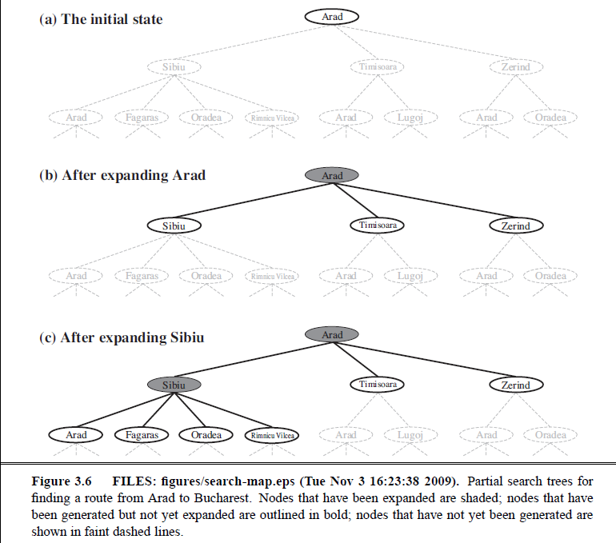
Frontier
Frontier
Frontier
Frontier

Slide 26
Arad is loopy
Why should we ignore loopy (redundant) paths?
1. DynProg
2. PathCost
Should we always ignore redundant paths?

Slide 27
Graph search avoids redundant paths
And, very importantly, getting rid of redundant paths reduces the number of tree nodes from pow(b, d) to approximately 2 d^2 !!!!!
b = branching factor
d = tree depth

Slide 28
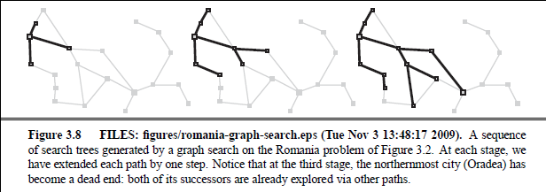
Graph search makes a state tree

Slide 29
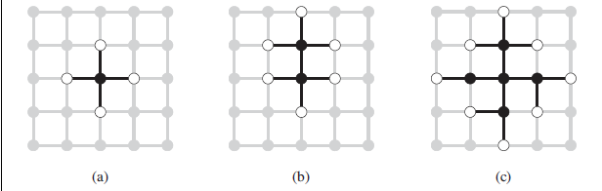
Graph search frontier separates explored and unexplored states

Slide 30
Implementing graph search
Node != problem state (states do not have parent, action, path-cost, …)
  Parent
  Action
  State
  Path-cost
function ChildNode(problem, parent, action) returns Node
  return a Node with
    State = problem.Result(parent.State, action)
    Parent = parent
    Action = action
    Path-cost = parent.Path-cost + problem.Step-cost(parent.State, action)
If node contains goal state, then you have to construct the solution – a path – by following the parent chain to the root

Slide 31
Implementing graph search
Frontier:
  Queue
    FIFO
    LIFO
    Priority
      Path-Cost?
Explored-Set:
  Hash table

Slide 32
Ready for Search
Different search strategies are defined by the order in which we choose nodes from the frontier to expand
  Lifo, fifo, …
We compare search strategies along the following dimensions
  Completeness: Does it always find a solution if one exists?
  Time Complexity: Number of nodes expanded/generated
  Space Complexity: Max number of nodes in Memory
  Optimality: Does it always find least-cost solution
Time and space complexity are measured in terms of
  b → maximum branching factor of search tree
  d → depth of least cost solution
  m → maximum depth of the tree (may be infinite!)

Slide 33
Uninformed Search
Breadth-first
Uniform-cost
Depth-first
Depth-limited
Iterative deepening

Slide 34
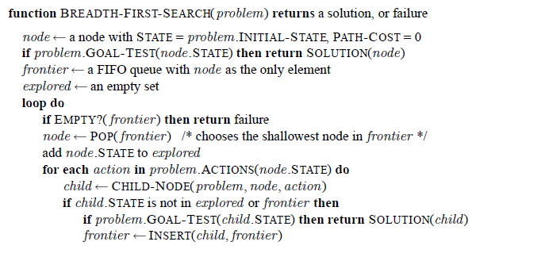
Breadth-first search – FIFO Q

Slide 35
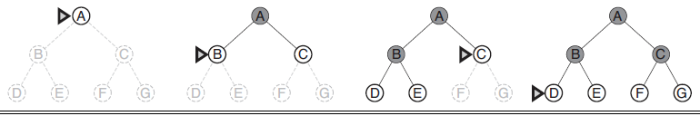
BFS
Complete: Yes – shallowest goal node
Time == Number of nodes expanded – assume b constant
  O(b^d) if you check for goal state upon generation of node or
  O(b^(d+1)) if you check when you pick node for expansion
Space == Space for nodes = number of nodes in explored set + number of nodes in frontier
  O(b^(d-1)) in explored + O(b^d) in frontier
  Uh-oh! Can generate nodes at the rate of 100MB/sec so 24 hours means 8640GB
  Look at figure 3.13 in the book
  With b = 10, d = 16, and 1M nodes/sec, 350 Years and 10 exabytes of storage needed
Optimality: Optimal if path cost is non-decreasing function of depth

Slide 36
Do BFS

Slide 37
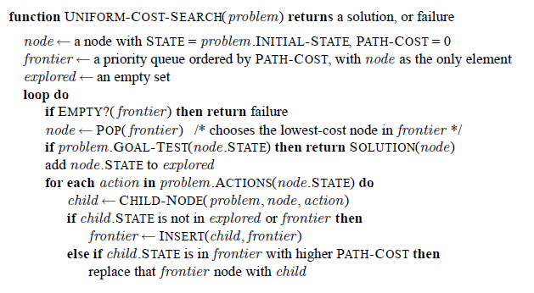
Uniform-cost search
Expand node with lowest path-cost
Goal test on expansion
Replace frontier node if you find better path to same node.State

Slide 38
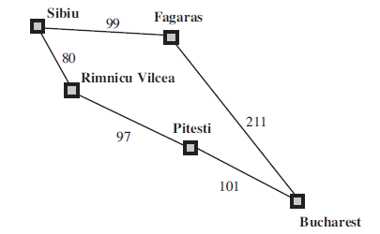
Uniform cost search
Draw the Uniform-cost search tree for getting from Sibiu to Bucharest

Slide 39
Uniform cost search
Complete if every step cost is > 0
Optimal
Time/Space – Strictly more than BFS

Slide 40
Do UCS

Slide 41
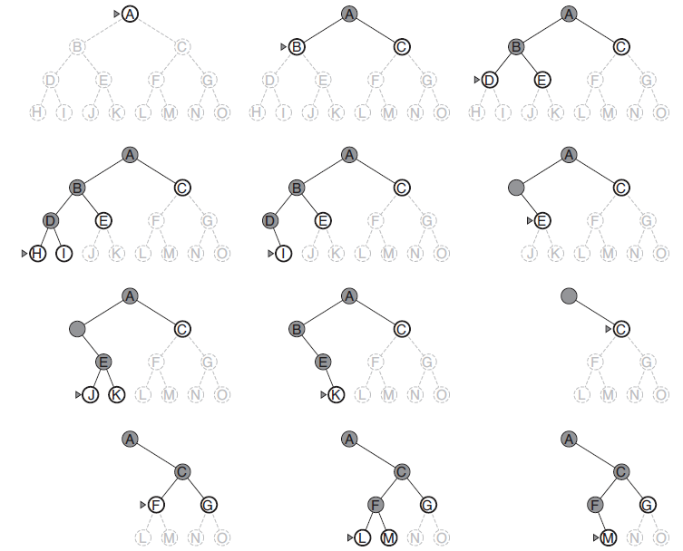
Depth-first search
LIFO Q

Slide 42
DFS
Often easy to implement recursively
Completeness:
  Graph search version is complete in finite spaces
  Tree search version can be infinitely loopy
Not-optimal
Time: If d is depth of shallowest optimal solution, and m is max depth of tree, DFS may generate O(b^m) >> O(b^d)
Space: O(bm) ! Not bad and we can go lower to O(m) with some fancy housekeeping (backtracking search)
Some kind of DFS used a lot in AI because space requirements are low
What kinds?

Slide 43
Depth-limited search
DFS with depth limit, l (el)
  If l < d you will never find solution (incomplete)
  If l > d non-optimal
  DFS = DLS with l = infinity
Romanian problem depth is 20 == number of states
  Actually 9. The diameter of the state space (max steps between any pair of states)

Slide 44
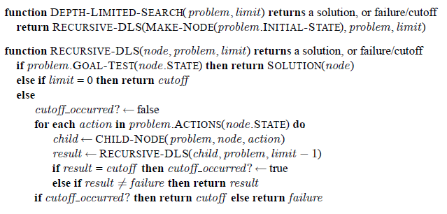
DLS (or DFS)
Remove limit to make DFS

Slide 45
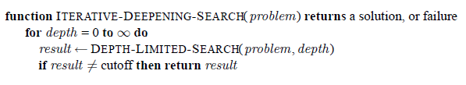
Iterative deepening DFS
DLS but keep increasing limit
Why?
  Space efficient like DFS and
  complete and optimal like BFS
  Not much extra work since the number of nodes at depth d is b^d
    And number of interior nodes = b^d -1
    Most nodes are leaves
Numerical comparison for b = 10 and d = 5, solution at far right leaf:
N(IDS) = 50 + 400 + 3; 000 + 20; 000 + 100; 000 = 123; 450
N(BFS) = 10 + 100 + 1; 000 + 10; 000 + 100; 000 + 999; 990 = 1; 111; 100

Slide 46
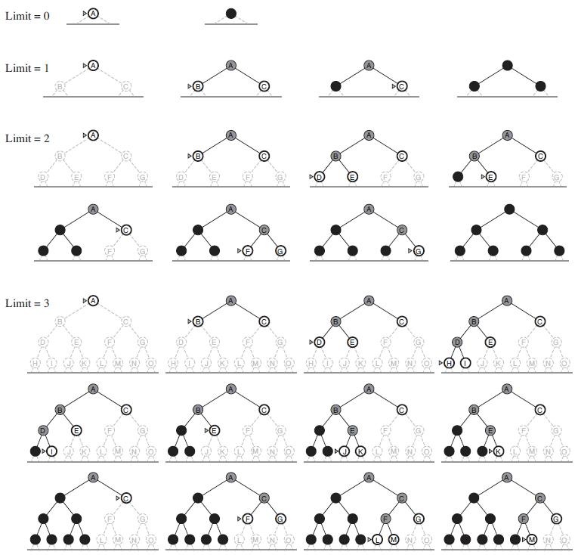
Iterative deepening

Slide 47
Do DFS

Slide 48
Iterative lengthening
Expand all nodes with cost less than < C
Increase C if goal not found
  Min of all node costs explored in prior step
Check textbook

Slide 49
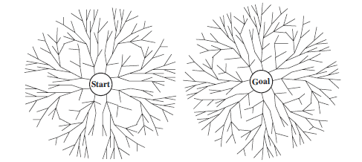
Bidirectional Search
b^(d/2) + b^(d/2) << b^d
Search “forwards” from start and “backwards” from goal
Check for frontier intersection
One search must be BFS for good check on frontier intersection
How do you search backwards for
  Romania
  Vacuum cleaner
  8-queens

Slide 50
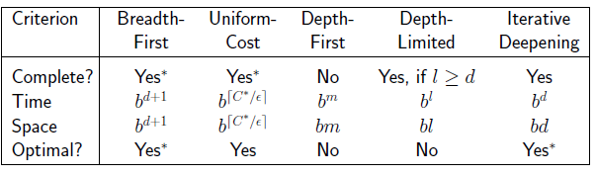
Comparison of uninformed search

Slide 51
Informed Search
Best First Search
  A*
  Heuristics
Basic idea
  Order nodes for expansion using a specific search strategy
    Remember uniform cost search?
      Nodes ordered by path length = path cost and we expand least cost
      This function was called g(n)
  Order nodes, n, using an evaluation function f(n)
  Most evaluation functions include a heuristic h(n)
    For example: Estimated cost of the cheapest path from the state at node n to a goal state
    Heuristics provide domain information to guide informed search

Slide 52
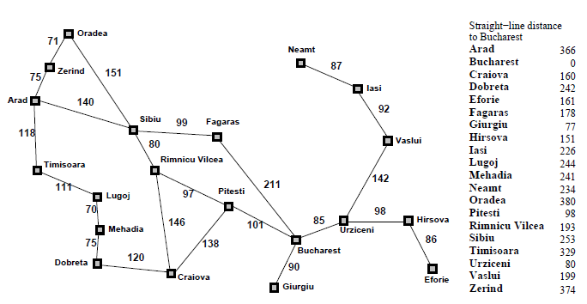
Romania with straight line distance heuristic
h(n) = straight line distance to Bucharest

Slide 53
Greedy search
F(n) = h(n) = straight line distance to goal
Draw the search tree and list nodes in order of expansion (5 minutes)
Time?
Space?
Complete?
Optimal?

Slide 54
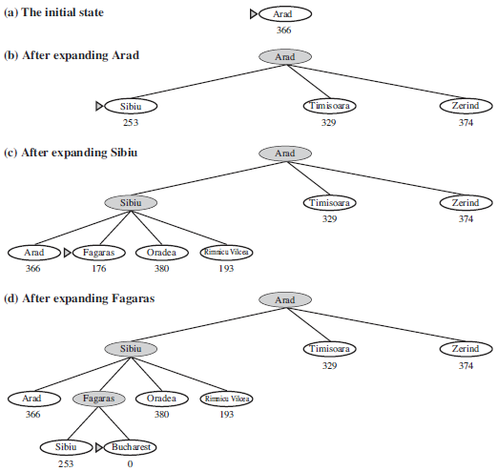
Greedy search

Slide 55
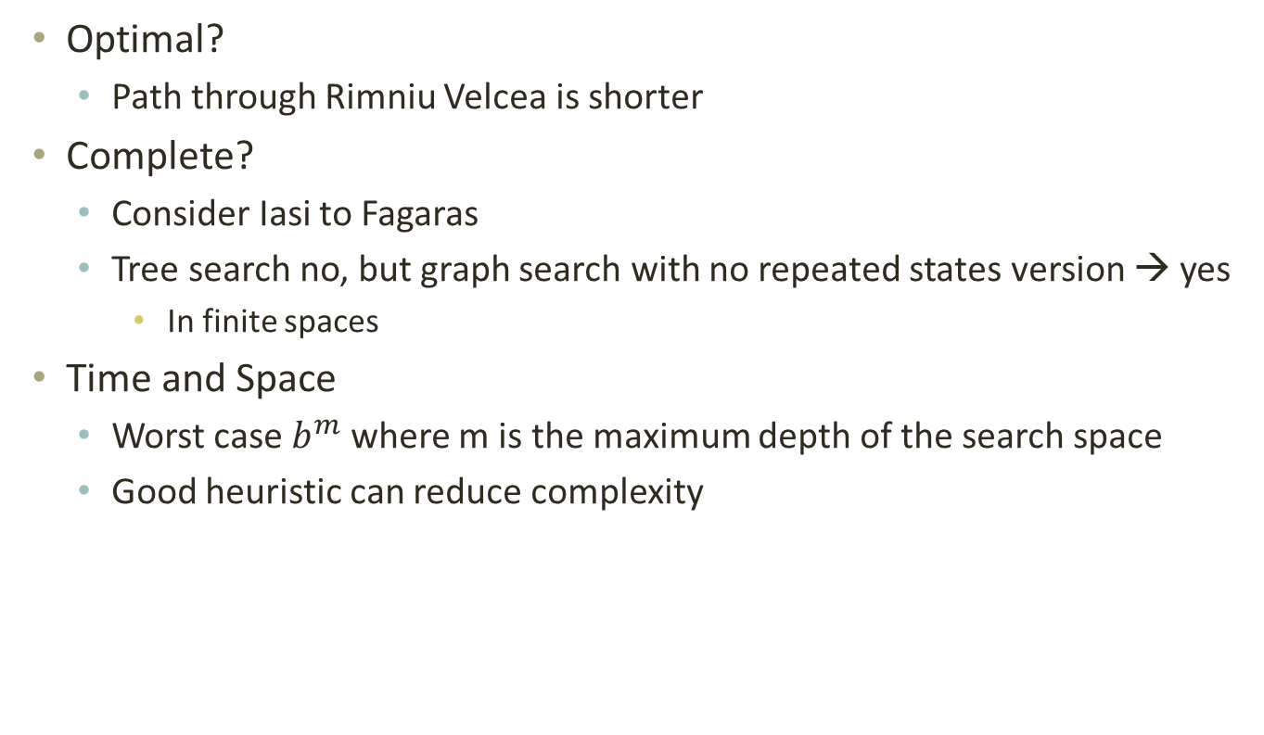
Greedy analayis
Optimal?
  Path through Rimniu Velcea is shorter
Complete?
  Consider Iasi to Fagaras
  Tree search no, but graph search with no repeated states version → yes
    In finite spaces
Time and Space
  Worst case $b^{m}$ where m is the maximum depth of the search space
  Good heuristic can reduce complexity

Slide 56

$$A^{∗}$$
f(n) = g(n) + h(n)
= cost to state + estimated cost to goal
= estimated cost of cheapest solution through n

Slide 57
$$A^{∗}$$
Draw the search tree and list the nodes and their associated cities in order of expansion for going from Arad to Bucharest
5 minutes

Slide 58
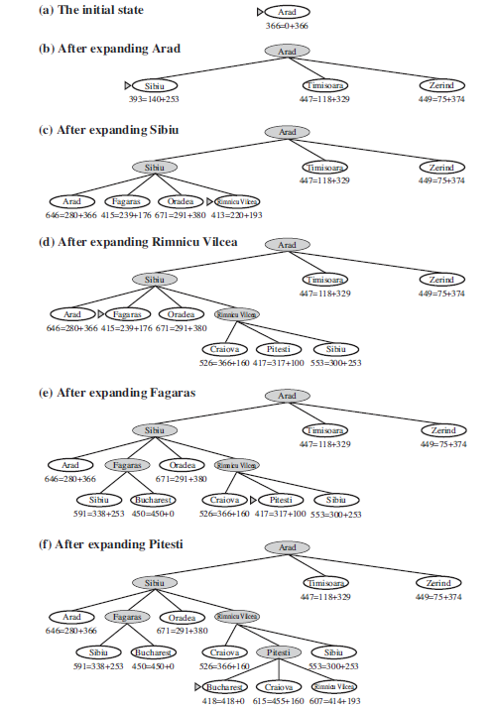
A*

Slide 59
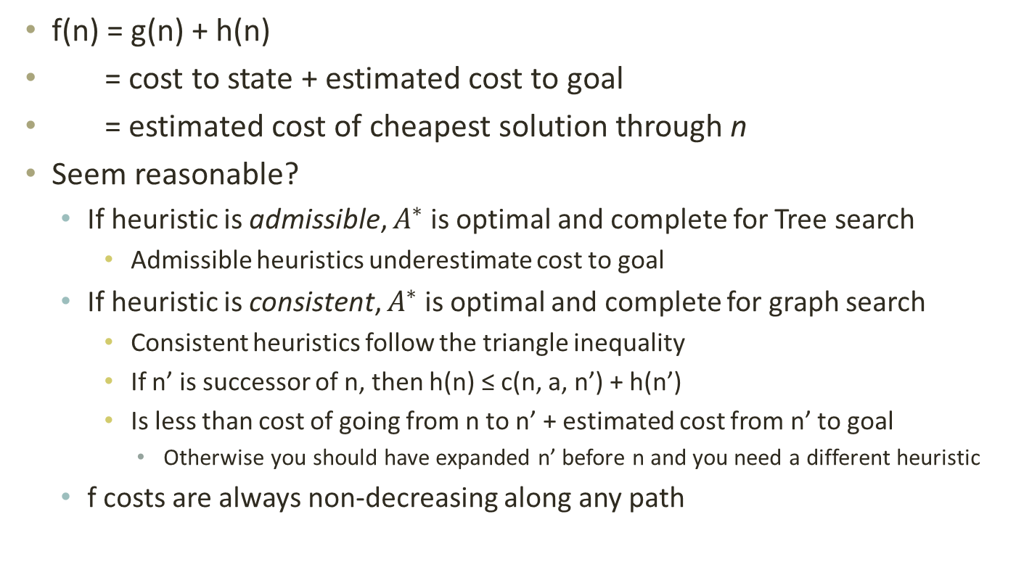
$$A^{∗}$$
f(n) = g(n) + h(n)
= cost to state + estimated cost to goal
= estimated cost of cheapest solution through n
Seem reasonable?
  If heuristic is admissible, $A^{∗}$ is optimal and complete for Tree search
    Admissible heuristics underestimate cost to goal
  If heuristic is consistent, $A^{∗}$ is optimal and complete for graph search
    Consistent heuristics follow the triangle inequality
    If n’ is successor of n, then h(n) ≤ c(n, a, n’) + h(n’)
    Is less than cost of going from n to n’ + estimated cost from n’ to goal
      Otherwise you should have expanded n’ before n and you need a different heuristic
  f costs are always non-decreasing along any path

Slide 60
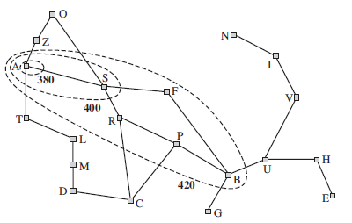

$A^{∗}$ contours
Non decreasing f implies
  We can draw contours
  Inside the 400 contour
    All nodes have f(n) ≤ 400
  Contour shape
    Circular if h(n) = 0
    Elliptical towards goal for h(n)
If C* is optimal path cost
  A* expands all nodes with f(n) < C*
  A* may expand some nodes with f(n) = C* before getting to a goal state
  If b is finite and all step costs > e, then A* is complete since
    There will only be a finite number of nodes with f(n) < C*
      Because b is finite and all step costs > e

Slide 61
Pruning
A* does not expand nodes with f(n) > C*
  The sub-tree rooted at Timisoara is pruned

Slide 62
Search
Problem solving by searching for a solution in a space of possible solutions
Uninformed versus Informed search
Atomic representation of state
Solutions are fixed sequences of actions

