Slide 1
Two Stage Transfer Learning for Medical Imaging
Augustine Ofoegbu, Dan Eassa

Slide 2
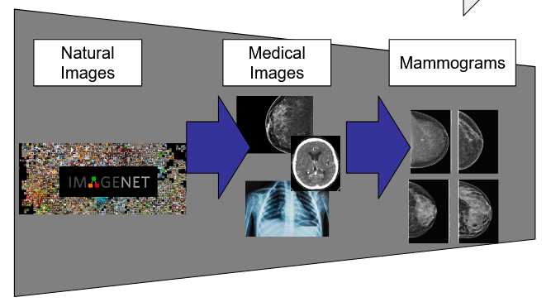
Introduction
Can multiple stages of training improve downstream classification tasks?
Hypothesis is that increasing model exposure to diverse medical images will increase robustness for target task
Notes:
The transferability of features decreases as the distance between the base task and target task increases, but that transferring features even from distant tasks can be better than using random features.

Slide 3
Introduction
Stage 1
Initialize model with ImageNet or Random weights
Stage 2
Train model on Medical Collection (entire network)
Stage 3
Fine tune on target dataset
CBIS-DDSM
Inbreast
Brain Tumors
etc.

Slide 4
Experiment Design
Exp | Model | Pretraing Stage1 (Initialization) | Pretraing Stage2 | Fine Tune Dataset
1 | ResNet50 | ImageNet1k | Medical Collection | CBIS-DDSM
2 | ResNet50 |  |  | INBreast
3 | ResNet50 |  | None | CBIS-DDSM
4 | ResNet50 |  |  | INBreast
5 | ResNet50 | Random | Medical Collection | CBIS-DDSM
6 | ResNet50 |  |  | INBreast
7 | ResNet50 |  | None | CBIS-DDSM
8 | ResNet50 |  |  | INBreast

Slide 5
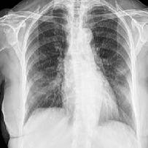
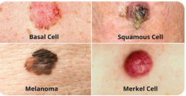
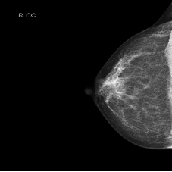
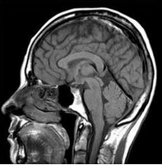
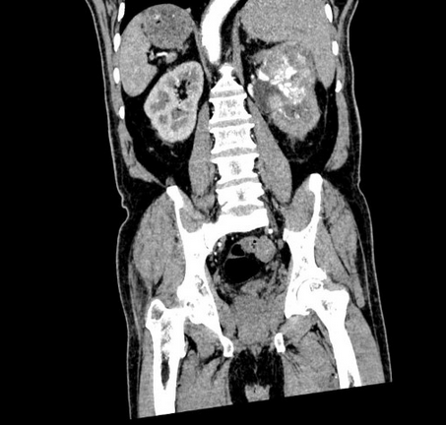
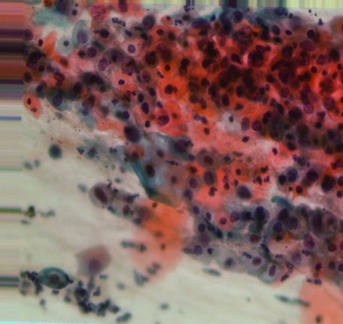
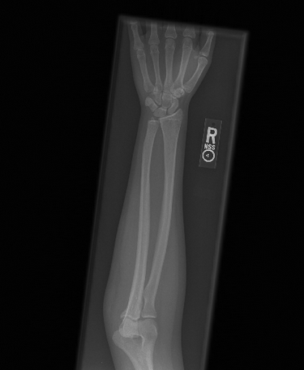
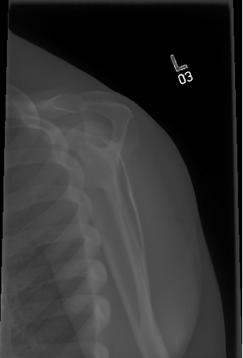
Medical Collection Summary
dataset | modalities | num_classes | train_size | val_size | Reference
chest xray | Xray | 3 | 2400 | 600 | sachinkumar413/covid-pneumonia-normal-chest-xray-images
chest covid | Xray | 4 | 3200 | 800 | preetviradiya/covid19-radiography-dataset
skin lesion | Dermoscopic | 8 | 6287 | 1700 | salviohexia/isic-2019-skin-lesion-images-for-classification
breast cancer | Xray | 2 | 1600 | 400 | theoviel/rsna-breast-cancer-256-pngs/
brain tumors | MRI | 4 | 3200 | 800 | mohammadhossein77/brain-tumors-dataset
multi cancer | CT, MRI, Pathology, Xray | 22 | 17600 | 4400 | obulisainaren/multi-cancer
mura | Xray | 14 | 10572 | 2800 | cjinny/mura-v11
TOTAL |  | 57 | 43259 | 11100
Notes:
CLS denotes classification, SEG denotes segmentation, SP denotes survival prediction. For datasets with official division of training and testing sets, the number of images are shown in (number of training images) / (number of testing images), otherwise the total amounts of images.

Slide 6
Data preprocessing for Medical Collection
Rescaled pixel values to 8 bit
Resized images to 224x224x3
Applied CLAHE
Applied on different datasets differently
Organized directories
Subset classes to improve class balance
800 train, 200 val
7 classes had fewer than 1k images available

Slide 7
Medical Collection Training
Same hyperparameters for Random and ImageNet initialization
Trained entire network on Medical Collection
Default ResNet50 parameters
Batch size = 32
Adam optimizer, LR = 0.001
Early stopping with patience = 10
No learning rate scheduler

Slide 8
Medical Collection Training
Augmentations
RandomPerspective
RandomHorizontalFlip
RandomVerticalFlip
RandomRotation(180)
GaussianBlur(kernel_size = (5, 9), sigma = (0.1, 1))
ColorJitter(brightness = 0.5, contrast = 0.5, saturation = 0.5)

Slide 9
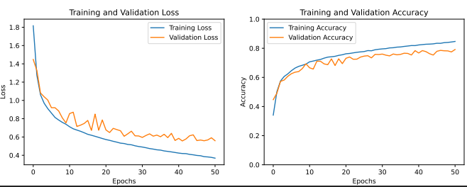
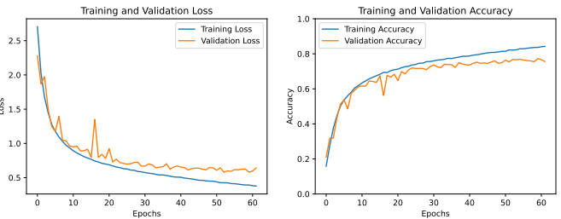
Medical Collection Training Metrics
Metric = validation loss
Patience for early stop = 10
Metric | ImageNet Init | Random Init
Epochs to Train | 42 | 53
Train Accuracy | 82.5% | 82.2%
Val Accuracy | 78.4% | 76.7%
Train Loss | 0.419 | .425
Val Loss | 0.557 | .580
ImageNet initialization
Random initialization

Slide 10
Fine Tune/Test Datasets
Tried augmentation to improve class balance on inbreast
80/20 split for train/val
INBreast
BiRads | Train | Val | Test
1 | 84 | 22 | 15
2 | 281 | 71 | 44
3 | 43 | 11 | 6
4a | 48 | 12 | 3
4b | 43 | 11 | 3
4c | 40 | 11 | 5
5 | 62 | 16 | 10
6 | 43 | 11 | 3
CBIS-DDSM
BiRads | Train | Val | Test
0 | Excluded
1
2 | 40 | 11 | 12
3 | 204 | 51 | 74
4 | 408 | 103 | 167
5 | 227 | 57 | 73

Slide 11
Results
Exp | Initial Weights | Intermediate Weights | Test Dataset | Test Accuracy
1 | ImageNet1k | Medical Collection | CBIS-DDSM | 0.7178
2 |  |  | INBreast | 0.7294
3 |  | None | CBIS-DDSM | 0.7607
4 |  |  | INBreast | 0.7176
5 | Random | Medical Collection | CBIS-DDSM | 0.7393
6 |  |  | INBreast | 0.3882
7 |  | None | CBIS-DDSM | 0.7454
8 |  |  | INBreast | 0.7412

Slide 12
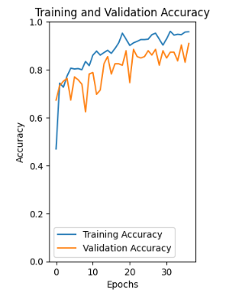
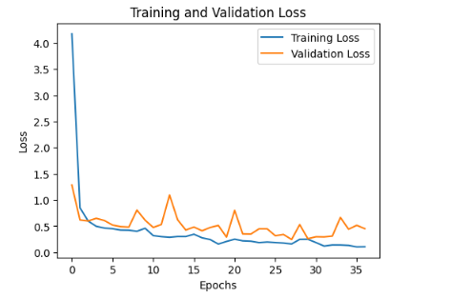
ImageNet InBreast
Test accuracy: 0.7176

Slide 13
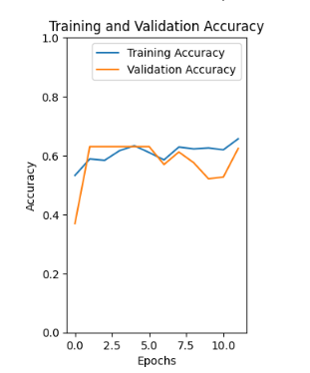
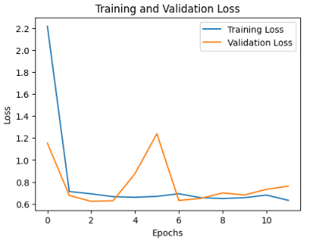
Random InBreast
Test accuracy: 0.7412

Slide 14
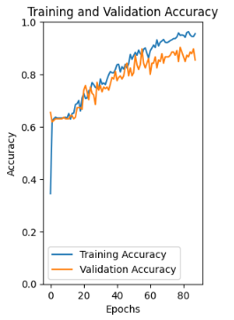
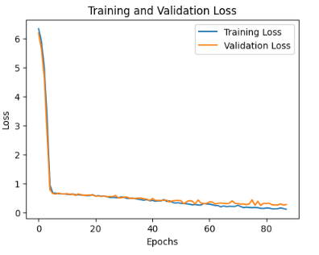
MedCol_InBreast
Test accuracy: 0.3882

Slide 15
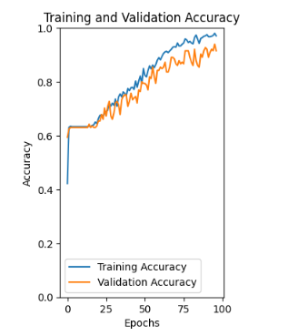
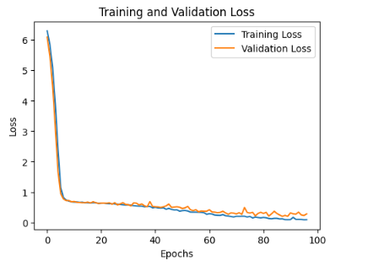
ImageNet_MedCol_InBreast
Test accuracy: 0.7294

Slide 16
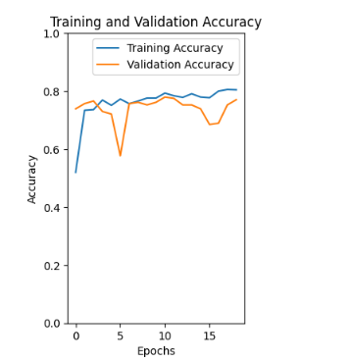
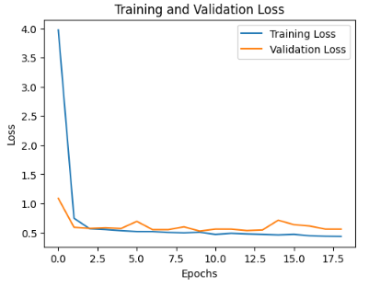
ImageNet on CBIS-DDSM
Test accuracy: 0.7607

Slide 17
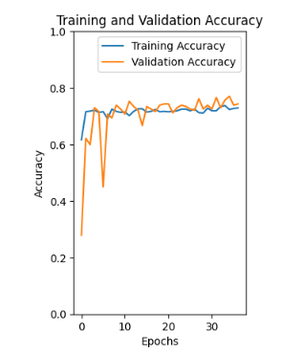
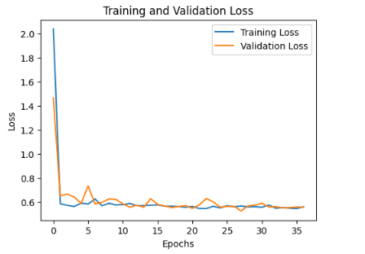
Random CBIS-DDSM
Test accuracy: 0.7454

Slide 18
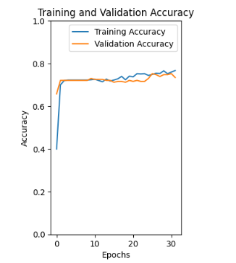
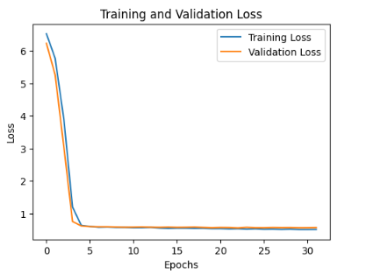
MedCol_CBIS-DDSM
Test accuracy: 0.7393

Slide 19
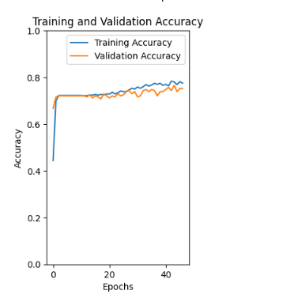
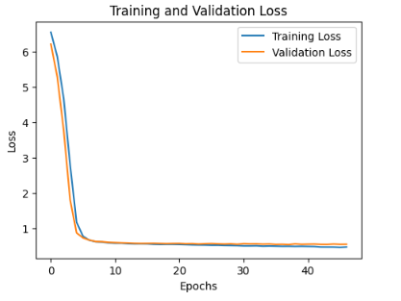
ImageNet_MedCol_CBIS-DDSM
Test accuracy: 0.7178

Slide 20
Challenges
Initially had too large of scope for the project
Developing efficient pipeline for data preprocessing took significant effort
Model overfitting
Identifying root cause of model not learning or performing poorly on the test set

Slide 21
Future Work
Further model optimization
Hyperparameter fine tuning
More experiments for freezing specific layers
Dataset optimization
Which modalities and images are most beneficial for a given downstream task, rebalance accordingly

Slide 22
Future Work
Interpretation of results, possible reasons for changes in performance
Possibly due to bias in mammography images at each stage of training
Possibly due to feature extraction from diversity of inputs
Interpretability of the model
Filter visualizations

