Slide 1
A review of various modalities in breast imaging technical aspects and clinical outcomes
By Sepideh Iranmakani, Tohid Mortezazadeh, Fakhrossadat Sajadian, Mona Fazel Ghaziani, Ali Ghafari, Davood Khezerloo, and Ahmed Eleojo Musa
Presented by Kelly Chinander & Ronald Du
October 30th, 2023

Slide 2
Slides
Overview
Introduction
Background
Objectives
Methodology
Imaging Modalities
Terminology
Acronyms
Modalities
Mammography
Digital Breast Tomosynthesis (DBT)
Contrast-Enhanced Digital Mammography (CEDM)
Ultrasound / Sonography
Magnetic Resonance Imaging (MRI)
Single-Photon Emission Computed Tomography (SPECT)
Positron Emission Tomography (PET)
Optical Imaging
Microwave Imaging
Analysis
Comparisons
Advances and Emerging Technologies
Challenges and Considerations
Conclusion
Questions?
References

Slide 3
Overview

Slide 4
Introduction
The research paper titled "A review of various modalities in breast imaging: technical aspects and clinical outcomes" by Iranmakani et al. (2020) provides an overview of many of the different types of imaging techniques used to detect breast cancer.
The authors compiled information from 40 research papers over 12 different modalities to provide an overview of each type and to make comparisons between them.

Slide 5
Background
Breast cancer is the second leading cause of death after cardiovascular diseases.
In general, one out of eight women (about 12%) suffer from this disease.
If breast cancer is detected at an early stage, its survival rate will be very high.
Several methods have been introduced to diagnose breast cancer with their clinical advantages and disadvantages.

Slide 6
Objectives
The objective of this paper was to evaluate the performance of conventional breast imaging methods for early detection of breast cancer in women and their effects on reducing mortality rates.

Slide 7
Methodology
The efforts of the authors to produce these evaluations include:
Selecting published articles relating to each modality
Filtered for recency and relevance
Finally, reviewing ~8 papers for each imaging method.

Slide 8
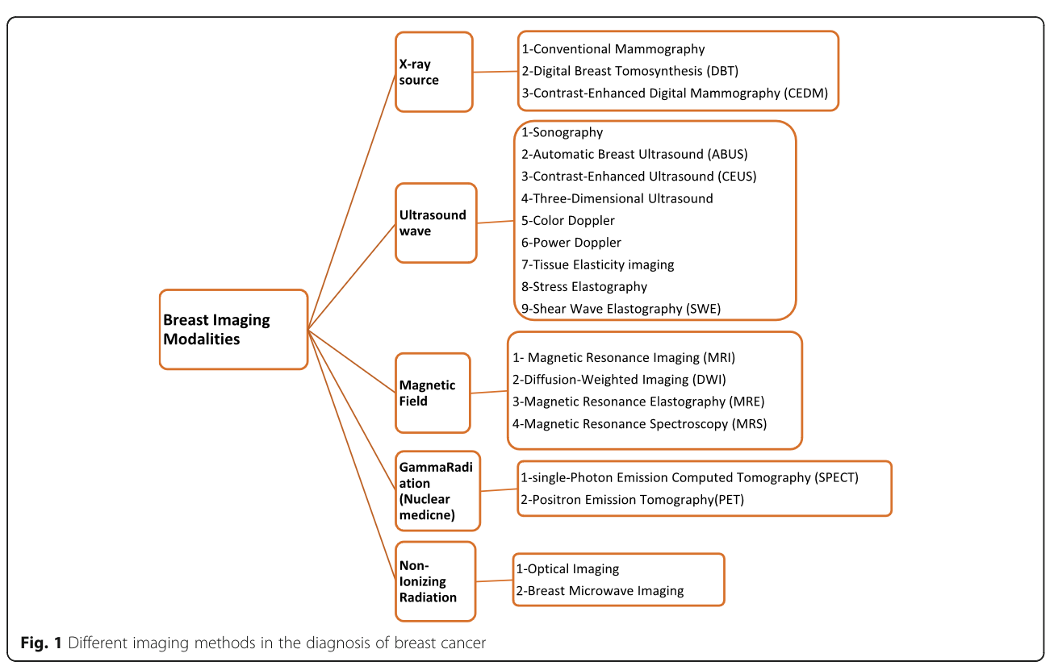
Imaging Modalities

Slide 9
Terminology
Sensitivity: how well a diagnostic test correctly identifies individuals who have a particular condition or disease. It calculates the proportion of true positives (correctly identified cases) relative to all actual cases. High sensitivity means the test is good at catching true positives but may have false positives.
Specificity: how well a diagnostic test correctly identifies individuals who do not have a particular condition or disease. It calculates the proportion of true negatives (correctly identified non-cases) relative to all actual non-cases. High specificity means the test is good at correctly ruling out non-cases but may have false negatives.

Slide 10
Acronyms
MLO: Mediolateral oblique views
CC: Craniocaudal view
DBT: Digital breast tomosynthesis
CEDM: Contrast-enhanced digital mammography
ABUS: Automatic breast ultrasound
CEUS: Contrast-enhanced ultrasound
SWE: Shear wave elastography
MRI: Magnetic resonance imaging
DWI: Diffusion-weighted imaging
MRE: Magnetic resonance elastography
MRS: Magnetic resonance spectroscopy
PEM: Positron emission mammography
18F-FDG: Fluorodeoxyglucose
NIR: Near infrared;
HbR: Hemoglobin rate
HbO2 : Oxyhemoglobin
CW: Continuous wave
tCho: Total choline-induced resonances

Slide 11
Modalities

Slide 12
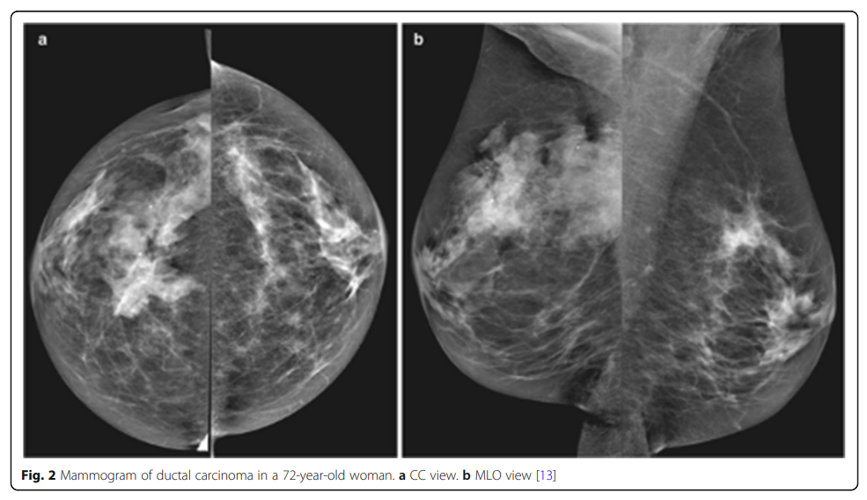
Mammography
A mammogram is a two-dimensional image that helps to identify morphologically suspicious findings.
To create the image, the breast tissue is pressed by a plate and then low-energy X-rays penetrate through the tissue.
Standard screening images:
the oblique views (MLO)
and craniocaudal views (CC)

Slide 13
Mammography - Technical Aspects
Initial studies have shown that the clinical application of mammography reduces the mortality rate about 20-40%
The sensitivity of mammography in the breast tissue of 50-year-old women varies from 68-90% and in women aged 40-49 is about 62%.
The specificity of mammography ranges from 82% to 97%.

Slide 14
Mammography - Challenges
Mammography can have high false positive rates due to the overlap of normal fibroglandular tissues in 2D imaging.
Another disadvantage of mammography is inducing radiation doses on a highly sensitive tissue.
Finally, the sensitivity of mammography is inversely related to the density of the breast tissue.

Slide 15
Mammography - Clinical Outcomes
Mammography is effective for breast cancer screening and early detection.
Clinical outcomes show that mammography has a high sensitivity and specificity for detecting breast abnormalities. Outcomes are improved with regular mammographic screening, particularly for individuals in high-risk categories.

Slide 16
Mammography - Advancements
Advancements in digital mammography have lead to two major subsets of mammographic technologies:
Digital breast tomosynthesis
Contrast-enhanced digital mammography

Slide 17
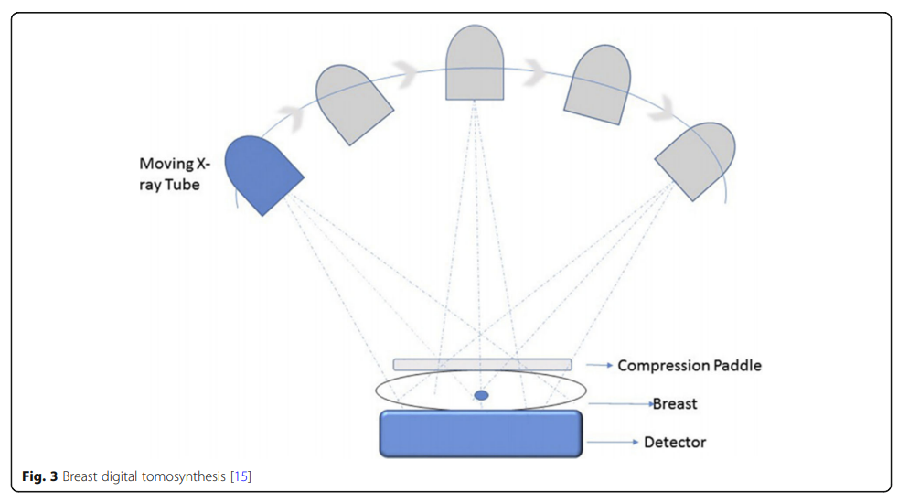
Digital Breast Tomosynthesis (DBT)
Digital Breast Tomosynthesis (DBT) is a subset of mammography, where the X-Ray Tube rotates around the breast tissue to generate a 3D image.
DBT images are
generated from the
repeated exposure to
the breast tissue at
various angles and
reconstructed as
half-millimeter slices.

Slide 18
DBT - Technical Aspects
The patient’s radiation dose is increased by 20% with DBT over standard mammography, but the cancer detection rate increase about 15-30% and the recall rate decreases by about 15-20%.
Combining DBT with digital mammography has reduced the recurrence rate by up to 30%.
DBT causes a 27% increase in the diagnosis of breast cancer and a 15% decrease in false-positive findings

Slide 19
DBT - Clinical Outcomes
The main advantage of DBT is the detection of masses and lesions that may not appear in normal mammograms due to overlap with dense breast tissue.
The major limitation of DBT is that it has low sensitivity when detecting microcalcifications.
Overall, DBT is better than mammography in diagnosis and screening.

Slide 20
Contrast-Enhanced
Digital Mammography (CEDM)
Contrast-Enhanced Digital Mammography represents the angiogenic pattern of masses, which depicts anatomical information of the tissue.
There are two methods to produce CEDM imagery, both using iodine-based contrast media with digital mammography devices. They are:
Temporal subtraction
Dual-energy

Slide 21
CEDM - Temporal Subtraction
The first method of CEDM is ‘temporal subtraction technique’, where images of before and after contrast media injection are subtracted. The whole scanning time takes about 15 minutes.
Images are taken immediately after injection of the contrast media at successive times and then the patterns of vascular filling and emptying is observed.
In this imaging technique, one can draw a time-diagram of the vessels being filled with contrast material.

Slide 22
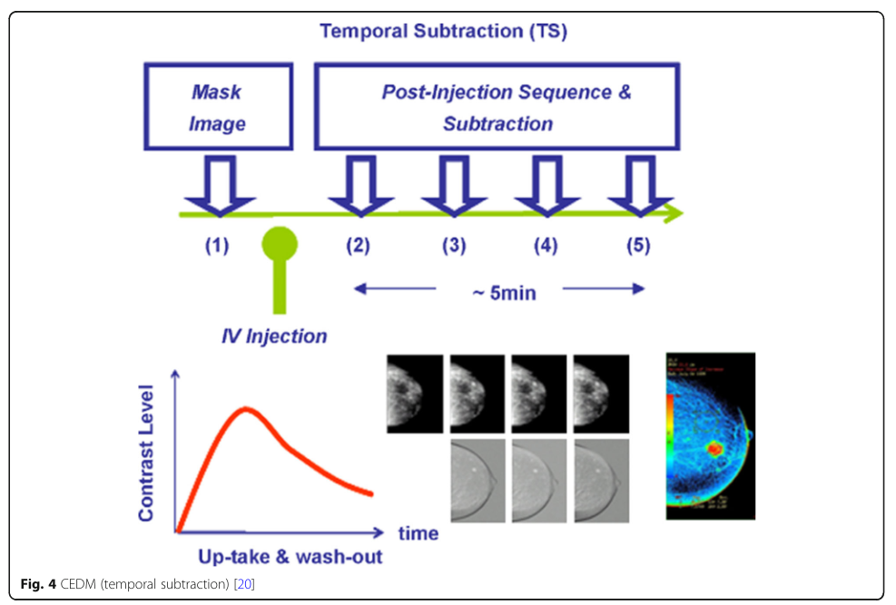
CEDM - Temporal Subtraction

Slide 23
CEDM - Dual-energy
The second method of CEDM is ‘dual-energy technique’, also known as CESM, where images of before (at high energy) and after (at low energy) contrast media injection. The whole scanning time takes about 5 to 10 minutes. Afterward, the images are combined to improve contrast.
Since the magnitude of the produced signal in the receiver is proportional to the energy received, threshold filters can be applied. The information from these images is useful for differentiating different parts of the breast tissue, such as the cystic masses from tumors.

Slide 24
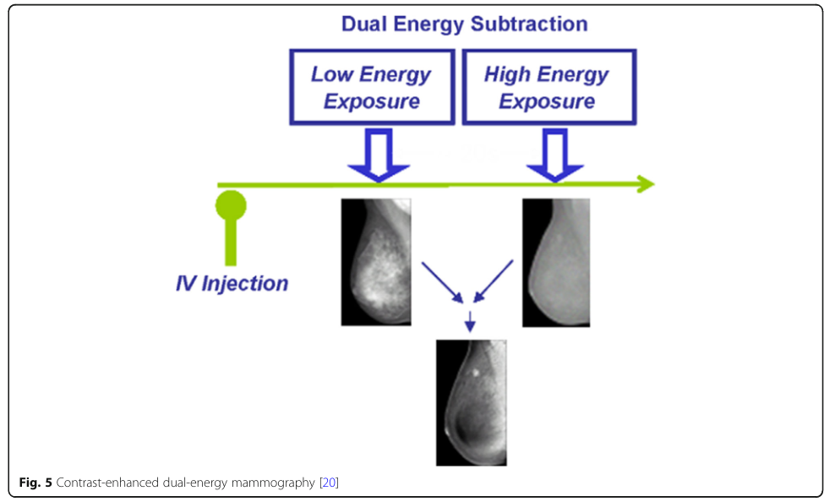
CEDM - Dual-energy

Slide 25
CEDM - Technical Aspects
The sensitivity of CEDM methods are about 93%, which is an increase compared to mammography. The specificity is around 63%.
The dual-energy technique aims to reduce the average breast radiation does by 98%.
When combined with DBT, the impact of surrounding soft tissues is reduced and contrast between the tumor and surrounding tissues is increased. This leads to increased sensitivity by about 35-59% even for dense breast tissue.

Slide 26
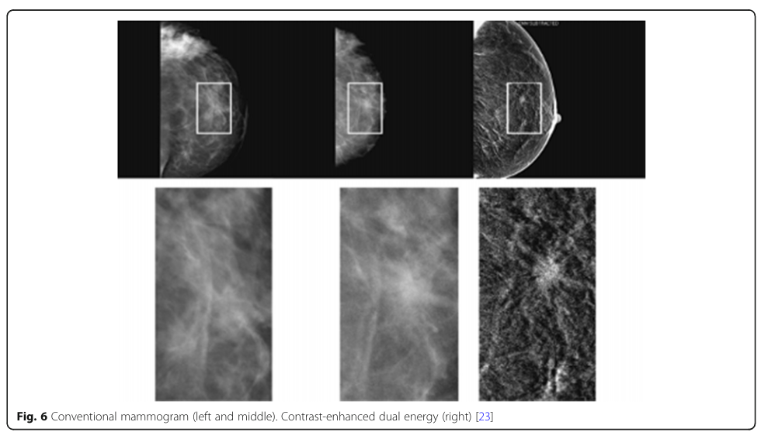
CEDM -
Comparison to Mammography

Slide 27
CEDM - Clinical Outcomes
CEDM techniques are commonly used to evaluate tumor angiogenesis in specific individuals, but despite their high sensitivity, they have low specificity and have limitations in the diagnosis of breast ductal carcinoma. It is also limited by high cost, difficult access, and lack of familiarity.
However, adding CEDM to conventional mammography enhances the quality of diagnosis and sensitivity.

Slide 28
Ultrasound / Sonography
In this method, an ultrasound wave is transmitted to the tissue at frequencies ranging between 3-12 MHz.
Different organs have different acoustic impedances, leading them to reflect ultrasounds differently.
Doppler ultrasound and contrast media are also used to measure tumour blood flow and vascularization.

Slide 29
Ultrasound / Sonography continued
Many ultrasound techniques have been developed. Ultrasound can be used to determine morphology, orientation, internal structures, and margin of lesions in dense breasts.
The usage of ultrasound can help to differentiate benign and solid breast lesions. Sensitivity increases to 97.3% and specificity to 76.1% by adding ultrasound imaging to conventional breast cancer screening methods.

Slide 30
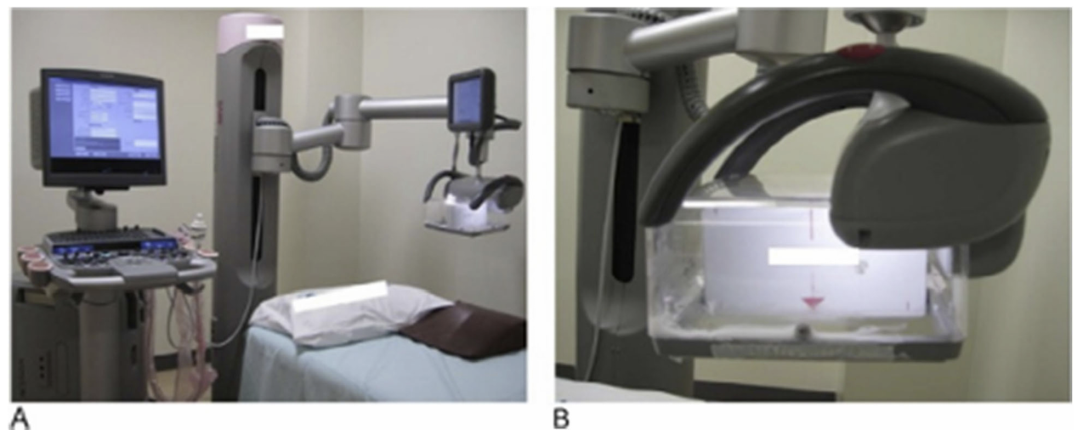
Ultrasound / Sonography - ABUS
Automatic breast ultrasound, or ABUS, has high diagnostic accuracy and better determination of lesion size.
Three positions are obtained by the operator with flat ultrasonic plates. The images are then reconstructed in 3D. This technique is a good method for women with dense breasts. The sensitivity of ABUS in the diagnosis of breast cancer is 79% and its specificity is 83.3%

Slide 31
Ultrasound / Sonography - CEUS
Contrast-enhanced ultrasound, or (CEUS), is used to observe different vascular structures.
Gas microbubbles with a diameter of 1-7um is injected into the veins, and reflect sound more than red blood cells. Combining the microbubbles with nonlinear imaging such as power doppler allows the imaging of the vascular morphology.
The sensitivity and specificity of this method for diagnosis of breast lesions are 100% and 87.5%, respectively

Slide 32
Ultrasound / Sonography - 3D
Two variants
First variant uses normal 2D equipment and reconstructs a 3D volume using 2D images.
Second variant uses a matrix array converter that scans in 3D.

Slide 33
Ultrasound / Sonography - Color Doppler
Color doppler estimates local blood flow by using mean Doppler shift coding in the ROI and colors the areas where it is seen. The colors show the flow and the speed.
Malignant areas usually increase the intensity of the signal.
Color doppler has less transducer pressure, and when the chest wall and transducer are squeezed, the vessels can close within the lesion.

Slide 34
Ultrasound / Sonography - Power Doppler
In this technique, pulse power is coded into the doppler signal and it is displayed in a single color unlike color doppler. The frequency is determined by the number of red blood cells, so signal strength depends on the amount of blood in the area.
Power doppler is even more sensitive in detecting blood flow but does not show direction.

Slide 35
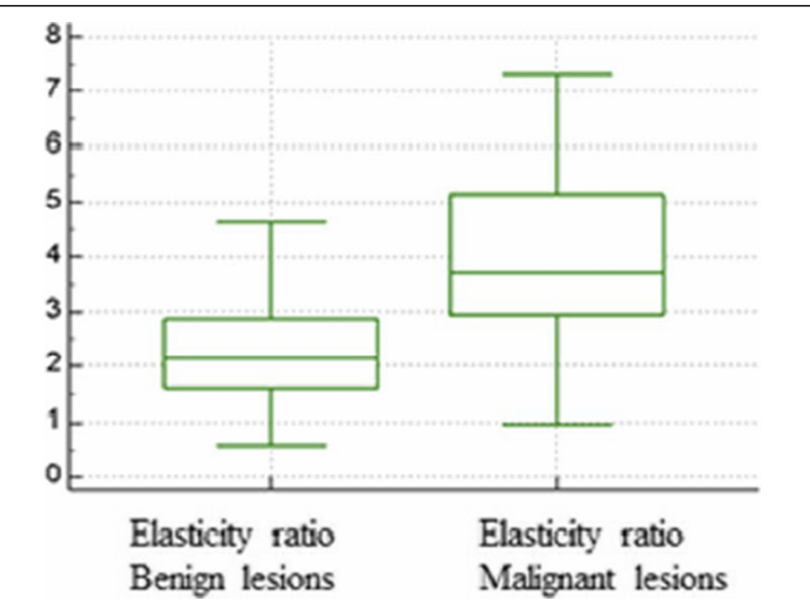
Ultrasound / Sonography -
Sonoelastography
Solid tumours are physically more rigid than their surroundings. This can be exploited in sonoelastography, where the tissue is imaged before and after compression.
The solid masses will be less deformed and appear darker in the elastogram.

Slide 36
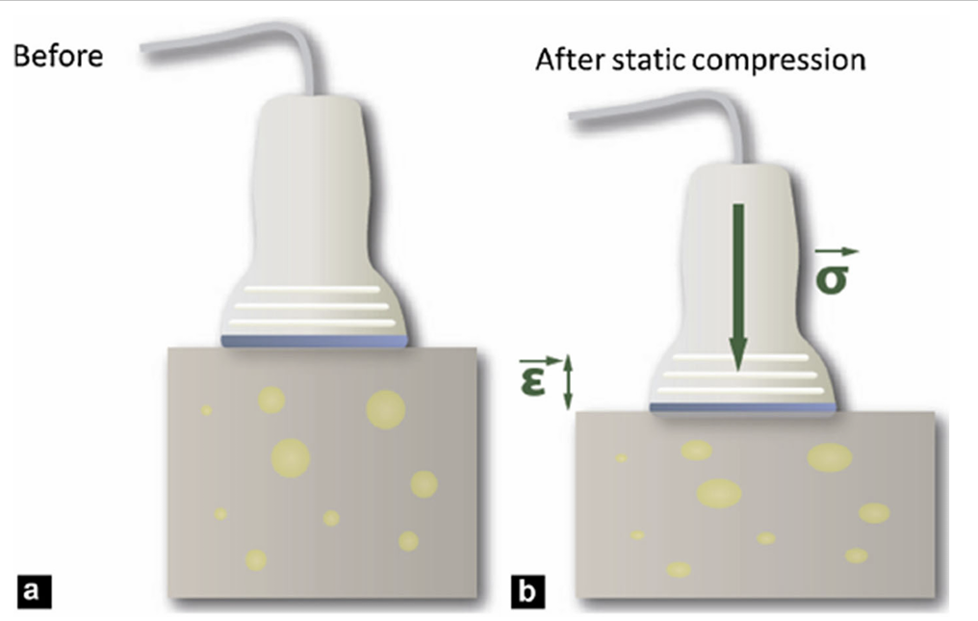
Ultrasound / Sonography -
Stress elastography
A static force is applied to the tissue. Soft tissue will change more than hard tissue when a static force is applied.
Noise can be an issue, as well as repeatability.

Slide 37
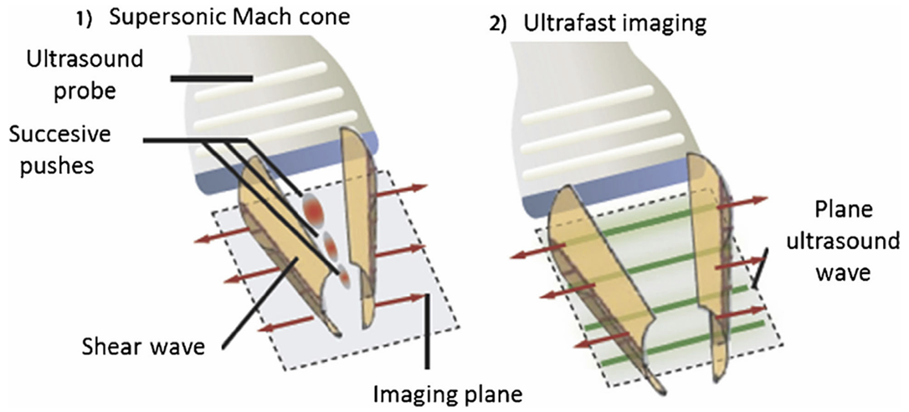
Ultrasound / Sonography -
Shear wave elastography
Shear wave elastography uses transverse ultrasound waves. These waves are produced from volume changes due to ultrasonic pressure.
Repeatability for this method is high.

Slide 38
Magnetic Resonance Imaging (MRI)
In Magnetic Resonance Imaging, the image is produced using the magnetic properties of the hydrogen atoms in tissues.
It is frequently used for screening patients with a high risk of breast cancer.
MRI imaging is more sensitive than mammography and ultrasound in the diagnosis of breast cancer.
MRIs suffer from high cost and high time. Patients also struggle to maintain the proper posture during an MRI scan.

Slide 39
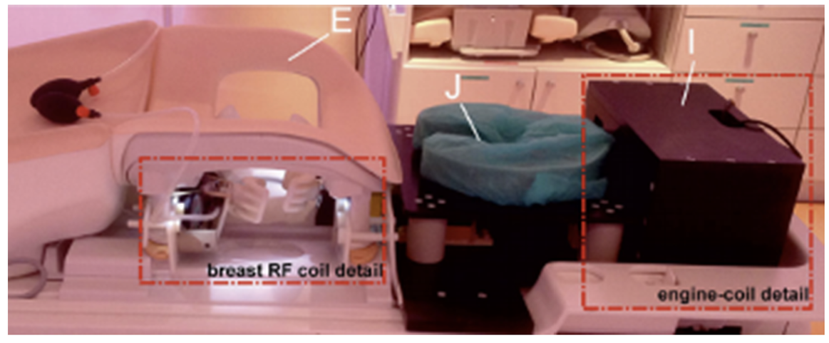
Magnetic Resonance Imaging (MRI)
There are three main techniques that are commonly used to diagnose breast cancer:
Diffusion-weighted imaging
dynamic information of water molecule diffusion
Magnetic resonance elastography
biomechanical properties of tissue
Magnetic resonance spectroscopy
chemical content of breast lesions

Slide 40
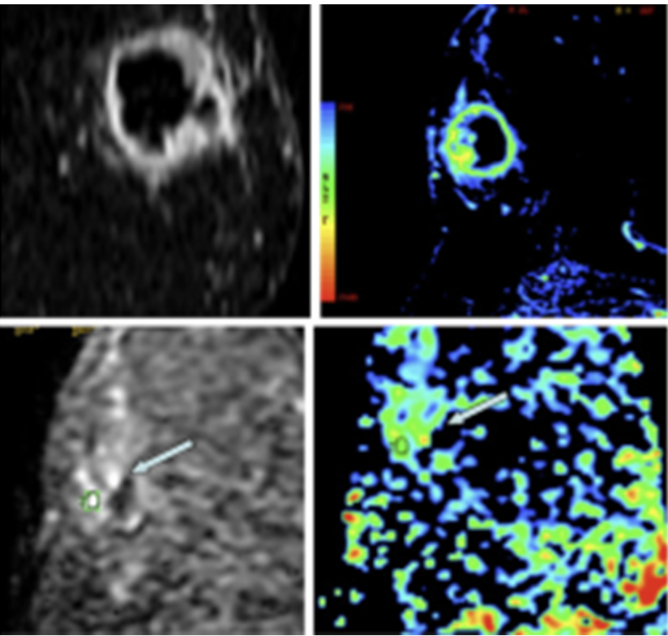
MRI -
Diffusion-weighted imaging
The release of water molecules within the body is not random due to certain physiological barriers.
Differences in water diffusion between tissues can provide information on tumours.
DWI is very sensitive. Water permeability in tissue is inversely related to cell membrane integrity, so signal intensity in DWI is higher in regions with limited propagation such as cancerous tissues.

Slide 41
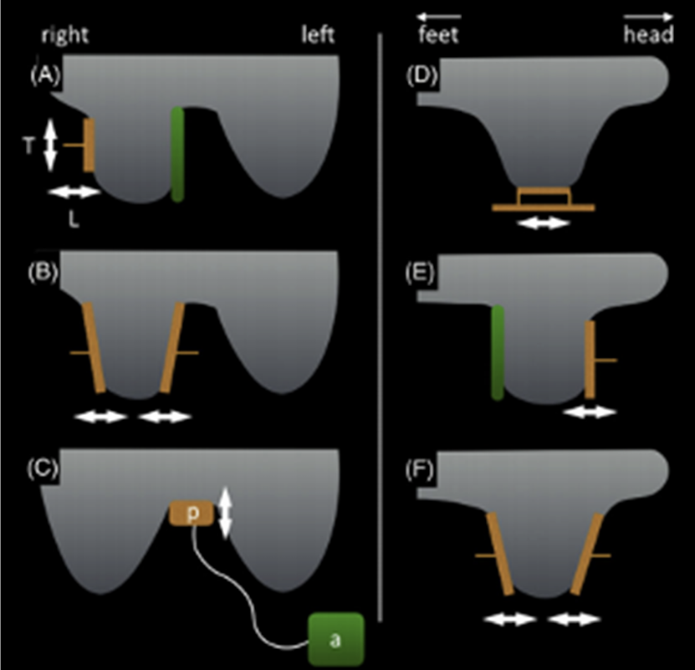
MRI -
Magnetic resonance elastography
Magnetic resonance elastography (MRE) involves applying a shear wave to the breast. In tumours, due to the tumour being more rigid, will appear differently on the MRI when a sheer force is applied than normal tissue.
One issue is that the motor used to apply the push can interfere with the magnets, so it is placed at a distance from the scanner.

Slide 42
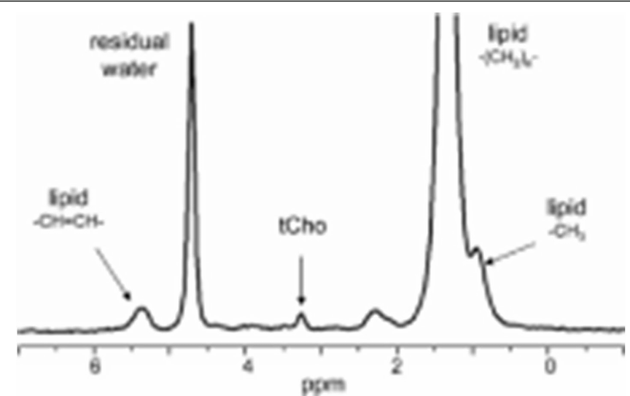
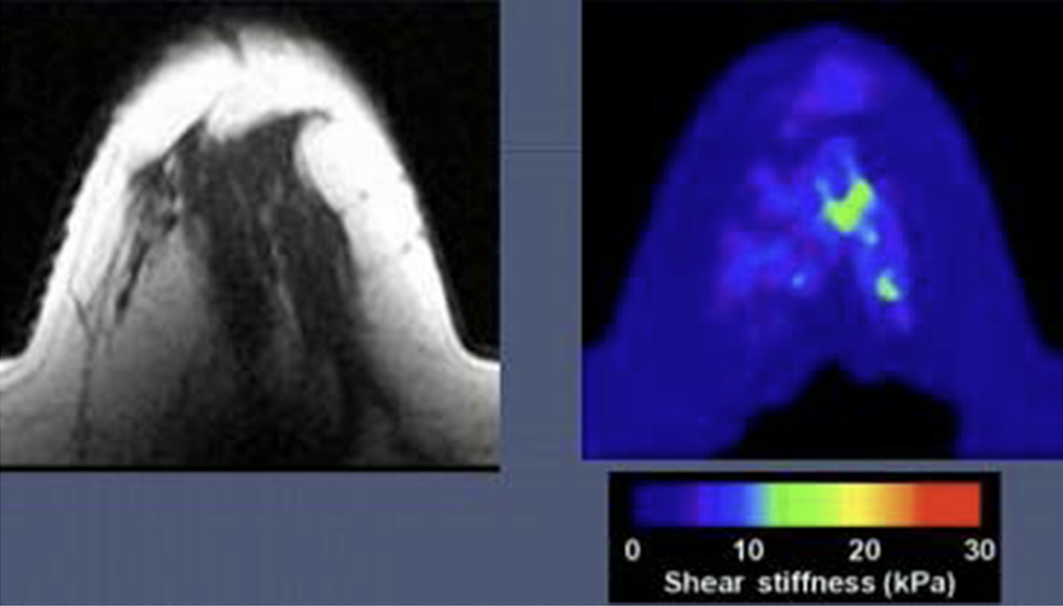
MRI -
Magnetic resonance spectroscopy
Magnetic resonance spectroscopy (MRS) is done in combination with an MRI to obtain chemical information about the lesions.
This information is useful for monitoring the response to cancer treatments and improving the accuracy of diagnostics.
Some studies show that chemicals such as tCho show up more in malignant tissue.

Slide 43
MRI - Technical Aspects
MRI sensitivity has been shown at 92% in previous studies with specificity of 71%. Combining both mammograms and MRIs lead to a sensitivity of 94%, and a specificity of 77%.

Slide 44
Nuclear medicine imaging (SPECT)
SPECT, or single-photon emission computed tomography, is a physiological imaging method.
Involves the injection of an isotope of Technetium. Since malignant cells are metabolically active, they absorb the isotope and emit gamma rays with 140 keV of energy, which a gamma ray detector then detects.
High sensitivity, and high false negative rate makes this a scan greatly used to find the exact location of a tumor in a patient known to have cancer.

Slide 45
Nuclear medicine imaging (PET)
Positron Emission Tomography, or PET, is used for quantification of the biochemical and physiological activity of cells in a molecular level.
PET involves the detection of positrons instead of gamma rays. It is frequently used to identify the grade, stage, and evaluation of treatment response as well.
A commonly used radionuclide tracer in PET scans is the fluorinated analog of glucose, 18F of FDG.

Slide 46
SPECT and PET- Technical Aspects
Both PET and SPECT rely on tracers. PET relies on detecting positrons while SPECT relies on detecting gamma rays.
PET has higher spatial resolution than SPECT and can detect smaller lesions of about 2.2mm. SPECT has about 1.1 mSv less radiation dose than PET.
Both SPECT and PET are generally used for identifying current tumours and stages of the tumours due to the high cost and the high radiation dose of 30 to 40x more than a mammogram.

Slide 47
PET - Clinical Outcomes
PET scans cost approximately 3.7x more than a SPECT scan. Both scans are generally only used when the patient is known to have cancer, and the issue is identifying the location of the cancer as well as the stage of the cancer.

Slide 48
Optical Imaging
Optical imaging is a broad category that covers imaging with visible light, ultraviolet, and infrared.
One advantage of optical imaging is its ability to obtain information at the metabolic and molecular level that can produce images of microscopic structures.
It is considered an attractive option due to the low cost and provides physiological and molecular images, but has suffered from issues related to the depth of light penetration into the tissue.

Slide 49
Optical Imaging Continued
NIR light, or near infrared, which looks reddish, has a high penetration ability in soft tissue.
Main features of breast cancer masses include abnormal growth of the vascular and tissue lymphatic system, disruptions to the biochemical and biophysical equilibrium of the ECM, and changes to the blood flow rate (HbR) and blood oxygen rate (HbO2). Each one of these factors can contribute to the contrast of the optical image. Varying the wavelength of the optical image allows for detection of different components of the image.

Slide 50
Optical Imaging Continued
Imaging total hemoglobin needs about 800nm, blood oxygen is about 650-690nm, and for detection of water and fat, 925-975nm light should be used.
Combining this information with Mie scattering (elastic scattered light of particles that have a diameter similar to or larger than the wavelength of the incident light) can give an estimate of the size and density of scattering centers. In breast cancers, an increase in hemoglobin concentration and a decrease in oxygen saturation is observed.

Slide 51
Optical Imaging Continued
Oxygen saturation does not decrease in all breast cancers, but depends on the vascular network within the breast. It is possible to do structural, vascular and molecular studies with OI, but it is not qualified to diagnose breast cancer as it has less spatial resolution and accuracy. It is useful for providing more information about cancers that are already present. Potential is present in doing an optical image after cancer has been confirmed to provide additional information.

Slide 52
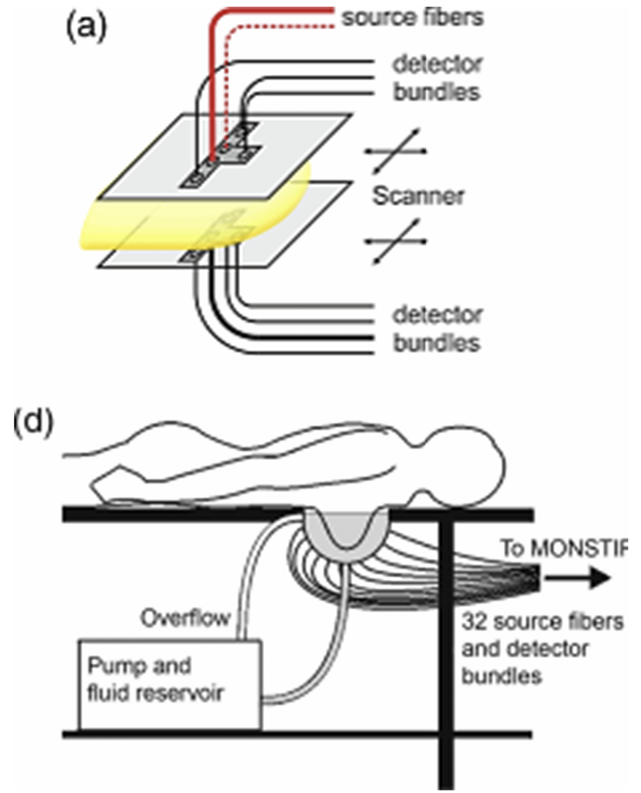
Optical Imaging 1st Generation
Parallel plate method
Compressed the breast between two plates, and used fiber optic cables for transferring near infrared light.

Slide 53
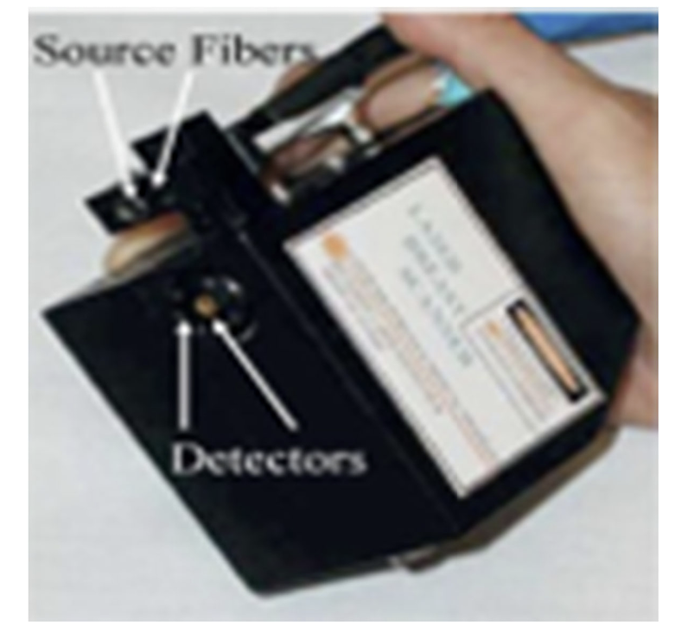
Optical Imaging 2nd Generation
Conical chamber
Surrounded by source and detector optical fibers, enabled 3D images with the actual size and shape of the breast

Slide 54
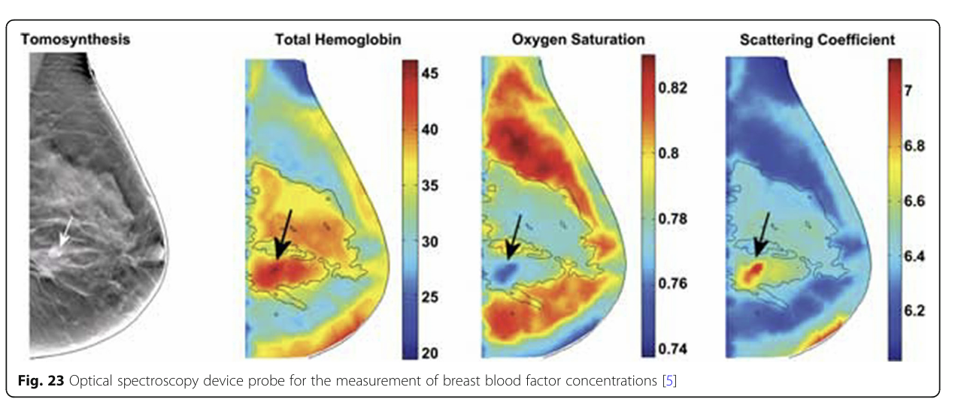
Optical Imaging 3rd Generation
Molecular spectroscopy
Handheld device with source fibers and detectors, with each at a different wavelength. Can be combined with information from other scans, such as MRI, mammogram, ultrasound etc. Current difficulties include combining OI with MRIs as the OI device interferes with the MRI.

Slide 55
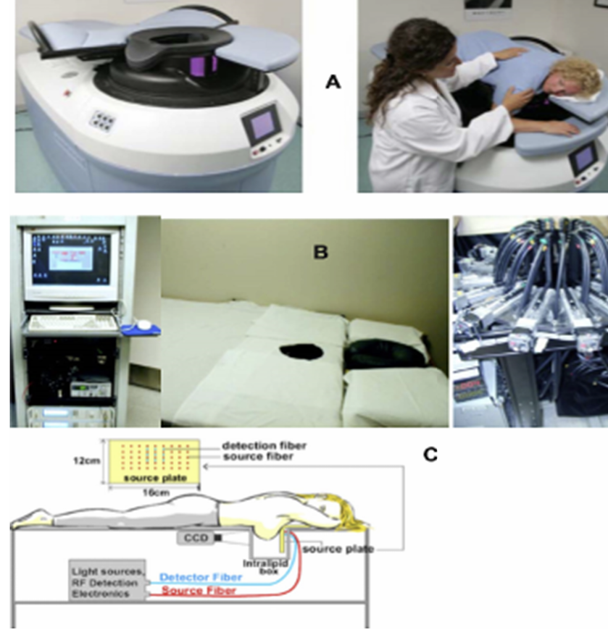
Optical Imaging continued
Device used where the pressure plate method was combined with an X-Ray

Slide 56
Breast microwave imaging
Breast microwave imaging is imaging that uses microwaves between 1 GHz and 300 GHz. This range has acceptable penetration into soft tissue. Microwave imaging solutions are expensive, but in recent decades biosensor based solutions have become more popular.
Breast microwave imaging relies on the dielectric properties which differ between healthy breast tissue and tumour tissue.

Slide 57
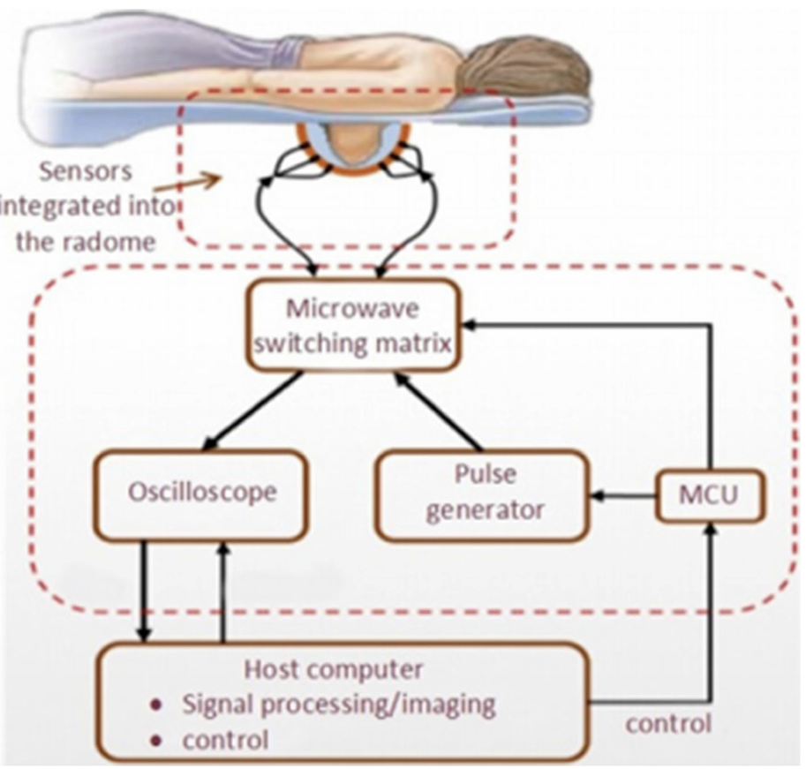
Breast microwave imaging continued
Microwave tomography is currently not as feasible as radar based microwave imaging.
Radar based microwave imaging maps the internal organ structure by measuring the dielectric properties of the tissue, and relies heavily on the shortest wavelength of the microwave radiation. The shorter the higher the resolution of the image.

Slide 58
Analysis

Slide 59
Comparisons
Sensitivity:
Mammography: widely used and effective for screening with a focus on early detection
MRI: known for high sensitivity, particularly in detecting invasive breast cancer
DBT: improves sensitivity compared to traditional mammography by reducing overlapping tissue
Specificity:
Mammography: limited, leading to some false-positive results
Ultrasound: often used alongside mammography, can help increase specificity
PET: potential for high specificity by detecting areas of increased metabolic activity
CT: may provide high specificity in specific cases

Slide 60
Advances and
Emerging Technologies
Advances:
DBT - becoming more widespread with improved detection rates and reduced recall rates
MRI - newer techniques such as dynamic contrast-enhanced MRI and diffusion-weighted imaging enhance diagnostic capabilities
AI - assisting radiologists in interpreting images more accurately and quickly
Contrast-Enhanced Imaging - CEDM and CEUS enhance lesion characterization

Slide 61
Challenges and Considerations
There are several factors that need to be considered when utilizing breast imaging modalities. Things like radiation exposure, false positive / false negative rates, cost, accessibility, and comfort are all risks that must be taken into account when developing a treatment regimen.

Slide 62
Conclusion
There are a wide variety of imaging modalities available to healthcare professionals in their quest to diagnose and treat breast cancer. All of these modalities come with their own strengths and weaknesses and must be carefully considered.
There is no ‘one size fits all’ approach to breast cancer imaging, but often the combination of multiple modalities improves early detection of breast cancer and therefore the survival rate.

Slide 63
Questions?

Slide 64
References
Iranmakani, F., Nasiripour, A. A., & Fouladi, D. F. (2020). A review of various modalities in breast imaging: Technical aspects and clinical outcomes. Journal of Medical Imaging and Radiation Sciences, 51(2), 234-249.

