Slide 1
Rethinking pre-training on medical imaging
Yang Wen, Leiting Chen, Yu Deng, Chuan Zhou, Rethinking pre-training on medical imaging, Journal of Visual Communication and Image Representation, Volume 78, 2021, 103145, ISSN 1047-3203, https://doi.org/10.1016/j.jvcir.2021.103145. (https://www.sciencedirect.com/science/article/pii/S1047320321000894)
Augustine Ofoegbu, Dan Eassa

Slide 2
Outline
Introduction
Methods
Datasets
Experiments
Results
Conclusions
* Image Source: Internet

Slide 3
Introduction
Transfer Learning has been widely used in industry and research
It is very important in the medical field for analyzing many diseases as most medical datasets usually contain limited number of samples
Despite its popularity there has been little study on its precise effects
Major shortcomings of natural images include overestimated generalization ability and poor transfer effectiveness even between similar tasks
Studies have not focused on medical imaging and their findings remain questionable since medical and natural images differ considerably

Slide 4
Contributions
Proposed novel approaches for visualizing and quantifying similarity of images in the convolved space
Convolution-based visualization (cmv)
Convolution-based distance (cmd)
Evaluated ImageNet vs Medical Image pre-training
Quantitative performance for classification and segmentation
Single dataset transfer learning
Diverse medical modality transfer learning
Qualitative filter representation
Survival Prediction

Slide 5
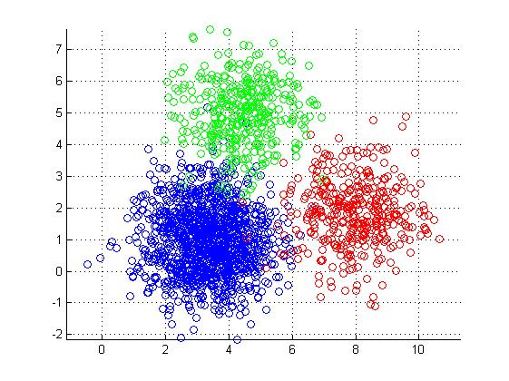
Methods - cmv
Convolution-based visualization (cmv) is used to aggregate features and reduce them to 2-D coordinates
cmv uses an untrained CNN unlike previous approaches
Requires some CNN weight initialization
CNN (F) excludes non-linear activation, normalization, and dropout
X-Ray image dataset
Natural image
dataset
CT image dataset
*cmv for many subsamples from 3 datasets
Notes:
n is the number of samples in s (not S)

Slide 6
Methods - cmd
Convolution-based modality distance (cmd)
Measures the Euclidean distance of all coordinates between two datasets
Distance uses cmv coordinates

Slide 7
Methods - average cmd
cmd changes with initialization type so average cmd was reported
Average cmd includes scaling factor ε to rescale the cmd then take the average
Initializations used: Kaiming, Orthogonal, Xavier

Slide 8
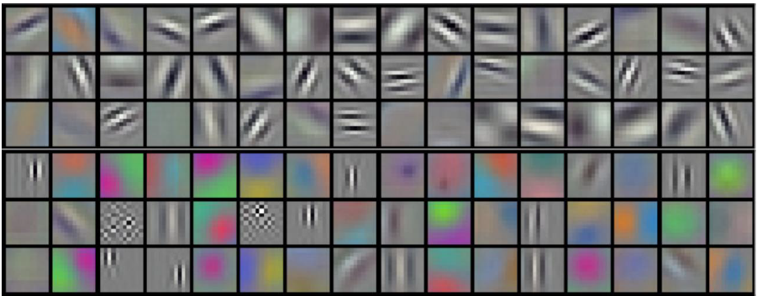
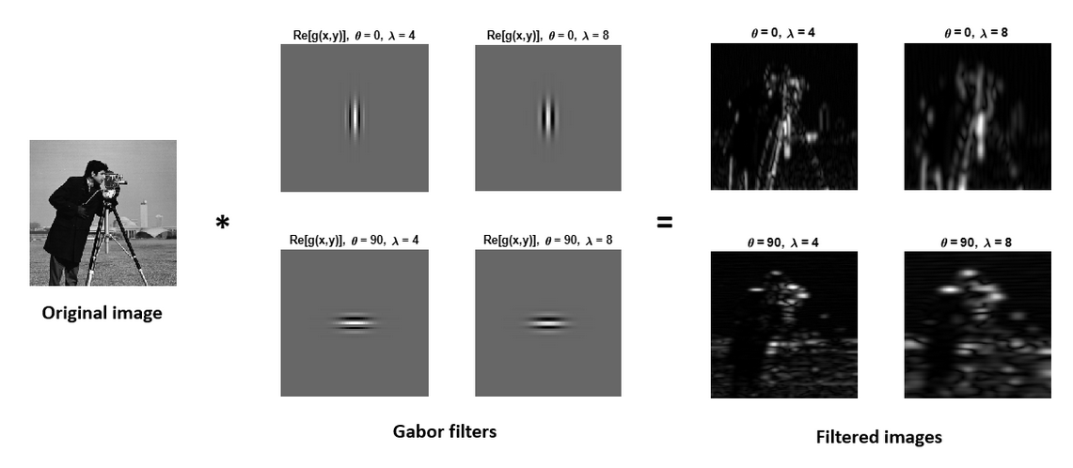
Methods - Filter Representation
CNNs learn textures and shapes in low level layers with filters similar to Gabor filters
Conv1 filters from GaborNet
Gabor filters are directional filters

Slide 9
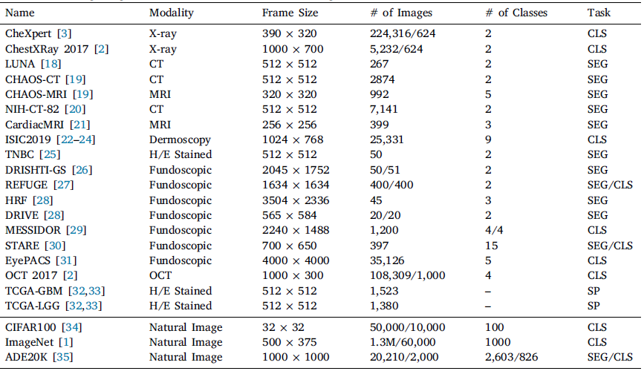
Datasets
Notes:
CLS denotes classification, SEG denotes segmentation, SP denotes survival prediction. For datasets with official division of training and testing sets, the number of images are shown in (number of training images) / (number of testing images), otherwise the total amounts of images.

Slide 10
Datasets
For Classification/Segmentation tasks 17 medical and 3 natural datasets used
Datasets without official division were randomly divided into 80/20 for training and testing
Authors excluded the target class shared between pre-training and test datasets to prevent task-specific information leakage
Subset of 20k images used in some experiments to eliminate effect of number of samples (ie ImageNet-20k)
Survival Prediction used Brain Cancer Datasets from TCGA - lower-grade glioma (LGG) and glioblastoma (GBM)
patches were extracted with a size of 512 × 512 pixels from WSIs.

Slide 11
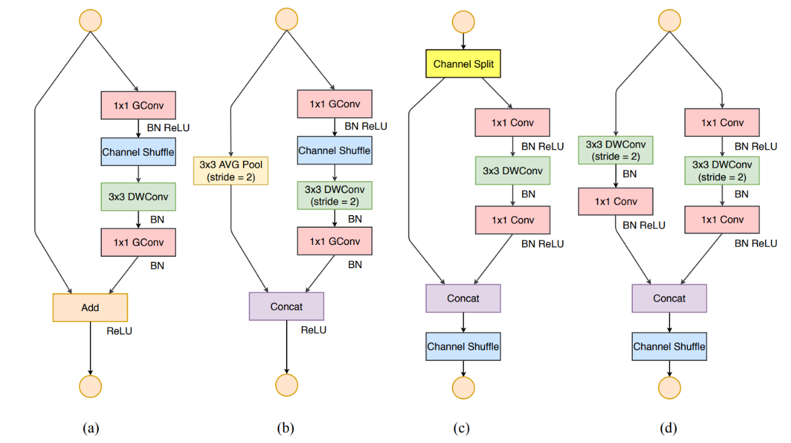
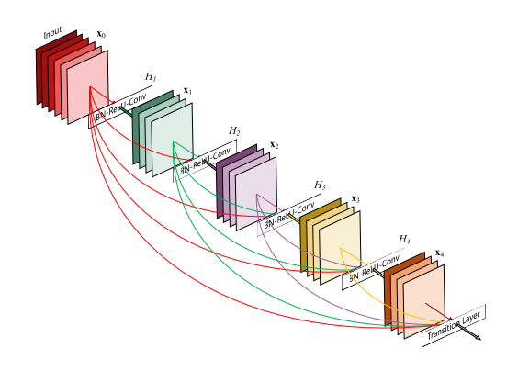
Evaluation Models
Classification
ResNet-18
ShuffleNet V2
DenseNet 121
Segmentation
U-Net
DeepLabv3
CE-Net
HyNet
ET-Net
Survival Prediction
Deep learning models (ResNet-18 and DenseNet-121)
Two clustering methods (K-means and spectral clustering)
Deep-learning-based survival prediction frameworks, WSISA and DeepAttnMISL
ResNet-18
ShuffleNet V2
‹#›
DenseNet-121

Slide 12
Experiment Setup
Python 3.7, PyTorch 1.3
Ubuntu 16.04
NVIDIA GeForce GTX 1080 Ti and NVIDIA GeForce RTX 2080 Ti, total 22 GB memory
Early-stopping is triggered when metrics stop improving for 20 iterations
Balanced Cross Entropy loss function
Metrics obtained from 3 runs
micro-averaged AUC
mean IoU
For most experiments, model training from scratch (Random) or full ImageNet dataset (ImageNet*) was reported

Slide 13
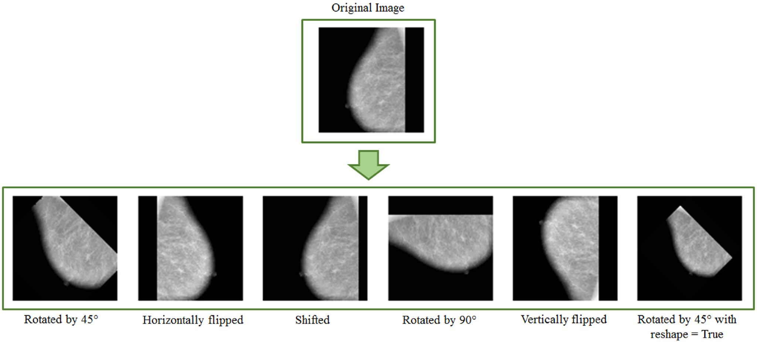
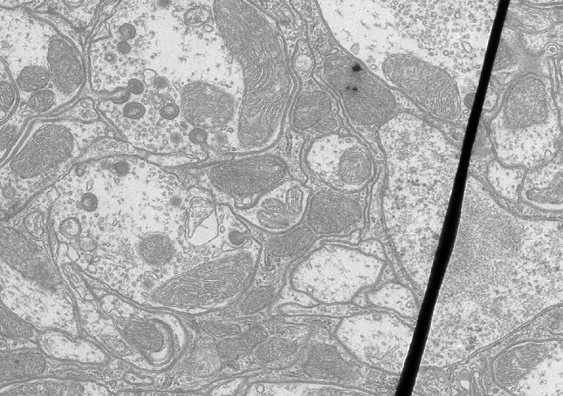
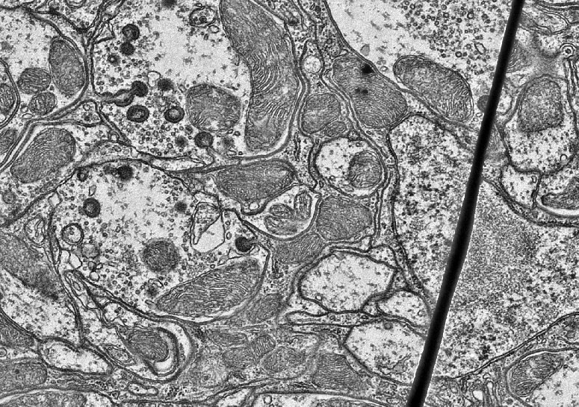
Data Preprocessing
Crop and resize image to 256 x 256 by bilinear interpolation for CLS and SEG
Apply CLAHE
Augmentation to expand datasets
90/180/270 degree rotations
Horizontal/vertical/diagonal random flip
ROI extraction is adopted for certain tasks (e.g., optic disk/cup segmentation)
For SP, patches were extracted with a size of 512 × 512 pixels from WSIs
Before CLAHE
After CLAHE
Augmentation

Slide 14
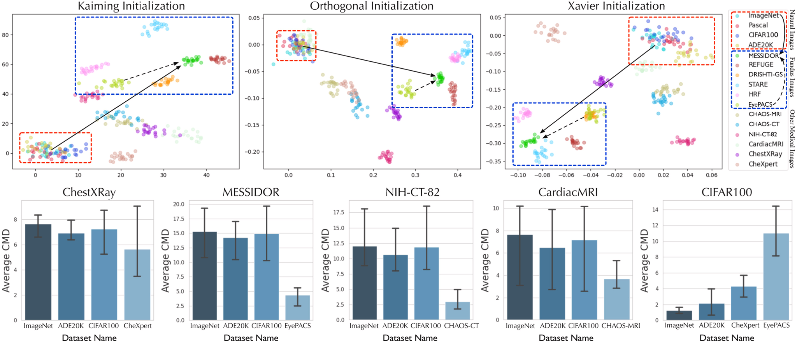
Results - cmv and cmd
Datasets with same modalities aggregate in cmv space and measure smaller cmd
Notes:
The cmv (top) and average cmd (bottom) of natural and medical image datasets.
In cmv, each dataset was aggregated separately, and the natural (red box ) and fundus image datasets ( blue box ) tended to aggregate, indicating that a CNN could detect the visual similarity of images.
Medical imaging datasets with similar modalities show the smallest average cmd among all other datasets.

Slide 15
Results - Classification
For classification task pretraining ResNet-18 on dataset with closest modality (small cmd) produces best results
Most similar modality boxed

Slide 16
Results - Segmentation
For segmentation task pretraining ResNet-18 on natural image dataset (large cmd) produces best results
Most similar modality boxed

Slide 17
Results - CLS and SEG
Similar modalities show worse transfer to segmentation tasks
Due to lack of morphological features to train from in single dataset medical images (transfer learning and self-supervised learning)
classification
segmentation

Slide 18
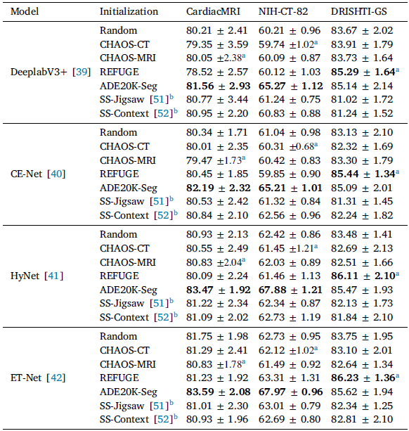
Results - SEG

Slide 19
Results - CLS and SEG
Findings for performance in classification and segmentation task are independent of number of samples
More samples cannot compensate for lack of morphological awareness in segmentation

Slide 20
Multi-modality datasets
To overcome lack of morphological characteristics the authors created multi-modality datasets
CLS
CheXpert (M3/M6)
EyePACS (M3/M6)
ISIC (M3/M6)
OCT (M6 only)
MURA (M6 only)
STARE-CLS (M6 only)
SEG
CHAOS-CT (M3/M6)
CHAOS-MRI (M3/M6)
TNBC (M3/M6)
LUNA (M6 only)
REFUGE-OD (M6 only)
STARE-SEG (M6 only)

Slide 21
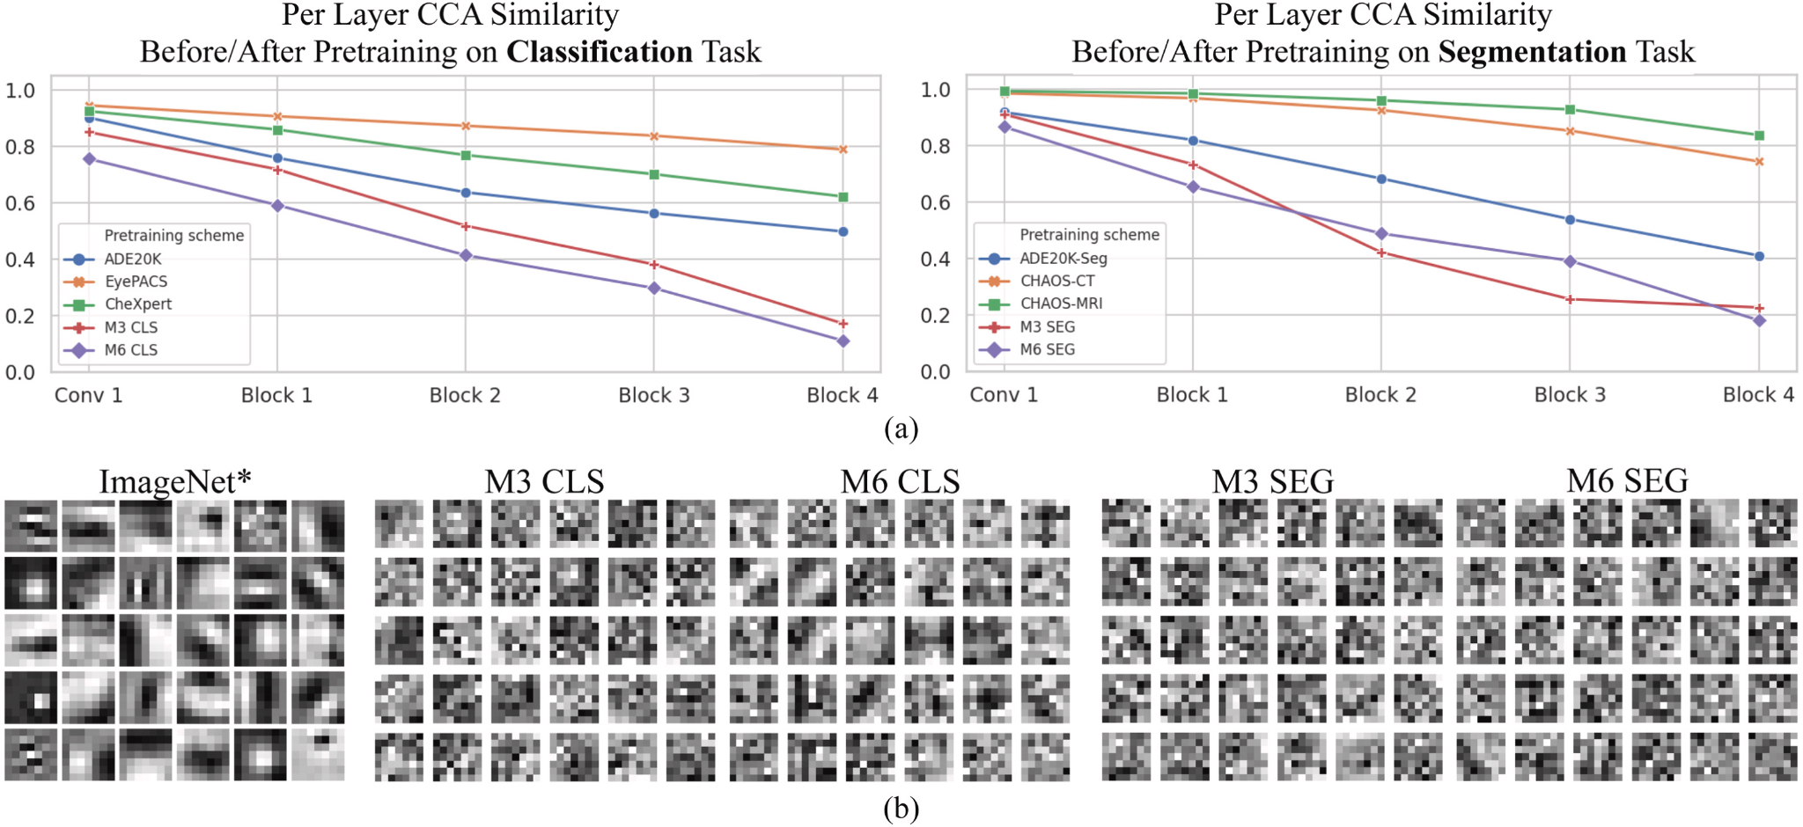
Visualizing Multi-Modality Datasets
Canonical Correlation Analysis (CCA)
M3/M6 datasets provide more filter modifications compared to single datasets
Indicates more task-specific features learned
Notes:
Visualizing the conv1 filter of the CNN shows that M6 brings more Gabors than M3 and make conv1 closer to that of ImageNet
The use of large amount of medical data with diverse modalities for pre-training resulted in representational improvement of CNN
The representational improvement resulting from the use of M6 led to better performance, which indicated enhanced morphological awareness.
M3 and M6 did not degrade the performance, indicating strong transfer robustness.
Both M6 CLS and M6 SEG outperformed their M3 counterparts, indicating that for both segmentation and classification, morphological awareness could be improved by involving diverse modalities.
Pre-training on medical dataset collections is effective for overcoming the aforementioned drawback of medical pre-training and yields satisfactory results.

Slide 22
Visualizing Multi-Modality Datasets
More modalities introduces more changes in conv1 filters
As number of modalities increases
Number of Gabors increase
Filters more closely match ImageNet* filters
Notes:
SVCCA - Singular Vector Canonical Correlation Analysis

Slide 23
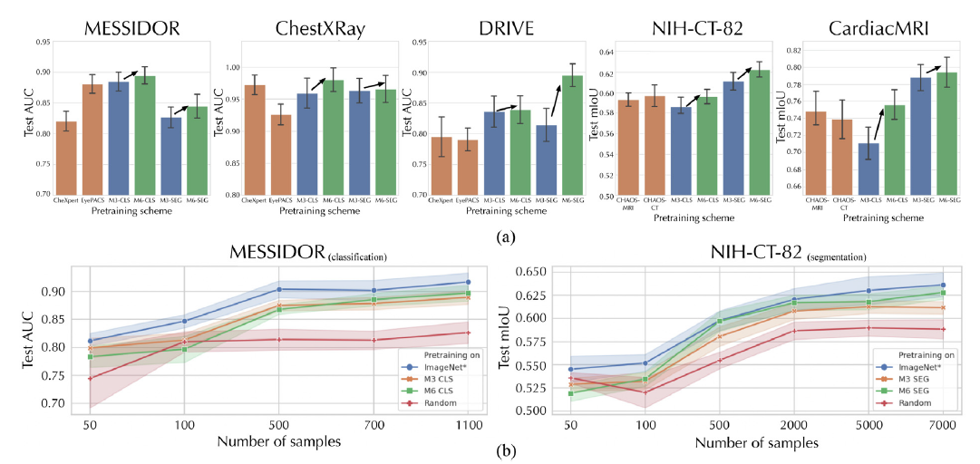
Results with Multi-Modality Datasets
M6 datasets show improvement over M3, single modality, and random weight initialization
Notes:
(top) M6 consistently outperforms M3 and single modality pretraining results
(bottom) M6/M3 show improvements over random pre-training, provide comparable results to ImageNet* with much less pretraining data

Slide 24
Summary Multi-Modality Datasets
Visualizing the conv1 filter of the CNN shows that M6 brings more Gabors than M3 and make conv1 closer to that of ImageNet
The use of large amount of medical data with diverse modalities for pre-training resulted in representational improvement of CNN
The representational improvement resulting from the use of M6 led to better performance, which indicated enhanced morphological awareness.
M3 and M6 did not degrade the performance, indicating strong transfer robustness.
Both M6 CLS and M6 SEG outperformed their M3 counterparts, indicating that for both segmentation and classification, morphological awareness could be improved by involving diverse modalities.
Pre-training on medical dataset collections is effective for overcoming the aforementioned drawback of medical pre-training and yields satisfactory results.
Notes:
RSF - Random Survival Forest
BoostCI - Boost Concordance Index

Slide 25
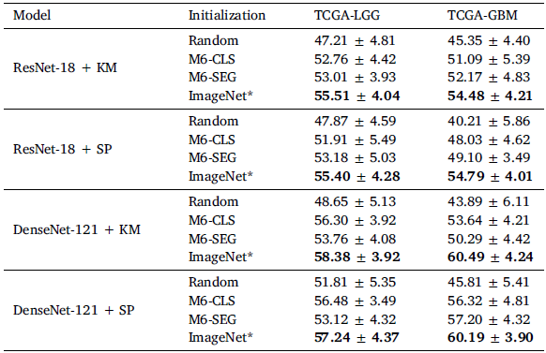
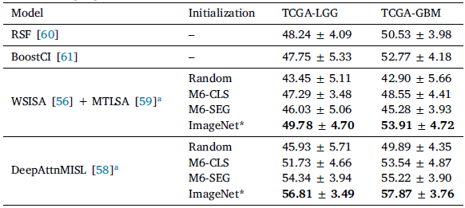
Survival Prediction Task
M6 show improvement over random initialization in survival prediction
M6 slightly worse than ImageNet* in all cases reported
Evaluated on the Concordance Index
Notes:
RSF - Random Survival Forest
Greater scores should be attributed to the subjects who are at a higher risk of experiencing an event
The C-index can quantify the correlation between risk predictions and event times in such a way that maximising this metric means improving the quality of discrimination between early events, associated with higher-risk subjects, and later occurrences
BoostCI - Boost Concordance Index

Slide 26
Opportunities for Improvement
Gradual Domain Adaptation
Leverage ImageNet* filters in lower model layers for morphological features
Adapt higher layers to task using multi-modality dataset
Use Transformer models instead of CNNs
No focus / visualization on how the models arrived at their results

Slide 27
Conclusion
Medical images with high modality similarity provide more transfer benefits in classification tasks
Diverse modality medical pre-training showed improved performance for segmentation task
Medical pre-training with tens of thousands of samples can lead to performance comparable to that with ImageNet, which contains millions of samples
Increasing Sample Size Does Not Compensate for Lack of Morphological Awareness
Natural images and their corresponding annotations are considerably more varied, which allows for more morphological awareness
ImageNet is the best choice for medical imaging, but medical pre-training has significant potential

Slide 28
References
Rethinking pre-training on medical imaging
Yang Wen a, Leiting Chen a,b, Yu Deng c, Chuan Zhou
Notes:
RSF - Random Survival Forest
BoostCI - Boost Concordance Index

