Slide 1
Ultra‑high resolution, multi‑scale, context‑aware approach for detection of small cancers on mammography
Krithika Rangarajan, Aman Gupta, Saptarshi Dasgupta, Uday Marri,
Arun Kumar Gupta, Smriti Hari, Subhashis Banerjee, & Chetan Arora
Presented by Kelly Chinander & Ronald Du
December 6th, 2023
Notes:
This paper is extremely short and sparse on details…

Slide 2
Slides
Overview
Introduction
Background
Importance of Resolution
Importance of Scale
Importance of Context
Resolution, Scale, & Context
Referenced Literature
Automatic mass detection in mammograms using deep convolutional neural networks
A multi-scale cnn and curriculum learning strategy for mammogram classification
Finding Tiny Faces
Methods and Materials
Training dataset
Test datasets
Diagnostic Mammography
Screening Mammography
Small Cancer
Dataset info
Architecture
Data Preprocessing
Image Rescaling and Systemic Cropping
Baseline Architecture
Combining Outputs
Results and experiments
Baseline model comparison
Dataset comparison
Ablation study results
Scale comparison
Detection comparison
Discussion and Conclusion
Conclusion
Limitations
Questions?
References

Slide 3
Overview

Slide 4
Introduction
"Ultra‑high resolution, multi‑scale, context‑aware approach for detection of small cancers on mammography" by Rangarajan et al. (2022) examines the importance of high resolution, scale, and context in identifying small cancers.
By using a fully convolutional network combined with multiple scales and context encoding, the authors demonstrate significant improvements in detection on cancers smaller than one centimeter, which may likely be missed by radiologists or other models.

Slide 5
Background
The 10 year survival rate from breast cancer falls from over 95% in patients where the cancer is less than 1 cm to about 60% when the size of the cancer is over 3 cm
Only about 5 out of 1000 scans would harbor a cancer
The cancer may also only occupy less than 1% of the image

Slide 6
Importance of Resolution
Mammography has the highest spatial resolution of all imaging modalities
Digital Mammograms have a pixel size of around 50–100 microns
DMs tend to be very large images, ranging from 2300 × 1800 pixels (of dimension 100 microns) to 4096 × 5625 pixels (of dimension 54 micron)

Slide 7
Importance of Scale
When mammograms are used in full resolution as input to a network, the receptive field typically includes only a fraction of the image
Masses may not be seen in its entirety within the receptive field
The shape and margins of the mass may not be visualized, which are important descriptors of any mammographic mass

Slide 8
Importance of Context
The features essential for detection of small cancers, may be significantly different from those for large (or average sized) cancers
For a very small mass, features such as margins and shape may not be visible directly
Other cues in surrounding parenchyma such as architectural distortion and the skin bulge or retraction play an important role in the detection

Slide 9
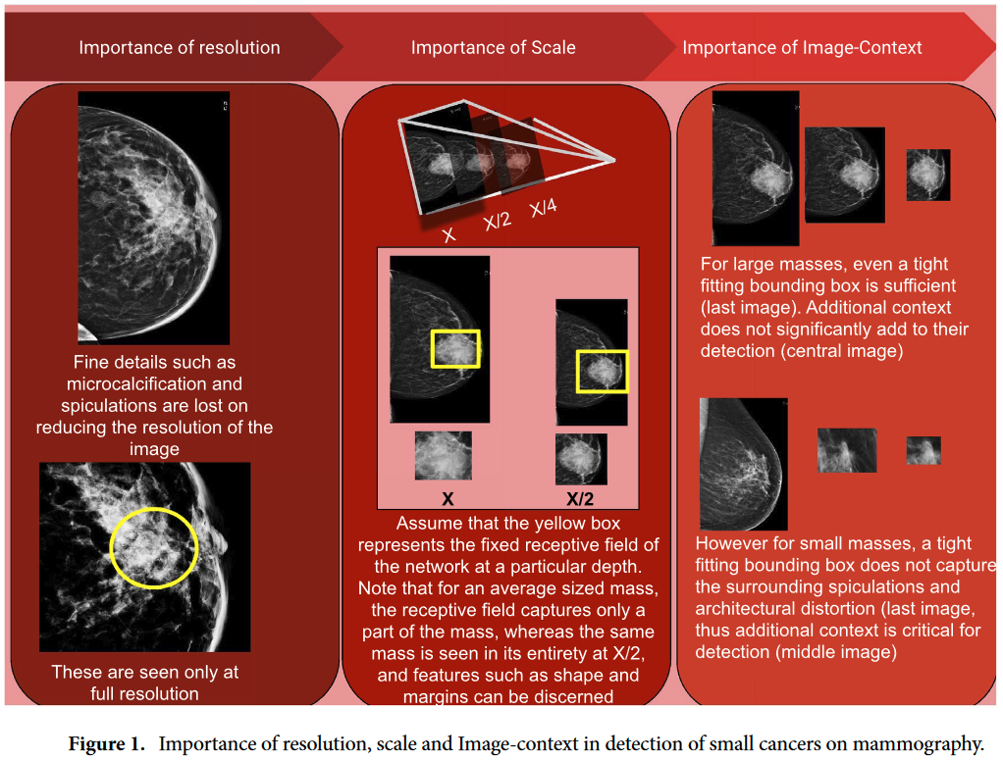
Resolution, Scale, & Context

Slide 10
Referenced Literature

Slide 11
Automatic mass detection in mammograms using deep convolutional neural networks
One of the first papers the authors compared to was Automatic mass detection in mammograms using deep convolutional neural networks by Agarwal et al.
Agarwal et al. trained a patch-based classifier while showing the benefit of domain adaptation in mammography
They showed their results on masses of different sizes in their analysis, demonstrating that the performance of CNNs drops for small masses
Cited in class page as interesting though previously presented
Agarwal, R., Diaz, O., Lladó, X., Yap, M. H. & Martí, R. Automatic mass detection in mammograms using deep convolutional neural networks. J. Med. Imaging 6, 031409 (2019).

Slide 12
A multi-scale cnn and curriculum learning strategy for mammogram classification
Next, the authors compared to A multi-scale cnn and curriculum learning strategy for mammogram classification by Lotter et al.
Lotter et al. perform multi-scale curriculum learning on mammograms to deal with the problem of very small lesions in comparison to image size
However, they perform only image level classification, without precise cancer localisation
Lotter, W., Sorensen, G. & Cox, D. A multi-scale cnn and curriculum learning strategy for mammogram classification. ArXiv170706978 Cs (2017).

Slide 13
Finding Tiny Faces
(again!!!)
Finally, the authors took inspiration from Finding Tiny Faces by Hu et al.
Finding Tiny Faces improves face detection in crowded images by training separate detectors for different scales and extract features from multiple layers of a single (deep) feature hierarchy
The authors directly state: “Our ideas and network for incorporating scale and context for detection are inspired by the work of Hu et al. on small object detection in natural images”
Hu, P. & Ramanan, D. Finding tiny faces. In 2017 IEEE Conference on Computer Vision and Pattern Recognition (CVPR) 1522–1530. https://doi.org/10.1109/CVPR.2017.166 (2017).

Slide 14
Methods and Materials

Slide 15
Training dataset
Mammograms collected at All India Institute of Medical Sciences, New Delhi, India
Collected in 2015
Filtered for images with BIRADS 4 category with expert evaluations.
Suspicious abnormality – Biopsy should be considered
Images | 839
Confirmed cancers | 393

Slide 16
Test dataset -
Diagnostic Mammography
Mammograms collected at All India Institute of Medical Sciences, New Delhi, India
Collected in 2018
Filtered for images with BIRADS 4 category or above
Referred to as the DM dataset throughout the paper
Images | 2569
Confirmed cancers | 243

Slide 17
Test dataset -
Screening Mammography
Mammograms collected at All India Institute of Medical Sciences (Cancer Center), New Delhi, India
Collected in 2021
All patients selected except those without confirmation
Referred to as the SM dataset throughout the paper
Images | 2146
Confirmed cancers | 59

Slide 18
Test dataset -
Small Cancer
Mammograms curated from the other datasets
Selected only images with cancers less than 1 cm
Diameter for mass
Longest dimension for microcalcification
Referred to as the SC dataset throughout the paper
Images | 79
Average cancer size | 5.8 mm

Slide 19
Dataset info
All datasets are not publicly available
Bounding box annotations were performed by 3 breast radiologists with 2, 8 and 15 years of experience in breast imaging
All images were of size 3328 × 4096 pixels

Slide 20
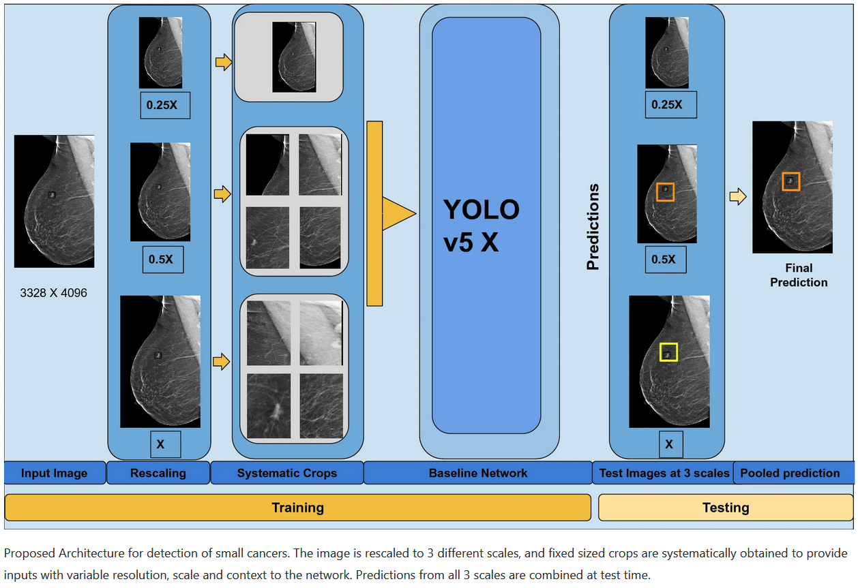
Architecture

Slide 21
Data Preprocessing
All images were of size 3328 × 4096
Images cropped to remove portion with no breast, resulting in variable size image along the horizontal axis dependent on the size of the breast
All vertical axises of images were 4096px

Slide 22
Image Rescaling and Systemic Cropping
Original image scaled to 0.25, 0.5 and the original
Crops of 0.25x of the original image are taken from each scaled image
1 for 0.25x, 4 for 0.5x, 16 for X
Crops were taken right to left and top to bottom to cover the whole image

Slide 23
Baseline Architecture
Authors describe default YOLOv5 implementation
CSPDarknet backbone and feature extraction, PANet neck for upsampling and concatenations between different layers - feature fusion, and a final YOLO head for convolution - computing class and object score
No modifications were made to the YOLOv5 architecture by the authors

Slide 24
Baseline Architecture
For many masses, including small ones, important details are present at higher resolutions but as the image progresses through the network, resolution decreases
PANet employs adaptive feature pooling which concatenates features from each layer to merge together information from all resolutions

Slide 25
Baseline Architecture
Google Cloud cluster of 32GB V100 GPUs were used
YOLOv5 default implementation used, with binary cross entropy loss with logits loss for object scores, and SGD as the optimizer
0.01 learning rate and batch size of 16

Slide 26
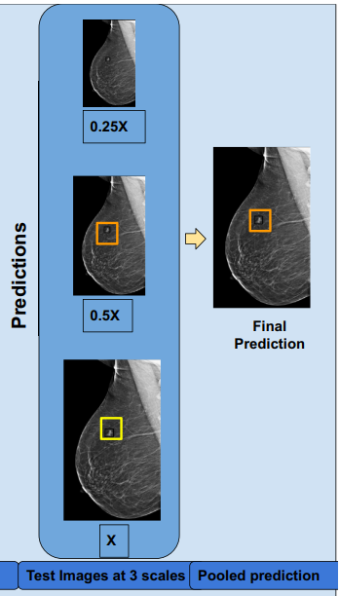
Combining Outputs
Each resulting cropped image from each scaled image is passed through the network
End result from them is combined using weighted box fusion (WBF)
Authors tried NMS and found WBF performs better

Slide 27
Results and Experiments

Slide 28
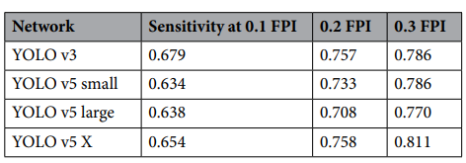
Baseline model comparison
YOLOv3 performed the best at a .1 FPI (false positive per image) or specificity
YOLOv5X, their chosen baseline, had the best sensitivity at .3 specificity
Trained on training dataset, tested on DM dataset

Slide 29
Dataset comparison
Model performed best on screening mammography dataset
Baseline is original preprocessed image without systemic cropping or scaling
Proposed algorithm is with the systemic scaling, cropping, and combining

Slide 30
Ablation study results
Goal of analyzing the effects of scale, resolution and context
Resolution - instead of using cropped higher resolution images, upsampled smaller resolution images were used - worse results
Scale - Train the YOLOv5 model with full resolution images without rescaling - performed worse than model trained on scaled images
Context - Upsample downscaled .25x images to original size, to negate resolution, and take crops from each scale - crops from .25X have the most context and X has the least, but all have the same resolution

Slide 31
Scale comparison
Importance of scale/resolution relative to size of the image also analyzed
Analysed the results of each individual scale prior to WBF (combining) on the SM dataset. Average masses exclusively caught only on that particular scale are shown to the right
Original resolution picked up the smallest masses

Slide 32
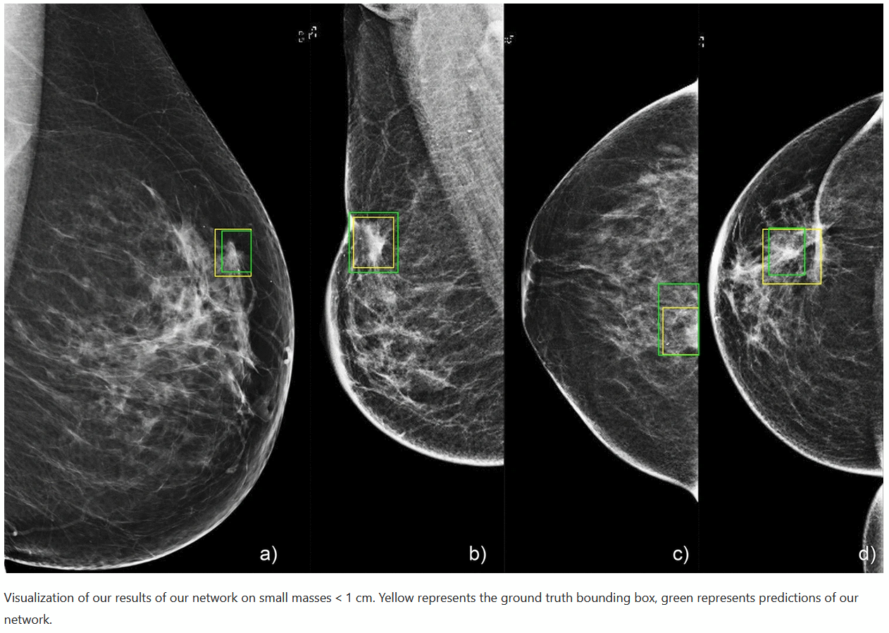
Detection comparison

Slide 33
Discussion and Conclusion

Slide 34
Conclusion
The proposed model improves detection of small cancers in mammogram imagery
Improvements were best on the SC dataset, suggesting the approach is particularly suited for detection of small cancers
Scale, context, and resolution all shown to be important factors in cancer detection
Notes:
Experts are 0 because they originally classified the mammogram as normal
False predictions are due to the model not being trained on Prior as they had no annotations and were classed as normal.

Slide 35
Limitations
Masses missed by the network are primarily isodense, obscure, and masses in the peripheral
Only 12 images total had microcalcifications
Single source of data
Benign lesions were counted as false positives
Cluster of 32GB V100s used, difficult to replicate without expensive Google Cloud access
Notes:
Experts are 0 because they originally classified the mammogram as normal
False predictions are due to the model not being trained on Prior as they had no annotations and were classed as normal.

Slide 36
Questions?

Slide 37
References
Rangarajan, K., Gupta, A., Dasgupta, S. et al. Ultra-high resolution, multi-scale, context-aware approach for detection of small cancers on mammography. Sci Rep 12, 11622 (2022). https://doi.org/10.1038/s41598-022-15259-7
Agarwal, R., Diaz, O., Lladó, X., Yap, M. H. & Martí, R. Automatic mass detection in mammograms using deep convolutional neural networks. J. Med. Imaging 6, 031409 (2019).
Lotter, W., Sorensen, G. & Cox, D. A multi-scale cnn and curriculum learning strategy for mammogram classification. ArXiv170706978 Cs (2017).
Hu, P. & Ramanan, D. Finding tiny faces. In 2017 IEEE Conference on Computer Vision and Pattern Recognition (CVPR) 1522–1530. https://doi.org/10.1109/CVPR.2017.166 (2017).

