Slide 1
Visual CASE for Learning Computer Science
Ashley Stafford

Slide 2
What is CASE?
Computer Aided Software Engineering
The use of a computer system to aid in the creation of software
Used to reduce the amount of time required for software development while improving upon the quality of the software that is developed

Slide 3
Popularity
Peaked in 1990’s
  Fix all for software problems
  Cheap solution to large scale company problems
Huge decline in popularity
  73.5% of company's do no use CASE
  Of the companies that do, only 25% of employees use CASE
  Expense

Slide 4
Structure of Case
Tools – support specific tasks
Workbenches – support a few tasks
Environments – support large aspects of software process

Slide 5
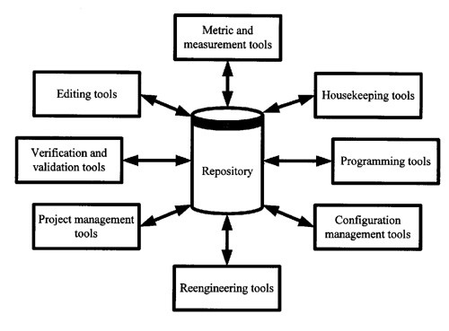

Slide 6
Uses
Prototyping
  Blend
Design
  UML diagrams
Code Generation
  Enterprise Architect
Testing
  Ranorex

Slide 7
Visual CASE
Subset of CASE tools and relies on a highly graphical visual interface for developing software, and is easier to use than many traditional CASE programs

Slide 8
Visual Programming
Allow users to visually create computer programs with limited experience in computer programming.
limited in what they are able to produce
lack flexibility

Slide 9
Visual Programming as a Teaching Tool
Easy
Fun
Visual

Slide 10
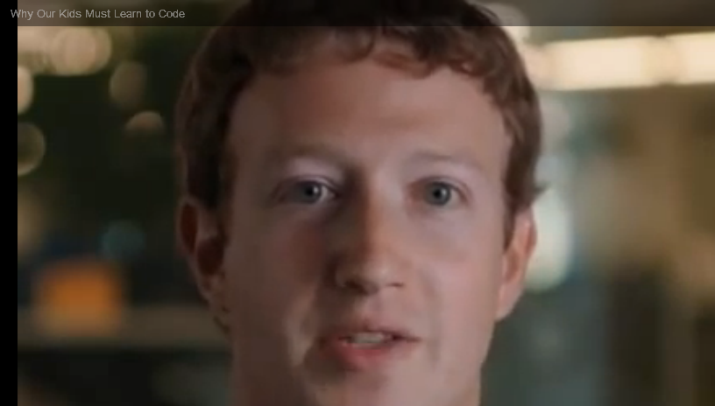
Why teach kids?

Slide 11
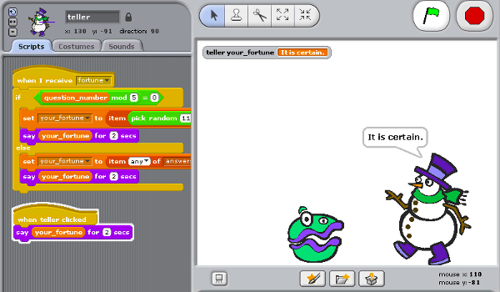
Scratch
Initialization
Variables
Concurrency
Booleans

Slide 12
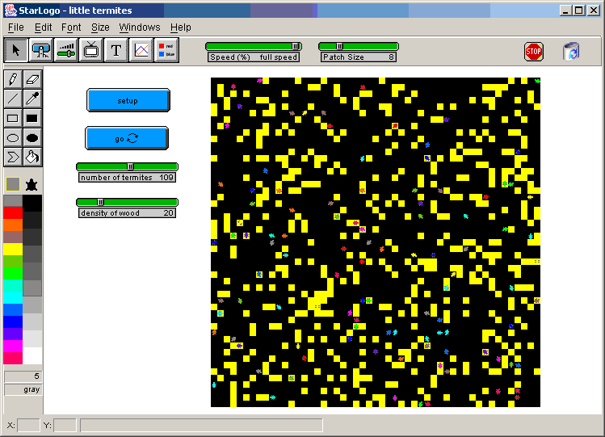
Logo
Conditionals

Slide 13
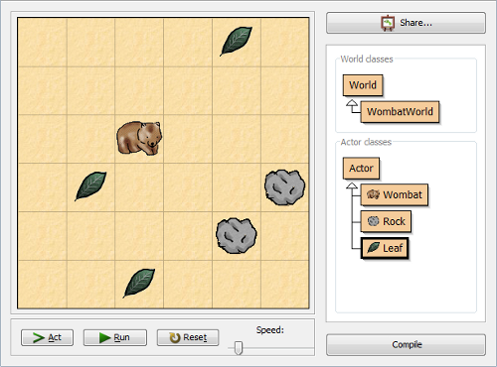
Greenfoot
Text Based

Slide 14
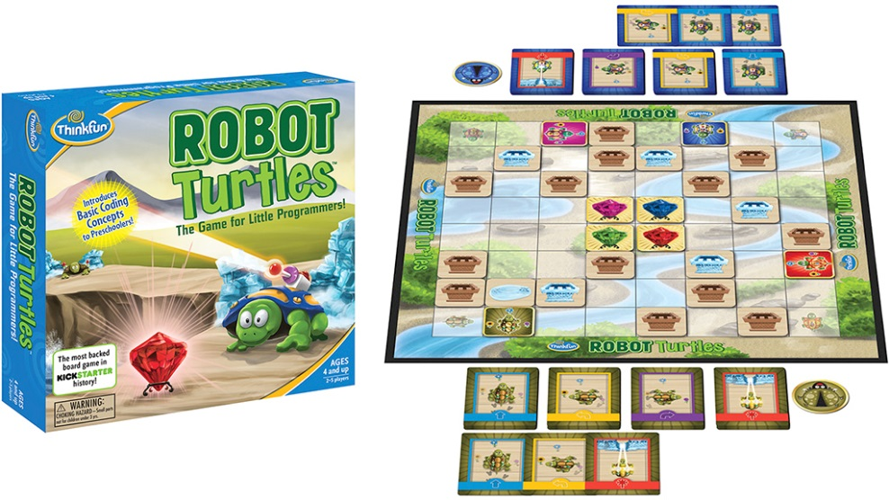
Existing Early Education
Primarily through after school/summer programs
  NCLab
Board games to encourage critical thinking and software concepts

Slide 15
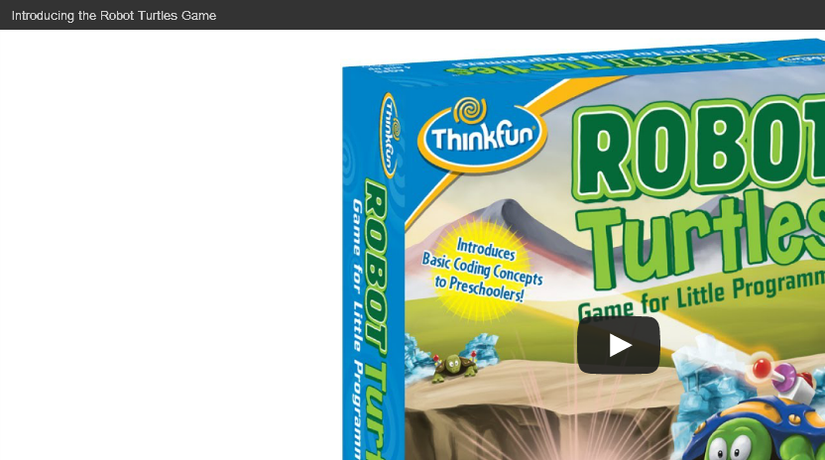
Too Young?

Slide 16
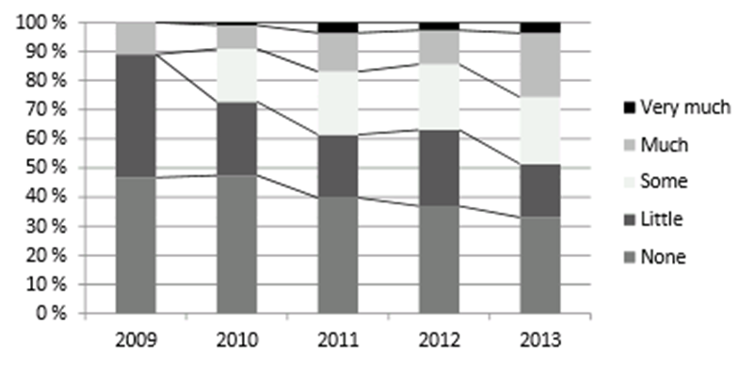
Desire to Learn
Programming experience

Slide 17
Challenges
Initial Language
Text book
Rate that material is taught
Top down
Bottom up
Motivation
Critical Thinking

Slide 18
What Does Work
Visual First then Traditional
See someone creating code
Game play/creation
Immersive like second language
  Educators facilitate conversations
  Ask the user to enter two numbers, obtain the numbers and display the sum.

Slide 19
Questions
What are some of the problems individuals face when teaching programming?
What techniques can be used to overcome these problems?
Why are computer programming concepts not taught in traditional K-12 computer courses?

