Slide 1
Intensity Transformations
CS 474/674 – Prof. Bebis
Sections 2.5, 3.1, 3.2, 3.3

Slide 2
Spatial Domain Methods
f(x,y)
processed image
g(x,y)
Point
Processing
T operates on a single pixel at a time
f(x,y)
g(x,y)
processed image
Area/Mask
Processing
T operates on a “group” of pixels !

Slide 3
Point Processing Transformations
Convert a given pixel value to a new pixel value based on some predefined function T().

Slide 4
Identity Transformation

Slide 5
Negative Transformation
g(x,y) = 255-f(x,y)
image negative
image negative

Slide 6
Contrast Stretching or Compression
Stretch gray-level ranges where
we desire more information
(slope > 1)
Compress gray-level ranges that
are of little interest
(0 < slope < 1)

Slide 7
Image stretching/compression using a linear transformation
[a,b] → [c, d]
d
Stretching: [c,d] should be wider than [a,b]
Compression: [c,d] should be narrower than [a,b]
a→c: c=ma+k
b→d: d=mb+k
y=mx+k m,k?
c
a
b
two equations
in two unknowns
Solution: y=(x-a)(d-c)/(b-a)+c

Slide 8
Special case: [a, b] → [0, 255]
Image values are typically in the range [0, 255] (e.g., PGM images use 8 bits/pixel)
Certain image processing operations might yield pixel values outside the range [0, 255]!
If the pixels values are outside of [0, 255], the image will not be displayed correctly!
You must explicitly re-map the values to [0, 255]

Slide 9
Special case: [a, b] → [0, 255] (cont’d)
Find the min (f_{min}) and max (f_{max}) intensity values of the image (note: could be negative).
Compute the transformation:
[f_{min}, f_{max}] → [0, 255]
Solution: y=255(x - f_{min})/(f_{max} - f_{min})
Note: y should be truncated/rounded to (int)

Slide 10
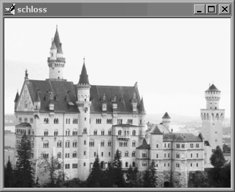
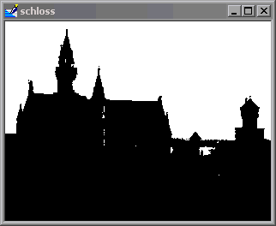
Thresholding
Special case of contrast compression!
“hard” threshold
“hard” threshold
“soft” threshold

Slide 11
Intensity Level Slicing
Highlight values within a specific range only!
Remove
background:
This is in essence
“double”
thresholding!

Slide 12
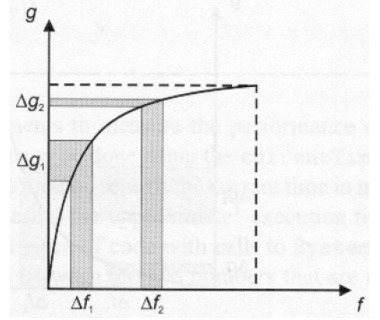

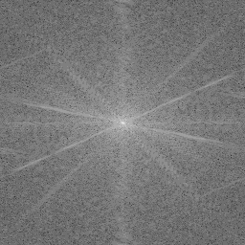
Logarithmic transformation
Enhance details in the darker regions of an image at the expense of details in brighter regions.
Example: visualize the spectrum of the
Fourier Transform using a log() transformation
compress
T(r)
stretch

Slide 13
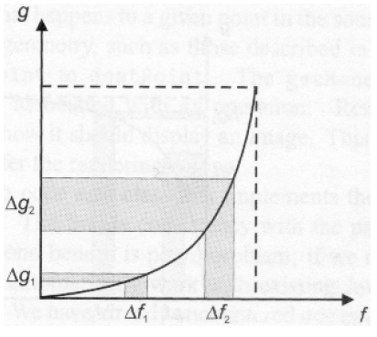
Exponential transformation
Reverse effect of that obtained using logarithmic mapping.
stretch
compress

Slide 14

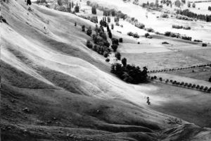
Histogram Equalization
A fully automatic technique for contrast enhancement!
Need to define image histograms and review random variables from probability theory first!

Slide 15
Image Histograms
An image histogram is a plot of gray-level frequencies.

Slide 16
Normalized Image Histograms
Divide frequencies by total number of pixels in the image to represent them as probabilities.

Slide 17
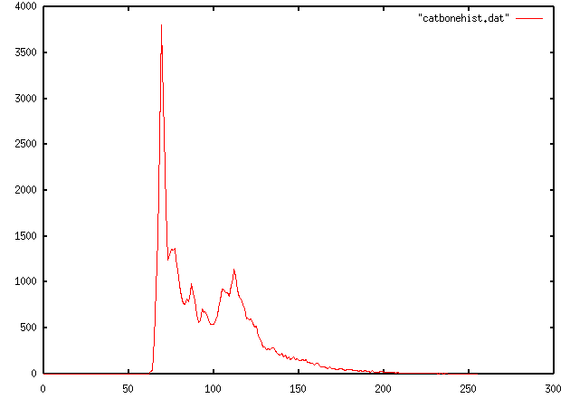
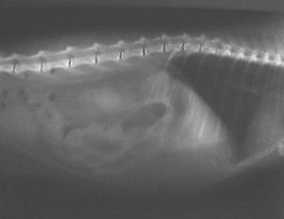
Image Histograms (cont’d)
Example:
Unnormalized Histogram
Could different images have the same histogram?

Slide 18
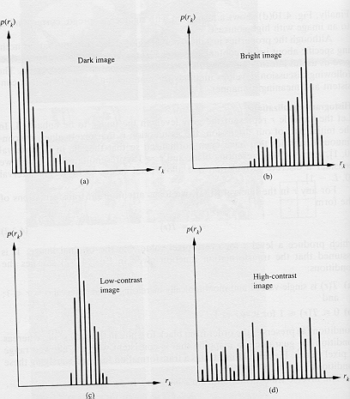
Properties of Image Histograms
Histograms clustered at the low end correspond to dark images.
Histograms clustered at the high end correspond to bright images.

Slide 19
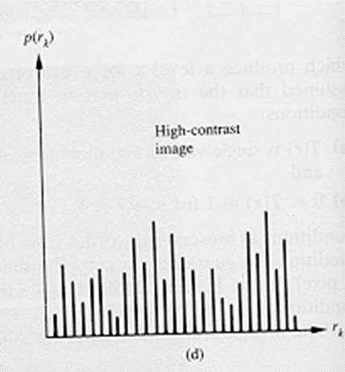
Properties of Image Histograms (cont’d)
Histograms with small spread correspond to low contrast images (i.e., mostly dark, mostly bright, or mostly gray).
Histograms with wide spread correspond to high contrast images.

Slide 20
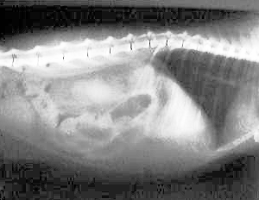
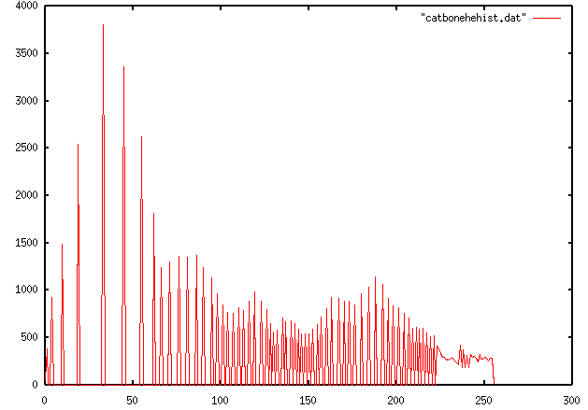
Properties of Image Histograms (cont’d)
Low contrast
High contrast

Slide 21
Histogram Equalization
The goal of histogram equalization is to redistribute the gray-level values uniformly!

Slide 22
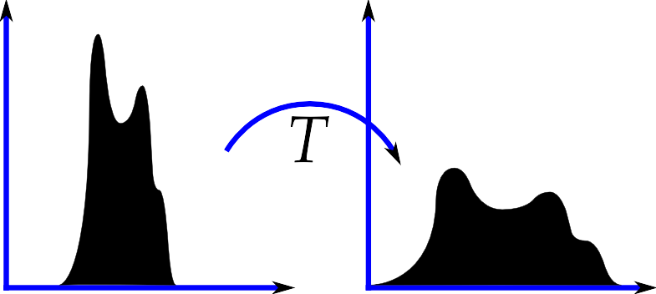
Histogram Equalization (cont’d)
In practice, the equalized histogram will not be completely flat due to the discrete nature of the data.

Slide 23
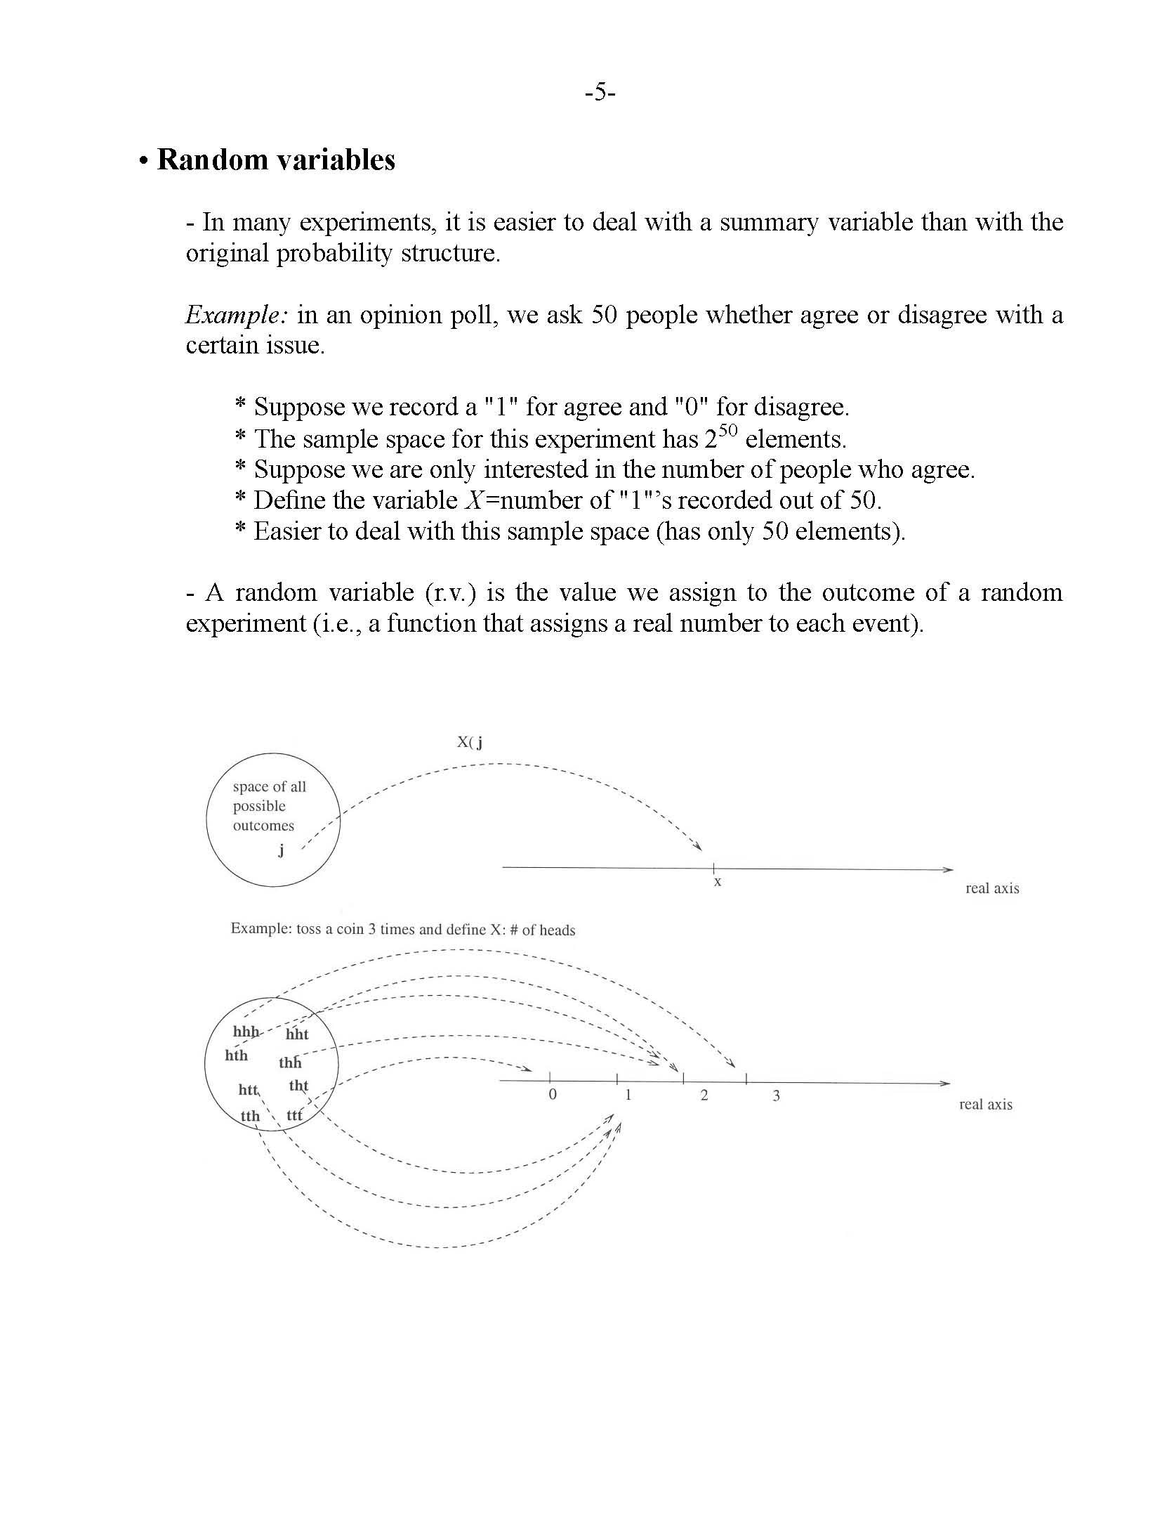
Random Variables
A random variable (r.v.) is a function that assigns a discrete or continuous value to the outcome of a random experiment.
X(j)=x
Notation: X: random variable, x: value of random variable
Example: toss a coin 3 times, define X: # of heads

Slide 24
Random Variables (cont’d)
How do we compute probabilities using random variables?
  Suppose the sample space is S=<s₁, s₂, …, s_{n}>
  Let the random variable X assume values in <x₁,x₂,…,x_{m}>
  What is
  Find all outcomes such that X(s_{i})=x_{j} and take the sum of their probabilities:
X(s_{i})=x_{j}
s_{i}
x_{j}

Slide 25
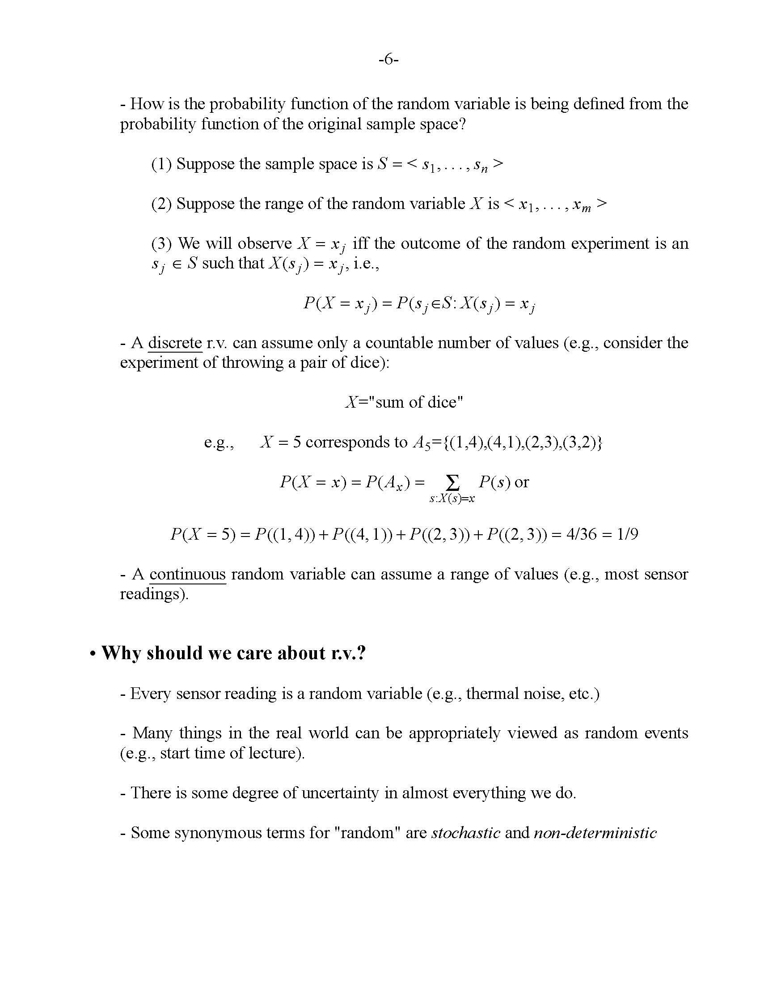
Example
Consider the random experiment of throwing a pair of dice.
Let’s define X=“sum of dice”, what is P(X=5)?

Slide 26
Random Variables (cont’d)
A random variable (r.v.) can be discrete or continuous:
  Discrete: assumes only discrete values (countable).
  Continuous: assumes continuous values (e.g., sensor readings).
Random variables are associated with a probability distribution.
    Probability mass function(pmf) f(x) → discrete case
    Probability density function(pdf) f(x) → continuous case

Slide 27
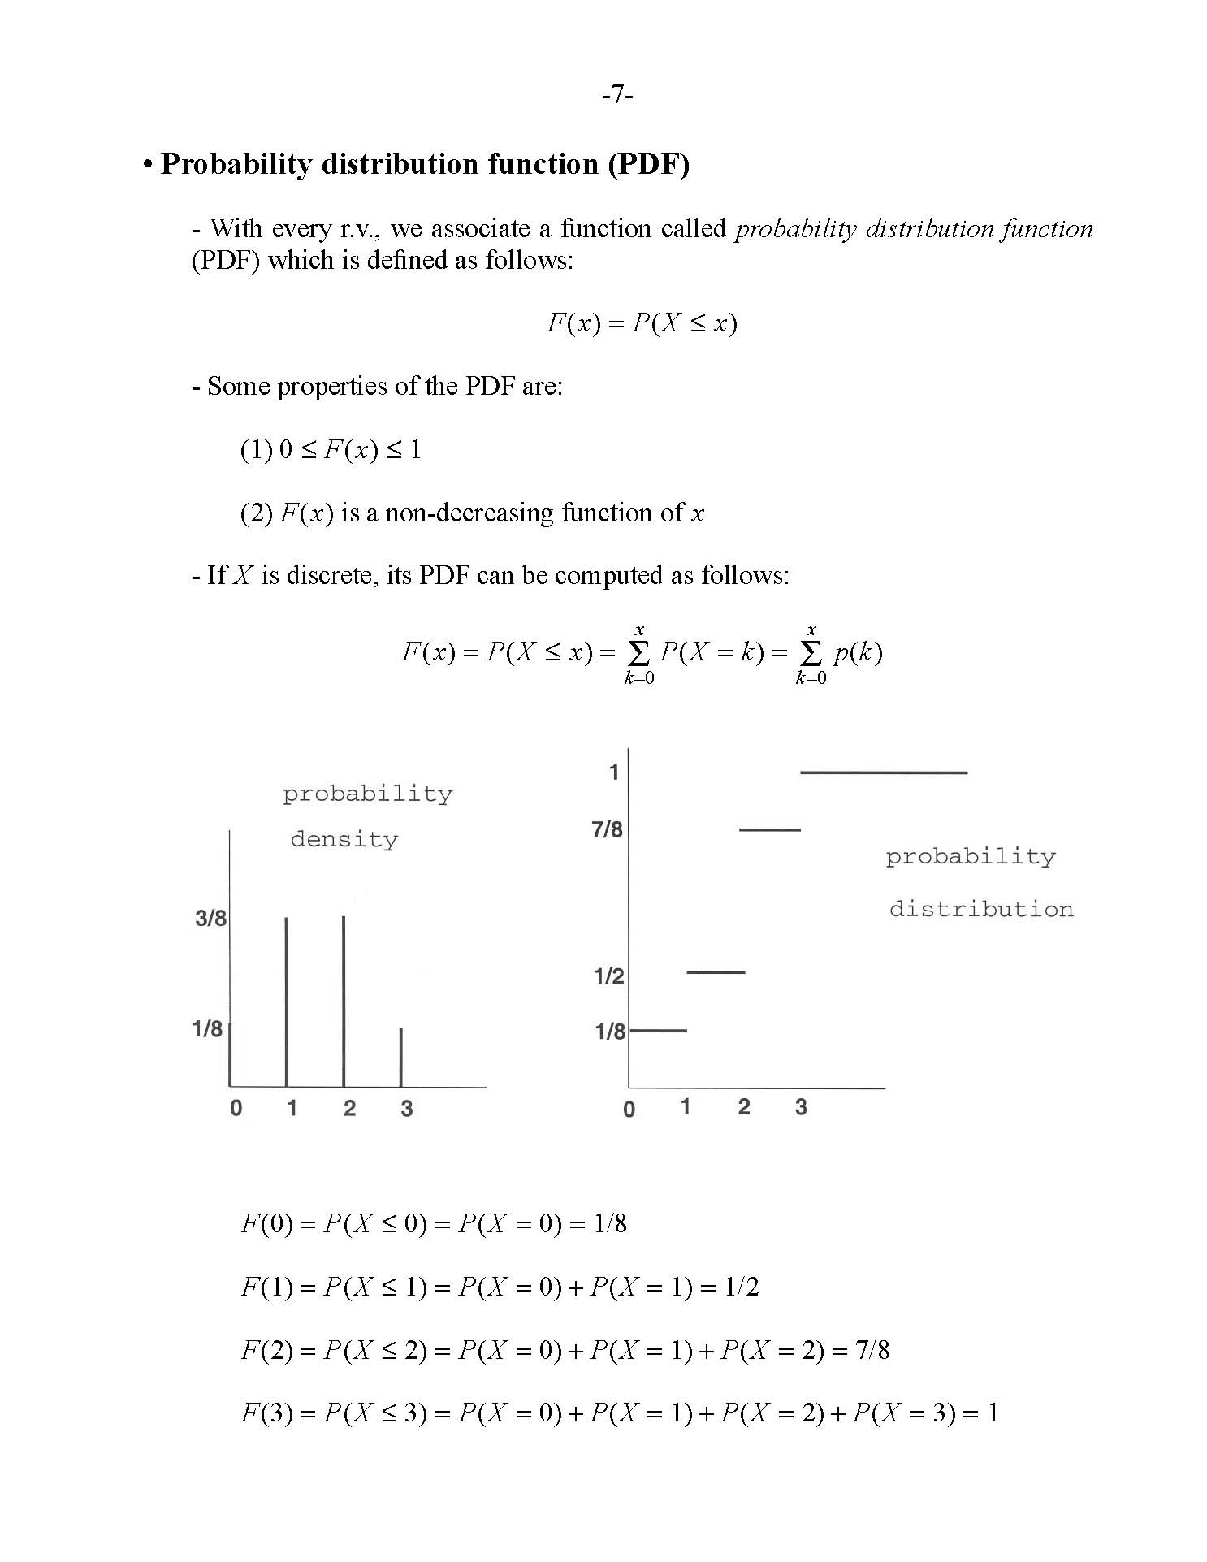
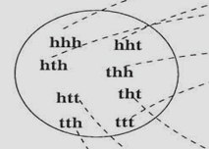
Probability mass function (pmf)
The pmf f(x) of a discrete r.v. X assigns a probability to each possible value x of the r.v. X.
Example:
toss a coin 3 times
X: # of heads
pmf f(x)
P(X=0)=P(X=3)=1/8
P(X=1)=P(X=2)=3/8

Slide 28
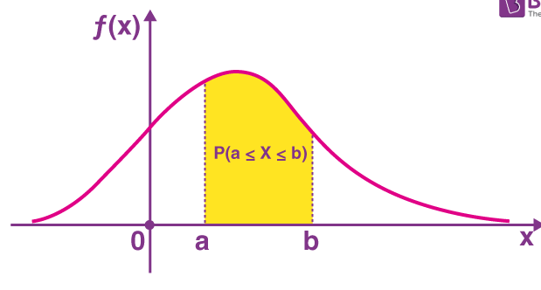
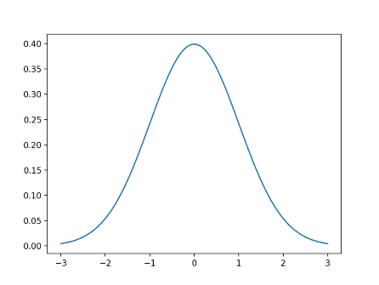
Probability density function (pdf)
The pdf f(x) of a continuous r.v. X represents the probability of being close to some value x (i.e., the probability of landing inside an infinitesimal region with area δx is f(x)δx).
Gaussian pdf

Slide 29
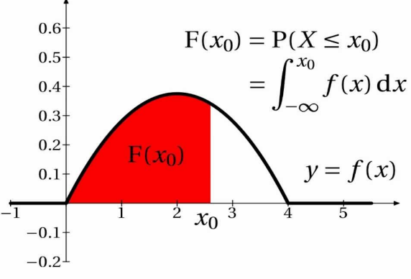
Cumulative Distribution Function (CDF)
The cumulative distribution function (CDF) is defined as:
Computing in the continuous case:
Computing in the discrete case:
  F(x) is always non-decreasing

Slide 30
Example – Discrete Case
Example:
toss a coin 3 times
X: # of heads
pmf
CDF

Slide 31
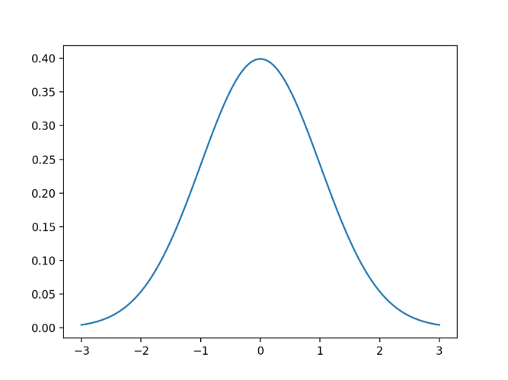
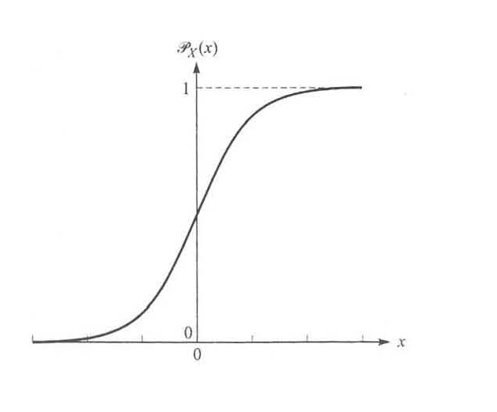
Example – Continuous Case
Gaussian pdf
Gaussian CDF

Slide 32

Transformations between Random Variables
We can define a new random variable Y from another random variable X using some transformation Y=T(X)
  e.g., Y=X+1
Question: if we know f_{X}(x), can we find f_{Y}(y)?
Yes - it can be shown that:

Slide 33
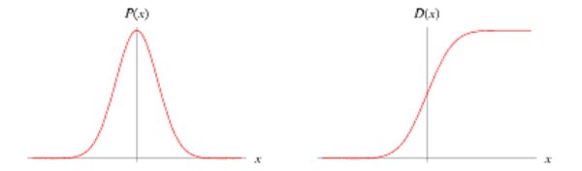
Transformations of r.v. - Example
μ=0, σ=1
0
μ=1, σ=1

Slide 34
Special Case: T() is the CDF
cumulative distribution
https://ocw.mit.edu/courses/res-6-012-introduction-to-probability-spring-2018/resources/simulation

Slide 35
Histogram Equalization (cont’d)
r: original intensity
s: new intensity
How do we apply this result to images?

Slide 36
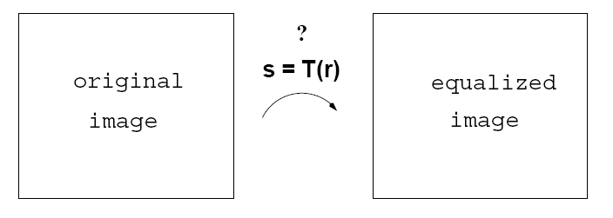
Histogram Equalization (cont’d)
We will assume that “each intensity level” is the result
of some “random experiment”.
pdf: p_{r}(r)
pdf: p_{s}(s)
r: original intensity
s: new intensity
de-normalize:
s_{k} x (L-1)
k=0,1,2, …, L-1

Slide 37
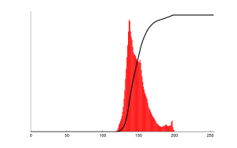
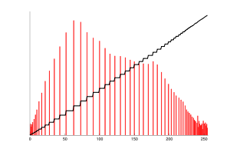
Histogram Equalization (cont’d)

Slide 38
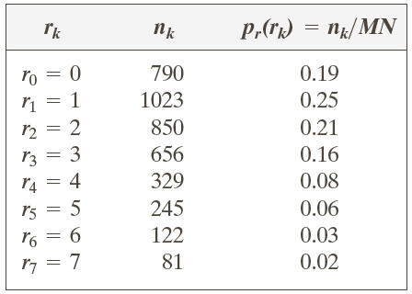
Example – Discrete Case
3 bit
64 x 64 image

Slide 39
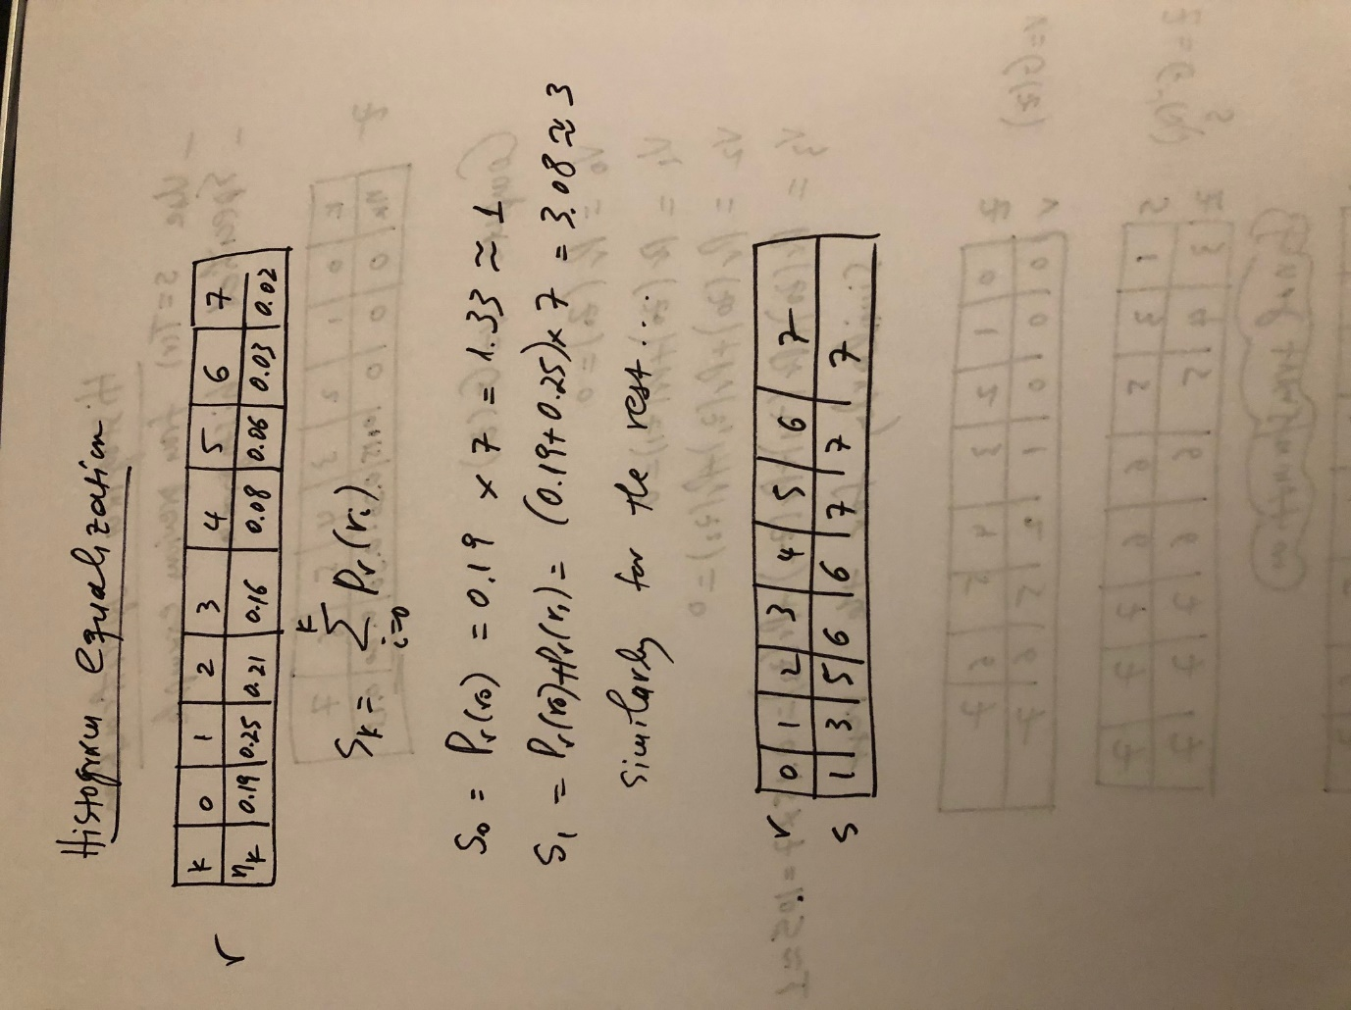
Example – Discrete Case (cont’d)
de-normalize:
x (L-1)
Equalization Transformation
truncate/round

Slide 40
Example – Discrete Case (cont’d)
Equalization Transformation
Original Image
Equalized Image
3 | 5 | 0 | …
… | … | … | …
… | … | … | …
… | … | … | …
6 | 7 | 1 | …
… | … | … | …
… | … | … | …
… | … | … | …

Slide 41
Example – Discrete Case (cont’d)
3 bit
64 x 64 image
input histogram
equalized histogram

Slide 42
Example – Continuous Case

Slide 43
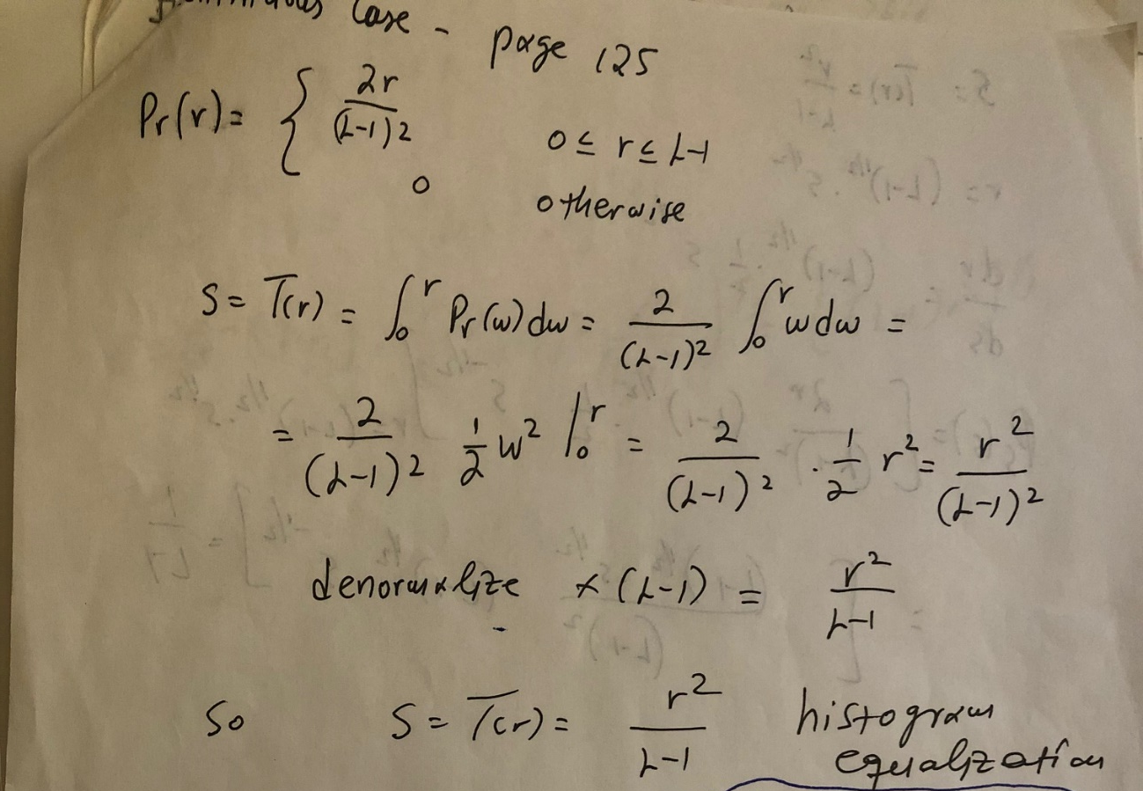
Example – Continuous Case (cont’d)

Slide 44
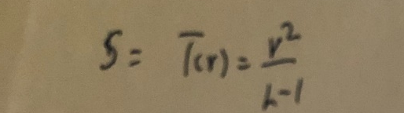
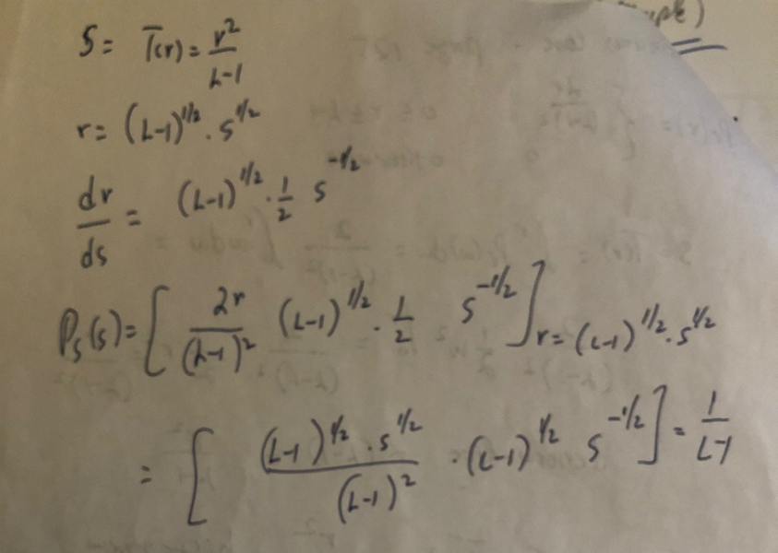
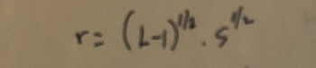
Example – Continuous Case (cont’d)
Verify that p_{s}(s) is indeed uniform!
Uniform!

Slide 45
Histogram Equalization - Examples
original images and histograms
equalized images and histograms

Slide 46
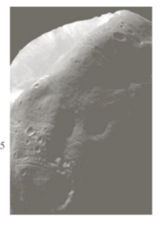
Histogram Specification (or Matching)
Find a transformation Q(r) which maps an image to a new image that has a specific histogram (not necessarily uniform!)
We need to provide the following:
  (1) original image
  (2) desired pdf (histogram)
histogram-matched
image
f_{R}(r)
f_{Z}(z)

Slide 47
Histogram Specification (Matching)
Input
(1) original image I₁
(2) desired pdf f_{Z}(z) (histogram)
Output
(1) histogram specified image I₂
f_{R}(r)
f_{Z}(z)
Goal: find transformation
z=Q(r)
f_{R}(a)da
f_{Z}(a)da

Slide 48
Histogram Specification (Matching)
(1) Compute the equalization
transformation v=G(z)
i.e., we can do this since we have
f_{Z}(z) which is the desired pdf
(2) Compute I₂ through z=G⁻¹(v)
But, we do not know I’₂
since we only have the desired
histogram for I₂ !
f_{R}(r)
f_{Z}(z)
f_{R}(a)da
f_{Z}(a)da

Slide 49
Histogram Specification (Matching)
Idea:
Compute the equalization
transformation s=T(r)
Compute I₂ using z=G⁻¹(s) instead of G⁻¹(v) (i.e., replace v by s)
Can we do this?
Yes, both s and v follow a uniform distribution!
f_{R}(r)
f_{Z}(z)
f_{R}(a)da
f_{Z}(a)da
Desired transformation:
z=Q(r)=G⁻¹(T(r))

Slide 50
Histogram Specification (Matching)
Summary of steps:
(1) Compute equalization
transformation s=T(r)
(2) Compute equalization
transformation v=G(z)
(3) Compute I₂ through z=G⁻¹(s)
or z=G⁻¹(T(r)) using I’₁
f_{R}(r)
f_{Z}(z)
f_{R}(a)da
f_{Z}(a)da
  Note: G⁻¹ is not always easy to find.

Slide 51
Example – Discrete Case
same 3 bit
64 x 64 image
as before
histogram of input image
specified histogram

Slide 52
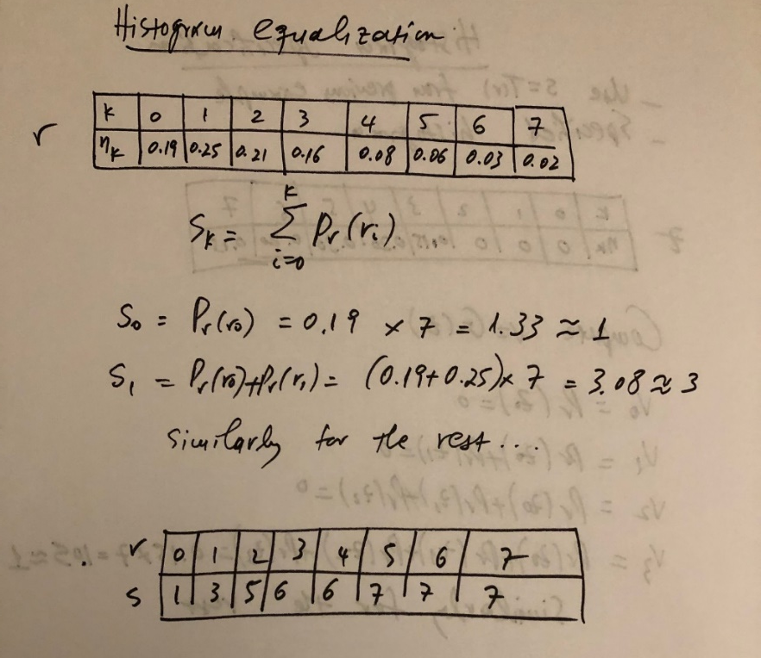
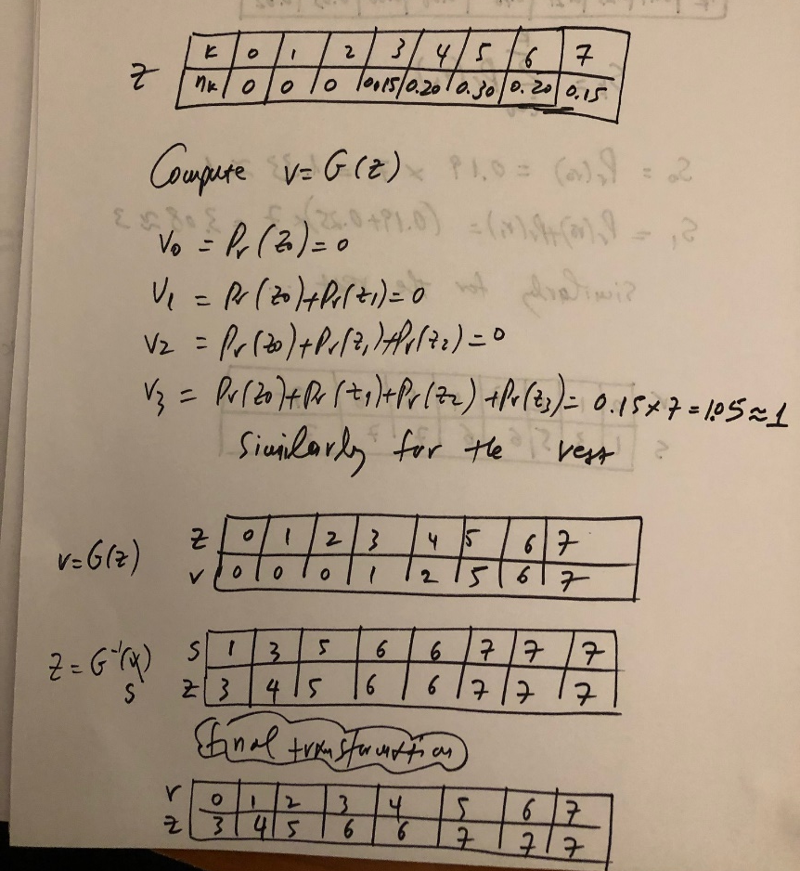
Example – Discrete Case (cont’d)
Step 2: find v=G(z)
using specified histogram
Step 1: find s=T(r)
(we did it already in previous example)
flip table
Step 3: find z=G⁻¹(s)
replace v with s
compute new z values
z=Q(r)= G⁻¹(s)=G⁻¹(T(r))

Slide 53
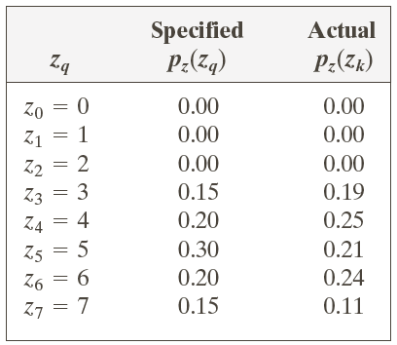
Example – Discrete Case (cont’d)
histogram of
input image
specified histogram
resulted histogram

Slide 54
Example – Continuous Case

Slide 55

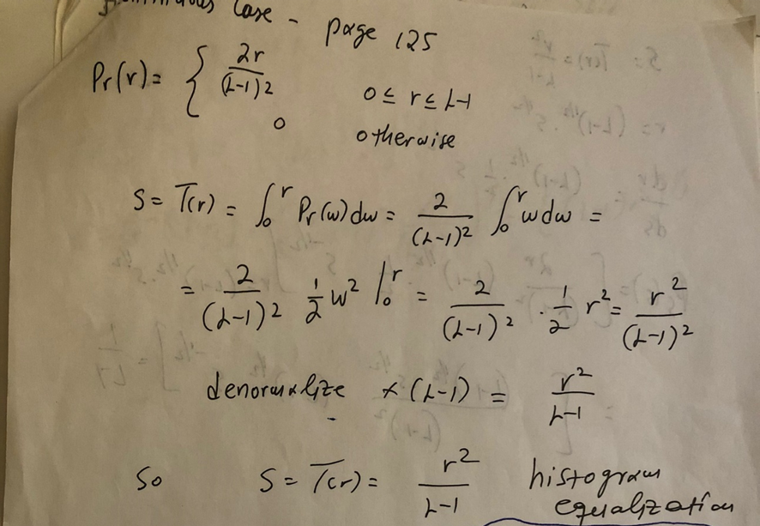
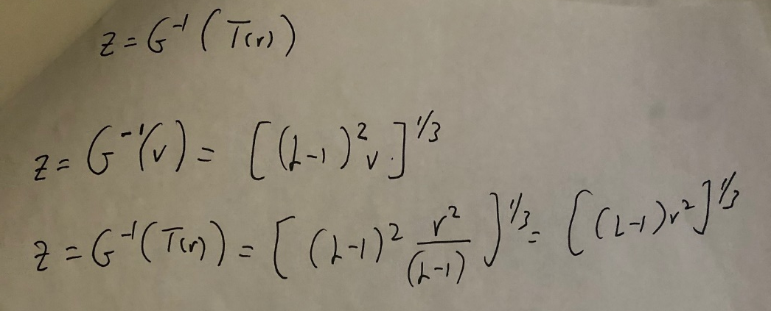
Example – Continuous Case (cont’d)
Step 2: find v=G(z)
Step 1: find s=T(r)
(we have already done it)
Step 3: find z=G⁻¹(s)=G⁻¹(T(r))

Slide 56
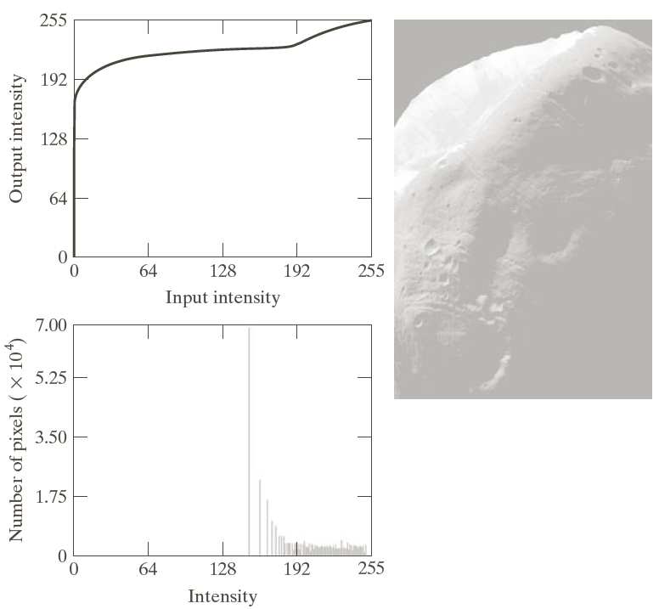
Histogram Specification - Example
Histogram specification can yield better results than histogram equalization.
Result of histogram equalization

Slide 57
Histogram Specification – Example (cont’d)
Result of histogram specification
specified
histogram
G(z)
G⁻¹(z)
resulted
histogram

Slide 58
Local Histogram Processing
Both histogram equalization and specification are global transformations.
  i.e., the intensity transformation is computed from the entire image.
Global transformations are not appropriate for enhancing small details in an image.
  i.e., the number of pixels in these areas might be very small, contributing very little to the computation of the transformation.
detail

Slide 59
Local Histogram Processing (cont’d)
Define a window w x w and move its center from pixel to pixel (row by row, top to bottom):
At each location (x,y) of the input image, compute the histogram of the pixels in the window and the corresponding histogram equalization s=T(r).
Apply the computed transformation to the intensity of the pixel at location (x,y) and assign the equalized value to the same location in the output image.
Move the center of the window to the next image location and repeat the process.
Input Image
(x,y)
r
s=T(r)
Output Image
(x,y)
s

Slide 60
Local Histogram Processing: Example
Global histogram
equalization
Local histogram
equalization using a
3 x 3 window

Slide 61
Histogram Statistics
Useful statistics can be computed from image histograms.
mean
(average intensity)
variance
(2nd moment)
n-th moment
around mean

Slide 62
Histogram Statistics (cont’d)
σ is useful for estimating image contrast!

Slide 63
Local Histogram Statistics
Compute image histogram statistics in a local region.

Slide 64

Local Histogram Statistics (cont’d)
Local histogram statistics could be used for local image enhancement.
Task: enhance dark
areas without affecting
much bright areas.
Idea: Find dark, low contrast
areas using local statistics and
enhance them.

Slide 65
Local Histogram Statistics (cont’d)
“dark” constraint
“low-contrast” constraint
m_{G}=161
σ_{G}=103
E=22.8 k₀=0.25 k₁=0 k₂=0.1
chosen experimentally
local image enhancement using histogram statistics

Slide 66
Quiz #1
When: 9/15/2025 (Monday) at 1:00pm
What: Introduction to Image Processing & Intensity Transformations
Duration: 15 minutes

