Slide 2
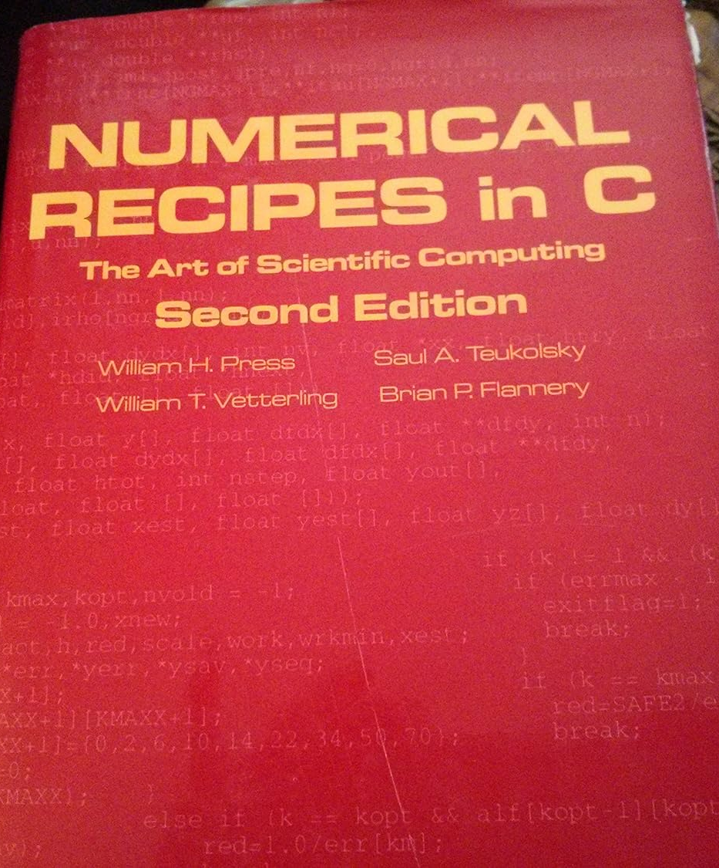
The same function can be used to compute both the forward and inverse FFT!
https://www.cse.unr.edu/~bebis/CS474/Handouts/fft.pdf
You can also use any other (reliable) 1D FFT implementation (but NOT a 2D implementation as you would have to implement the 2D FFT yourself, using 1D FFTs)

Slide 4
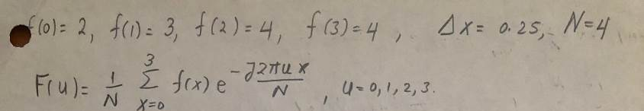
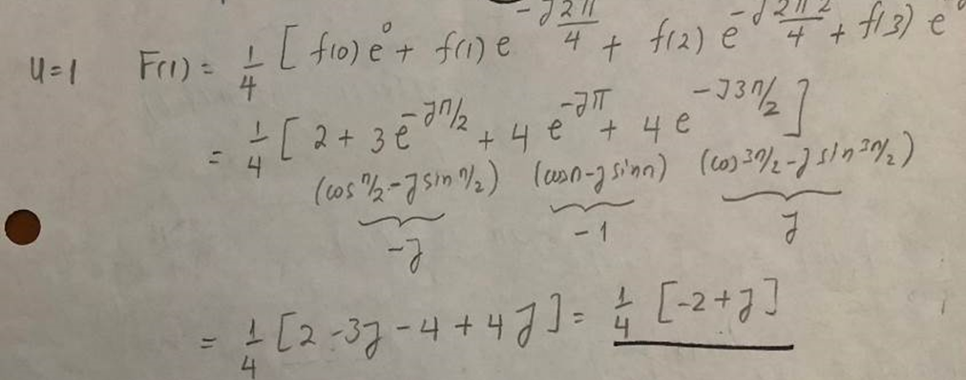
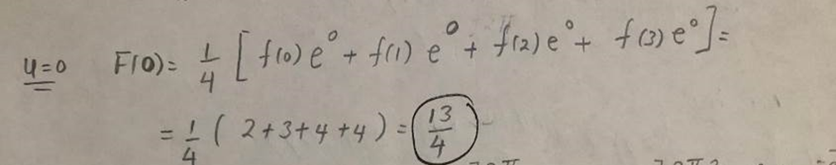
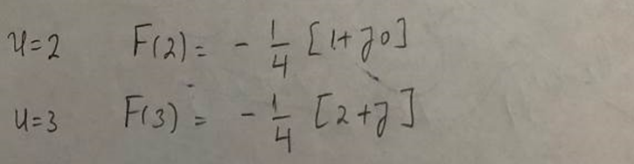

Slide 5
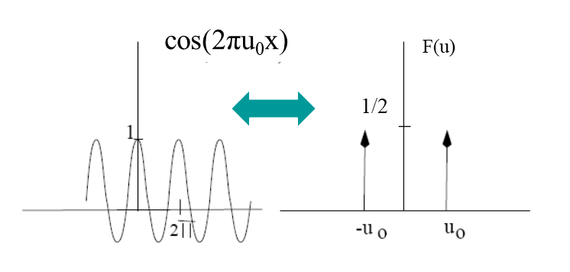

Slide 6
F(u)
Magnitude |F(u)|
u
u

Slide 9
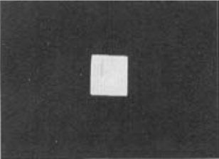

Slide 10
F(u)
Magnitude |F(u)|
zeros of sinc( )
u
u

Slide 11
Extra Credit

