Slide 1
Multi-view matching for unordered image sets
Abbas Roayaei

Slide 2
Multi-view matching for unordered image sets
Problem: establishing relative viewpoints given a large number of images where no ordering information is provided
Application: images are obtained from different sources or at different times
Notes:
: -> both the viewpoint (position, orientation, scale) and lighting conditions may vary signiﬁcantly over the data set.

Slide 3
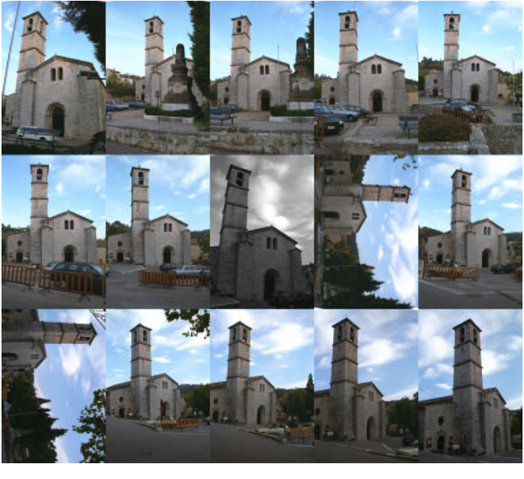
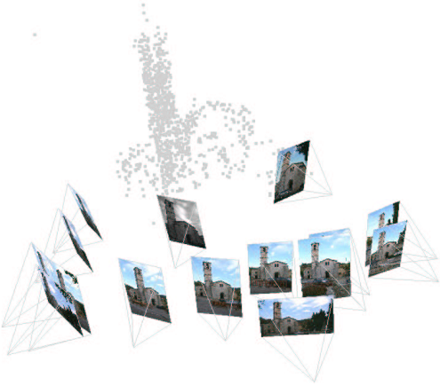
Multi-view matching for unordered image sets
Given an unordered set of images, divide the data into clusters of related (i.e. from the same scene) images and determine the viewpoints of each image -> spatially organizing the image set
Notes:
The result is a matching algorithm which is linear in the number of views.

Slide 4
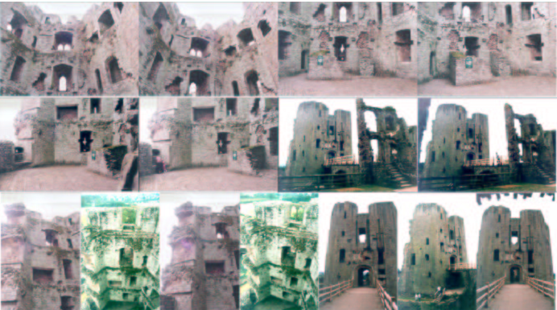
Image set example
The image set may have been acquired by a person photographing a scene (e.g. a castle or mountain) at various angles while walking back and forth around the area
The set may be the response from a query to an image database (e.g. a web search engine)

Slide 5
We develop an efﬁcient indexing scheme based on invariant image patches
    The output is a table of features vs views
    The table at this stage will contain many ambiguous and many erroneous matches.
    The overall complexity of this stage is linear in the number of images.
Notes:
This problem can be divided into three main stages

Slide 6
The quality of the matches is improved by a number of global “clean-up” operations such as selective use of two-view and three-view matching constraints.
  The output is a feature vs view table with considerably more correct matches, and fewer incorrect matches.
  The complexity of this stage, which is opportunistic, is linear in the number of views

Slide 7
A 3D reconstruction of cameras and points is computed for connected sub-sets of views using the multiple view tracks

Slide 8
From images to multiview matches
Objective: efﬁciently determine putative multiple view matches, i.e. a point correspondence over multiple images.
Features with viewpoint invariant descriptors
  afﬁne geometric transformation
  afﬁne photometric transformation
Features are determined in two stages:
  regions which transform covariantly with viewpoint in each image
  a vector of invariant descriptors is computed for each region
The invariant vector is a label for that region, and will be used as an index into an indexing structure for matching between views using the fact that:
  The corresponding region in other images will (ideally) have an identical vector.
Notes:
The viewpoint transformations which must be considered are an afﬁne geometric transformation and an afﬁne photometric
transformation

Slide 9
These features are determined in all images independently.
The descriptors for all images are then stored in the indexing structure.
Features with ‘close’ descriptors establish a putative multiple view match.

Slide 10
Covariant regions
We use two types of features:
  based on interest point neighborhoods.
  based on the “Maximally Stable Extremal” (MSE) regions
Each feature deﬁnes an elliptical (viewpoint covariant) region which is used to construct an invariant descriptor
Notes:
the output is an image point with an elliptical neighbourhood which transforms co-variantly with viewpoint. Similar neighbourhoods have been developed by Mikolajczyk and Schmid (Harris)

Slide 11
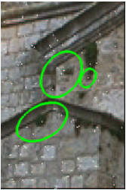
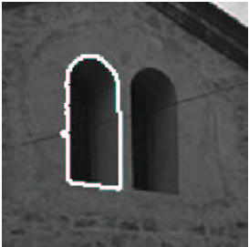
Interest point neighborhood: generally succeeds at points where there is signal variation in more than one direction (e.g. near “blobs” or “corners”)
MSE regions: typically correspond to blobs of high contrast with respect to their surroundings.

Slide 12
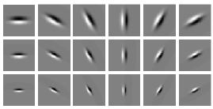

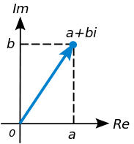
Invariant descriptor
Apply a bank of linear ﬁlters, K_{mn}, similar to derivatives of a Gaussian
Taking the absolute value of each ﬁlter response gives 16 invariants
Using this formula we guarantee that Euclidean distance in invariant space is a lower bound on image SSD difference
Notes:
The objective of invariant indexing is to reduce the cost of search by discarding match candidates whose invariants are different
first derivatives of Gaussians at 6 orientations and 3 scales
If we have two regions that have very different invariants we can conclude that these two regions are not similar regions (discard)

Slide 13
Find, among the coefﬁcients for with the one with the largest absolute value and artiﬁcially “rotate” the patch so as to make the phase zero.
We have constructed, for each neighborhood, a feature vector which is invariant to afﬁne intensity and image transformations.
Notes:
Moreover, the Euclidean distance between feature vectors directly predicts a lower bound on the SSD distance between image patches, obviating the need to learn this connection empirically.

Slide 14
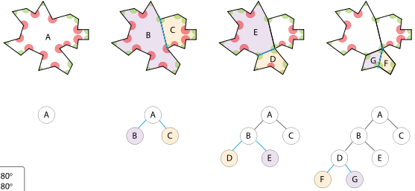
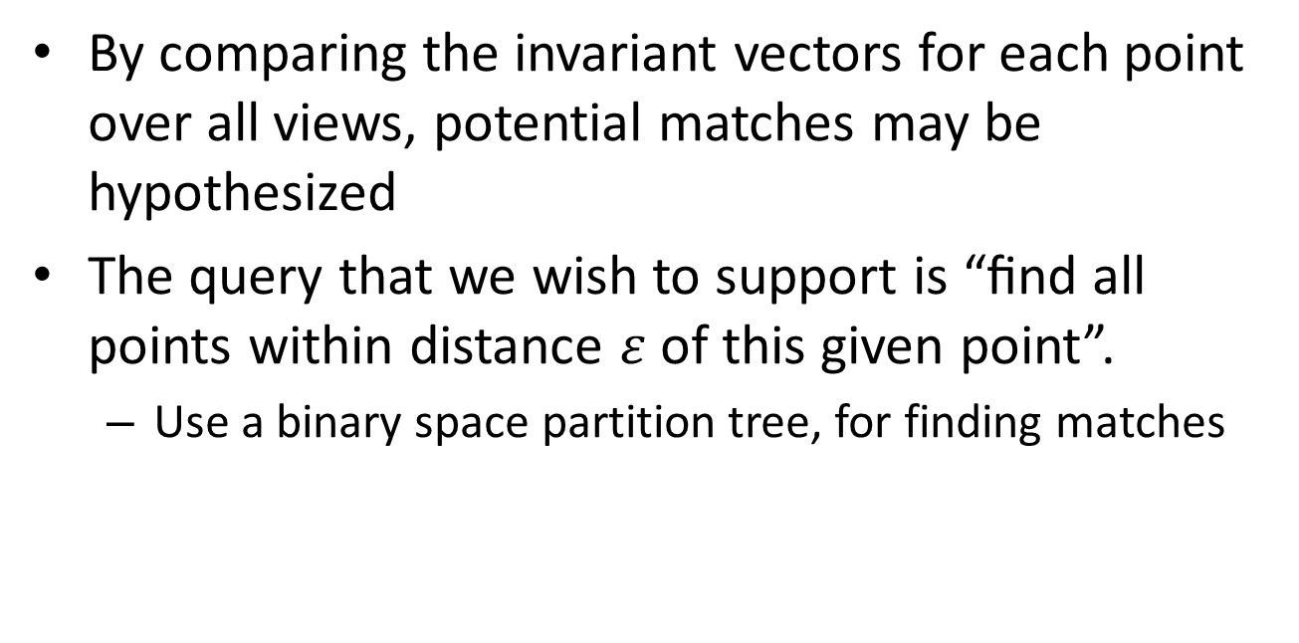
Invariant indexing
By comparing the invariant vectors for each point over all views, potential matches may be hypothesized
The query that we wish to support is “ﬁnd all points within distance $ε$ of this given point”.
  Use a binary space partition tree, for finding matches
Notes:
: i.e. a match is hypothesized if the invariant vectors of two points are within a threshold distance.
We take epsilon to be one tenth of the image dynamic range
is a method for recursively subdividing a space into convex sets by hyperplanes.

Slide 15
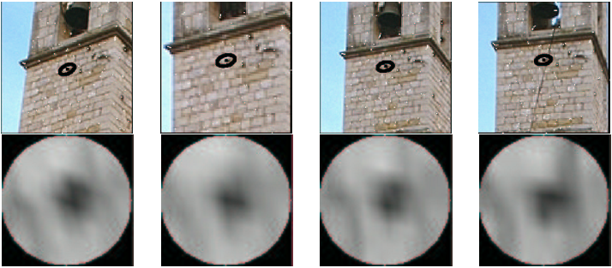
Notes:
Illustration of the invariant indexing stage. The query point is taken from the second image (from the left) and the hits found in the index structure are shown in the other images. Below each image is the corresponding afﬁne normalized image patch. Note that the patches are approximately rotated versions of each other. This shows only four of the eight “hits” correctly found for this particular point
The high dimensionality of the invariant space (and it is generally the case that performance increases with dimension) rules out many indexing structures, such as R-trees, whose performances do not scale well with dimension

Slide 16
Veriﬁcation
Since two different patches may have similar invariant vectors, a “hit” match does not mean that the image regions are afﬁne related -> we need a verification step
Two points are deemed matched if there exists an afﬁne geometric and photometric transformation which registers the intensities of the elliptical neighborhood within some tolerance -> too expensive
Instead we compute an approximate estimate of the local afﬁne transformation between the neighborhoods from the characteristic scale and invariants
If after this approximate registration the intensity at corresponding points in the neighborhood differ by more than a threshold then the match can be rejected
Notes:
it is too expensive, and unnecessary, to search exhaustively over afﬁne transformations in order to verify every match

Slide 17
Similar regions close indexes
Non-similar regions different indexes
Close indexes similar (affine related) regions
Using “2” we can reduce the cost of search by discarding match candidates whose invariants (indexes) are different

Slide 18
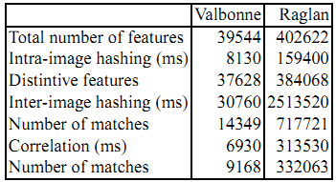
The outcome of the indexing and veriﬁcation stages is a large collection of putative “multi-tracks”;
The index table matches two features if they “look” similar up to an afﬁne transformation (the possible putative tracks contain many false matches)
To reduce the confusion (false matches), we only consider features which are “distinctive” in the sense that they have at most 5 intra-image matches
The overall complexity depends on the total number of hits.
Notes:
Multi-track: set of matches resulting from a query to the index table
within-image matching (intra-hashing) (a process that is linear in the number of views) to reduces the cost inter-matching

Slide 19
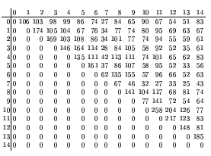
The problem now is that there are still many false matches.
These can be resolved by robustly ﬁtting multi-view constraints to the putative correspondences -> prohibitively expensive (15 images -> 15× (15-1)/2= 105 pairs of view)
Single out pairs of views which it will be worth spending computational effort on.
Notes:
since the number, say, of fundamental matrices is quadratic in the number of views

Slide 20
Improving the multiview matches
Our task here then is to “clean-up” the multiple view matches in order to support camera computation:
  remove erroneous and ambiguous matches
  add in new correct matches
The matching constraint tools at our disposal, range from semi-local to global across the image
  Semi-local: how sets of neighboring points transform (a similar photometric or geometric transformation)
  Global: multi-view relations which apply to point matches, globally across the image (such as epipolar and trifocal geometry)
These constraints can be used both to generate new matches and to verify or refute existing matches.

Slide 21
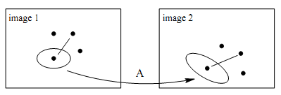
Growing matches
the ﬁtted local intensity registration provides information about the local orientation of the scene near the match
for example, if the camera is rotated about its optical axis, this will be reﬂected directly by cyclo-rotation in the local afﬁne transformation
The local afﬁne transformation can thus be used to guide the search for further matches.
Notes:
This idea of growing matches enables matches which have been missed as hits to be recovered and is crucial in increasing the number of correspondences found to a sufﬁcient level.

Slide 22
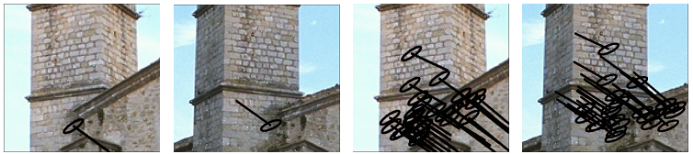
Growing matches
Growing is the opposite of the approach taken by several previous researchers, where the aim was to measure the consistency of matches of neighboring points as a means of verifying or refuting a particular match
In our case we have a veriﬁed match and use this as a “seed” for growing. The objective is to obtain other veriﬁed matches in the neighborhood, and then use these to grow still further matches etc.
A seed match (left) and the 25 new matches grown from it (right)
Notes:
A seed match (left) and the 25 new matches grown from it (right).
We use the estimated afﬁne transformation provided by the initial veriﬁed match to guide the search for further matches which are then veriﬁed in the standard manner.

Slide 23
Robust global veriﬁcation
Having grown matches the next step is to use fundamental matrix estimation between pairs of views with a sufﬁcient number of matches
This is a global method to reject outlying two-view matches between each pair of views
A novelty here is to use the afﬁne transformations between the patches and fundamental matrices together.
Notes:
points transferred under the afﬁne transformation must agree with the fundamental matrix in the neighborhood

Slide 24
Greedy algorithm
Before we can “clean up” the putative matches in the feature vs view table we need to efﬁciently select pairs of views
Construct a spanning tree
Starting from the pair of images with the most putative two view matches, we robustly impose the epipolar constraint and then join up those images in the graph.
Then we do the same for the pair of images with the highest number of two-view matches, subject to the constraint that joining those images will not create a cycle in the graph

Slide 25
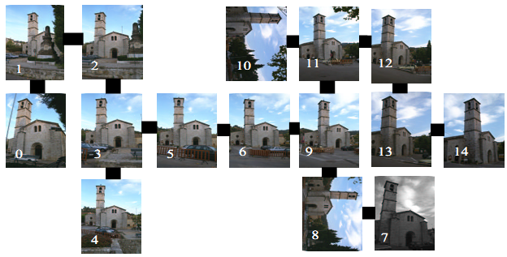
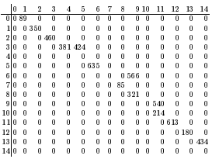
If there are N images, the spanning tree will have N-1 edges so this process is linear in the number of views
Once the spanning tree has been constructed, we delete any edges corresponding to fewer than 100 matches

Slide 26
In summary, we have described a method for singling out particular views for processing which allows us to split the data set into subsets that are likely to be related
This process is of course sub-optimal compared to enforcing epipolar constraints between all pairs of images but on the data sets tried, it gives almost comparable performance

Slide 27
From matches to cameras
The objective now is to compute cameras and scene structure for each of the components from the previous section separately
Our sub-goal is to ﬁnd many long tracks (i.e. correspondences across many views)
Compute structure for a sub-set of views ﬁrst and then enlarge to more views:
Order the views in each component, greedily, by starting with the pair with the most matches and sequentially adding in the next view with the largest number of matches, subject to it being adjacent to a view already included ordering on image set

Slide 28
We next look at the initial subsequences of length two, three, four, … in each ordered image set and compute the number of tracks that can be made across the whole subsequence
We take the longest subsequence of views with at least 25 complete tracks and then use the 6-point algorithm to robustly compute projective structure for the subsequence.
Then sequentially re-section the remaining cameras into the reconstruction
Instead of sparse connections between pairs of views we now have a global view of our data set, facilitated by being able to quickly look up relationships in the feature vs view table

Slide 29
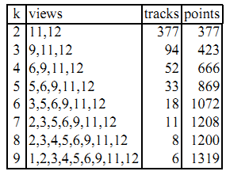

Slide 31
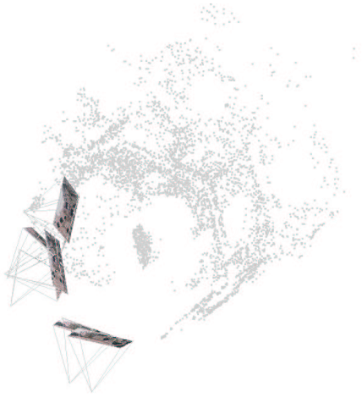

Slide 32
Algorithm summary
Detect two types of feature independently in each image, and compute their invariant descriptors.
Use hashing (followed by correlation, but no registration) to ﬁnd initial putative matches and make a table counting two-view matches.
Greedy spanning tree growing stage:
  Choose the pair i, j of images with the largest number of matches, subject to i, j not already being in the same component.
  Apply full two-view matching to images i and j, that is:
    Increase correlation neighbourhood sizes if this improves the score.
    Intensity based afﬁne registration.
    Growing using afﬁne registrations.
    Robustly ﬁt epipolar geometry.
  Join images i and j in the graph.
  Repeat till only one component is left.

Slide 33
Algorithm summary
Form connected components of views as follows:
  Erase from the spanning tree all edges corresponding to fewer than 100 matches.
  Greedily grow connected components as before; this induces an ordering on the images in each component.
  From each ordered component, choose the largest initial subsequence of images with at least 25 complete tracks.
  Compute structure for that subsequence.
  Re-section the remaining views into the reconstruction in order, bundling the structure and cameras at each stage.

