Slide 1
Object Recognition Using Locality-Sensitive Hashing of Shape Contexts
Andrea Frome, Jitendra Malik
Presented by Ilias Apostolopoulos

Slide 2
Introduction
Object Recognition
  Calculate features from query image
  Compare with features from reference images
  Return decision about which object matches
Full object recognition
  Algorithm returns:
    Identity
    Location
    Position

Slide 3
Introduction
Problem
  Full object recognition is expensive
    High dimensionality
    Time linear with reference features
    Reference features linear with example objects
Relaxed Object Recognition
  Pruning step before actual recognition
  Reduces computation time
  Does not reduce success rate

Slide 4
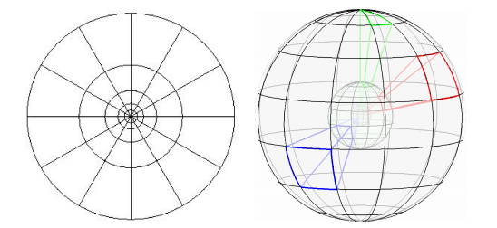
Features
Shape Context
  Characterize shape in 2D or 3D
  Histograms of edge pixels

Slide 5
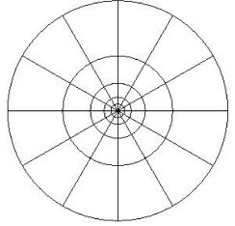
Features
Two-dimensional Shape Contexts
  Detect edges
  Select coordinate in edge map
  Radar like division of region around point
  Count edge points in each region

Slide 6
Features
Two-dimensional Shape Contexts
  Each region is 1 bin
  Regions further from center summarize larger area
  More accurately captures and weighs more heavily information toward the center

Slide 7
Features
Two-dimensional Shape Contexts
  Shapes must be similar to match
  Similar orientation relative to the object
    Orientation variant
  Similar scale of the object
    Scale variant

Slide 8
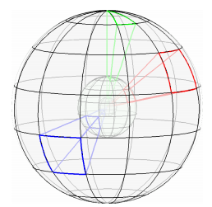
Features
Three-dimensional Shape Contexts
  Similar idea in 3D
  Use 3D range scans
  No need to consider scale
    Real world dimensions
  Rotate sphere around azimuth in 12 discrete angles
    No need to take rotation of query image into consideration

Slide 9
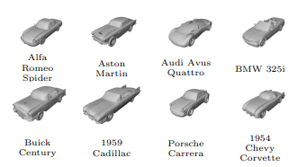
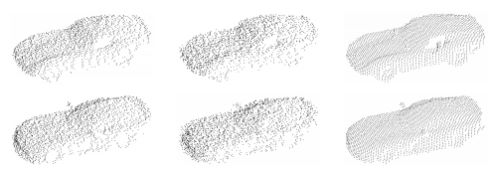
Experiments with 3D shape contexts
56 3D car models
  376 features/model
Range scans of models
  5cm & 10cm noise
  300 features/scan
  Use NN to match features

Slide 10
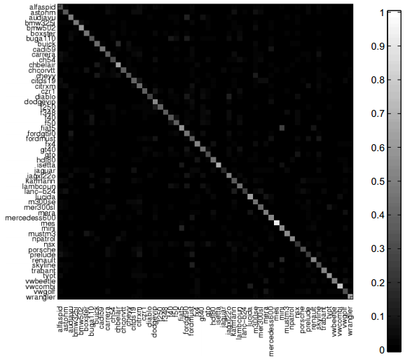
Experiments with 3D shape contexts
Experiment 1
  5cm noise
  100% success rate on top choice

Slide 11
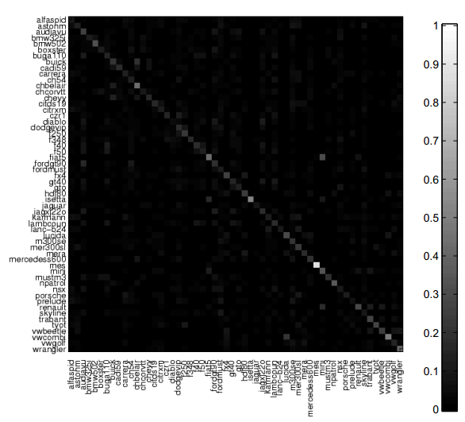
Experiments with 3D shape contexts
Experiment 1
  10cm noise
  92.86% success rate on top choice
  100% success rate on top 4 choices

Slide 12
Experiments with 3D shape contexts
Experiment 1
Pros
  Great results even with a lot of noise
  Match found in 4 first options
Cons
  Each query image takes 3.3 hours to match
  Computational cost should be reduced:
    By reducing the features calculated per query image
    By reducing the features calculated per reference image

Slide 13
Reducing Running Time with Representative Descriptors
If we densely sample from reference scans we can sparsely sample from query scans
  Features are fuzzy, robust to small changes
  Few regional descriptors are needed to describe scene
  These features can be very discriminative
Representative Descriptor method
  Use a reduced number of query points as centers
  Choose which points to use as RD
  Calculate a score between an RD and a reference object
  Aggregate RD scores to get one score

Slide 14
Experiments
Experiment 2
  Same set of reference data
  Variable number of random RDs
  Smallest distance between RD and feature as score
  sum of RD scores for a model as scene score
  Model with smallest summation is the best match

Slide 15
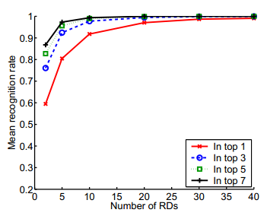
Experiments
Experiment 2
  5cm noise
  30 RDs
    100% recognition on top 7 matches
  40 RDs
    99.9% on top 2
    100% on top 3
  Reduced computation by 87% to 90%

Slide 16
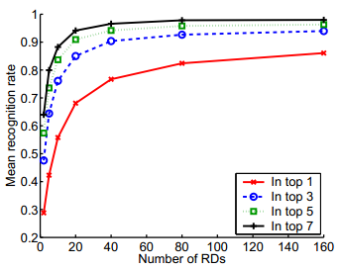
Experiments
Experiment 2
  10cm noise
  80 RDs
    97.8% recognition on top 7 matches
  160 RDs
    98% on top 7
  Reduced computation by 47% to 73%

Slide 17
Reducing Search Space with a Locality-Sensitive Hash
Compare query features only to the reference features that are nearby
Use an approximate of k-NN search called Locality-Sensitive Hash (LSH)
  Sum range of data for each dimension
  Choose k values from range
  Each value a cut in one of the dimensions
    A hyperplane parallel to that dimension’s axis
  These planes divide the feature space into hypercubes
  Each hypercube represented by an array of integers called first-level hash or locality-sensitive hash

Slide 18



Reducing Search Space with a Locality-Sensitive Hash
Exponential number of hashes
  Use second-level hash function to translate the arrays to single integers
  This is the number of bucket in the table
Create L tables to reduce the probability of missing close neighbors
hash function for the table
set of identifiers stored in
For each reference feature we calculate and store j in bucket

Slide 19


Reducing Search Space with a Locality-Sensitive Hash
Given a query feature q, we find matches in two stages
  Retrieve features and calculate ,

Slide 20
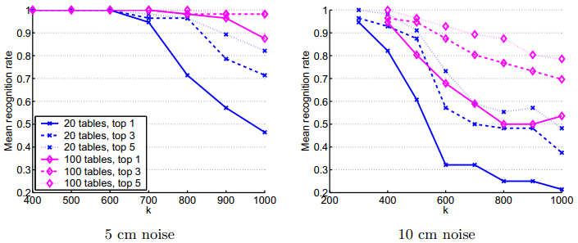
LSH with Voting Method
5 cm
  100% with 600 divisions for 20 tables
  100% with 800 divisions for 100 tables
10cm
  100% with 300 or 400 divisions

Slide 21
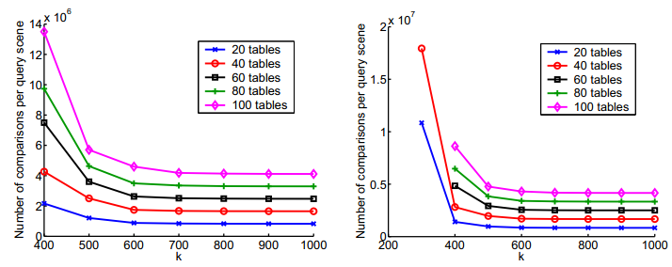
LSH with Voting Method

Slide 22
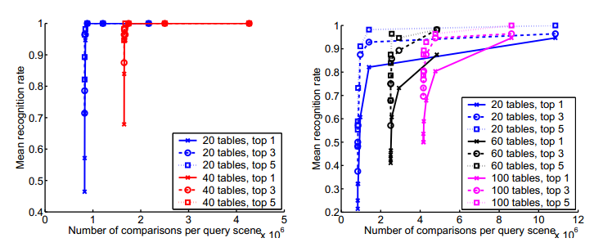
LSH with Voting Method

Slide 23
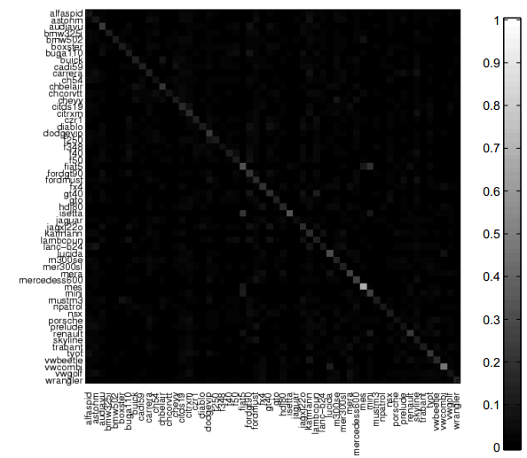
LSH with Voting Method

Slide 24
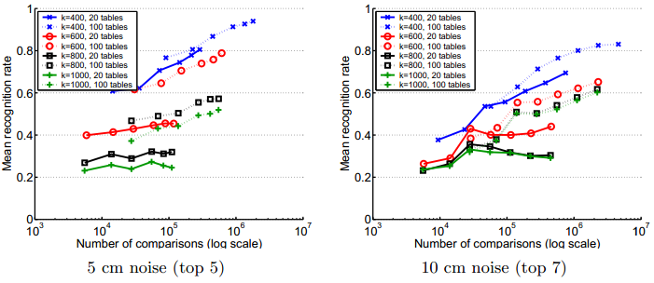
Using RDs with LSH
5cm
80% with 400 divisions and 20 tables
94% with 400 divisions and 100 tables
10cm
83% with 400 divisions and 100 tables

Slide 25
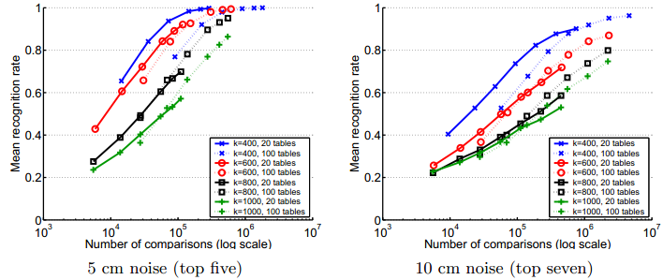
Using x percent of RDs with LSH
5cm
99.8% with 40 RDs, 400 divisions and 20 tables
10cm
96% with 160 RDs, 400 divisions and 100 tables

Slide 26
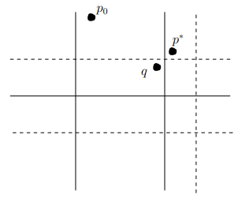
Associative LSH
Variation of LSH
Get results from LSH
Check neighborhood of q for better results
Increases the success rate
Number of comparisons increases

Slide 27
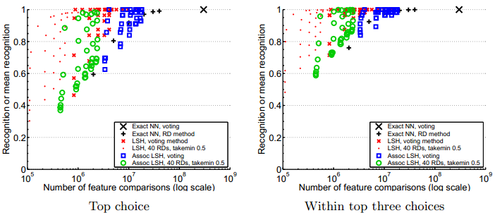
Summary
5cm
LSH with RDs smallest number of comparisons for list of top 3

Slide 28
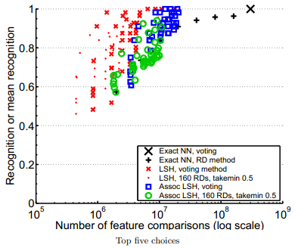
Summary
10cm
LSH with voting smallest number of comparisons for list of top 5

Slide 29

Questions?

