Slide 1
WLD: A Robust Local Image Descriptor
Jie Chen, Shiguang Shan, Chu He, Guoying Zhao, Matti Pietikainen, Xilin Chen, Wen Gao
TPAMI 2010
Rory Pierce
CS691Y

Slide 2
Agenda
Summary of the Descriptor
Creation of the Descriptor
Applications/Experiments
Experimental Validation/Discussion

Slide 3

Weber's Law
Devised by Ernst Weber, 19th-century experimental psychologist
Equation:
delta(I): incremental threshold for noticeable discrimination
I: initial stimulus intensity
k: signifies proportion on left side remains constant despite changes in I term
Example: One must shout in a noisy environment to be heard, yet a whisper works in a quiet room

Slide 4
Creation of the Descriptor
Differential Excitation (ξ), Orientation (ϴ), and the WLD Histogram
Notes:
First symbol is lower-case xi (pron: zai)

Slide 5





Differential Excitation
Simulating pattern perception of humans
Determine ξ(x_{c}) using filter ƒ₀₀:
Employ Weber's law:
Combining equations and scaling factor:
where x_{i} (i=0,1,...p-1) is the i-th neighbor of x_{c} and p is the number of neighbors
Notes:
Not sure if f00 filter multiplies center pixel by -8? Does not appear to do so from the subsequent equations.

Slide 6
Differential Excitation
Generally:
ξ(x) > 0 surrounding lighter than current pixel
ξ(x) < 0 surrounding darker than current pixel
Role of Arctan
Limit output increasing/decreasing too quickly when inputs become larger/smaller
Logarithm function matches human's perception, but outputs of Δ(I) could be negative
Sigmoid not used for simplicity

Slide 7
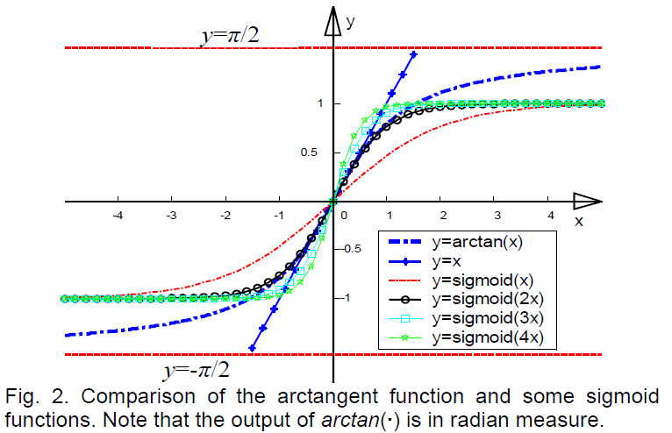
Differential Excitation

Slide 8
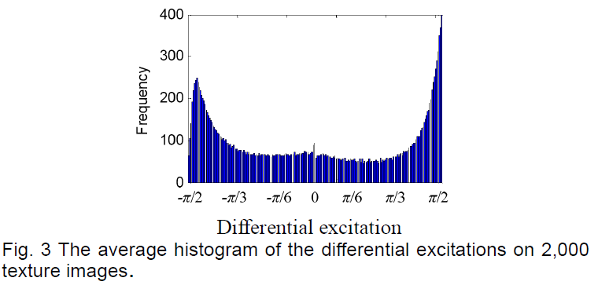
Differential Excitation
Higher frequencies towards extents:
Delimitation action of arctan
Approach of differential excitation

Slide 9




Orientation
Gradient orientation similar to that of Lowe:
v¹⁰ and v¹¹ are outputs of filters ƒ₁₀ and ƒ₁₁:
Notes:
γ is lower-case gamma.

Slide 10
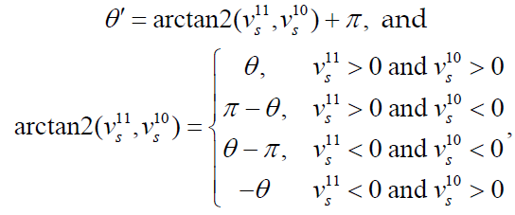


Orientation
ϴ further quantized into T dominant orientations:
Map ƒ: ϴ → ϴ' :
Notes:
Theta is further quantized into T dominant orientations for simplicity

Slide 11

Orientation
ϴ further quantized into T dominant orientations:
Then quantize:

Slide 12
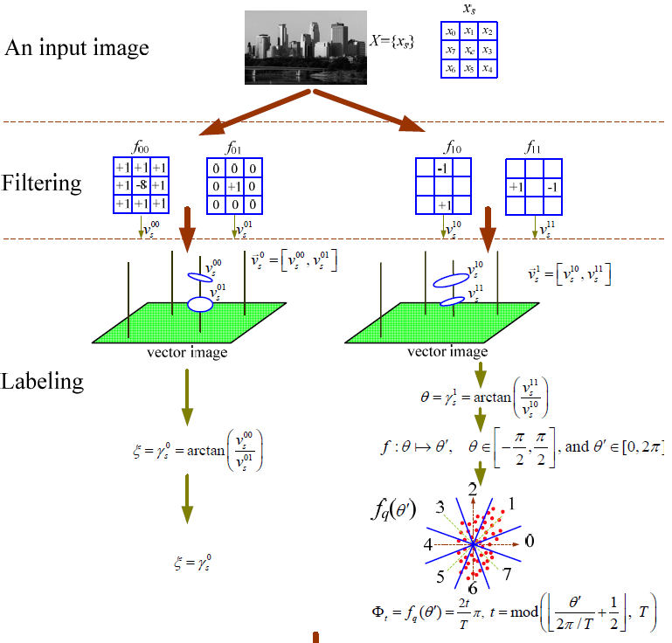
Summary Differential Excitation and Orientation

Slide 13
WLD Histogram Steps Overview
Start with 2D histogram of differential excitements and orientations
Convert to sub-histograms of differential excitement in dominant orientations
Construct histogram matrix introducing M segments per differential excitement histogram
Concatenate rows of histogram matrix to form reorganized sub-histograms
Concatenate reorganized sub-histograms to form WLD Histogram

Slide 14
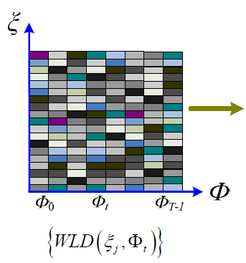
WLD Histogram (Step 1)
2D Histogram
Columns represent one of T dominant orientations
A row represents a differential excitation {-π/2, π/2} histogram across orientations
Intersection of row/column corresponds to frequency of differential excitation on a dominant orientation

Slide 15
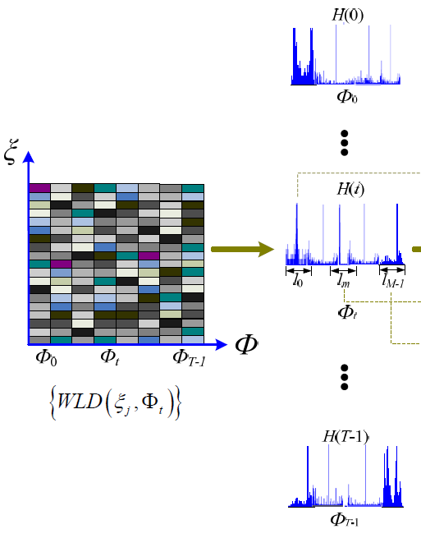
WLD Histogram (Step 2)
Encode 2D histogram {WLD(ξ_{j},Φ_{t})}, (j=0,1,...N-1, t=0,1,...T-1, where N is dimensionality of image and T is the number of dominant orientations) to a 1D histogram H(t), t=0,1,...,T-1
Each sub-histogram H(t) corresponds to a dominant orientation, Φ_{t}

Slide 16
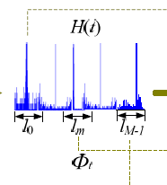
WLD Histogram (Step 2)
Divide sub-histogram into M evenly-spaced segments
H_{m,t}, (m=0,1,...,M-1)
This paper uses M=6
Range of ξj, l=[-π/2, π/2] evenly divided into M intervals
l_{m}=[η_{m,l}, η_{m,u}]
Notes:
n-looking Greek symbol is Eta.

Slide 17
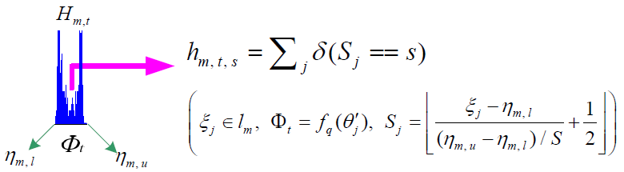

WLD Histogram (Step 2)
η_{m,l}=(m/M-1/2)π
η_{m,u}=[(m+1)/M-1/2]π
m is interval to which ξ_{j} belongs (i.e. ξ_{j}ϵl_{m})
t is index of quantized orientation
Notes:
hm,t,s intuitively means the number of pixels whose differential excitations belong to the same interval lm, and orientations (theta prime j) are quantized to the same dominant orientation (Phi t) and that the computed index Sj is equal to s.
(Eta upper - Eta lower)/S is the width of each bin, and the part of the quation that is in the floor function (not the 1/2) is a linear mapping used to map the differential exitation to its corresponding bin since the values of Sj are of real.

Slide 18
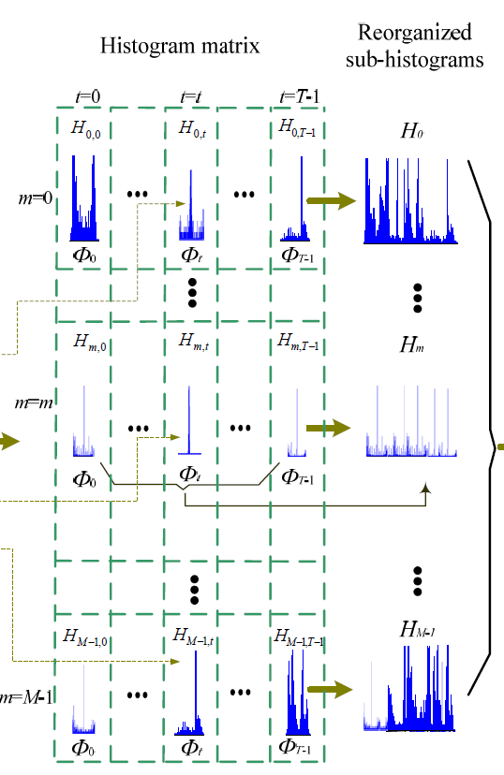
WLD Histogram (Step 3)
Each column is dominant orientation
Each row is a differential excitation segment
Each row is concatenated as a sub-histogram so there are M sub-histograms

Slide 19
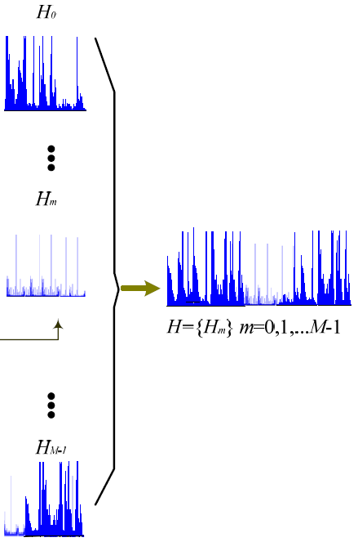
WLD Histogram (Step 4)
The resulting M sub-histograms are concatenated leading to a 1D histogram
H={H_{m}}, m=0,1,...,M-1

Slide 20
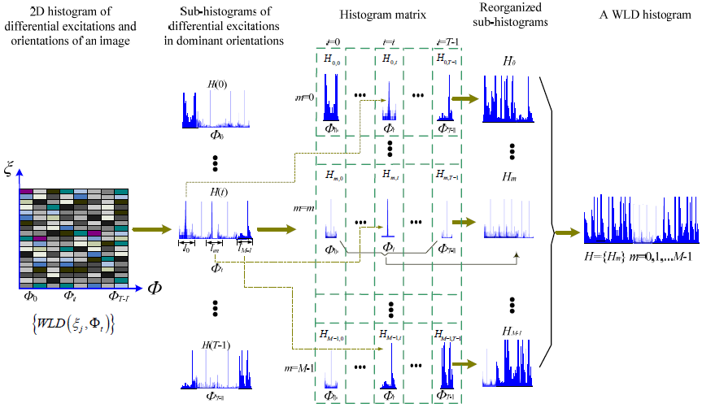
WLD Histogram Summary

Slide 21
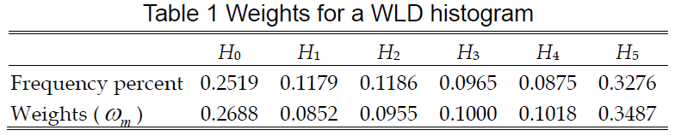
Weights of a WLD Histogram
Parameter M in Step 2 of Histogram construction set to 6 to simulate high, middle, or low frequencies in a given image
For P_{i}, if ξ_{i} l₀ or l₅, then variance near P_{i} is of high frequency
More attention should be paid to regions of high variance as opposed to flat areas
Rates determined heuristically from recognition rate on texture dataset
Notes:
Weights determined are consistent with idea that higher frequencies point out more salient variations of an object.

Slide 22
Weights of a WLD Histogram
Side effect of this weighting scheme may enlarge influence of noise
Combated by remove a few bins at ends of high frequency segments
Left end of H_{0,t}
Right end of H_{M-1,t}
t=0,1,...T-1

Slide 23
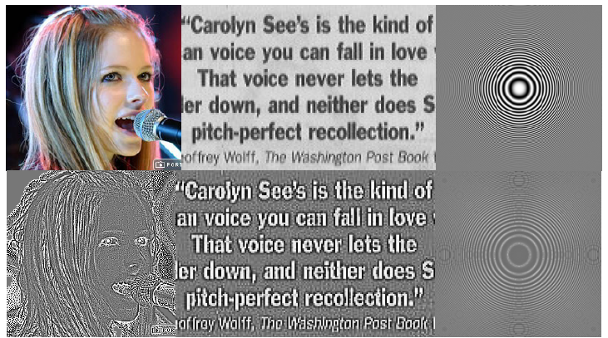
Characteristics of WLD
Bottom row represents scaled [0 to 255] differential excitation of a WLD filtered image

Slide 24
Characteristics of WLD
Detects edges elegantly
Preserves differences between neighbors and center point
Ratio of these differences to center pixel serve to correctly identify significant information (v⁰⁰ and v⁰¹)
Robust to noise and illumination change
Similar to smoothing in image processing
Constants added to pixel values will be cancelled in v⁰⁰
Pixel values multiplied by a constant cancelled by v⁰⁰/v⁰¹
Representation ability

Slide 25
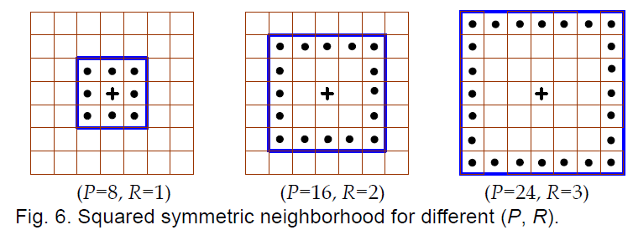
Multi-scale WLD
WLD_{P,R}
P members on a square with side length 2R+1
Can be generalized to a circle
Multi-scale analysis: concatenate histograms from multiple operators with different (P,R)

Slide 26
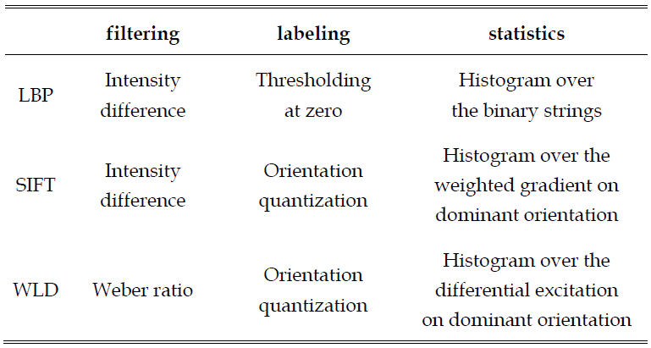
Comparison to other descriptors
Filtering, Labeling, and Statistics (FLS) framework [C. He, T. Ahonen and M. Pietikäinen]
Filtering: inter-pixel relationship in local image region
Labeling: intensity variations that cause psychology redundancies
Statistics: capture the attribute which is not in adjacent regions

Slide 27


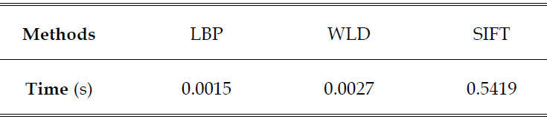
Comparison to other descriptors
1.86GHz Intel Prentium 4 Processor with 1.5GB RAM
C/C++ code

Slide 28
Applications

Slide 29
Texture Classification
Important roles in robot vision, content-based access to image databases, and automatic tissue recognition in medical images
Databases
Brodatz
2,048 samples; 64 samples in each of 32 texture categories
Additional samples generated to produce different rotations and scales
KTH-TIPS2-a [B. Caputo, E. Hayman and P. Mallikarjuna]
11 texture classes with 4,395 images
9 scales under four different illumination directions and 3 different poses

Slide 30
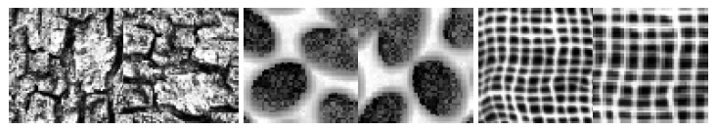
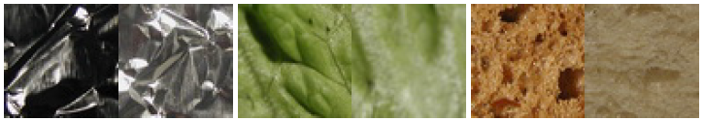
Texture Classification
Brodatz
KTH-TIPS2-a

Slide 31

Texture Classification
WLD histogram feature used as representation
M=6, T=8, S=20
Histogram weights determined from Slide 24
Classifier is K-nearest neighbor
Intersection measurement between two histograms from texture images (L is # of bins in histogram):
Accuracy=# correct classification/# total images

Slide 32
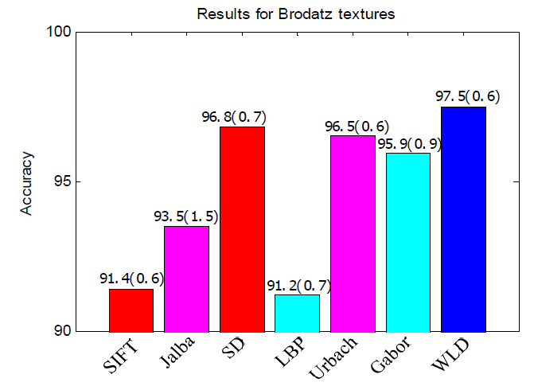
Texture Classification Results

Slide 33
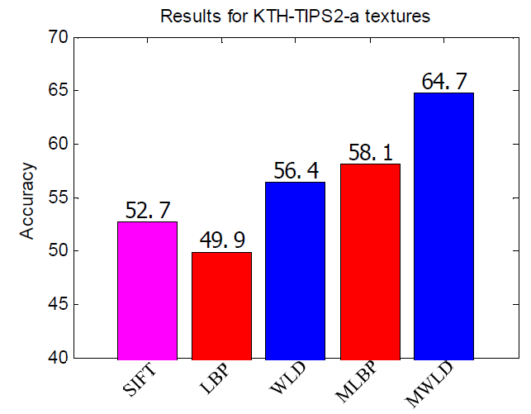
Texture Classification Results

Slide 34
Texture Classification Results Comments
Poor SIFT performance in Brodatz due to small image size (64 x 64)
Variations in KTH-TIPS2-a (i.e., pose, scale, and illumination) much more diverse
Utilizing SVM-based classification may iprove performance significantly

Slide 35
Face Detection
Train one classifier to detect frontal, occluded, and profile faces
Divide input sample into 9 overlapping regions and use a P=8, R=1 WLD operator
M=6, T=4, S=3, Histogram weights same as slide 24

Slide 36
Face Detection
Number of valid face blocks larger than threshold (Ξ), face exists
Datasets
Training set of 50,000 frontal face samples with variation in pose, facial expression, and lighting
Samples rotated, translated, and scaled to get a total training sample of 100K face samples
Training set of 31,085 images containing no faces
Test sets
MIT+CMU frontal face test set
Aleix Martinez-Robert (AR) face database
CMU profile testing set

Slide 37
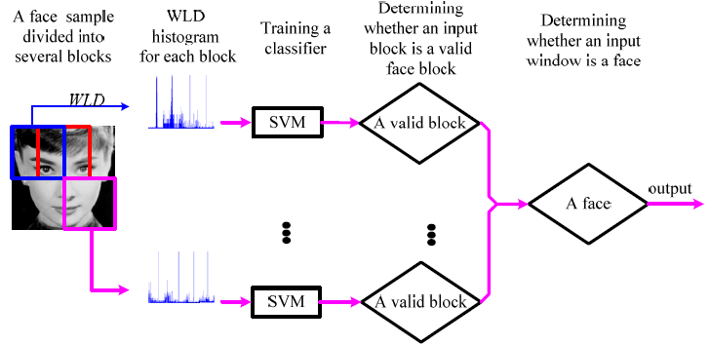
Face Detection
WLD feature for a face

Slide 38
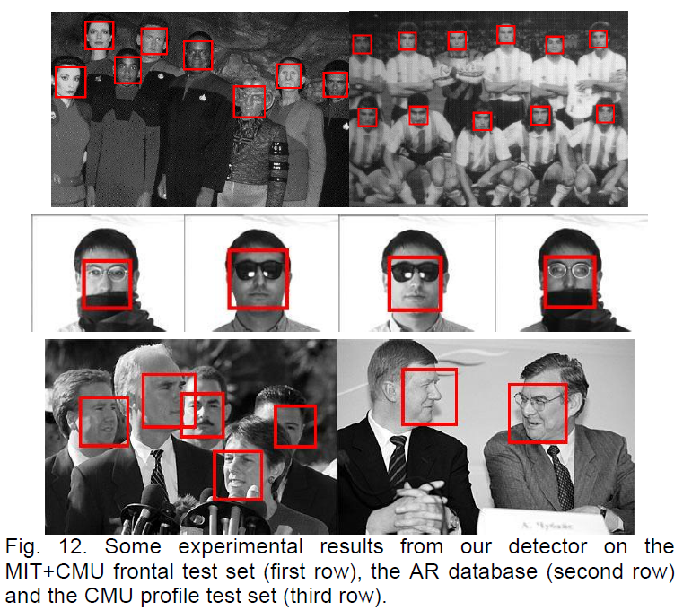
Face Detection Results

Slide 39
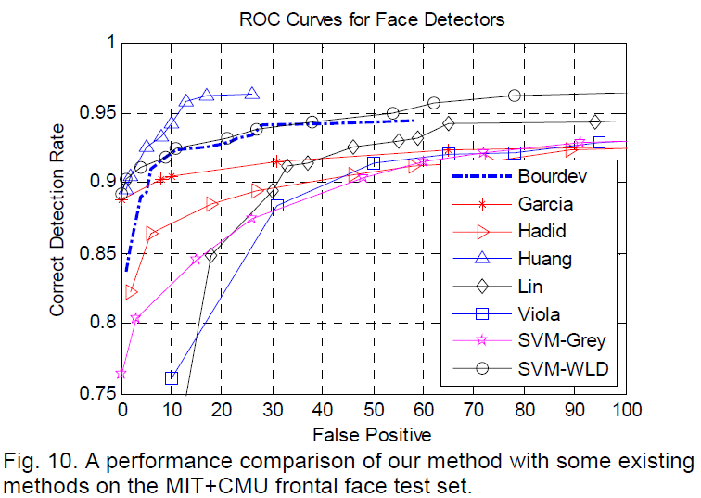
Face Detection Results

Slide 40
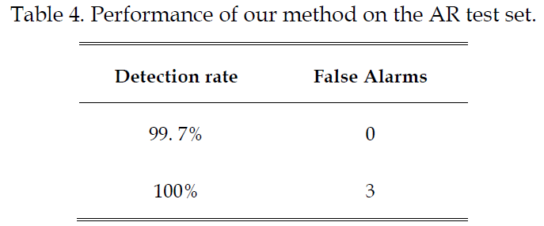
Face Detection Results

Slide 41
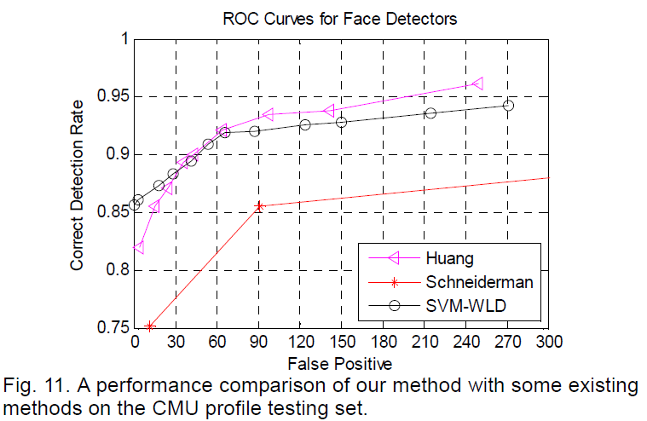
Face Detection Results

Slide 42
Experimental Validation and Discussion

Slide 43
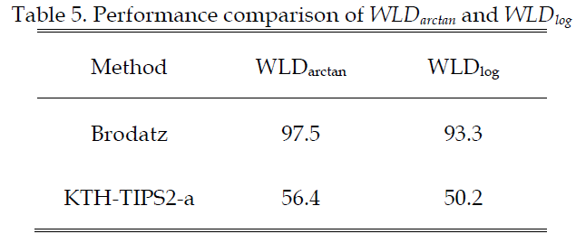
WLD and Weber's Law
Logarithm operator more appropriately follows Weber's law where Im is the mean in a local neighborhood:
Gradient computation in f₀₀ deal better with illumination variations rather than intensity:

Slide 44
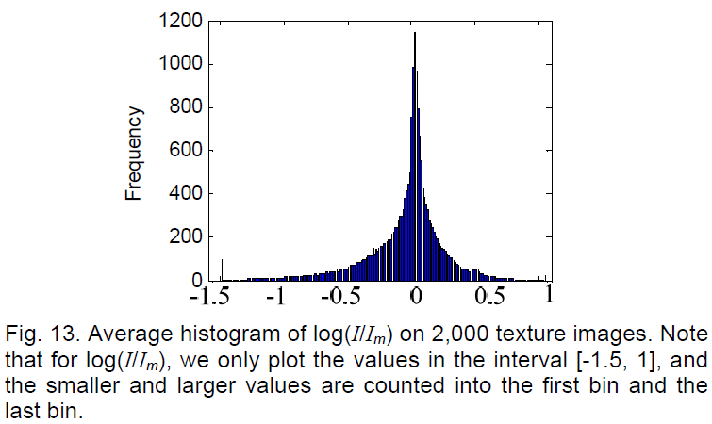
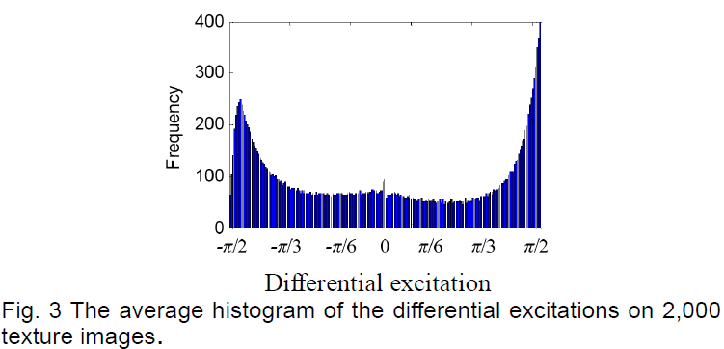
WLD and Weber's Law

Slide 45
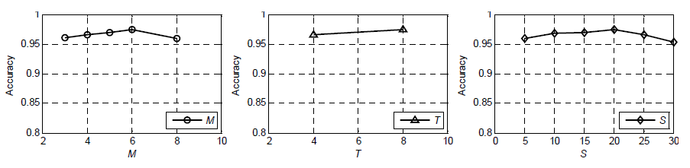
Effects of Parameters
M, T, and S
Tradeoff between discriminability and statistical reliability

Slide 46
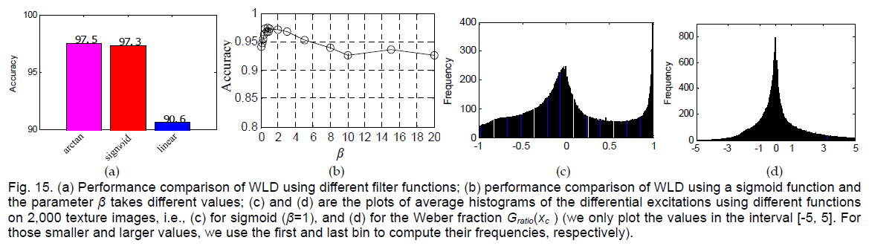
Performance of different filters

Slide 47
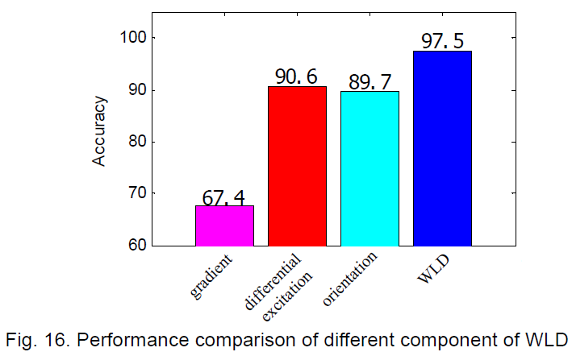
Performance comparison of components

Slide 48


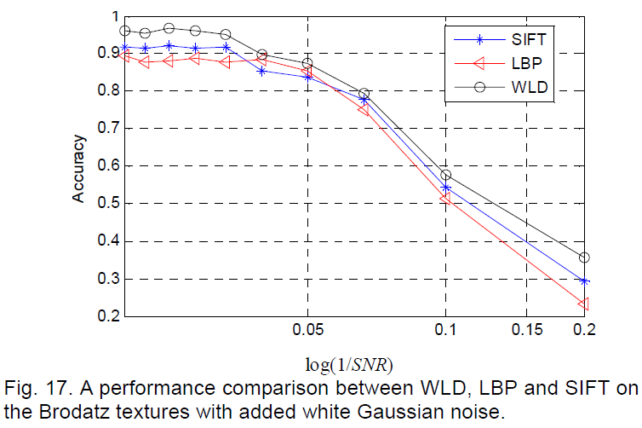
Robustness to noise

Slide 49
Conclusions
WLD inspired by Weber's Law, developed according to perception of human beings
WLD features compute a histogram from:
differential excitement
orientation
Computational cost of WLD is comparable to LBP and far exceeds SIFT
Performance of WLD meets if not exceeds that of other state-of-the-art descriptors

Slide 50
Questions?

