Slide 1
CS791 Topics: Mass Detection in Mammograms
Drs. George Bebis & Alireza Tavakkoli
Deep Learning Architectures

Slide 2
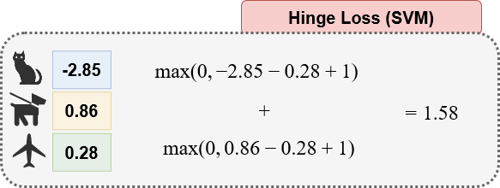
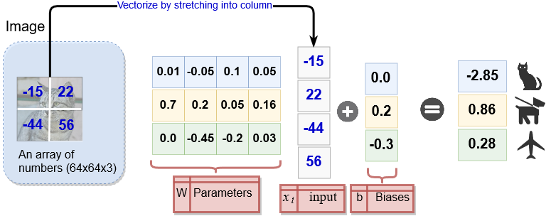
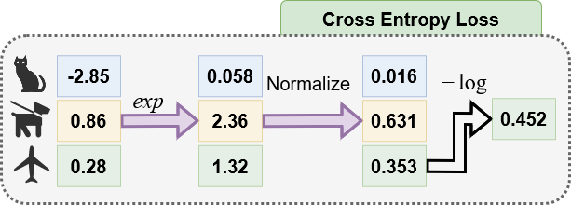
Recall
Linear Classifier
Matrix multiply + linear bias

Slide 3
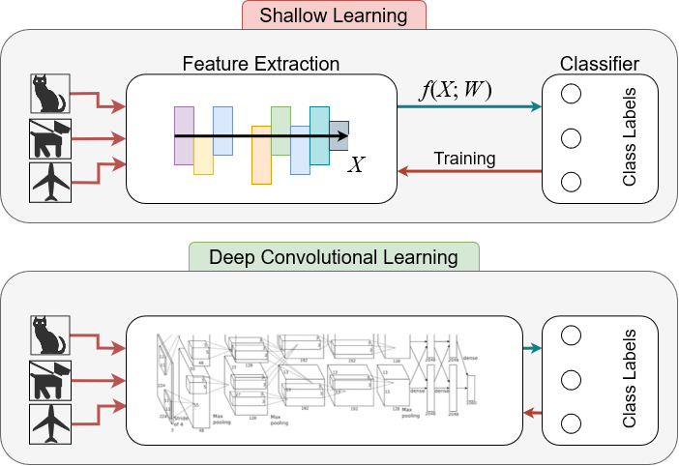
From Shallow to Deep Networks

Slide 4
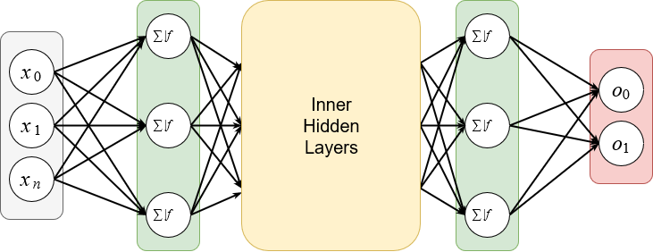
Disadvantages of Deep Neural Networks
Deep neural nets are inefficient
  scalability issues
    dense connections
    no repeat weights
    no spatial information integration

Slide 5
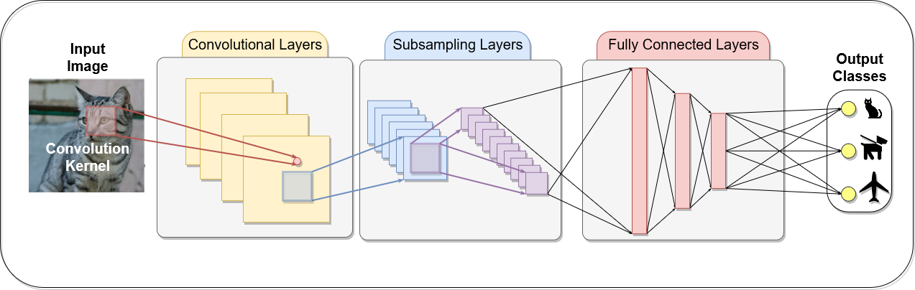
Convolutional Neural Networks (CNNs)
Addressing the deep network problems
  Instead of using matrix multiplication use convolution
  This will result in Convolutional Neural Networks (CNN)
    Almost synonymous with deep learning

Slide 6
Best practices to improve CNN performance
Pre-processing mammograms
Combination of learned and hand-crafted features
Data augmentation
Transfer learning
Dropout
Batch normalization
Attention-based modules
Multi-view images
Balanced data distributions
Context and patient information
Multi-stage vs end-to-end (E2E) methods

Slide 7

Beyond Training Error
Loss Vs. Accuracy
  Regularization
    L2 Regularization
      $∑∑{\left|w_{k,l}\right|}^{2}$
    L1 Regularization
      $∑∑\left|w_{k,l}\right|$
    Elastic Regularization
      $αL_{1}+\left(1−α\right)L_{2}$

Slide 8
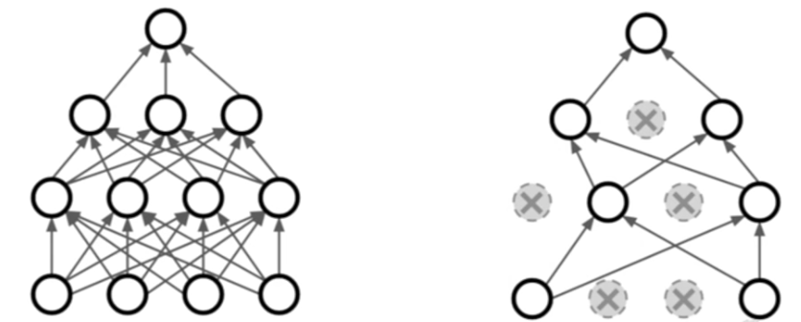

Beyond Training Error
Loss Vs. Accuracy
  Regularization
    Dropout Regularization
      In each forward pass, randomly set some neurons to zero.
        $P_{drop}$ is a hyperparameter for meta learning
Srivastava et al. (2014). ”Dropout: A simple way to prevent neural networks from overfitting”. JMLR.

Slide 9
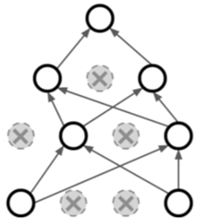
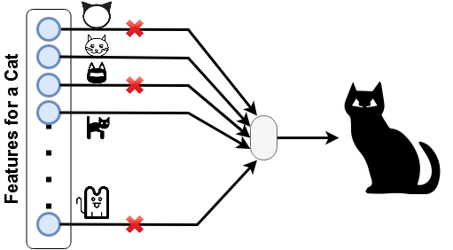
Beyond Training Error
Loss Vs. Accuracy
  Dropout Regularization
    Q: How could dropout work?
      A: This forces the network to have
      redundant representation
        Prevents co-adaptation of features
        Acts as a large ensemble each with
        a separate dropout mask

Slide 10
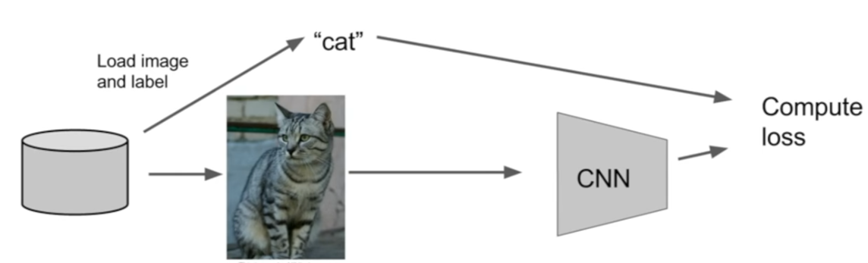
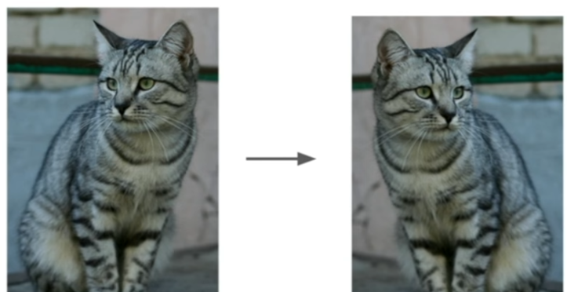
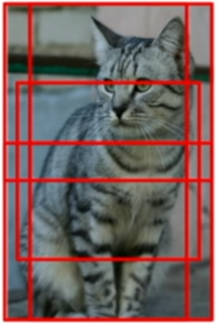
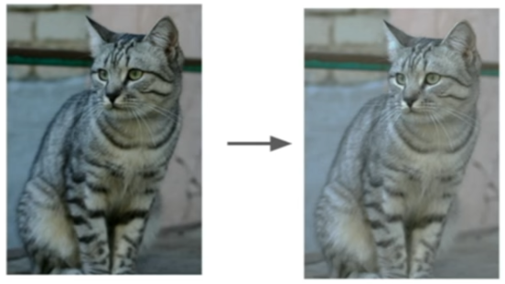
Beyond Training Error
Loss Vs. Accuracy
  Data Augmentation
Perform random transformation on your input data to train:
Translation
Rotation
Stretching
Shearing
Affine transforms
Gamma correction
Lens distortions,
….

Slide 11
Beyond Training Error
Transfer Learning
  You need a lot of data to train and use deep networks
    Train your network on a large and annotated data
      ImageNet
    Freeze some (majority of) your early layers
      Reinitialize the remaining network
        Mostly the linear classifier portion of your network
      Retrain the network
        (only the unfrozen weights update)
    Fine tune your performance on the overall network
      Especially if you have a medium sized dataset

Slide 12
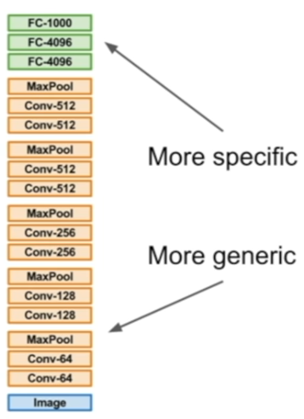
Beyond Training Error
Transfer Learning Strategies
Similar Dataset
Different Dataset
Very Little Data
Change linear classifier on top and retrain
Try changing different linear classifiers from different stages
Lots of Data
Fine tune a few layers
Fine tune a large number of layers

Slide 13
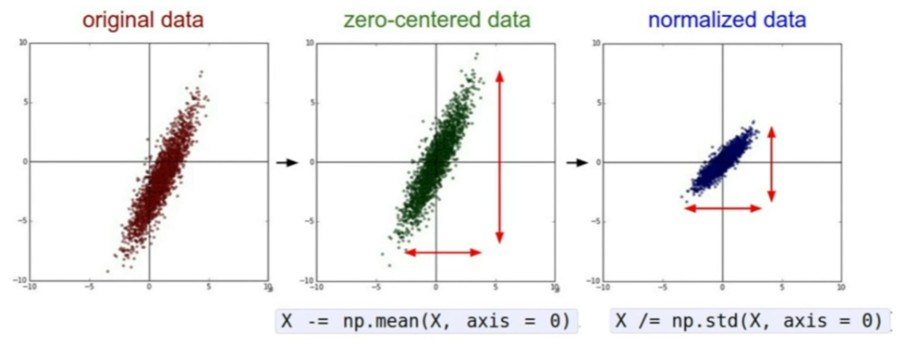
Data Normalization
Now that we have weights and activation function
  Normalize your data
Avoid imbalance in + or – to prevent suboptimal gradient optimization

Slide 14
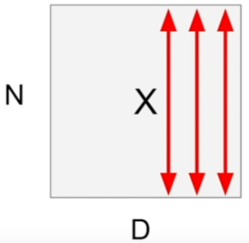

Batch Normalization
[Loffe & Szegedy, 2015]
Idea: Keep the activations to be unit Gaussians
  Batch Normalization
    Make your activations to be unit Gaussians
      Note: this is a good differentiable function
        Take the mean and variance of each batch
        and normalized by them.
        Do it on every forward pass
${\hat{x}}^{\left(k\right)}=\frac{x^{\left(k\right)}−E\left[x^{\left(k\right)}\right]}{\sqrt{Var\left[x^{\left(k\right)}\right]} }$
Compute the mean and variance independently for each dimension
Normalize

Slide 15
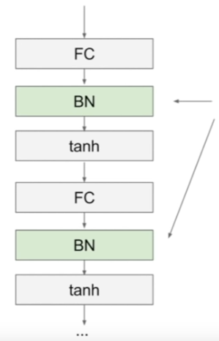
Batch Normalization
[Loffe & Szegedy, 2015]
Idea: Keep the activations to be unit Gaussians
  Batch Normalization
Usually inserted after Fully Connected or Convolutional layers but before nonlinearity
${\hat{x}}^{\left(k\right)}=\frac{x^{\left(k\right)}−E\left[x^{\left(k\right)}\right]}{\sqrt{Var\left[x^{\left(k\right)}\right]} }$

Slide 16


Batch Normalization
[Loffe & Szegedy, 2015]
Idea: Keep the activations to be unit Gaussians
  Batch Normalization
    Input: values of $x$ over a mini batch: $B=\left\{x_{i}\right|i∈ \{1,⋯, m\}\}$
$$μ_{B}←\frac{1}{m}\sum_{i}{x_{i}}$$
$$σ_{B}^{2}←\frac{1}{m}\sum_{i}{{\left(x_{i}−μ_{B}\right)}^{2}}$$
$${\hat{x}}_{i}←\frac{x_{i}−μ_{B}}{\sqrt{σ_{B}^{2}+ε} }$$
$y_{i}←γ{\hat{x}}_{i}+β$ $γ$ and $β$learned
Benefits:
  Improves gradient flow through the network
  Allows higher learning rates
  Reduces dependence on initialization
  Acts as a form of regularization
    Since it takes other inputs into account becomes less deterministic.

Slide 17
Attention Mechanism
Idea
  In psychology:
    attention is the cognitive process of selectively concentrating on one or a few things while ignoring others.
  In deep learning:
    attention mechanism emerged as an improvement over the encoder decoder-based neural machine translation system in natural language processing (NLP).
    Later, this mechanism, or its variants, was used in other applications, including computer vision, speech processing, etc.
We will get back to this later. (first we need to see how RNNs work)
https://www.analyticsvidhya.com/blog/2019/11/comprehensive-guide-attention-mechanism-deep-learning/#h2_8

Slide 18
CNN Architectures
Case studies for Classification
  LeNet
  AlexNet
  VGGNet
  GoogLeNet
  ResNet
Additionally
  NiN
  WideResNet, DenseNet, FractalNet, SqueezeNet, Stochastic Depth,

Slide 19
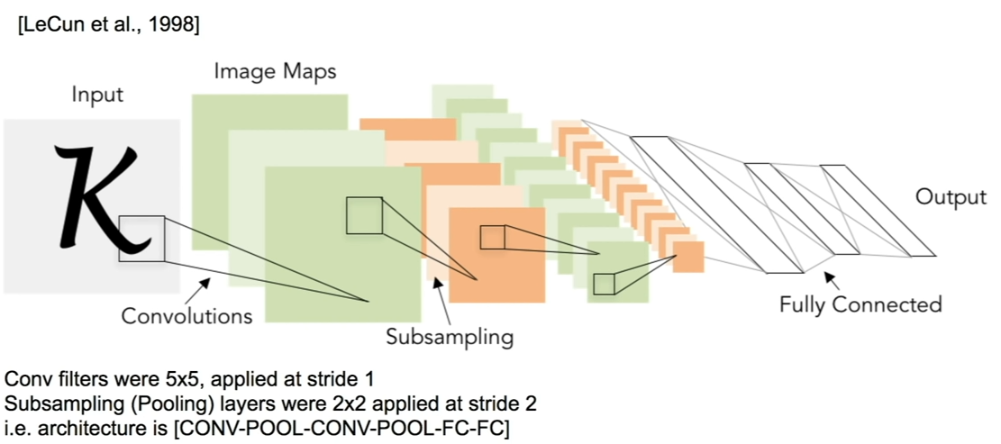
CNN Architectures
Review:
  LeNet-5

Slide 20
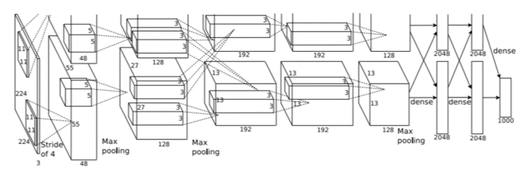
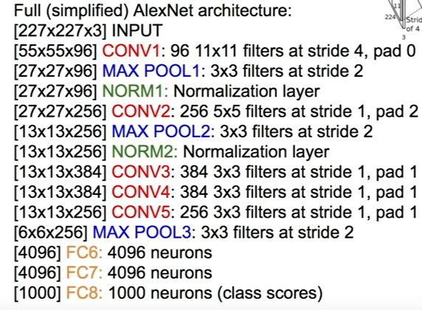
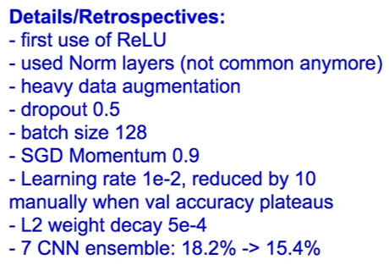
CNN Architectures
Case Study:
  AlexNet

Slide 21
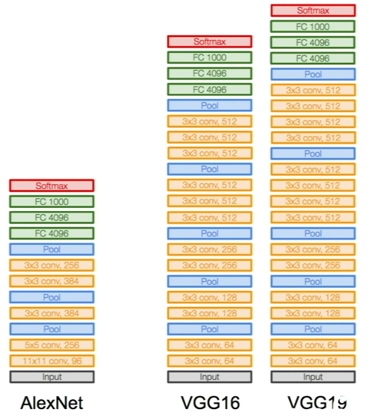
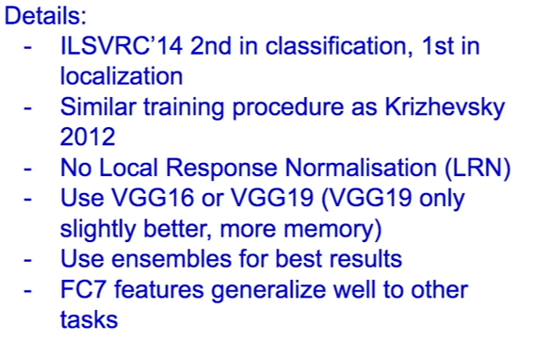
CNN Architectures
Case study:
  VGG-Net
    Simonyan and Zimmerman 2014

Slide 22
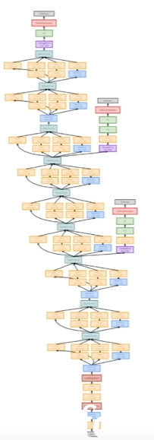

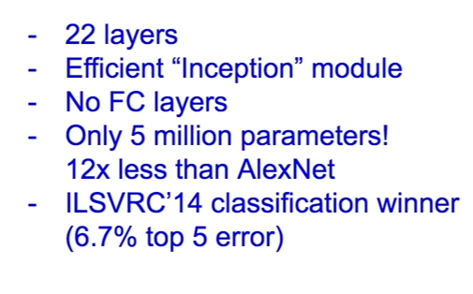
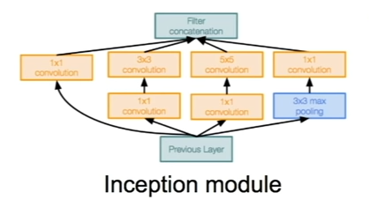
CNN Architectures
Case Study: GoogLeNet
  Szegedy et al. 2014

Slide 23
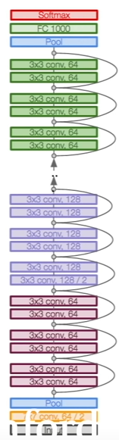

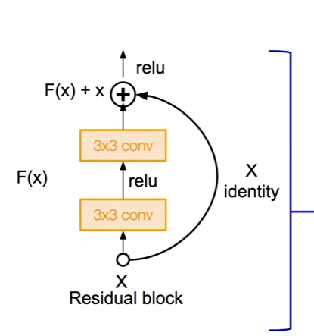
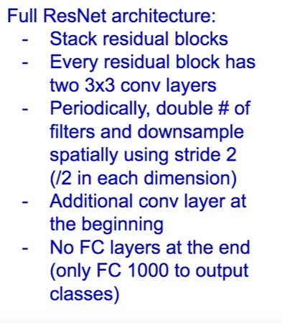
CNN Architectures
Case Study: ResNet
  He et al. 2015

Slide 24
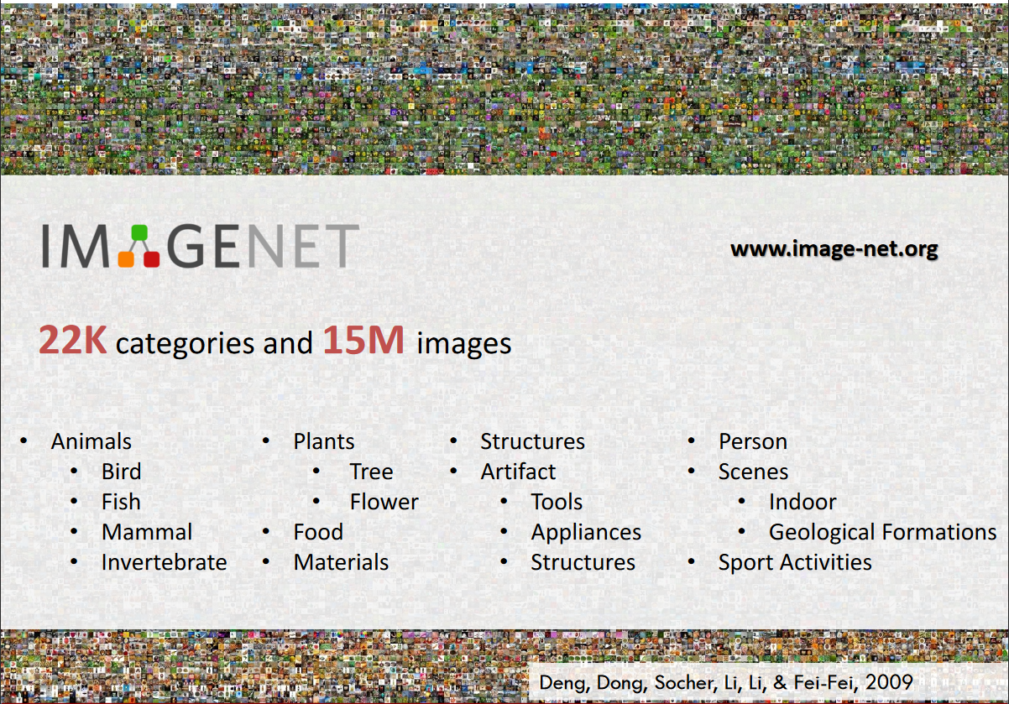
Data: ImageNet

Slide 25
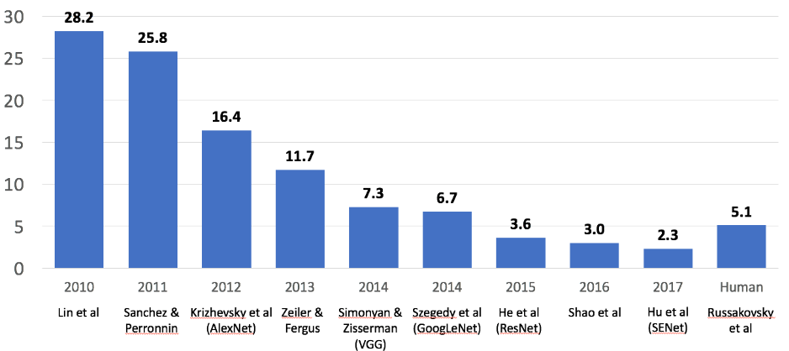
ImageNet Large Scale Visual Recognition Challenge
Image Classification Challenge
  1,000 object classes
  1,431,167 images

Slide 26
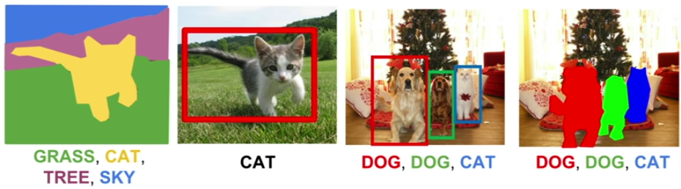
Computer Vision Tasks
What about other tasks?
Semantic Segmentation
Object Localization
Object Detection
Instance Segmentation

Slide 27
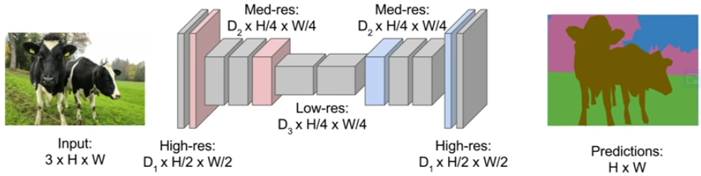
Semantic Segmentation
Design the network with a sequence of convolutions to encode features
Then map back to the image plane.
Up Sampling
Unpooling or Transpose Convolution
Down Sampling
Pooling,
Strided Convolution

Slide 28
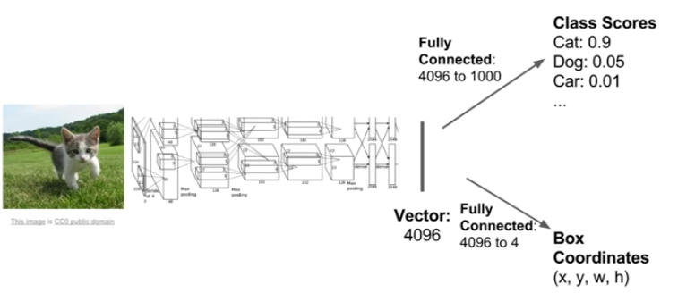
Object Localization
Classification + Localization
  Two pathways
    Classification
    Regression
      We treat localization as regression
Softmax loss
L2 loss

Slide 29
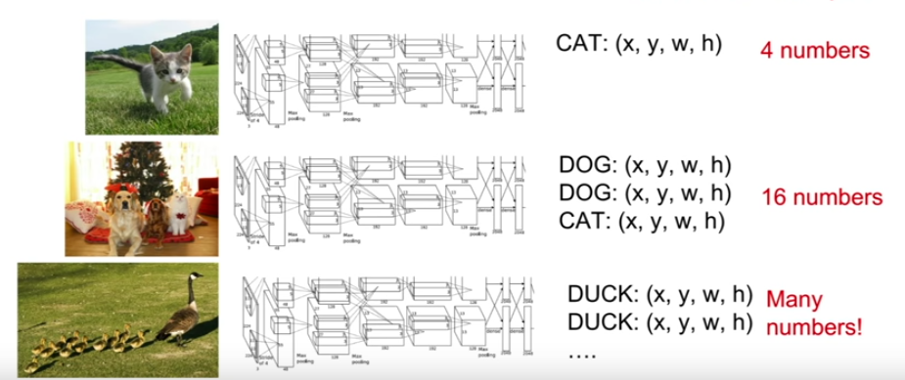
Object Detection
Detection as Regression?
4 Numbers
12 Numbers
Many Numbers

Slide 30
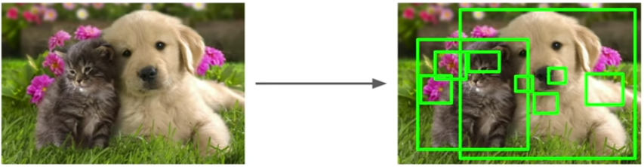
Object Detection
Object Detection as Classification
  Determine a crop (size, location)
    Region Proposals
      Find blobby regions
        Can run these really fast on CPU

Slide 31
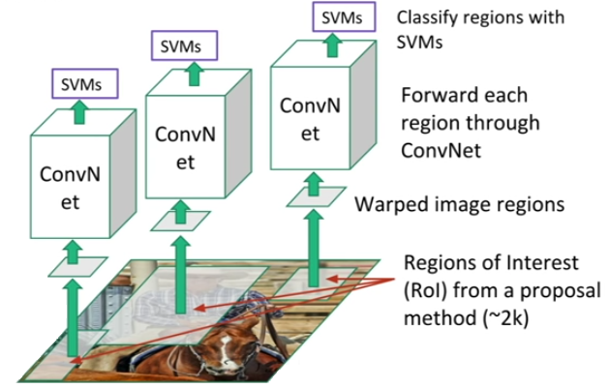
Object Detection
R-CNN

Slide 32
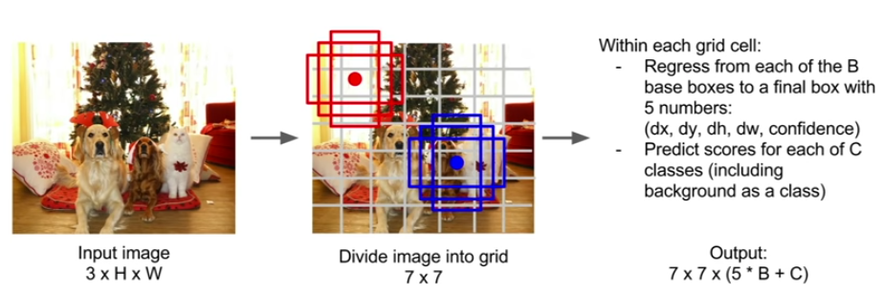
Object Detection
Detection without Region Proposals (YOLO/SSD)
  Split the image into 7x7 grids
    Center a number of boxes (of different size/orientation) in each grid

Slide 33
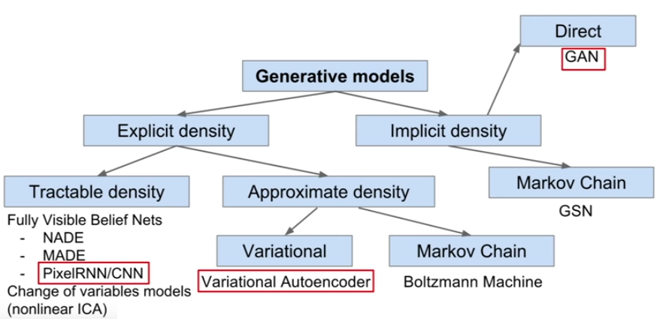
Generative Models
Taxonomy of Generative Models
  Most popular generative models

Slide 34
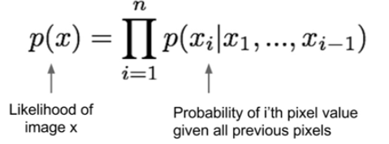
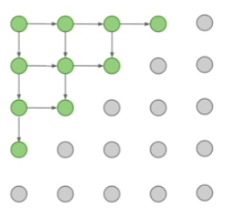
Generative Models
Tractable Density Functions
Pixel RNN
  Start from top left pixel
  Use RNN/LSTM to generate
  neighboring pixels
  Continue till whole image
  generated
  Drawback
    Slow generation!

Slide 35
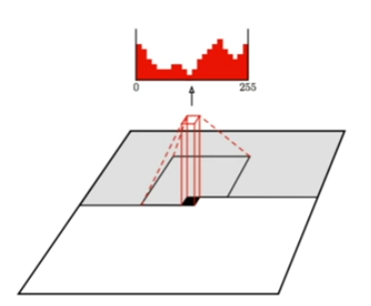
Generative Models
Tractable Density Functions
Pixel CNN
  Start from top left pixel
  Use CNN over a neighborhood
  (context region) to generate
  pixels
  Continue till whole image
  generated
  Drawback
    Slow generation!

Slide 36

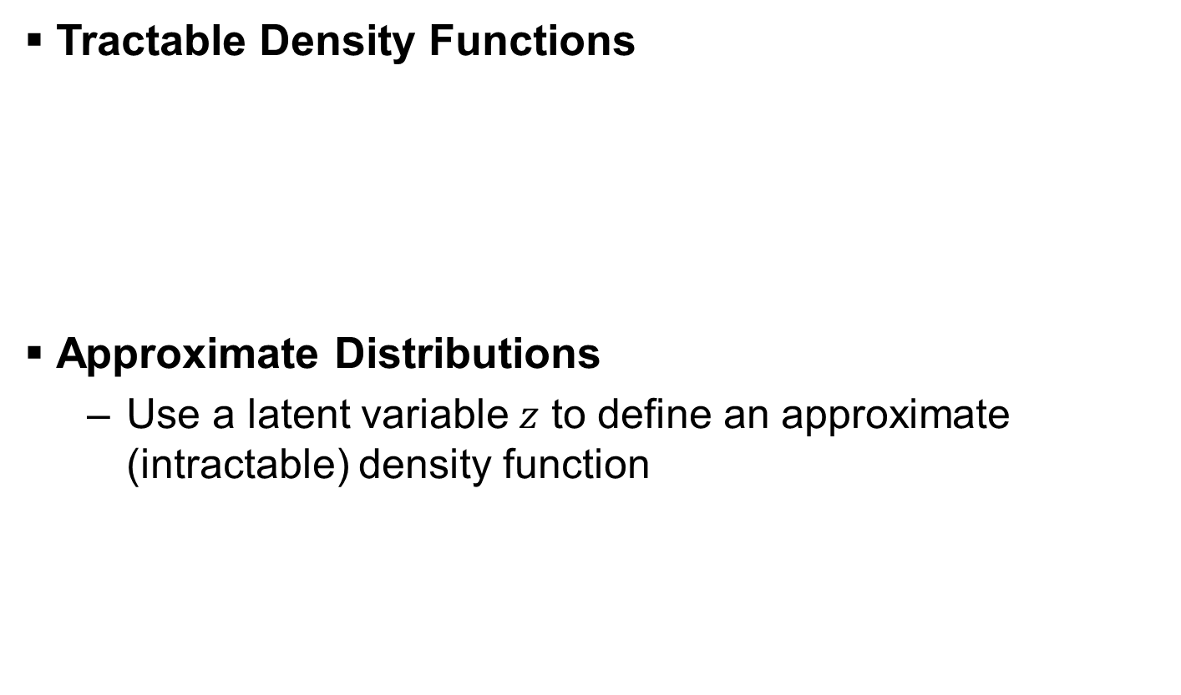
Variational Auto Encoders (VAE)
Tractable Density Functions
Approximate Distributions
  Use a latent variable $z$ to define an approximate (intractable) density function

Slide 37
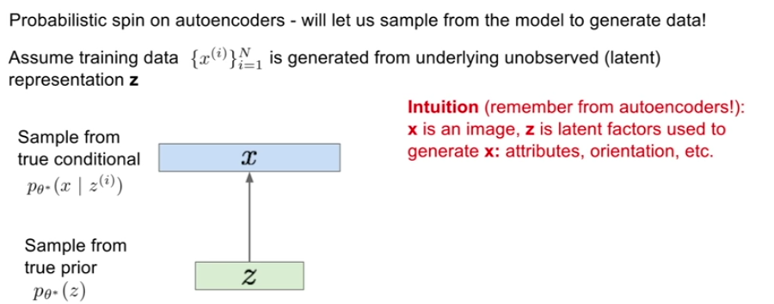

Variational Auto Encoders (VAE)
Use a latent variable $z$ to define an approximate (intractable) density function

Slide 38

Variational Auto Encoders (VAE)
VAE Training
For each minibatch
compute forward, backprop

Slide 39


Variational Auto Encoders (VAE)
VAE Generation
  We use the decoder network
    Sample $z$ from prior

Slide 40

Variational Auto Encoders (VAE)
VAE

Slide 41

Generative Adversarial Networks (GAN)
Two networks
  Discriminator
    Take an input image and returns fake/real
    Convolutional encoder
  Generator
    Take a vector and generate an image
    Transpose convolutional decoder

Slide 42

Generative Adversarial Networks (GAN)
A Two Player Game
  Generator
    From a simple distribution generate images
  Discriminator
    Classify fake and real

Slide 43

Generative Adversarial Networks (GAN)
GANs

Slide 44

Recurrent Neural Networks
One to One
One to Many
Many to One
Many to Many
Many to Many
Frame-level
Video Classification

Slide 45




Recurrent Neural Networks (RNNs)
What are RNNs?
Processing a sequence by applying a recurrence formula at every time step:
$$h_{t}=f_{W}\left(h_{t−1},x_{t}\right)$$
New State
Old state
Some function with parameters $W$
Input vector at some time step
Note: The same function $f_{W}$ are used at every time step.

Slide 46

Recurrent Neural Networks (RNNs)
A simple RNN:
  Average the loss

Slide 47


Recurrent Neural Networks (RNNs)
An Encoder-Decoder RNN:
  How do we address the sequence to sequence translation?
Encoder:
A many to one mapping of the sequence to a code.
Decoder:
A one to many mapping of the code to a sequence.

Slide 48
Recurrent Neural Networks (RNNs)
An Encoder-Decoder RNN:
  Drawback:
    If the encoder makes a bad summary, the translation will also be bad.
      It has been observed that the encoder creates a bad summary when it tries to understand longer sentences. It is called the long-range dependency problem of RNN/LSTMs.

Slide 49

Recurrent Neural Networks (RNNs)
Attention Module:
  How do we solve this issue?
    Instead of using the last stage of the encoder as the context vector, combine all embeddings from the entire encoder
      Basically, a weighted sum of the embeddings
+

Slide 50


Transformer
For each embedding keep
three vectors
  Key, Query, and Value.
    For each embedding use
      The key and query to
      find weights on the values
        This is the attention mechanism

Slide 51

Recurrent Neural Networks (RNNs)

Slide 52

Attention in Computer Vision
Image captioning

Slide 53

Attention in Computer Vision
Examples
  Classifying videos
  by a series of
  “glimpses”.
Mnih & Kavukcuoglu. (2015). “Multiple Object Recognition with Visual Attention”, ICLR.
Gregor et al. (2015). “Draw: A Recurrent Neural Network for Image Generation”, ICML.

Slide 54

Attention in Computer Vision
Examples
Mnih & Kavukcuoglu. (2015). “Multiple Object Recognition with Visual Attention”, ICLR.
Gregor et al. (2015). “Draw: A Recurrent Neural Network for Image Generation”, ICML.

Slide 55

Questions

