Slide 1
Early detection and classification of abnormality in prior mammograms using image-to-image translation and YOLO techniques
Presented by Kelly Chinander & Ronald Du
November 22nd, 2023

Slide 2
Slides
Overview
Introduction
Background
Key terms
Objectives
Methods and Materials
YOLO-based fusion model: overview
Image-to-image translation technique
Early detection and classification framework
Results and Analysis
Dataset
Data Preparation
Evaluation metrics and experiments settings
Evaluation of YOLO-based model on current mammograms
Evaluation of YOLO-based model on prior mammograms
Retrospective analysis for the early detection and classification
Discussion and Conclusion
Questions?
References

Slide 3
Overview

Slide 4
Introduction
The research paper titled "Early detection and classification of abnormality in prior mammograms using image-to-image translation and YOLO techniques" by Baccouchea et al. (2022) examines the usage of a YOLO (You-Only-Look-Once) fusion model to detect and classify abnormalities.
Then, the authors use image translation with Pix2Pix and CycleGAN to obtain a synthetic prior mammogram. Finally, they run their YOLO fusion model on the prior mammogram again to obtain a region of interest for the prior image.

Slide 5
Background
Using CAD based systems to screen mammograms could improve early detection and diagnosis of breast cancer. Many cancer signs also appear in a mammogram before the cancer is formally detected in a later mammogram, but are missed by radiologists.
A CAD system that could detect early signs of cancer in the breast could provide early detection and further improve survival rates. However, it has been difficult to train a model using prior and current mammograms due to issues with keeping the breast aligned between the mammograms.

Slide 6
Key terms
Current image - the most recent mammogram, with a detected abnormality confirmed by expert radiologists and/or biopsy. Used as the ground truth.
Prior image - a previous mammogram from the same patient that did not appear abnormal and was not flagged by radiologists.
Synthetic prior image - a mammogram image generated by one of the two GANs from the prior image and the current image. Sometimes referred to as a generated prior image.

Slide 7
Objectives
The objective of this paper was to first develop a YOLO fusion model to classify and detect breast abnormalities, specifically masses, architectural distortions, and calcifications.
The next objective was to obtain a synthetic prior mammogram image from a combination of the current image and the original prior image. This was achieved using GANs and then evaluated by the YOLO fusion model for identification and compared to the ground truth of the current mammogram image.

Slide 8
Methods and Materials

Slide 9
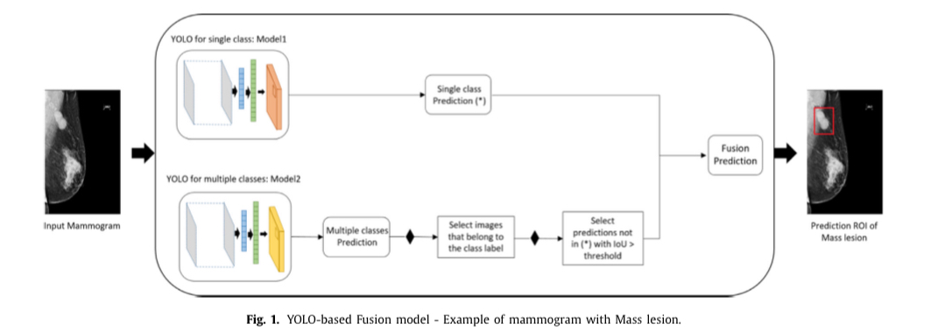
YOLO-based fusion model: overview
The authors used a fusion YOLO model, which combined a YOLOv3 model trained on each class with a YOLOv3 model that was trained on all the classes.
The final prediction was based on the combined outputs of the models trained on only one class label and the model trained with all class labels.

Slide 10
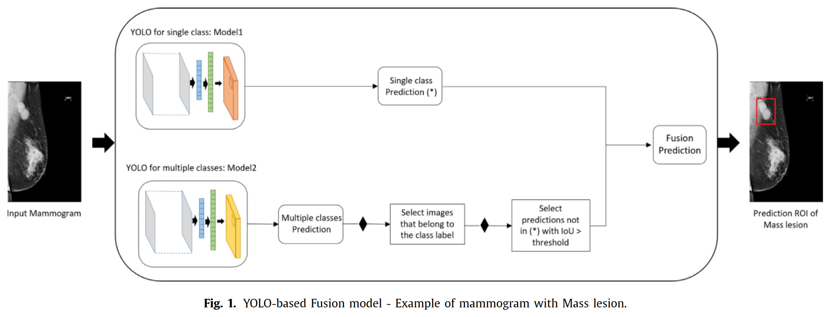
YOLO-based fusion model: overview

Slide 11
Image-to-image translation technique
GANs have performed well for image generation, including for medical imaging. Further work has developed GANs that can generate images from mappings of earlier learned images.
In these GANs, a pair of generators are trained on the mappings of images, and a pair of discriminators is trained on the two different types of images.
Two common GANs that apply this image to image translation technique are Pix2Pix and CycleGAN.

Slide 12
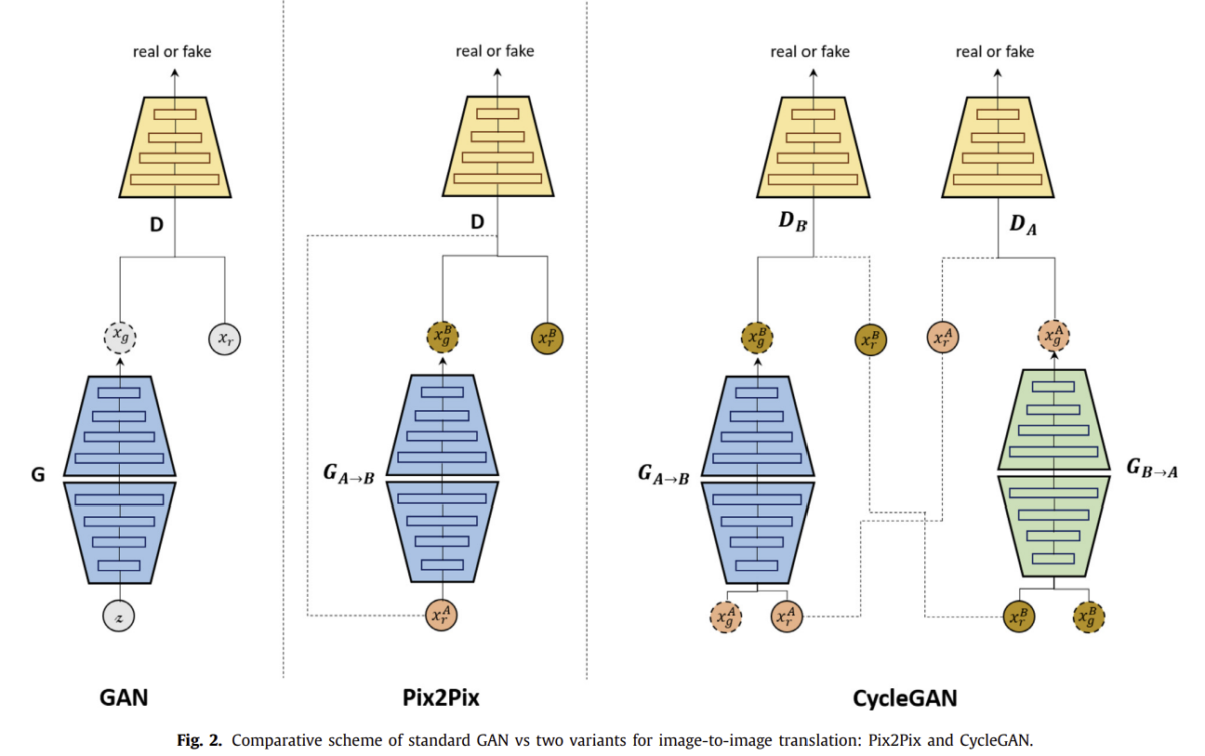
Image-to-image translation technique
PIx2Pix works on paired datasets but only accepts one image from the source domain. It then updates its training using the corresponding image from the target domain.
In comparison, CycleGAN works on unpaired datasets, where the GAN accepts two images, and performs a cyclic translation between the domains to return new synthetic images.

Slide 13
Image-to-image translation technique
Pix2Pix is based on a conditional GAN architecture, where the network tries to transfer special characteristics of the input image to get an output image. It compares the images to the actual corresponding image from the dataset to update the learning.
CycleGAN is built on top of Pix2Pix and works on unpaired data by employing two generators and two discriminators, and employs a new cycle consistency loss to prevent mismatch when generating images.

Slide 14
Image-to-image translation technique

Slide 15
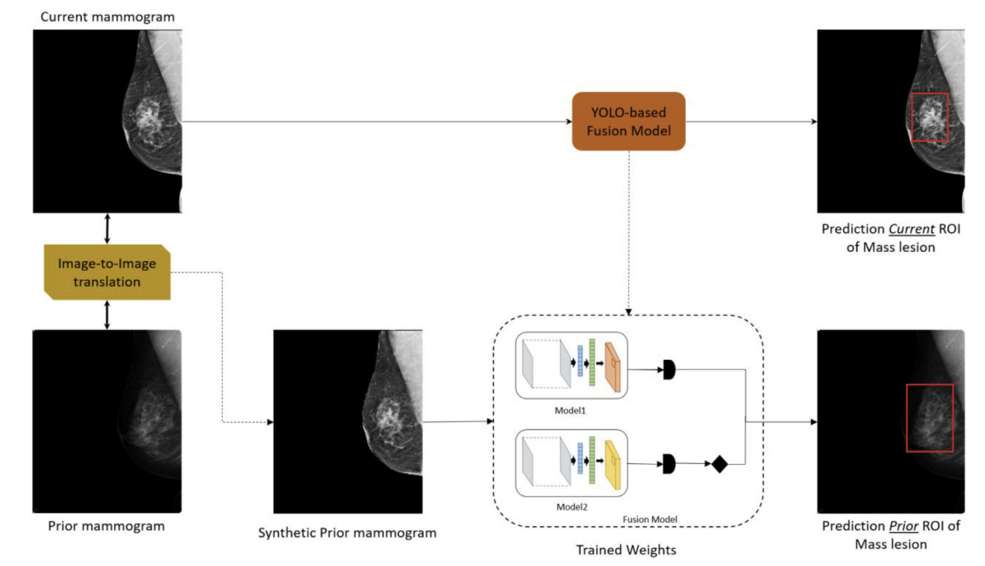
Early detection and classification framework
The authors begin by evaluating mammograms with their YOLO fusion model. Then, a new synthetic prior mammogram is generated from the current image and the prior image using the GANs to avoid misalignment issues.
Finally, the fusion YOLO model
is used to evaluate the generated
prior mammograms to see if the
ROI was detected.

Slide 16
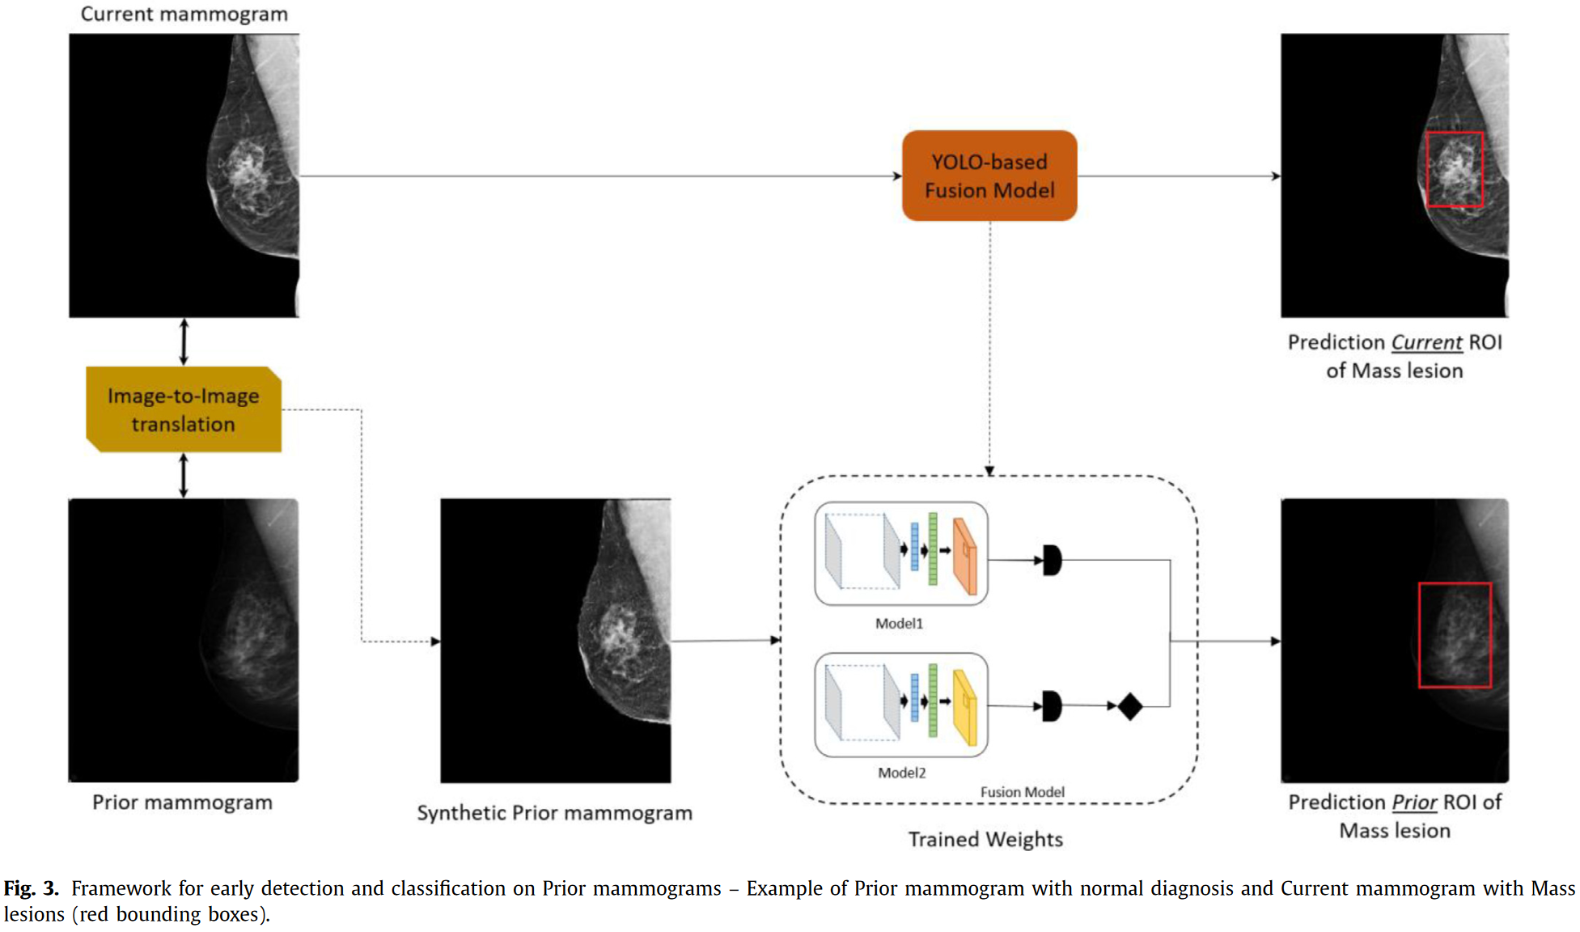
Early detection and classification framework

Slide 17
Results and Analysis

Slide 18
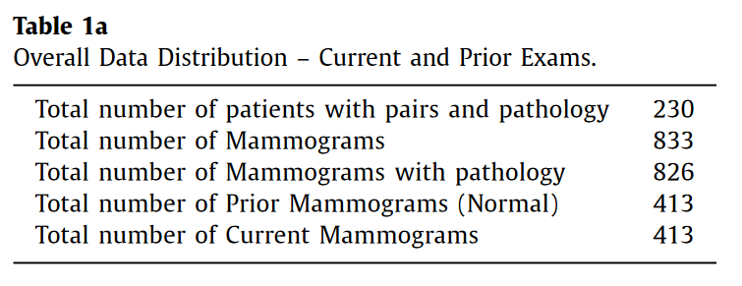
Datasets
Authors used a private dataset from the University of Connecticut - UCHC DigiMammo.
Contains both CC and MLO mammograms of 230 patients, where each patient has an initial mammogram called prior, and a follow up mammogram 1 to 6 years after the prior.

Slide 19
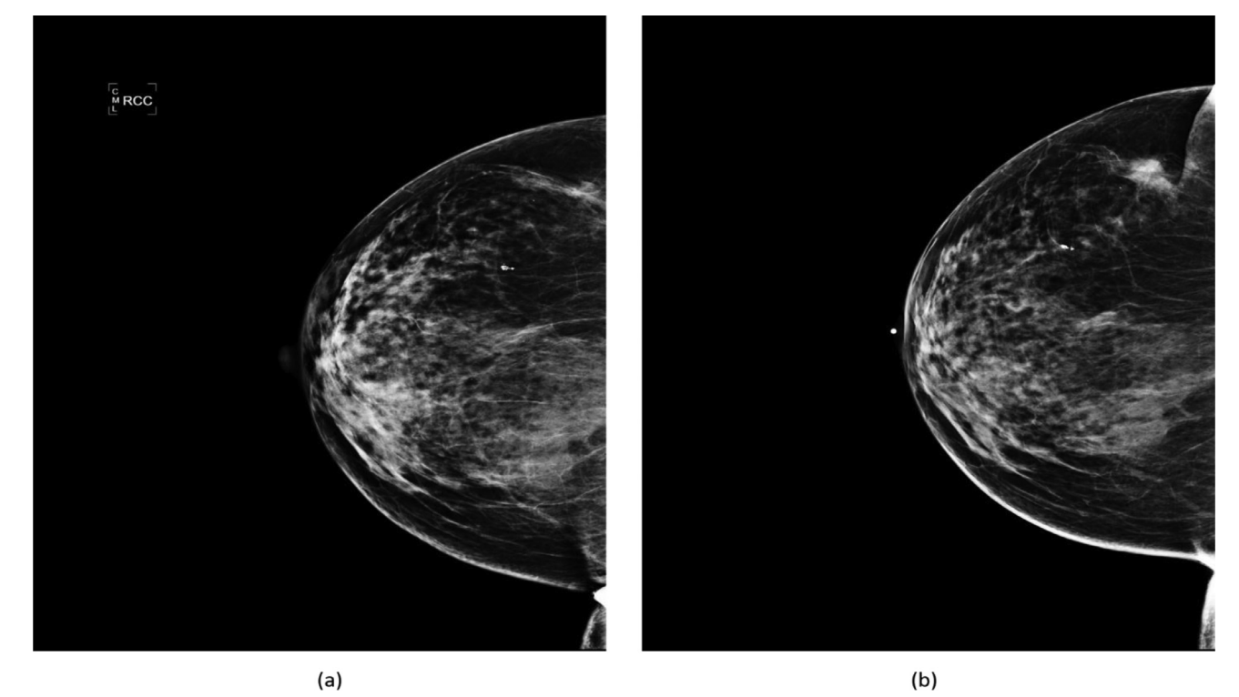
Data Preparation
Authors applied denoising and histogram equalization to all mammogram images.
All mammograms were also downsampled using
bicubic interpolation
to 448x448 pixels.
Finally, images were rotated
0, 90, 180, and 270 degrees
and added to the dataset.
(a) Prior exam with Normal mammogram (i.e. No diagnosis). (b) Current exam with Mass present.

Slide 20
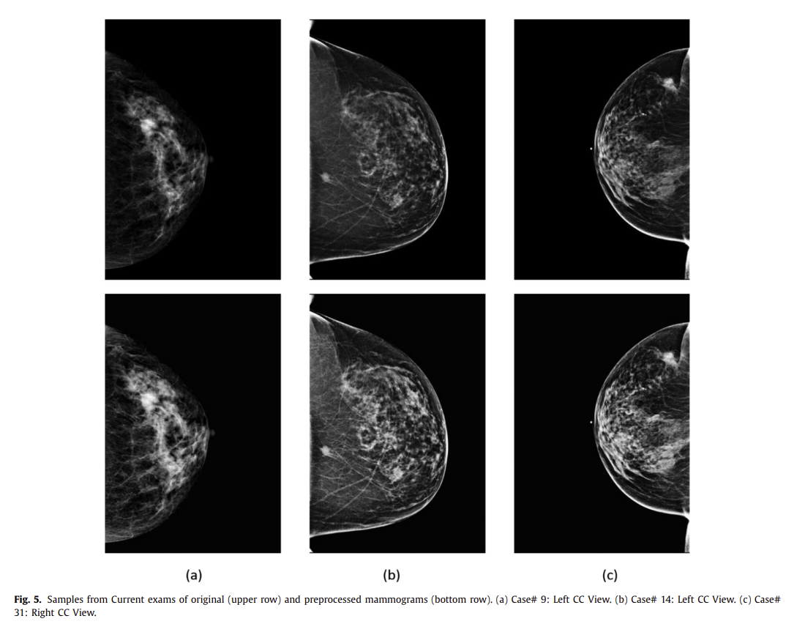
Data Preparation

Slide 21
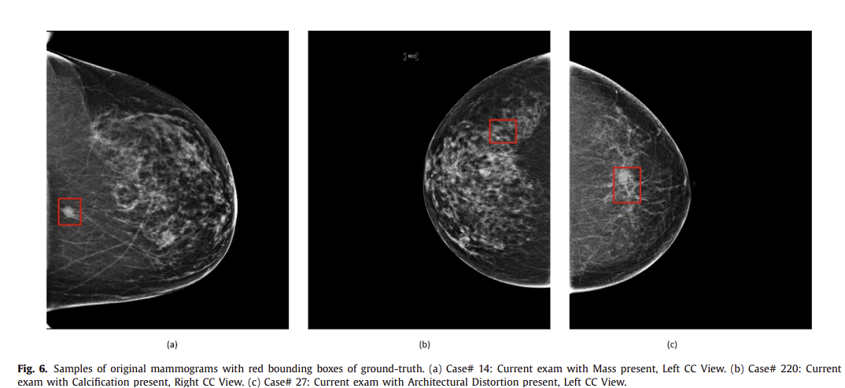
Evaluation metrics and experiments settings
IoU score was used to determine the accuracy of the lesion location.
Detection accuracy was also used, defined as the true detected cases divided by the total number of cases. If the IoU score for the image was below .35, then it was not considered a true detected case even if it was classified correctly.
AUC score was also used to
determine TPR vs FPR.

Slide 22
Evaluation metrics and experiments settings
The CycleGAN model was based off the tutorial on Keras at https://keras.io/examples/generative/cyclegan. It is composed of two generators and two discriminators.
The generator network consists of two down-sampling blocks with filter sizes [128, 256], nine residual blocks with filter size 256, and two up-sampling blocks with filter sizes [128, 64].
The discriminator network is based on four down-sampling blocks with filter sizes [64, 128, 256, 512].
For Pix2Pix, the Keras tutorial was also used, with the corresponding filter sizes and blocks from the tutorial.

Slide 23
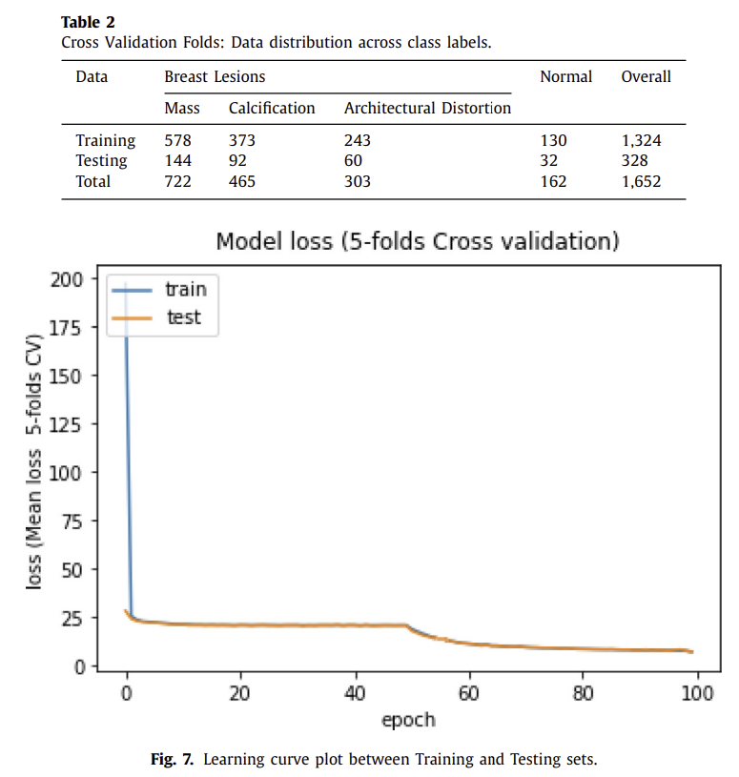
Evaluation metrics and experiments settings
100 epochs, learning rate of 0.00002, and beta of 0.5 for GAN
5 fold cross validation with 80% and 20% split with respect to imbalance classes was used.
For YOLO fusion, the loss function was the combination of bounding box regression loss, class label loss, and confidence loss. Loss values were calculated using cross entropy loss.
YOLO fusion was initially set with COCO weights, and then re-trained and fine-tuned.

Slide 24
Evaluation of YOLO-based model on current mammograms
The Fusion model had the highest score of .95 for architectural distortion, 93% for mass lesions, 88% for calcifications, and 92% overall. Normal mammograms were classified with an accuracy of 94%.

Slide 25
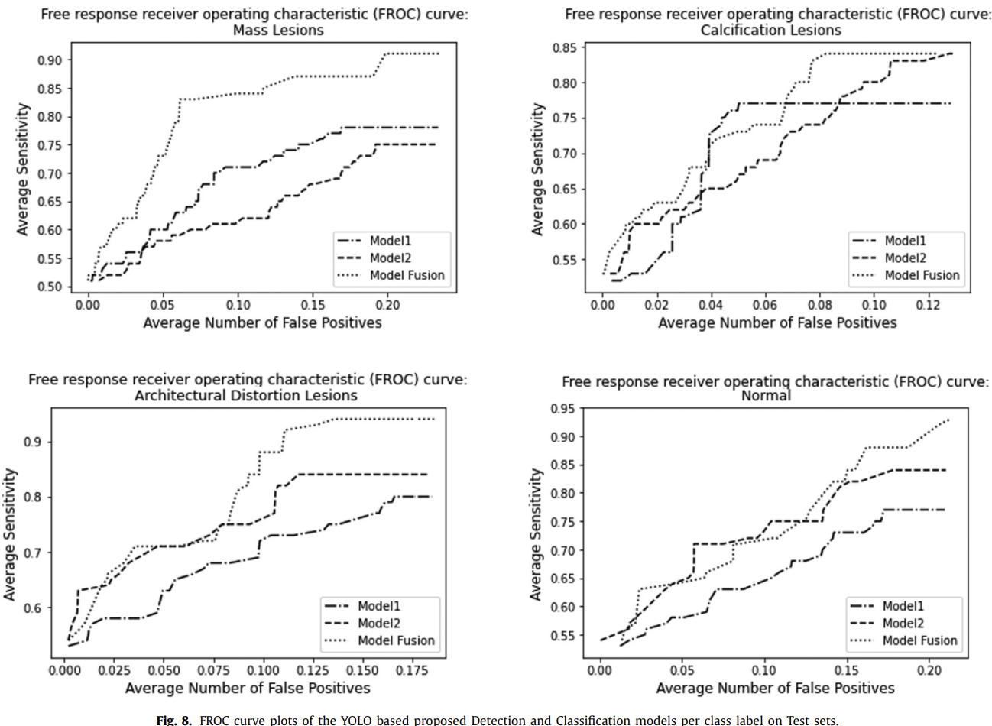
Evaluation of YOLO-based model on current mammograms
FROC curves and AUC show that the fusion model performs best, where Model1 is the individual class model and Model2 is the multi class model.

Slide 26
Evaluation of YOLO-based model on prior mammograms
Authors compare running the fusion model on prior mammograms compared to running it on synthesized prior mammograms.
Synthesized prior mammograms were generated by using a Pix2Pix and CycleGAN model that was trained on the prior and current mammograms images.
The synthesized prior images should “resemble the Current mammograms and preserve the general texture of the Prior mammograms”.

Slide 27
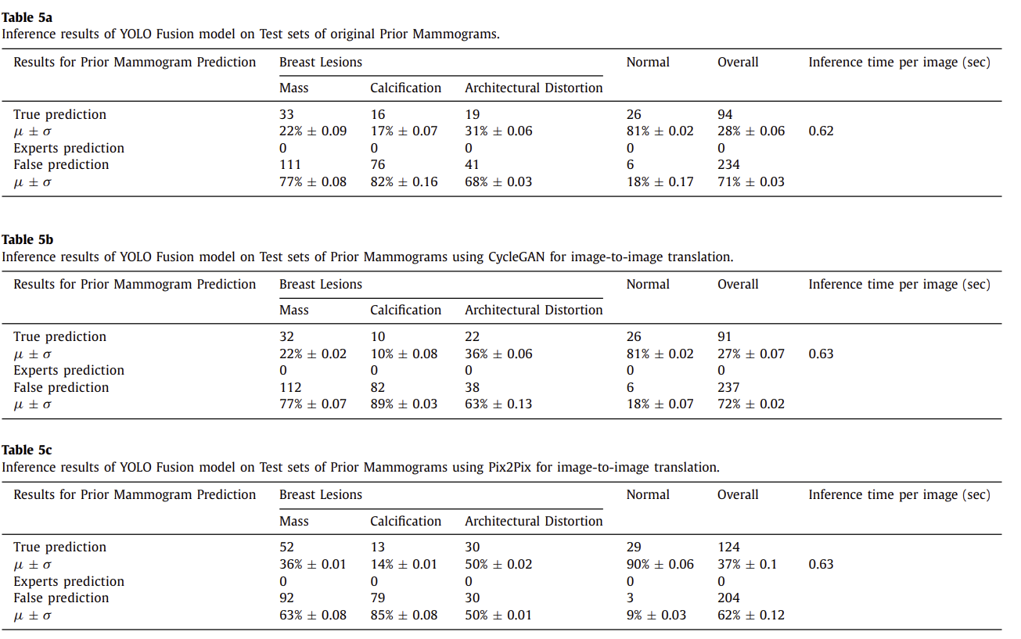
Evaluation of YOLO-based model on prior mammograms
Pix2Pix GAN performed the best, with 36% accuracy on masses, 14% on calcification, and 50% on architectural distortion.
Calcification performance was best on the original prior image.
Notes:
Experts are 0 because they originally classified the mammogram as normal
False predictions are due to the model not being trained on Prior as they had no annotations and were classed as normal.

Slide 28
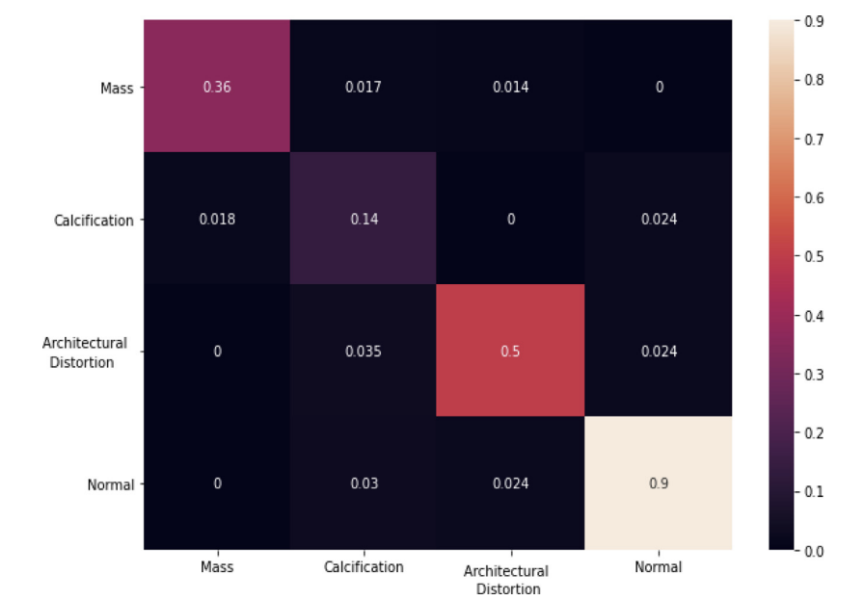
Evaluation of YOLO-based model on prior mammograms
Pix2Pix performed the best, with 36% accuracy on masses, 14% on calcification, and 50% on architectural distortion.
Calcification performed best in the original prior image, due to its general inconsistency.
Notes:
Experts are 0 because they originally classified the mammogram as normal
False predictions are due to the model not being trained on Prior as they had no annotations and were classed as normal.

Slide 29
Retrospective analysis for the early detection and classification
Standouts - Pix2Pix performed the best, most likely due to being trained between paired images where as CycleGAN was unpaired.
The YOLO models detected calcifications better on the original prior images, likely due to their irregular size and location, making it difficult for the GAN to identify a mapping.
One year prior from follow up images performed the best.
Some masses were detected in the prior mammogram but not with the current - likely caused by mammogram quality differences and the type of lesion.
Notes:
Experts are 0 because they originally classified the mammogram as normal
False predictions are due to the model not being trained on Prior as they had no annotations and were classed as normal.

Slide 30
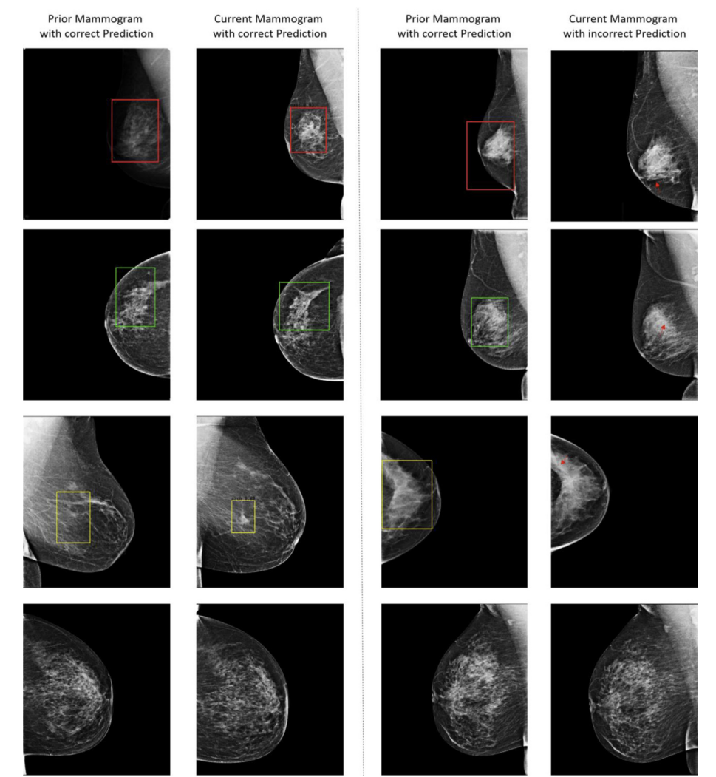
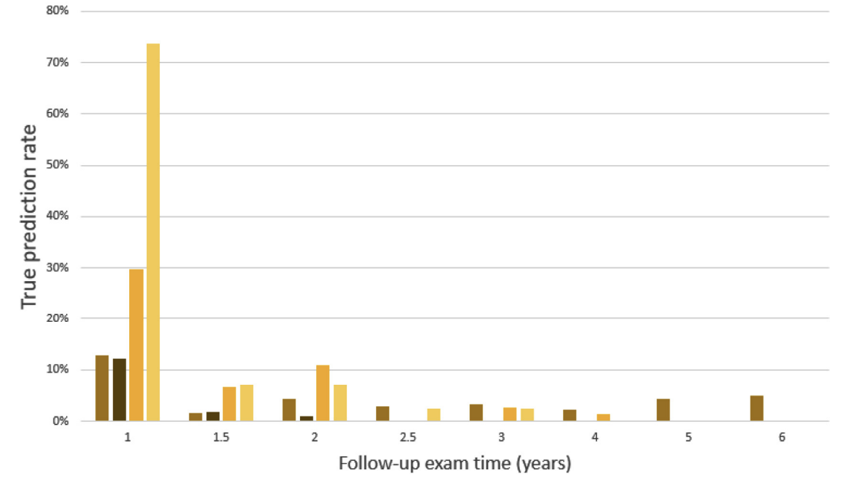
Retrospective analysis for the early detection and classification
Notes:
Experts are 0 because they originally classified the mammogram as normal
False predictions are due to the model not being trained on Prior as they had no annotations and were classed as normal.

Slide 31
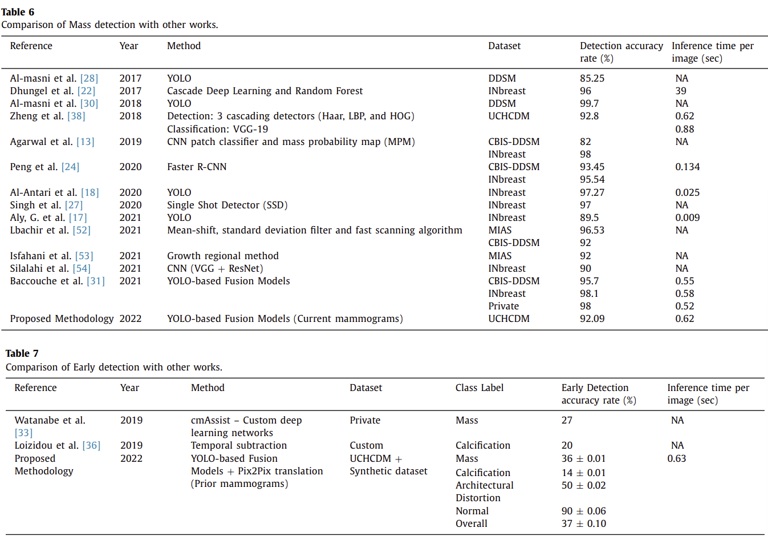
Retrospective analysis for the early detection and classification (YOLO fusion only)
Authors say they achieved good accuracy of 98.1% on CBIS-DDSM and have good performance at 0.62 seconds per image.
Authors noted that it is difficult to compare due to different data preprocessing and private datasets.
Notes:
Experts are 0 because they originally classified the mammogram as normal
False predictions are due to the model not being trained on Prior as they had no annotations and were classed as normal.

Slide 32
Discussion and conclusion
The authors have tested Pix2Pix and CycleGAN to create image translations between original prior and prior generated images to try to detect abnormalities earlier, and evaluated their YOLO fusion model for abnormality detection.
Limitations include a long training time for both the GANs and the YOLO fusion network. The accuracy rates on prior generated mammograms are also too low to be clinically useful but may be useful as an early warning sign of breast cancer.
Notes:
Experts are 0 because they originally classified the mammogram as normal
False predictions are due to the model not being trained on Prior as they had no annotations and were classed as normal.

Slide 33
Questions?

Slide 34
References
Baccouche A, Garcia-Zapirain B, Zheng Y, Elmaghraby AS. Early detection and classification of abnormality in prior mammograms using image-to-image translation and YOLO techniques. Comput Methods Programs Biomed. 2022 Jun;221:106884. doi: 10.1016/j.cmpb.2022.106884. Epub 2022 May 13. PMID: 35594582.

