Slide 1
Intensity Transformations
CS 474/674 – Prof. Bebis
Sections 2.5, 3.1, 3.2, 3.3

Slide 2
Spatial Domain Methods
f(x,y)
processed image
g(x,y)
Point
Processing
T operates on a single pixel at a time
f(x,y)
g(x,y)
processed image
Area/Mask
Processing
T operates on a “group” of pixels !

Slide 3
Point Processing Transformations
Convert a given pixel value to a new pixel value based on some predefined function T().

Slide 4
Identity Transformation

Slide 5
Negative Transformation
g(x,y) = 255-f(x,y)
image negative
image negative

Slide 6
Contrast Stretching or Compression
Stretch gray-level ranges where
we desire more information
(slope > 1)
Compress gray-level ranges that
are of little interest
(0 < slope < 1)

Slide 7
Image stretching/compression using a linear transformation
[a,b] → [c, d]
d
Stretching: [c,d] is wider than [a,b]
Compression: [a,b] is wider than [c,d]
a→c: c=ma+k
b→d: d=mb+k
y=mx+k m,k?
c
a
b
two equations
in two unknowns
Solution: y=(x-a)(d-c)/(b-a)+c

Slide 8
Special case: [a, b] → [0, 255]
Image values are typically in the range [0, 255] (e.g., PGM images use 8 bits/pixel)
If the pixels values are outside of [0, 255], the image will not be displayed correctly!
  e.g., some image processing operations might yield pixel values outside the range [0, 255].
We must explicitly re-map the values to [0, 255]

Slide 9
Special case: [a, b] → [0, 255] (cont’d)
Find the min (f_{min}) and max (f_{max}) intensity values of the image (note: could be negative).
Compute the transformation:
[f_{min}, f_{max}] → [0, 255]
Solution: y=255(x - f_{min})/(f_{max} - f_{min})
Note: result should be truncated/rounded to (int)

Slide 10
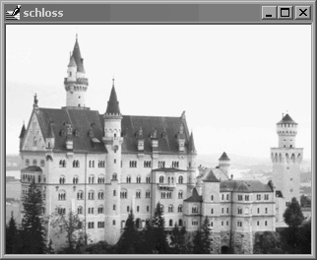
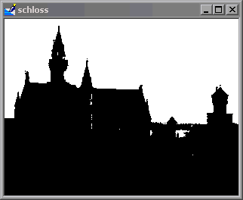
Thresholding
Special case of contrast compression!
“hard” threshold
“hard” threshold
“soft” threshold

Slide 11
Intensity Level Slicing
Highlight values within a specific range only!
Remove
background:
This is “double”
thresholding!

Slide 12
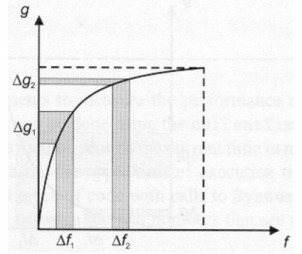

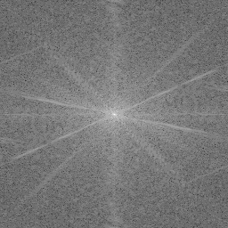
Logarithmic transformation
Enhance details in the darker regions of an image at the expense of details in brighter regions.
Example: visualize the spectrum of the
Fourier Transform using a log() transformation
compress
T(r)
stretch

Slide 13
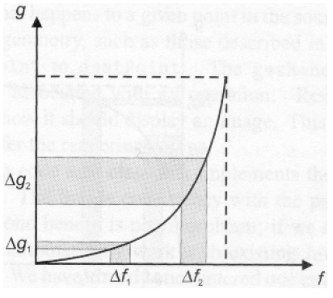
Exponential transformation
Reverse effect of that obtained using logarithmic mapping.
stretch
compress

Slide 14
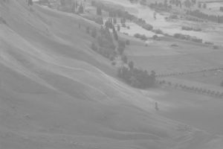
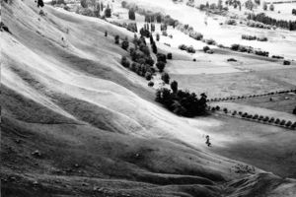
Histogram Equalization
A fully automatic technique for contrast enhancement!
Need to define image histograms and review random variables from probability theory first!

Slide 15
Image Histograms
An image histogram is a plot of gray-level frequencies.

Slide 16
Normalized Image Histograms
Divide frequencies by total number of pixels in the image to represent them as probabilities.

Slide 17
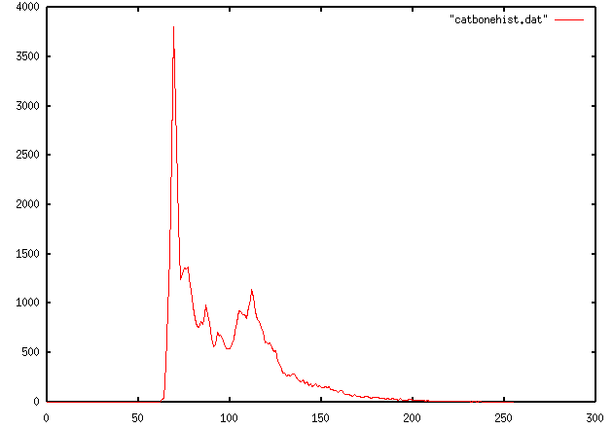
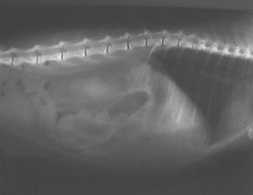
Image Histograms (cont’d)
Example:
Histogram
Could different images have the same histogram?

Slide 18
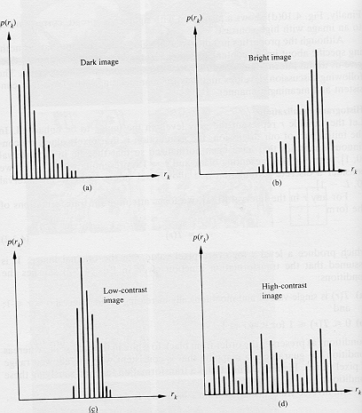
Properties of Image Histograms
Histograms clustered at the low end correspond to dark images.
Histograms clustered at the high end correspond to bright images.

Slide 19
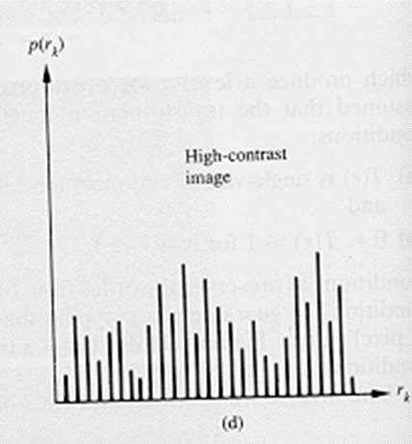
Properties of Image Histograms (cont’d)
Histograms with small spread correspond to low contrast images (i.e., mostly dark, mostly bright, or mostly gray).
Histograms with wide spread correspond to high contrast images.

Slide 20
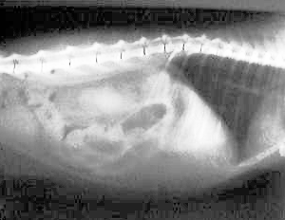
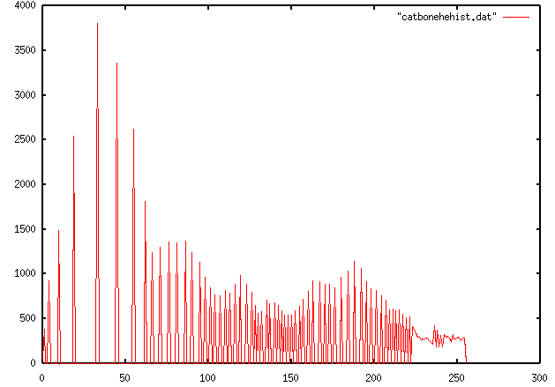
Properties of Image Histograms (cont’d)
Low contrast
High contrast

Slide 21
Histogram Equalization
The goal of histogram equalization is to redistribute the gray-level values uniformly!

Slide 22
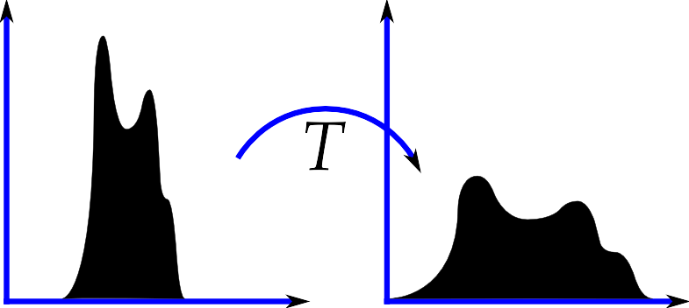
Histogram Equalization (cont’d)
In practice, the equalized histogram is not completely flat due to the discrete nature of the data.

Slide 23
Random Variables - Review
A function that assigns a real number to each outcome of a random experiment.
Random variables could be “discrete” or “continuous”
X(j)
X: # of heads

Slide 24
How do we compute probabilities using Random Variables?
Consider the experiment of “throwing a pair of dice”
  Define the r.v. X = “sum of dice”
  What is P(X=5)?
  In general, what is P(X=x)?

Slide 25
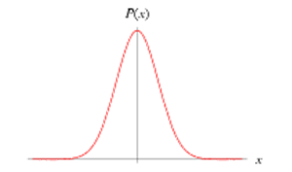
Probability density function f_{X}(x)
The probability density function (pdf) is a real-valued function f_{X}(x) describing the probability of each value the r.v. can assume (discrete case) or being “close” to some value (continuous case).
Gaussian pdf
continuous case
discrete case
(just a histogram)

Slide 26

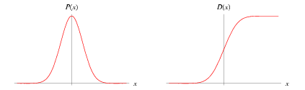
Probability distribution function F_{X}(x)
The integral of f_{X}(x) defines the probability distribution function F_{X}(x) (or cumulative distribution function - CDF)
In the discrete case, this is equivalent to computing the sum:
f_{X}(x)
F_{X}(x)
f_{X}(a)da
Gaussian
always non-decreasing

Slide 27
Probability distribution function (cont’d)

Slide 28

Transformations between Random Variables
We can define a new random variable Y from another random variable X using some transformation Y=T(X)
  e.g., Y=X+1
Question: if we know f_{X}(x), can we find f_{Y}(y)?
Yes - it can be shown that:

Slide 29
Transformations of r.v. - Example
μ=0, σ=1
0
μ=1, σ=1

Slide 30
Special Case: T() is the CDF
cumulative distribution
https://ocw.mit.edu/courses/res-6-012-introduction-to-probability-spring-2018/resources/simulation

Slide 31
Histogram Equalization (cont’d)
r: original intensity
s: new intensity
How do we apply this result to images?

Slide 32
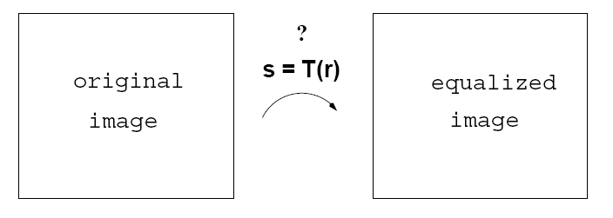
Histogram Equalization (cont’d)
We will assume that “each intensity level” is the result
of some “random experiment”.
pdf: p_{r}(r)
pdf: p_{s}(s)
r: original intensity
s: new intensity
de-normalize:
s_{k} x (L-1)
k=0,1,2, …, L-1

Slide 33
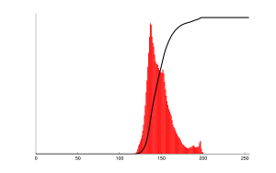
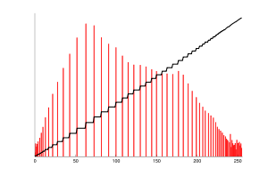
Histogram Equalization (cont’d)

Slide 34
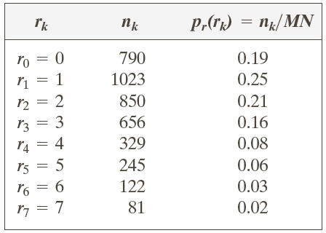
Example – Discrete Case
3 bit
64 x 64 image

Slide 35
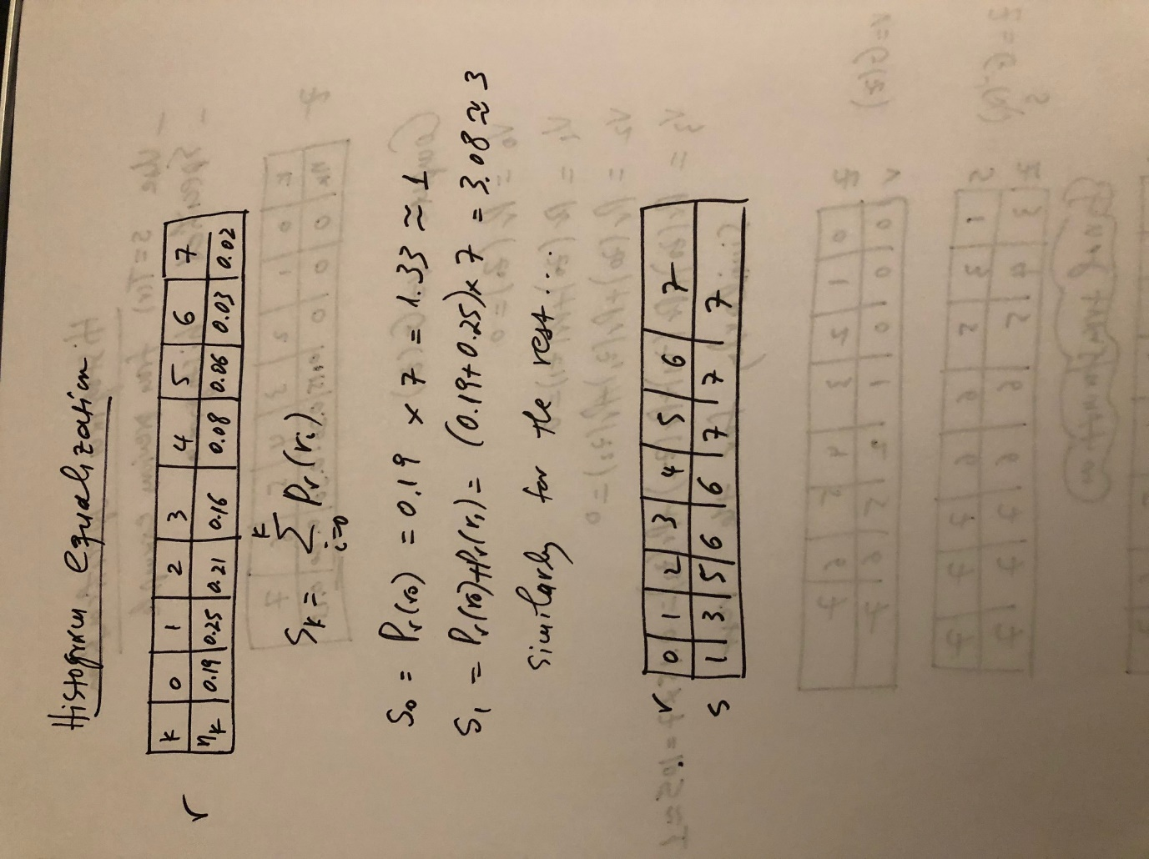
Example – Discrete Case (cont’d)
de-normalize:
x (L-1)
Equalization Transformation
truncate/round

Slide 36
Example – Discrete Case (cont’d)
Equalization Transformation
Original Image
Equalized Image
3 | 5 | 0 | …
… | … | … | …
… | … | … | …
… | … | … | …
6 | 7 | 1 | …
… | … | … | …
… | … | … | …
… | … | … | …

Slide 37
Example – Discrete Case (cont’d)
3 bit
64 x 64 image
input histogram
equalized histogram

Slide 38
Example – Continuous Case

Slide 39
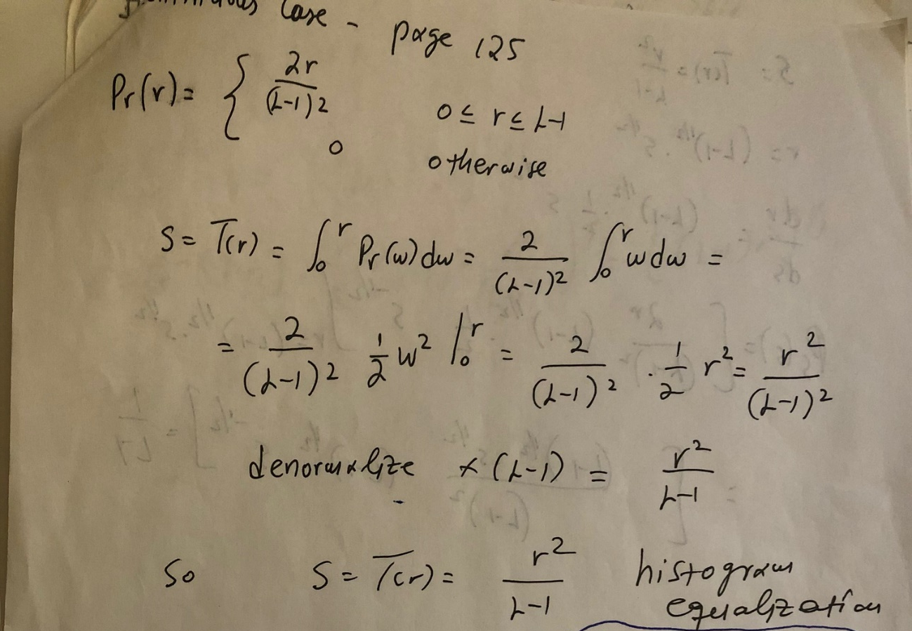
Example – Continuous Case (cont’d)

Slide 40
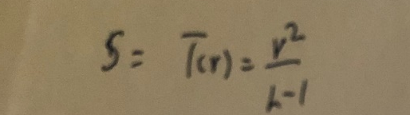
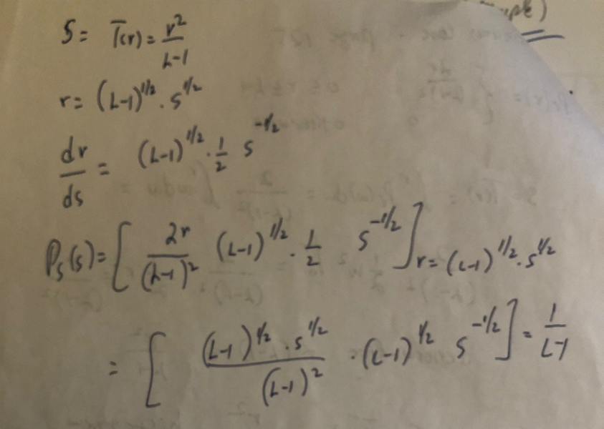
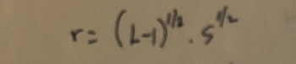
Example – Continuous Case (cont’d)
Verify that p_{s}(s) is indeed uniform!
Uniform!

Slide 41
Histogram Equalization - Examples
original images and histograms
equalized images and histograms

Slide 42
Histogram Specification (or Matching)
Find a transformation Q(r) which maps an image to a new image that has a specific histogram (not necessarily uniform!)
We need to provide the following:
  (1) original image
  (2) desired pdf (histogram)
f_{R}(r)
f_{Z}(z)

Slide 43
Histogram Specification (Matching)
Input
(1) original image I₁
(2) desired pdf f_{Z}(z) (histogram)
Output
(1) histogram specified image I₂
f_{R}(r)
f_{Z}(z)
Goal: find transformation
z=Q(r)
f_{R}(a)da
f_{Z}(a)da

Slide 44
Histogram Specification (Matching)
Possible Steps
(1) Compute the equalization
transformation v=G(z)
We can do this since we have
f_{Z}(z) which is the desired pdf
(2) Compute I₂ through z=G⁻¹(v)
But, we do not have I’₂ !!
We only know the specified
histogram for I₂ !
f_{R}(r)
f_{Z}(z)
f_{R}(a)da
f_{Z}(a)da

Slide 45
Histogram Specification (Matching)
Idea
Compute the equalization
transformation v=G(z)
Also, compute the equalization
transformation s=T(r)
Compute I₂ using z=G⁻¹(s) instead of G⁻¹(v) (i.e., replace v by s)
Can we do this?
Yes, both s and v follow a uniform distribution!
f_{R}(r)
f_{Z}(z)
f_{R}(a)da
f_{Z}(a)da
Desired transformation:
z=Q(r)=G⁻¹(T(r))

Slide 46
Histogram Specification (Matching)
Summary of steps:
(1) Compute equalization
transformation s=T(r)
(2) Compute equalization
transformation v=G(z)
(3) Compute I₂ through z=G⁻¹(s)
or z=G⁻¹(T(r)) using I’₁
f_{R}(r)
f_{Z}(z)
f_{R}(a)da
f_{Z}(a)da
  Note: G⁻¹ is not always easy to find.

Slide 47
Example – Discrete Case
same 3 bit
64 x 64 image
as before
histogram of input image
specified histogram

Slide 48
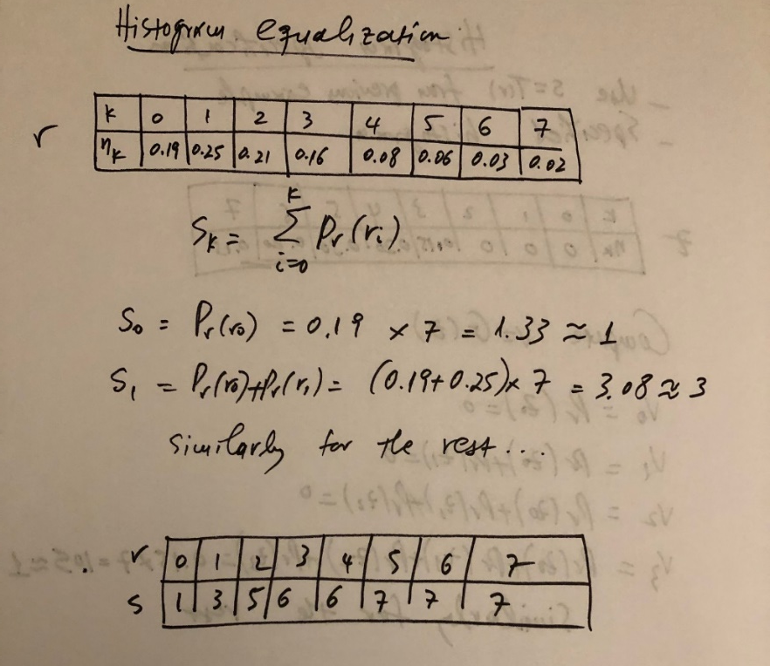
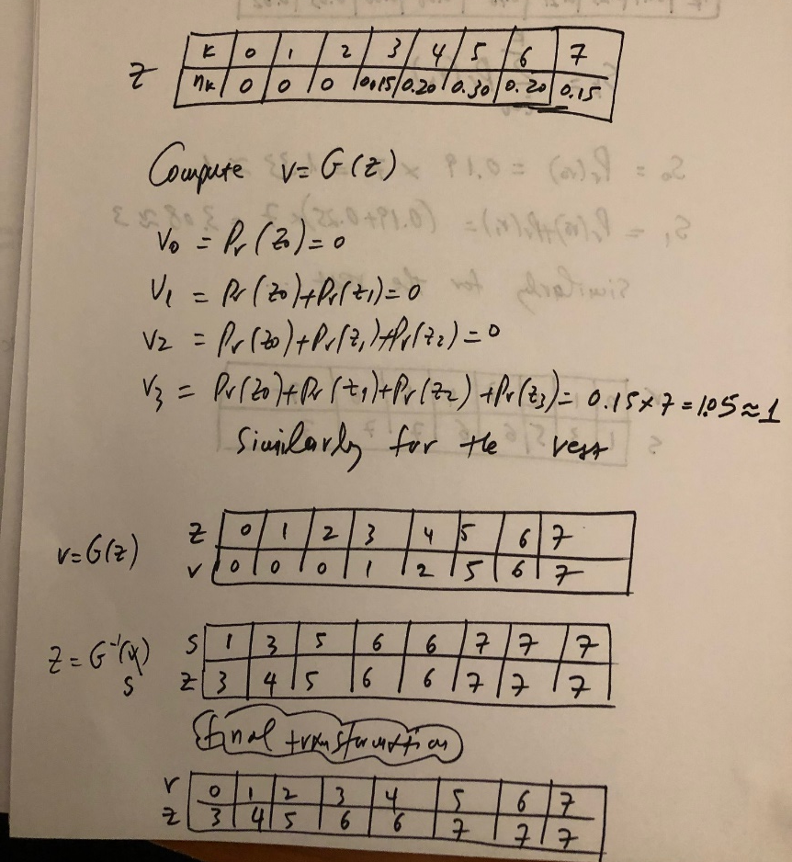
Example – Discrete Case (cont’d)
Step 2: find v=G(z)
using specified histogram
Step 1: find s=T(r)
(we did it already in previous example)
Step 3: find z=G⁻¹(s)
z=Q(r)= G⁻¹(s)=G⁻¹(T(r))

Slide 49
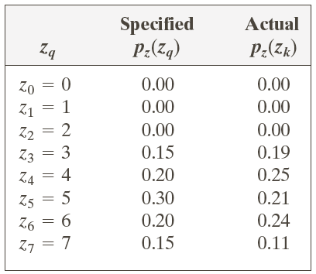
Example – Discrete Case (cont’d)
histogram of
input image
specified histogram
resulted histogram

Slide 50
Example – Continuous Case

Slide 51

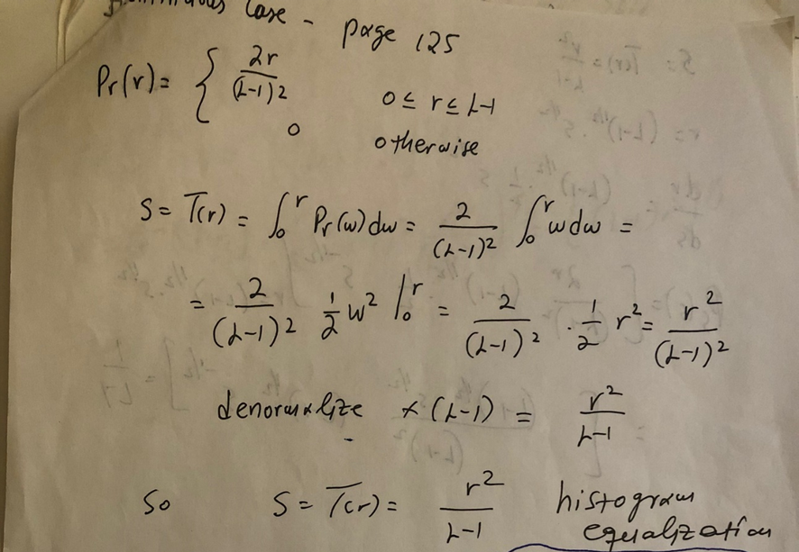
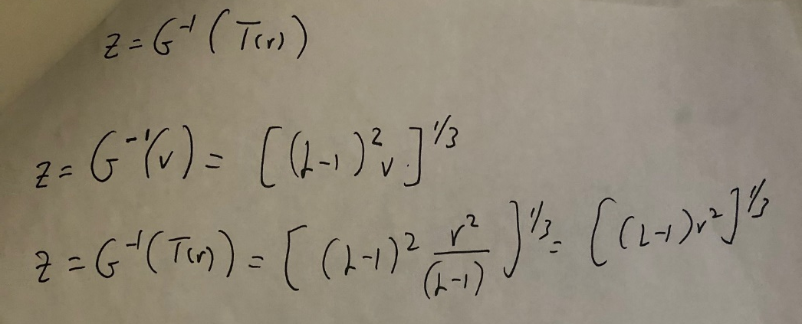
Example – Continuous Case (cont’d)
Step 2: find v=G(z)
Step 1: find s=T(r)
(we have already done it)
Step 3: find z=G⁻¹(s)=G⁻¹(T(r))

Slide 52
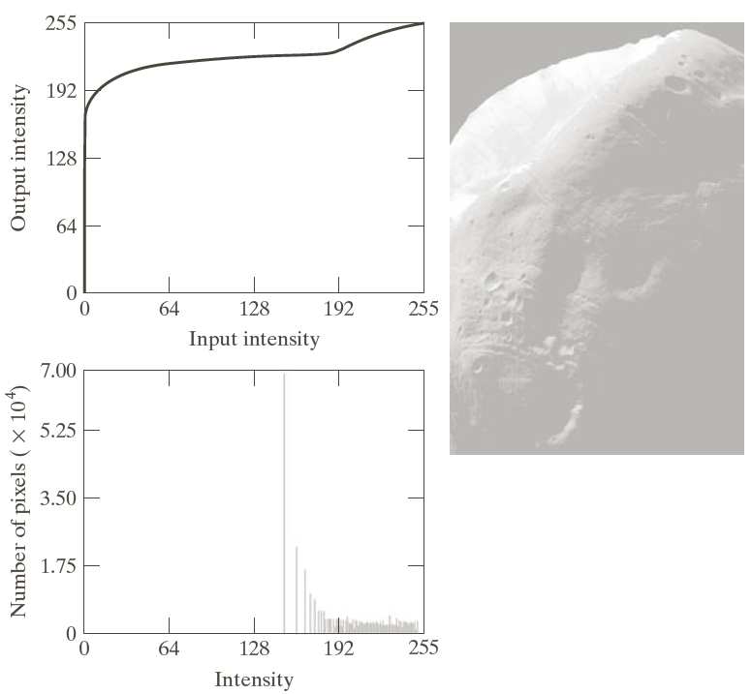
Histogram Specification - Example
Histogram specification might yield better results than histogram equalization.
Result of histogram equalization

Slide 53
Histogram Specification – Example (cont’d)
Result of histogram specification
Result of histogram equalization
specified
histogram
G(z)
G⁻¹(z)
resulted
histogram

Slide 54
Local Histogram Processing
Both histogram equalization and specification are global methods.
  i.e., the intensity transformation is computed from the entire image.
Global transformations are not appropriate for enhancing small details in an image.
  i.e., the number of pixels in these areas might be very small, contributing very little to the computation of the transformation.
detail

Slide 55
Local Histogram Processing (cont’d)
Define a window w x w and move its center from pixel to pixel:
At each location (x,y) of the input image, compute the histogram of the pixels in the window and the corresponding histogram equalization s=T(r).
Apply the computed transformation to the intensity of the pixel at location (x,y) and assign the equalized value to the same location in the output image.
Move the center of the window to the next image location and repeat the process.
Input Image
(x,y)
r
s=T(r)
Output Image
(x,y)
s

Slide 56
Local Histogram Processing: Example
Global histogram
equalization
Local histogram
equalization using a
3 x 3 window

Slide 57
Histogram Statistics
Useful statistics can be computed from image histograms.
mean
(average intensity)
variance
(2nd moment)
n-th moment
around mean

Slide 58
Histogram Statistics (cont’d)
σ is useful for estimating image contrast!

Slide 59
Local Histogram Statistics
Compute image histogram statistics in a local region.

Slide 60

Local Histogram Statistics (cont’d)
Could be useful for local image enhancement.
Task: enhance dark
areas without affecting
much bright areas.
Idea: Find dark, low contrast
areas using local statistics and
enhance them.

Slide 61
Local Histogram Statistics (cont’d)
“dark” constraint
“low-contrast” constraint
m_{G}=161
σ_{G}=103
E=22.8 k₀=0.25 k₁=0 k₂=0.1
local histogram equalization
local image enhancement

Slide 62
Quiz #1
When: 9/18/2024 (Wednesday) at 1:00pm
What: Introduction to Image Processing & Intensity Transformations
Duration: 15 minutes

