Slide 1
CS474/674 Image Processing and Interpretation
Fall 2024 – Dr. George Bebis
Programming Assignment
Due Date: 12/11/2024

Slide 2
Experiment 1: Noise Removal
The noisy “boy” image shown below has been generated by adding “cosine” (i.e., periodic) noise to the original “boy” image.
Using frequency domain filtering, use (i) a band-reject filter and (ii) a notch filter to remove the noise and show your results in each case.
For comparison purposes, attempt to remove the noise in the spatial domain using Gaussian filtering (e.g., 7 x 7 or 15 x 15 filters).
Instead of removing the noise, devise a procedure to extract the noise pattern.

Slide 3
Experiment 1: Noise Removal (cont’d)
Accurate and reliable face verification and recognition relies heavily on high-quality face images.
What are some potential consequences of failing to reduce noise or introducing artifacts due to algorithmic errors?
  This is a free response question; you can discuss both safety and economic implications.
  Provide proper citation for any information you obtain from other sources.

Slide 4
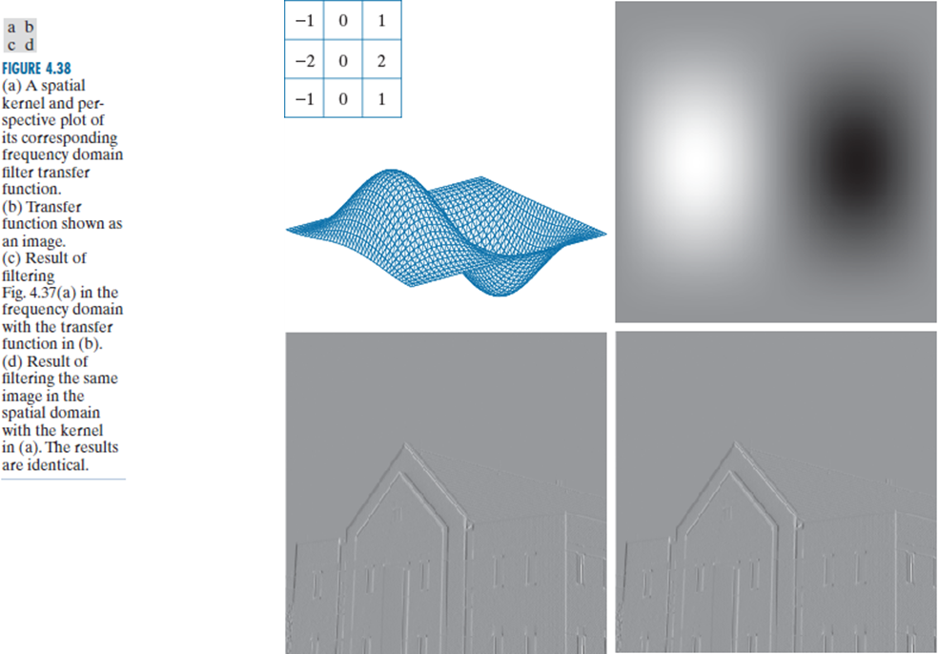
Experiment 2: Convolution in the frequency domain
Repeat the experiment described in Example 4.15 (page 317), using the “lenna” image (i.e., Sobel filtering).
For comparison purposes, perform the convolution both in the spatial and frequency domains (i.e., see Figure 4.38, page 319) and compare your results.

Slide 5
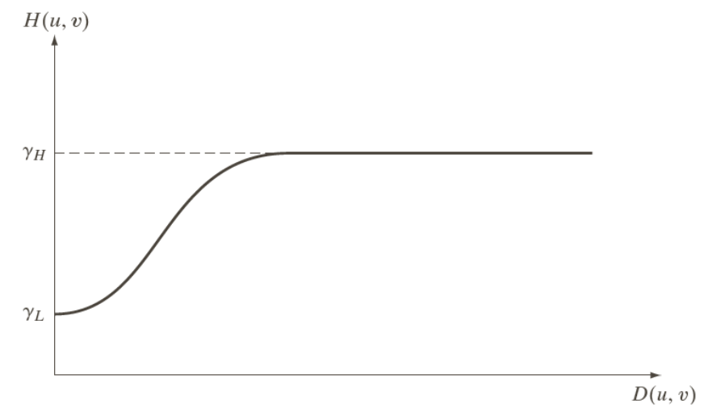
Experiment 3: Homomorphic Filtering
Implement the homomorphic filtering method and apply it on the “girl” image shown to improve its quality.
For high-pass filtering, use a high-emphasis filter:

Slide 6
30% Extra Credit: Image Restoration
Assuming Motion Blur
Apply the motion blur function H(u,v) on the “lenna” image using a=b=0.1 and T=1
Add Gaussian noise (see notes)
Restore image quality using (1) Inverse Filtering and (2) Wiener Filtering

