Slide 1
Bayesian Decision Theory & ML Estimation Case Studies
CS479/679 Pattern Recognition Dr. George Bebis

Slide 2
Case Study 1
A. Madabhushi and J. Aggarwal, A bayesian approach to human activity recognition, 2nd International Workshop on Visual Surveillance, pp. 25-30, June 1999.

Slide 3
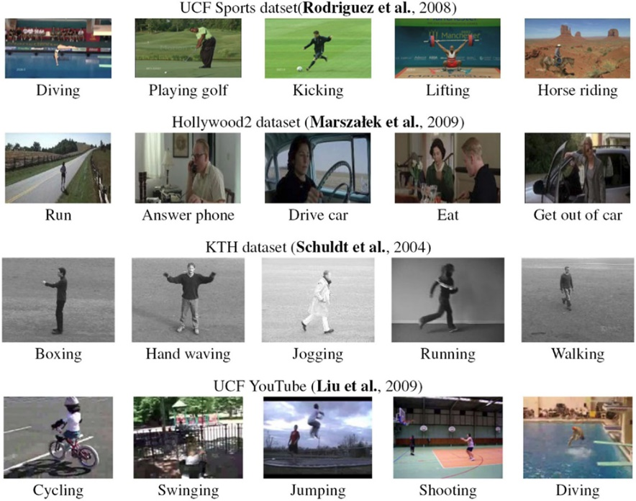
Human activity recognition
Recognize human actions using visual information.
Useful for monitoring of human activity in department stores, airports, high-security buildings etc.
Demo
https://www.youtube.com/watch?v=IQ-J46FPVyA

Slide 4
Goal (this paper)
Build a system to recognize the following 10 actions, from a frontal or lateral view:
sitting down
standing up
bending down
getting up
hugging
squatting
rising from a squatting position
bending sideways
falling backward
walking
Multi-class
classification problem
10 x 2 views = 20 classes

Slide 5
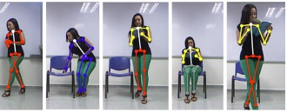
Background
Building systems that can recognize any type of action is a difficult and challenging problem.
In general, human actions can be recognized by tracking various body parts.

Slide 6
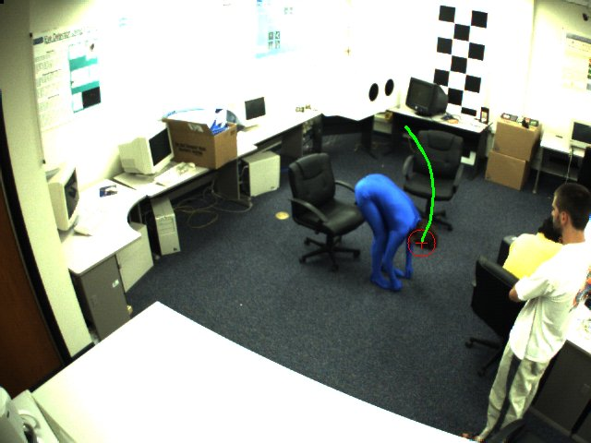

Approach (this paper)
Use head motion trajectory
The head of a person moves in a characteristic fashion when performing these actions.
Recognition is formulated as Bayesian classification using the movement of the head over consecutive frames.

Slide 7
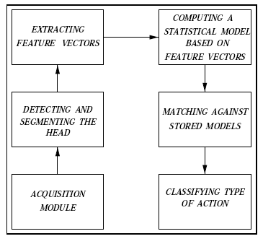
Main Steps
Two models were computed for each action, one for the frontal view and another one for the lateral view.
(i.e., 20 models total,
one for each class).
input
output

Slide 8


Representing Actions (i.e., features)
Estimate the centroid of the head in each frame:
Compute absolute differences in successive frames:
features
,
|
|
|
|
Q: Why did they take the difference?

Slide 9
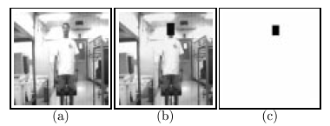
Head Detection and Tracking
Accurate head detection and tracking are challenging problems.
The centroid of the head was tracked manually from frame to frame.

Slide 10


Bayesian Formulation
Given an input sequence (X,Y), the posterior probabilities were computed for each action (frontal or lateral) using the Bayes rule:
(i=1, 2, …, 20)
Q: Is it a valid assumption?

Slide 11
Class Likelihoods
Feature vectors X and Y were assumed to be independent, following a multivariate Gaussian distribution:
Q: Is it a valid assumption?

Slide 12
Parameter Estimation (use ML approach)
The sample mean is used to estimate μ_{iX} and μ_{iY}
The sample covariance matrix is used to estimate Σ_{iX} and Σ_{iY} :

Slide 13

Action Classification
Given an input sequence, the posterior probability is computed for each action.
The unknown action is classified based on the most likely action:
P_{i}=
(i=1, 2, …, 20)

Slide 14
Discriminating Between Similar Actions
In some actions, the head moves in a similar fashion, making it difficult to distinguish these actions from one another.
Heuristics were used to distinguish among similar actions since their features are not highly discriminatory!
e.g., when bending down, the head goes much lower than when sitting down.

Slide 15
Training
They collected a total of 38 sequences.
People of diverse physical appearance were used to model the actions.
Subjects were asked to perform the actions at a comfortable pace.
Q: Is the # of training data enough?

Slide 16
Training (cont’d)
It was found that each action can be completed within 10 frames.
Only the first 10 frames from each sequence were used for training.
Q: Is this a valid assumption in practice?

Slide 17
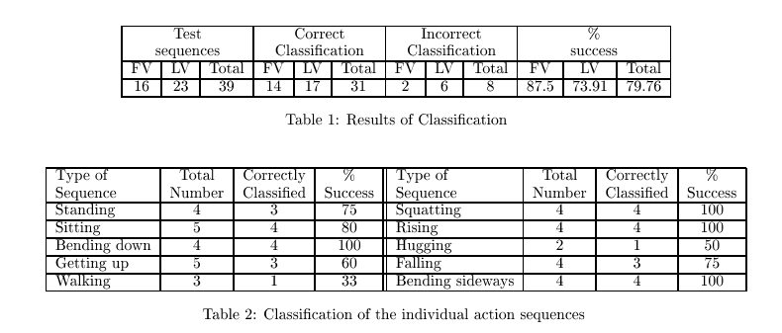
Testing
39 sequences (different from training).
The first 10 frames from each sequence were used.
Q: Is the # of test data enough?

Slide 18
Case Study 2
J. Yang and A. Waibel, A Real-time Face Tracker, Proceedings of WACV, 1996.

Slide 19
Goal
Build a system that can detect and track a person’s face while the person moves freely in some environment.
Demo
https://www.youtube.com/watch?v=QXYDKAg3xnE

Slide 20
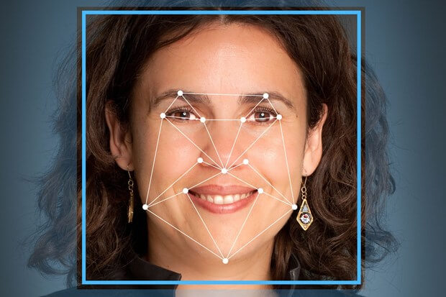
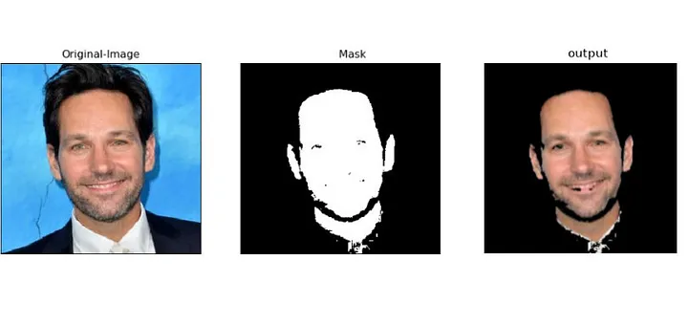
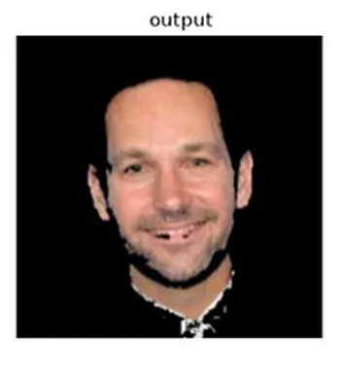
Background
Traditional systems for face detection relied on template matching or facial features.
Not very robust and time consuming.
Use skin color (this paper).
Faster and more robust face detection.

Slide 21
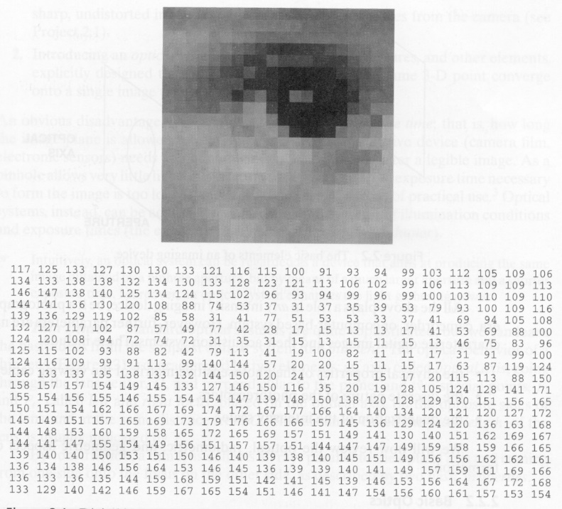
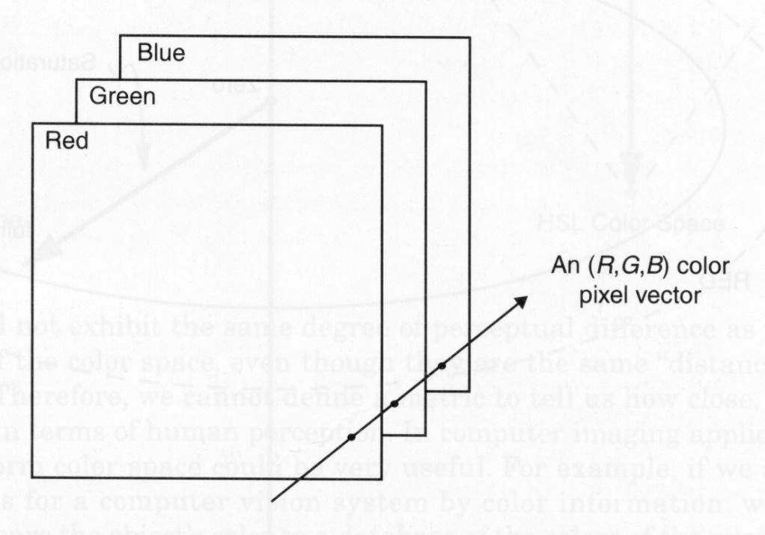
Image Representation
Grayscale
Color

Slide 22
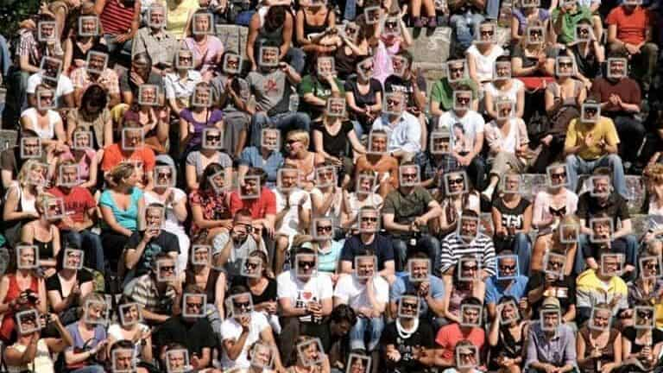
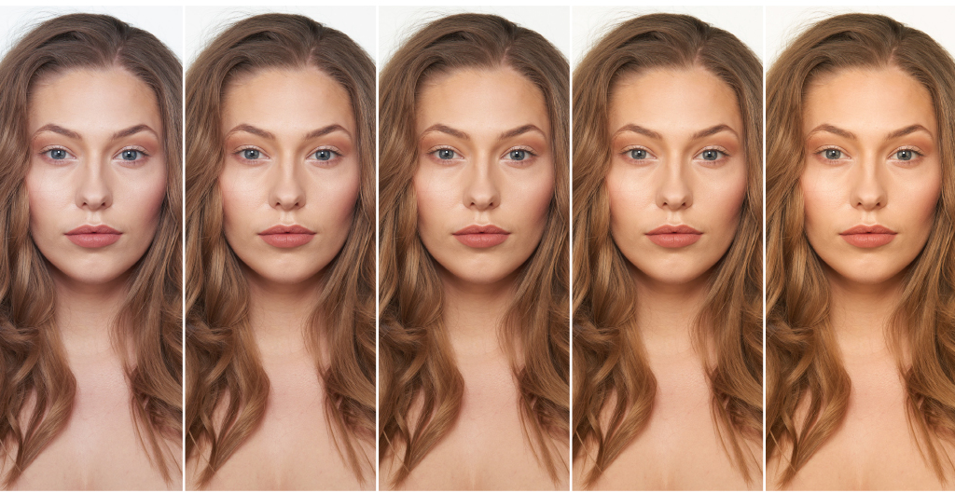
Skin Color
Skin color is typically affected by several factors:
Person, lighting, motion, camera type etc.
Idea: model skin color distribution using a statistical model!

Slide 23
Skin Color Classification
A Bayesian classifier can be used to classify each pixel x into two classes: skin and non-skin
We need:
class likelihoods:
p(skin/x)
p(non-skin/x)
class priors:
P(skin)
P(non-skin)
Skin classifications: original color.
Non-skin classifications: black.

Slide 24
Skin Color Classification (cont’d)
The Bayes rule can be used to perform classification:
If P(x/skin)>P(x/non-skin), then “skin”;
otherwise, “non-skin”
How should we estimate the prior probabilities P(skin) and P(non-skin) ?
How should we model the skin distribution p(skin/x) ?
How should we model the non-skin distribution p(non-skin/x)?
Spoiler: they modeled the skin distribution p(skin/x) only !

Slide 25

Feature Extraction
RGB is the most commonly used color space but not the best one for characterizing skin-color (i.e., encodes not only color but also brightness).
They used normalized RGB values (i.e., chromatic space):
(R,G,B)
features
(Normalized blue value is redundant since r + g + b = 1)

Slide 26
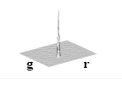
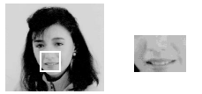
Skin-Color Clustering
Skin colors do not fall randomly in the chromatic color space but actually form a cluster.
p(skin/x)
Note: this is a color image, shown in grayscale, since printing
color images back in the 90s was a bit costly!

Slide 27
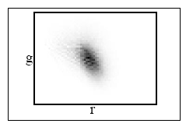
Skin-Color Clustering (cont’d)
Skin-colors of different people are also clustered in chromatic color space
i.e., they differ more in brightness than in color.
p(skin/x)
(skin-color distribution of 40 people - different races)

Slide 28
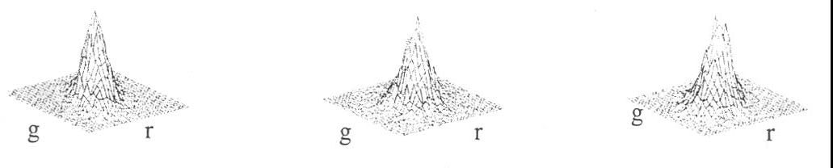
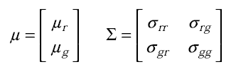
Model Skin-Color Distribution Using a 2D Gaussian
Experiments under different lighting conditions and persons revealed that the skin-color distribution has a rather regular shape.
They represented skin-color distribution as a 2D Gaussian with mean μ and covariance Σ:
p(skin/x)

Slide 29
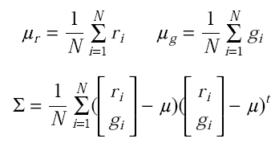
Parameter Estimation (used ML estimation)
Estimated the mean and covariance using the sample mean and sample covariance from training data:

Slide 30
Face Detection Using Only the Skin-Color Distribution
Each pixel x in a given image is:
(1) converted into the chromatic color space.
(2) likelihood computed using the skin-color model.
If g(x)>t, then “skin”; otherwise, “non-skin”
An appropriate threshold t is needed in this case since they only modeled the skin color distribution!

Slide 31
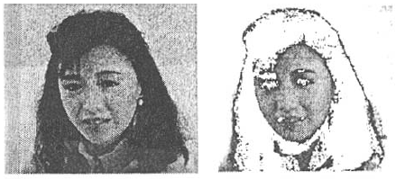
Example
Input Classification
Visualization of classification results:
If g(x)>t, keep original color; otherwise, change color to white

Slide 32
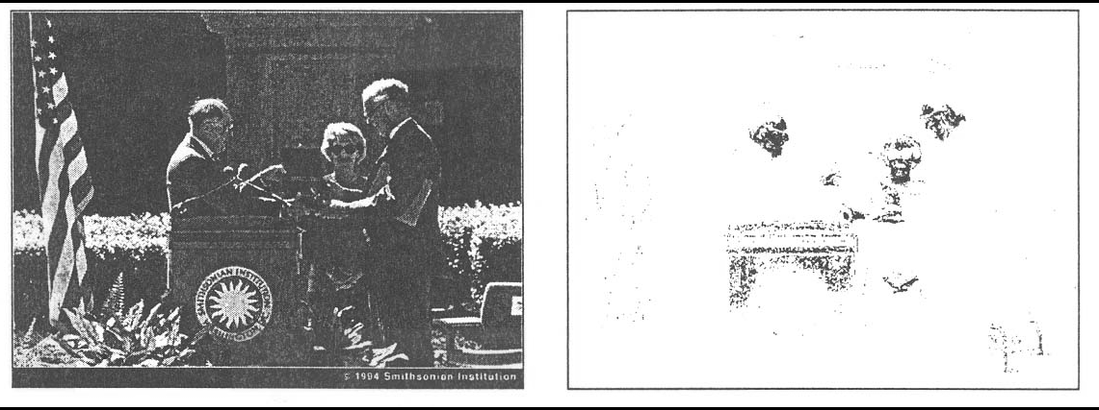
False Positives
It is difficult in general to detect only faces simply from the result of color classification.
e.g., background may contain skin colors
false positives
Additional information can be used to reject false positives (e.g., shape & motion information)

Slide 33
Extensions to Face Tracking
(1) Detect human faces using a generic skin-color model.
(2) Track face of interest.
(3) Adapt skin-color model parameters over time.

Slide 34
Skin-color model adaptation
The weights a_{i}, b_{i}, c_{i} determine how much past estimates will influence current estimates.
N determines how long the past estimates will influence the current estimates.

Slide 35
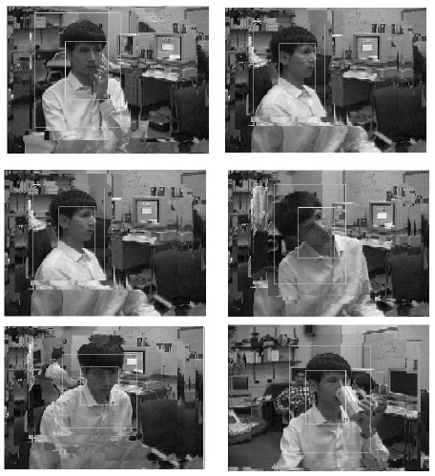
Sample Face Detection Results
Search window
Viewpoint changes
Face
Occlusion

