Slide 1
Bayesian Decision Theory
Case Studies
CS479/679 Pattern Recognition
Dr. George Bebis

Slide 2
Case Study 1
A. Madabhushi and J. Aggarwal, A bayesian approach to human activity recognition, 2nd International Workshop on Visual Surveillance, pp. 25-30, June 1999.

Slide 3
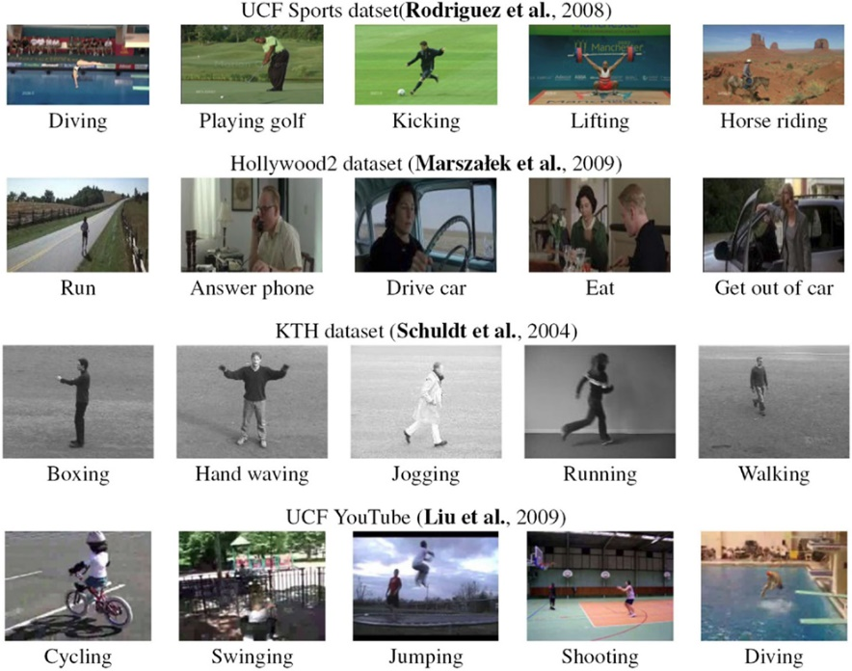
Human activity recognition
Recognize human actions using visual information.
Useful for monitoring of human activity in department stores, airports, high-security buildings etc.
Demo
https://www.youtube.com/watch?v=IQ-J46FPVyA

Slide 4
Goal (this paper)
Build a system to recognize the following 10 actions, from a frontal or lateral view:
    sitting down
    standing up
    bending down
    getting up
    hugging
    squatting
    rising from a squatting position
    bending sideways
    falling backward
    walking
Multi-class
classification problem
10 x 2 views = 20 classes

Slide 5
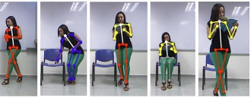
Background
Building systems that can recognize any type of action is a difficult and challenging problem.
In general, human actions can be recognized by tracking various body parts.

Slide 6
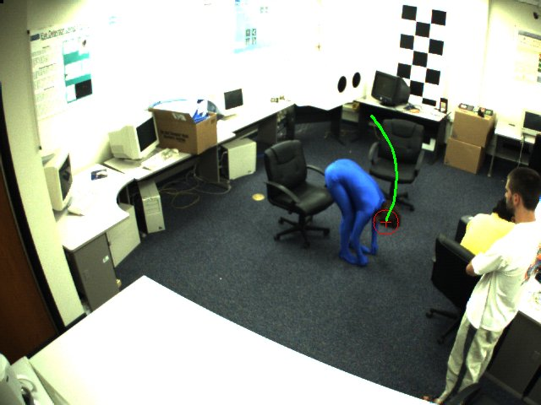

Approach (this paper)
Use head motion trajectory
  The head of a person moves in a characteristic fashion when performing these actions.
Recognition is formulated as Bayesian classification using the movement of the head over consecutive frames.

Slide 7
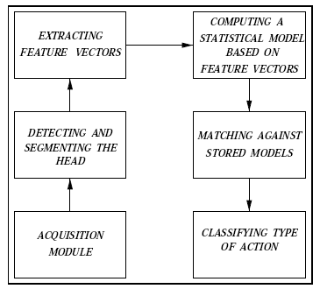
Main Steps
Two models are computed for each action, corresponding to the frontal and lateral views
(i.e., 20 models total,
one for each class).
input
output

Slide 8


Representing Actions (i.e., features)
Estimate the centroid of the head in each frame:
Compute absolute differences in successive frames:
features
,
|
|
|
|

Slide 9
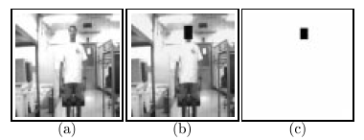
Head Detection and Tracking
Accurate head detection and tracking are challenging problems.
The centroid of the head was tracked manually from frame to frame.

Slide 10


Bayesian Formulation
Given an input sequence (X,Y), the posterior probabilities are computed for each action (frontal or lateral) using the Bayes rule:
(i=1, 2, …, 20)
Valid assumption?

Slide 11
Class Likelihoods
Feature vectors X and Y are assumed to be independent, following a multivariate Gaussian distribution:
Valid assumption?

Slide 12
Parameter Estimation
(Bayesian Estimation – we’ll cover later)
The sample mean is used to estimate μ_{iX} and μ_{iY}
The sample covariance matrix is used to estimate Σ_{iX} and Σ_{iY} :

Slide 13

Action Classification
Given an input sequence, the posterior probability is computed for each action.
The unknown action is classified based on the most likely action:
P_{i}=
(i=1, 2, …, 20)

Slide 14
Discriminating Between
Similar Actions
In some actions, the head moves in a similar fashion, making it difficult to distinguish these actions from one another.
Heuristics were used to distinguish among similar actions.
  e.g., when bending down, the head goes much lower than when sitting down.

Slide 15
Training
They collected a total of 38 sequences.
People of diverse physical appearance were used to model the actions.
Subjects were asked to perform the actions at a comfortable pace.

Slide 16
Training (cont’d)
It was found that each action can be completed within 10 frames.
Only the first 10 frames from each sequence were used for training.
Valid assumption?

Slide 17
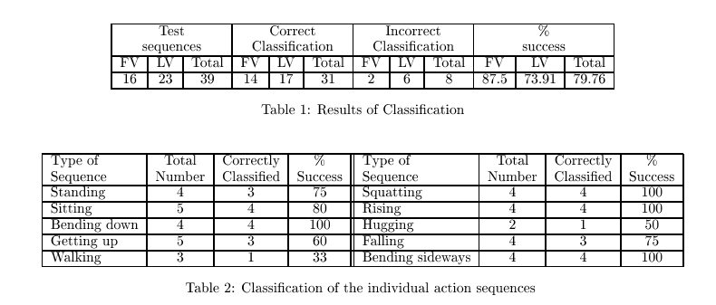
Testing
39 sequences (different from training).
  The first 10 frames from each sequence were used.
Of the 8 sequences classified incorrectly, 6 were assigned to the correct action but to the wrong view.

Slide 18
Limitations
How would one find the first and last frames of an action in general (segmentation)?
How would one deal with actions performed at different speeds or with incomplete sequences (i.e., missing frames)?
How would one deal with different viewpoints?
J. Usabiaga, G. Bebis, A. Erol, Mircea Nicolescu, and Monica Nicolescu, "Recognizing Simple Human Actions Using 3D Head Trajectories", Computational Intelligence (special issue on Ambient Intelligence), vol. 23, no. 4, pp. 484-496, 2007.

Slide 19
Case Study 2
J. Yang and A. Waibel, A Real-time Face Tracker, Proceedings of WACV, 1996.

Slide 20
Goal
Build a system that can detect and track a person’s face while the person moves freely in some environment.
Demo
https://www.youtube.com/watch?v=QXYDKAg3xnE

Slide 21
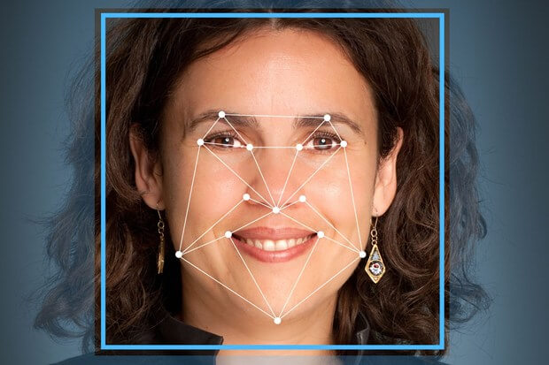
Background
Traditional systems for face detection rely on template matching or facial features.
  Not robust and time consuming.
Use skin color distribution.
  Leads to faster and more robust face detection.

Slide 22
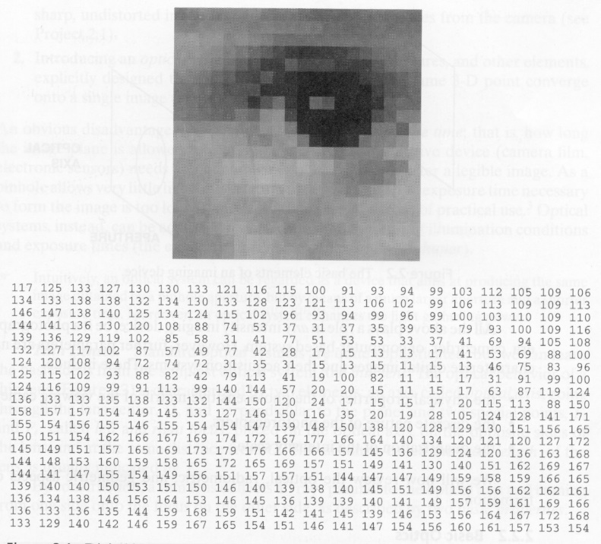
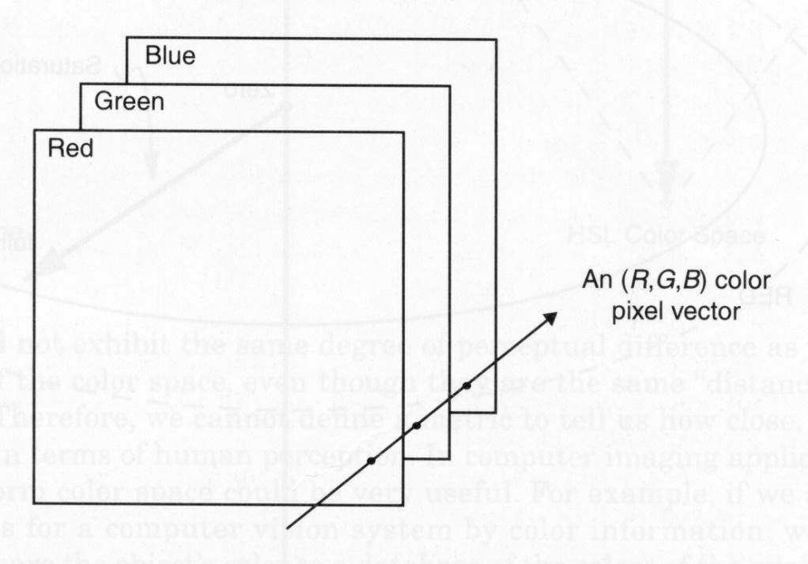
Image Representation
Grayscale
Color

Slide 23
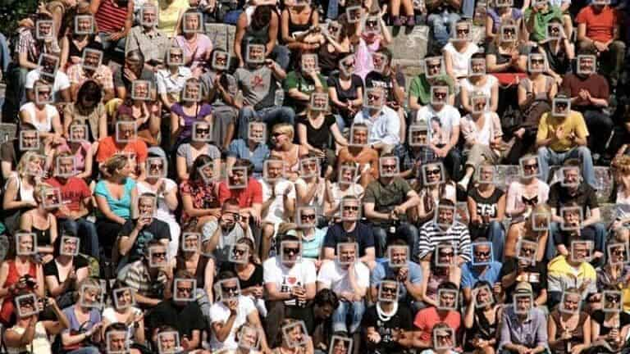
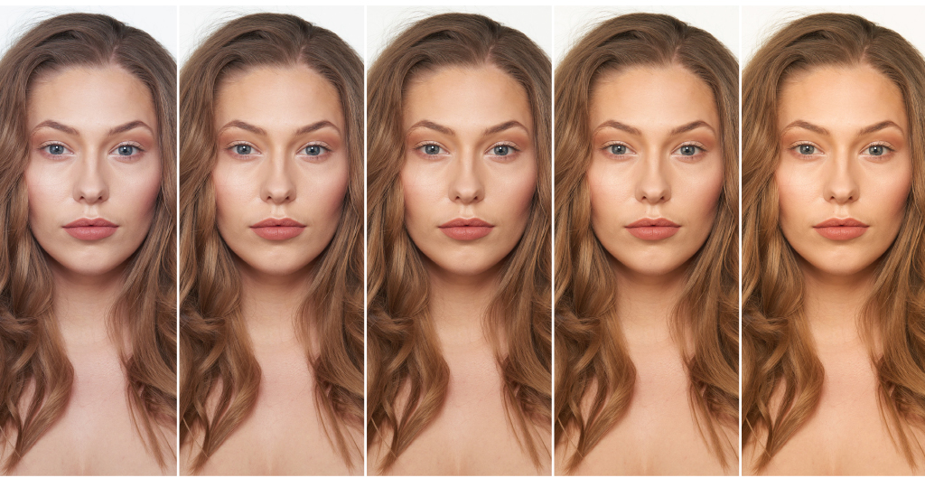
Skin Color
Skin color is affected by several factors:
  Person, lighting, motion, camera type etc.
Need to model skin color distribution using statistical models.

Slide 24

Feature Extraction
RGB is the most common color space but not the best one for characterizing skin-color (i.e., encodes not only color but also brightness).
Use normalized RGB (i.e., chromatic space):
(R,G,B)
features
(Normalized blue value is redundant since r + g + b = 1)

Slide 25
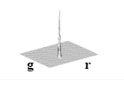
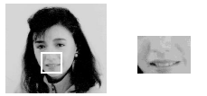
Skin-Color Clustering
Skin colors do not fall randomly in the chromatic color space but actually form a cluster.
Warning: this was actually a color image but shown as grayscale since printing
color images back in the 90s was a bit costly!

Slide 26
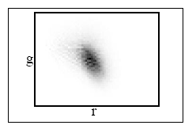
Skin-Color Clustering (cont’d)
Skin-colors of different people are also clustered in chromatic color space
  i.e., they differ more in brightness than in color.
(skin-color distribution of 40 people - different races)

Slide 27
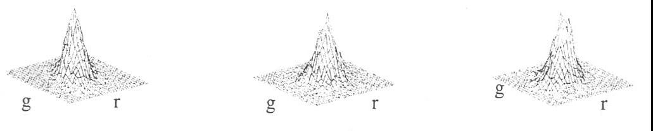
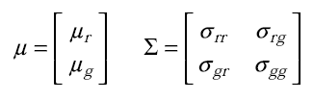
Model Skin-Color Distribution
Using a 2D Gaussian
Experiments under different lighting conditions and persons revealed that the skin-color distribution has a rather regular shape.
Represent skin-color distribution using a 2D Gaussian with mean μ and covariance Σ:

Slide 28
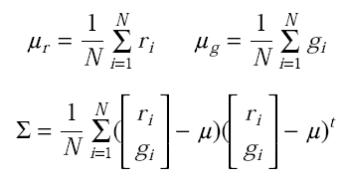
Parameter Estimation
(Bayesian Estimation – we’ll cover later)
Collect skin-color regions from face images.
Estimate the mean and covariance using the sample mean and sample covariance:

Slide 29
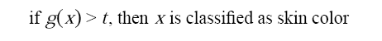
Face Detection Using
Skin-Color Model
Each pixel x in the input image is:
(1) converted into the chromatic color space.
(2) compared with the skin-color model.

Slide 30
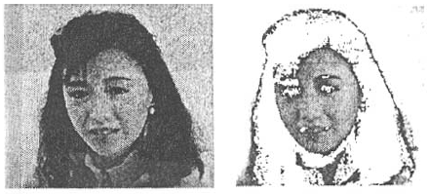
Example
Input Classification
Only the skin color class is modeled in this case which requires choosing an optimum threshold t.

Slide 31
Modeling both skin and non-skin color distributions
One can also model the non-skin color distribution.
  Becomes a two-class classification: skin vs non-skin
Compute max posterior probability using Bayes rule.
  No need to explicitly select a threshold t.
  Prior probabilities are needed for each class.
  Modeling the non-skin color distribution is challenging.

Slide 32
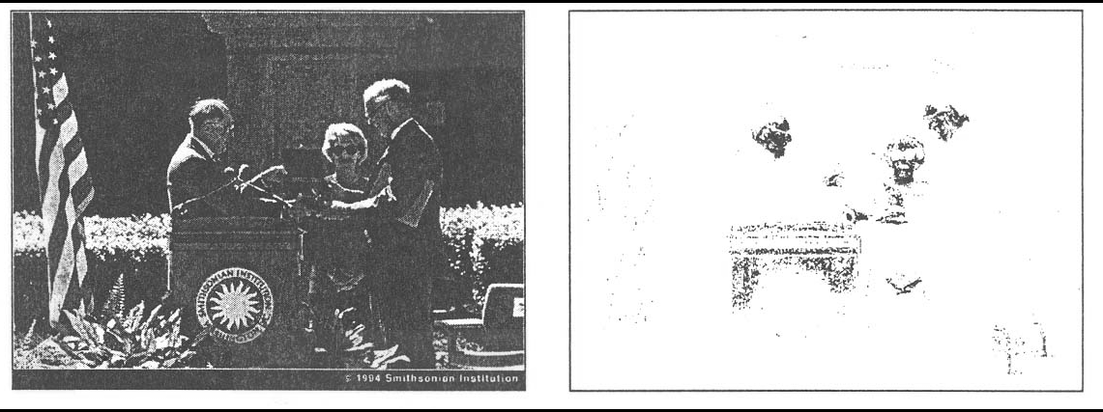
Dealing with skin-color-like objects
It is impossible in general to detect only faces simply from the result of color matching.
  e.g., background may contain skin colors
false positives
Additional information can be used to reject false positives (e.g., shape & motion information)

Slide 33
Main Steps
  (1) Detect human faces using a generic skin-color model.
  (2) Track face of interest.
  (3) Adapt skin-color model parameters based on face appearance and lighting conditions.

Slide 34
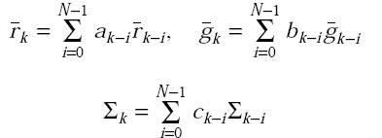
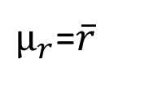
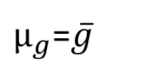
Skin-color model adaptation
The weights a_{i}, b_{i}, c_{i} determine how much past estimates will influence current parameters.
N determines how long the past estimates will influence the current estimates.
$μ_{r}$=$\overline{r}$
$μ_{g}$=$\overline{g}$

Slide 35
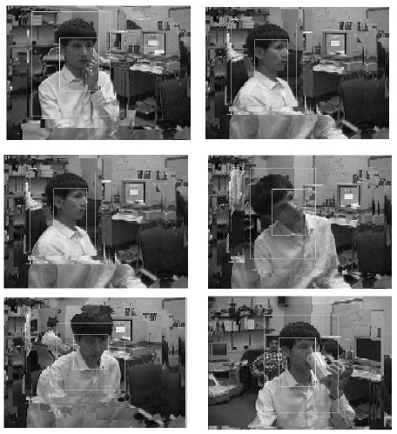
Sample Face Detection Results
Search window
Viewpoint changes
Face
Occlusion

