Slide 1
Object Recognition Using Locality-Sensitive Hashing of Shape Contexts
Andrea Frome, Jitendra Malik
Presented by Ilias Apostolopoulos

Slide 2
Introduction
Object Recognition
Calculate features from query image
Compare with features from reference images
Return decision about which object matches
Full object recognition
Algorithm returns:
Identity
Location
Position

Slide 3
Introduction
Problem
Full object recognition is expensive
High dimensionality
Time linear with reference features
Reference features linear with example objects
Relaxed Object Recognition
Pruning step before actual recognition
Reduces computation time
Does not reduce success rate

Slide 4
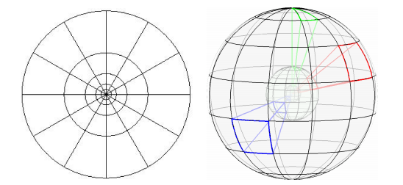
Features
Shape Context
Characterize shape in 2D or 3D
Histograms of edge pixels

Slide 5
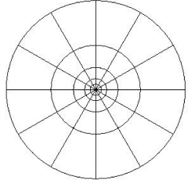
Features
Two-dimensional Shape Contexts
Detect edges
Select coordinate in edge map
Radar like division of region around point
Count edge points in each region

Slide 6
Features
Two-dimensional Shape Contexts
Each region is 1 bin
Regions further from center summarize larger area
More accurately captures and weighs more heavily information toward the center

Slide 7
Features
Two-dimensional Shape Contexts
Shapes must be similar to match
Similar orientation relative to the object
Orientation variant
Similar scale of the object
Scale variant

Slide 8
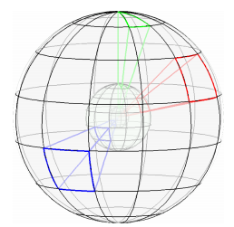
Features
Three-dimensional Shape Contexts
Similar idea in 3D
Use 3D range scans
No need to consider scale
Real world dimensions
Rotate sphere around azimuth in 12 discrete angles
No need to take rotation of query image into consideration

Slide 9
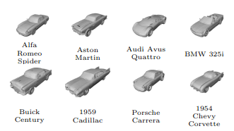
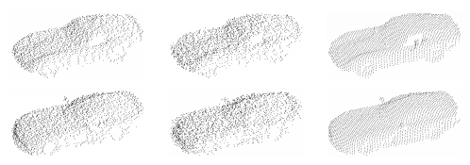
Experiments with 3D shape contexts
56 3D car models
376 features/model
Range scans of models
5cm & 10cm noise
300 features/scan
Use NN to match features

Slide 10
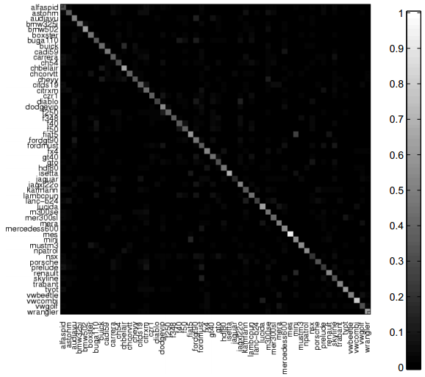
Experiments with 3D shape contexts
Experiment 1
5cm noise
100% success rate on top choice

Slide 11
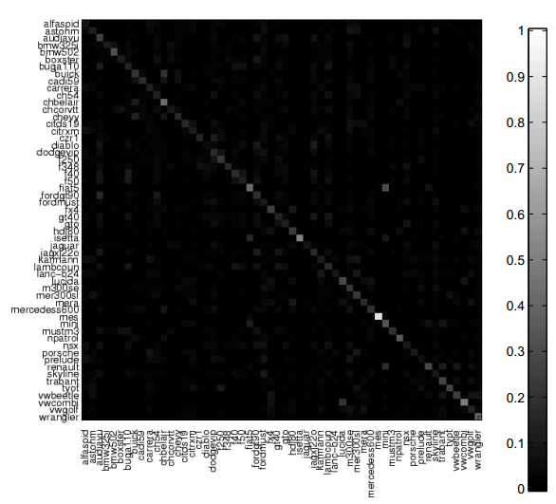
Experiments with 3D shape contexts
Experiment 1
10cm noise
92.86% success rate on top choice
100% success rate on top 4 choices

Slide 12
Experiments with 3D shape contexts
Experiment 1
Pros
Great results even with a lot of noise
Match found in 4 first options
Cons
Each query image takes 3.3 hours to match
Computational cost should be reduced:
By reducing the features calculated per query image
By reducing the features calculated per reference image

Slide 13
Reducing Running Time with Representative Descriptors
If we densely sample from reference scans we can sparsely sample from query scans
Features are fuzzy, robust to small changes
Few regional descriptors are needed to describe scene
These features can be very discriminative
Representative Descriptor method
Use a reduced number of query points as centers
Choose which points to use as RD
Calculate a score between an RD and a reference object
Aggregate RD scores to get one score

Slide 14
Experiments
Experiment 2
Same set of reference data
Variable number of random RDs
Smallest distance between RD and feature as score
sum of RD scores for a model as scene score
Model with smallest summation is the best match

Slide 15
Experiments
Experiment 2
5cm noise
30 RDs
100% recognition on top 7 matches
40 RDs
99.9% on top 2
100% on top 3
Reduced computation by 87% to 90%

Slide 16
Experiments
Experiment 2
10cm noise
80 RDs
97.8% recognition on top 7 matches
160 RDs
98% on top 7
Reduced computation by 47% to 73%

Slide 17
Reducing Search Space with a Locality-Sensitive Hash
Compare query features only to the reference features that are nearby
Use an approximate of k-NN search called Locality-Sensitive Hash (LSH)
Sum range of data for each dimension
Choose k values from range
Each value a cut in one of the dimensions
A hyperplane parallel to that dimension’s axis
These planes divide the feature space into hypercubes
Each hypercube represented by an array of integers called first-level hash or locality-sensitive hash

Slide 18
Reducing Search Space with a Locality-Sensitive Hash
Exponential number of hashes
Use second-level hash function to translate the arrays to single integers
This is the number of bucket in the table
Create L tables to reduce the probability of missing close neighbors
hash function for the table
set of identifiers stored in
For each reference feature we calculate and store j in bucket

Slide 19
Reducing Search Space with a Locality-Sensitive Hash
Given a query feature q, we find matches in two stages
Retrieve features and calculate ,

Slide 20
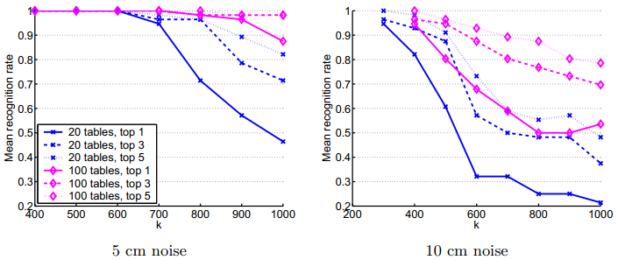
LSH with Voting Method
5 cm
100% with 600 divisions for 20 tables
100% with 800 divisions for 100 tables
10cm
100% with 300 or 400 divisions

Slide 21
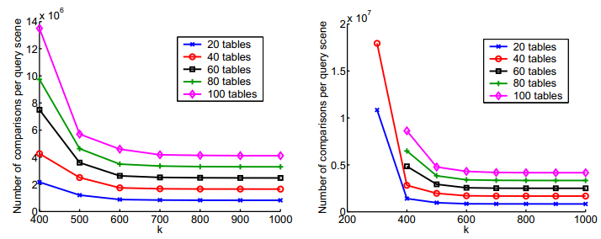
LSH with Voting Method

Slide 22
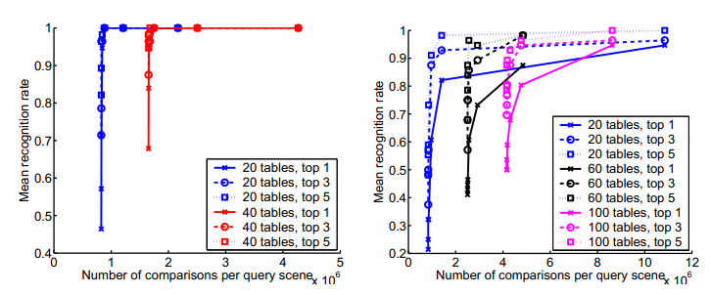
LSH with Voting Method

Slide 23
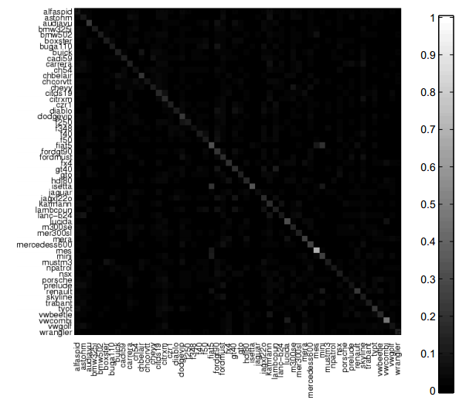
LSH with Voting Method

Slide 24
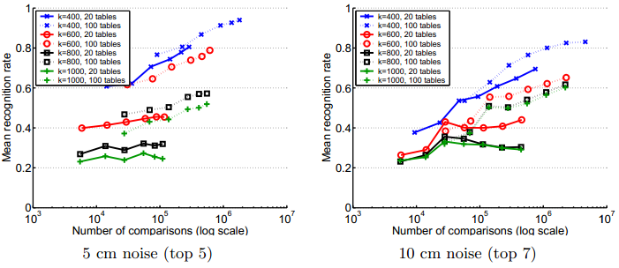
Using RDs with LSH
5cm
80% with 400 divisions and 20 tables
94% with 400 divisions and 100 tables
10cm
83% with 400 divisions and 100 tables

Slide 25
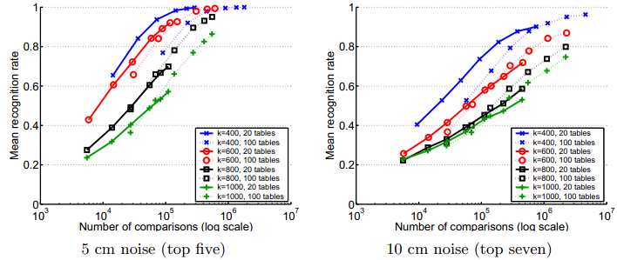
Using x percent of RDs with LSH
5cm
99.8% with 40 RDs, 400 divisions and 20 tables
10cm
96% with 160 RDs, 400 divisions and 100 tables

Slide 26
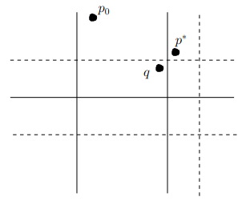
Associative LSH
Variation of LSH
Get results from LSH
Check neighborhood of q for better results
Increases the success rate
Number of comparisons increases

Slide 27
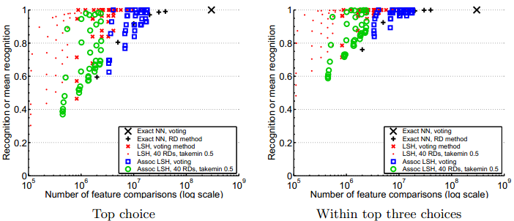
Summary
5cm
LSH with RDs smallest number of comparisons for list of top 3

Slide 28
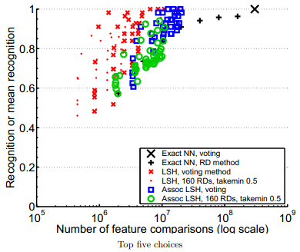
Summary
10cm
LSH with voting smallest number of comparisons for list of top 5

Slide 29
Questions?

