Slide 1
CS791 Topics: Mass Detection in Mammograms Drs. George Bebis & Alireza Tavakkoli
Introduction to Deep Learning

Slide 2
Outline
History
What is Machine Learning
Linear Classification
Data Driven Approach to Linear Classification
Loss
Optimization
Training
Convolutional Neural Networks

Slide 3
What Is Machine Learning?

Slide 4
Everything Is Basically Classification
Linear
Non-Linear

Slide 5
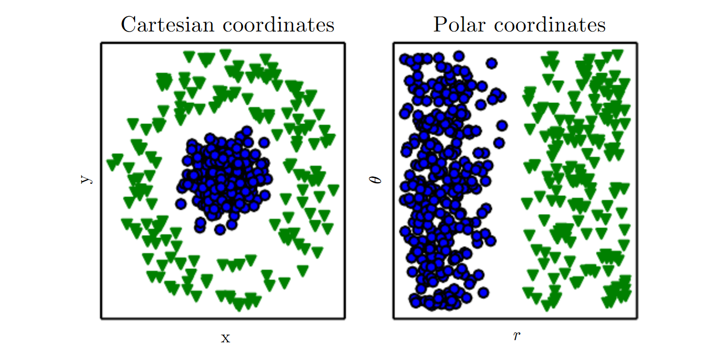
Data Representation
Representation Matters

Slide 6
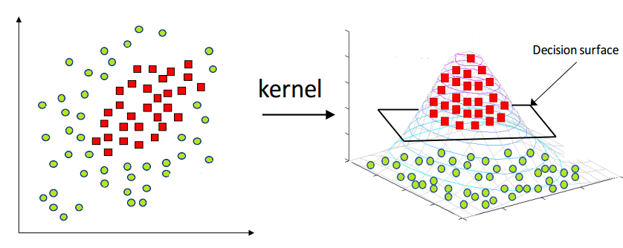
Data Representation
Kernel Methods

Slide 7
Everything Is Basically Classification
So everything is basically Linear Classification
Change of representation
Kernel methods
High dimensional representation
Feature spaces

Slide 8
Classification
Classification tasks
take an image as input
return image label
No way to hard-code
the recognition problem for any arbitrary class of objects with the aforementioned variances.
Many attempts have been made in computer vision to solve this problem.
def image_classifier (image):
# some magic happens here
return label

Slide 9
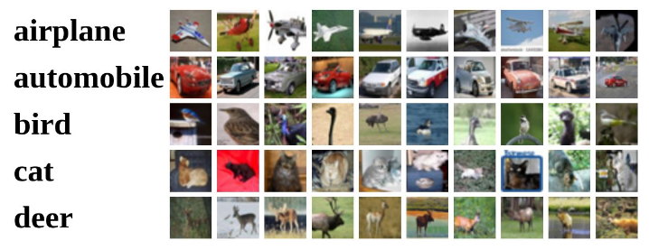
Machine Learning Approach to Classification
Data-driven approach
Collect annotated data
Use Machine Learning to train a model for the classifier
Evaluate the classifier on new images
this will classify unseen new images (test set)
def train (images, labels):
# Machine Learning Happens Here.
return model
def predict (test_image, model):
# Use Model -> Predict Label
return label

Slide 10
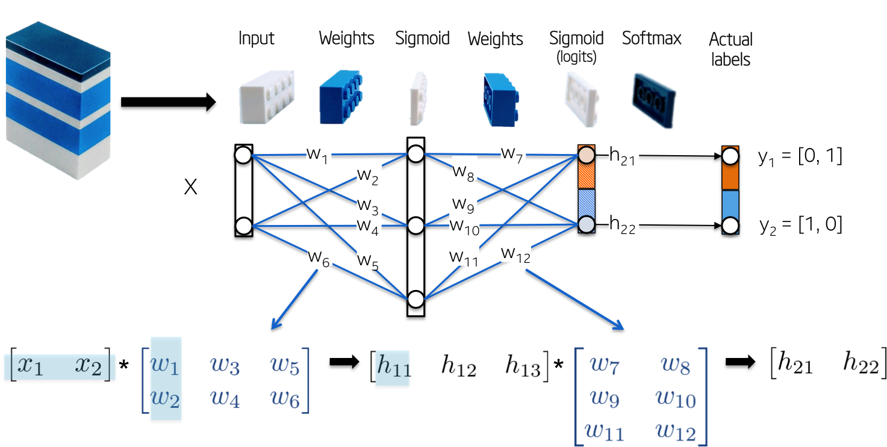
Machine Learning Approach to Classification
Linear classification

Slide 11
Machine Learning Approach to Classification
Linear classification
Parametric approach
Take image features
Map features to a class score

Slide 12
Machine Learning Approach to Classification
Linear classification
Parametric approach
Take image features
Map features to a class score
this mapping is a linear function $f\left(x,W\right):ℝ^{n} \underset{→}{ Φ } ℝ$

Slide 13
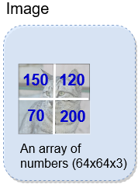
Machine Learning Approach to Classification
Linear classification
Parametric approach example
4 pixels, 2 classes (cat, dog)

Slide 14
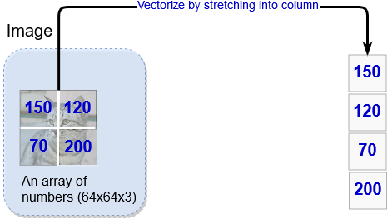
Machine Learning Approach to Classification
Linear classification
Parametric approach example
4 pixels, 2 classes (cat, dog)

Slide 15
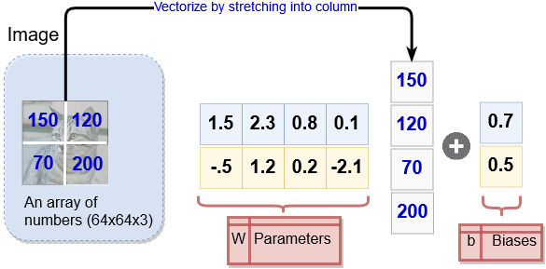
Machine Learning Approach to Classification
Linear classification
Parametric approach example
4 pixels, 2 classes (cat, dog)

Slide 16
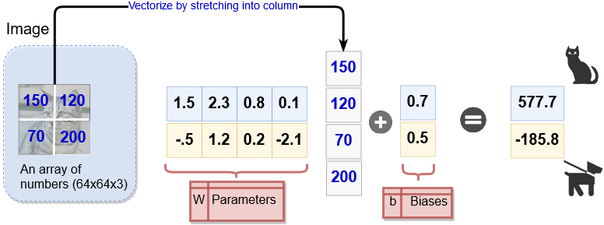
Machine Learning Approach to Classification
Linear classification
Parametric approach example
4 pixels, 2 classes (cat, dog)

Slide 17
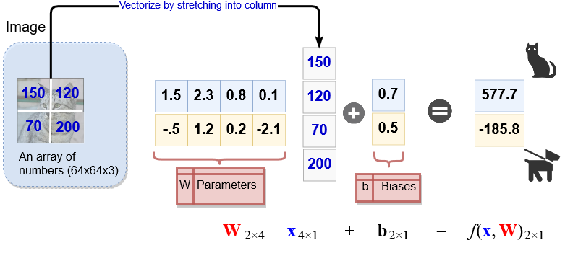
Machine Learning Approach to Classification
Linear classification

Slide 18
Machine Learning Approach to Classification
Linear score function
How did we produce them?
Model training.
How can we tell these values are good or bad?
loss function
quantifying the good/bad-ness of $W,b$
Optimization
start with randomized values for $W$ and $b$ and minimize the loss
Convolutional Nets
a tweak to the function $f$
$$f\left(x,W\right)=W x+b$$

Slide 19
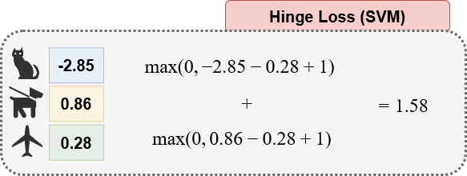
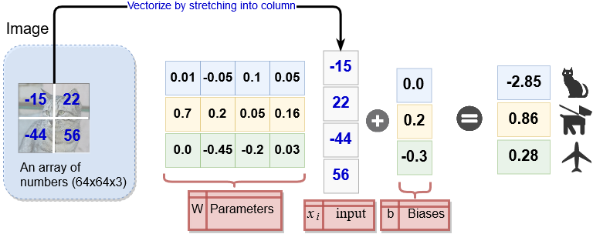
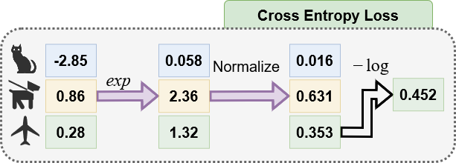
Loss: Softmax vs. SVM
Linear Classifier
Matrix multiply + linear bias

Slide 20
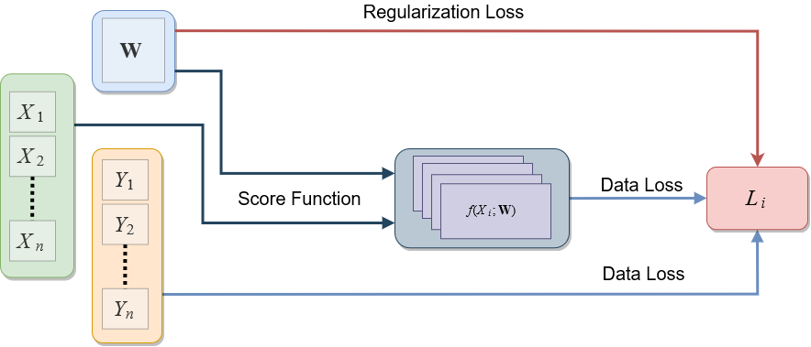
Linear Classification
Some dataset
$X=\left(x,y\right)$
Some score function
$s=f\left(X;W\right)=WX$
Some Loss function
$L= \frac{1}{N}∑L_{i}+R(W)$
$L_{i}=−\log\left(\frac{e^{{s_{y}}_{i}}}{∑e^{s_{j}}}\right)$
$L_{i}=\sum_{i≠j}{\max\left(0,s_{j}−s_{y_{i}}+1\right)}$
We want $∇_{W}L$

Slide 21
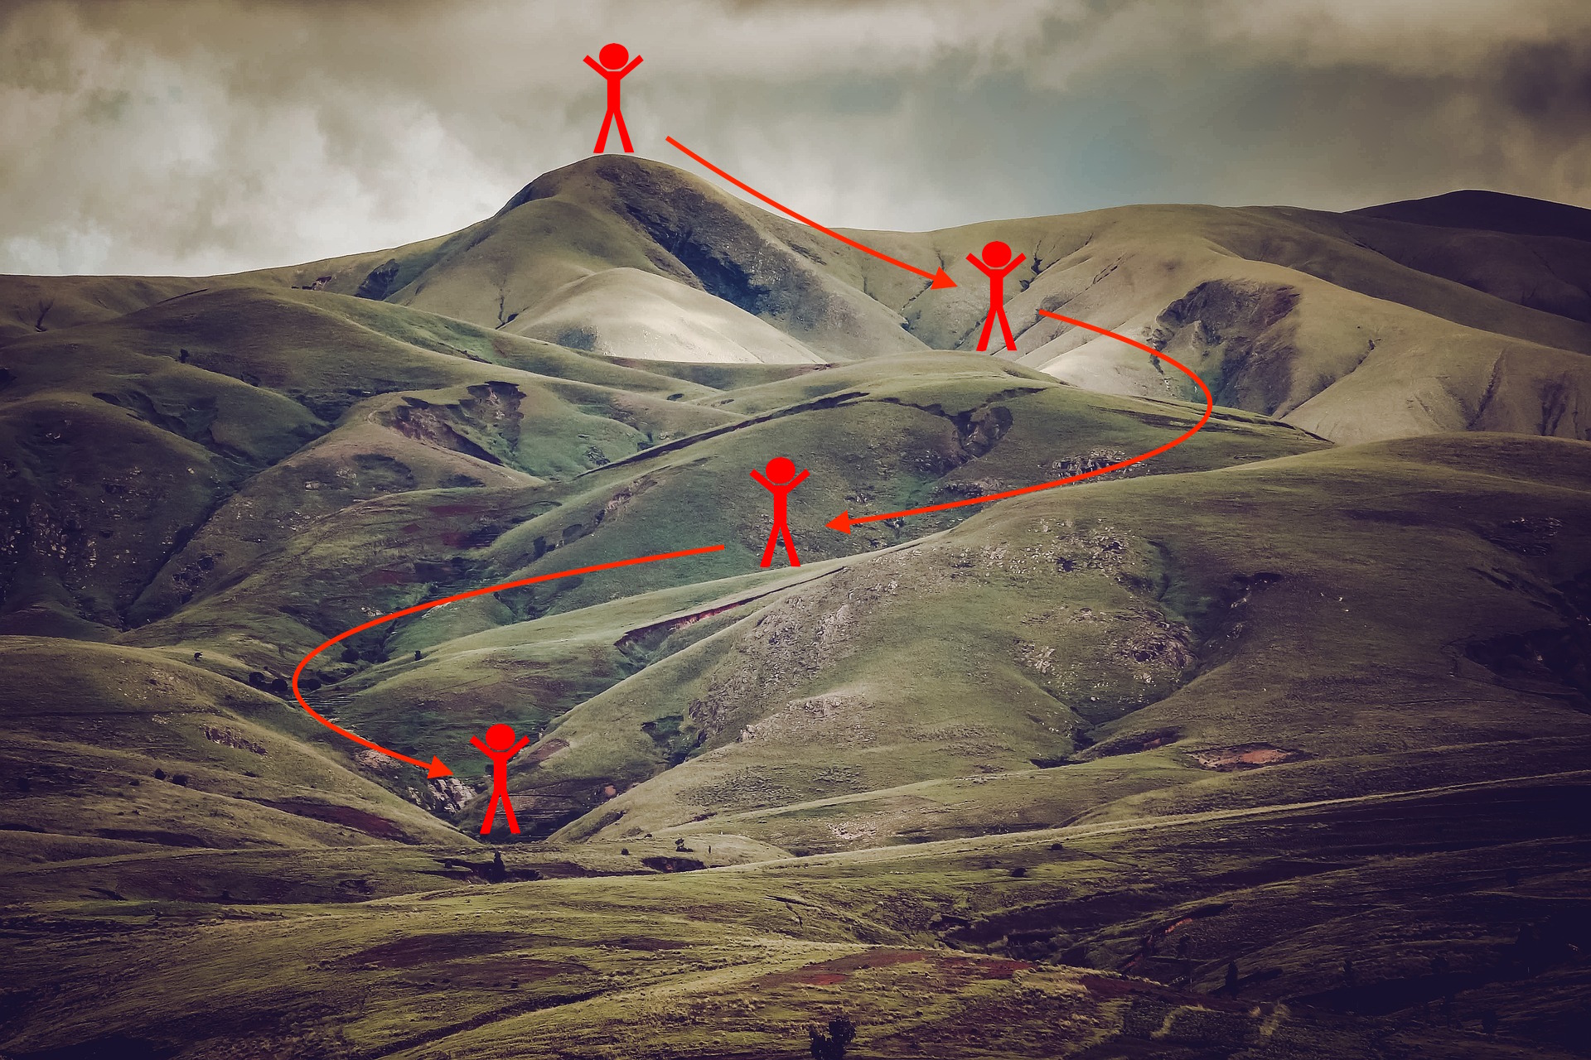
Optimization
So how exactly do we use the loss function?
Need to minimize the loss
This is an optimization problem
Some iterative method for finding the minimum loss values.
# simple gradient descent
while True:
batch = sample_training_date(data, batch_size)
w_grads = evaluate_gradient(loss, batch, weights)
weights += -step_size * w_grads

Slide 22
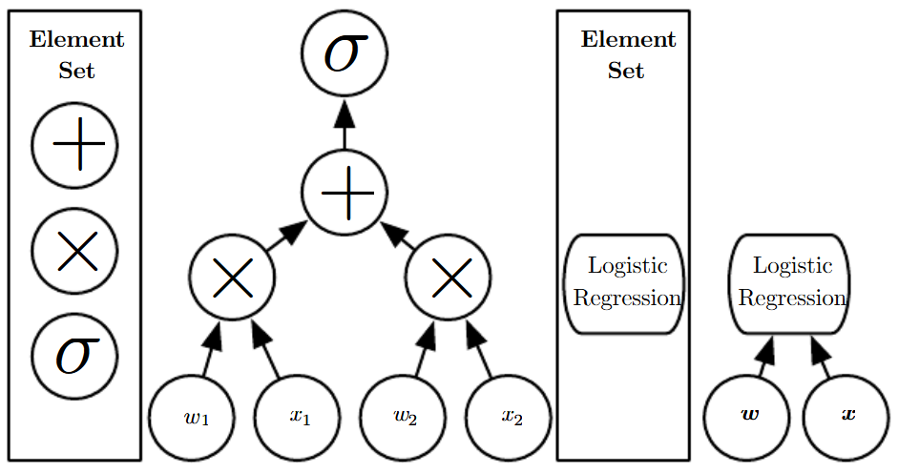
Computational Graphs
A way to efficient compute gradients
Depth:
length of the path from input layer to output layer

Slide 23
Backpropagation
Using the computational graph and calculus rules
We can formulate gradient with backpropagation.
Example
$f\left(x,y,z\right)=\left(x+y\right)×z$
$x=−2,y=5,z=−4$
(1) Forward pass

Slide 24
Backpropagation
Backpropagation
(2) Backward Pass
we go backwards and apply chain rule
$$\frac{df}{dz}$$
$$\frac{df}{dx}=\frac{df}{dq}×\frac{dq}{dx}$$
Loss $f$
$$\frac{df}{dq}$$
$$\frac{df}{dy}=\frac{df}{dq}×\frac{dq}{dy}$$

Slide 25
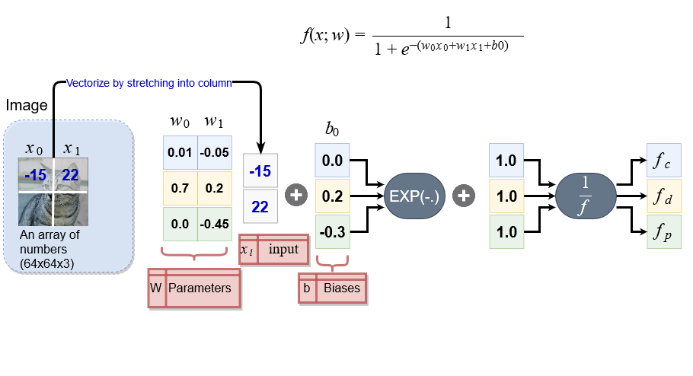
Backpropagation in Linear Classification
A more complex example

Slide 26
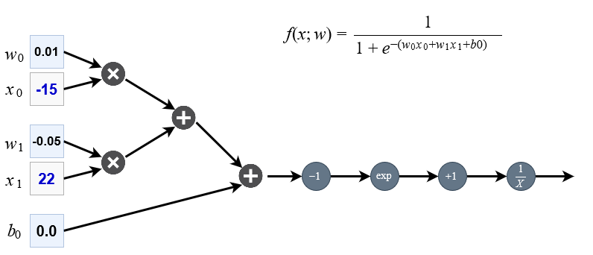
Backpropagation in Linear Classification
Example
Forward Pass

Slide 27
Backpropagation in Linear Classification
Example
Forward Pass
-1.5
-2.6
-2.6
2.6
13.5
14.5
0.07
-1.1

Slide 28
Backpropagation in Linear Classification
Example
Backward Pass
-0.96135
$$n$$
-1.5
0.06409
$$v$$
0.0006409
-2.6
1.40998
0.06409
0.06409
$$u$$
$$z$$
$$y$$
$$x$$
$$f$$
-2.6
2.6
13.5
14.5
0.07
-1.1
-0.003205
$$m$$
0.06409
-0.06409
-0.00476
-0.00476
1
0.06409

Slide 29
Modularized Implementation
Pseudocode
# modularized computational graphs
class comp_graph (object):
#...
def forward(inputs):
#1. [pass input to input gates]
#2. forward through computational graph
for gate in self.graph.nodes():
gate.forward() # here we implement each gate function
return loss # the final gate has the output loss
def backward():
for gate in reversed(self.graph.nodes()):
gate.backward() # here we implement each gate local gradients
return input_gradients

Slide 30
Recall: Linear Classification
$$f\left(x,W\right)=W x+b$$
Catness
0
Dogness

Slide 31
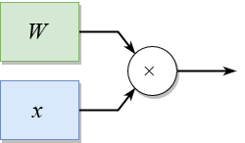
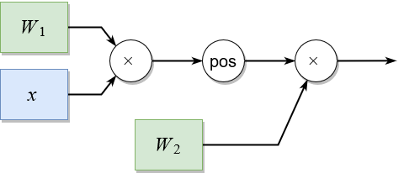
Neural Networks
It translates to this linear function (A Perceptron)
$f=W x$
Multi-layer neural net
Stack these on top of each other
$f=W_{2}\max\left(0, W_{1} x\right)$

Slide 32
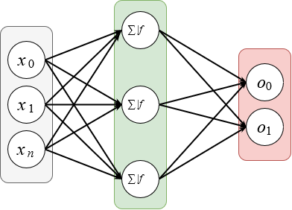
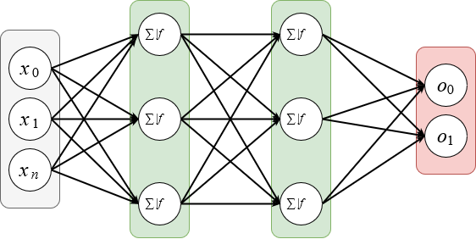
Neural Network Architectures
Two-layer neural net
counting No. multiplies
one hidden layer
fully connected
Multi-layer neural net
counting No. multiplies
multiple hidden layers
fully connected

Slide 33
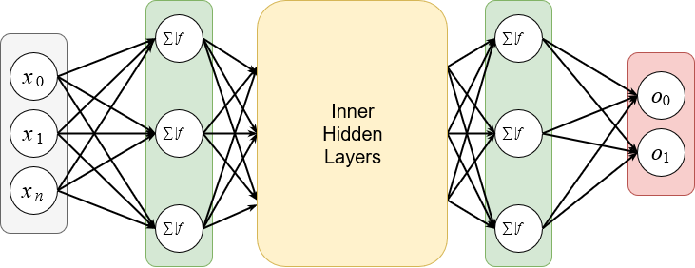
Disadvantages of Deep Neural Networks
Deep neural nets are inefficient
scalability issues
dense connections
no repeat weights
no spatial information integration

Slide 34
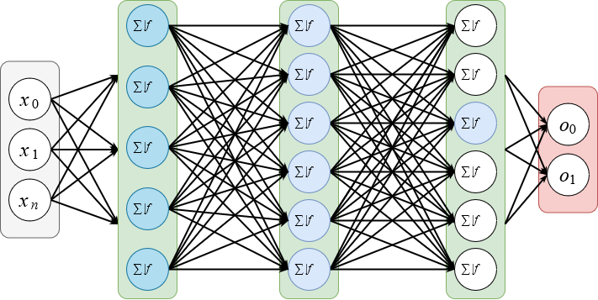
Disadvantages of Deep Neural Networks
Deep neural nets are inefficient
Problem: dense connectivity

Slide 35
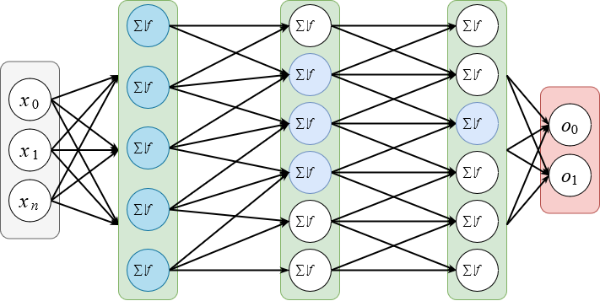
Disadvantages of Deep Neural Networks
Deep neural nets are inefficient
Solution: sparse connectivity

Slide 36
Convolutional Neural Networks (CNNs)
Addressing the deep network problems
Instead of using matrix multiplication use convolution
This will result in Convolutional Neural Networks (CNN)
Almost synonymous with deep learning

Slide 37
Hierarchical Organization of Visual System
Training hierarchical models
gradient based training of parameters
LeCun, et al. 1998
backpropagation and gradient based learning

Slide 38
Hierarchical Organization of Visual System
Modern Deep Convolutional Neural Networks
gradient based training of parameters
Krizhevsky, et al. 2012
AlexNet

Slide 39
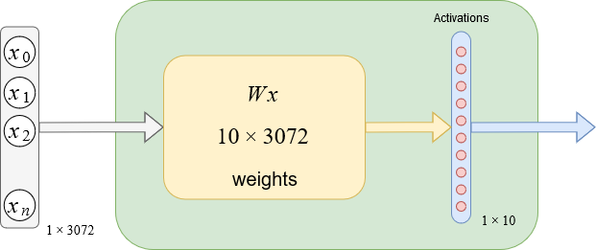
Convolutional Neural Networks
So what exactly are these and how do they work?
First let’s take a look at a fully connected layer
input image 32x32x3:
stretch the image into one column (row) 1x3072

Slide 40
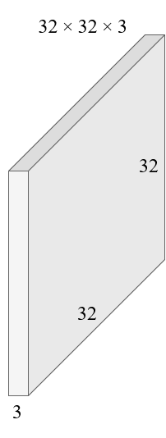
Convolutional Neural Networks
In convolutional networks
input image 32x32x3:
we preserve spatial structure, share weights, local computations

Slide 41
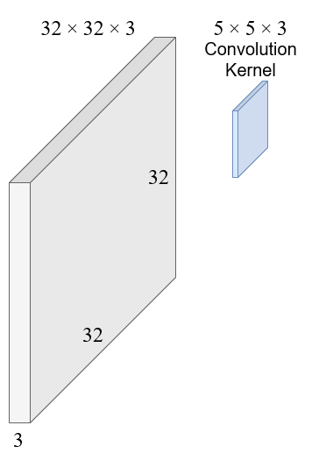
Convolutional Neural Networks
In convolutional networks
input image 32x32x3:
convolve a smaller kernel with each pixel in the input image

Slide 42
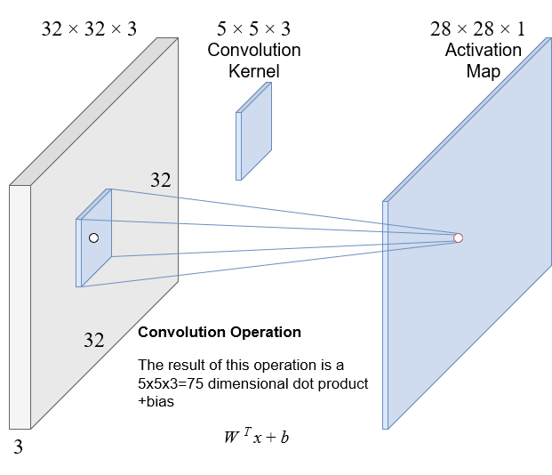
Convolutional Neural Networks
In convolutional networks
input image 32x32x3:
convolve a smaller kernel with each pixel in the input image

Slide 43
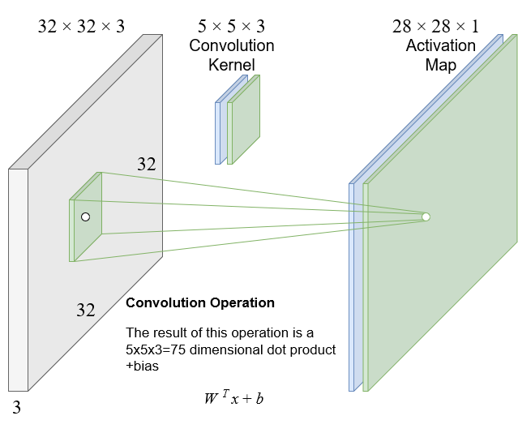
Convolutional Neural Networks
In convolutional networks
input image 32x32x3:
now consider a second convolution kernel (the green filter)

Slide 44
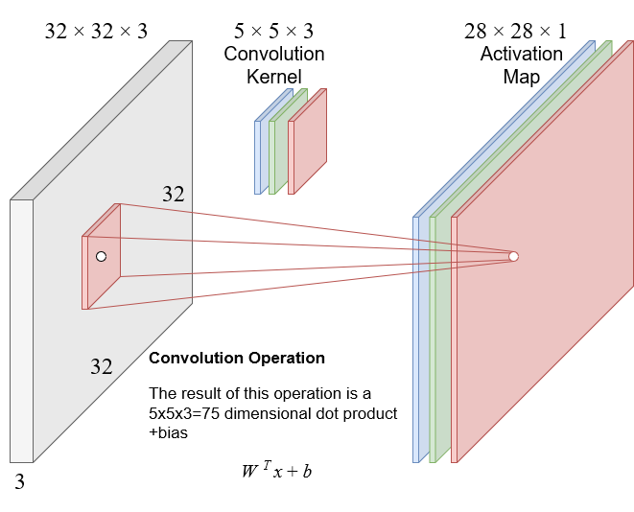
Convolutional Neural Networks
In convolutional networks
input image 32x32x3:
now consider a third convolution kernel (the red filter)

Slide 45
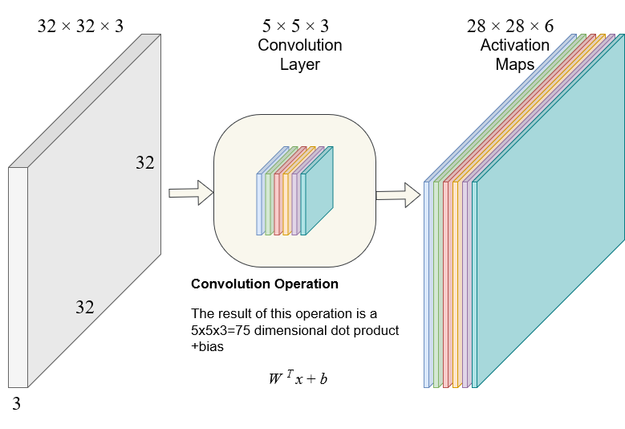
Convolutional Neural Networks
In convolutional networks
input image 32x32x3:
now consider 6 convolution kernels (filters in the yellow box)

Slide 46
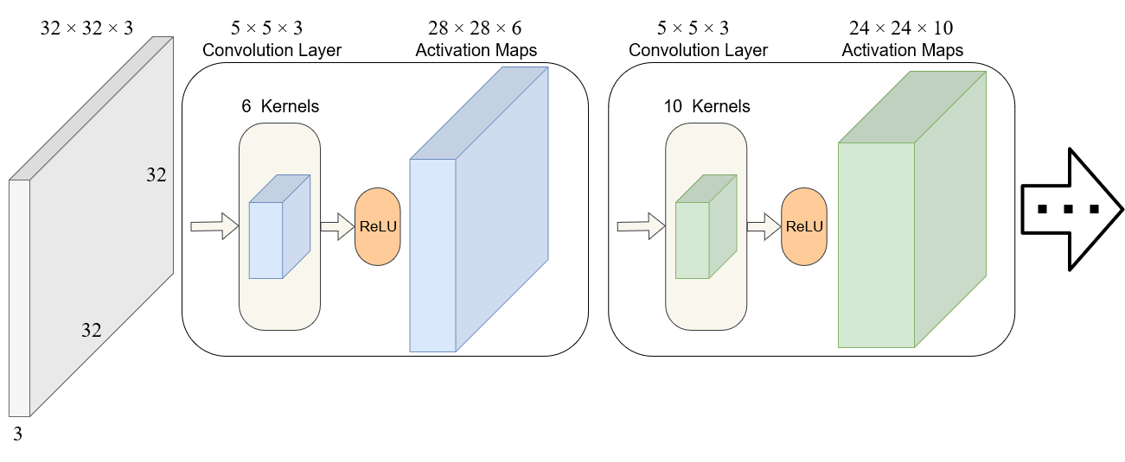
Convolutional Neural Networks
Building a convolutional network
Chain convolution layers and ReLUs (activation maps)

Slide 47
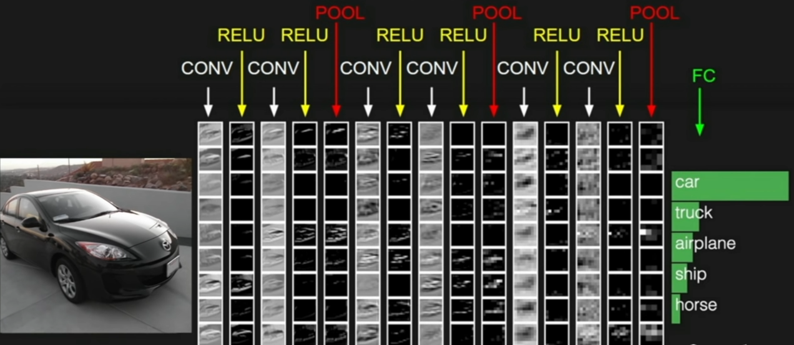
Convolutional Neural Networks
A Complete CNN

Slide 48
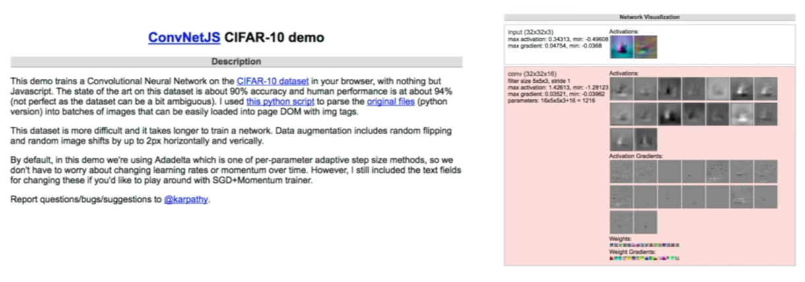
CNNs
Demo
https://cs.stanford.edu/people/karpathy/convnetjs/demo/cifar10.html
NeuralNet Playground

Slide 49
Deep Learning vs. Artificial Intelligence

Slide 50
Ingredients for Deep Learning
Data
Algorithms
Platform

Slide 51
Data: ImageNet

Slide 52
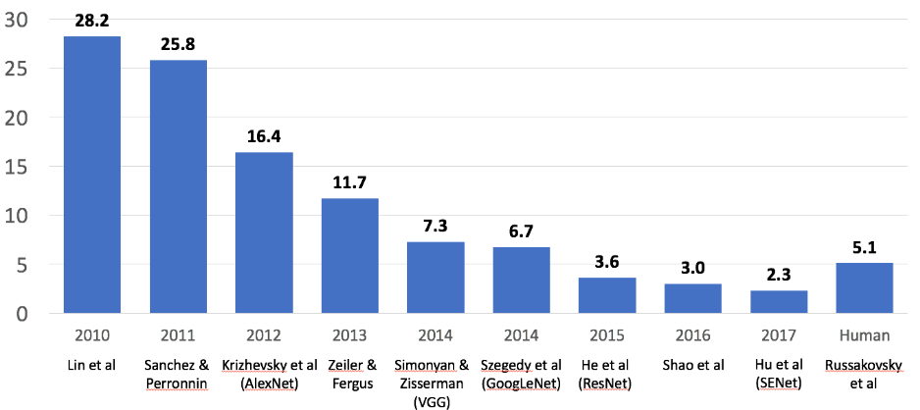
ImageNet Large Scale Visual Recognition Challenge (CVPR 2015)
Image Classification Challenge
1,000 object classes
1,431,167 images

Slide 53
Architecture

Slide 54
Platforms

Slide 55
What Made It All Possible
Convolutional Neural Networks (CNNs)
Early Stages
LeCun et al. (1998)
Platform:
Pentium 2 (No. Transistors ~ 10⁶)
Training:
NIST (No. of Pixels ~ 10⁷)

Slide 56
What Made It All Possible
Convolutional Neural Networks (CNNs)
Contemporary CNNs
AlexNet: Krizhevsky et al. (2012)
Platform:
Xeon+GPU (No. Transistors ~ 10⁹)
Training:
ImageNet (No. of Pixels ~ 10¹⁴)

Slide 57
Questions

