Slide 1
Adapting patch-based classifiers for whole image classification
Brian Székely and Gaurav Srikar

Slide 2
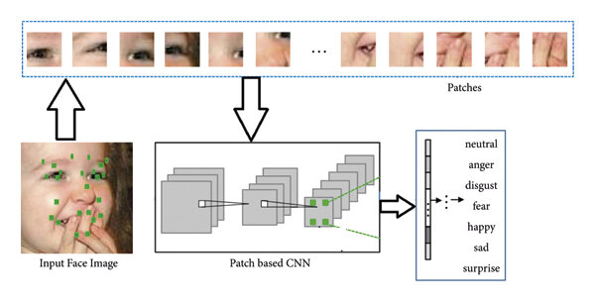
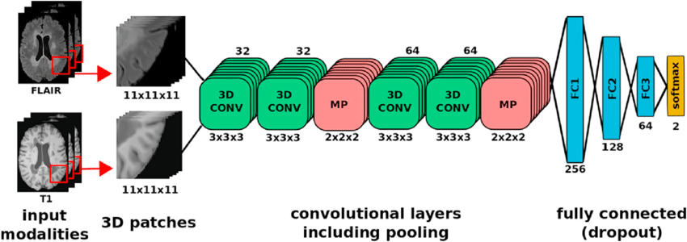
Overview
Project Focus: Employ Patch-based CNNs for high-resolution mammography image classification.
Goal: Develop a patch-based classifier to discriminate whether an image contains abnormal or normal tissue, as well as apply a sliding window whole-image classifier
Hypothesis: Enhance mammogram mass classification accuracy using Patch-based methods.
Objective: Preserve essential details like small malignant masses and calcifications for improved high-resolution image classification.
Notes:
Subsequently, we intend to utilize this patch-based classifier to extract the lesion area using class activation maps.
Finally, we will feed this extracted area into a whole-image classifier,
generating patches for analysis, and predicting whether the area is malignant or benign.

Slide 3
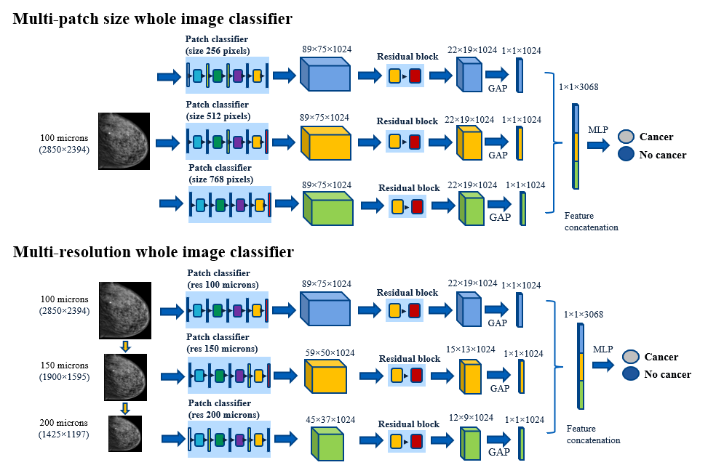
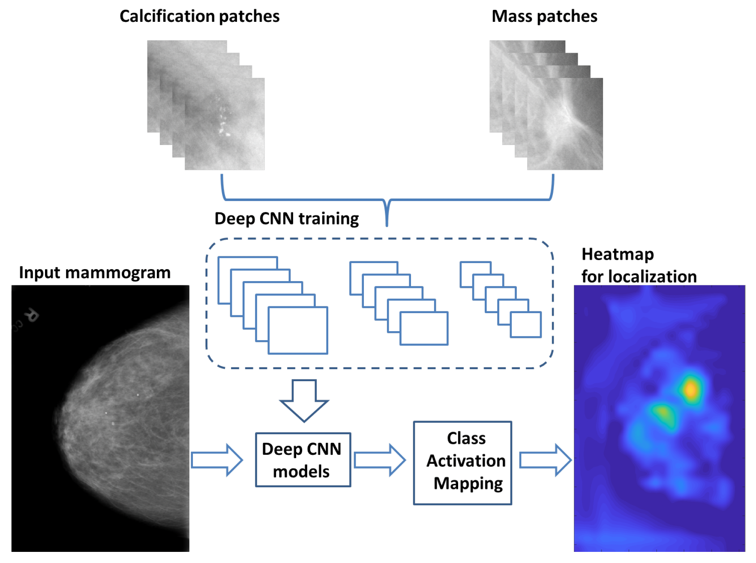
Brief Review
Quintana et. al. 2023
Xi et. al. 2018

Slide 4
Table1. accuracy (Acc) on CBIS-DDSM.
Quintana et. al. 2023 Results
Xi et. al. 2018 Results
Accuracy (Acc) on CBISD-DDSM
Accuracy on MIAS database
Accuracy (Acc) on GEHC dataset.

Slide 5
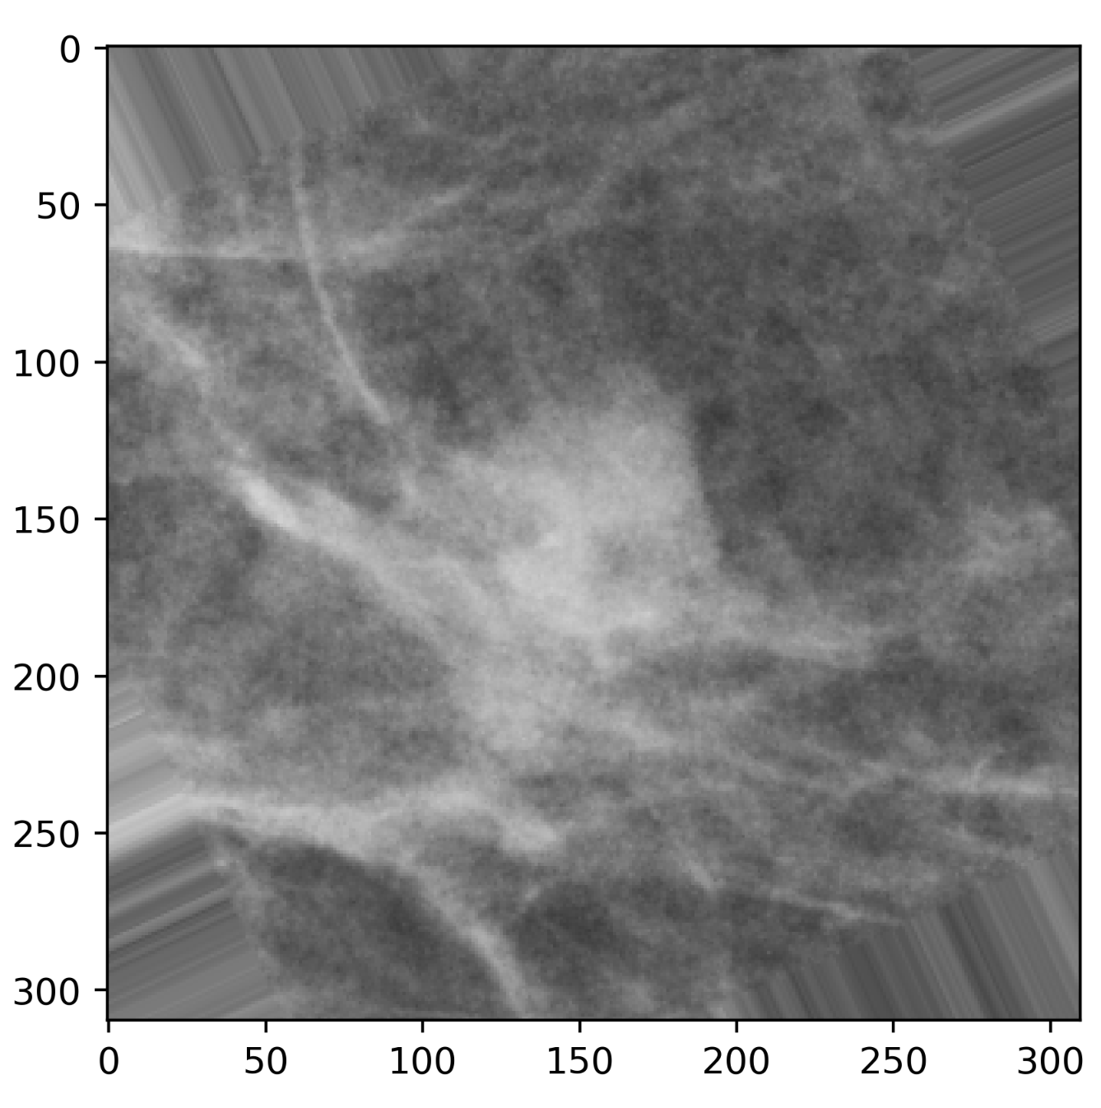
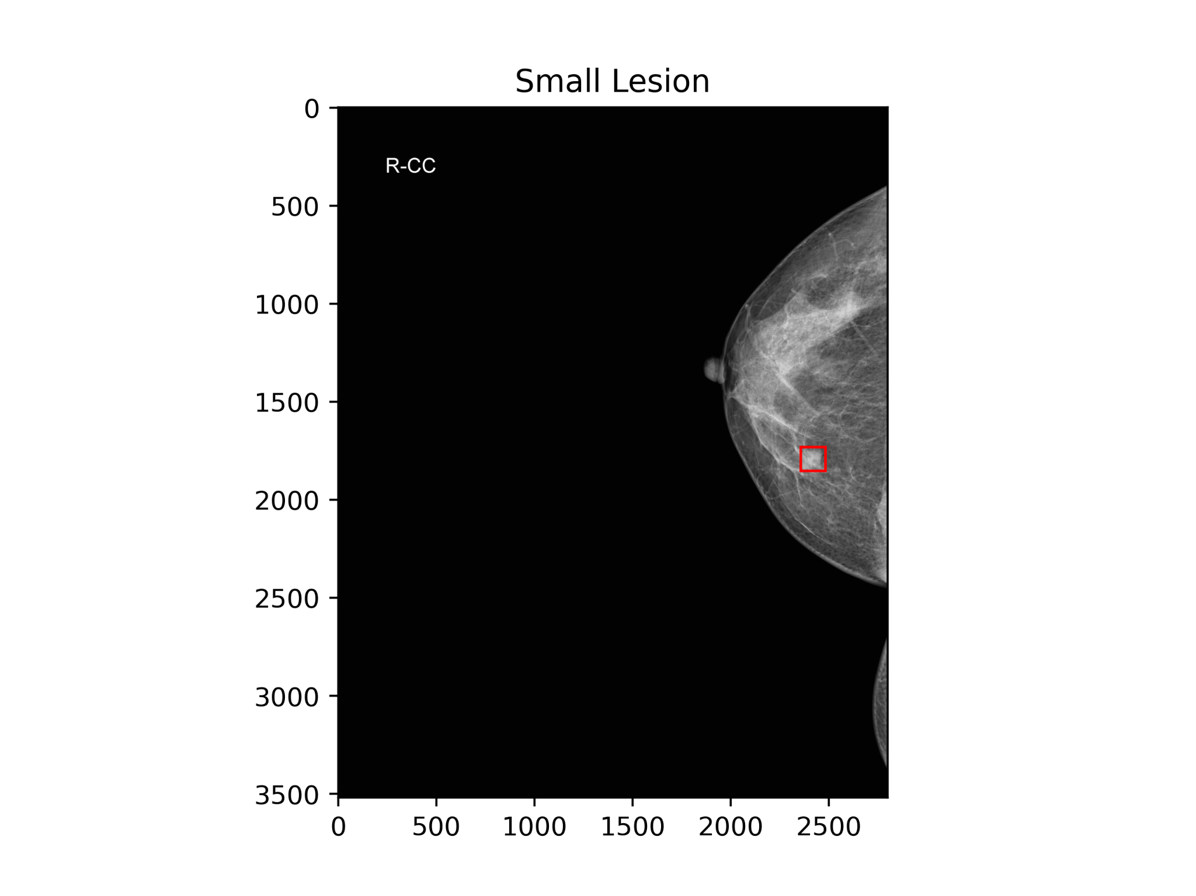
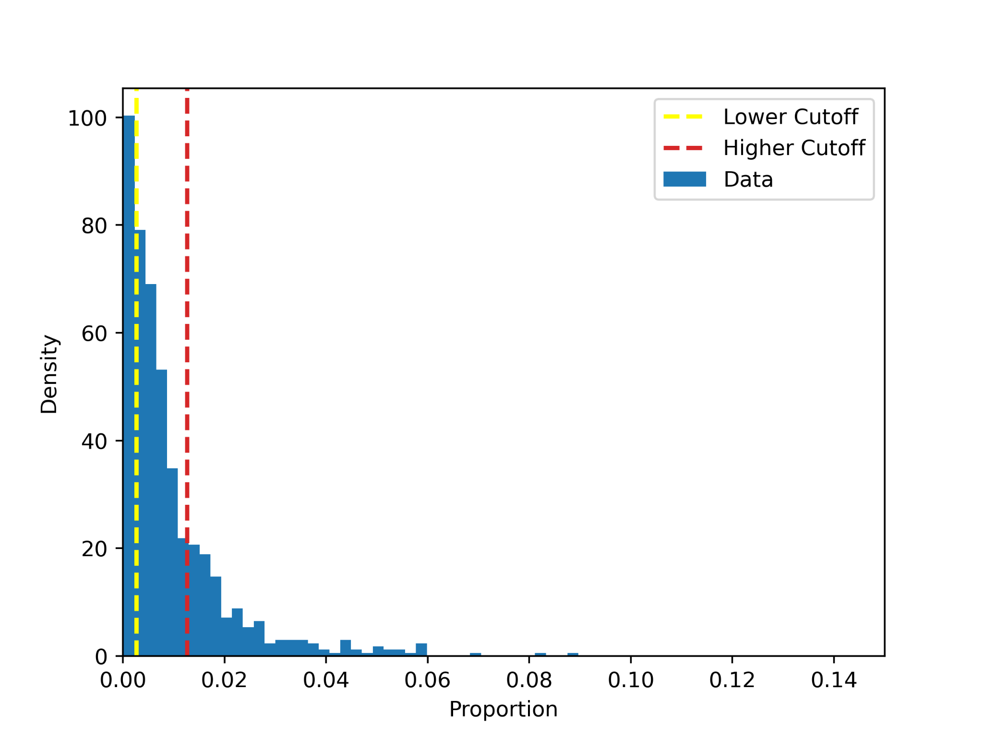
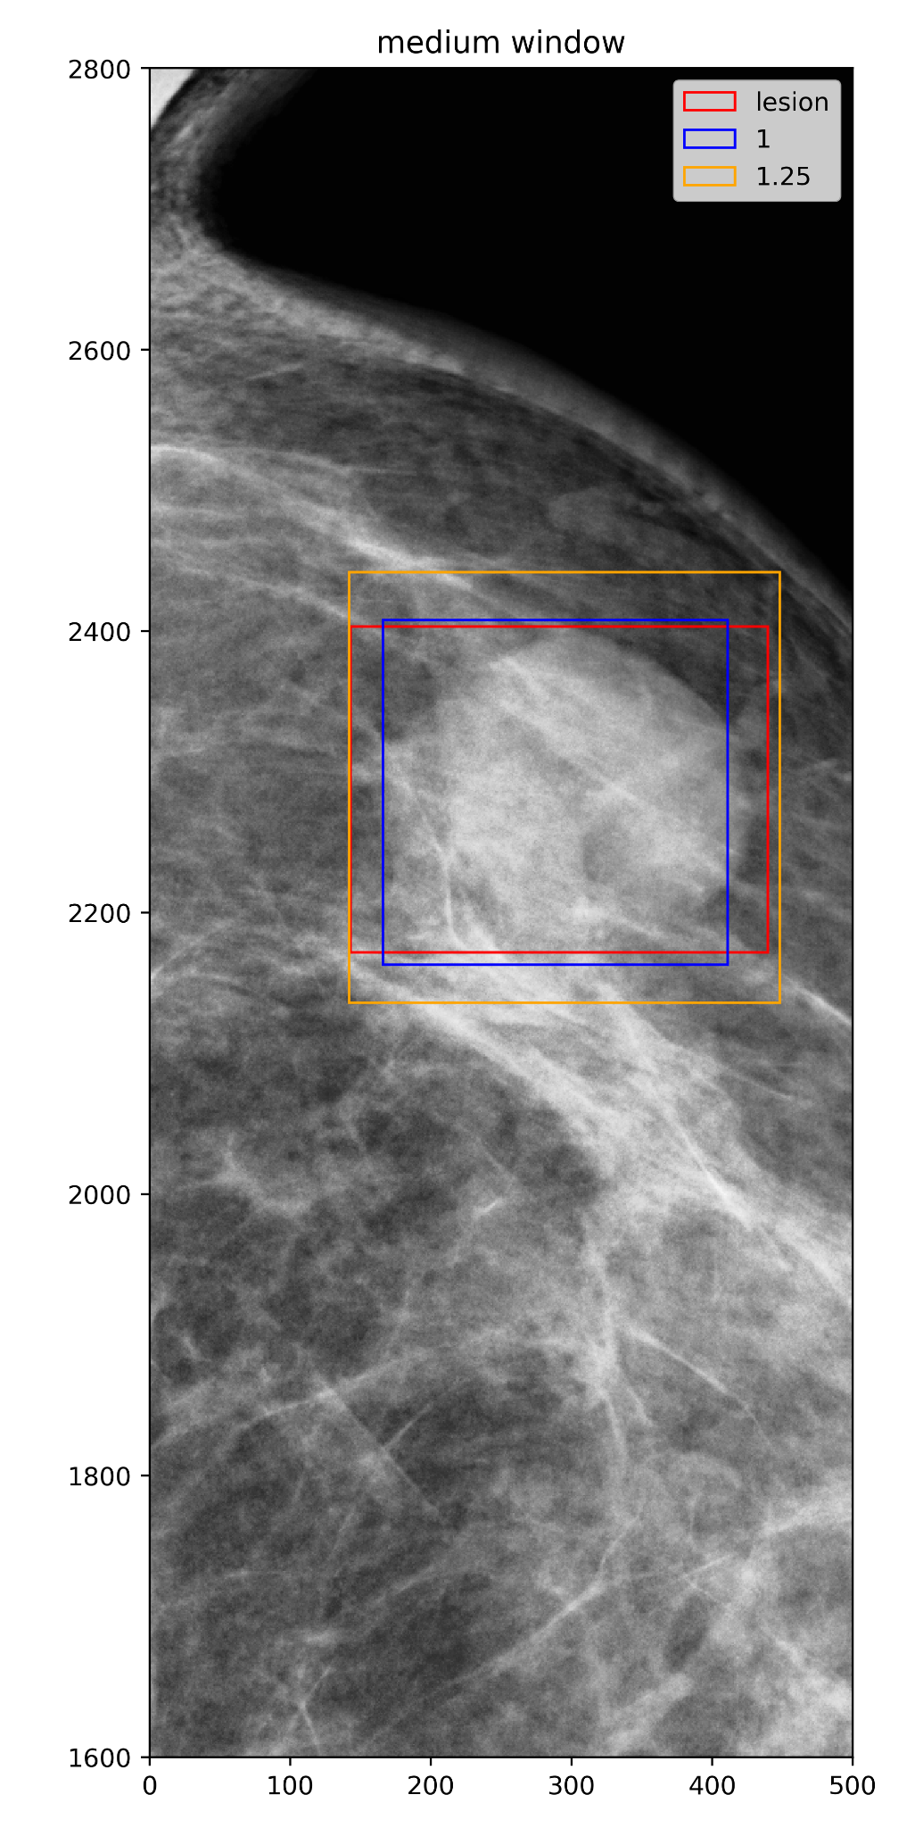
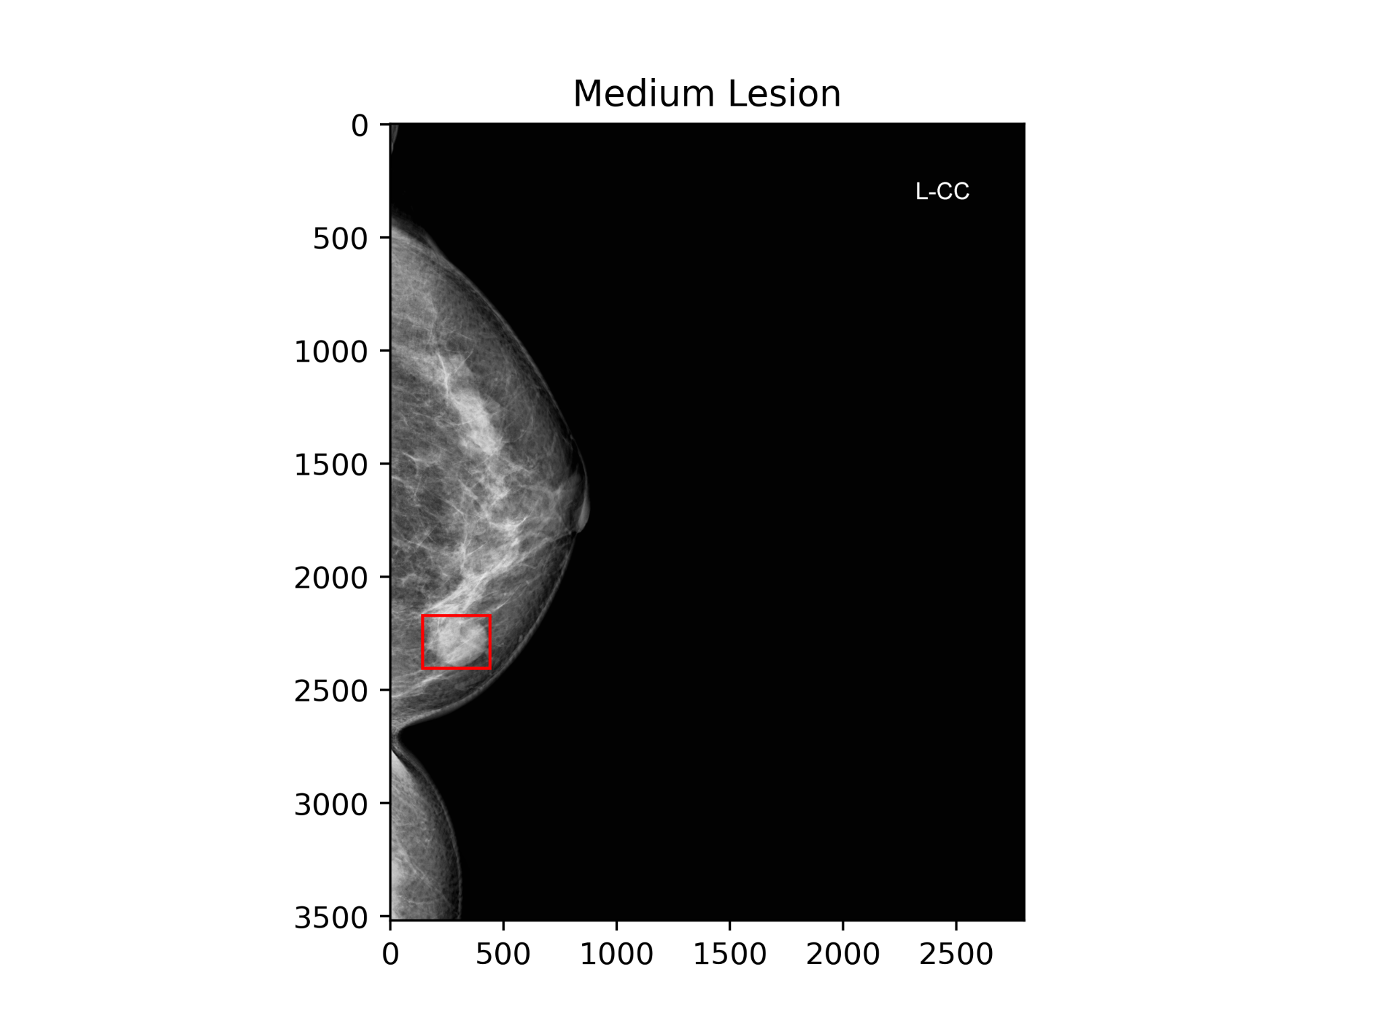
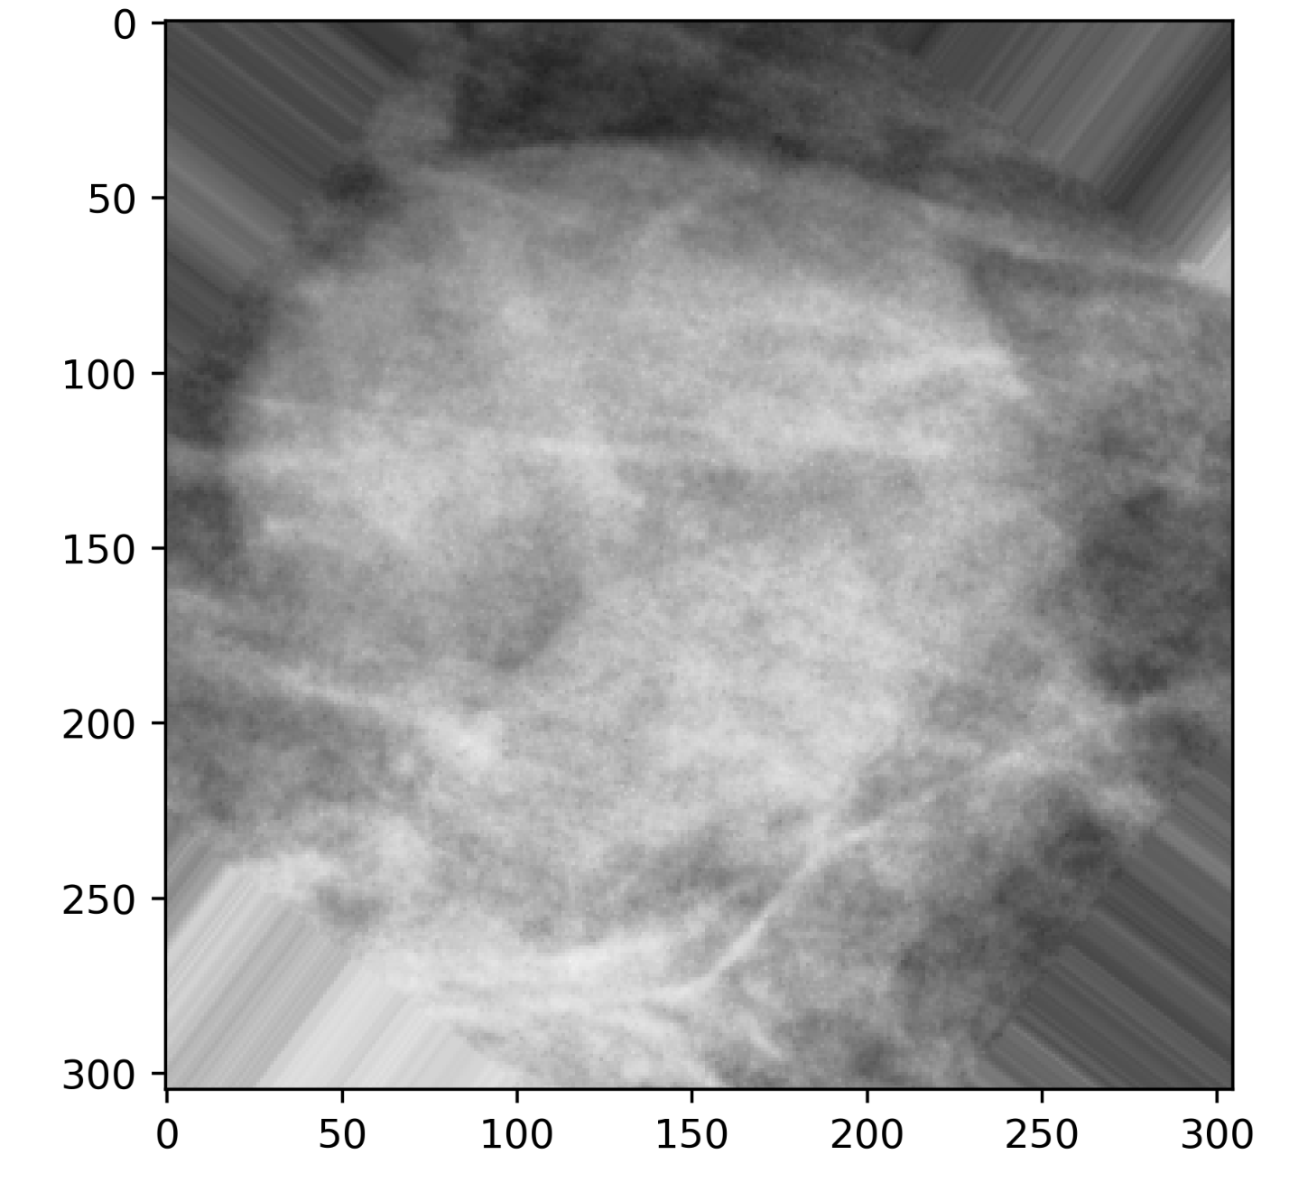
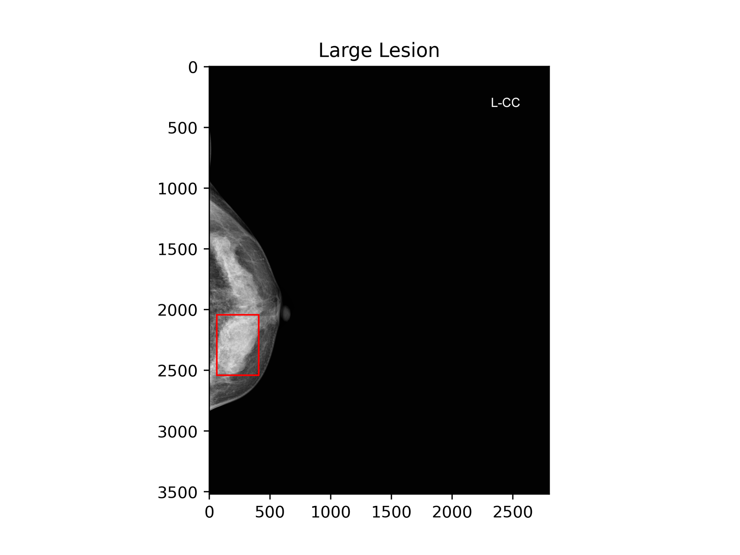
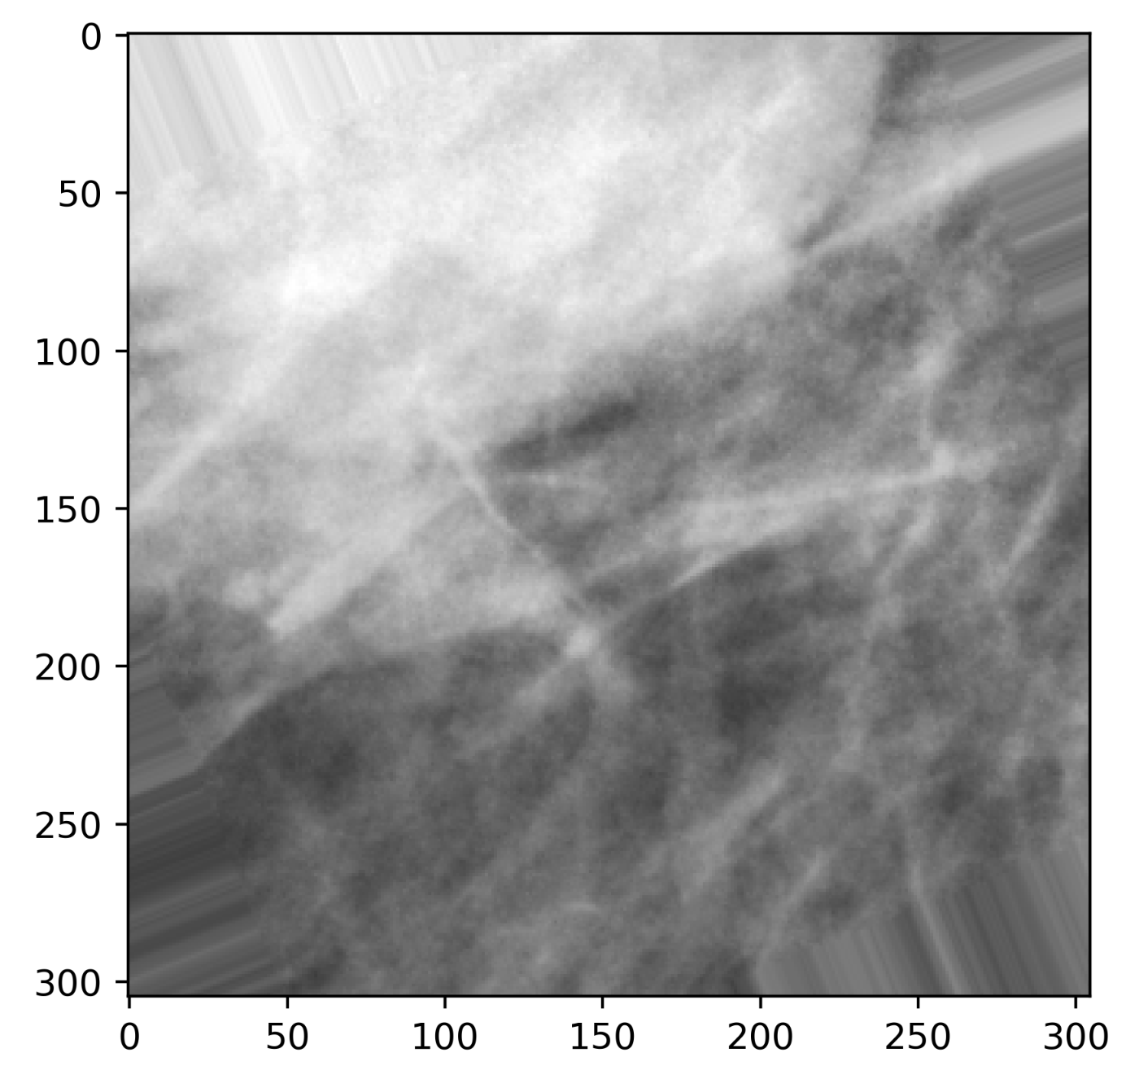
Experimental Design - Patch Classification
Datasets
Training and Validation
VINDR-Mammo Dataset (20,000 images)
Test
Patch-based CNN (80-20 training-validation)
Whole Image Classifier
Patch Extraction
Small, Medium, Large
Augmentation
Dataset
Distribution
Model
VINDR
795 images
Contrast Limited Adaptive Histogram Equalization
Notes:
Contrast Limited Adaptive Histogram Equalization (CLAHE; Kaur et al., 2022).
This technique will help eliminate artifacts and reduce background noise in the images.

Slide 6
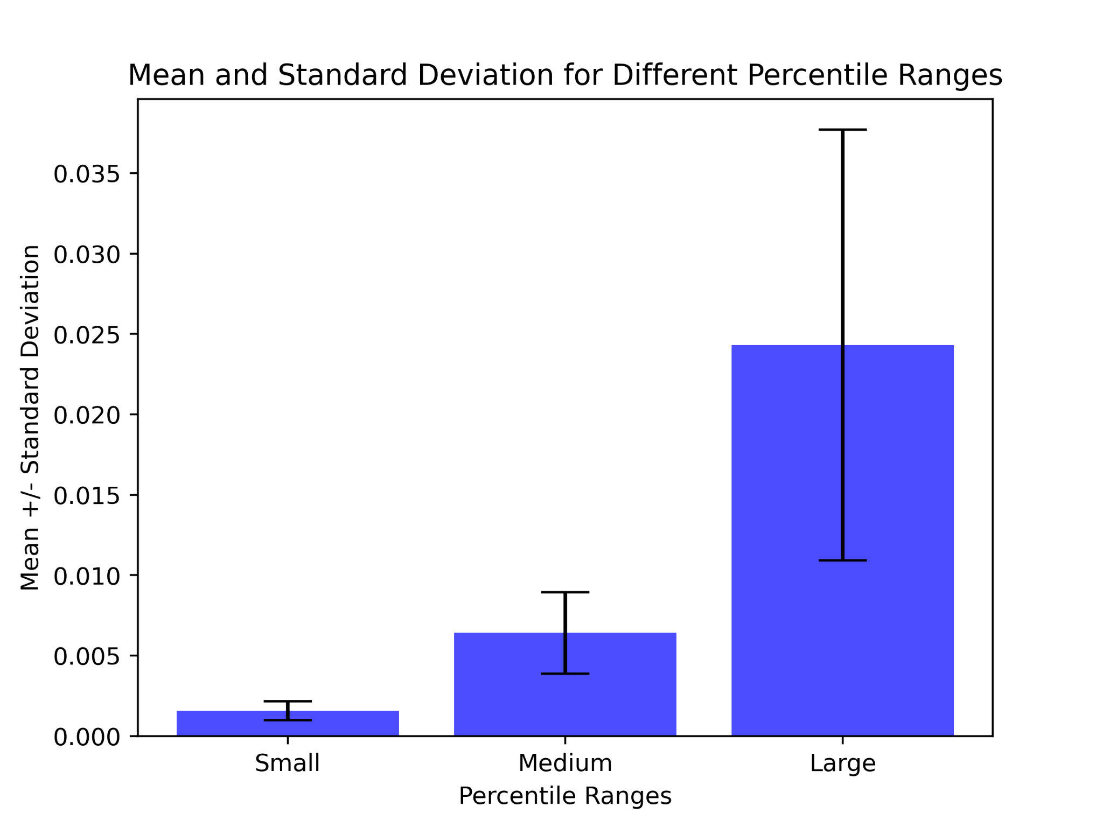
Small, Medium, Large Categories
450
244
138

Slide 7
Whole image dataset
140 small images
470 medium images
185 large images
98 train, 21 validate, 21 test
329 train, 70 validate, 71 test
129 train, 28 validate, 28 test
Notes:
-80/10/10 train/validation/test

Slide 8
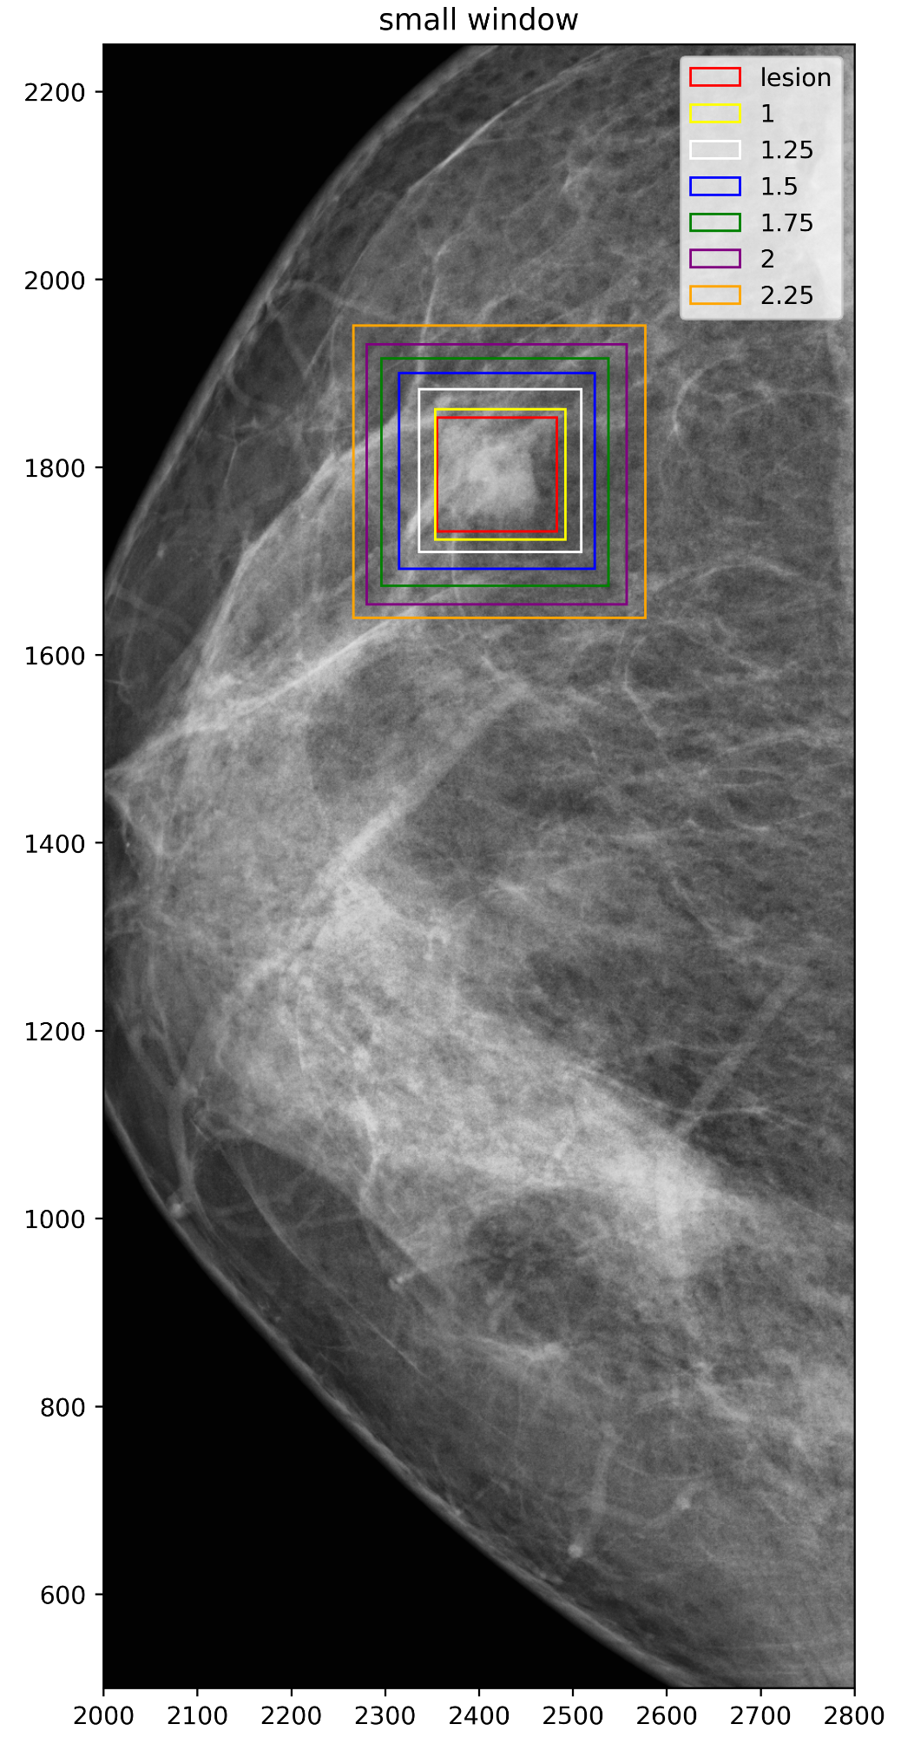
Patchify Lesions
Small Patches
138x138 (x1)
172x172 (x1.25)
207x207 (x1.50)
241x241 (x1.75)
276x276 (x2)
310x310 (x2.25)
Medium Patches
244x244 (x1)
305x30x (x1.25)
Large
450x450 (x1)

Slide 9
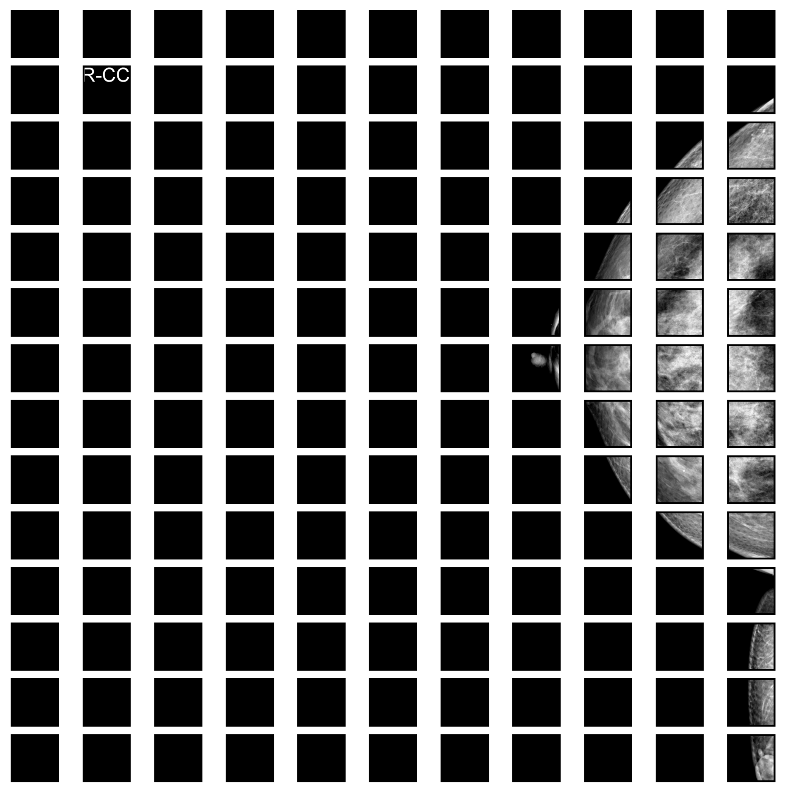
Patchify Normal
Remove black squares
Remove lesion patches
Randomly select normal tissue patch

Slide 10
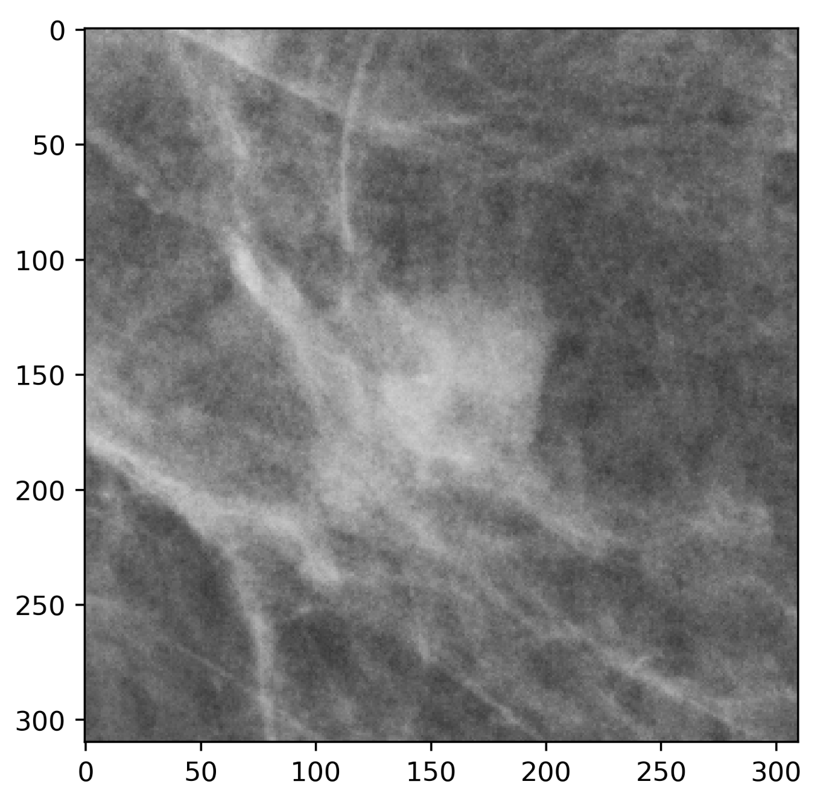
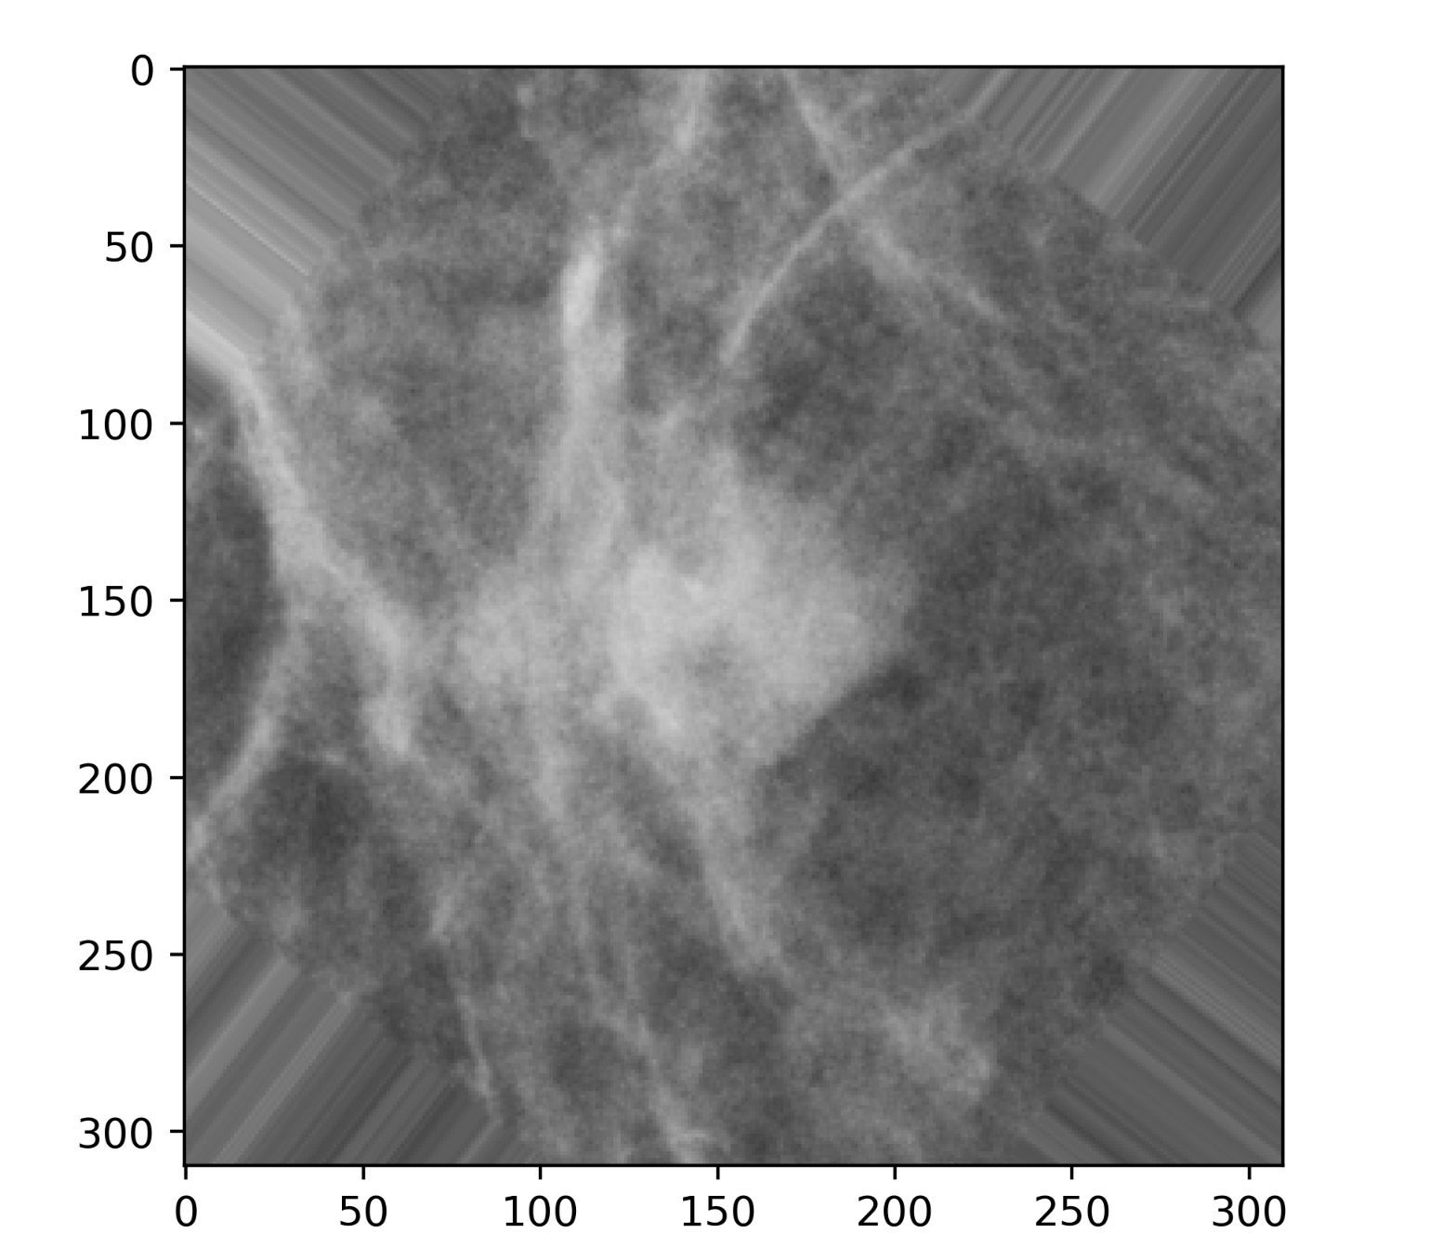
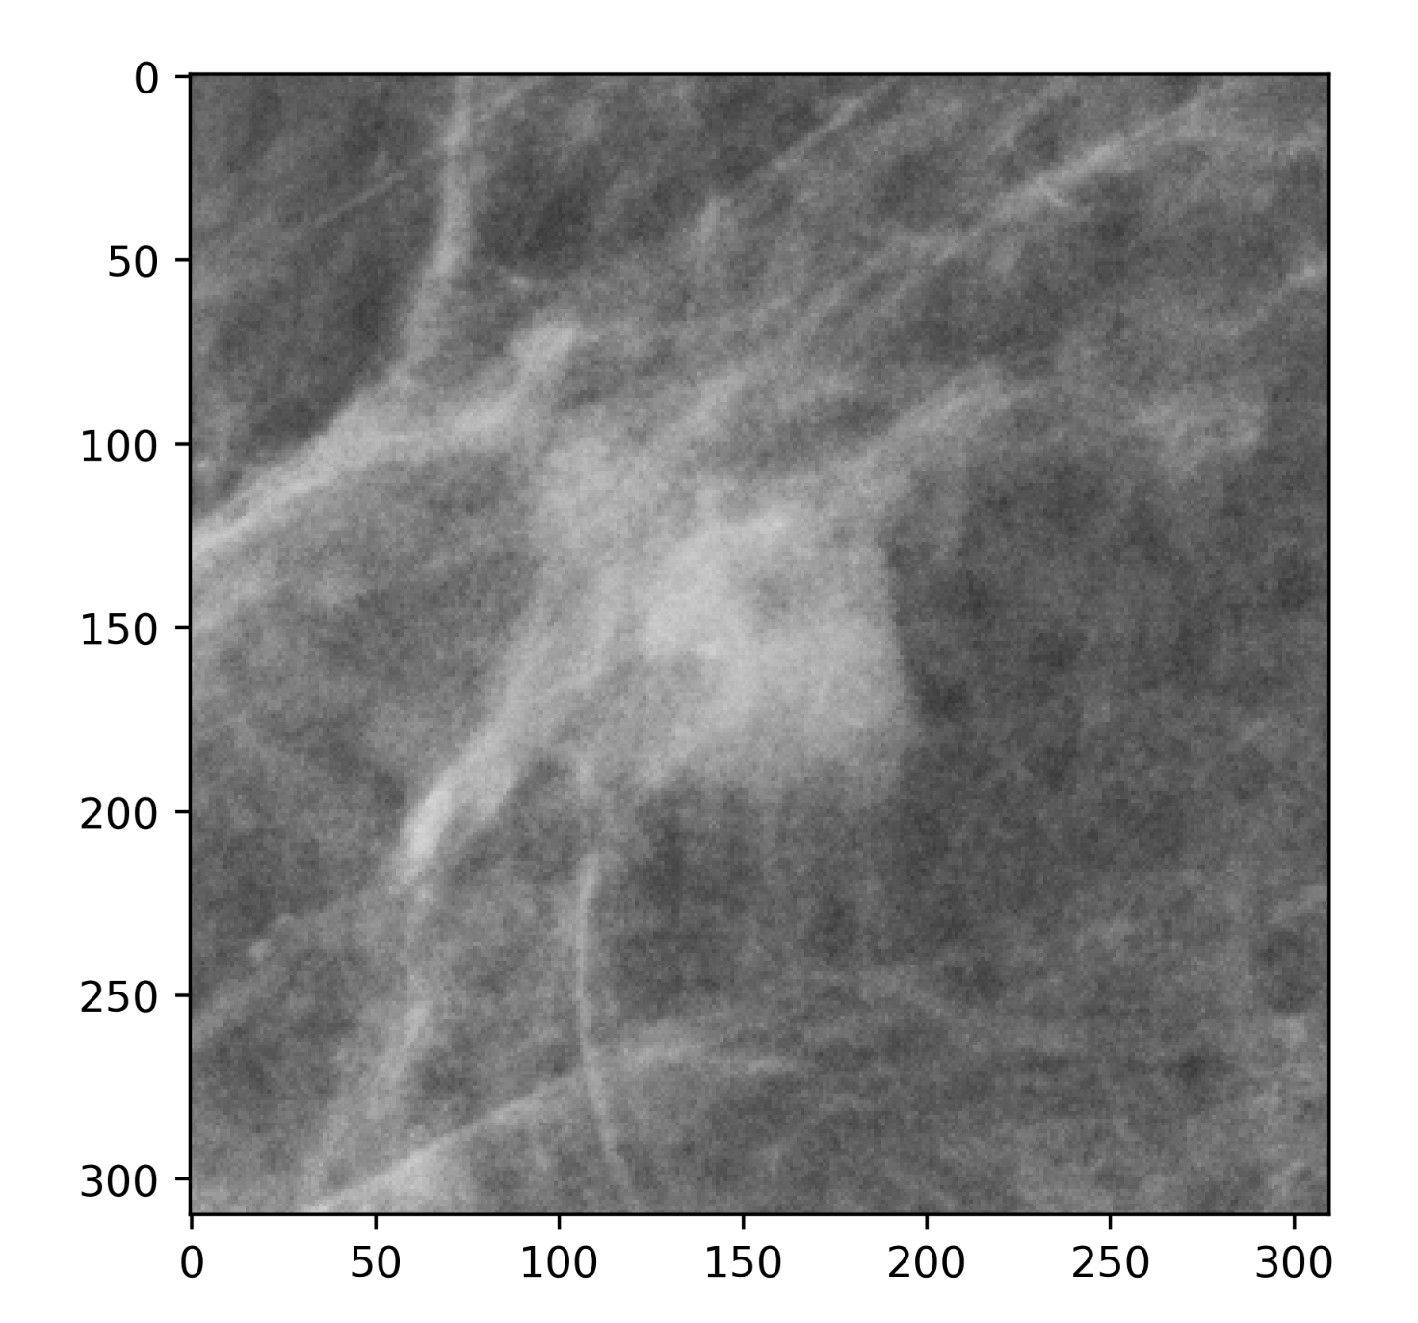
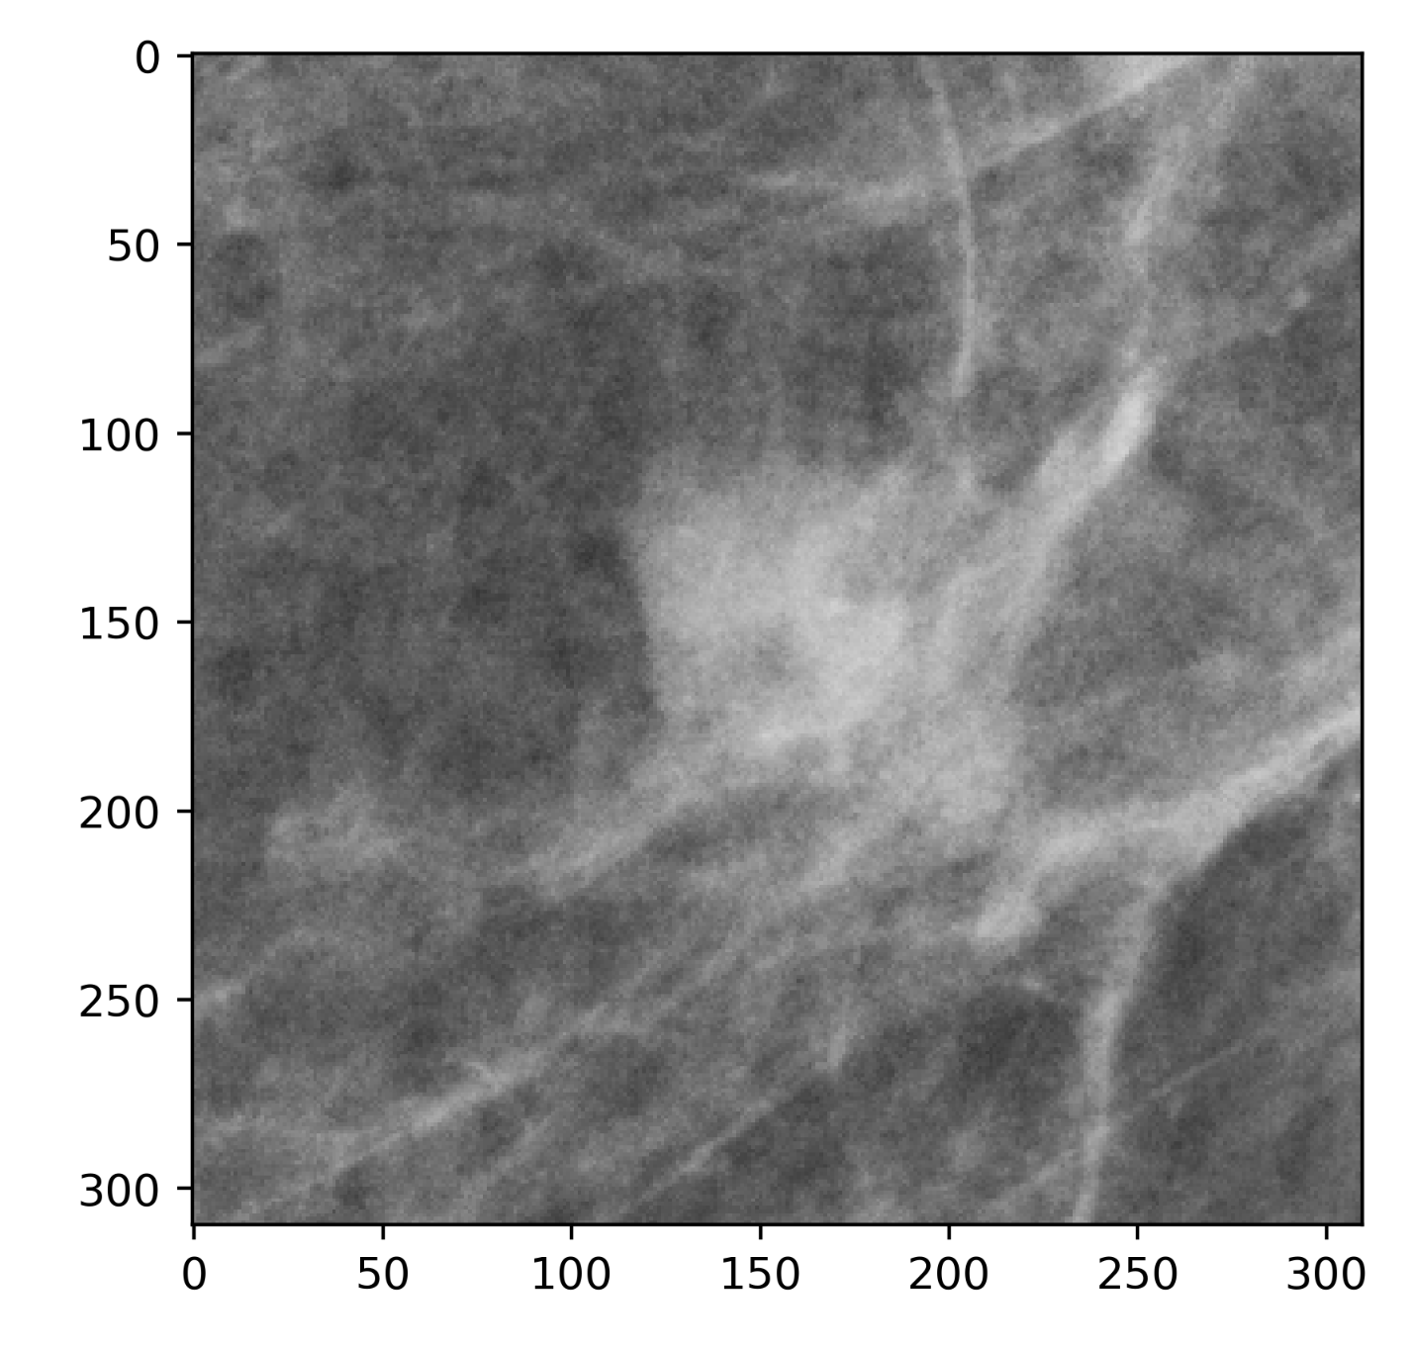
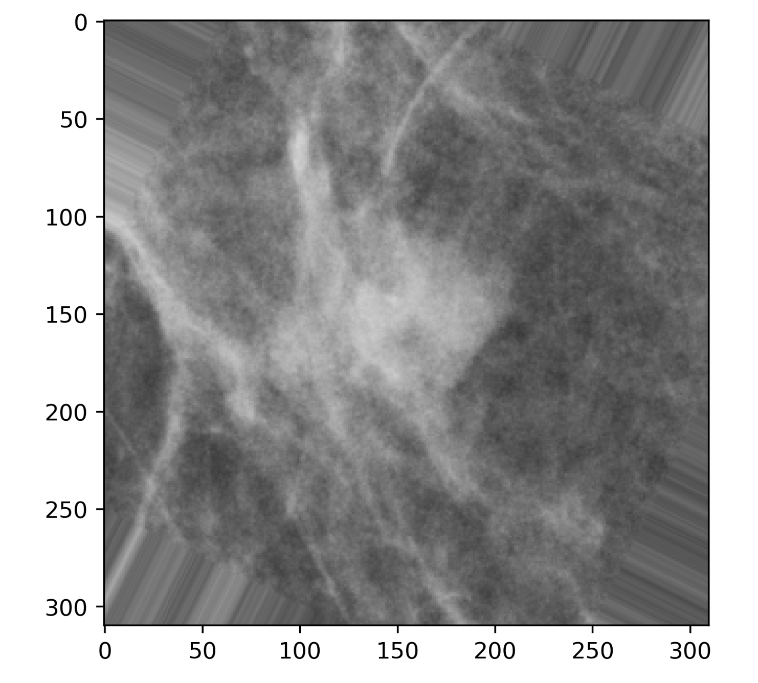
Patch Augmentation
Original
Rotations
Vertical flips
Horizontal Flips
=
Notes:
Generated 3000 images per category - small medium and large.
1500 abnormal and 1500 normal

Slide 11
Models
General Architecture
Adapted from Quintana et al, 2023
Notes:
Two models used in Quintana 2023
Global Average Pooling, followed by fully connected layer, with a soft max layer
Use standard metrics like accuracy, specificity and sensitivity, may use F1 score due to class imbalances

Slide 12
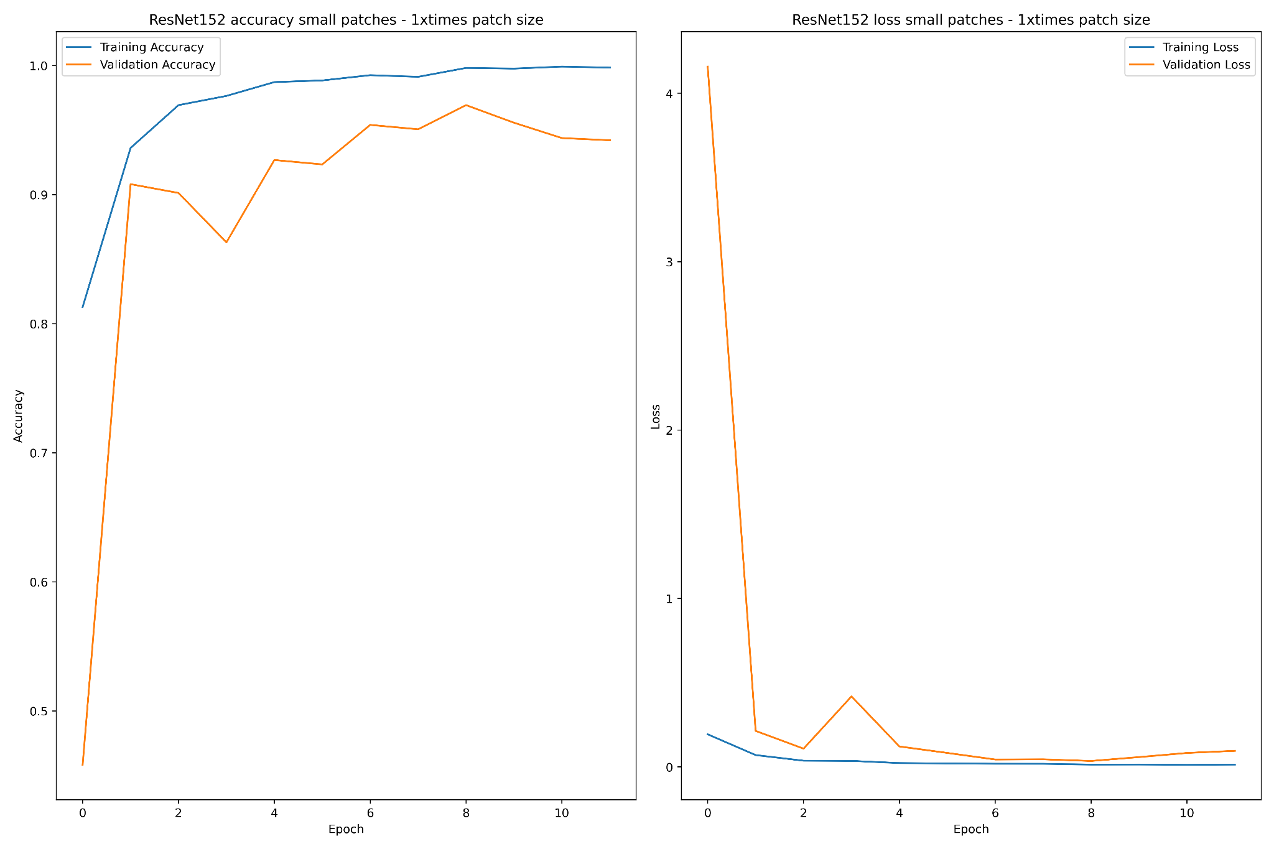
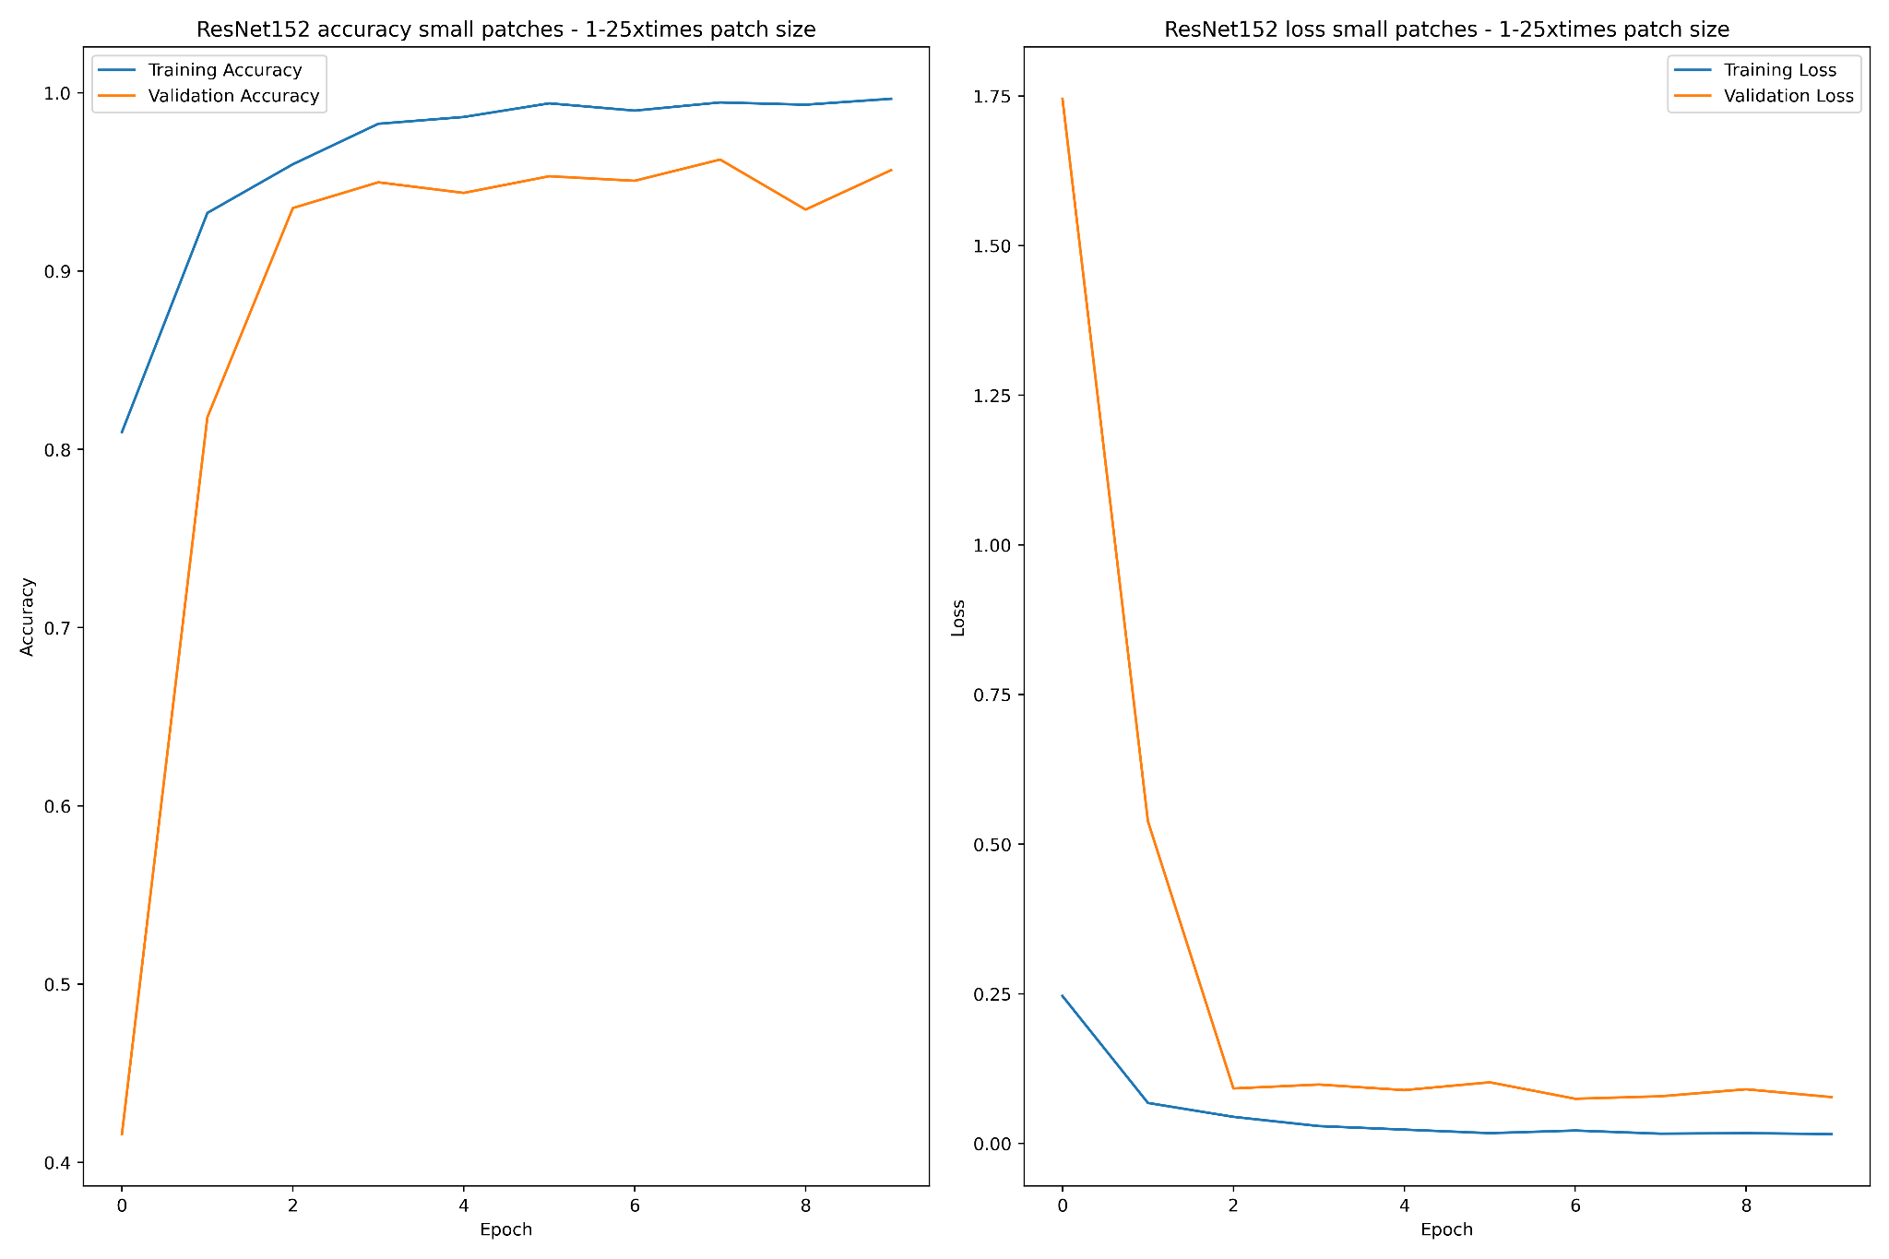
Results - Small x1 and x1.25 ResNet152

Slide 13
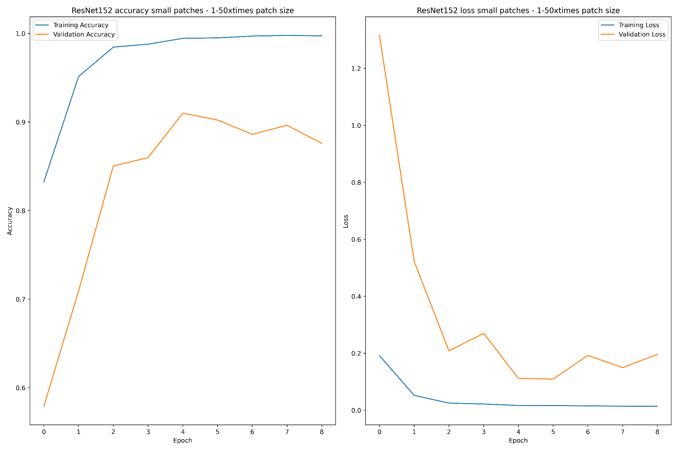
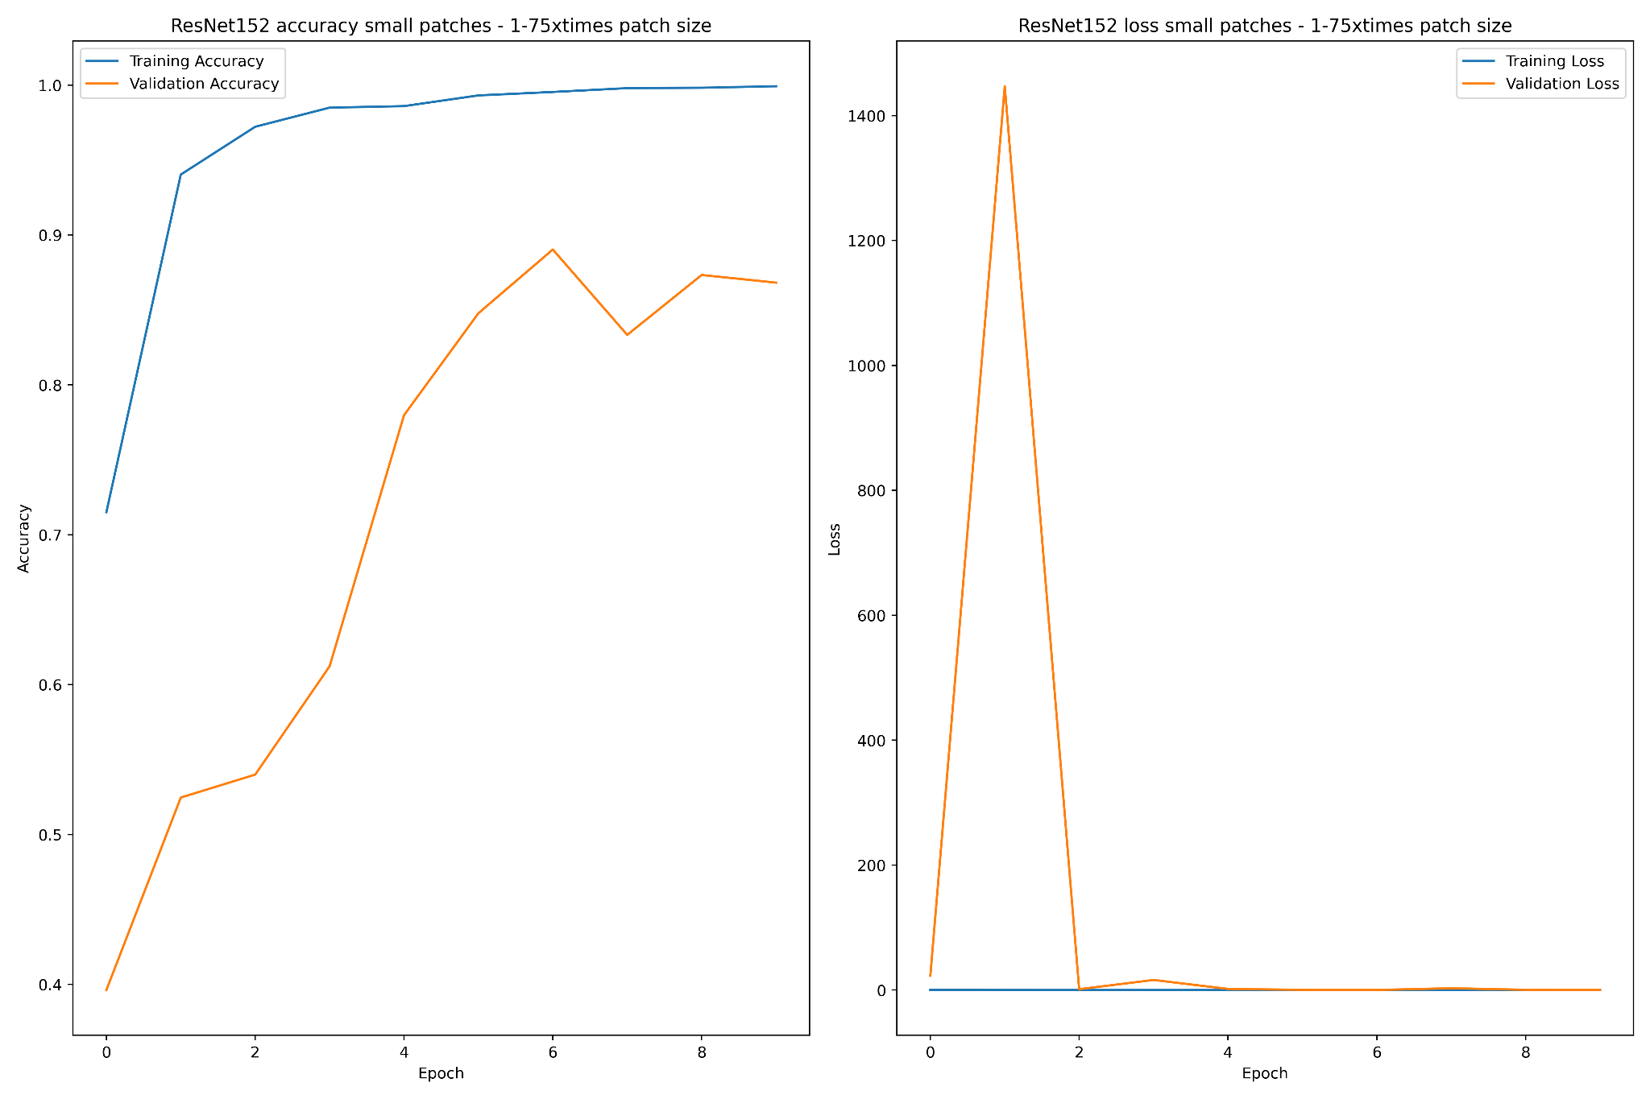
Results - Small x1.50 and x1.75 ResNet152

Slide 14
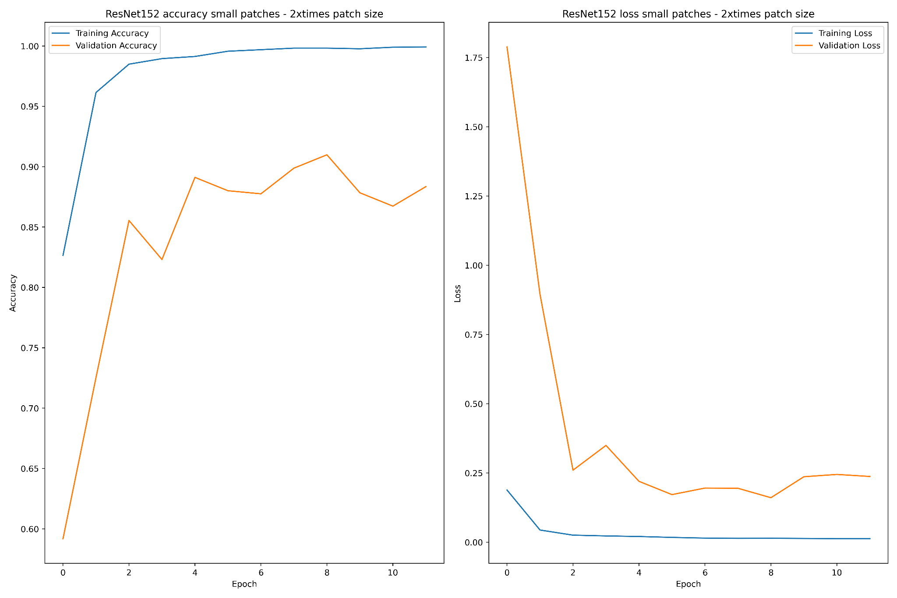
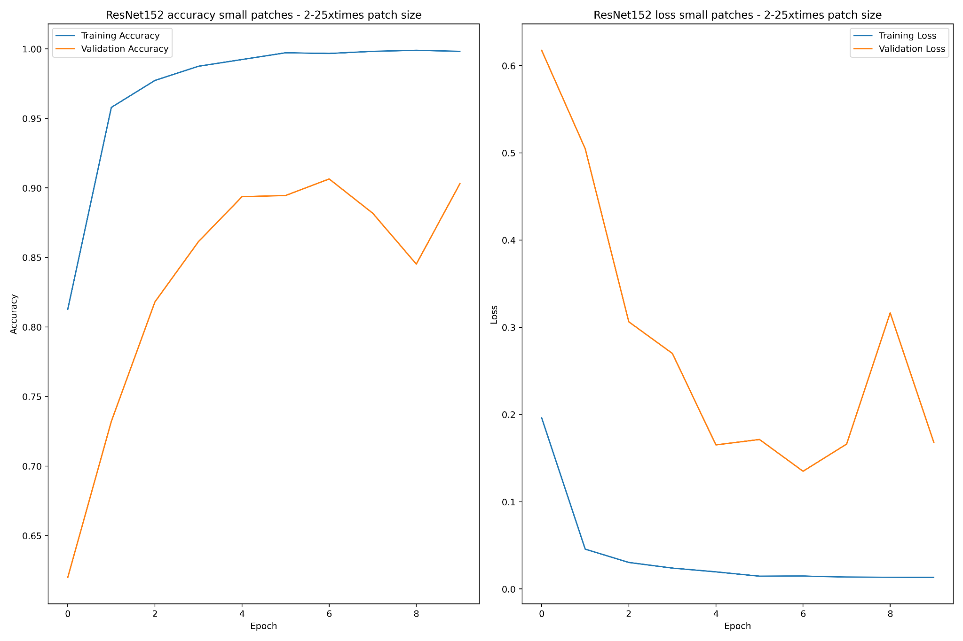
Results - Small x2 and x2.25 ResNet152

Slide 15
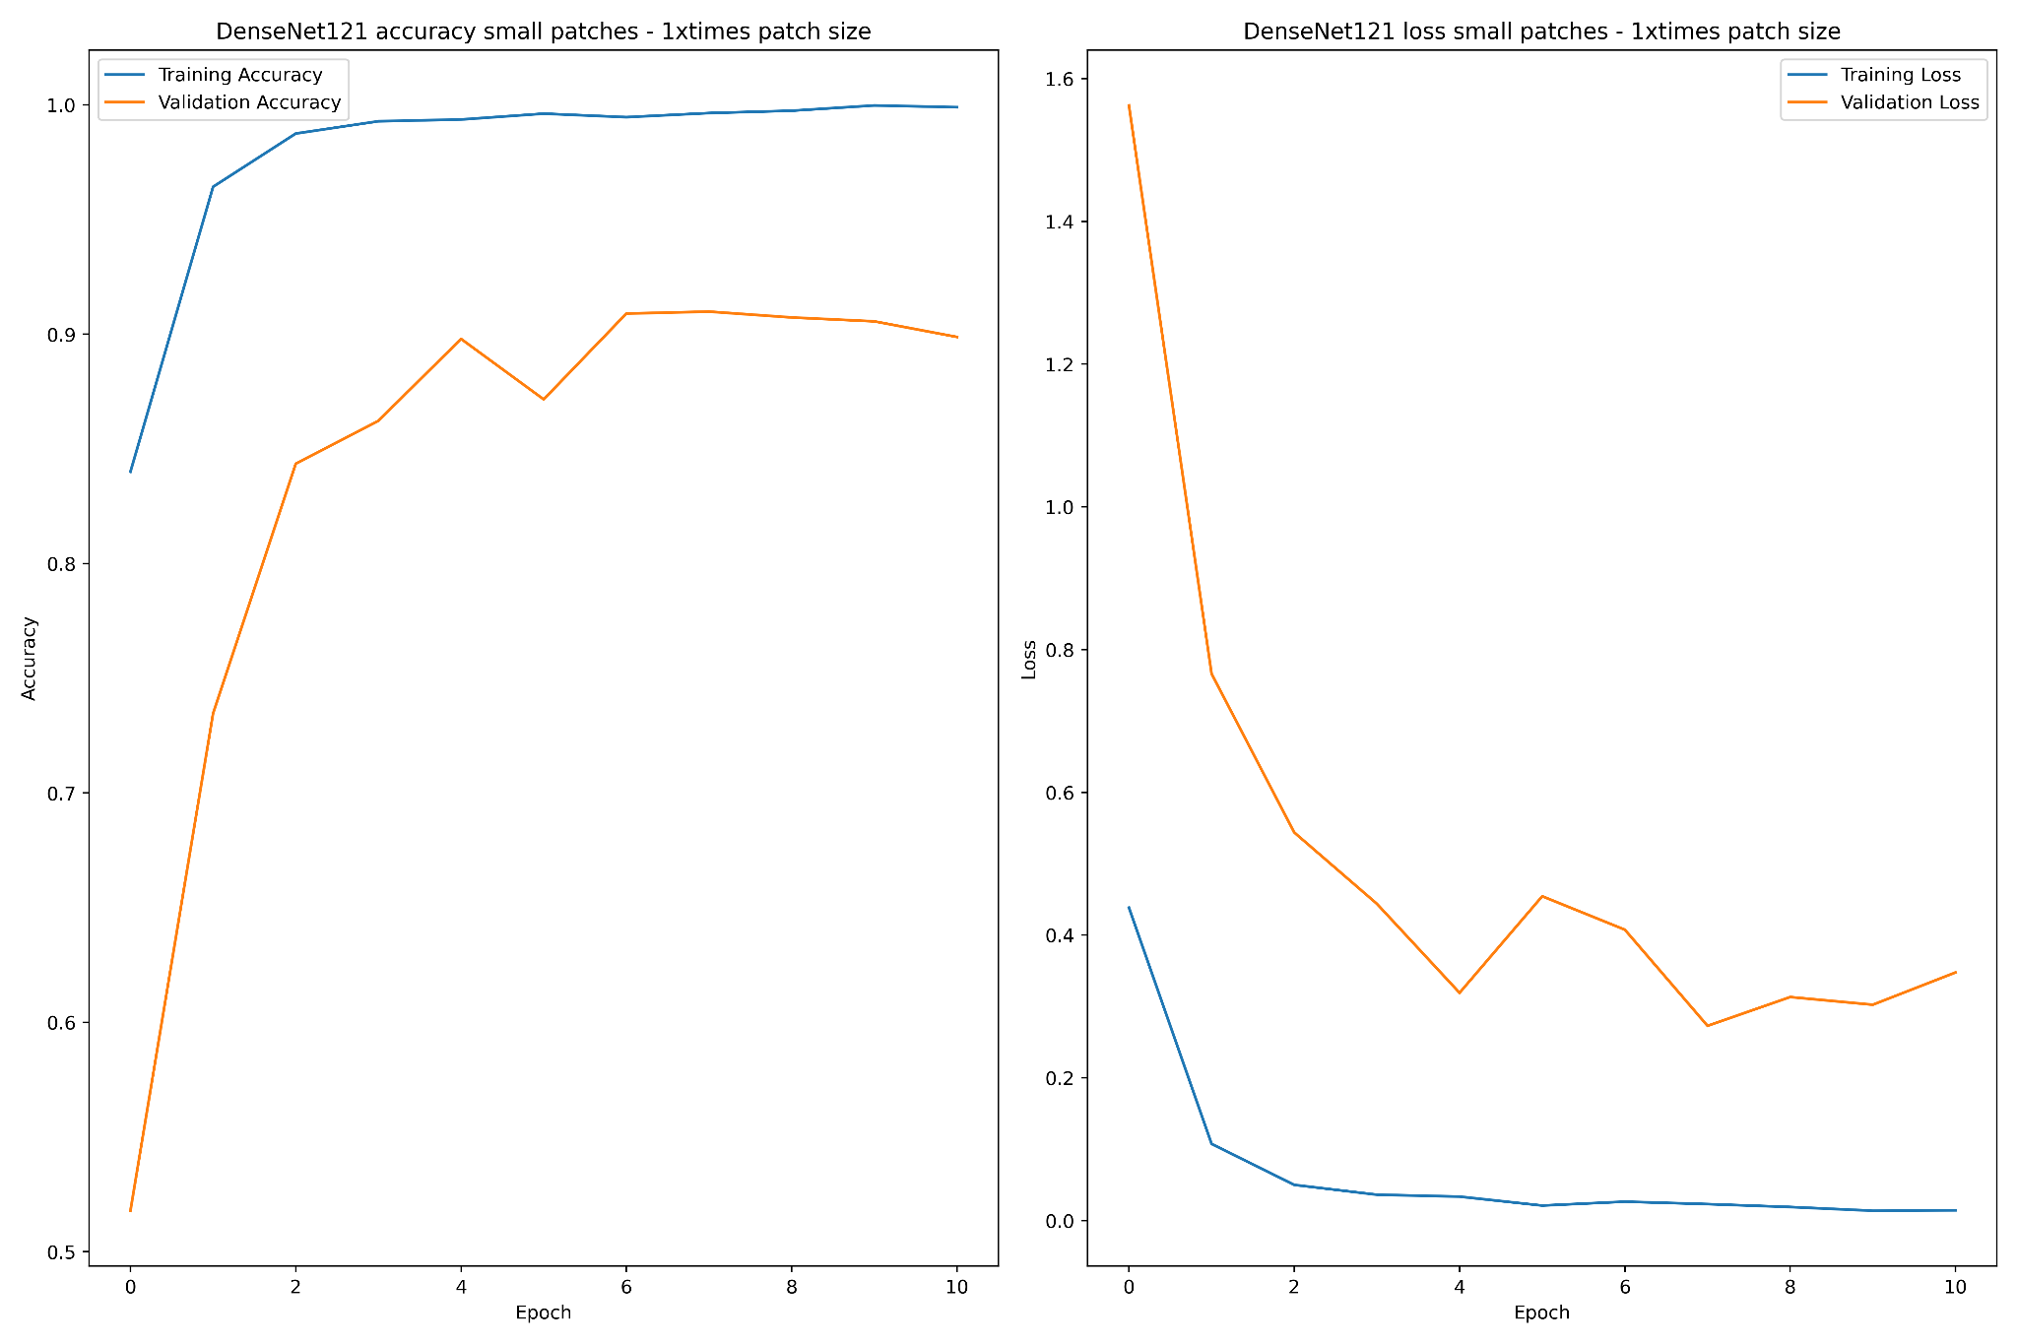
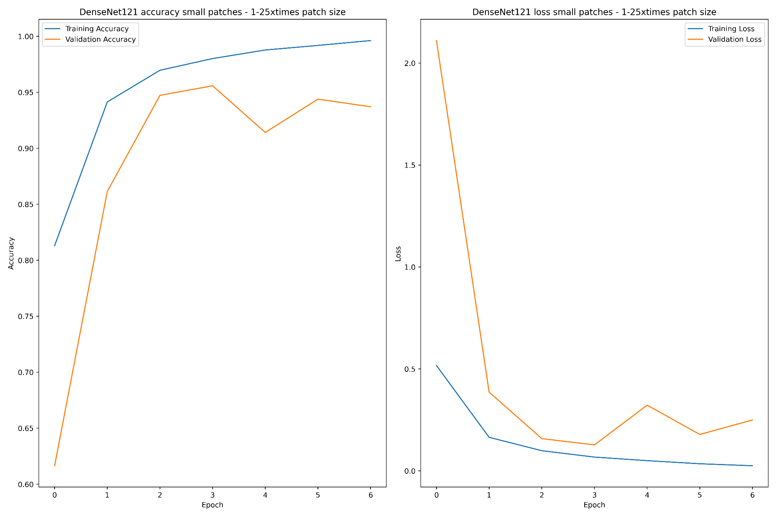
Results - Small x1 and x1.25 DenseNet121

Slide 16
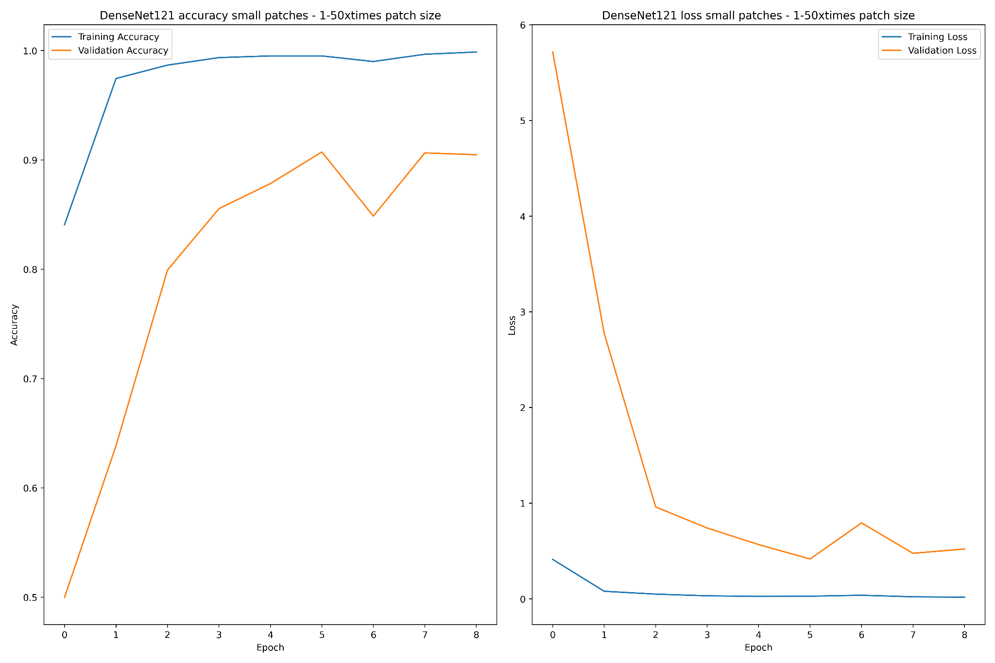
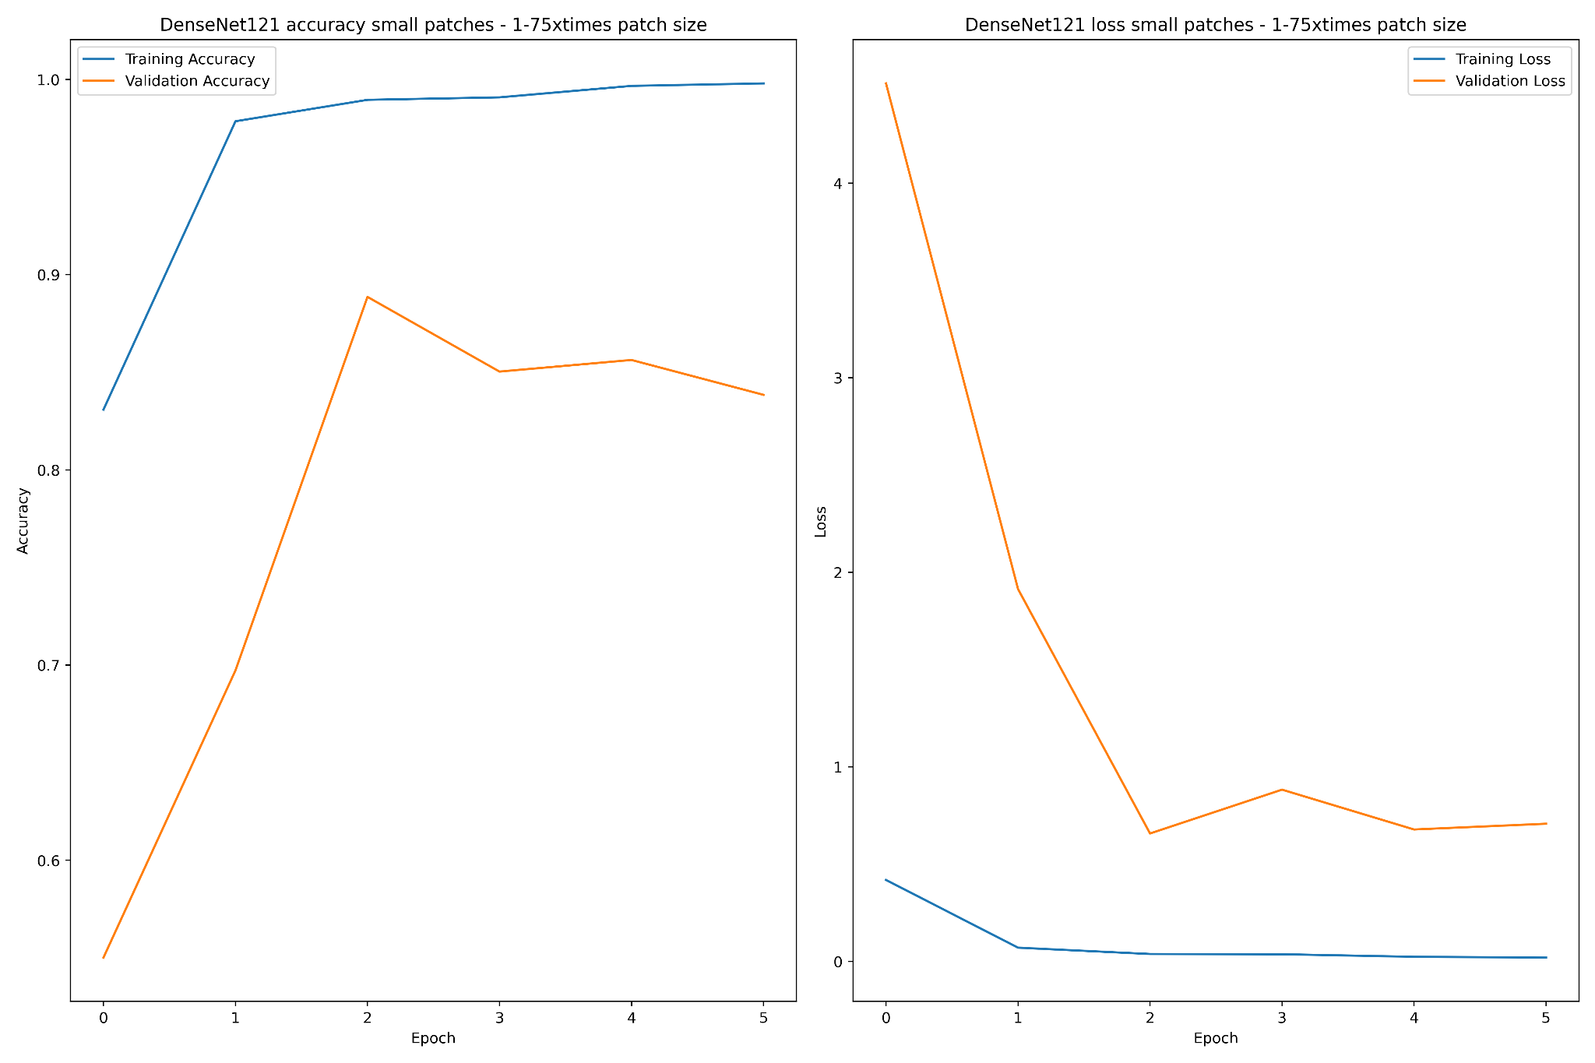
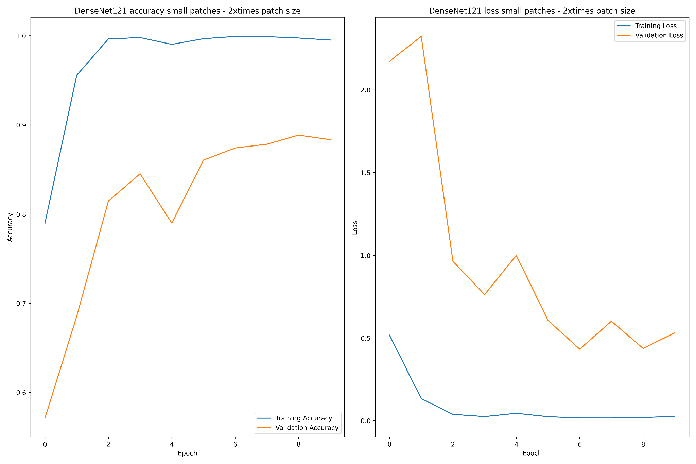
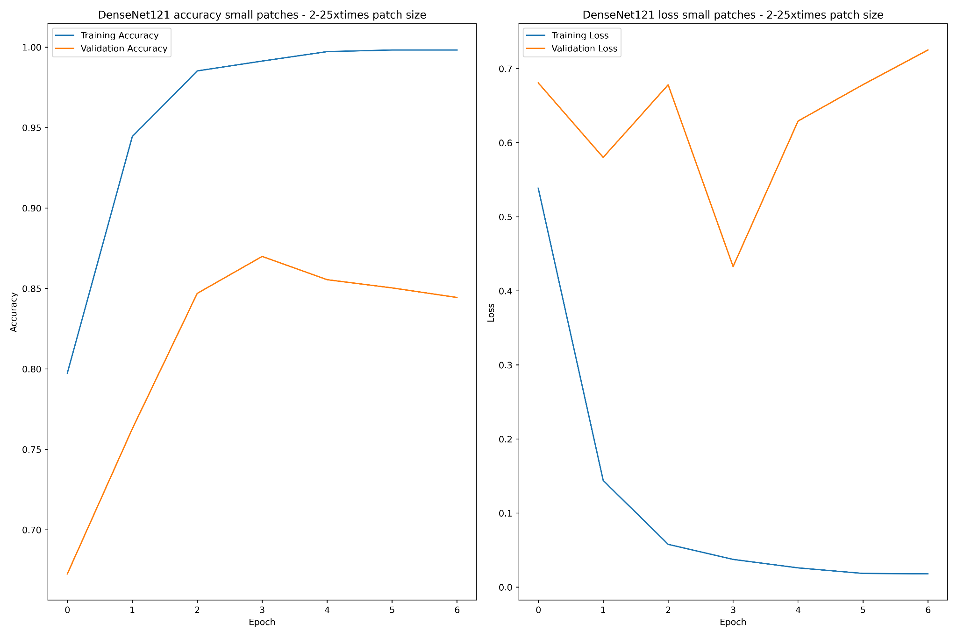
Results - Small x1.50 and x1.75 DenseNet121

Slide 17
Results - Small x2 and x2.25 DenseNet121

Slide 18
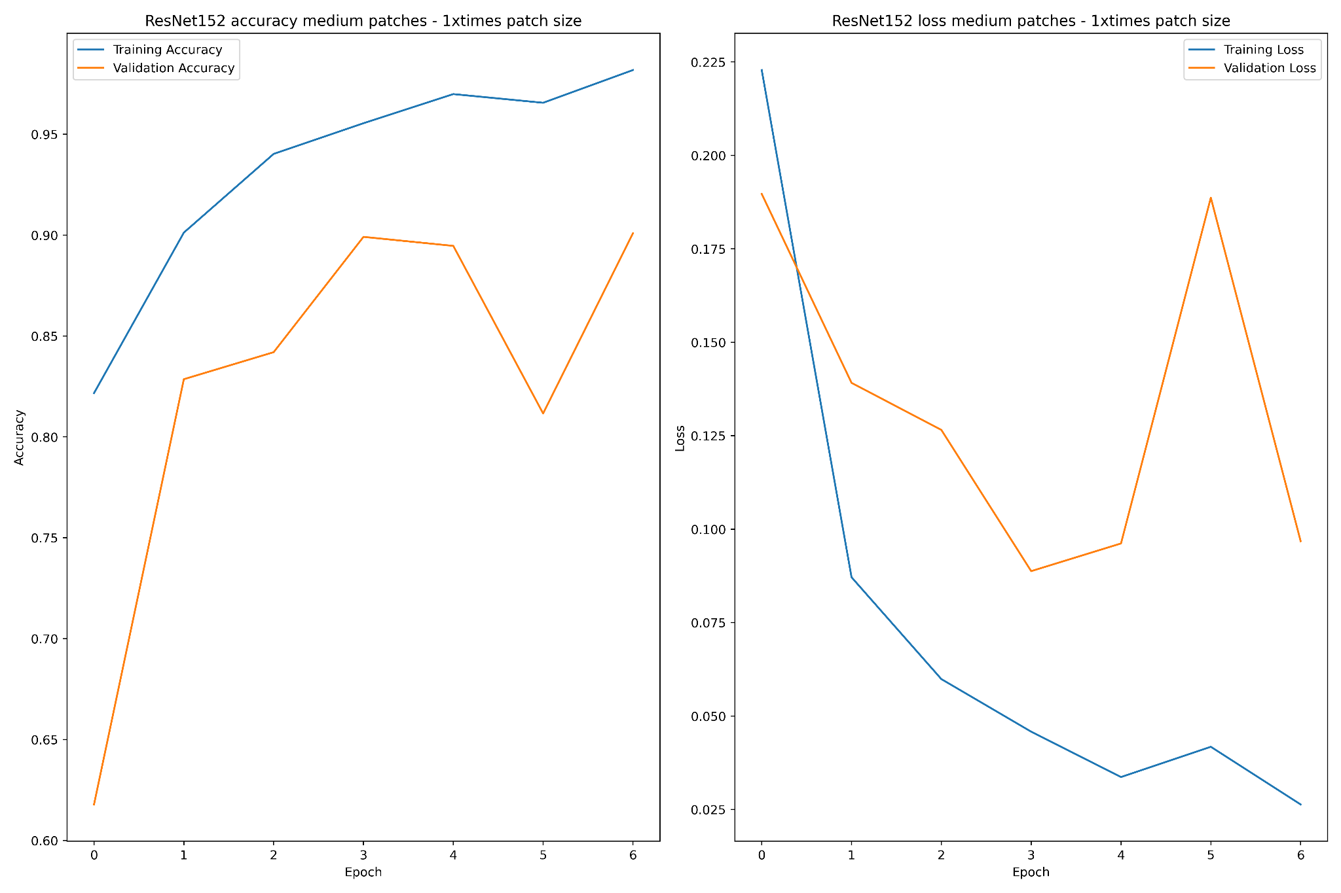
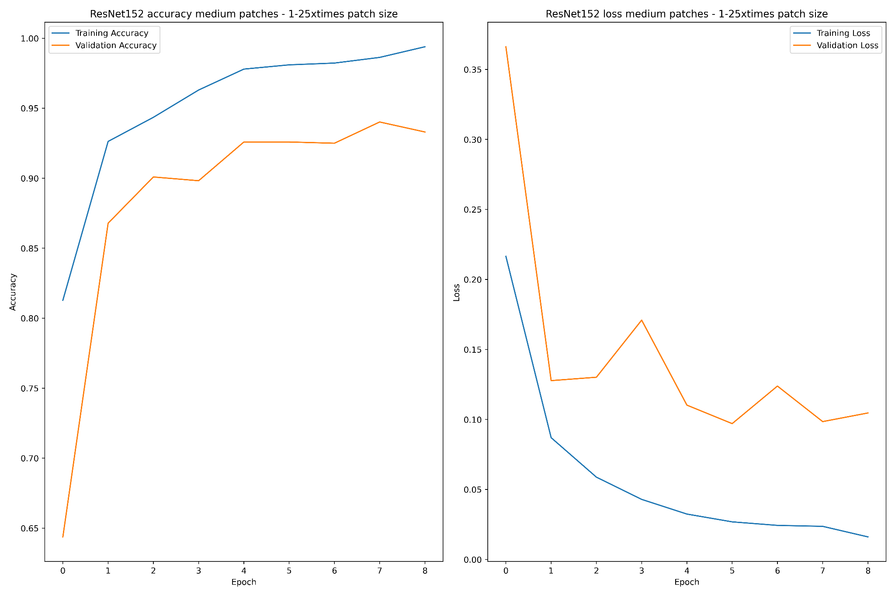
Results - Medium x1 and x1.25 ResNet152

Slide 19
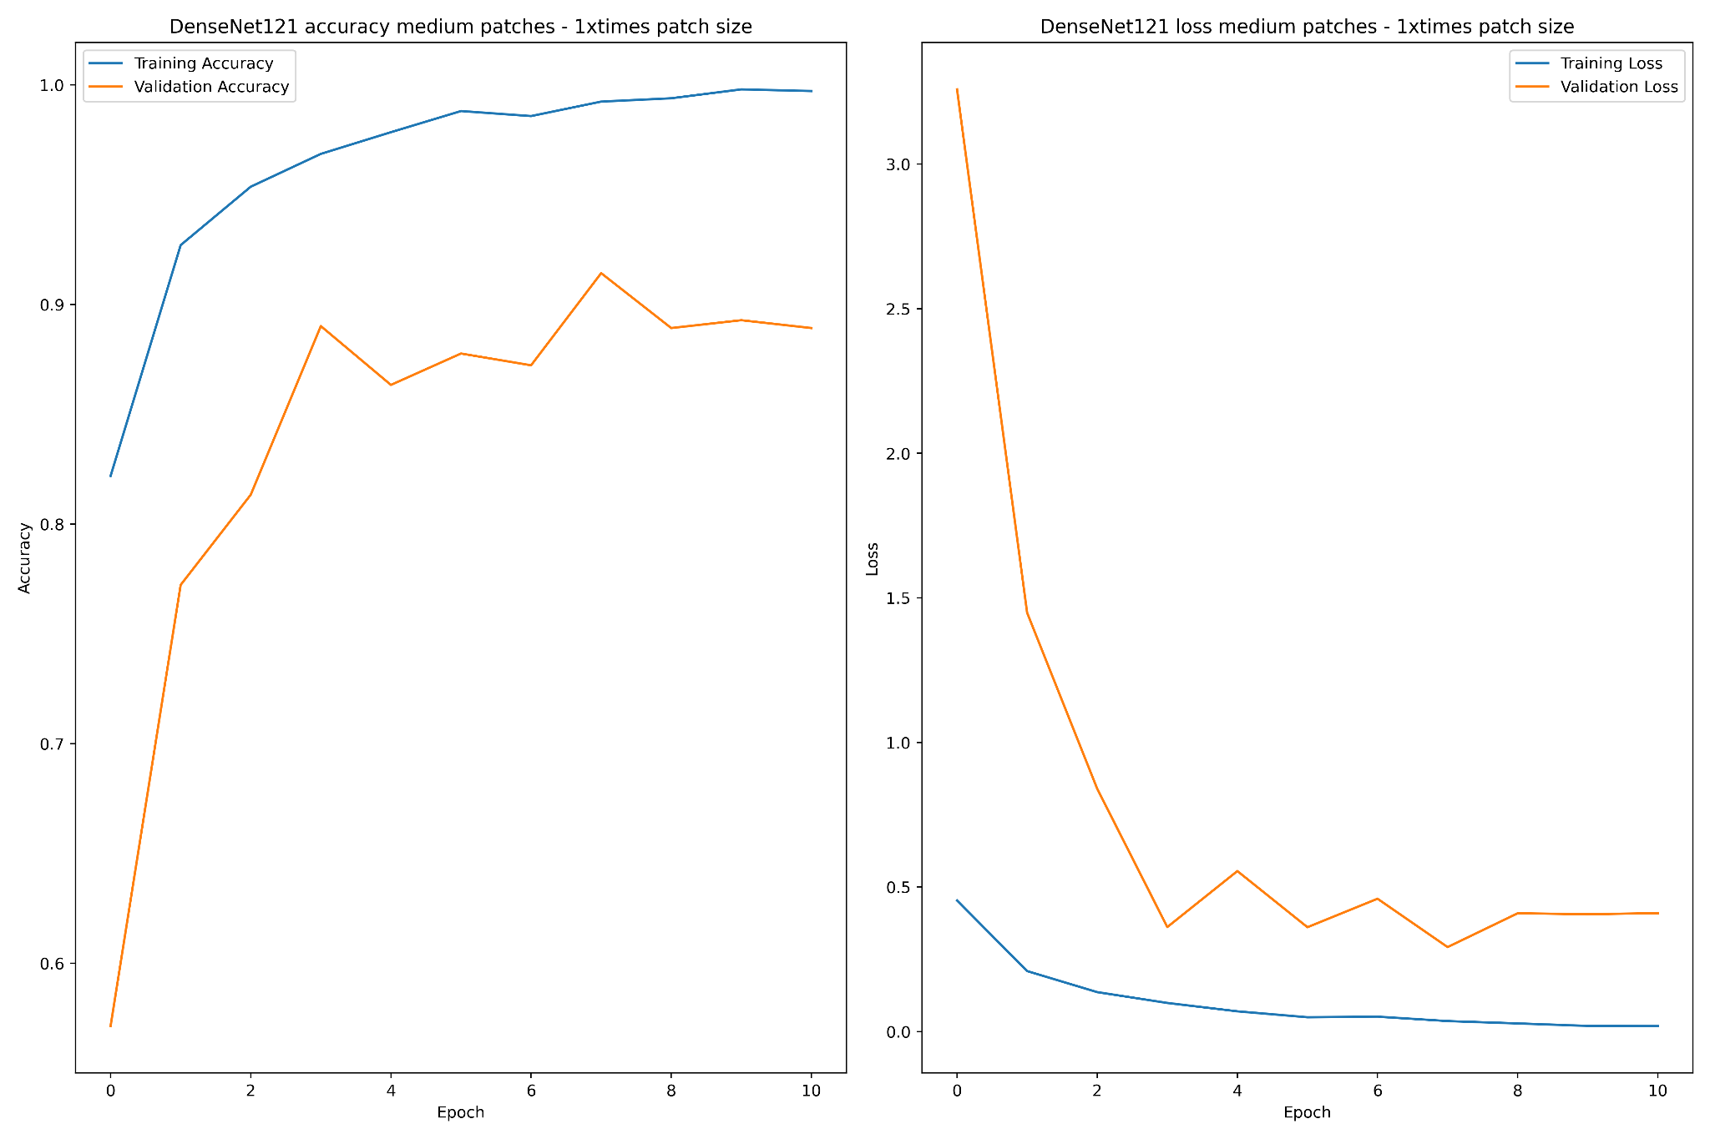
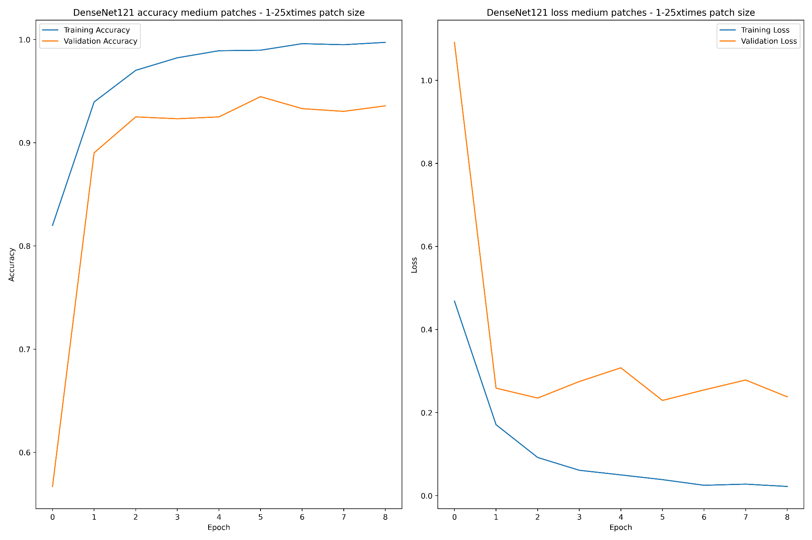
Results - Medium x1 and x1.25 DenseNet121

Slide 20
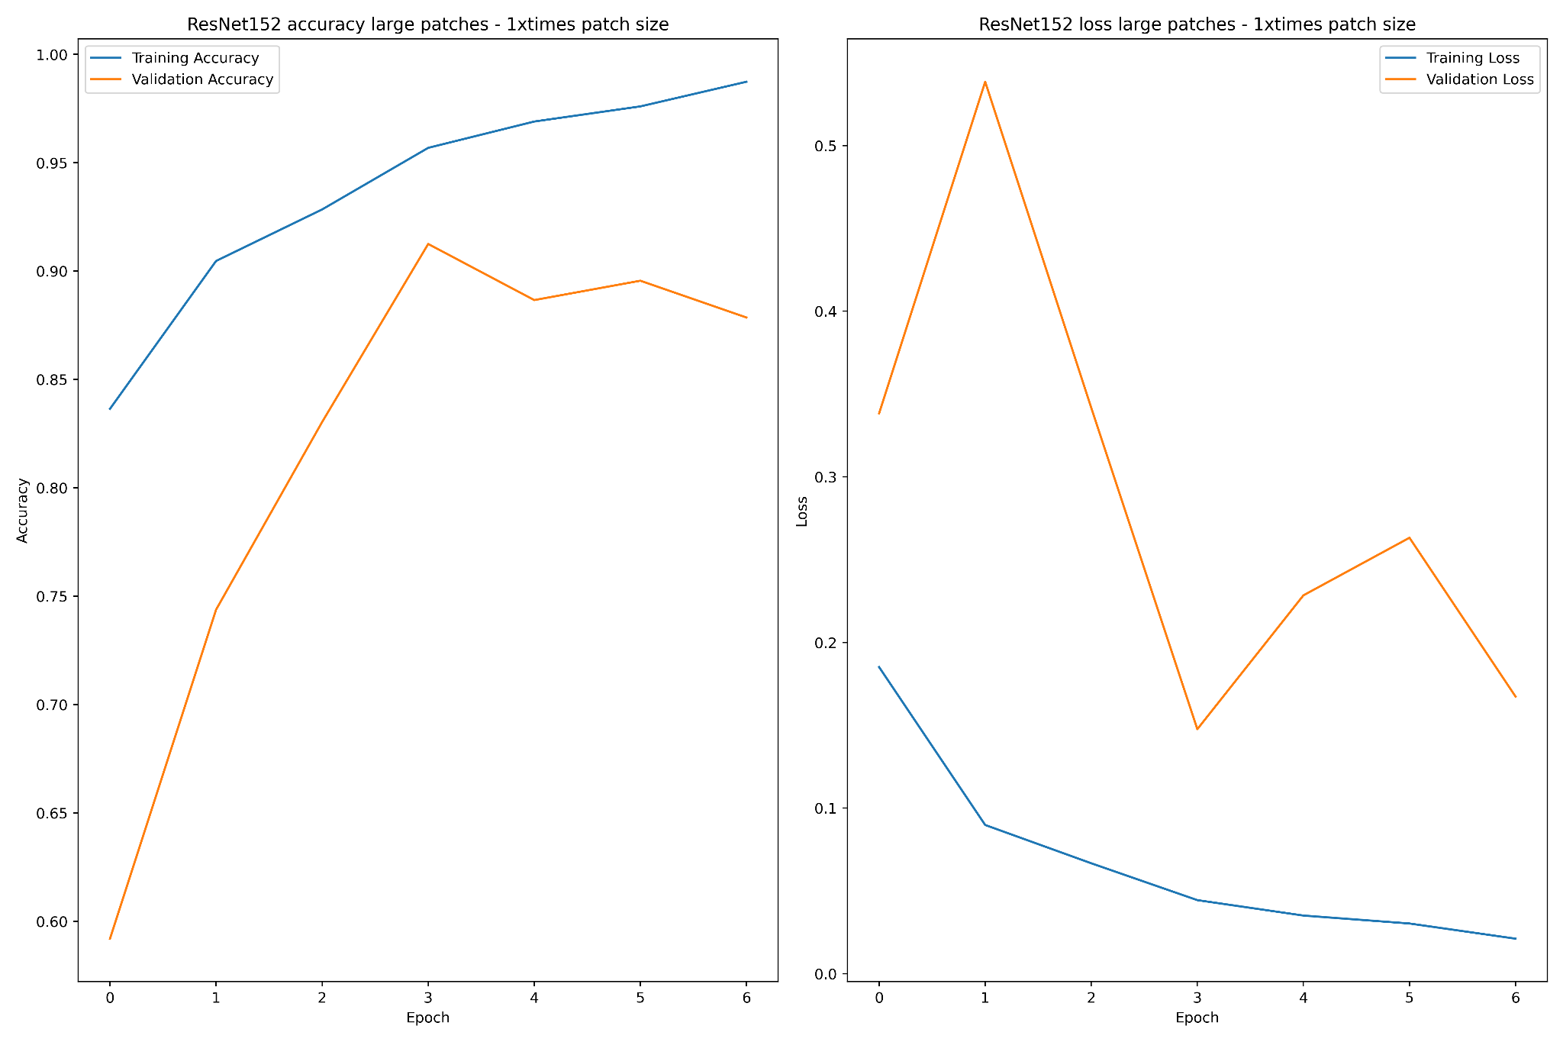
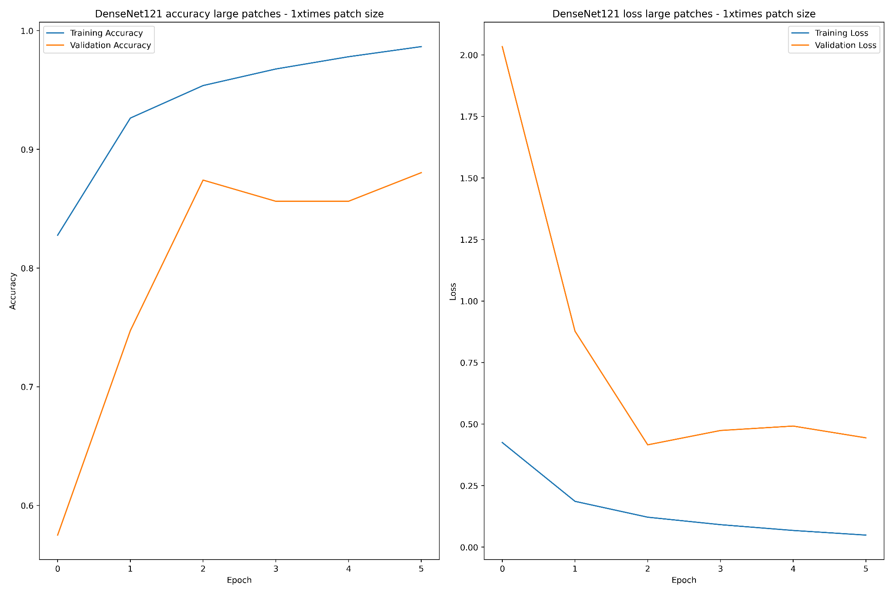
Results - Large x1 ResNet125 and Large x1 DenseNet121

Slide 21
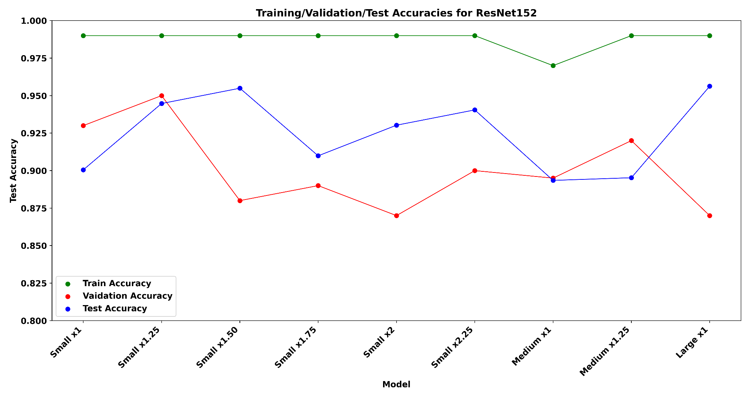
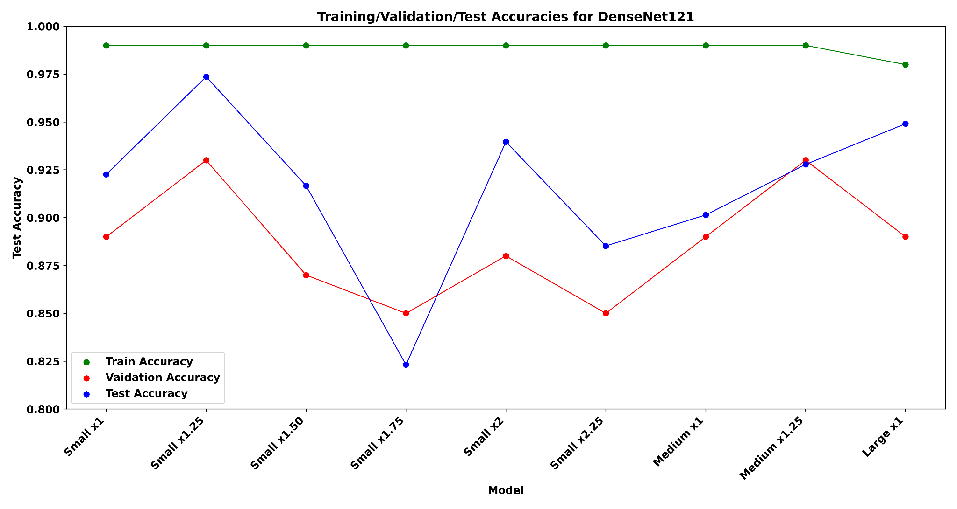
Small patches training/validation/test accuracy

Slide 22
Sliding Window Approach
0
0
0
0
0
0
0
1
0
0
0
0
0
0
0
0
0
0
0
0
Image Size = (3518, 2800, 3)
Patch size = (175x175)
Stride = (33, 33, 3),
# Windows = (102, 80)
Disadvantages:
Time consuming
Not to scale

Slide 23
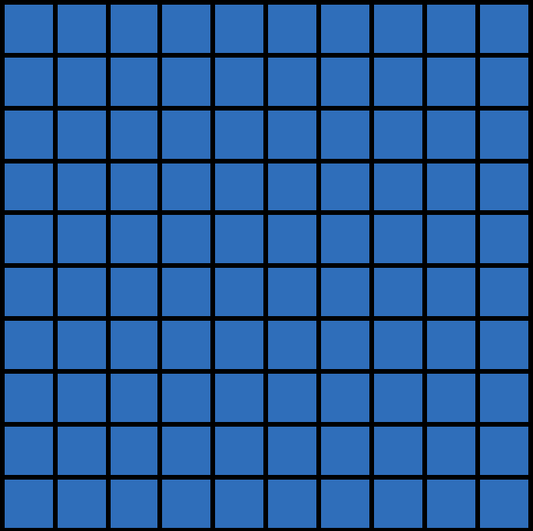
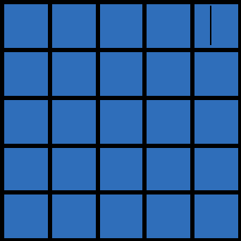
Convolutional Implementation of Sliding Window Approach
Training
MAX POOL
FC
FC
FC
5 X 5
2 X 2
5 X 5
1 X 1
1 X 1
14 X 14 X 3
10 X 10 X 16
5 X 5 X 16
1 X 1 X 400
1 X 1 X 400
1 X 1 X 4
Testing

Slide 24
Convolutional Implementation of Sliding Window Approach
Feature Maps
Trained
DenseNet121
/ ResNet152
Patch Classifier
f1 X f2
1 X 1
1 X 1
3518 x 2800 x 3
h X w X 3
h X w X 1024
h X w X 1024
106 x 83 x 2

Slide 25
Results with Whole Image

Slide 26
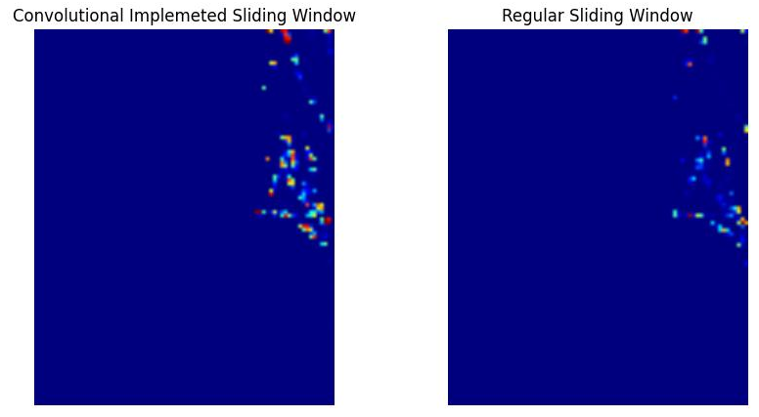
Results with Whole Image
CISW Duration: 2 Secs 841814 msec
SW Duration: 12.0 Mins 25 Secs 293741 msec

Slide 27
Results without Regularization
Without Dropout
With Dropout

Slide 28
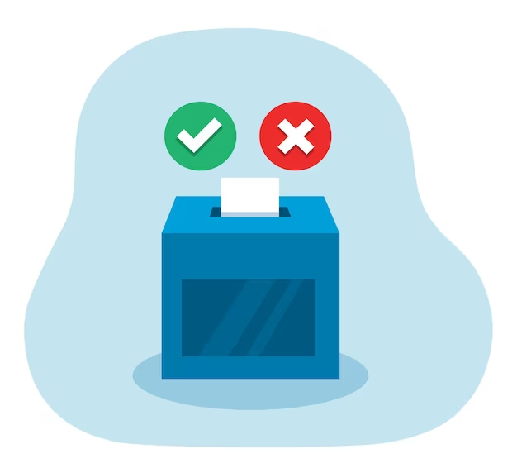
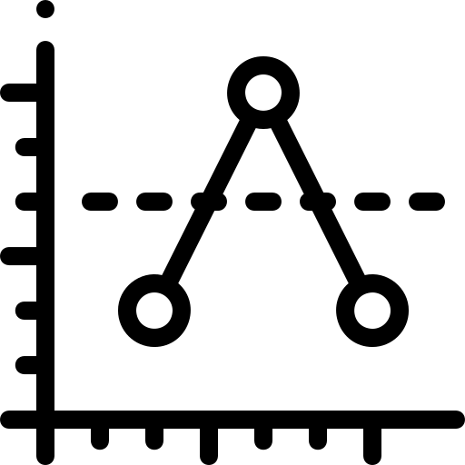
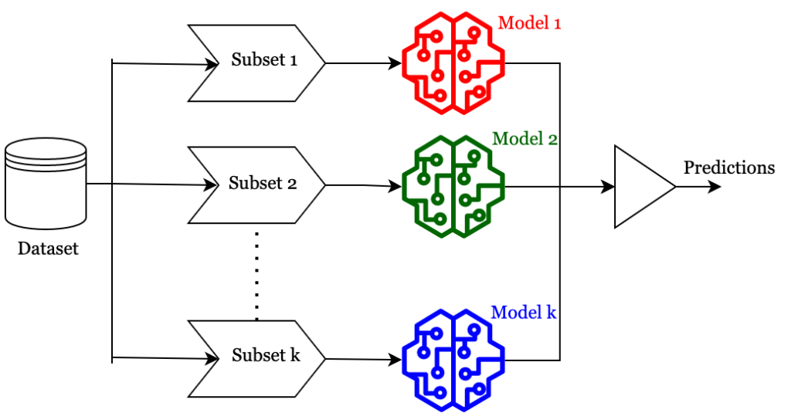
Aggregation Techniques
Multiple Instance Learning - Campanella 2019 - Requires large datasets
Majority vote of class predictions
Averaging the prediction scores
Compute a quantile function of the patch prediction scores to more fully characterize their distribution, then train a linear classifier from the quantile function or build quantile aggregation into a CNN
- Couture 2018a&b.
Other patch feature aggregation techniques.

Slide 29
Our Current Direction
Our Patch Classifier
Abnormal
GAP
Dense
1 X 1
Dense
Normal
3518 x 2800 x 3
h X w X 1024
106 x 83 x 2
106 x 83 x 2
2.

Slide 30
References
Hou, L., Samaras, D., Kurc, T. M., Gao, Y., Davis, J. E., & Saltz, J. H. (2016). Patch-based Convolutional Neural Network for Whole Slide Tissue Image Classification. Proceedings / CVPR, IEEE Computer Society Conference on Computer Vision and Pattern Recognition. IEEE Computer Society Conference on Computer Vision and Pattern Recognition, 2016, 2424–2433.
Kaur, G., Joseph, A. J., & Pournami. (2022, March 10). Patch-based All convolutional neural network model for classification of benign and malignant mammograms. 2022 IEEE International Conference on Signal Processing, Informatics, Communication and Energy Systems (SPICES). 2022 IEEE International Conference on Signal Processing, Informatics, Communication and Energy Systems (SPICES), THIRUVANANTHAPURAM, India. https://doi.org/10.1109/spices52834.2022.9774096
Quintana, G. I., Li, Z., Vancamberg, L., Mougeot, M., Desolneux, A., & Muller, S. (2023). Exploiting Patch Sizes and Resolutions for Multi-Scale Deep Learning in Mammogram Image Classification. Bioengineering (Basel, Switzerland), 10(5). https://doi.org/10.3390/bioengineering10050534
Xi, P., Shu, C., & Goubran, R. (2018). Abnormality Detection in Mammography using Deep Convolutional Neural Networks. In arXiv [cs.CV]. arXiv. http://arxiv.org/abs/1803.01906
Rangarajan, K., Gupta, A., Dasgupta, S., Marri, U., Gupta, A. K., Hari, S., ... & Arora, C. (2022). Ultra-high resolution, multi-scale, context-aware approach for detection of small cancers on mammography. Scientific reports, 12(1), 11622.

Slide 31
Thank You for Your Attention
Questions?

