Slide 1
Class Activation Maps as Attentions for Abnormality Classification in Mammograms
Aminul Huq and Mst. Tasnim Pervin

Slide 2
Motivation
Experiment on binary classification( Benign and Malignant) .
Identification of small, medium and large mass and calcification.
Improve classification performance by using class activation maps.

Slide 3
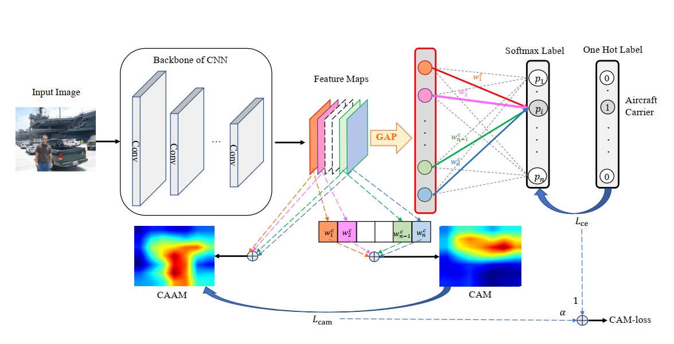
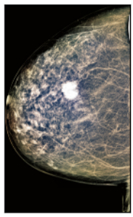

Related Works
Notes:
Max min normalization
Discard averaging in Lcam

Slide 4
Implementation Details
CAM-Loss integration after 15 epochs
Copying an instance in each iteration for preserving gradients to generate class activation maps
Class Agnostic Activation Map
Saliency Map
Notes:
GMIC

Slide 5
Data Augmentation and Preprocessing
Dataset:
INbreast - Benign: 220, Malignant: 123, Total: 343
Ignored Normal ones.
Training & Validation: 80% (90% & 10%)
Testing: 20%
Preprocessing:
Training:
  Cropped images according to the contours to remove as much black images as possible.
  Perform Truncation Normalization
  CLAHE(1.0 and 2.0)
  Resized into 1024 x 768
Validation & Testing :
  Resized into 1024 x 768
  No augmentation applied
Training Augmentations
Random Horizontal Flip
Random Vertical Flip
Random Rotation
Random Auto Contrast
Random Adjust Sharpness
TABLE I. Data Distribution after Preprocessing
Training (After Augmentation) |  | Validation |  | Testing
Benign | Malignant | Benign | Malignant | Benign | Malignant
352 | 140 | 16 | 10 | 47 | 20

Slide 6
Model Description & Hyper-parameter
ResNet-34
Focal Loss (gamma = 2)
Adam Optimizer
Learning Rate 0.0002
Reduce Learning Rate on Plateau
Batch Size - 8
Epochs - 50 - Choose the model with best validation performance

Slide 7
Experiments
ResNet34 vs Finetuned ResNet34
Class Agnostic Activation Maps vs Saliency Maps
ResNet34 vs ResNet34+CAMloss
ResNet34+CAMloss (GradCAM vs LayerCAM )
Small vs Medium vs Large

Slide 8
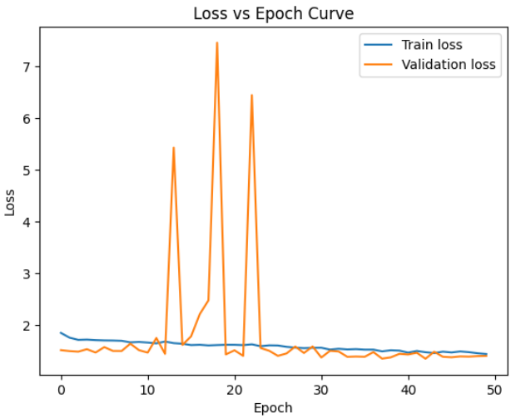
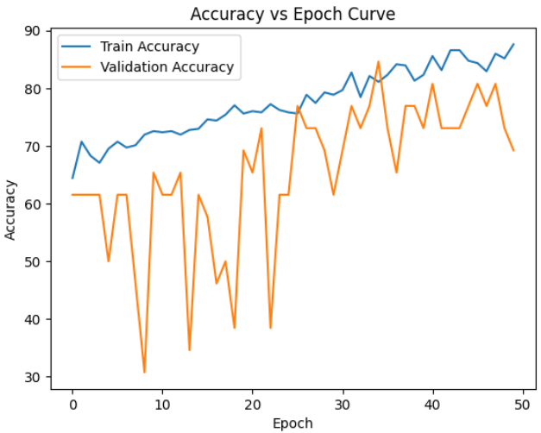
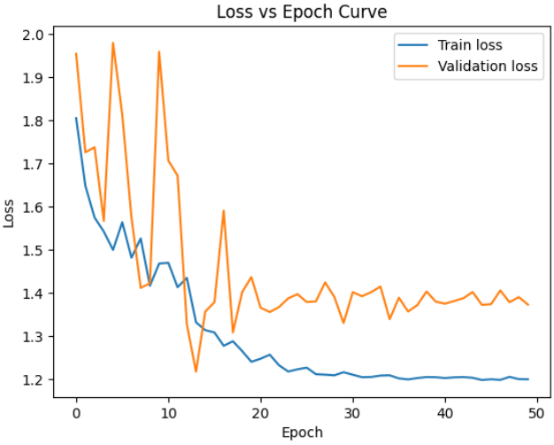
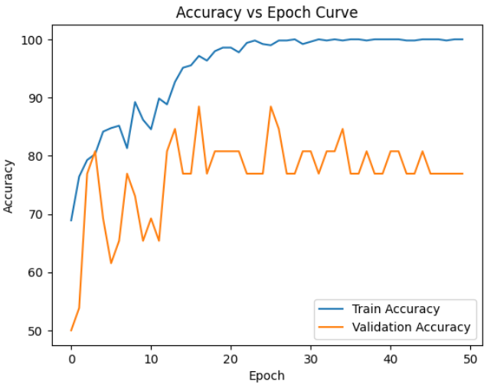
ResNet34 vs Finetuned ResNet34
Without Finetuning
Froze initial 2 layers
 | Training Acc | Validation Acc | Testing Acc
Without Finetuning | 83.74 | 84.62 | 73.13
With Finetuning | 98.98 | 88.46 | 82.09

Slide 9
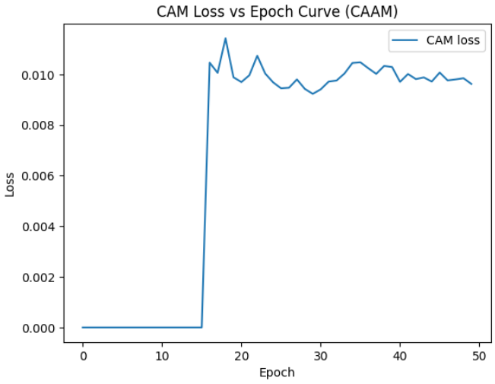
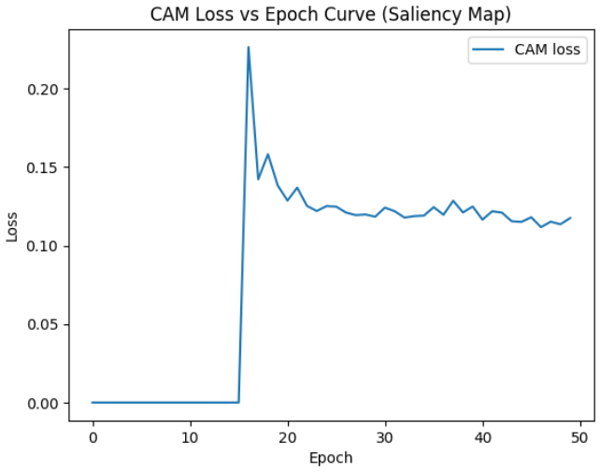
Class Agnostic Activation Maps vs Saliency Maps
Only the difference between (CAM-Saliency) is shown in the graph
 | Training Acc | Validation Acc | Testing Acc
CAM-Loss (CAAM) | 98.17 | 88.46 | 82.09
CAM-Loss (Saliency) | 100.00 | 88.46 | 83.58

Slide 10
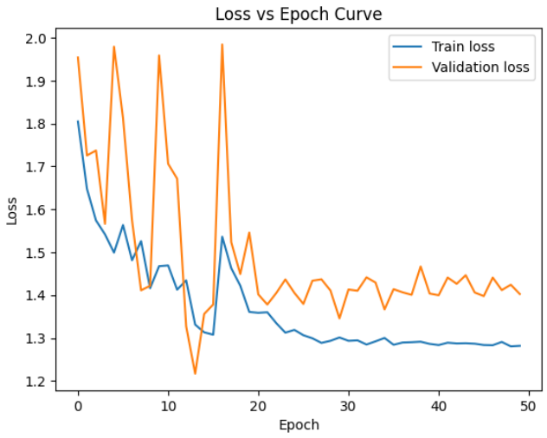
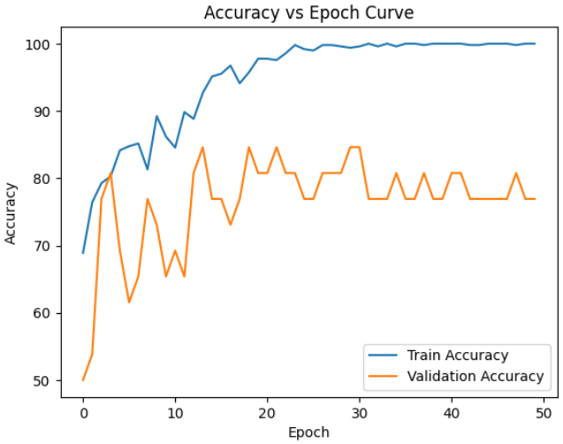
ResNet34 vs ResNet34+CAM-Loss
ResNet-34
 | Training Acc | Validation Acc | Testing Acc
ResNet-34 | 98.98 | 88.46 | 82.09
ResNet-34 + CAM Loss (Saliency) | 95.73 | 84.62 | 86.57
 | Precision | Recall | F1 Score
ResNet-34 | 81.69 | 82.08 | 81.04
ResNet-34 + CAM Loss (Saliency) | 87.31 | 86.56 | 85.60
ResNet-34 + CAMLoss

Slide 11
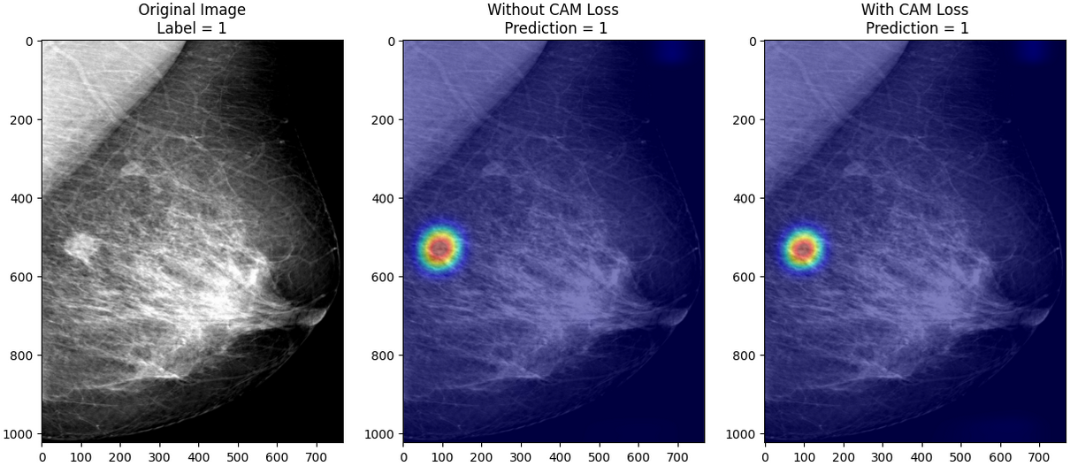
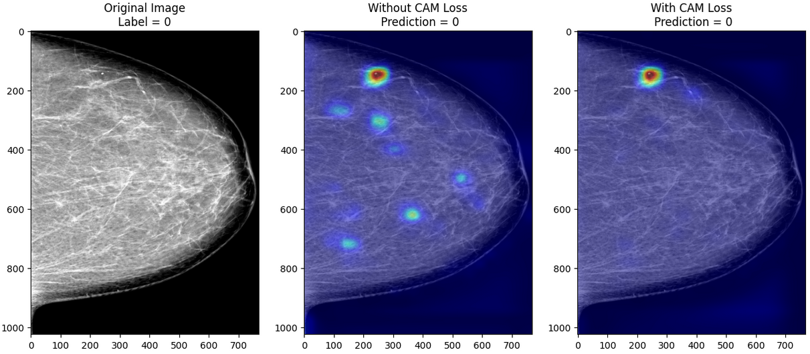

Slide 12
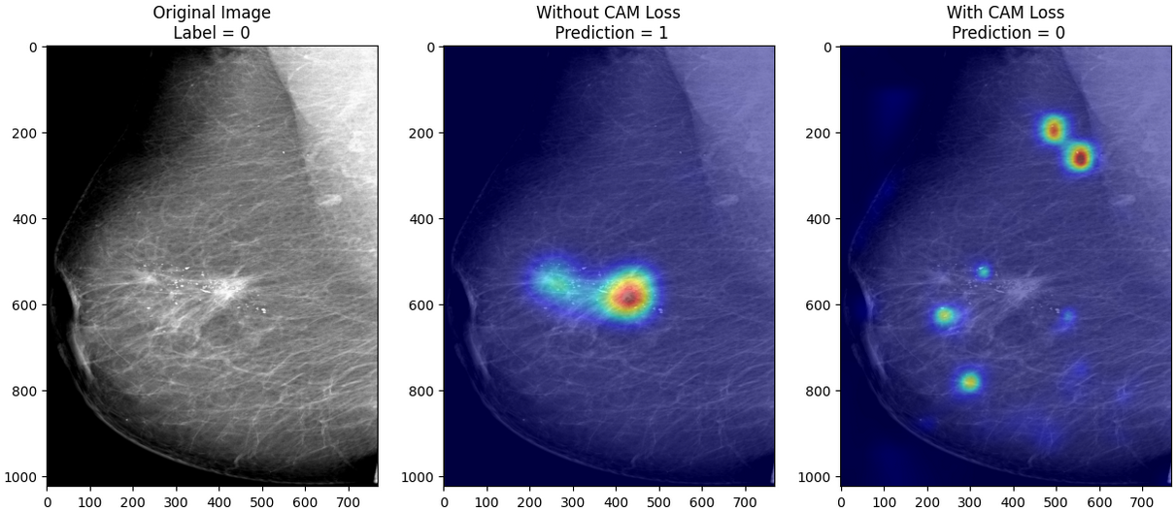
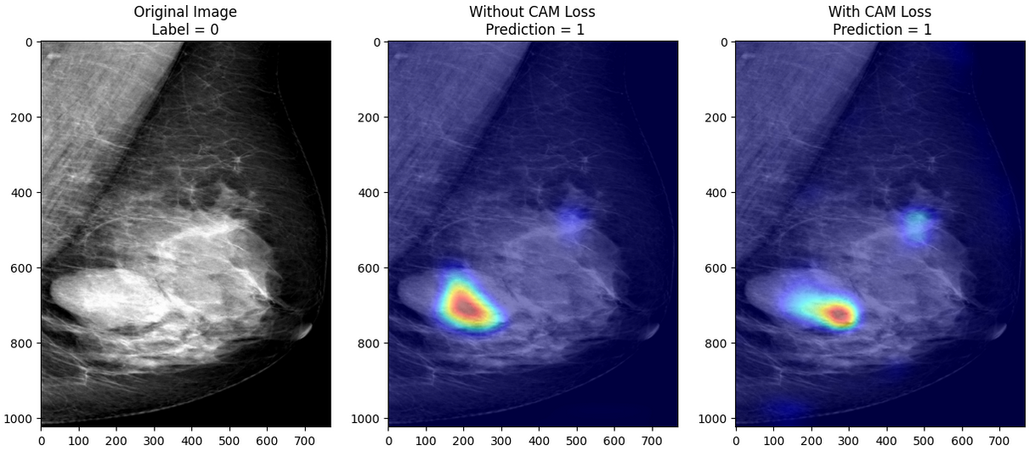

Slide 13
ResNet34 +CAMLoss (GradCAM vs LayerCAM)
 | Training Acc | Validation Acc | Testing Acc
CAM-Loss(GradCAM) + L2 distance | 100 | 88.46 | 82.09
CAM-Loss(GradCAM) + L1 distance | 92.68 | 84.62 | 86.57
CAM-Loss(LayerCAM) + L2 distance | 95.73 | 84.62 | 86.57
CAM-Loss(LayerCAM) + L1 distance | 97.76 | 88.46 | 83.58

Slide 14
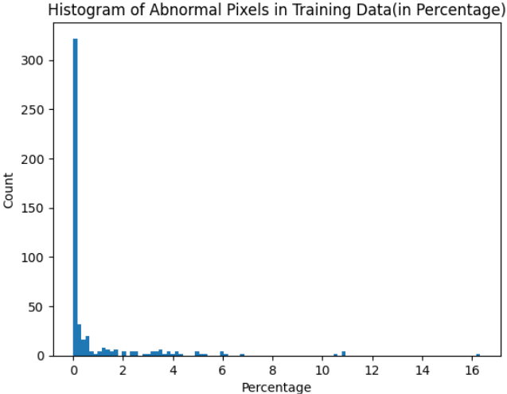
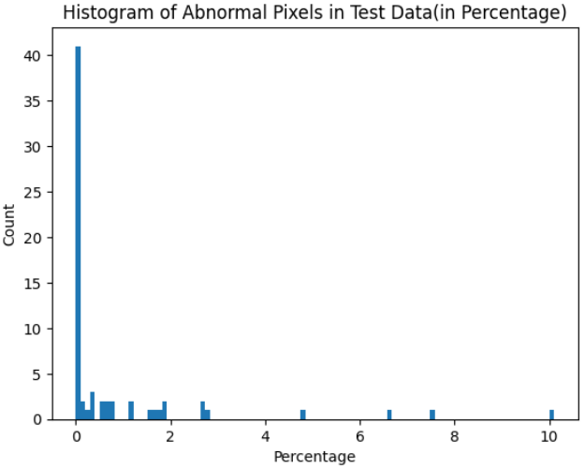
Small vs Medium vs Large
Included both Malignant and Benign
 | Small (0-0.5%) | Medium (0.5-3%) | Large (>3%)
Training | 372 | 66 | 54
Testing | 47 | 16 | 4

Slide 15
Small vs Medium vs Large Performance
 | Small | Medium | Large
Train Data | 96.50 (13 msclf) | 100 (0 msclf) | 98.15 (1 msclf)
Test Data | 91.48 (4 msclf) | 75.00 (4 msclf) | 75.00 (1 msclf)
Predicted benign but should be malignant
Predicted malignant but should be benign

Slide 16
Challenges & Future Work
Disruption of gradients to generate class activation maps
Using too many augmentations
Long training time

Slide 17
Thank You!

