Slide 1
Final Project Presentation
Synthesis of CC view (from MLO/CC view) mammogram using Cycle-GAN followed by multi-view breast cancer classification using Parameterized hypercomplex neural network.
By
Neha Ujjainkar & Abhishek Khandekar

Slide 2
Problem Statement
.
Synthesis of CC view (from MLO/CC view) mammogram using Cycle-GAN followed by multi-view breast cancer classification using Parameterized hypercomplex neural network.

Slide 3
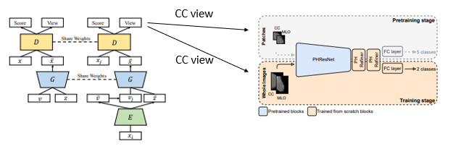
Initial approach
.
  Task 1: CC view generation from the MLO view by using the CR-GAN network.
  Task 2: To employ parameterized hypercomplex ResNets (PHResNets) for multi-view breast cancer classification

Slide 4
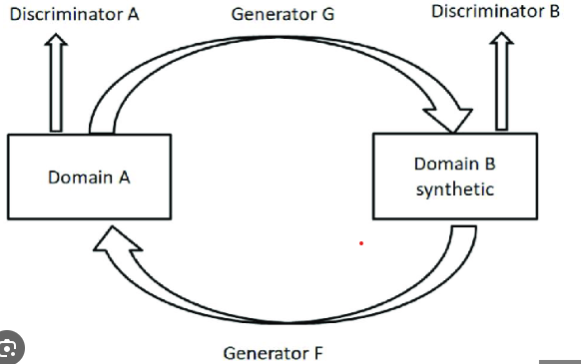
Current approach
.
CC/MLO
  Task 1: CC view generation by using the Cycle-GAN.
  Task 2: To employ parameterized hypercomplex ResNets (PHResNets) for multi-view breast cancer classification

Slide 5
Dataset
.
1054 pairs from CBIS-DDSM (3000 x 4500 to 4000 x 5700)
188 pairs from INBreast (3328 x 4084 or 2560 x 3328)
330 pairs from MIAS (1024x1024)

Slide 6
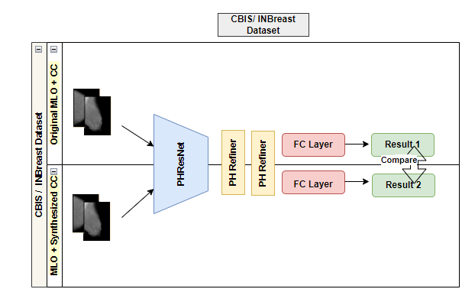
Method
.

Slide 7
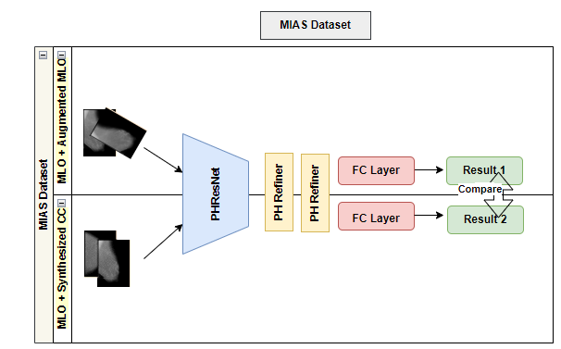
Method
.

Slide 8
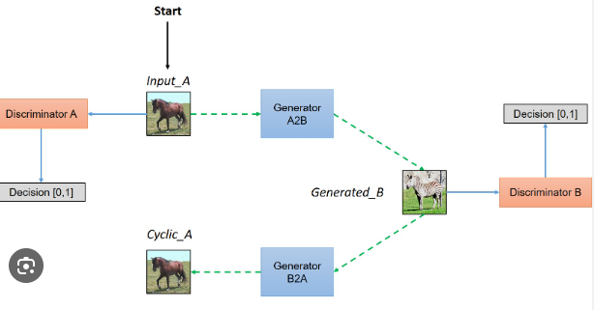
Cycle-GAN
.
Cycle-GAN

Slide 9
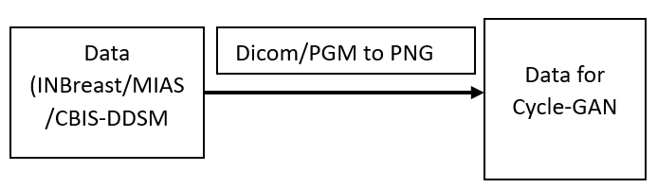
Data Preparation
.
Cycle-GAN :

Slide 10
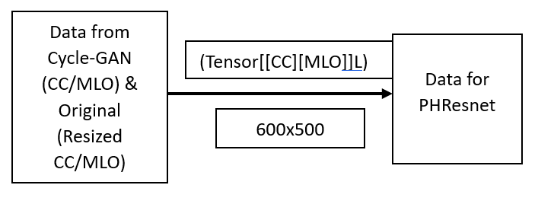
Data Preparation
.
PHResNets

Slide 11
Evaluation Matrix
.
Cycle-GAN:
None
PHResNets:
AUC
Accuracy

Slide 12
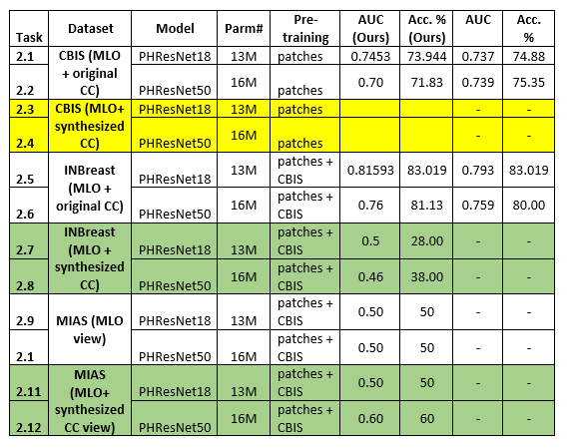
Results
.

Slide 13
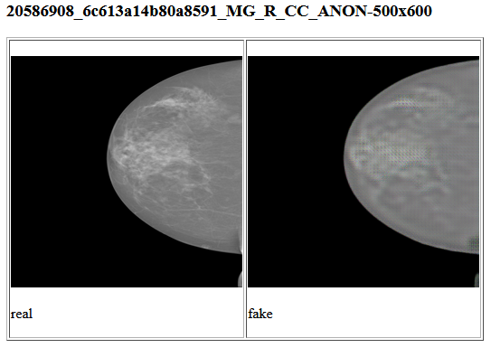
Result
.
INbreast:

Slide 14
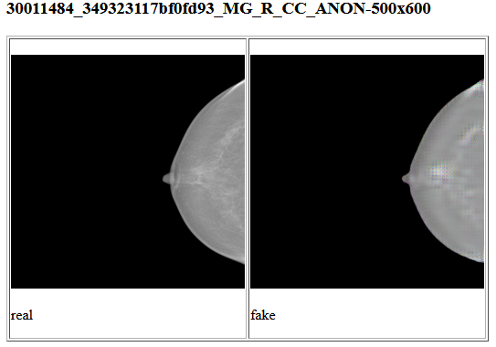
Result
.
INbreast: Malignant

Slide 15
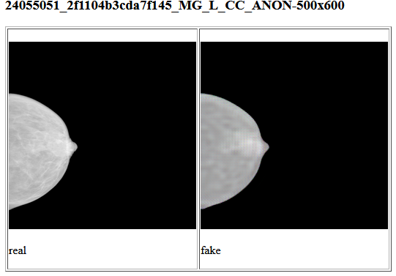
Result
.
INbreast: Benign

Slide 16
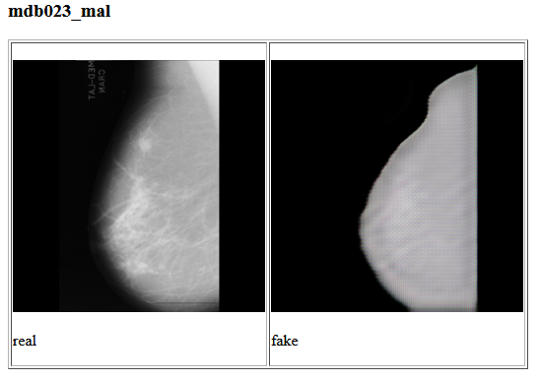
Result
.
MIAS: Malignant

Slide 17
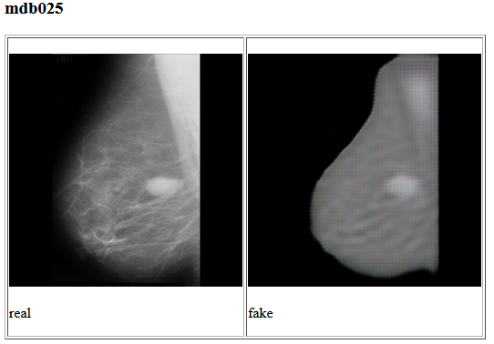
Result
.
INbreast: Benign

Slide 18
Challenges
.
CR-GAN code was not available.
PHResNets Code is not available for Single views.
Cycle-GAN does not accept DICOM images.
Cycle-GAN while processing converted the input to the resolution of 256X256 and accordingly it might lose some details.
Generated CC views (in Cycle-GAN) have different depths than the input required for PHResNets.
PHResNets accepts input only in the Pytorch tensor form.
PHResNets require a two-view or four-view image tensor.
CUDA out of memory.

Slide 19
Advantages
.
We are able to generate synthesized CC views (for MIAS dataset) and perform breast cancer classification.
We performed this experiment on multiple data sets like MIAS, INBreast and CBIS-DDSM.
We also observed that the generated CC views for MIAS helped improve breast cancer classification accuracy by PHResnets when compared to only using Single-view mammograms.

Slide 20
Drawbacks
.
Synthesized Images are of low quality.
Accuracy needs to be improved.
We cannot evaluate the generated images.
Resizing the high-resolution input images to low resolution during image synthesis causes information loss.
Performance of PHResNets is not expected in calcification cases.

Slide 21
Future Improvement
.
We would like to explore other models to improve synthesized image quality and resolution.
We would like to perform our experiment on other large datasets.
We would like to update and enhance our experiment based on latest relevant studies.

Slide 22
Conclusion
.
In this experiment, we tried to incorporate the innovative approach of breast cancer classification using PHResnets to leverage information in multi-view mammograms while exploiting the correlation between different views. (Similar to the Radiologist)
As noted earlier, we were able to demonstrate that the breast cancer classification for single-view mammograms could be improved using the synthesized views.

Slide 23
Timeline and Milestones
.
Sr. No | Milestones | Duration | Completion Date
1 | Defining the problem statement. | 1 week | 10/8/2023
2 | Submit the Project Proposal. | 1 week | 10/16/2023
3 | Data Exploration and data analysis for task 2. (non-synthesized image only) | 1 week | 10/22/2023
4 | Splitting the data and pretraining the network on patches for task 2. (non-synthesized image only) | 1 week | 10/29/2023
5 | Splitting the data and training the model on the whole image for task 2. (non-synthesized image only) | 1 week | 11/5/2023
6 | Evaluate the performance of the model for task 2. (non-synthesized image only) | 1 week | 11/11/2023
7 | Data exploration and data analysis for task 1. | 0.5 week | 11/14/2023
8 | Implementation of CR-GAN for task 1. | 2 weeks | 11/28/2023
9 | Splitting the data and training the model for task 1. | 0.5 week | 12/2/2023
10 | Evaluate the performance of the model for task 1 | 0.25 week | 12/4/2023
11 | Data Exploration and data analysis for task 2. (Original MLO +synthesized CC image only) | 0.5 week | 12/7/2023
12 | Splitting the data and pretraining the network on patches for task 2. (Original MLO +synthesized CC image only) | 0.5 week | 12/10/2023
13 | Splitting the data and training the model on the whole image for task 2. (Original MLO +synthesized CC image only) | 0.5 week | 12/12/2023
14 | Evaluate the performance of the model for task 2. (Original MLO +synthesized CC image only) | 0.5 week | 12/14/2023
15 | Final testing. | 0.5 week | 12/17/2023
16 | Project Presentation | 0.5 week | 12/18/2023
17 | Submit Final Project Report. | 0.5 week | 12/22/2023

Slide 24
References
1. Yamazaki, A., & Ishida, T. (2022). Two-View Mammogram Synthesis from Single-View Data Using Generative Adversarial Networks. Applied Sciences, 12(23), 12206. https://www.mdpi.com/2076-3417/12/23/12206
2. Tian, Y., Peng, X., Zhao, L., Zhang, S., & Metaxas, D. N. (2018). CR-GAN: learning complete representations for multi-view generation. arXiv preprint arXiv:1806.11191. https://arxiv.org/abs/1806.11191
3. Geras, K. J., Wolfson, S., Shen, Y., Wu, N., Kim, S., Kim, E., ... & Cho, K. (2017). High-resolution breast cancer screening with multi-view deep convolutional neural networks. arXiv preprint arXiv:1703.07047. https://arxiv.org/abs/1703.07047
4. Lopez, E., Grassucci, E., Valleriani, M., & Comminiello, D. (2022). Multi-View Breast Cancer Classification via Hypercomplex Neural Networks. arXiv e-prints, arXiv-2204. https://arxiv.org/pdf/2204.05798.pdf
5.Liu, Y., Zhang, F., Chen, C., Wang, S., Wang, Y., & Yu, Y. (2021). Act like a radiologist: towards reliable multi-view correspondence reasoning for mammogram mass detection. IEEE Transactions on Pattern Analysis and Machine Intelligence, 44(10), 5947-5961. https://ieeexplore.ieee.org/abstract/document/9444895
6.Yang, Z., Cao, Z., Zhang, Y., Tang, Y., Lin, X., Ouyang, R., ... & Ma, J. (2021). MommiNet-v2: Mammographic multi-view mass identification networks. Medical Image Analysis, 73, 102204. https://www.sciencedirect.com/science/article/pii/S1361841521002498

Slide 25
.
Thank You

