Slide 1
Finding Tiny Masses
Final Report
Presented by Kelly Chinander & Ronald Du
December 20th, 2023

Slide 2
Slides
Project Recap
Modifications
Methodology
CBIS-DDSM Mask to Image Ratio
Ratio Classification
Pre-processing
Data Augmentation
Hypercolumn
Metrics
Results
Results Summary
Issues Faced
Future Possibilities
Questions?
References

Slide 3
Project Recap
For our project Finding Tiny Masses, we proposed that the techniques in Finding Tiny Faces could be applied to mass classification in mammograms to improve small mass classification.
By training a model to classify masses and then evaluating the model with different scaled variations of the input image and incorporating the hypercolumn algorithm, we propose that the model will be better at identifying small masses in the mammograms.

Slide 4
Modifications
After meeting with Dr Bebis, we modified a few goals of our project:
Do classification of masses (benign vs malignant)
Get CBIS-DDSM dataset (replaced MIAS)
Create histogram of mask to image size ratio
Use Finding Tiny Faces code
Add scale-invariance and hypercolumn
Measure accuracy between different hypercolumn combinations

Slide 5
Methodology
Preprocess data
Convert from DICOM to PNG, standardize names
Normalize image heights (all 1024px currently)
Scale and crop (from Finding Tiny Faces)
Augment data
90 degree rotations, CLAHE
Train model - ResNet101
Build hypercolumn (from Finding Tiny Faces)
Evaluate accuracy with different configurations

Slide 6
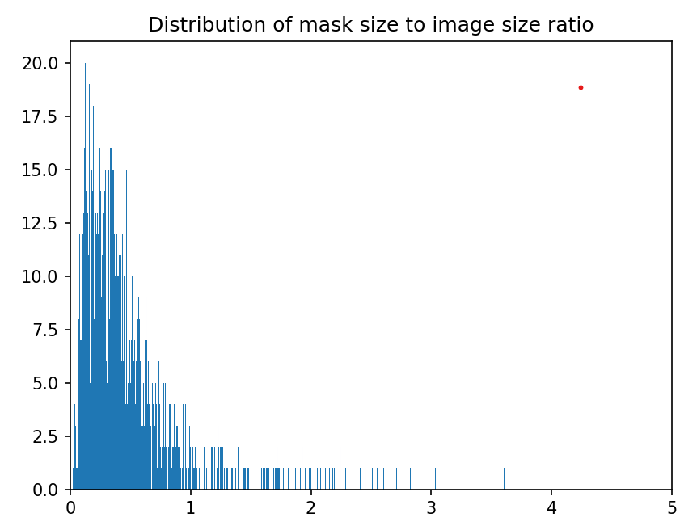
CBIS-DDSM Mask to Image Ratio

Slide 7
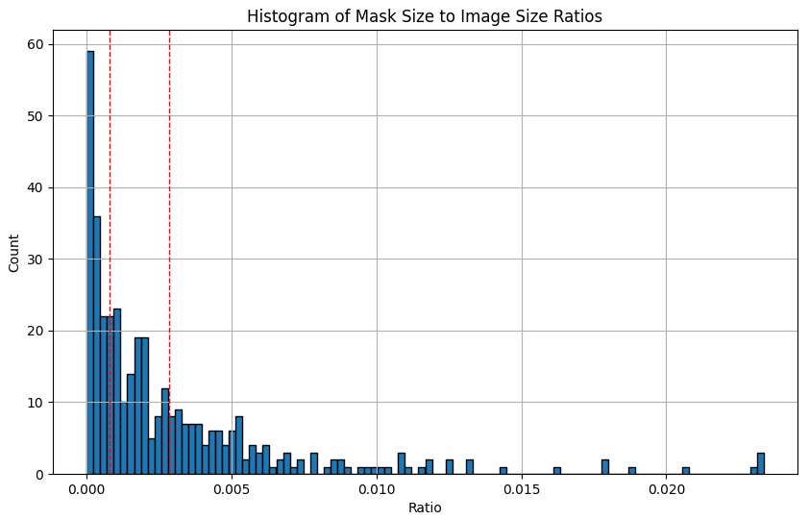
CBIS-DDSM Mask to Image Ratio

Slide 8
Ratio Classification
Lower 33 percentile = 0.000737
Upper 33 percentile = 0.002775
 | Small | Medium | Large
Ratio | Less than 0.000737 | Between 0.000737 and 0.002775 | Above 0.002775

Slide 9
Pre-processing
Converted to PNG from DICOM
Normalized height to 1024, testing 2048 as well
Standardized naming for images and masks
Focused only on Mass, dropped the Calc data

Slide 10
Data augmentation
Random scale 0.5x, 1x, 2x like Finding Tiny Faces
Crop image centered on mask centroid
currently 300x300, testing 200x200
Rotation of image 0 + 90 + 180 + 270
Added CLAHE version of image too

Slide 11
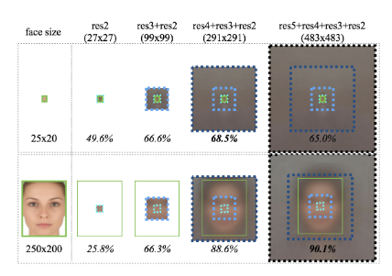
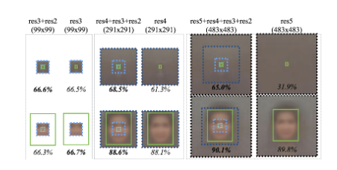
Hypercolumn
Create a hypercolumn layer comprised of the region of interest across different layers of the model.

Slide 12
Metrics
We measured accuracy, broken out by the small / medium / large ratio values
Sample measurements from a training run
Epoch | Train Accuracy | Small Train Acc | Medium Train Acc | Large Train Acc | Val Accuracy | Small Val Acc | Medium Val Acc | Large Val Acc
1 | 53.9439 | 51.9924 | 56.2862 | 58.3180 | 41.0058 | 58.8592 | 54.9266 | 48.2556
2 | 56.1084 | 53.5104 | 58.2205 | 56.4899 | 45.6479 | 59.3655 | 57.9270 | 51.2226

Slide 13
Results

Slide 14
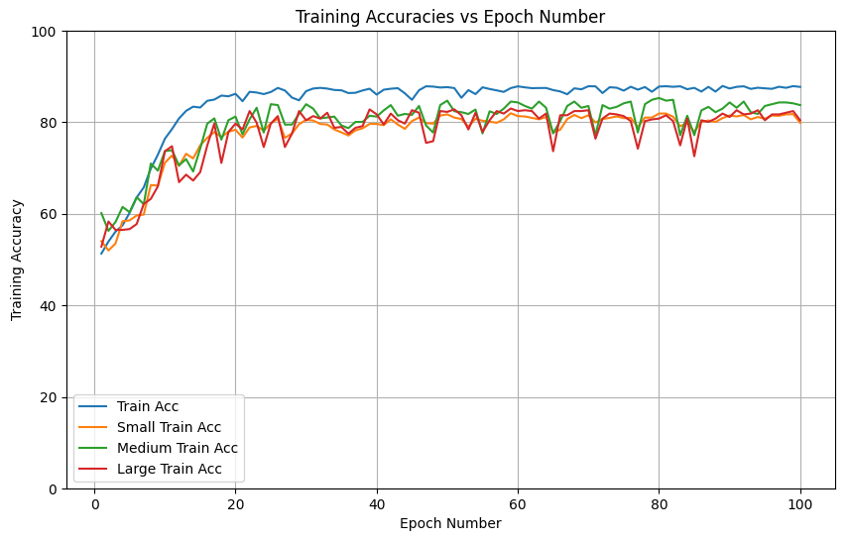
Training Accuracy - Baseline

Slide 15
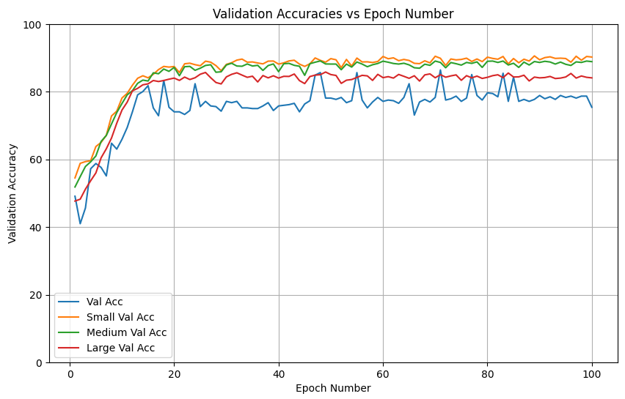
Validation Accuracy - Baseline

Slide 16
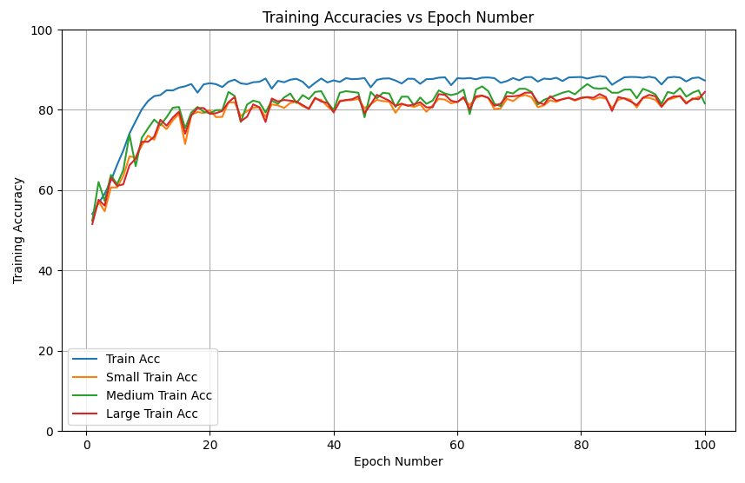
Training Accuracy - ResNet50

Slide 17
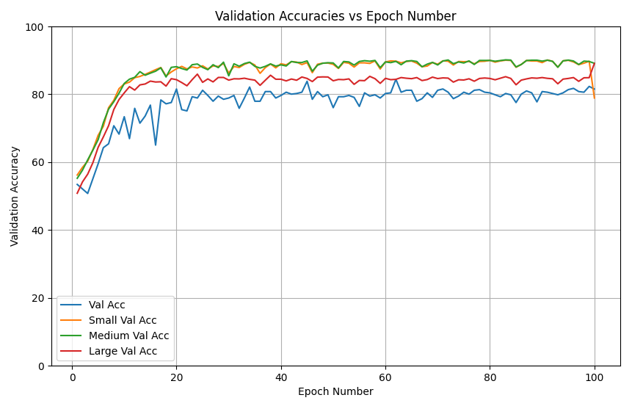
Validation Accuracy - ResNet50

Slide 18
Test Accuracy
Model | Overall Accuracy | Small Accuracy | Medium Accuracy | Large Accuracy
ResNet101 | 55.9854 | 56.1000 | 58.4677 | 53.4884
ResNet50 | 51.8519 | 52.7000 | 52.7218 | 50.1938

Slide 19
Results Summary
Summarization of high points
Waiting on hypercolumn results… see Zoom presentation!
Training & validation accuracy seem to top out around 80%
Validation total accuracy is less than the individual accuracies… may be an indication of a bug?
Test accuracies are significantly lower - is this overfitting or a shared issue with the eval code?

Slide 20
Issues Faced
Hypercolumn generation
CBIS-DDSM data structure inconsistencies
DICOM format
Converting Finding Tiny Faces code from detection to classification
Time…

Slide 21
Future Possibilities
Need to run more configuration variations for better data analysis
Different base models, loss functions, optimizers
Different input image sizes, scale factors
Focused on classification, could potentially be expanded to use Finding Tiny Face’s detection capabilities
Need to calculate bounding boxes from mask centroids
Update template generation from faces to masses

Slide 22
Questions?

Slide 23
References
Peiyun Hu, Deva Ramanan. “Finding Tiny Faces”, CVPR 2017.

