Slide 1
Enhancing Breast Cancer Diagnosis Through BEMD-Guided Mass Classification
Negar Maghsoudi – Ashkan Reisi

Slide 2
Introduction - Recap
Aim to utilize BEMD to decompose the mammogram images, into Bi-dimensional Intrinsic Mode Functions (BIMFs) → each capturing different scales or patterns within the data
The BIMFs will capture various image features, from fine textures to larger structures
Network training → involves feeding each set of BIMFs into network channels, which is expected to enhance the accuracy and efficiency of our analysis.

Slide 3
Data
CBIS-DDSM Data
ROI image
Total | ~ 1660
Training and validation | ~1300 ( 80 - 20 ratio)
Test | ~360

Slide 4
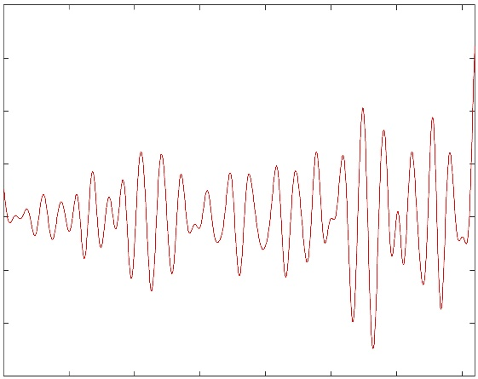
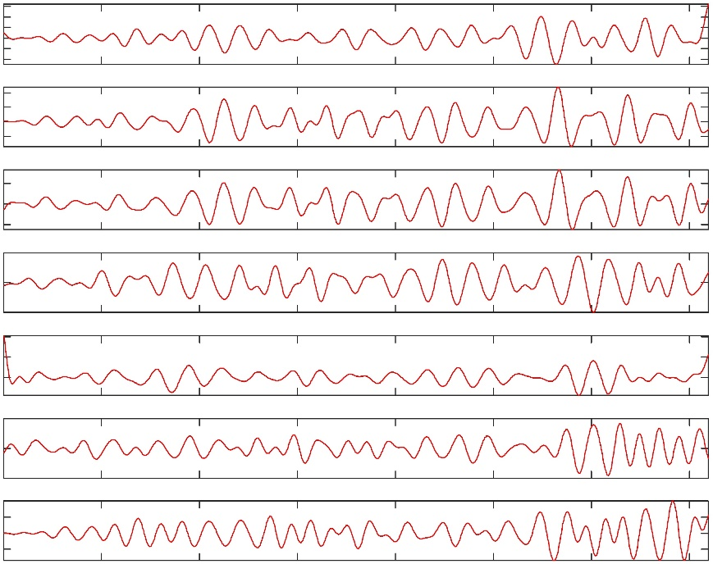
Framework Structure
1
$${Bimf}_{1}$$
BEMD
2
$$Network Input$$ Construction
3
$${Bimf}_{2}$$
$${Decomposed ROIS}_{1}$$
4
$$B{imf}_{3}$$
5
$$B{imf}_{4}$$
$$Bimf5$$
B${imf}_{5}$
ROIs
Decomposition
$${imf}_{6}$$
Putting Bimfs of each image together
Bimfs
Input size: 1300 images of 320*320*5
Malignant
Deep learning model
Benign
Classification
Training

Slide 5
Data Preprocessing
Contrast Limited Adaptive Histogram Equalization (CLAHE) enhancement
Aspect ratio consideration: r = w/h.
Excluding images with: I = {I | I ∈ R^{w×h}, 0.4 ≤ r ≤ 1.5}
Resizing ROI images → Cropped the resized image around its center → 320*320
Denoising by fast non-local means denoising algorithm

Slide 6
Pre-processing

Slide 7
BEMD
Data checking to make sure the input data type is appropriate and numerical operations can be performed with floating-point accuracy.
Initializing values for the data to be sifted and BIMF index are done
Sifting process: The 2D signal (input image) will be taken as input and a while loop iteratively applies the sifting process -> the cost of the BIMF is computed as a ratio of the sum of squared differences between the BIMF and the input signal. If the cost is below a certain threshold, the loop is broken.
After breaking out of the loop, the residue is computed by subtracting the computed BIMF from the original input image. At last, the BIMFs are stored in the BIMF matrix.

Slide 8
Decomposed Images

Slide 9
Decomposed Images

Slide 10
ResNet50
ResNet50 framework
Less trainable parameters: 200 million→20 million
Faster
Played with hyperparameters
L2 regularization – Early stopping (10 Epochs) – Data augmentation
Applied cross fold validation : k=5

Slide 11
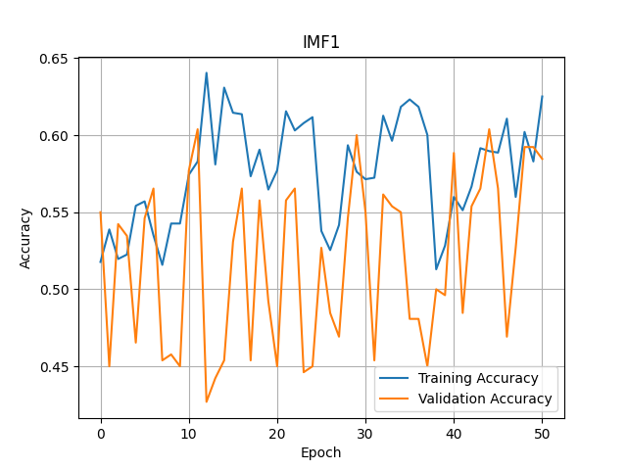
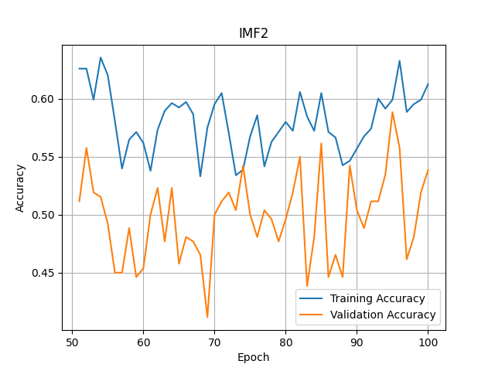
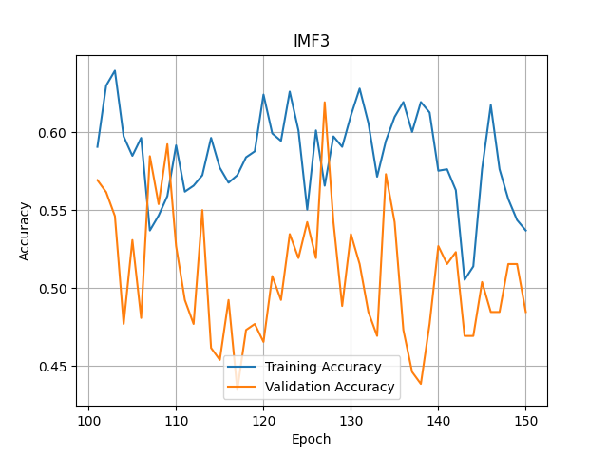
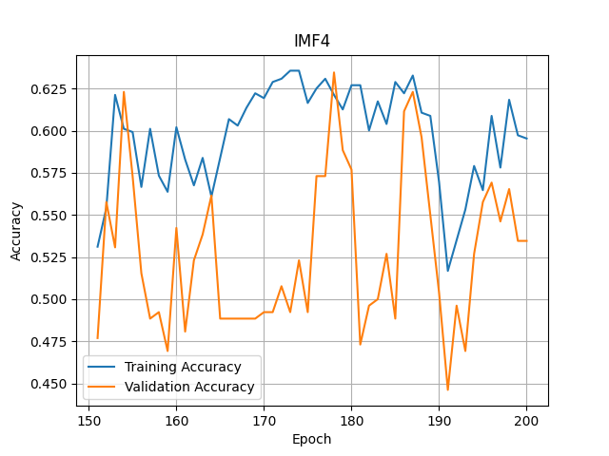
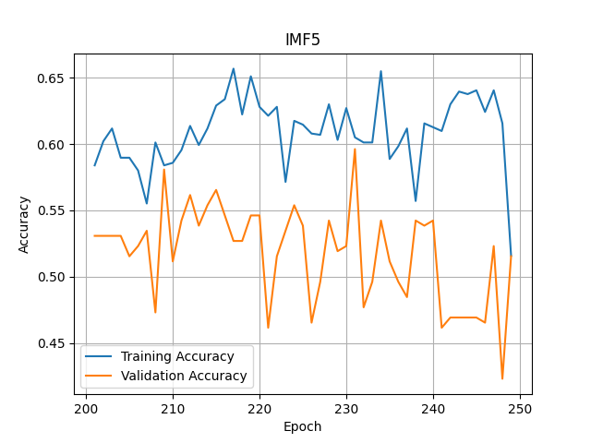

Slide 12
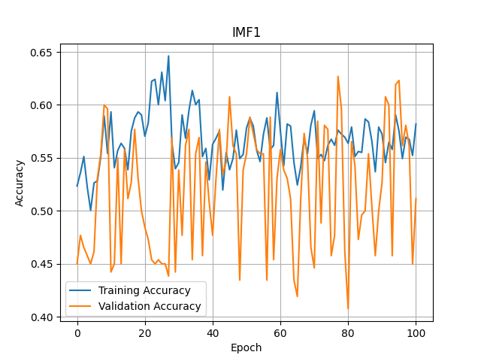
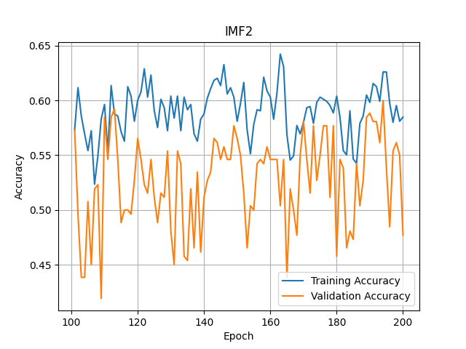
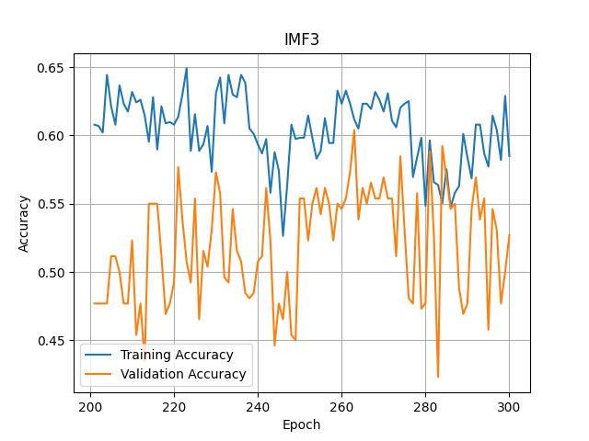
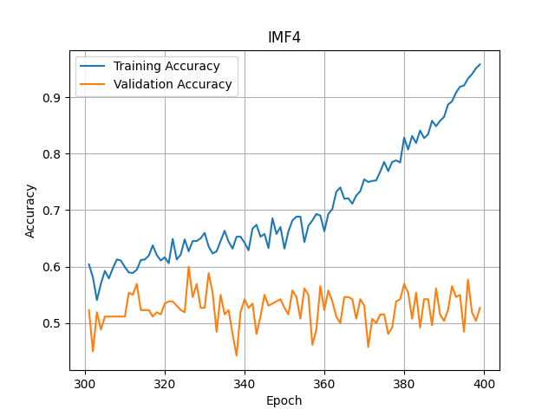
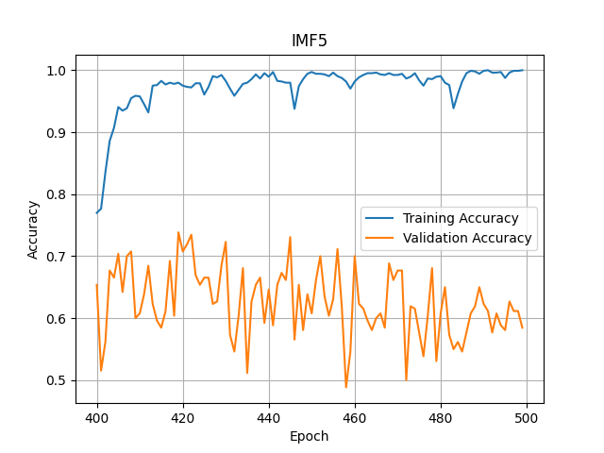

Slide 13
VGG16
Data augmentation: Employed rotation, horizontal flip, and vertical flip to enhance the diversity of training data.
Learning rate: Initialized with 0.001 and applied a decay rate of 0.5 every 10 epochs to adaptively adjust model’s weights.
L2 regularization: Applied L2 with a rate 1e-4 to prevent overfitting.
Dropout after dense layer: Inserted a dropout layer with rate of 0.5 after each dense layer to improve generalization.
Each of these settings are applied and tested individually and in combination together across a range of values for each parameter. After evaluation, the above set of parameters overall had better results.

Slide 14
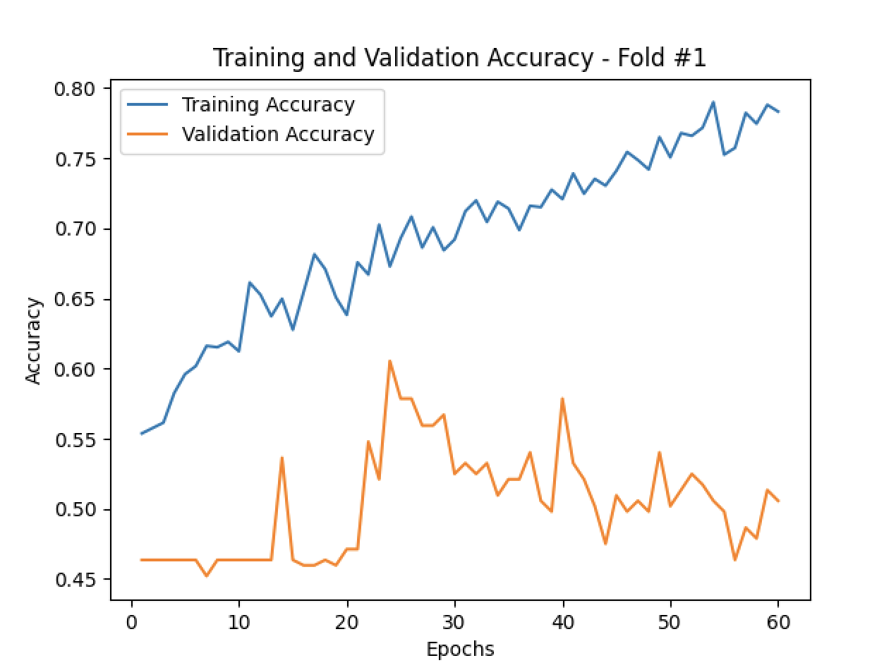
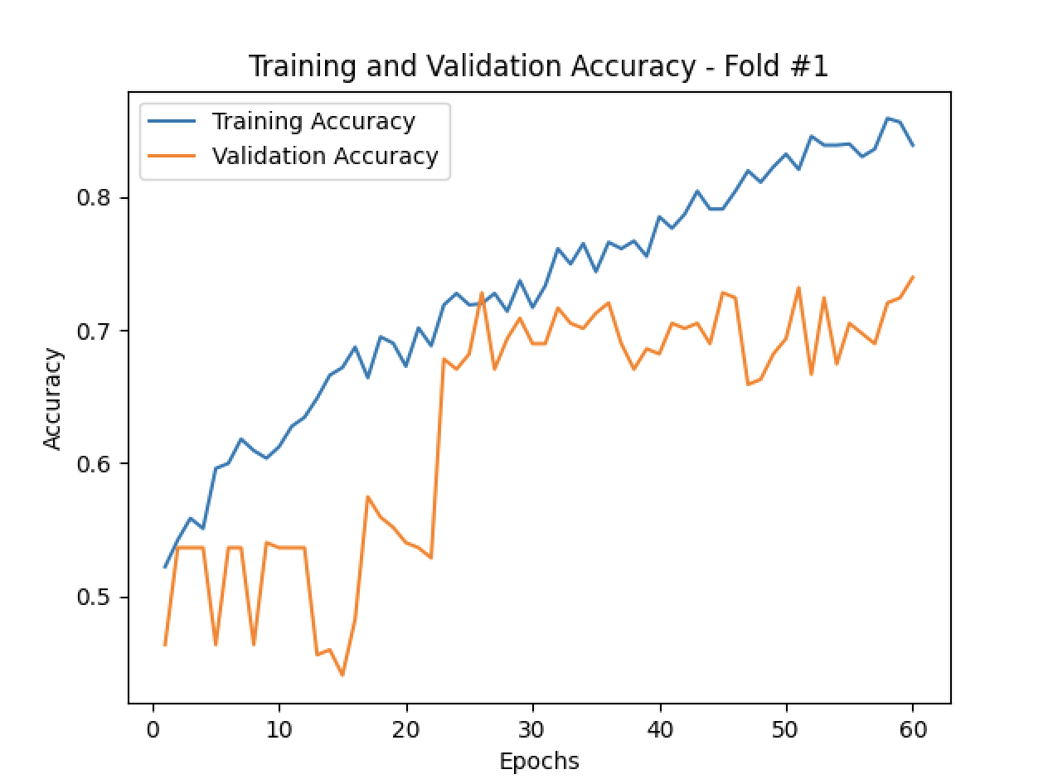
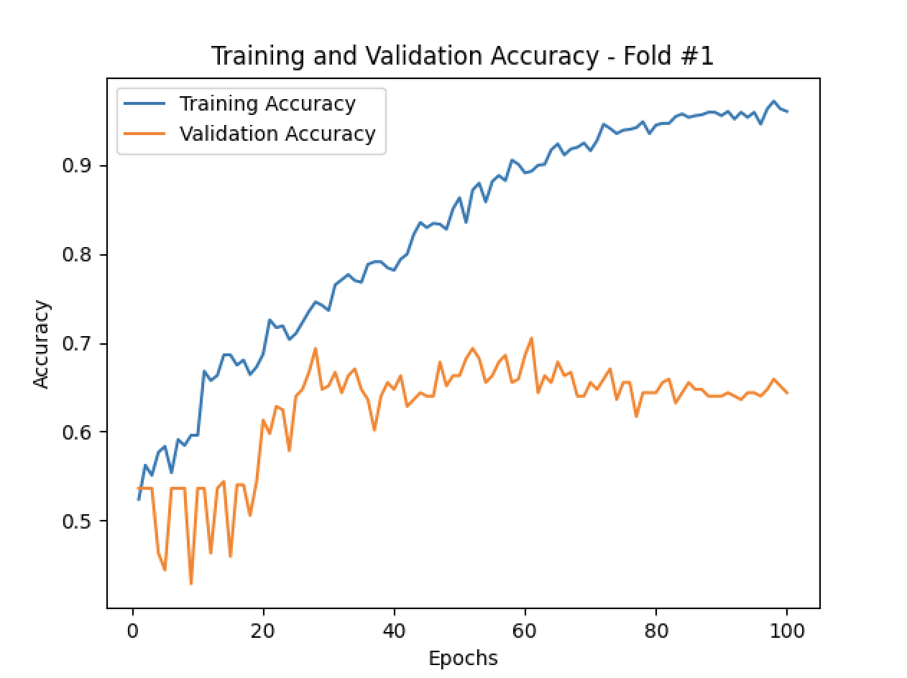
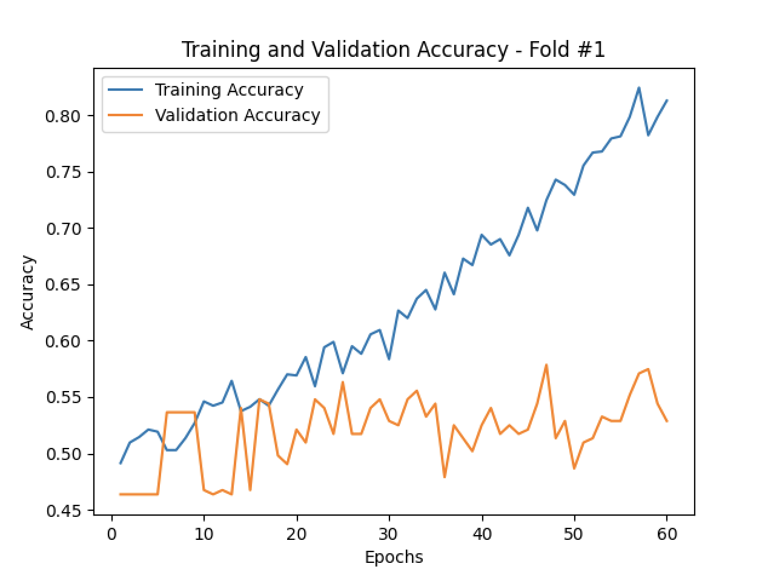
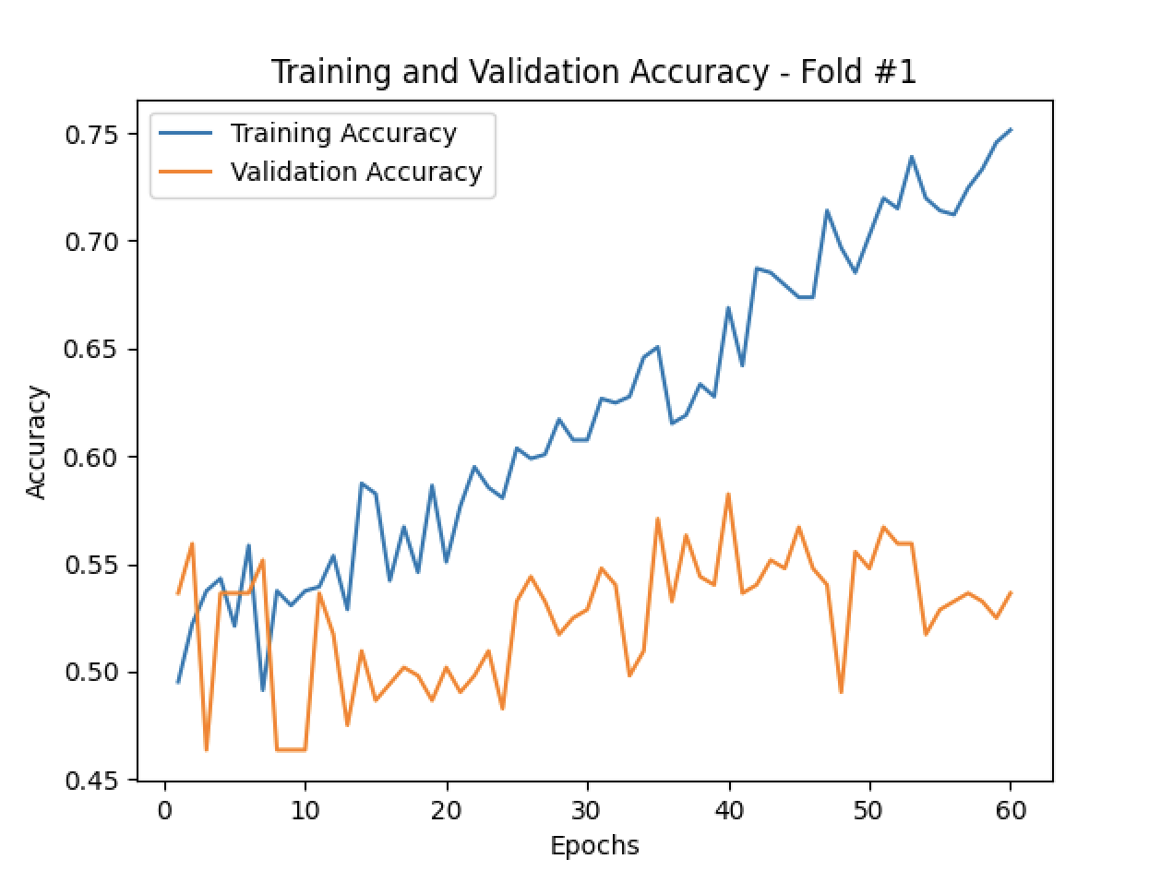
VGG16-Single IMFs
IMF1
IMF2
IMF3
IMF4
IMF5

Slide 15
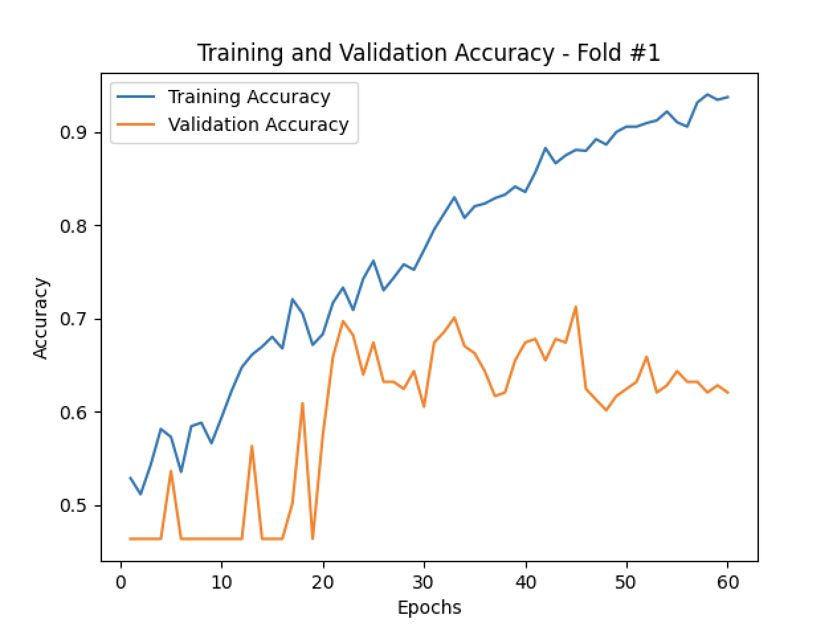
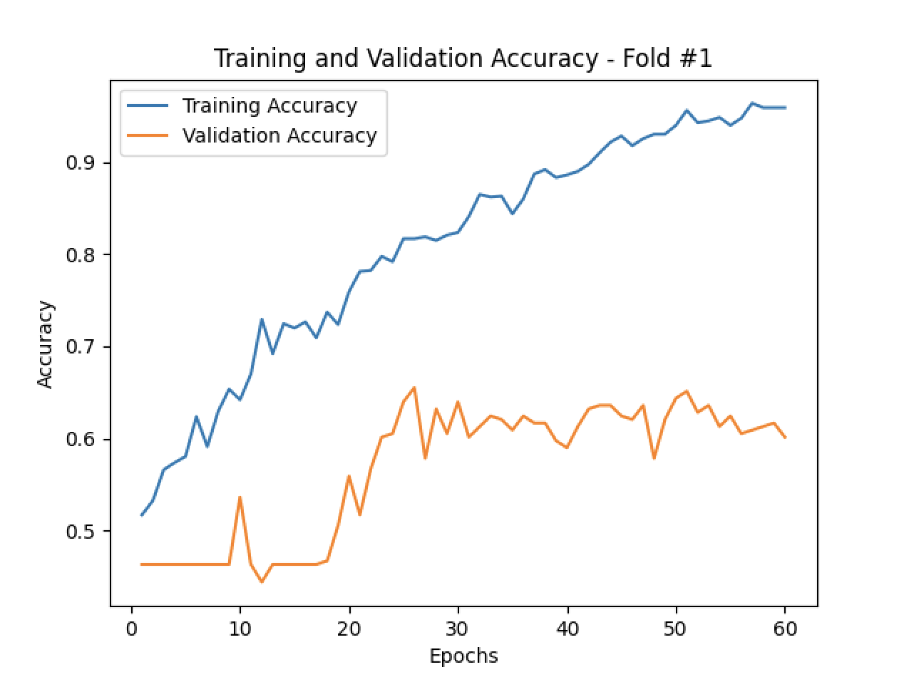
VGG16-Combined IMFs
IMF2,3
IMF2,3,4

Slide 16
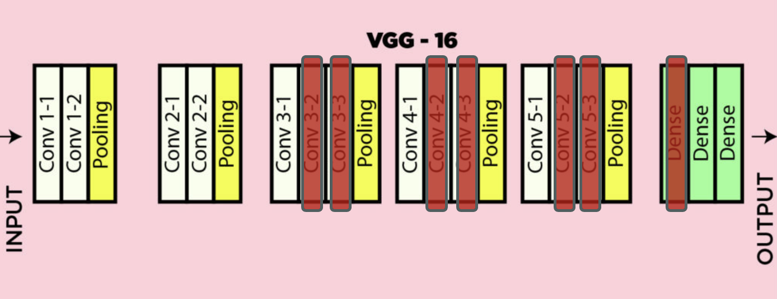
Modified VGG
Dataset is small so using a reduced model might help prevent overfitting.
Deep networks, with a large number of parameters, are prone to overfitting.

Slide 17
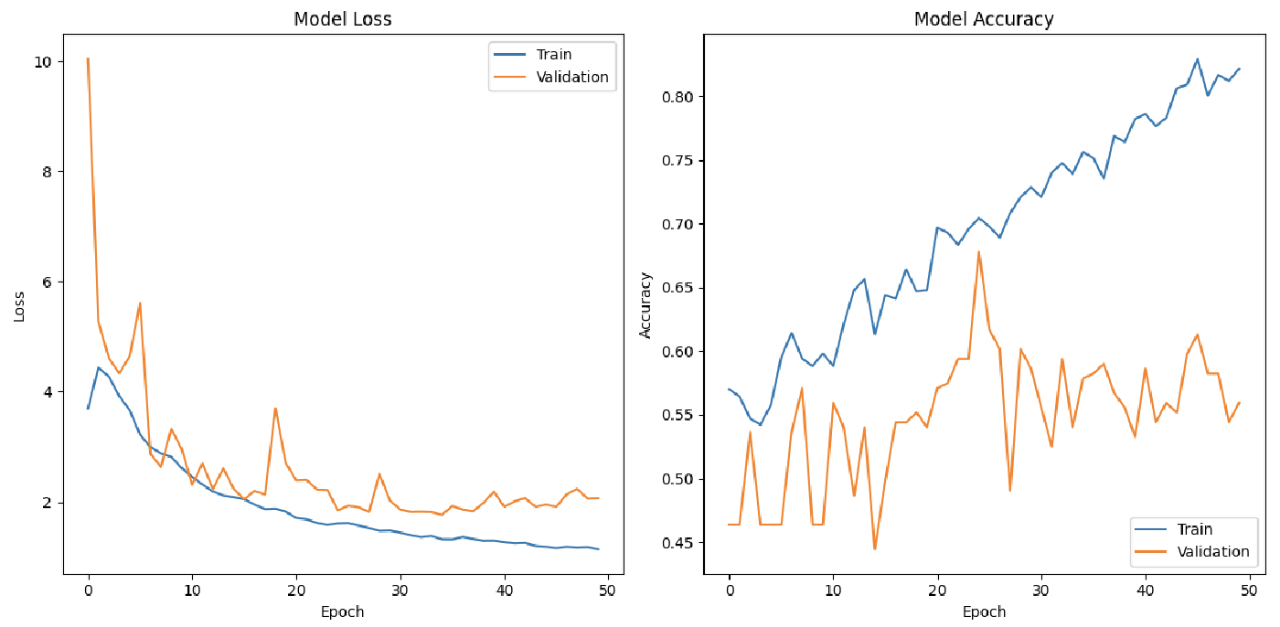
Modified VGG-IMF1
 | AUC |  | Accuracy |  | Precision |  | Recall
Fold 1 | 0.90 | 0.56 | 0.82 | 0.56 | 0.82 | 0.54 | 0.85 | 0.52
Fold 2 | 0.90 | 0.64 | 0.83 | 0.61 | 0.81 | 0.65 | 0.87 | 0.55
Fold 3 | 0.87 | 0.54 | 0.80 | 0.52 | 0.80 | 0.51 | 0.83 | 0.54
Fold 4 | 0.89 | 0.44 | 0.81 | 0.43 | 0.82 | 0.45 | 0.84 | 0.43
Fold 5 | 0.95 | 0.56 | 0.90 | 0.52 | 0.89 | 0.49 | 0.92 | 0.35
Avg | 0.90 | 0.55 | 0.83 | 0.53 | 0.83 | 0.53 | 0.86 | 0.48

Slide 18
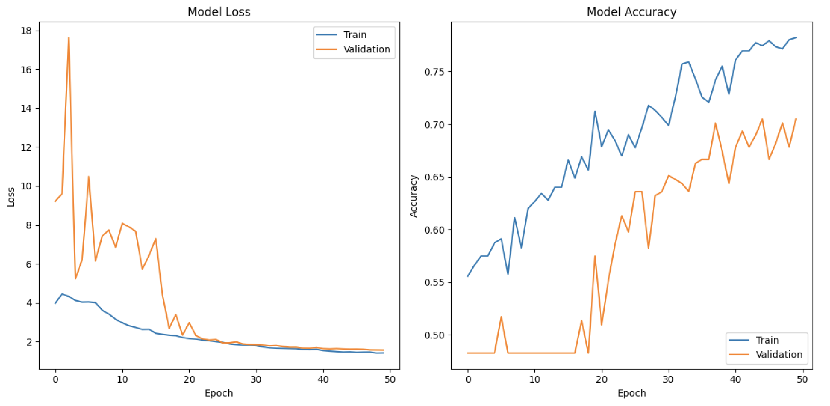
Modified VGG-IMF2
 | AUC |  | Accuracy |  | Precision |  | Recall
Fold 1 | 0.90 | 0.72 | 0.83 | 0.66 | 0.83 | 0.70 | 0.84 | 0.65
Fold 2 | 0.86 | 0.75 | 0.78 | 0.70 | 0.80 | 0.70 | 0.79 | 0.70
Fold 3 | 0.91 | 0.72 | 0.83 | 0.66 | 0.84 | 0.67 | 0.83 | 0.71
Fold 4 | 0.91 | 0.74 | 0.84 | 0.60 | 0.84 | 0.70 | 0.87 | 0.40
Fold 5 | 0.96 | 0.77 | 0.90 | 0.67 | 0.90 | 0.70 | 0.91 | 0.46
Avg | 0.91 | 0.74 | 0.82 | 0.66 | 0.82 | 0.69 | 0.85 | 0.58

Slide 19
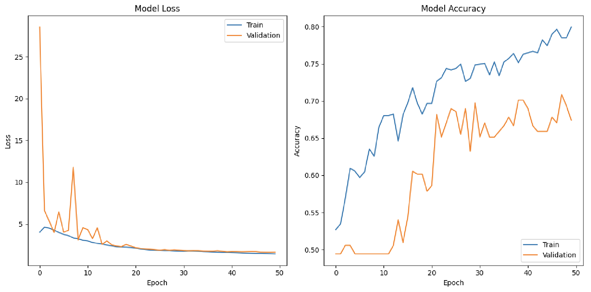
Modified VGG-IMF3
 | AUC |  | Accuracy |  | Precision |  | Recall
Fold 1 | 0.85 | 0.73 | 0.76 | 0.64 | 0.76 | 0.68 | 0.78 | 0.65
Fold 2 | 0.89 | 0.80 | 0.81 | 0.70 | 0.80 | 0.71 | 0.84 | 0.63
Fold 3 | 0.88 | 0.74 | 0.80 | 0.67 | 0.81 | 0.65 | 0.82 | 0.68
Fold 4 | 0.91 | 0.69 | 0.83 | 0.64 | 0.83 | 0.68 | 0.84 | 0.72
Fold 5 | 0.84 | 0.80 | 0.76 | 0.73 | 0.77 | 0.65 | 0.78 | 0.75
Avg | 0.87 | 0.75 | 0.79 | 0.70 | 0.79 | 0.67 | 0.81 | 0.69

Slide 20
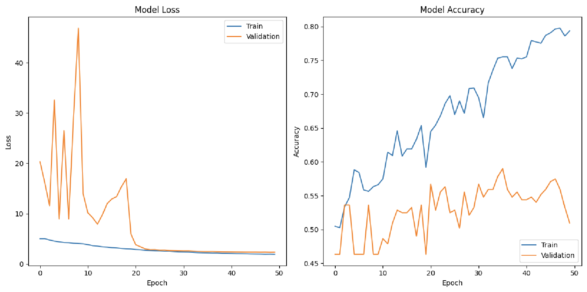
Modified VGG-IMF4
 | AUC |  | Accuracy |  | Precision |  | Recall
Fold 1 | 0.87 | 0.55 | 0.79 | 0.51 | 0.79 | 0.54 | 0.83 | 0.53
Fold 2 | 0.86 | 0.58 | 0.78 | 0.56 | 0.79 | 0.57 | 0.82 | 0.63
Fold 3 | 0.84 | 0.64 | 0.76 | 0.58 | 0.77 | 0.52 | 0.79 | 0.51
Fold 4 | 0.87 | 0.58 | 0.78 | 0.59 | 0.80 | 0.58 | 0.80 | 0.62
Fold 5 | 0.83 | 0.66 | 0.76 | 0.63 | 0.76 | 0.57 | 0.77 | 0.63
Avg | 0.85 | 0.60 | 0.77 | 0.57 | 0.78 | 0.56 | 0.80 | 0.58

Slide 21
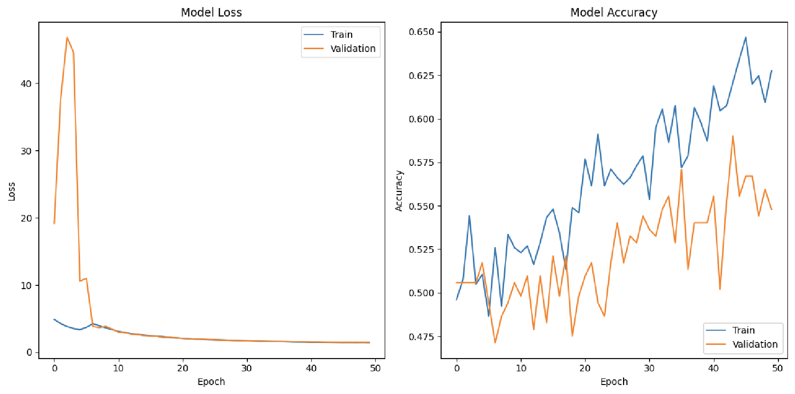
Modified VGG-IMF5
 | AUC |  | Accuracy |  | Precision |  | Recall
Fold 1 | 0.71 | 0.52 | 0.66 | 0.53 | 0.66 | 0.58 | 0.70 | 0.61
Fold 2 | 0.62 | 0.55 | 0.58 | 0.53 | 0.60 | 0.50 | 0.64 | 0.40
Fold 3 | 0.67 | 0.56 | 0.63 | 0.55 | 0.64 | 0.52 | 0.69 | 0.67
Fold 4 | 0.69 | 0.53 | 0.65 | 0.52 | 0.65 | 0.52 | 0.72 | 0.54
Fold 5 | 0.68 | 0.51 | 0.62 | 0.51 | 0.63 | 0.52 | 0.69 | 0.42
Avg | 0.67 | 0.53 | 0.63 | 0.53 | 0.64 | 0.53 | 0.69 | 0.53

Slide 22
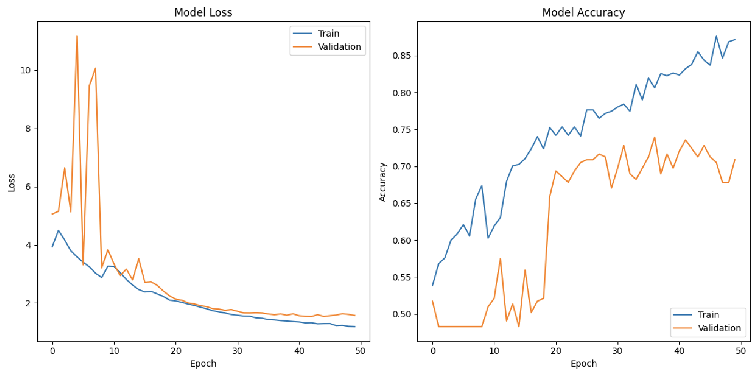
Modified VGG-IMF2,3
 | AUC |  | Accuracy |  | Precision |  | Recall
Fold 1 | 0.94 | 0.78 | 0.87 | 0.72 | 0.88 | 0.76 | 0.86 | 0.72
Fold 2 | 0.94 | 0.77 | 0.87 | 0.71 | 0.87 | 0.78 | 0.89 | 0.62
Fold 3 | 0.93 | 0.74 | 0.86 | 0.67 | 0.86 | 0.70 | 0.89 | 0.71
Fold 4 | 0.98 | 0.74 | 0.94 | 0.66 | 0.93 | 0.66 | 0.95 | 0.66
Fold 5 | 0.94 | 0.82 | 0.87 | 0.76 | 0.88 | 0.71 | 0.88 | 0.69
Avg | 0.95 | 0.77 | 0.88 | 0.72 | 0.88 | 0.72 | 0.89 | 0.68

Slide 23
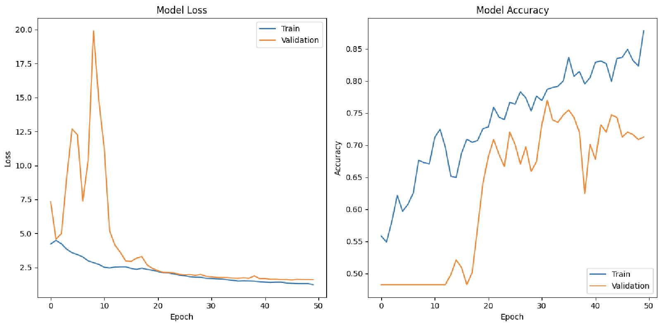
Modified VGG-IMF2,3,4
 | AUC |  | Accuracy |  | Precision |  | Recall
Fold 1 | 0.96 | 0.78 | 0.89 | 0.72 | 0.89 | 0.71 | 0.90 | 0.80
Fold 2 | 0.94 | 0.77 | 0.88 | 0.71 | 0.88 | 0.71 | 0.89 | 0.74
Fold 3 | 0.92 | 0.77 | 0.85 | 0.69 | 0.85 | 0.68 | 0.86 | 0.83
Fold 4 | 0.92 | 0.73 | 0.85 | 0.69 | 0.85 | 0.66 | 0.87 | 0.78
Fold 5 | 0.93 | 0.77 | 0.86 | 0.70 | 0.86 | 0.63 | 0.87 | 0.72
Avg | 0.93 | 0.76 | 0.87 | 0.70 | 0.87 | 0.68 | 0.88 | 0.79

Slide 24
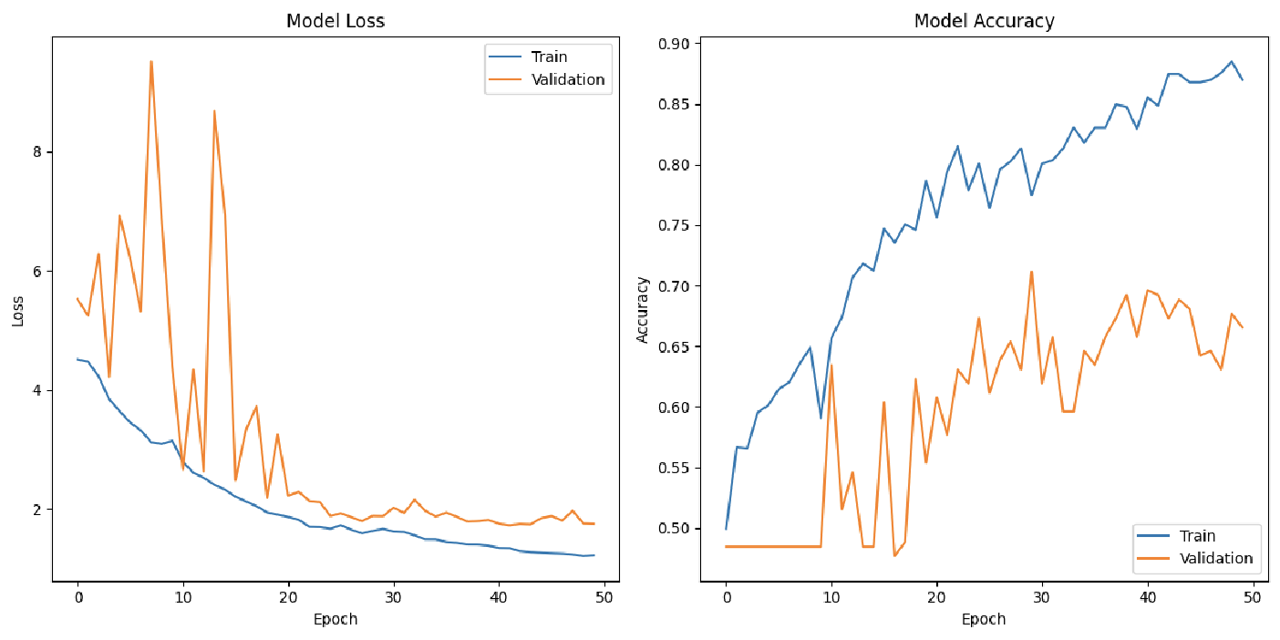
Modified VGG-IMFs-All
 | AUC |  | Accuracy |  | Precision |  | Recall
Fold 1 | 0.96 | 0.76 | 0.89 | 0.68 | 0.89 | 0.64 | 0.91 | 0.88
Fold 2 | 0.97 | 0.76 | 0.91 | 0.69 | 0.90 | 0.70 | 0.93 | 0.71
Fold 3 | 0.96 | 0.75 | 0.90 | 0.68 | 0.89 | 0.66 | 0.92 | 0.75
Fold 4 | 0.94 | 0.73 | 0.87 | 0.67 | 0.87 | 0.68 | 0.89 | 0.60
Fold 5 | 0.97 | 0.81 | 0.92 | 0.74 | 0.92 | 0.66 | 0.93 | 0.72
Avg | 0.96 | 0.76 | 0.90 | 0.62 | 0.89 | 0.67 | 0.92 | 0.73

Slide 25
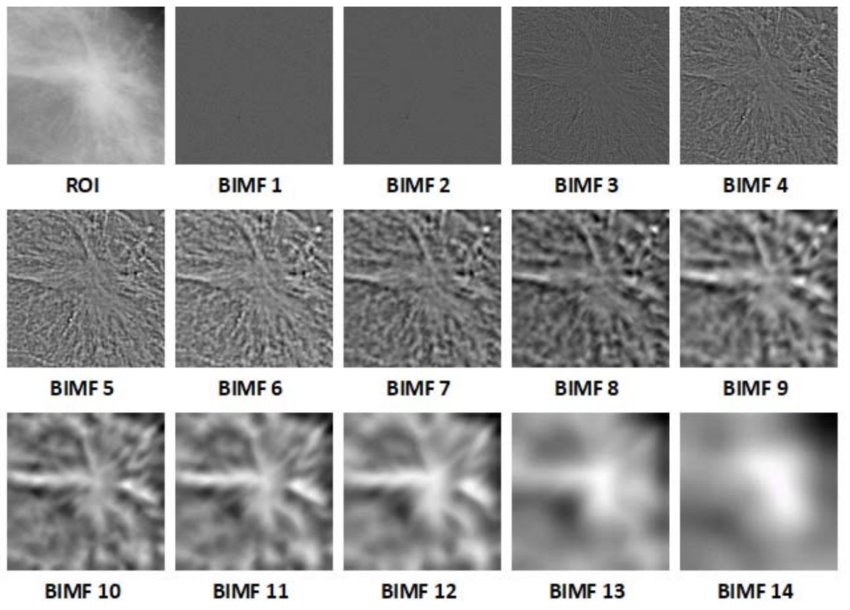
BIMFs Limitation
The generated BIMFs do not capture details of the mass in ROIs.

Slide 26
Conclusion and Future Works
We investigated the application of BEMD in combination with neural networks, specifically ResNet50, VGG16, and a simplified version of VGG.
For each network, different sets of values are tested for each hyper-parameter to evaluate performance.
ResNet50 yielded the highest accuracy at 0.6, followed by VGG16 at 0.62, and the simplified model outperformed both with an accuracy of 0.7.
The generated BIMFs demonstrated limitations in capturing details of mass within the Region of Interest.

Slide 27
Faced Challenges
.
A proper BEMD implementation was not easy
Understanding BEMD code is challenging
GPU out of memory issues
Coming up with a proper framework for the whole BEM-Neural Network integration
Finding appropriate network architecture

Slide 28
We will continue to work on it …
SVMs sound to be very promising for our method
Enhanced BEMD Implementation: Investigate modifications to the BEMD algorithm to improve its performance in extracting meaningful features.
Ensemble Methods: Investigate the effectiveness of ensemble methods by combining predictions from multiple models.

