Slide 1
Adapting patch-based classifiers for whole image classification
Brian Székely and Gaurav Srikar

Slide 2
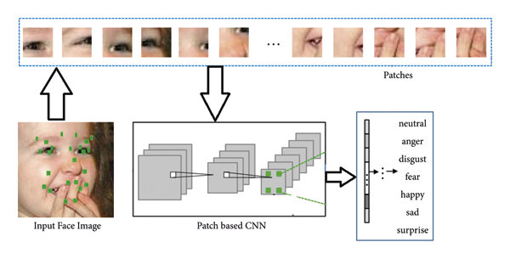
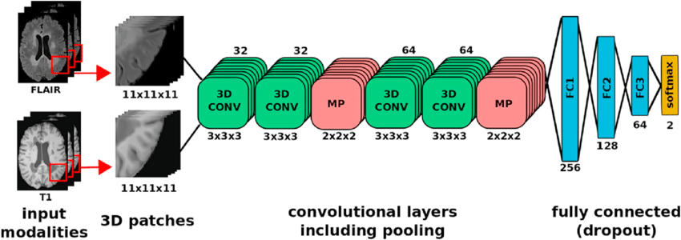
Overview
Project Focus: Employ Patch-based CNNs for high-resolution mammography image classification.
Goal: Develop a patch-based classifier to discriminate whether an image contains background, tissue, or a lesion
Hypothesis: Enhance mammogram mass classification accuracy using Patch-based methods.
Objective: Preserve essential details like small malignant masses and calcifications for improved high-resolution image classification.
Notes:
Subsequently, we intend to utilize this patch-based classifier to extract the lesion area using class activation maps.
Finally, we will feed this extracted area into a whole-image classifier,
generating patches for analysis, and predicting whether the area is malignant or benign.

Slide 3
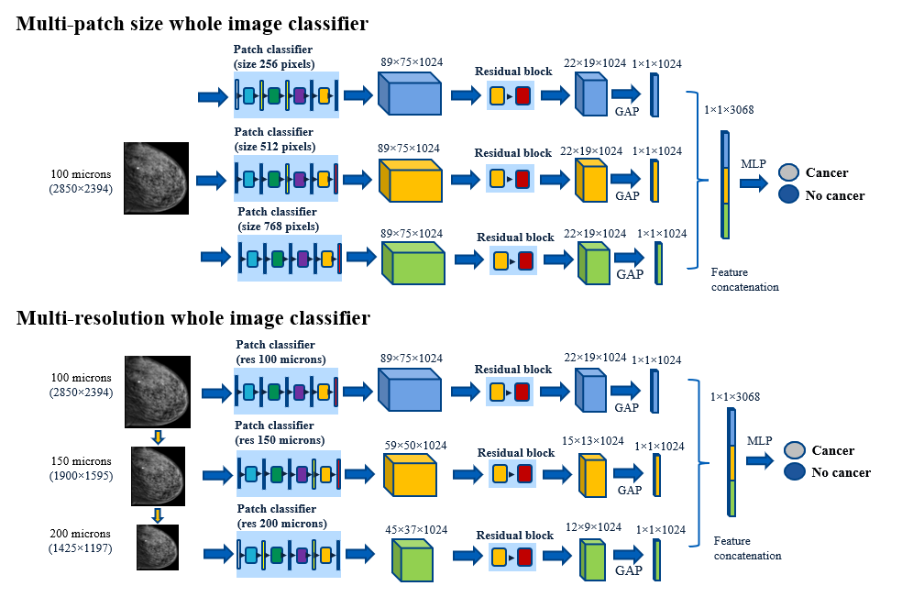
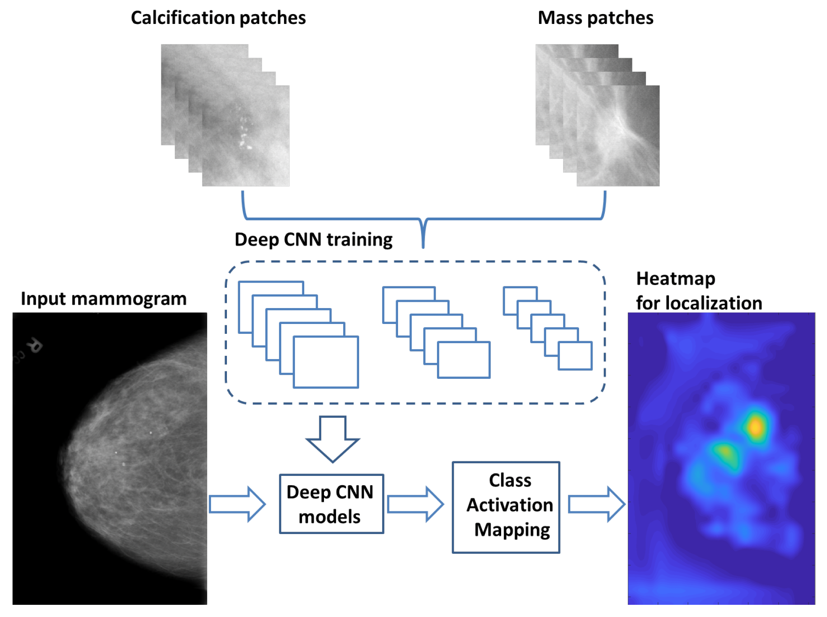
Brief Review
Quintana et. al. 2023
Xi et. al. 2018

Slide 4
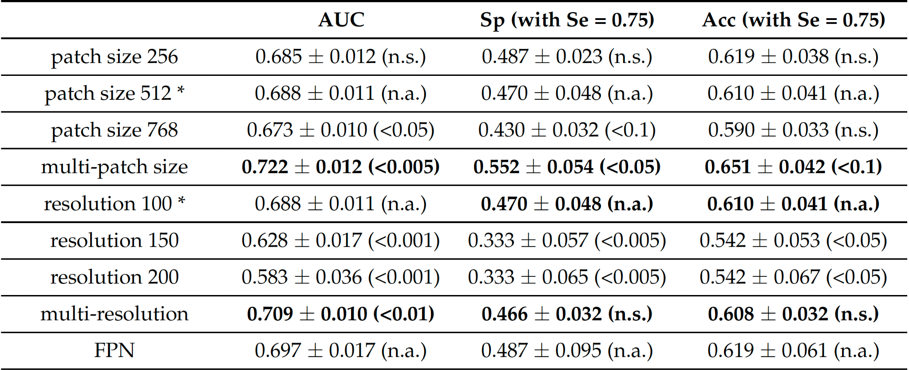
Quintana et. al. 2023 Results
Table1. AUC, specificity (Sp), and accuracy (Acc) of the whole image classifiers in CBIS-DDSM.
Table2. AUC, specificity (Sp), and accuracy (Acc) of the whole image classifiers in the GEHC dataset.

Slide 5
Xi et. al. 2018 Results

Slide 6
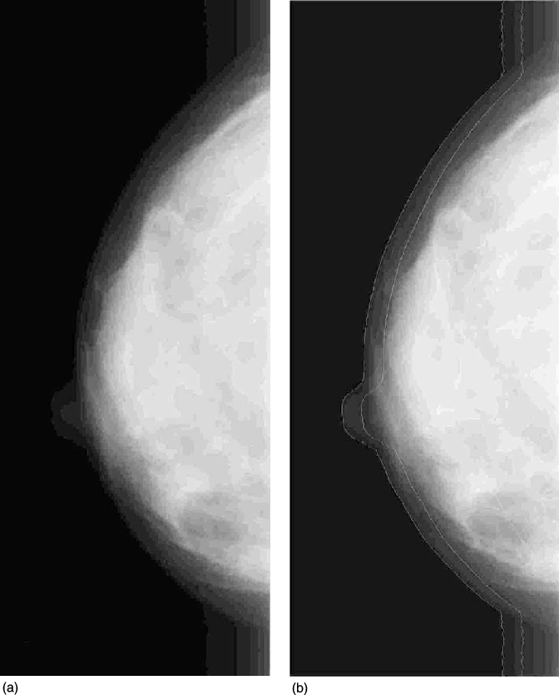
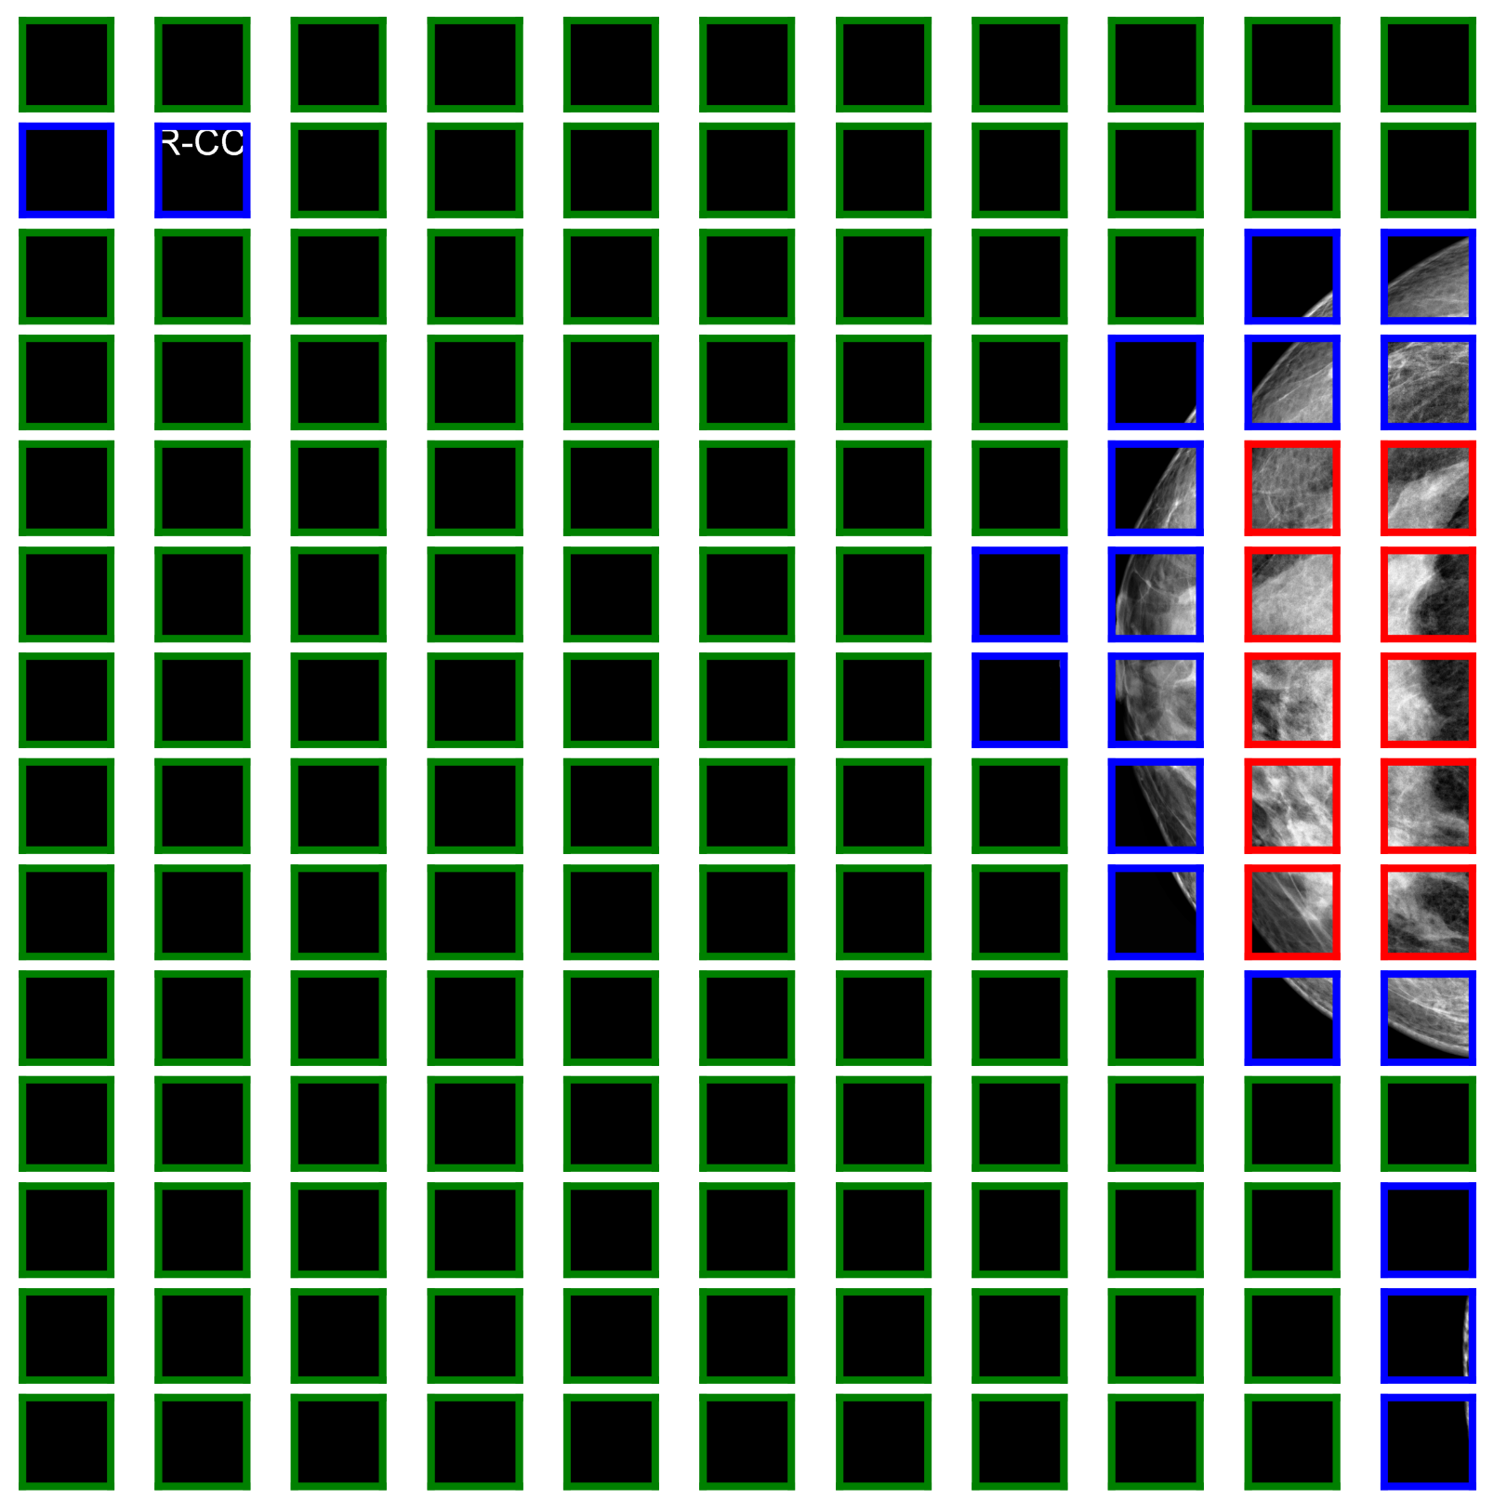
Experimental Design
Datasets
Training and Validation
VINDR-Mammo Dataset ( 20,000 images)
Test
Curated Breast Imaging Subset of Digital Database for Screening Mammography (CBIS-DDSM; 2,620 cases)
Patch-based CNN
Whole Image Classifier
Contrast Limited Adaptive Histogram Equalization
Patch-based methods
Notes:
Contrast Limited Adaptive Histogram Equalization (CLAHE; Kaur et al., 2022).
This technique will help eliminate artifacts and reduce background noise in the images.

Slide 7
Patch Size
250x250 pixel patches
Background
Tissue
Lesion
VINDR
20,000 -> 2,255 CC and MLO view images
92,254 background and tissue patches
1,358 lesion patches
Notes:
Background: black patches
Tissue: any breast tissue, including pectoral muscle
Lesion: Radiologist labeled lesion area
Only 2,255 images that had lesion annotations
3518x2800 images were then parsed to create 250x250 pixel patches
Per Image I randomly selected black patches to match the number of tissue patches
Removed 4/5th of the background and tissue patches to get sample size close to lesion

Slide 8
Models
General Architecture
Adapted from Quintana et al, 2023
Notes:
Two models used in Quintana 2023
Global Average Pooling, followed by fully connected layer, with a soft max layer
Use standard metrics like accuracy, specificity and sensitivity, may use F1 score due to class imbalances

Slide 9
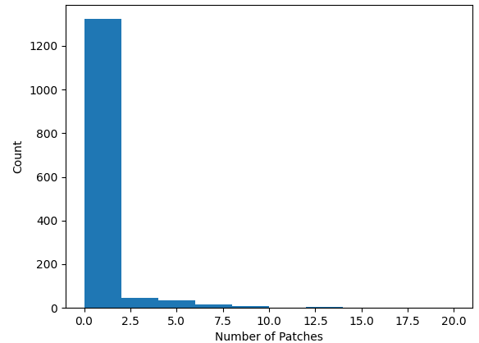
Lesion Extraction
Extract lesion areas for whole image classification
Most lesions are small
1,358 lesion patches

Slide 10
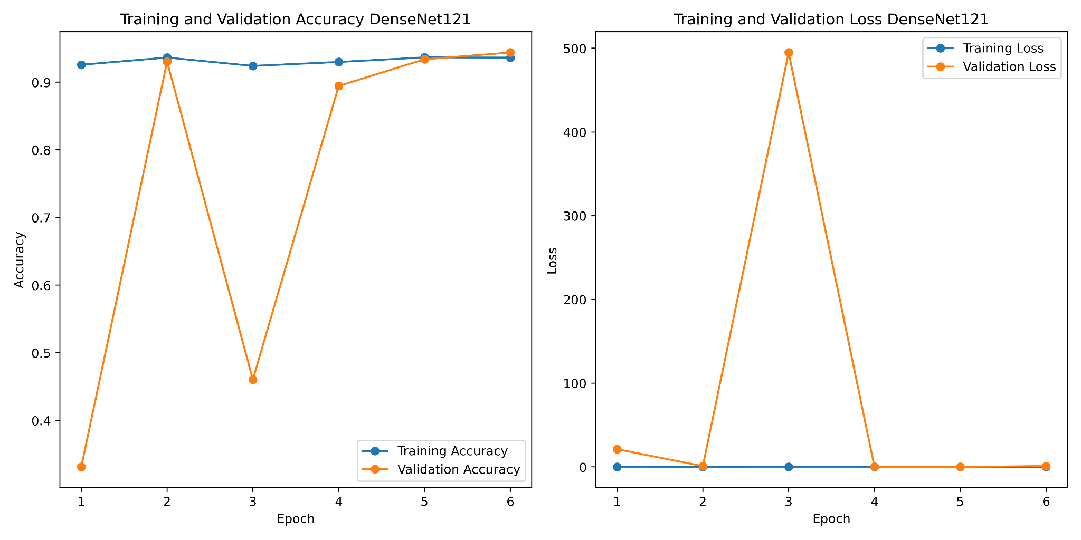
Preliminary Results

Slide 11
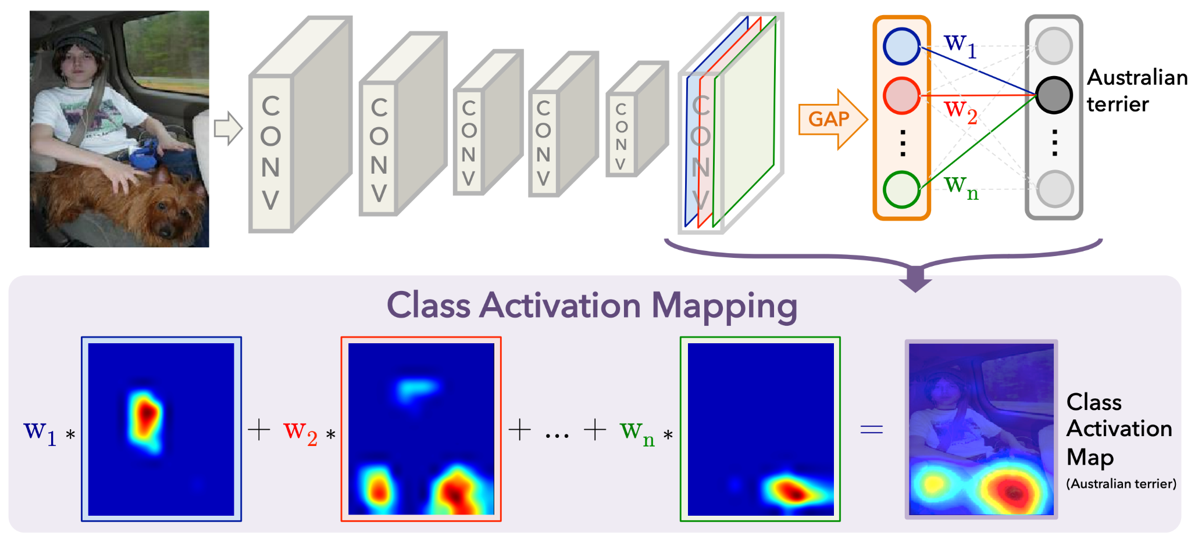
Class Activation Mapping (CAM)
Extract feature maps
Apply Global Average Pooling
Pass it through output layer - Softmax
CAM for class C with respect to each spatial element is given by
CAM ( Zhou et al., 2015)
Image Source: “Learning Deep Features for Discriminative Localization” study.
Notes:
1. We will train a Patch-based CNN, such as VGGNet or ResNet.
2. After the convolutional layers, we will introduce a global average pooling layer. This layer computes the spatial average of the feature maps.
3. Following the global average pooling layer, we will add a fully connected layer with a softmax activation function. This step helps us obtain class probabilities.
4. To generate CAM for each class (malignant, benign, or normal), we will focus on the weights of the fully connected layer corresponding to the class of interest.

Slide 12
Grad-CAM
Feed Forward a patch image.
Calculate the loss w.r.to a particular class (truth label).
Apply back-propagation for training.
Acquire gradient at the final layer.
Apply Global Average Pooling to the gradient to get the importance weights.
Perform weighted-sum with feature maps and importance weights.
Plot heatmap.
Repeat the process for all the patches across the whole image.
Gradient-weighted Class Activation Mapping (Grad-CAM)
Grad-CAM ( Selvaraju et al., 2019)
Image Source: https://medium.com/@ninads79shukla/gradcam-73a752d368be
Available code: https://github.com/jacobgil/pytorch-grad-cam.git.
(Selvaraju et al., 2019)
Notes:
1. We will train a Patch-based CNN, such as VGGNet or ResNet.
2. After the convolutional layers, we will introduce a global average pooling layer. This layer computes the spatial average of the feature maps.
3. Following the global average pooling layer, we will add a fully connected layer with a softmax activation function. This step helps us obtain class probabilities.
4. To generate CAM for each class (malignant, benign, or normal), we will focus on the weights of the fully connected layer corresponding to the class of interest.

Slide 13
Projected Timeline
CAM exploratory analysis: 11/13/23 - 11/17/23
Train whole image patch classifiers: 11/18/23 - 11/25/23
Collate preliminary results: 11/26/23 - 11/27/23
Adjustments to analysis: 11/28/23 - 11/30/23
Retrain: 12/1/23- 12/2/23
Finalize results: 12/3/23 - 12/5/23
Write report: 12/5/23 - 12/17/23

Slide 14
References
Hou, L., Samaras, D., Kurc, T. M., Gao, Y., Davis, J. E., & Saltz, J. H. (2016). Patch-based Convolutional Neural Network for Whole Slide Tissue Image Classification. Proceedings / CVPR, IEEE Computer Society Conference on Computer Vision and Pattern Recognition. IEEE Computer Society Conference on Computer Vision and Pattern Recognition, 2016, 2424–2433.
Kaur, G., Joseph, A. J., & Pournami. (2022, March 10). Patch-based All convolutional neural network model for classification of benign and malignant mammograms. 2022 IEEE International Conference on Signal Processing, Informatics, Communication and Energy Systems (SPICES). 2022 IEEE International Conference on Signal Processing, Informatics, Communication and Energy Systems (SPICES), THIRUVANANTHAPURAM, India. https://doi.org/10.1109/spices52834.2022.9774096
Quintana, G. I., Li, Z., Vancamberg, L., Mougeot, M., Desolneux, A., & Muller, S. (2023). Exploiting Patch Sizes and Resolutions for Multi-Scale Deep Learning in Mammogram Image Classification. Bioengineering (Basel, Switzerland), 10(5). https://doi.org/10.3390/bioengineering10050534
Xi, P., Shu, C., & Goubran, R. (2018). Abnormality Detection in Mammography using Deep Convolutional Neural Networks. In arXiv [cs.CV]. arXiv. http://arxiv.org/abs/1803.01906
Rangarajan, K., Gupta, A., Dasgupta, S., Marri, U., Gupta, A. K., Hari, S., ... & Arora, C. (2022). Ultra-high resolution, multi-scale, context-aware approach for detection of small cancers on mammography. Scientific reports, 12(1), 11622.

Slide 15
Thank You for Your Attention
Questions?

