Slide 1
Class Activation Maps as Attentions for Abnormality Classification in Mammograms
Aminul Huq and Mst. Tasnim Pervin

Slide 2
Motivation
Improve classification performance by using class activation maps.
Guide the class activation maps to cover the entire abnormal region.
Prepare custom loss function for the guiding purpose.

Slide 3
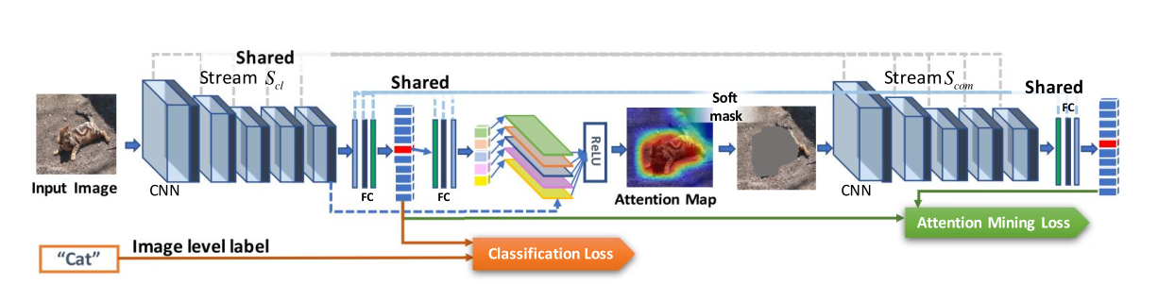
Related Works

Slide 4
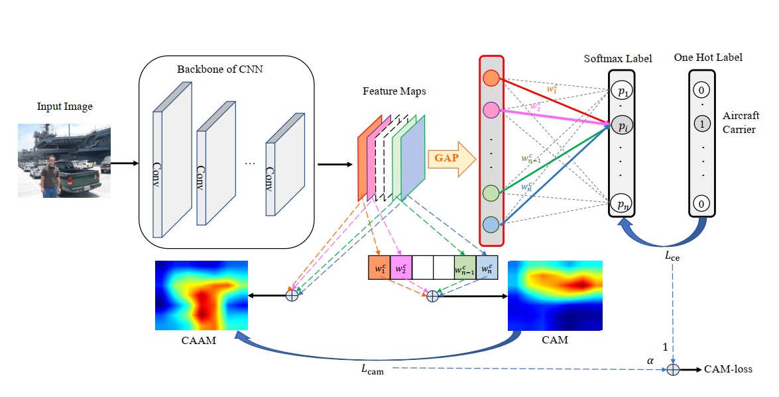
Related Works (cont’d)

Slide 5
Data Augmentation and Preprocessing
Dataset:
INbreast - Benign: 220, Malignant: 123, Total: 343
Ignored Normal ones but will be considered later
Preprocessing:
Cropped images according to the contours to remove as much black images as possible.
Perform Truncation Normalization.
CLAHE(1.0 and 2.0)
Resized to 1024 x 768

Slide 6
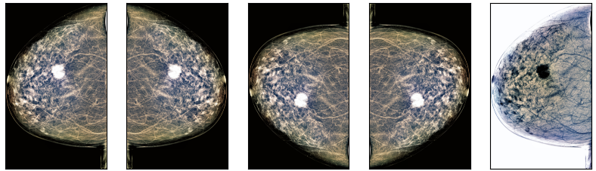
Data Augmentation and Preprocessing
Original Image
Horizontal Flip
Vertical Flip
Both Horizontal and Vertical Flip
Inversion
 | Malignant | Benign
Before | 123 | 220
After | 615 | 1100

Slide 7
Preliminary Results
ResNet-50
Cross Entropy Loss Function
100 epochs per fold
Learning Rate: 0.0001
Batch Size: 8
4 fold cross validation
 | Training Accuracy | Testing Accuracy | F1 Score
Fold1 | 63.32 | 61.58 | 76.59
Fold2 | 64.01 | 61.88 | 77.38
Fold3 | 63.92 | 65.75 | 77.54
Fold4 | 65.32 | 67.23 | 81.27
Avg | 64.14 | 64.14 | 78.14

Slide 8
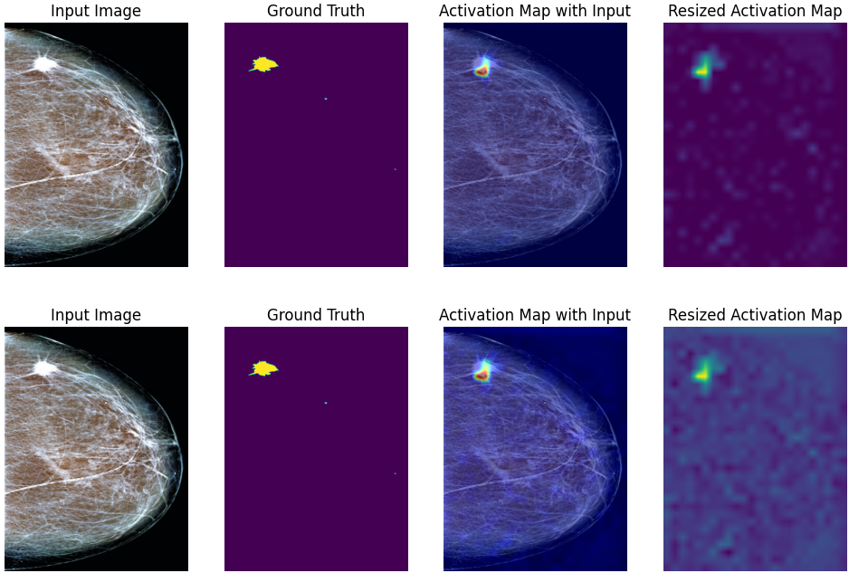
GradCAM
Benign
CAM

Slide 9
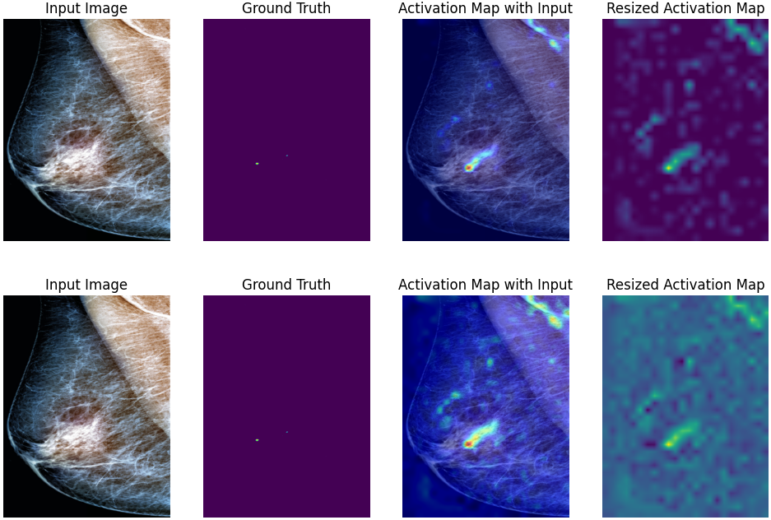
GradCAM
Malignant
CAM

Slide 10
Upcoming Tasks and Challenges
Improve performance on the INBreast dataset for classification performance.
Integrate CAM/GradCAM during training
Focus attention map on the entire region of interest.
Try to incorporate CAM Loss.
Experiment with the CBIS-DDSM dataset.
Training time CAM/GradCAM produces images which very small in dimension. Comparing them with ground truth is a problem.
Data Imbalance forcing the model to focus on one particular class.

Slide 11
Thank You!

