Slide 1
Project Proposal Synthesis of CC view (from MLO view) mammogram using CR-GAN followed by multi-view breast cancer classification using Parameterized hypercomplex neural network.
By
Neha Ujjainkar & Abhishek Khandekar

Slide 2
Problem Statement
.
Synthesis of CC view (from MLO view) mammogram using CR-GAN followed by multi-view breast cancer classification using Parameterized hypercomplex neural network.

Slide 3
Method
.
Task 1: CC view generation from the MLO view by using the CR-GAN network.
Task 2: To employ parameterized hypercomplex ResNets (PHResNets) for multi-view breast cancer classification

Slide 4
Dataset
.
1054 pairs from CBIS-DDSM (3000 x 4500 to 4000 x 5700)
188 pairs from INBreast (3328 x 4084 or 2560 x 3328)
330 pairs from MIAS (1024x1024)

Slide 5
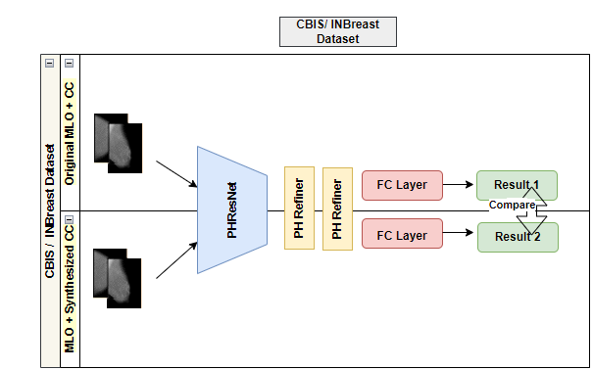
Method
.

Slide 6
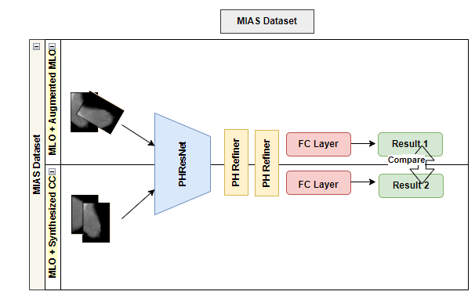
Method
.

Slide 7
Challenges
.
Challenge 1:
CR-GAN code was not available.
Resolution:
Plan to leverage the original CRGAN.
Include Progressive growing adaptation as proposed in the PG-GAN study.
Reference: GitHub - ziwei-jiang/PGGAN-PyTorch: A pytorch implementation of Progressive Growing GAN.
GitHub - bluer555/CR-GAN: Yu Tian et al. "CR-GAN: Learning Complete Representations for Multi-view Generation

Slide 8
Challenges
.
Challenge 2:
Patch Training issue
Resolution:
Got access to a Lab machine (with a GPU)

Slide 9
Challenges
.
Challenge 3:
CUDA out-of-memory error
Resolution:
Halved the batch size.

Slide 10
Challenges
.
Challenge 4:
Code is not for Single view PHResnet.
Resolution:
Option 1: Try to implement code
Option 2: Use the single-view mammogram image (MIAS dataset image) along with the rotated image (same single-view image) to form a 2-view

Slide 11
Preliminary Result
.
Task | Dataset | Model | Parm# | Pre- training | AUC (Ours) | Acc. % (Ours) | AUC | Acc. %
2.1 | CBIS (MLO + original CC) | PHResNet18 | 13M | patches | 0.7453 | 73.944 | 0.737 | 74.88
2.2 |  | PHResNet50 | 16M | patches | 0.70 | 71.83 | 0.739 | 75.35
2.3 | CBIS (MLO+ synthesized CC) | PHResNet18 |  | patches |  |  | - | -
2.4 |  | PHResNet50 |  | patches |  |  | - | -
2.5 | INBreast (MLO + original CC) | PHResNet18 | 13M | patches + CBIS | 0.81593 | 83.019 | 0.793 | 83.019
2.6 |  | PHResNet50 | 16M | patches + CBIS | 0.76 | 81.13 | 0.759 | 80.00
2.7 | INBreast (MLO + synthesized CC) | PHResNet18 |  | patches + CBIS |  |  | - | -
2.8 |  | PHResNet50 |  | patches + CBIS |  |  | - | -
2.9 | MIAS (MLO view) | PHResNet18 | 13M | patches + CBIS | 0.50 | 50 | - | -
2.1 |  | PHResNet50 | 16M | patches + CBIS |  |  | - | -
2.11 | MIAS(MLO+ synthesized CC view) | PHResNet18 |  | patches + CBIS |  |  | - | -
2.12 |  | PHResNet50 |  | patches + CBIS |  |  | - | -

Slide 12
Timeline and Milestones
.
Sr. No | Milestones | Duration | Completion Date
1 | Defining the problem statement. | 1 week | 10/8/2023
2 | Submit the Project Proposal. | 1 week | 10/16/2023
3 | Data Exploration and data analysis for task 2. (non-synthesized image only) | 1 week | 10/22/2023
4 | Splitting the data and pretraining the network on patches for task 2. (non-synthesized image only) | 1 week | 10/29/2023
5 | Splitting the data and training the model on the whole image for task 2. (non-synthesized image only) | 1 week | 11/5/2023
6 | Evaluate the performance of the model for task 2. (non-synthesized image only) | 1 week | 11/11/2023
7 | Data exploration and data analysis for task 1. | 0.5 week | 11/14/2023
8 | Implementation of CR-GAN for task 1. | 2 weeks | 11/28/2023
9 | Splitting the data and training the model for task 1. | 0.5 week | 12/2/2023
10 | Evaluate the performance of the model for task 1 | 0.25 week | 12/4/2023
11 | Data Exploration and data analysis for task 2. (Original MLO +synthesized CC image only) | 0.5 week | 12/7/2023
12 | Splitting the data and pretraining the network on patches for task 2. (Original MLO +synthesized CC image only) | 0.5 week | 12/10/2023
13 | Splitting the data and training the model on the whole image for task 2. (Original MLO +synthesized CC image only) | 0.5 week | 12/12/2023
14 | Evaluate the performance of the model for task 2. (Original MLO +synthesized CC image only) | 0.5 week | 12/14/2023
15 | Final testing. | 0.5 week | 12/17/2023
16 | Project Presentation | 0.5 week | 12/20/2023
17 | Submit Final Project Report. | 0.5 week | 12/23/2023

Slide 13
References
1. Yamazaki, A., & Ishida, T. (2022). Two-View Mammogram Synthesis from Single-View Data Using Generative Adversarial Networks. Applied Sciences, 12(23), 12206. https://www.mdpi.com/2076-3417/12/23/12206
2. Tian, Y., Peng, X., Zhao, L., Zhang, S., & Metaxas, D. N. (2018). CR-GAN: learning complete representations for multi-view generation. arXiv preprint arXiv:1806.11191. https://arxiv.org/abs/1806.11191
3. Geras, K. J., Wolfson, S., Shen, Y., Wu, N., Kim, S., Kim, E., ... & Cho, K. (2017). High-resolution breast cancer screening with multi-view deep convolutional neural networks. arXiv preprint arXiv:1703.07047. https://arxiv.org/abs/1703.07047
4. Lopez, E., Grassucci, E., Valleriani, M., & Comminiello, D. (2022). Multi-View Breast Cancer Classification via Hypercomplex Neural Networks. arXiv e-prints, arXiv-2204. https://arxiv.org/pdf/2204.05798.pdf
5.Liu, Y., Zhang, F., Chen, C., Wang, S., Wang, Y., & Yu, Y. (2021). Act like a radiologist: towards reliable multi-view correspondence reasoning for mammogram mass detection. IEEE Transactions on Pattern Analysis and Machine Intelligence, 44(10), 5947-5961. https://ieeexplore.ieee.org/abstract/document/9444895
6.Yang, Z., Cao, Z., Zhang, Y., Tang, Y., Lin, X., Ouyang, R., ... & Ma, J. (2021). MommiNet-v2: Mammographic multi-view mass identification networks. Medical Image Analysis, 73, 102204. https://www.sciencedirect.com/science/article/pii/S1361841521002498

Slide 14
.
Thank You

