Slide 1
Finding Tiny Masses
Interim Report
Presented by Kelly Chinander & Ronald Du
November 20th, 2023

Slide 2
Slides
Overview
  Project Inspiration
  Proposal Recap
Completed Efforts
  Running source project
  Project setup
  MIAS dataset setup
  ML framework
  Transfer Learning model
  Custom Learning model
Remaining Tasks
  Expand model capabilities
  Implement scaling and sliding window detection
  Add more datasets
  Model comparisons
  Goal adjustment
  Updates
Questions?
References

Slide 3
Overview

Slide 4
Project Inspiration
Our term project, Finding Tiny Masses, was inspired by the paper “Finding Tiny Faces” by Peiyun Hu and Deva Ramanan [1].
The premise of Finding Tiny Faces was to improve object detection (specifically faces) in crowded pictures by training the model on scale-invariant images of faces, and then during evaluation combine the outputs from the model when passed multiple variations of the input imagery at different scales.
The end result was that the model was better at detecting faces of different sizes in the image.
Notes:
Clarification that they do a sliding window approach to detection on the scaled up faces - not a scale up then down like was discussed in the proposal lol

Slide 5
Proposal Recap
For our project Finding Tiny Masses, we proposed that the techniques in Finding Tiny Faces could be applied to mass detection in mammograms to improve small mass detection.
By training a model to detect masses and then evaluating the model with different scaled variations of the input image, we propose that the model will be better at picking out small masses in the mammograms.

Slide 6
Completed Efforts

Slide 7
Running source project
The first step we completed was to run the Finding Tiny Faces project to ensure repeatability and to use as a reference during future development.
We ran the PyTorch port of the project found here:
https://github.com/varunagrawal/tiny-faces-pytorch
Notes:
PyTorch version ran on Python 3.6, which was a bit old. Was a struggle to get all the libs working with it too. Good architecture and documentation tho

Slide 8
Project setup
The next step completed was the project setup. We created our GitHub repo for collaboration between team members.
Then we configured our development environments for this project. We are both running VS Code 2022 as our IDE with the Python 3.11 interpreter. We also had to configure PyTorch and CUDA for our machines, which had a little bit of variation because Ronald is developing on Windows 11 and Kelly is developing on Debian 12.
Finally, we ran test projects on our systems to ensure all of the functionality we would need was working correctly.

Slide 9
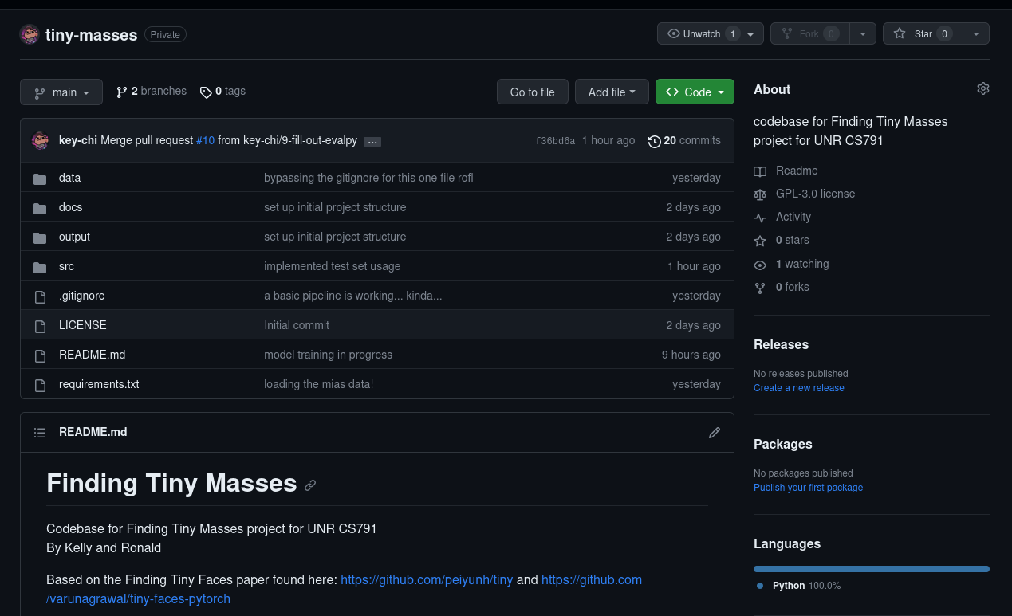
Project setup
The repo is currently hosted privately under Kelly’s account at https://github.com/key-chi/tiny-masses.

Slide 10
MIAS dataset setup
For an initial dataset to work with, we downloaded the MIAS dataset linked from the course webpage. We chose this dataset because of its small file size and consistent structure. The label information was pulled from the info.txt file in the dataset and isolated into a file in our repository. For reproducibility, setup instructions in our project’s README.md include where to install the imagery data in our project structure.
With the MIAS dataset available to work with, we implemented the Python code to load the imagery into a tensor for PyTorch to be able to use. Then we made the functionality to decode the label strings to create tensors of the classification and bounding box. We also created utility functions that displayed imagery from the dataset with Matplotlib and the information from the labels.
Notes:
MIAS is small but the labelling is good plus the bounding box is helpful for the direction we want to go with detection.

Slide 11
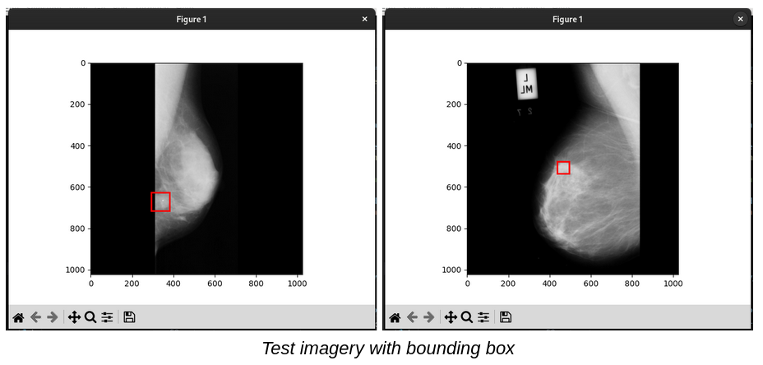
MIAS dataset setup
Display results from the MIAS dataset

Slide 12
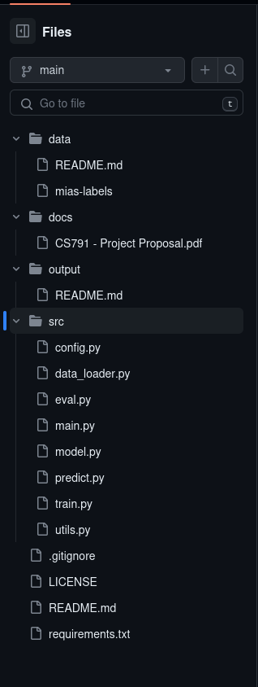
Machine Learning framework
With the environment and dataset completed, we were then able to create a basic machine learning framework that we would fill out as we completed portions of the development. This framework is structured with scripts specific to each of the major components of machine learning:
config.py
  Contains configurations items like batch size, learning rate, etc
data_loader.py
  Logic for loading the MIAS dataset and creating PyTorch tensors from it
eval.py
  Functionality for running evaluations of the model on a provided dataset
main.py
  The main entry point for our project, responsible for orchestrating model creation, training and evaluation
model.py
  Definition of the model we are using
predict.py
  Logic for making a prediction on an image given a model
train.py
  Functionality to train a given model
utils.py
  Utility functions to be used elsewhere in the code

Slide 13
Transfer Learning model
After completing the basic machine learning framework, we created a model to start experimenting with. We chose to start with a pretrained model, opting for the ResNet101 model for image classification. This model was the top performing model from Finding Tiny Faces, though like that paper we can easily swap out the underlying pretrained model for experimentation.
Then we added a new Linear layer to the model and trained the model with the new layer on our MIAS dataset imagery and labels. Since the dataset is small, training is pretty quick. The training function uses cross-entropy loss for loss calculations and stochastic gradient descent for the optimizer.
Notes:
ResNet101 can be swapped out (at least in testing to ResNet50 with a single line change, pretty cool! SGD optimizer seems to be the root of some of the issues seen in the next slide.

Slide 14
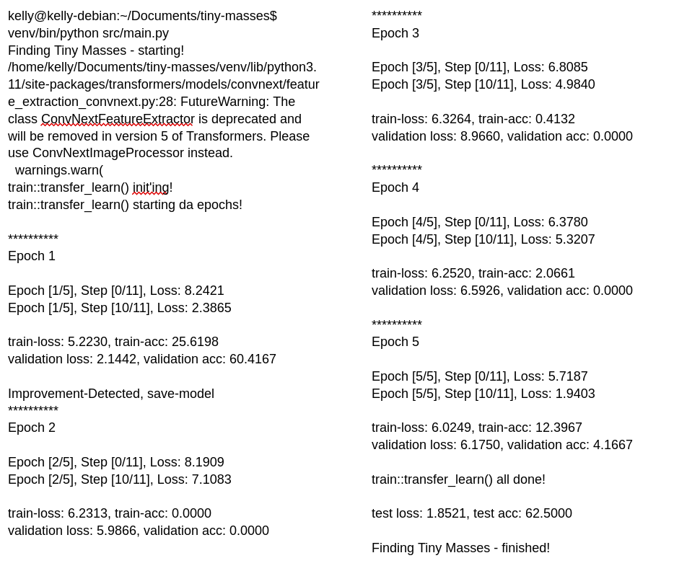
Transfer Learning model

Slide 15
Custom Learning model
We are also working on implementing a custom model using PyTorch Lightning based off of Finding Tiny Faces and related papers on SWIN transformers.
Our custom model will eventually include SWIN transformer blocks and currently is made up of a 1024x1024 CNN layer with a 2D convolution, using the full resolution of the MIAS dataset. The feature channels are connected to three linear layers and the ReLU activation function is used.
Our losses for the custom model are also currently high but we are working on improving this. Our biggest issue is using the relatively small MIAS dataset since I am currently hard drive space constrained and am working on fixing this. We believe that our losses for the custom model can be improved by refining the model and by adding the CBIS-DDSM dataset.
We are also working hard to improve our model architecture to be optimized for small mass detections by using SWIN transformer blocks to take advantage of sliding windows.

Slide 16
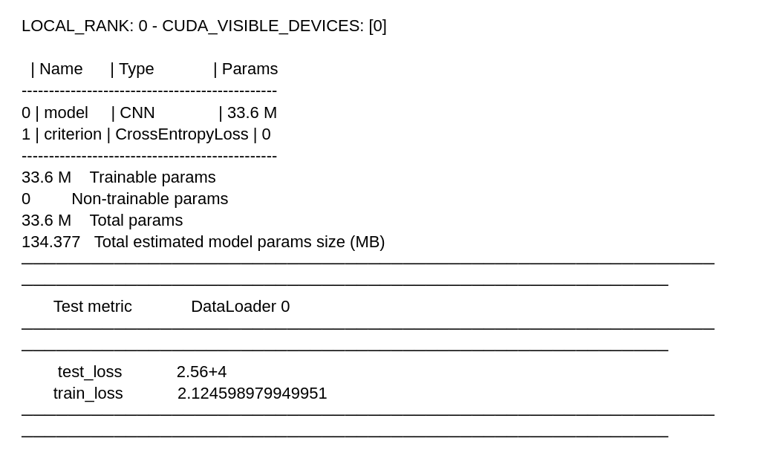
Custom Learning model

Slide 17
Remaining Tasks

Slide 18
Expand model capabilities
We need to expand on our models’ capabilities. Currently, our models are set up for image classification as a first step, but image detection requires both image classification and image localization capabilities.
There will need to be modifications to the models to handle creating a bounding box around the objects in the mammograms that the model identifies.
Models such as Faster R-CNN, YOLO, and SSD are potential options for detection oriented pretrained models.

Slide 19
Implement scaling
and sliding window detection
The main contribution from the Finding Tiny Faces paper was the evaluation logic combining the outputs from the model when passed multiple variations of the input imagery at different scales.
Our data_loader.py and eval.py scripts will be expanded to use this technique by taking the image to evaluate, resizing it, and making multiple predictions on those images.
For the case of scaling the image up, we will need to use a sliding window technique to pass chunks of the higher-res image to the model.

Slide 20
Add more datasets
For our initial development, we started with the MIAS dataset, but it is quite small compared to other available datasets.
We will expand our data_loader.py script to be able to import downloaded imagery from multiple data sources, and will target adding the INBreast and CBIS-DDSM imagery.

Slide 21
Model comparisons
Once we have more data imagery available and better test accuracy, we can experiment with different models and hyper-parameters.
In the case of the transfer learning models, swapping out the pretrained models would provide interesting insights.
For the custom models, there is a lot of experimentation we can do on the structure of it.
For both, experimenting with various loss calculations, optimizers, and other components might provide interesting comparisons as well.

Slide 22
Goal adjustment
Currently, our goals for our project don’t appear to need much change, but we have refined our understanding of what we want to do and how to get there.
We feel we are on track with the project and can accomplish interesting experiments with it!

Slide 23
Updates
Added data augmentation - 90 degree rotations, applied CLAHE
Also added logic for preserving bounding box location through rotation
Current model does classification on 7 classes, not just a binary yes/no
Tried both ResNet-101 and ResNet-50 so far, results below are with ResNet-50
Started with 0.001 learning rate, now using 0.0002 and 0.0003
Switch from SGD to Adam optimizer, getting much better results now
Increased num_epochs now that Adam is actually learning past the first epoch
Training accuracy and validation accuracy seem to top out about epoch 12, then start dropping

Slide 24
Updates
Sample test results with ResNet-50 setup, Adam optimizer, and data augmentation:
5 epochs, 0.0003 LR: final test acc 73.1518
5 epochs, 0.0002 LR: final test acc 79.7665
5 epochs, 0.0001 LR: final test acc 71.9844
10 epochs, 0.0004 LR: final test acc 77.8210
10 epochs, 0.0003 LR: final test acc 80.5447
10 epochs, 0.0002 LR: final test acc 78.5992
10 epochs, 0.0001 LR: final test acc 84.4358
10 epochs, 0.00009 LR: final test acc 82.8794
10 epochs, 0.00008 LR: final test acc 79.7665
10 epochs, 0.00007 LR: final test acc 75.0973
20 epochs, 0.0003 LR: final test acc 81.3230
20 epochs, 0.0002 LR: final test acc 78.9883
20 epochs, 0.0001 LR: final test acc 78.9883

Slide 25
Questions?

Slide 26
References
Peiyun Hu, Deva Ramanan. “Finding Tiny Faces”, CVPR 2017.

