Slide 1
Two Stage Transfer Learning for Medical Imaging
Dan Eassa, Augustine Ofoegbu

Slide 2
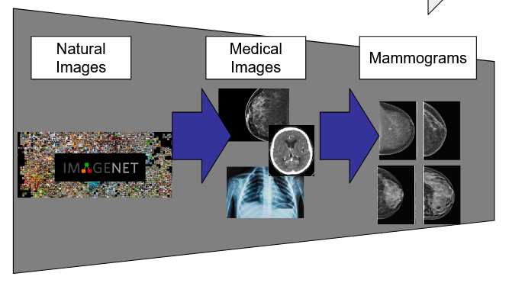
Introduction
Goal is to improve classification results by implementing two stage transfer learning approach
Provide medical imaging dataset and pre-trained backbone for other tasks

Slide 3
Introduction
1st stage of transfer learning will use ImageNet-1k pretrained weights
2nd stage of transfer learning will use a large medical images dataset
Dataset will contain images from
diverse modalities
diverse body parts
increased number of classifications compared to mammography classification task

Slide 4
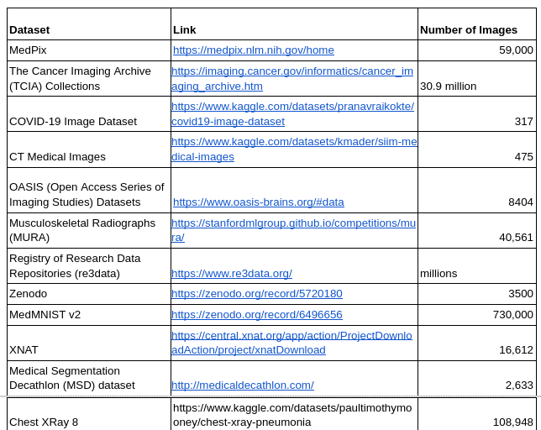
Datasets
Notes:
CLS denotes classification, SEG denotes segmentation, SP denotes survival prediction. For datasets with official division of training and testing sets, the number of images are shown in (number of training images) / (number of testing images), otherwise the total amounts of images.

Slide 5
Previous Works
Rethinking pre-training on medical imaging
For classification task pretraining on dataset with closest modality produces best results
Similar modalities show worse transfer to segmentation tasks
classification
segmentation
Yang Wen, Leiting Chen, Yu Deng, Chuan Zhou, Rethinking pre-training on medical imaging, Journal of Visual Communication and Image Representation, Volume 78, 2021, 103145, ISSN 1047-3203, https://doi.org/10.1016/j.jvcir.2021.103145. (https://www.sciencedirect.com/science/article/pii/S1047320321000894)

Slide 6
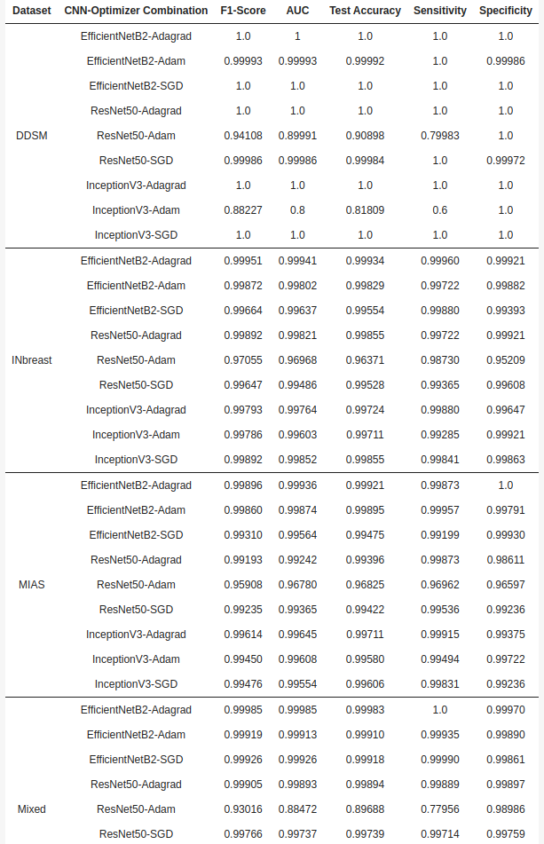
2. Patchless Multi-Stage Transfer Learning for Improved Mammographic Breast Mass Classification
Pre Training on medical images led to better classification
Ayana G, Park J, Choe S-w. Patchless Multi-Stage Transfer Learning for Improved Mammographic Breast Mass Classification. Cancers. 2022; 14(5):1280. https://doi.org/10.3390/cancers14051280

Slide 7
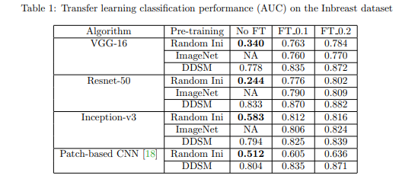
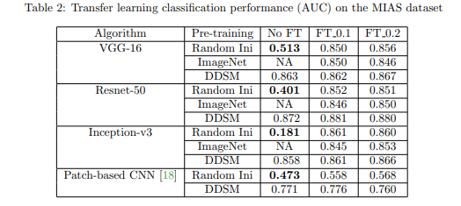
3. Transfer Learning Pre-training Dataset Effect
Analysis for Breast Cancer Imaging
Fine-tuning can mask the inefficacy of a pre-training dataset and give false impression of high classification performance
Some datasets are not a good pre-training datasets for classification on others
Bulathsinghalage, Koushik & Liu, Lu. (2022). Transfer Learning Pre-training Dataset Effect Analysis for Breast Cancer Images.
Notes:
learning different distributions

Slide 8
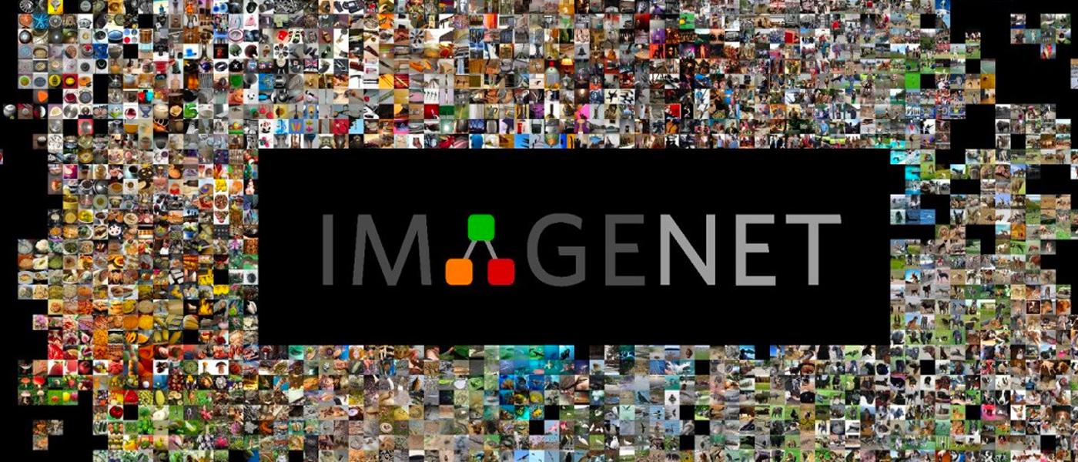
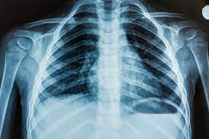
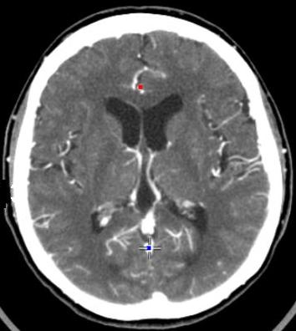
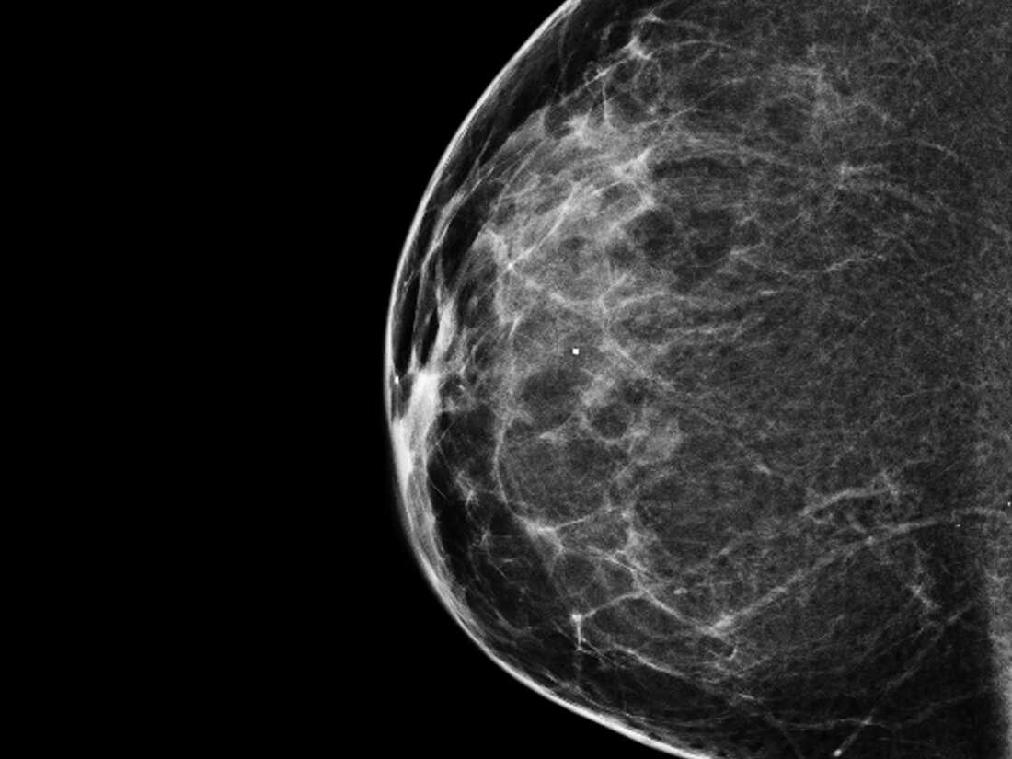
Methods
Freeze ImageNet weights
General medical image classification
Freeze medical image weights
Mammography classification

Slide 9
Data Preprocessing
Augmentations for robustness and to improve class balance
Normalize image size/channels
ResNet50 - 224x224x3
SwinT - 224x224x3
CLAHE, clip limit = 3, tile_size = 8x8

Slide 10
Experiment Design
Fine Tuning task - classification on
INBreast,
CBIS-DDSM,
Brain MRI,
Chest X-Ray
Exp Num | Model | Pretraining Stage 1 Dataset | Pretraining Stage 2 Dataset
1 | Swin T | ImageNet 1k | General medical images
2 | ResNet 50
3 | Swin T |  | None
4 | ResNet 50
5 | Swin T | None | General medical images
6 | ResNet 50
7 | Swin T |  | None
8 | ResNet 50

Slide 11
Results
Exp Num | Model | Pretraining Stage 1 Dataset | Pretraining Stage 2 Dataset | Train/Test Dataset | Train Accuracy | Train Loss | Test Accuracy | Test Loss
1 | ResNet 50 | None | MIAS+INBreast+DDSM+RSNA | MIAS | 0.570 |  | 0.8416
2 |  |  |  | INBreast |  |  | 0.4769
3 | ResNet 50 |  | None | INBreast 80/20
4 |  |  |  | CBIS-DDSM 80/20 | 0.570 | 0.086 | N/A | N/A
5 | Swin T | None | General medical images
6 | ResNet 50
7 | Swin T |  | None | INBreast 80/20 | 0.458 | 1.877 | 0.45 | 1.233
8 | ResNet 50
9 | ResNet 50 | ImageNet-1k |  | Brain MRI 80/20 | 1.0 | 1.884e06 | 0.9161 | 0.9681
 | ResNet 50 | None |  | Brain MRI 80/20 | 0.7929 | 0.4929 | 0.6905 | 0.5915
10 | ResNet 50 | ImageNet-1k |  | Chest XRay 80/20 | 0.8484 | 0.3862 | 0.8125 | 0.6320

Slide 12
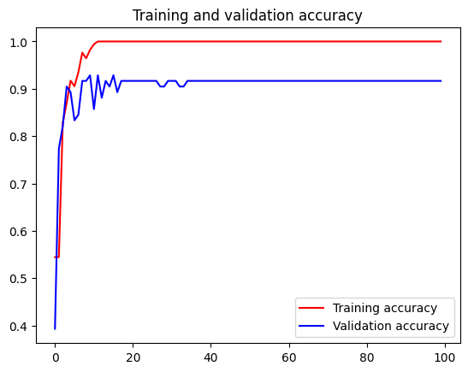
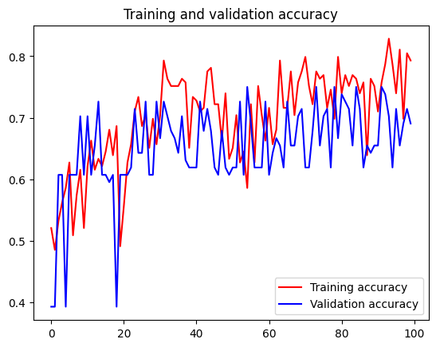
Results
Brain MRI Images for Brain Tumor Detection
169 train, 84 test images
Pretrained
Random Initialization

Slide 13
Challenges and Future Works
Creating many class labels in narrow domain
Potential Solution: artificially expand number of classifications
Create combined classification from two descriptors
Visualize Learned Feature Maps
Finetune several different layers in each model
INBreast metadata

Slide 14
Timeline
S/N | Task | Description | ECD
1 | Dataset Collection | Compile all medical datasets for final aggregated dataset. | 11/25
2 | Train Benchmark Experiments | Train experiments using traditional transfer learning. | 11/25
3 | Test Benchmark Experiments | Test experiments using traditional transfer learning. | 11/29
3 | Dataset Preprocessing | Clean, convert to common format, preprocess, and organize images by classification, and aggregate into final dataset. | 11/29
4 | Model Training | Training our models on different identified tasks using the relevant datasets. | 12/9
5 | Experiments and Evaluations | Test models, make adjustments, compile results. | 12/22

Slide 15
References
Yang Wen, Leiting Chen, Yu Deng, Chuan Zhou, Rethinking pre-training on medical imaging, Journal of Visual Communication and Image Representation, Volume 78, 2021, 103145, ISSN 1047-3203, https://doi.org/10.1016/j.jvcir.2021.103145.
N. Tajbakhsh et al., Convolutional Neural Networks for Medical Image Analysis: Full Training or Fine Tuning?, in IEEE Transactions on Medical Imaging, vol. 35, no. 5, pp. 1299-1312, May 2016, doi: 10.1109/TMI.2016.2535302.
Ayana G, Park J, Choe SW. Patchless Multi-Stage Transfer Learning for Improved Mammographic Breast Mass Classification. Cancers (Basel). 2022 Mar 1;14(5):1280. doi: 10.3390/cancers14051280. PMID: 35267587; PMCID: PMC8909211.
Li, Y., Han, Y., Li, Z. et al. A transfer learning-based multimodal neural network combining metadata and multiple medical images for glaucoma type diagnosis. Sci Rep 13, 12076 (2023). https://doi.org/10.1038/s41598-022-27045-6
Huix, J. P., Ganeshan, A. R., Haslum, J. F., Söderberg, M., Matsoukas, C., & Smith, K. (2023). Are Natural Domain Foundation Models Useful for Medical Image Classification?. arXiv preprint arXiv:2310.19522.
Matsoukas, C., Haslum, J. F., Sorkhei, M., Söderberg, M., & Smith, K. (2022). What makes transfer learning work for medical images: Feature reuse & other factors. In Proceedings of the IEEE/CVF Conference on Computer Vision and Pattern Recognition (pp. 9225-9234).
Entezari, R., Wortsman, M., Saukh, O., Shariatnia, M. M., Sedghi, H., & Schmidt, L. (2023). The Role of Pre-training Data in Transfer Learning. arXiv preprint arXiv:2302.13602.
Bulathsinghalage & Liu, Lu. (2022). Transfer Learning Pre-training Dataset Effect Analysis for Breast Cancer Images. EPiC Series. https://par.nsf.gov/servlets/purl/10341853

Slide 16
Thank you

