Slide 1
An integrated framework for breast mass classification and diagnosis using stacked ensemble of residual neural networks
https://doi.org/10.1038/s41598-022-15632-6
Christopher Collum
Ayesh Meepaganithage

Slide 2
Introduction
Breast cancer leading cause of death among female cancer patients
Problem to solve?
Increase in number of daily-screened mammograms
no equivalent increase in the number of radiologists
CAD (computer-aided diagnosis) systems can be used to help diagnose suspicious masses or lesions

Slide 3
CAD Systems
An ideal CAD system would begin with detection and localization of suspicious lesions and distinguish between types
mass, calcification, architectural distortion
Next would be segmentation of the newly obtained ROI (region of interest) to remove tissue background without losing shape precision
Lesion’s pathology is used to determine if it is malignant or benign
characteristics used to the BI-RADS (Breast Imaging Reporting and Data System) score

Slide 4
CAD Systems Cont.
Breast tumors offer significant practical challenges due to variation in size, shape, location, and texture
Need to improve overall performance of CAD systems
Deep learning has been growing in prominence over the last two decades
This paper focuses on the last stage of a CAD system, the breast mass classification and diagnosis
Use a stacked ensemble of neural network models
Paper is a followup of previous work for breast lesions detection and classification from entire mammograms, followed by a segmentation step
Work provides integrated framework which relies on three connected stage
current step generates final decision about pathology (malignant or benign) and shape (oval, round, lobulated, irregular, etc)

Slide 5
Literature Review
Many papers focusing on accuracy of different machine learning algorithms to accurately predict using mammogram datasets
results discussed more in depth later in presentation
CNN model has been found across multiple publications to produce the overall best results on the publicly available datasets for mass classification
This paper makes the following contributions
demonstrates efficiency of a type of ensemble modeling technique to improve over individual performance
integrated framework, where detection and segmentation results are highlighted, is essential for precise classification and diagnosis
present a complete breast cancer diagnosis with malignancy, BI-RADS assessment, and shape categorization

Slide 6
Overview of the Framework
Performed on Curated Breast Imaging Subset of Digital Database for Screening Mammography (CBIS-DDSM) and INbreast. A third private data set was used
Notes:
Transfer learned on ImageNet dataset.
First four residual blocks of layers were frozen except for the BN layers that needed to be retrained in order to improve the training convergence.
After that, the entire architecture was modified by adding another FC layer with a size of 1024, followed by a dropout regularization layer to maintain a generalization aspect for the training.
A new final FC layer was placed according to the number of classes for each classification task and the entire TF-ResNetV2 is re-trained.

Slide 7
ResNet base model
Uses residual blocks with skip connections between layers to bypass a few convolution layers at a time
Common architectures such as ResNet-50, 101, 152
Indicates layers
ResNetV2 has last ReLU removed
Use transfer learning on ResNetV2
pre-trained on ImageNet
first four residual blocks of layers were frozen
BN layers were retrained to improve training convergence
Added another FC layer with size 1024
followed by dropout layer
New final FC placed and entire model is retrained

Slide 8
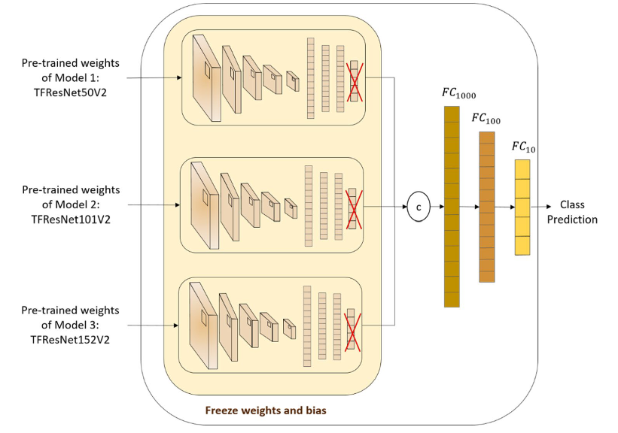
Stacked Ensemble Learning Algorithm
Notes:
After that, a stacked meta-classifier model is used.
This network concatenates the outputs of the three base models and creates a single vector
Used FC layer of size 1000 with sigmoid activation
Used FC layer of size 1000 with Relu activation
Used FC layer of size 1000 with sigmoid activation
Used a softmax layer with number of units similar to number of classes
The stacked model is trained using the same loss function and optimizer as the base models. The stacked model is also trained on the same training data as the base models.
Using three different sizes of FC layers: This is also a good idea, as it allows the meta-classifier model to learn from features at different levels of abstraction.

Slide 9
Benefits of this model
It can achieve higher accuracy than individual ResNet models.
It is more robust to overfitting.
It is flexible and can be used with any type of ResNet model.

Slide 10
Overall Framework
Original mammogram with ground truth of mass (red)
Detected ROI of mass (yellow) superimposed on the original mammogram
Detected ROI mass obtained with ground truth (red)
Output segmented binary mask of ROI mass
Segmented ROI mass with marked tissue
Notes:
Step 1
As shown in this figure, the integrated framework detects and localizes breast masses using YOLO-based fusion models.
This only require an entire mammogram image and outputs bounding boxes around suspicious lesions.
The model was evaluated and provided a maximum detection accuracy of 98.1% for mass lesions.
Step 2
In this step, the detected ROI of breast masses is segmented and a binary mask image where only the boundary of the lesions is visible is generated.
This was achieved by using a combination of two UNet models.
this model was trained on CBIS-DDSM, INbreast, Private dataset and a augmented and enhanced image set of these datasets using CycleGAN.
The segmentation step was conducted on ROI images scaled to 256 × 256 pixels.
Step 3
After that, the segmented and detected ROI of breast masses generated with masked tissue is used for the third and final classification step.
Resize input images to size 224 × 224
The stacked ensemble of ResNet models is trained independently on the input ROI masses for each classification task to finally predict
the pathology as either malignant or benign
the BI-RADS category with an assessment score between 2 to 6
the shape as either round, oval, lobulated or irregular.

Slide 11
Dataset
Three Datasets
CBIS-DDSM
2907 mammograms of 1555 patients
MLO and CC views
3000*4800 pixels
INbreast
410 mammograms of 115 patients
MLO and CC views
3328*4084 pixels
Private Dataset
389 mammograms of 208 patients
MLO, CC, ML and AT views
300*700 pixels
Notes:
The integrated framework was evaluated on two publicly available datasets, the Curated Breast Imaging Subset of Digital Database for Screening Mammography (CBIS-DDSM) and INbreast, and additionally on a private dataset.
The CBIS-DDSM dataset61 is an updated and standardized version of the Digital Database for Screening Mammography (DDSM), where images were reviewed by radiologists to eliminate inaccurate cases.
Private dataset is a collection of mammograms from the National Institute of Cancerology in Mexico.

Slide 12
Dataset
For each class,
Training - 80%
Validation - 10%
Testing - 10%
Loss Function
Binary Cross-entropy
Categorical Cross-entropy
Weighted Accuracy
Weighted accuracy was used to minimize the effect of class imbalance
Learning Rate is Dynamic
If accuracy didn’t improve after 2 iterations, the learning rate was reduced by a factor of 0.5.
Notes:
Weighted accuracy was used due to the class imbalance
If accuracy didn’t improve after 2 iterations, Learning rate was reduced by a factor of 0.5.

Slide 13
Dataset
 | Dataset distribution |  |  | Pathology
Dataset | Raw data | Raw ROI data | Augmented data (ROIs*6) | Benign | Malignant
CBIS-DDSM | 1467 | 1467 | 8802 | 4500 | 4302
INbreast | 107 | 112 | 672 | 150 | 522
Private | 389 | 638 | 3828 | 0 | 3828
 | BI-RADS
Dataset | Category 2 | Category 3 | Category 4 | Category 5 | Category 6
CBIS-DDSM | 792 | 1938 | 2238 | 3402 | 0
INbreast | 144 | 78 | 126 | 276 | 48
Private | 0 | 0 | 1627 | 2195 | 0
Notes:
Raw ROIs data was augmented four times by rotating them with the angles Δθ = {0°, 90°, 180°, 270°}, and transformed twice differently using the Contrast Limited Adaptive Histogram Equalization (CLAHE) method.
Cases with BI-RADS score > 3, are considered Malignant otherwise Benign.

Slide 14
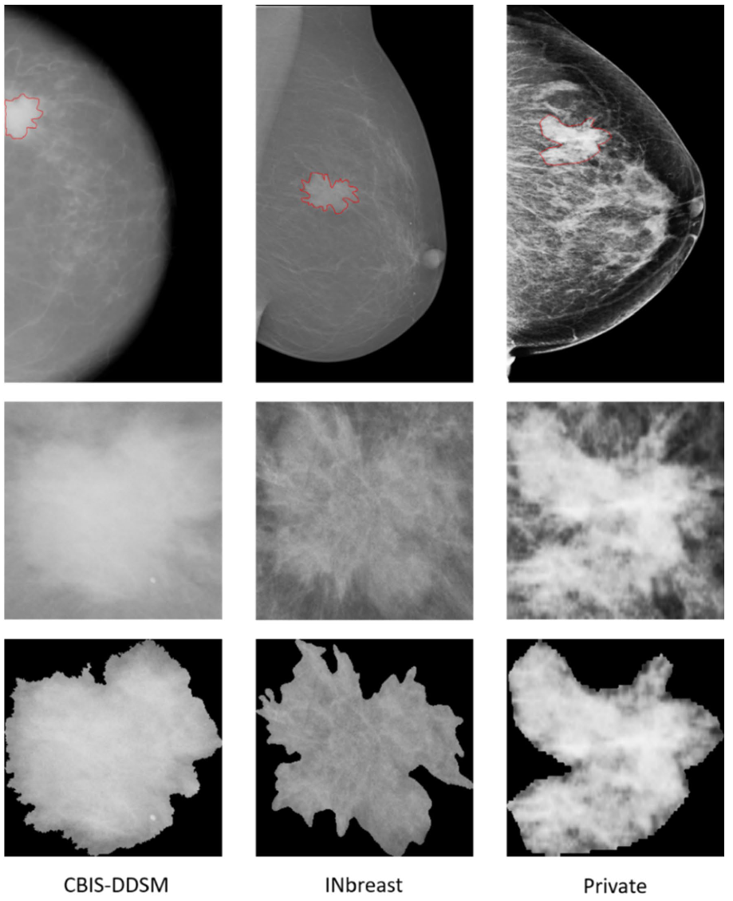
Dataset Sample
Entire mammogram
ROI of a mass detected
ROI segmented
Notes:
Samples of
Entire mammograms and
ROI of a mass detected and
ROI segmented
from different mammography datasets with ground-truth of location and contour of mass in red.

Slide 15
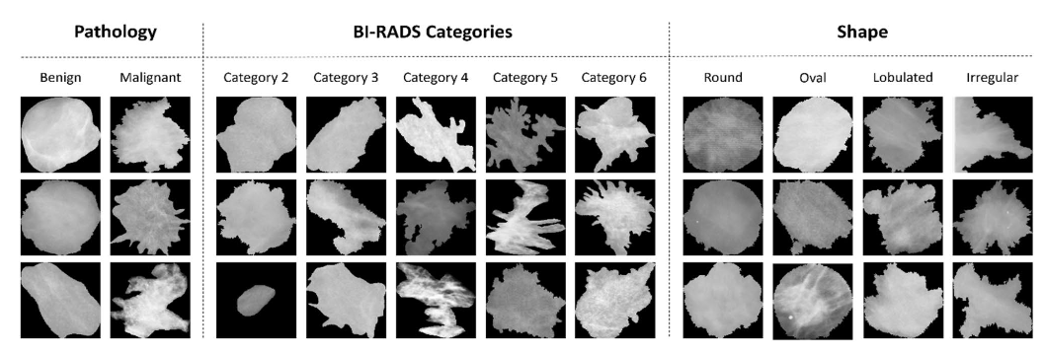
Dataset Sample
Samples of detected and segmented ROI masses for each class within different classification tasks from different mammography datasets.
Notes:
Samples of detected and segmented ROI masses for each class within different classification tasks from different mammography datasets.

Slide 16
Data Preparation
Remove Noises
using Histogram Equalization that smoothens pixel distribution
Resize the images
using an inter-area resampling interpolation
Normalize images
to a range of [0,1] to make sure all the images are on the same scale
Notes:
Removed noises using Histogram Equalization that smoothens pixel distribution
Pre-trained ResNet models require an input image size of 224 × 224;
therefore, resized the detected and segmented ROIs from 256× 256 using an inter-area resampling interpolation (such as using nearest neighbour filling)
Normalize images to a range of [0,1] to make sure all the images are on the same scale

Slide 17
Hyperparameters
The best evaluation was reported with a batch size of 32, 30 epochs, a dropout rate of 30%, a learning rate of 0.01, and a smoothing label of 25%.
Hyperparameter | Values explored
Batch size | 32, 64
Epochs | 20, 30, 50
Dropout | 0%, 20%, 30%
Learning rate | 0.1, 0.01, 0.001
Smoothing | 0%, 20%, 25%
Notes:
smoothing -> % of label smoothing for the loss function
The best evaluation was reported with a batch size of 32, 30 epochs, a dropout rate of 30%, a learning rate of 0.01, and a smoothing label of 25%.

Slide 18
Evaluation Matrices
For all classifications:
Accuracy
AUC
For pathology classification:
Sensitivity
Specificity
F1-score

Slide 19
Quantitative Classification Results
Proposed breast mass classification model was trained and compared to single base models
compared stacked ensemble of models to conventional average
Pathology results compared between different models for three datasets
Private dataset has only malignant cases so model was trained and tested on combination of all datasets

Slide 20
Results
Pathology classification results on the CBIS-DDSM dataset
Model | Accuracy | Sensitivity | Specificity | F1-score | AUC
ResNet50V2 | 89.97 | 0.89 | 0.91 | 0.9 | 0.9
ResNet101V2 | 93.57 | 0.92 | 0.95 | 0.94 | 0.93
ResNet152V2 | 92.11 | 0.92 | 0.92 | 0.92 | 0.92
Average weights of 3 models + XGBoost Classifier | 91.04 | 0.85 | 0.98 | 0.91 | 0.91
Stacked Ensemble of models | 95.13 | 0.93 | 0.97 | 0.95 | 0.95

Slide 21
Results
Pathology classification results on the INbreast dataset
Model | Accuracy | Sensitivity | Specificity | F1-score | AUC
ResNet50V2 | 98.52 | 1.0 | 0.93 | 0.97 | 0.96
ResNet101V2 | 95.58 | 1.0 | 0.80 | 0.93 | 0.90
ResNet152V2 | 96.6 | 1.0 | 0.90 | 0.91 | 0.94
Average weights of 3 models + XGBoost Classifier | 97.9 | 1.0 | 0.96 | 0.98 | 0.97
Stacked Ensemble of models | 99.2 | 1.0 | 0.98 | 0.99 | 0.99

Slide 22
Results
Pathology classification results on the private dataset
Model | Accuracy | Sensitivity | Specificity | F1-score | AUC
ResNet50V2 | 92.83 | 0.94 | 0.90 | 0.91 | 0.92
ResNet101V2 | 94.18 | 0.94 | 0.95 | 0.93 | 0.94
ResNet152V2 | 94.60 | 0.94 | 0.94 | 0.94 | 0.94
Average weights of 3 models + XGBoost Classifier | 94.89 | 0.94 | 0.97 | 0.93 | 0.94
Stacked Ensemble of models | 95.88 | 0.93 | 0.97 | 0.95 | 0.96

Slide 23
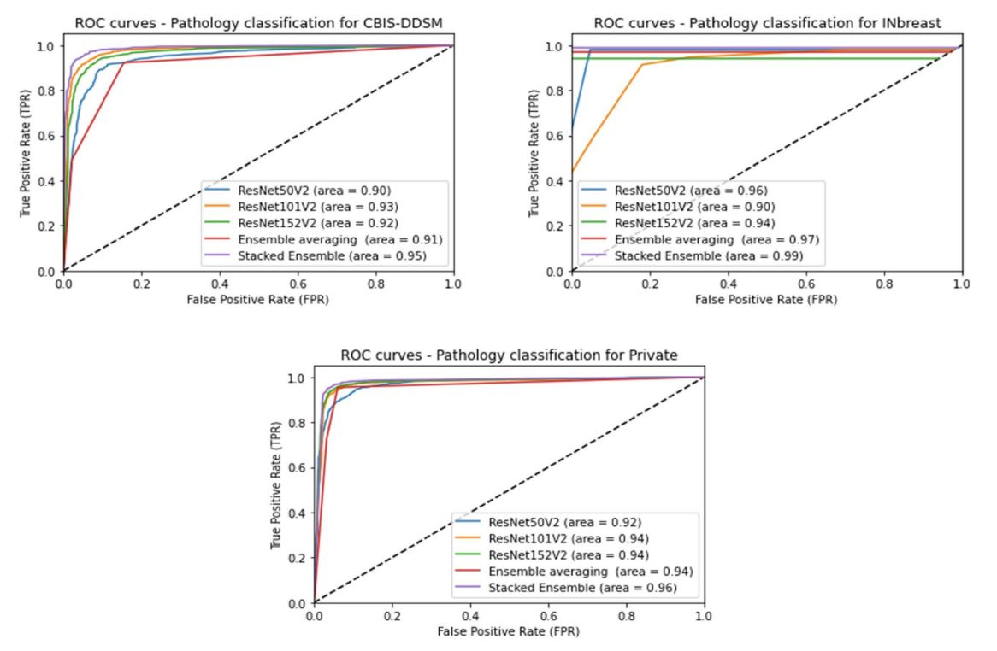
Quantitative Classification Results

Slide 24
Quantitative Classification Results
BI-RADS category classification saw similar overall improvements in the ensemble method
Each dataset has different class labels that vary from
2-6

Slide 25
Results
BI-RADS category classification results
 | CBIS - DDSM |  | INbreast |  | Private
Model | Accuracy | AUC | Accuracy | AUC | Accuracy | AUC
ResNet50V2 | 80.07 | 0.93 | 98.0 | 0.94 | 91.91 | 0.91
ResNet101V2 | 77.12 | 0.92 | 98.0 | 0.97 | 92.43 | 0.92
ResNet152V2 | 80.08 | 0.93 | 96.1 | 0.92 | 94.25 | 0.94
Average weights of 3 models + XGBoost Classifier | 79.48 | 0.85 | 97.1 | 0.99 | 92.95 | 0.93
Stacked Ensemble of models | 83.84 | 0.94 | 99.0 | 1.00 | 96.08 | 0.95

Slide 26
Results
Shape classification results
trained only on CBIS-DDSM due to being the only dataset with shape annotation done by experts
Model | Accuracy | AUC
ResNet50V2 | 75.51 | 0.90
ResNet101V2 | 89.90 | 0.95
ResNet152V2 | 88.32 | 0.97
Average weights of 3 models + XGBoost Classifier | 79.36 | 0.84
Stacked Ensemble of models | 90.02 | 0.98
Notes:
Only on the CBIS - DDSM dataset

Slide 27
Results
Private
Comparison of classification performance (accuracy %) using the proposed CAD system with and without mass segmentation.
 | Pathology |  | BI-RADS Category |  | Shape
Model | Without | With | Without | With | Without | With
CBIS - DDSM | 90.87 | 95.13 | 81.69 | 85.38 | 85.66 | 90.02
INbreast | 95.20 | 99.20 | 97.50 | 99 | NA | NA
Private | 90.38 | 95.88 | 95.70 | 96.08 | NA | NA

Slide 28
Comparison with previous methods
Pathology classification results on INbreast dataset
Ref. | Year | Method | Image Segmented | Acc. | AUC
[1] | 2017 | Multi-view deep residual neural network (mResNet) | Yes | - | 0.80
[2] | 2018 | Ensemble of AlexNet-based CNN | Yes | 95.64 | 0.94
[3] | 2020 | Improved Crow-Search Optimized Extreme Learning Machine (ICSELM) algorithm | No | 98.26 | -
[4] | 2021 | DualCoreNet: Texture and shape features fusion | Yes | - | 0.93
Proposed | 2022 | Stacked Ensemble of ResNet models | Yes | 99.20 | 0.99
References
[1] Dhungel, N., Carneiro, G., & Bradley, A. P. Fully automated classification of mammograms using deep residual neural networks. In 2017 IEEE 14th International Symposium on Biomedical Imaging (ISBI 2017), 310–314 (IEEE, 2017).
[2] Al-Antari, M. A., Al-Masni, M. A., Choi, M. T., Han, S. M. & Kim, T. S. A fully integrated computer-aided diagnosis system for digital X-ray mammograms via deep learning detection, segmentation, and classification. Int. J. Med. Informatics 117, 44–54 (2018).
[3] Chakravarthy, S. S. & Rajaguru, H. Automatic detection and classification of mammograms using improved extreme learning machine with deep learning. IRBM 43(1), 49–61 (2022).
[4] Yu, X. et al. ResNet-SCDA-50 for breast abnormality classification. IEEE/ACM Trans. Comput. Biol. Bioinform. 18, 94–102 (2020).

Slide 29
Comparison with previous methods
Pathology classification results on CBIS-DDSM dataset
Ref. | Year | Method | Image Segmented | Acc. | AUC
[5] | 2017 | MobileNet and NasNet + fine tuning | Yes | 78.4 | -
[6] | 2018 | VGG16 + fine tuning | No | 84.4 | 0.84
[7] | 2020 | AlexNet, VGG, GoogLeNet, ResNet + fine tuning | No | 93.47 | 0.97
Proposed | 2022 | Stacked Ensemble of ResNet models | Yes | 95.13 | 0.95
References
[5] Falconí, L. G., Pérez, M., & Aguilar, W. G. Transfer learning in breast mammogram abnormalities classification with mobilenet and nasnet. In 2019 International Conference on Systems, Signals and Image Processing (IWSSIP), 109–114 (IEEE, 2019).
[6] Falconi, L. G., Perez, M., Aguilar, W. G. & Conci, A. Transfer learning and fine tuning in breast mammogram abnormalities classification on CBIS-DDSM database. Adv. Sci. Technol. Eng. Syst. 5, 154–165 (2020).
[7] Alkhaleefah, M. et al. Double-shot transfer learning for breast cancer classification from X-ray images. Appl. Sci. 10, 3999 (2020).

Slide 30
Comparison with previous methods
BI-Rads classification results
Ref. | Year | Method | Dataset | Image Segmented | Acc. | AUC
[8] | 2020 | DenseNet201 + MLP | CBIS-DDSM | No | 63.4 | -
Proposed | 2022 | Stacked Ensemble of ResNet models | CBIS-DDSM | Yes | 85.38 | 0.94
[9] | 2020 | NasNet + fine tuning on VGG16 and VGG19 | INbreast | No | 90.9 | 0.99
Proposed | 2020 | AlexNet, VGG, GoogLeNet, ResNet + fine tuning | INbreast | Yes | 99 | 1.00
References
[8] Medeiros, A., Ohata, E. F., Silva, F. H., Rego, P. A., & Reboucas Filho, P. P. An approach to BI-RADS uncertainty levels classifica tion via deep learning with transfer learning technique. In 2020 IEEE 33rd International Symposium on Computer‑Based Medical Systems (CBMS), 603–608 (IEEE, 2020).
[9] Falconí, L., Pérez, M., Aguilar, W., & Conci, A. Transfer Learning and Fine Tuning in Mammogram BI-RADS Classification. In 2020 IEEE 33rd International Symposium on Computer‑Based Medical Systems (CBMS), 475–480 (IEEE, 2020).

Slide 31
Comparison with previous methods
Shape classification results
Ref. | Year | Method | Dataset | Image Segmented | Acc. | AUC
[10] | 2020 | CNN | DDSM | Yes | 80 | 0.80
Proposed | 2022 | Stacked Ensemble of ResNet models | CBIS-DDSM | Yes | 90.02 | 0.98
References
[10] Singh, V. K. et al. Breast tumor segmentation and shape classification in mammograms using generative adversarial and convolutional neural network. Expert Syst. Appl. 139, 112855 (2020).

Slide 32
Discussion
Integrated work on YOLO-based fusion models and connected-UNets model.
The ensemble method performed better than the individual models.
Masking the background tissues from the tumors’ boundaries is beneficial.
Long training time.
Notes:
Implemented a stacked ensemble of ResNet models to classify
breast masses as malignant or benign
diagnose their BI-RADS category assessment with a score from 2 to 6
shape as oval, round, lobulated or irregular.
long training time of 0.74 s per epoch, which is due to the high number of trainable parameters and computations of the ResNetV2 model

Slide 33
Improvements
Explore more label smoothing for the loss function during hyperparameter tuning
Explore more dropout rates
Explore more batch sizes
Use the same format for all evaluation metrics

Slide 34
Thank You!

Slide 35
Confusion

