Slide 1
Breast masses in mammography classification with local contour features
Brian Székely and Gaurav Srikar

Slide 2
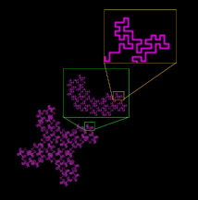
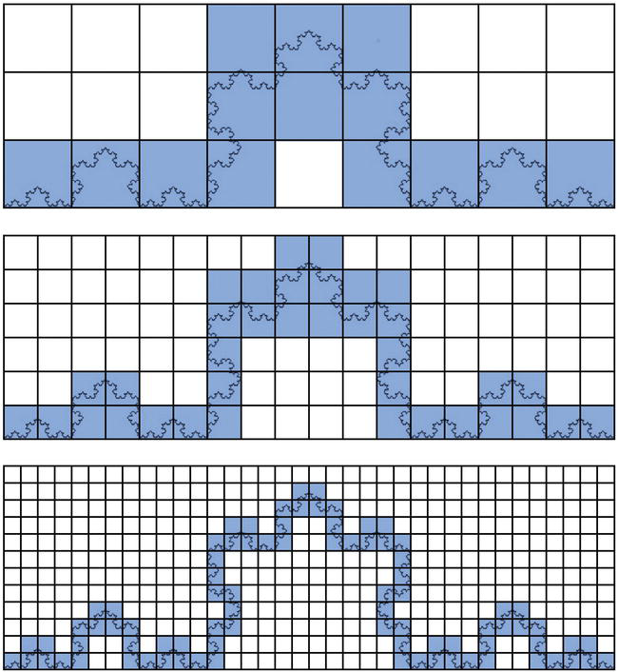
Introduction
Breast cancer is the most common cancer in women globally, with a significant impact in China.
Fractal analysis, particularly through methods like box-counting and ruler methods, has proven valuable for classifying breast masses in CAD systems, with classification accuracy exceeding 80%.
Regularity in mass shape, such as circular or oval shapes, is also considered important for distinguishing benign from malignant masses.
Notes:
Fractal analysis in breast cancer images involves quantifying the complex, self-similar patterns and structures present within breast tissue or lesions.

Slide 3
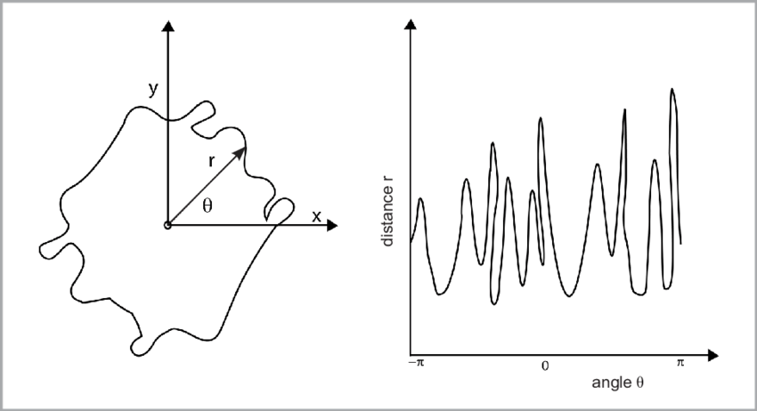
Proposed Methodology
A new method is introduced to characterize breast mass contour regularity, involving the labeling of abnormal areas in mammography images, translating 2D contours into 1D signatures based on Euclidean distances, segmenting signatures, and extracting local contour features.
Gabrijelčič and Hladnik, 2015

Slide 4
Datasets
Digital Database for Screening Mammography (DDSM), 2620 cases with mammography images
Massachusetts General Hospital
University of South Florida
Sandia National Laboratories
patient information and pixel-level ground truth data for suspicious regions.
Benign and malignant masses,
323 contours from DDSM (143 benign and 180 malignant).
Mammography images with single abnormalities to simplify experimentation

Slide 5
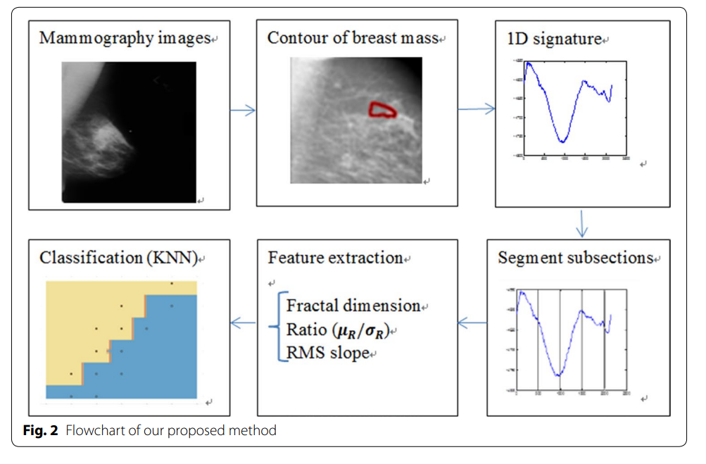
Methods Flowchart

Slide 6
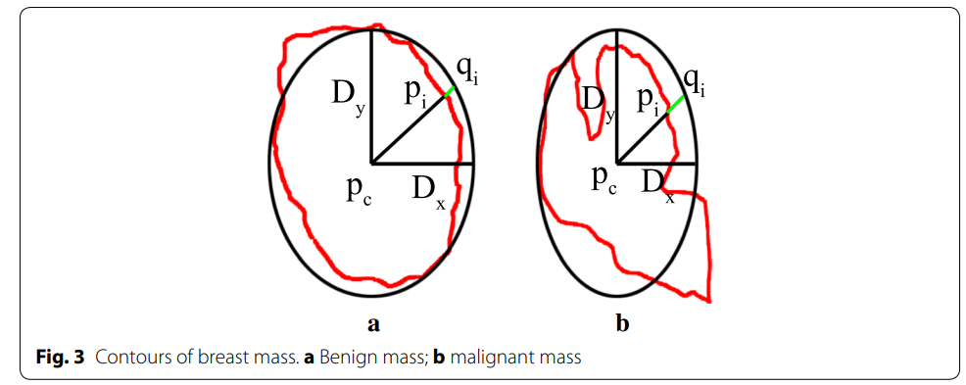
Contour extraction
Benign breast masses exhibit smooth contours, resulting in simple signatures
malignant tumors display jagged contours, leading to rough signatures.
Contours are extracted by connecting points expressed with chain code from overlay files.
Contours are formalized as ordered point sets along an anticlockwise direction
regularity is determined based on the proximity of contour points to a standard ellipse or circle.
High proximity indicates a regular contour associated with benign masses,
lower proximity suggests malignancy.
Distance functions (hp(i), hq(i), h(i)) and 1D signatures are used to quantify and differentiate between benign and malignant breast masses.

Slide 7
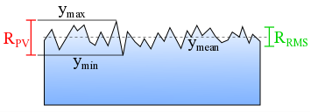
Four Features - RMS roughness and μR/R ratio
Root mean square roughness (w) measures the irregularity of the 1D signature, with smaller values indicating more regular shapes like circles or ellipses, potentially indicating benign breast masses.
The μR/R ratio, which compares the mean radial distance to the standard deviation of tumor boundary, indicates the circularity of the breast mass contour. Smaller values of this ratio are associated with malignant masses.

Slide 8
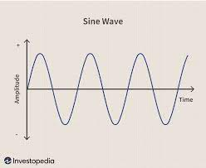
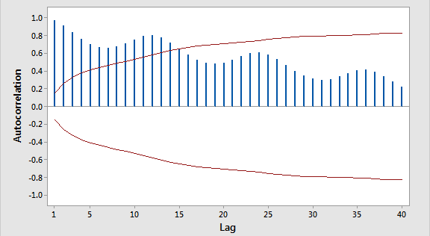
Fractal Dimension
Fractal dimension is used to describe self-similarity in various natural phenomena, including medical images.
The fractal Brownian motion model is suitable for analyzing medical images, as it treats intensity surfaces as the result of random walks
Autocorrelation functions and height-height correlation functions are used to characterize the fractal properties of surfaces, with the fractal exponent related to the fractal dimension
Notes:
Autocorrelation, also known as serial correlation or self-correlation, is a statistical concept that measures the degree to which a data series is correlated with itself at different time lags.
The fractal dimension indicates self-similarity and local non-smooth fluctuations in the signature, with larger D values indicating more pronounced local fluctuations, serving as a feature to distinguish between benign and malignant masses in 1D signatures.

Slide 9
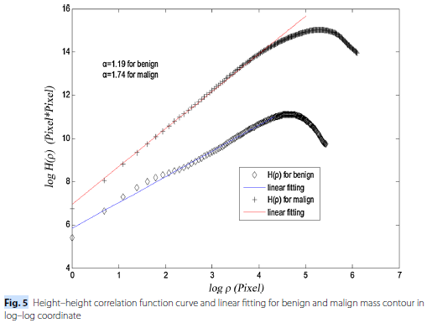
Correlation plot
Figure Displays the log-log curve of log(height-height correlation function) vs. log(p)
Fractal Dimension and Fluctuation: A larger fractal dimension (D) corresponds to more pronounced local fluctuations within the signature.
No idea what they are trying to show here - not a feature
Xi

Slide 10
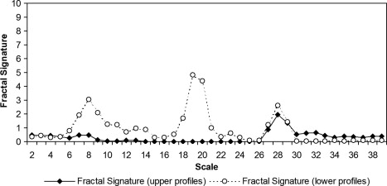
Fractal Signature
Dong, 2008
Notes:
A fractal signature typically includes a set of mathematical or statistical measurements that characterize the fractal's key attributes.
self-similarity scaling that describe how the fractal pattern repeats itself at different levels of magnification.

Slide 11
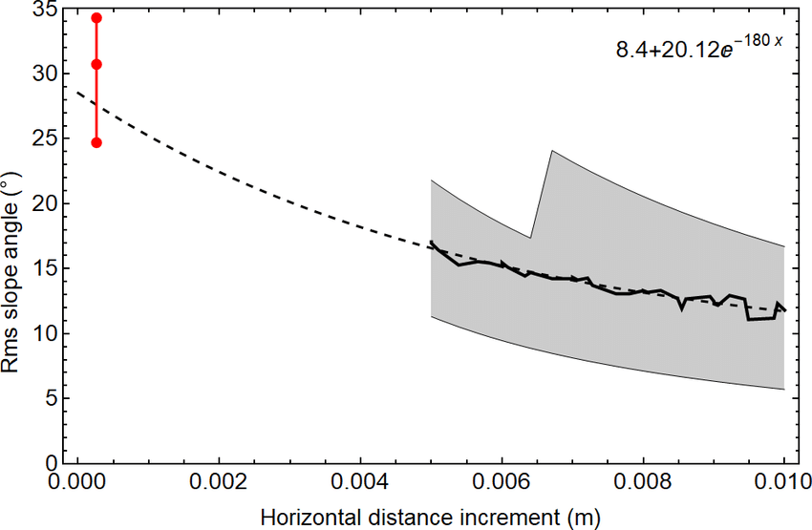
RMS slope
RMS slope s is a feature used to describe the shape of a contour.
It measures the variation in slope along the contour, where a smooth contour has slow and regular slope variation, while an irregular contour exhibits drastic slope changes.
Benign masses tend to have smaller RMS slope values with gentler fluctuations, whereas malignant masses have larger RMS s values with more violent fluctuations, resulting in a wider variation range for RMS s in malignant masses.
Notes:
Root mean square slope (RMS s) is calculated from the slope distribution of each point on the contour and is used as a feature to distinguish between benign and malignant masses.

Slide 12
Classifiers
Classification Methods: KNN, SVM, and ANN are employed for breast mass classification.
KNN Setting: KNN classifier uses K = 1.
SVM Configuration: A linear SVM classifier is utilized.
ANN Configuration: ANN has a hidden layer with 10 nodes and random weight initialization.
Data Split: The dataset is divided into 300 training and 23 testing contours.
Software: MATLAB R2015b
Notes:
artificial neural network (ANN)

Slide 13
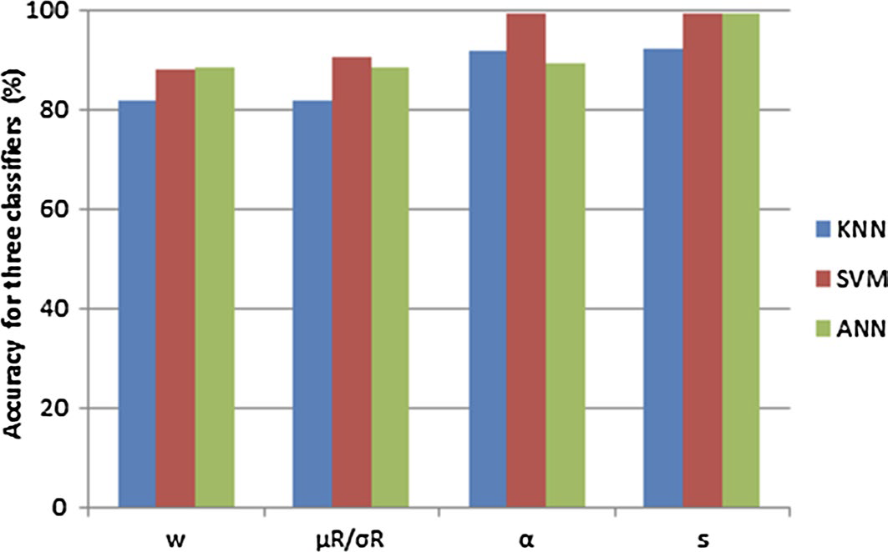
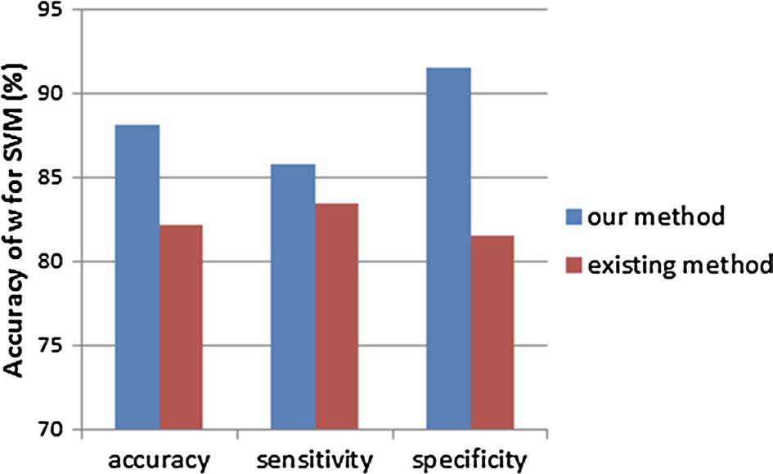
Results
The bar chart of accuracy for four features used KNN, SVM and ANN classifier.
The bar chart of accuracy, sensitivity and specificity for our method compared with existing method used SVM classifier.

Slide 14
Results
Curve of sections vs. accuracy with KNN.
Curve of sections vs. accuracy with SVM.
Curve of sections vs. accuracy with ANN.

Slide 15
Future Work
The selection of N and some texture features could be studied for improving the classification performances.
We can choose more cases in order that our study has a wider application range.
More advanced classification methods such as deep neural network can be used to improve the classification accuracy.

Slide 16
Limitations
The data used for training is less
Could have perform data augmentation
No comparison with CNN
Didn’t address anything about the problem of centroid falling outside the contour.

