Slide 1
Breast Lesions Detection and Classification via YOLO-Based Fusion Models
By
Asma Baccouche, Begonya Garcia-Zapirain,Cristian Castillo Olea & Adel S. Elmaghraby
Presented By
Aminul Huq and Mst. Tasnim Pervin

Slide 2
Introduction
Global incidence and mortality
Breast cancer accounts for 12.5% of all new annual cancer cases.
In 2020, 2.3 million new cases of breast cancer cases were diagnosed.
Breast cancer is also the most common cause of cancer death among women, with 685,000 deaths in 2020.
Breast cancer is the second leading cause of cancer death in US women, after lung cancer.
https://www.cdc.gov/cancer/breast/statistics/index.htm

Slide 3
Proposed CAD System
Baccouche, Asma, Begonya Garcia-Zapirain, and Adel S. Elmaghraby. "An integrated framework for breast mass classification and diagnosis using stacked ensemble of residual neural networks." Scientific reports 12.1 (2022): 12259.

Slide 4
Tasks Performed
Used a fusion model to localize and classify mass and calcification
Experimented with three different dataset
Utilized the result of this experiment to future research work

Slide 5
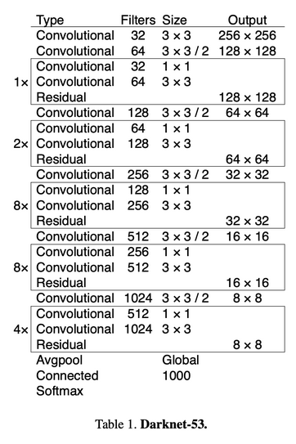
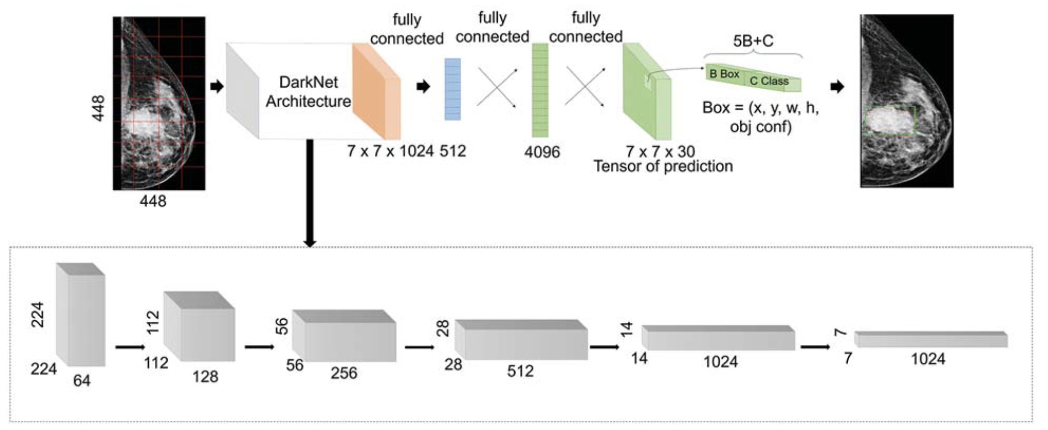
YOLO Based Architecture
Confidence Score = Prob(obj) x IoU Score
Cclass probability = Prob(class_i | obj) x IoU score

Slide 6
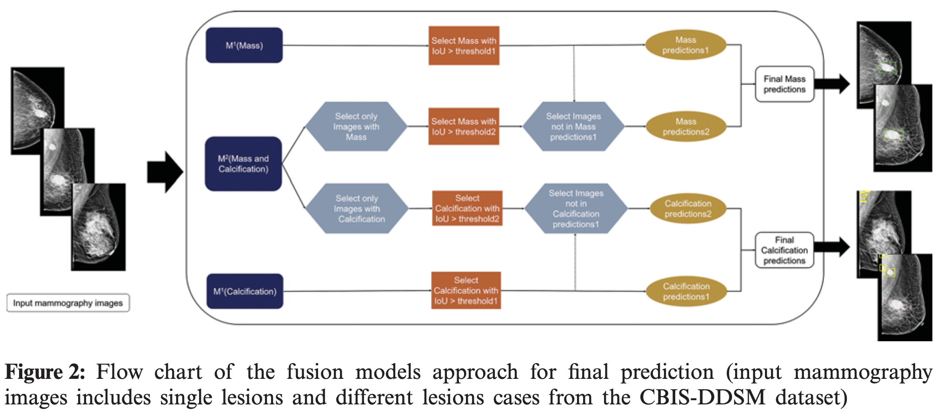
Fusion Model Approach
Threshold1 = 0.5
Threshold2 = 0.35

Slide 7
Dataset Description
CBIS-DDSM : 2907 (MLO & CC), resolution- 3000x4800
InBreast : 235 (MLO & CC), resolution- 3328x4048
Private (INCAN) : 487 (MLO & CC) , resolution- 300x700
All dataset have ground truth masks
70% training, 20% testing, 10% validation

Slide 8
Data Preprocessing & Augmentation
Preprocessing:
Histogram equalization on CBIS-DDSM and private dataset
Bicubic Interpolation over 4x4 neighborhood to resize images into 448x448
Data augmentation
Rotation - 0°,90°,180° and 270°
CLAHE
4x4 grid with contrast threshold of 40
8x8 grid with contrast threshold of 30
Total Data:
CBIS-DDSM : 18,909
INbreast: 1,410
Private: 2,922

Slide 9
Evaluation Metrics
IoU score = Area of Intersection / Area of Union
Detection Accuracy Rate = True Detected Cases / Total Number of Cases

Slide 10
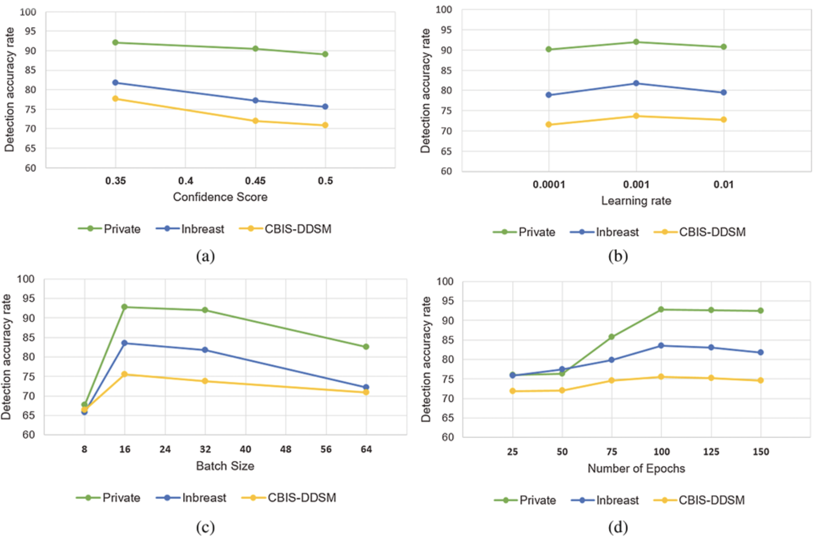
Hyperparameter Tuning
Confidence Score: 0.35
Learning Rate: 0.001
Batch Size: 16
No. of Epochs: 100

Slide 11
Experimental Results

Slide 12
Experimental Results (cont.)

Slide 13
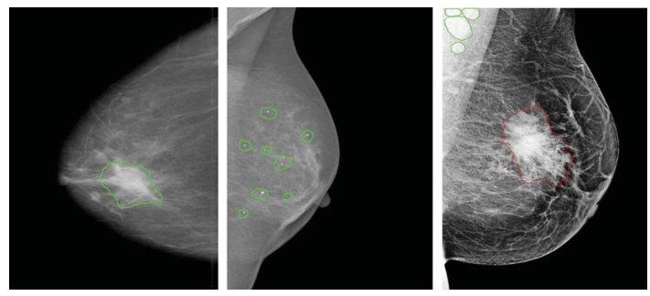
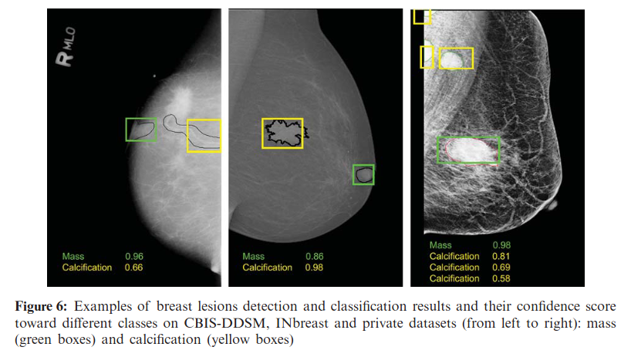

Slide 14
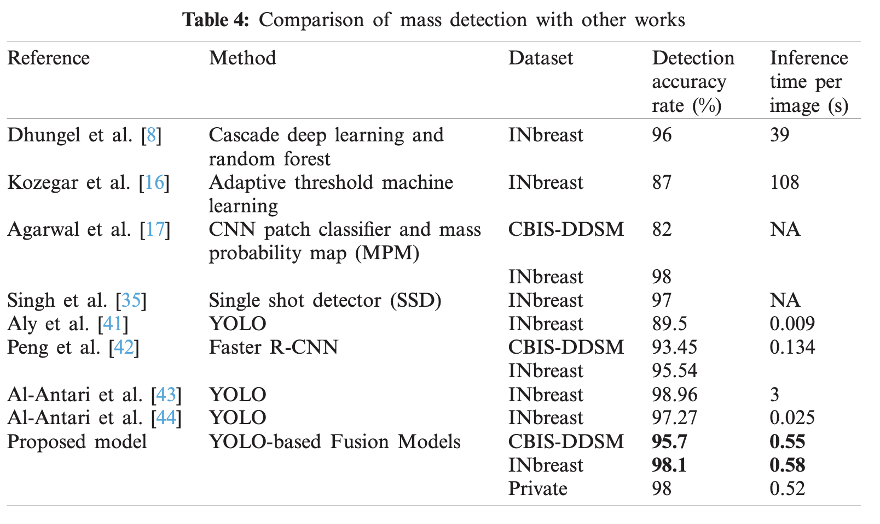

Slide 15
Limitations
Loss function not mentioned
No specific filtering approach of predicted images
Poor calcification detection performance
No of anchor boxes used not specified

Slide 16
Future Work
Exact detection of masses and calcifications
Segmentation of lesions and shapes
Type classification (benign or malignant)
Malignancy degree prediction
CAD system development

