Slide 1
Review of Paper: Two-view Mammogram Synthesis from single-view data using generative adversarial Networks
Neha Ujjainkar & Abhishek Khandekar

Slide 2
Outline
Introduction
Methods
Data set
Results
Advantages
Disadvantages
Conclusion

Slide 3
Introduction
.
Mammography methods
  Single-view mammography- only mediolateral-oblique (MLO) view.
  Two-view mammography- both mediolateral-oblique (MLO) and cranio-caudal (CC) views.
Why Single-view mammography is still performed?
  lower radiation dose
  increased examination throughput
  being less time- and cost-consuming
  reduced overdiagnosis

Slide 4
Introduction
.
Issue with Single view mammograms
  The cancer detection rate is inferior.
  Difficult to distinguish the overlapped cancer from surrounding tissues, particularly in single-view mammograms.
The diagnostic accuracy of single-view mammography would be improved if information from another view was available.

Slide 5
Earlier Techniques
.
Wasserstein GAN (WGAN)
Progressive growing GAN (PG-GAN) and
StyleGAN2

Slide 6
CR-GAN
.
CR-GAN -> Complete representation General Adversarial Network
Proposed by Tian et al. to yield superior-quality multi-view face images from single-view images.
In this study, the CR-GAN framework was used to synthesize novel-view images (i.e., CC views) from MLO-view mammograms. This study was conducted by Asumi Yamazaki and Takayuki Ishida. (both are radiological technologists with more than 10 years of experience)

Slide 7
Goal of this study
Improve the ability of single-view mammography to diagnose breast cancer using artificial intelligence (AI) technology.
With the aim of higher resolution and superior quality mammogram syntheses, the authors implemented two adaptations to CR-GAN:
(1) Progressive growing technique;
(2) Feature matching loss.

Slide 8
Method
.
CR-GAN
  CR-GAN was developed to generate multi-view face images from single-view photographs using two-pathway networks.
  Representation suggests that the generation of superior-quality and identity-preserved images is guaranteed, even from unseen inputs not included in the training data set.
  CR-GAN: Learning Complete Representations for Multi-view Generation - YouTube
  Two-pathway networks of CR-GAN includes:
  Generation Path
  Reconstruction paths

Slide 9
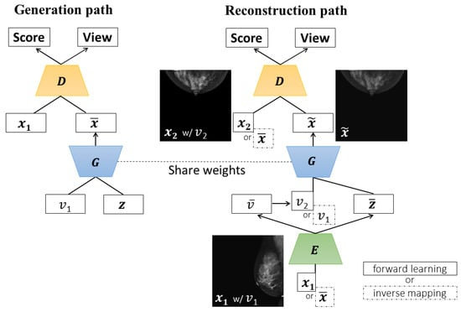
Method
.
CR-GAN

Slide 10
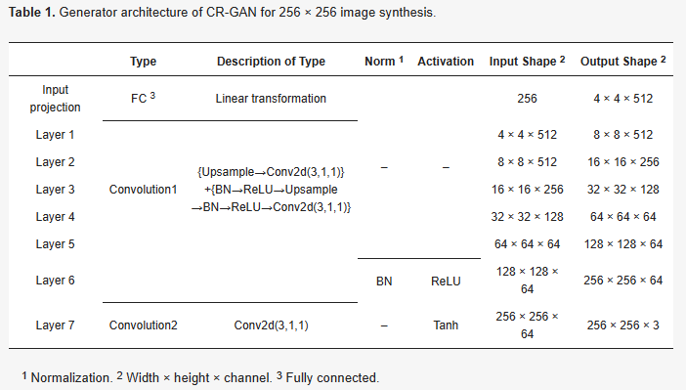
Method
.
Generator architecture of CR-GAN for 256 × 256 image synthesis.

Slide 11
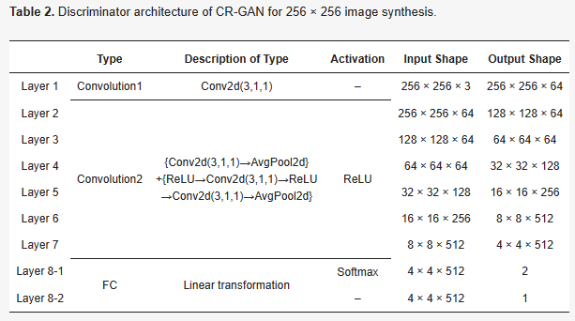
Method
Discriminator architecture of CR-GAN for 256 × 256 image synthesis.

Slide 12
Dataset
.
1054 pairs from CBIS-DDSM (3000 x 4500 to 4000 x 5700)
188 pairs from INBreast (3328 x 4084 or 2560 x 3328)
2542 pairs from CMMD (1914 x 2294)

Slide 13
Experimental Environment and Parameter Settings
.
NVIDIA GeForce RTX 3080 Ti with 16 GB GPU memory.
Pytorch 1.11.0 framework and Jupyter Notebook
During training Adam optimizer with a learning rate of 0.0001 and the following momentum parameters: 𝛽1 = 0 and 𝛽2 = 0.9.
Batch sizes of 10 and 4 for 256 × 256 and 20 for 128 × 128 and 4 for 512 × 512 image synthesis

Slide 14
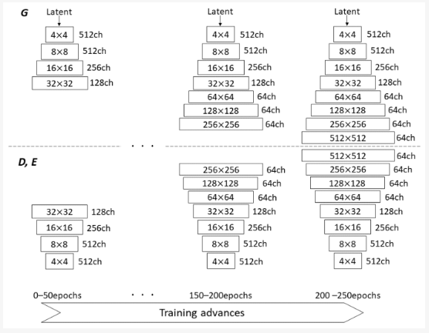
Progressive Growing Technique (PG)
Gradually increasing image resolution in the generator, discriminator, and encoder as training advances through the progressive growing technique.

Slide 15
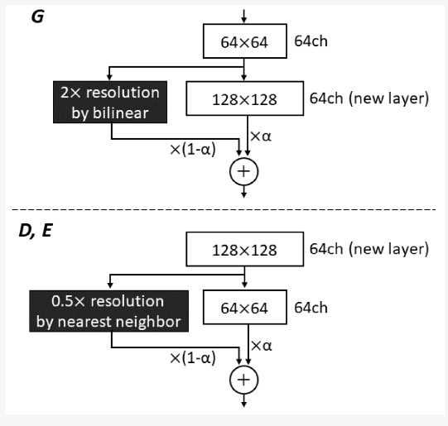
Progressive Growing Technique (PG)

Slide 16
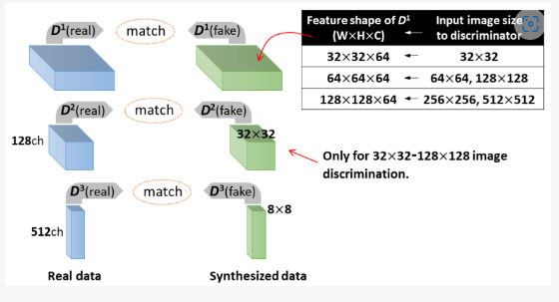
Feature Matching Loss (𝐿_{𝐹𝑀})
.
𝐿_{𝐹𝑀} is calculated by L1 regularization from feature vectors in multiple layers of D, using constraints to match intermediate representations between real and synthesized images.

Slide 17
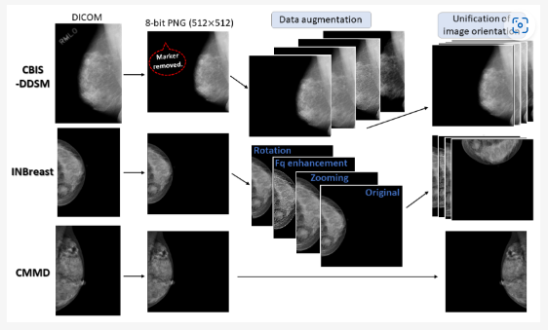
Pre-Processing for Training
.
DICOM > 8 bit (PNG) > replaced tiny artifacts/markers > Data Augmentation (4 fold data) > Left-MLO horizontally flipped > right/left CC views rotated.

Slide 18
Performance Evaluation
.
The Peak signal to Noise Ratio (PSNR) measures the image similarity based on the ratio of noise to the maximum pixel value, as follows:
𝑃𝑆𝑁𝑅 = 10log10(𝑃𝑚𝑎𝑥/𝑀𝑆𝐸)
where MSE is the mean square error (MSE) between two images and 𝑃𝑚𝑎𝑥
is the maximum value of the image pixels. The higher the PSNR value, the
more similar the two images.
Structural Similarity (SSIM) computes the image similarity between two images (𝐱,𝐲) using the three components of brightness, contrast, and structure.
𝑆𝑆𝐼𝑀(𝐱,𝐲)=[𝑙(𝐱,𝐲)][𝑐(𝐱,𝐲)][𝑠(𝐱,𝐲)]
where 𝑙(𝐱,𝐲) is the brightness comparison, 𝑐(𝐱,𝐲) is the contrast comparison
and 𝑠(𝐱,𝐲) is the structural comparison. The SSIM value ranges between 0
and 1; as the similarity increases, the value becomes closer to 1.

Slide 19
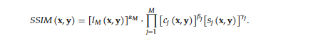

Performance Evaluation
.
Multi-scale SSIM (MS-SSIM) was introduced as an alternative metric of SSIM, incorporating image details at various resolutions. MS-SSIM is calculated by combining the three components of SSIM on multiple scales, as follows:
Cosine Similarity (Cos_sim) is commonly used to determine the similarity between two vectors. Cos_sim is defined in terms of the cosine of the angle between the two vectors, and is calculated as follows:
Cos_sim takes values within the interval from −1 to 1. When two images
are more similar, the Cos_sim value is closer to 1.

Slide 20
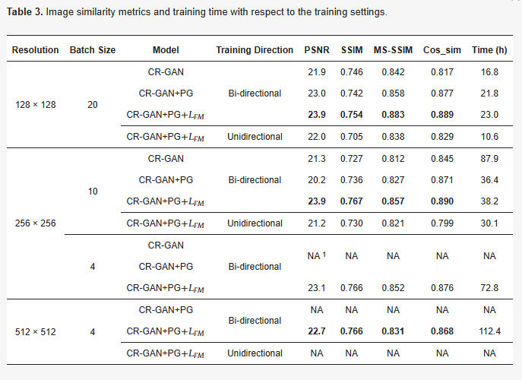
Results
.
Comparison of the Similarity Metrics by Training Methods

Slide 21
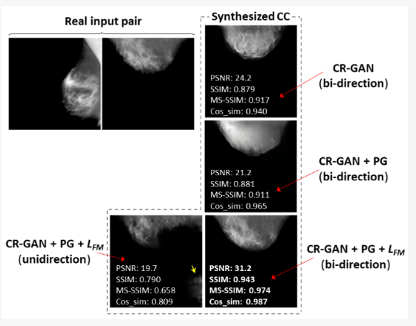
.
Results
Comparison of Images synthesized by different training methods (128 x 128)

Slide 22
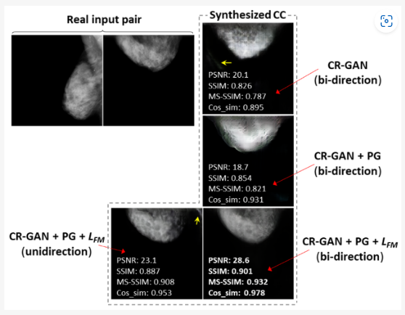
Results
.
Comparison of Images synthesized by different training methods (256 x 256)

Slide 23
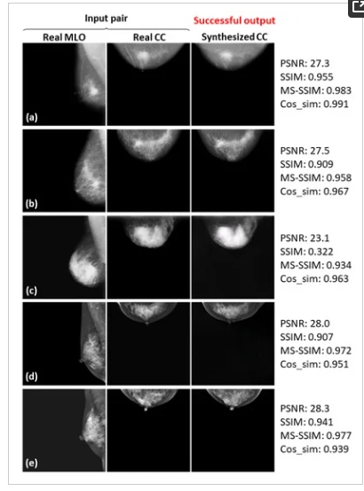
Successful Example
MS-SSIM has been introduced as an alternative metric of SSIM, incorporating image details at various resolutions [45]. MS-SSIM is calculated by combining the three components of SSIM on multiple scales, as follows:
𝑆𝑆𝐼𝑀(𝐱,𝐲)=[𝑙𝑀(𝐱,𝐲)]𝛼𝑀·∏𝑗=1𝑀[𝑐𝑗(𝐱,𝐲)]𝛽𝑗[𝑠𝑗(𝐱,𝐲)]𝛾𝑗.
.

Slide 24
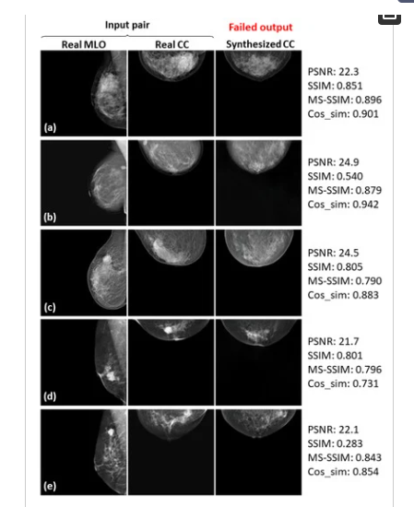
Failed Example
MS-SSIM has been introduced as an alternative metric of SSIM, incorporating image details at various resolutions [45]. MS-SSIM is calculated by combining the three components of SSIM on multiple scales, as follows:
𝑆𝑆𝐼𝑀(𝐱,𝐲)=[𝑙𝑀(𝐱,𝐲)]𝛼𝑀·∏𝑗=1𝑀[𝑐𝑗(𝐱,𝐲)]𝛽𝑗[𝑠𝑗(𝐱,𝐲)]𝛾𝑗.
.

Slide 25
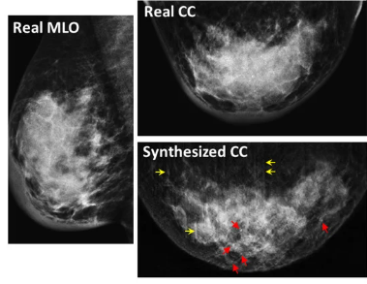
Calcifications example
MS-SSIM has been introduced as an alternative metric of SSIM, incorporating image details at various resolutions [45]. MS-SSIM is calculated by combining the three components of SSIM on multiple scales, as follows:
𝑆𝑆𝐼𝑀(𝐱,𝐲)=[𝑙𝑀(𝐱,𝐲)]𝛼𝑀·∏𝑗=1𝑀[𝑐𝑗(𝐱,𝐲)]𝛽𝑗[𝑠𝑗(𝐱,𝐲)]𝛾𝑗.
.
Image syntheses of calcifications were barely successful at all resolutions.

Slide 26
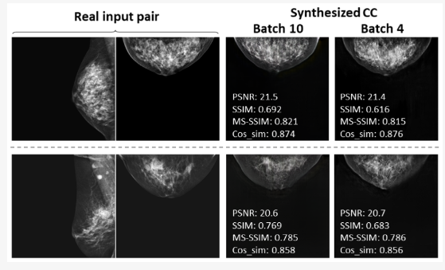
Comparison by Batch Size
MS-SSIM has been introduced as an alternative metric of SSIM, incorporating image details at various resolutions [45]. MS-SSIM is calculated by combining the three components of SSIM on multiple scales, as follows:
𝑆𝑆𝐼𝑀(𝐱,𝐲)=[𝑙𝑀(𝐱,𝐲)]𝛼𝑀·∏𝑗=1𝑀[𝑐𝑗(𝐱,𝐲)]𝛽𝑗[𝑠𝑗(𝐱,𝐲)]𝛾𝑗.
.
The similarity metrics slightly decreased with the use of a smaller batch size and clearly degraded the image quality.

Slide 27
Advantages
CR-GAN with progressive growing technique (PG) significantly reduced training time. (as the synthesized image resolution increased)
Feature Matching loss helped synthesize CC views that came closer to the real views.
Using both the progressive growing technique and feature matching loss offers the best performance, in terms of image quality and training time, for high-resolution CC-view synthesis.

Slide 28
Disadvantages
Even after utilizing the PG technique and feature matching loss, synthesis failed in some cases.
Image synthesis was barely successful in cases of calcification.
Authors noted the insufficient volume of training data and the restricted batch sizes as reasonable causes of synthesis failure.
Image quality was assessed by radiological technologists instead of radiologists or breast surgeons.

Slide 29
Conclusion
MS-SSIM has been introduced as an alternative metric of SSIM, incorporating image details at various resolutions [45]. MS-SSIM is calculated by combining the three components of SSIM on multiple scales, as follows:
𝑆𝑆𝐼𝑀(𝐱,𝐲)=[𝑙𝑀(𝐱,𝐲)]𝛼𝑀·∏𝑗=1𝑀[𝑐𝑗(𝐱,𝐲)]𝛽𝑗[𝑠𝑗(𝐱,𝐲)]𝛾𝑗.
.
Using progressive growing technique with CR-GAN effectively reduced the training time. (as the synthesized image resolution increased)
CR-GAN along with the adaptation of the progressive growing technique and feature matching loss considerably improved the quality of the synthesized images. (as compared to merely using CR-GAN)
The proposed method succeeded in synthesizing CC views similar to the real images for some (but not all) cases.

Slide 30
Future Improvements
MS-SSIM has been introduced as an alternative metric of SSIM, incorporating image details at various resolutions [45]. MS-SSIM is calculated by combining the three components of SSIM on multiple scales, as follows:
𝑆𝑆𝐼𝑀(𝐱,𝐲)=[𝑙𝑀(𝐱,𝐲)]𝛼𝑀·∏𝑗=1𝑀[𝑐𝑗(𝐱,𝐲)]𝛽𝑗[𝑠𝑗(𝐱,𝐲)]𝛾𝑗.
.
Utilizing a larger image training data set within a more powerful GPU environment.
Three or more vectors should be utilized in the feature-matching loss calculation for stronger constraints on middle-layer representations.
Optimizing hyperparameters—including the batch size.
Investigate evaluation metric that is more faithful to human perception to evaluate AI-generated medical images.

Slide 31
References
Terrasse, V. Latest global cancer data: Cancer burden rises to 19.3 million new cases and 10.0 million cancer deaths in 2020. In The International Agency for Research on Cancer Press Release 292; IARC: Lyon, France, 2020; pp. 1–3. [Google Scholar]
Sung, H.; Ferlay, J.; Siegel, R.L.; Laversanne, M.; Soerjomataram, I.; Jemal, A.; Bray, F. Global Cancer Statistics 2020: GLOBOCAN estimates of incidence and mortality worldwide for 36 cancers in 185 countries. CA Cancer J. Clin. 2021, 71, 209–249. [Google Scholar] [CrossRef] [PubMed]
Mayor, S. Survival of women treated for early breast cancer detected by screening is same as in general population, audit shows. BML 2008, 336, 1398–1399. [Google Scholar] [CrossRef] [PubMed][Green Version]
Duffy, S.W.; Vulkan, D.; Cuckle, H.; Parmar, D.; Sheikh, S.; Smith, R.A.; Evans, A.; Blyuss, O.; Johns, L.; Ellis, I.O.; et al. Effect of mammographic screening from age 40 years on breast cancer mortality (UK Age trial): Final results of a randomised, controlled trial. Lancet Oncol. 2020, 21, 1165–1172. [Google Scholar] [CrossRef] [PubMed]
Hamashima, C.; Ohta, K.; Kasahara, Y.; Katayama, T.; Nakayama, T.; Honjo, S.; Ohnuki, K. A meta-analysis of mammographic screening with and without clinical breast examination. Cancer Sci. 2015, 106, 812–818. [Google Scholar] [CrossRef][Green Version]
Van den Ende, C.; Oordt-Speets, A.M.; Vroling, H.; van Agt, M.E. Benefits and harms of breast cancer screening with mammography in women aged 40–49 years: A systematic review. Int. J. Cancer 2017, 141, 1295–1306. [Google Scholar] [CrossRef][Green Version]
Christiansen, S.R.; Autier, P.; Støvring, H. Change in effectiveness of mammography screening with decreasing breast cancer mortality: A population-based study. Eur. J. Public Health. 2022, 32, 630–635. [Google Scholar] [CrossRef]
Gossner, J. Digital mammography in young women: Is a single view sufficient? J. Clin. Diagn. Res. 2016, 10, TC10–TC12. [Google Scholar] [CrossRef]
Rubin, D. Guidance on Screening and Symptomatic Breast Imaging, 4th ed.; The Royal College of Radiologists: London, UK, 2019; pp. 1–27. [Google Scholar]
Sickles, E.A.; Weber, W.N.; Galvin, H.B.; Ominsky, S.H.; Sollitto, R.A. Baseline screening mammography: One vs two views per breast. Am. J. Roentgenol. 1986, 147, 1149–1155. [Google Scholar] [CrossRef][Green Version]

Slide 32
.
Thank You

