Slide 1
Transformer-based mass detection in digital mammograms
Betancourt Tarifa, Amparo S., et al. "Transformer-based mass detection in digital mammograms." Journal of Ambient Intelligence and Humanized Computing 14.3 (2023): 2723-2737.
Dan Eassa, Augustine Ofoegbu

Slide 2

Outline
Introduction
Prior Work
Methods
Dataset
Experiments
Results
Conclusion

Slide 3
Introduction
Breast cancer - leading cause of cancer deaths among women
685,000 deaths per year globally
Mammography screening reduces mortality by 40%

Slide 4
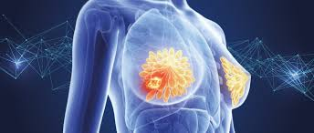
Introduction
Detection of masses is a manual and difficult process
Many times masses are missed by radiologists
Computer-Aided Detection (CADe) systems have improved Radiologists’ Sensitivity to identifying Masses

Slide 5
Introduction
CADe Systems have been largely built on CNN
Recent work has shown Transformer Architectures are viable in Vision tasks
Novel ideas explored in this paper include:
  The use of transformers for mass detection in mammography
  Comparison to CNN counterparts
  Results from combination of transformer and CNN architectures
  Comparison with State of the Art on OMI-DB Dataset

Slide 6
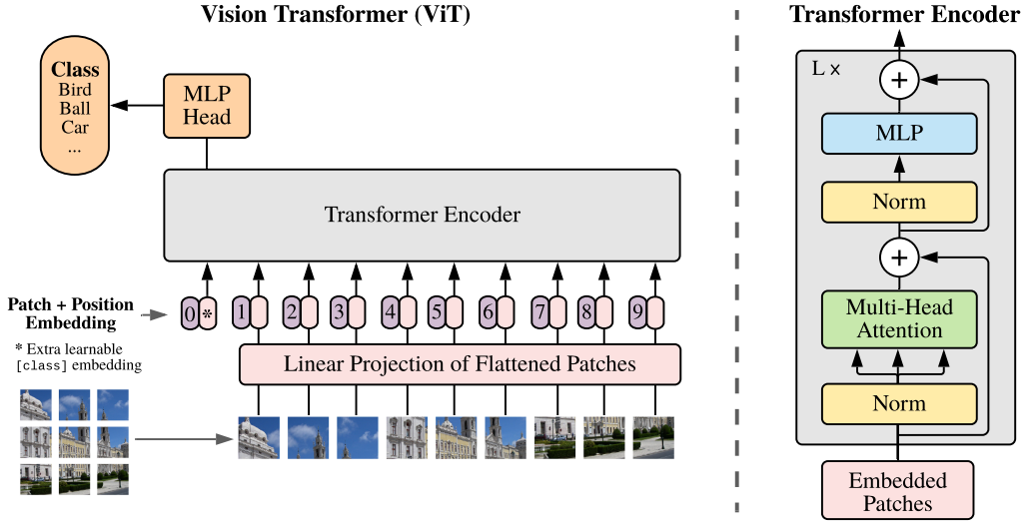
Prior Work - ViT
Transformers are common in NLP
Vision Transformer (ViT) architecture
  Creates both local and global connections between patches
  Quadratic time complexity with respect to image resolution

Slide 7
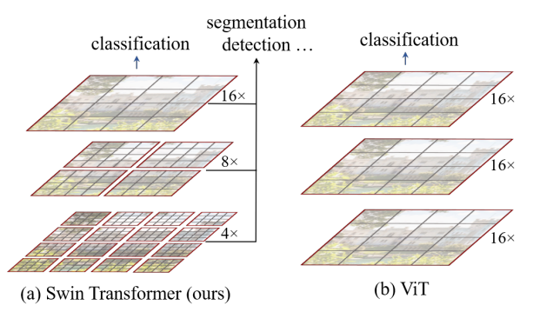
Prior Work - Swin Transformer
Shifted Window (Swin) Transformer improves upon ViT
Uses window scheme for self attention
  Linear time complexity (for fixed window size)
Contains hierarchical feature maps from patch merging

Slide 8
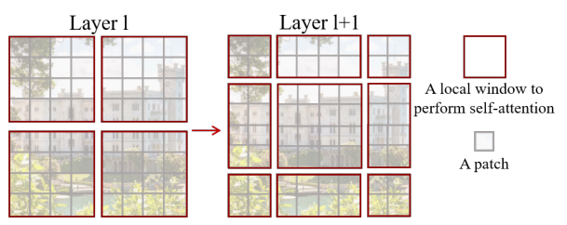
Prior Work - Swin Transformer
Window Architecture loses connections between neighboring patches in different window
Shifted Window scheme creates connections where missing
Regular Window
Shifted Window

Slide 9
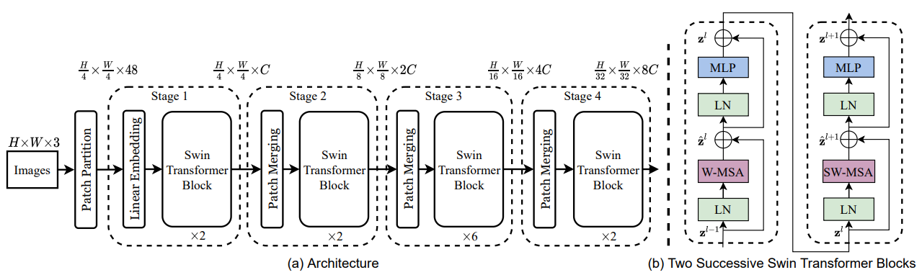
Prior Work - Swin Transformer
Shifted Window (Swin) Transformer architecture
*W-MSA = Regular Window Multihead Self-Attention
*SW-MSA = Shifted Window Multihead Self-Attention

Slide 10
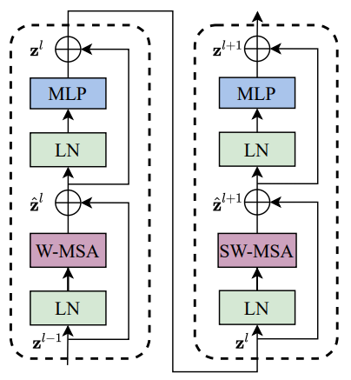
Methods
Swin Transformer evaluated with
  Backbone pre-trained on ImageNet
  Two object detection heads pre-trained on COCO
Fixed patch size of 4x4 pixels
Fixed window size of 7x7 patches
MLP layer
  Expansion factor of 4
  GELU activation function

Slide 11
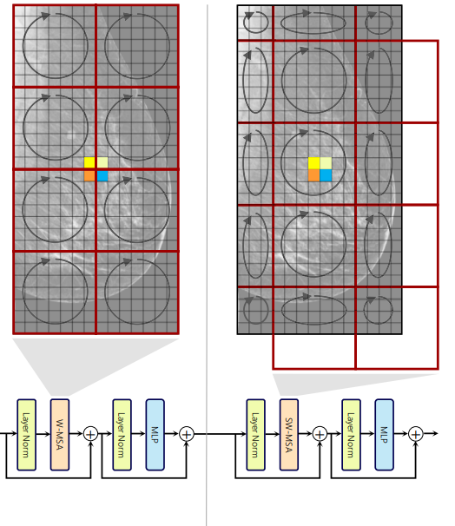
Methods
Shifted window scheme
  Shifts window by half H, W of window
Swin Transformer block with Regular Window
Swin Transformer block with Shifted Window

Slide 12
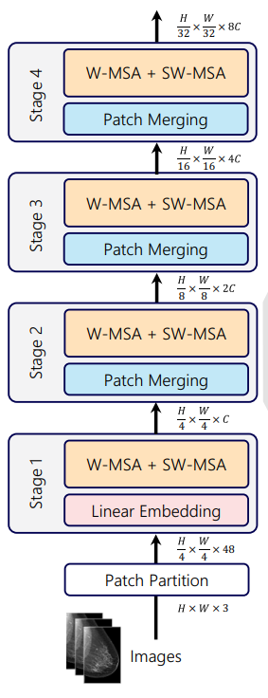
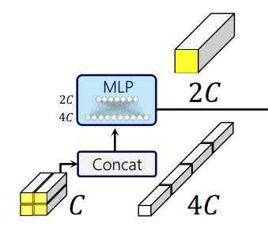
Methods
Patch merging provides hierarchical feature maps
  2x2 neighboring patches concatenated and passed through linear layer
  Linear layer increases input size by 2x
  Increases number of features as spatial dimension reduces
A Single Patch Merging Block

Slide 13
Methods
Pass result to two object detection heads and fuse predictions
RepPoints
  anchor-free
  represents objects as a set of sample points, suitable for both localization and recognition
Deformable DETR
  uses deformable attention module which attends to a restricted number of sample locations

Slide 14
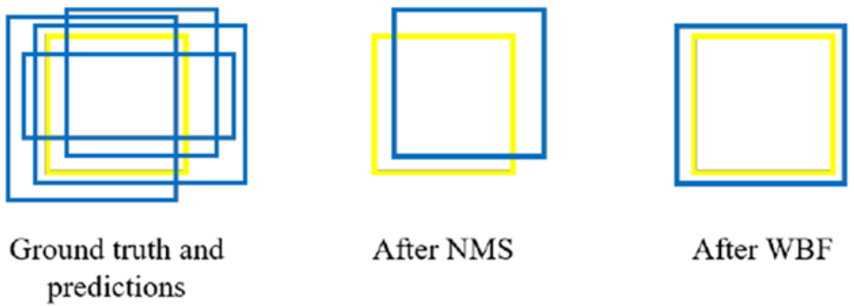
Methods
Predictions were fused with CNN counterpart predictions
Used Weighted Boxes Fusion (WBF)
  Calculated bounding box based on multiple predictions
Non-Maximum Suppression commonly used
  Discards predictions, takes the best score
Difference in results between NMS and WBF
Ground truth in yellow, predictions in blue.

Slide 15
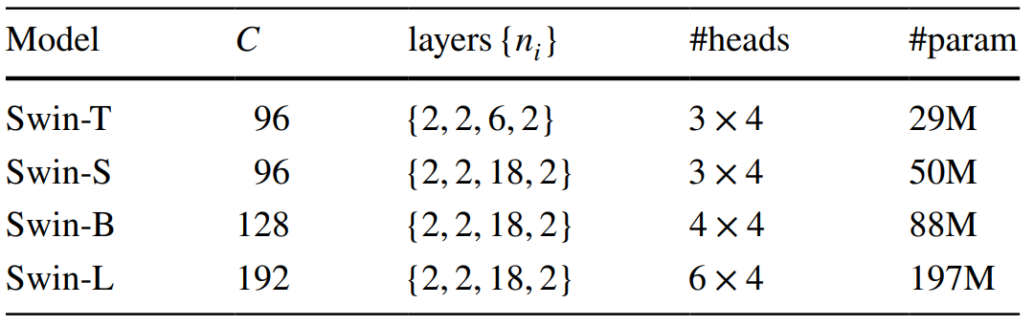
Methods
Four Swin Transformer models outlined by Liu et al.
Twin-T and Swin-B analyzed
  Swin-S discarded due to similar performance to Swin-T
  Swin-L discarded due to hardware limitations

Slide 16
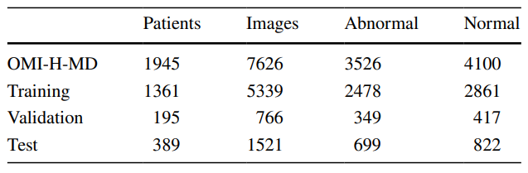
Data Set
Subset of OMI-DB dataset used
70/20/10 split for Train/Validation/Test
~45/55 split for Abnormal/Normal images
*OMI-H-DB is alias for subset of OMI-DB chosen for this study

Slide 17
Data Set
Only used images from Hologic Inc. scanners
Manually discarded images with artifacts
Where a patient had multiple studies, only the first images were used
Normal images belonging to a patient with abnormalities were discarded
Normal images from a study with one breast or one view were discarded

Slide 18
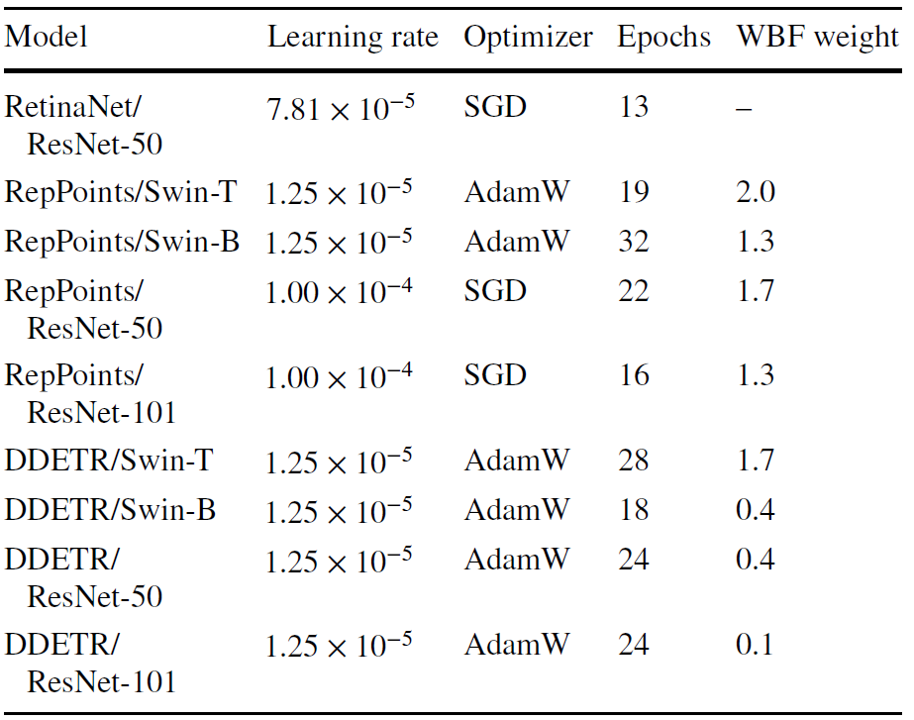
Experiments
Hyperparameters for best performing models
Mean Average Precision (mAP) metric for IoU threshold between 0.1 to 0.5 to evaluate best model

Slide 19
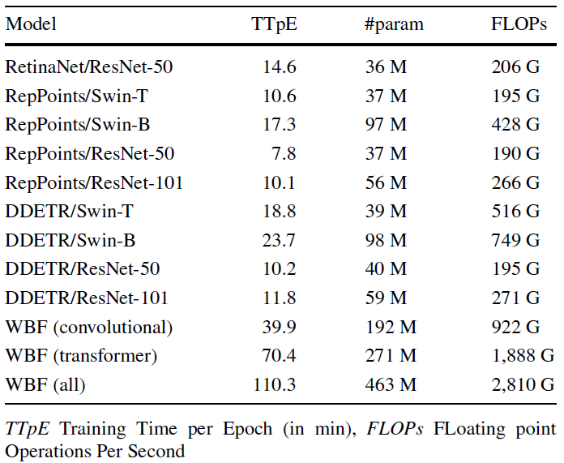
Experiments
Transformer architectures showed slower training time despite similar parameters

Slide 20
Experiments
All images resized to maximum of 800 x 1333 pixels with original aspect ratio
  600 x 1000 maximum for DDETR
50% Probability for each augmentation
  Horizontal flip
  Random crop
  Contrast transformation of magnitude: [0.4, 0.8, 1.5]
  Brightness transformation of magnitude: [0.3, 0.7 1.3]
  60% Probability for Swin-B and Resnet-101 augmentations
  RetinaNet only used horizontal flipping

Slide 21
Results
FROC evaluates True Positive Rate (TPR) vs False Positives per Image (FPpI)
Results reported
  AUC for FPpI ranging [0, 1]
  TPR at FPpI=0.1

Slide 22
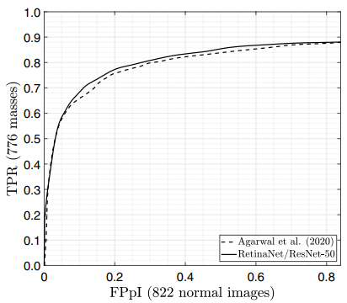
Results - Replication of benchmark
AUC results were largely replicated as compared to original paper

Slide 23
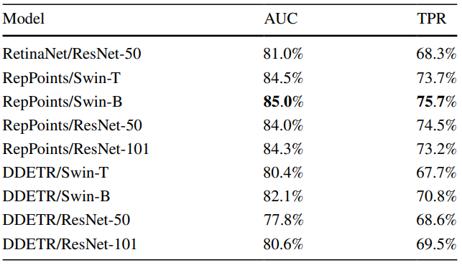
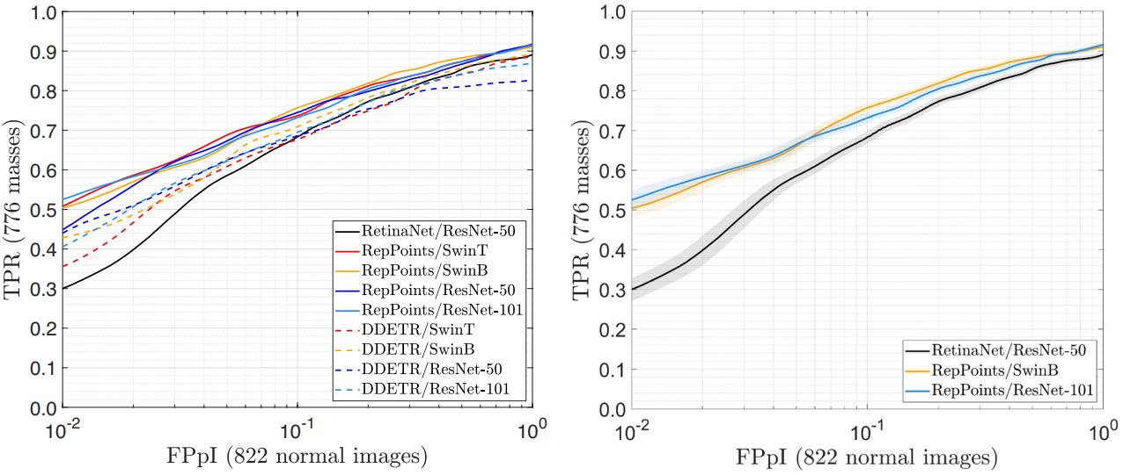
Results - Base Models
10,000 bootstrap iterations

Slide 24
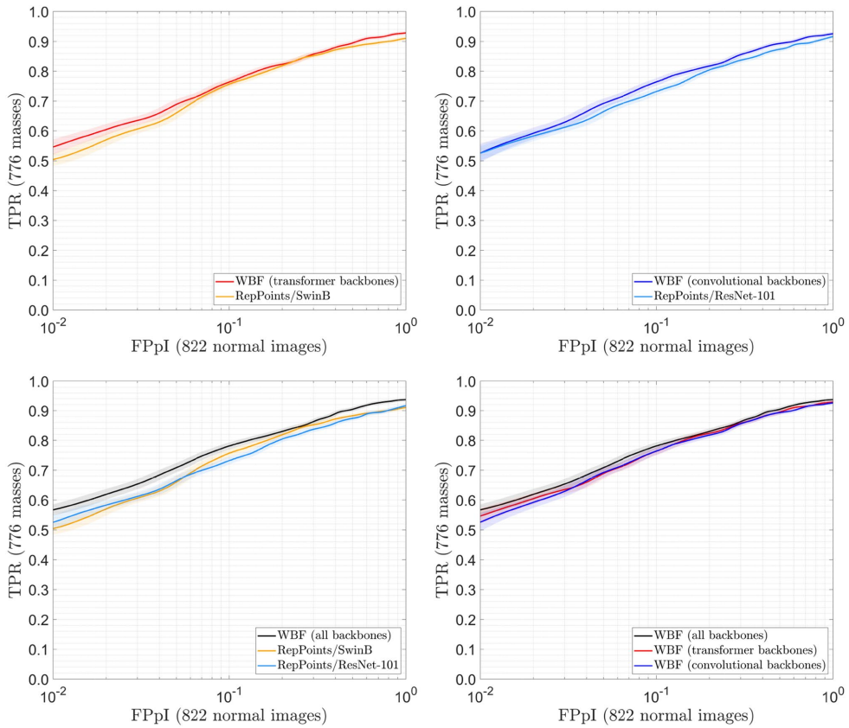
Results - Fusion Models
10,000 bootstrap iterations
T-fusion vs
T-best
CNN-fusion vs
CNN-best
T/CNN-fusion vs
T-best vs
CNN-best
T/CNN-fusion vs
T-fusion vs
CNN-fusion

Slide 25
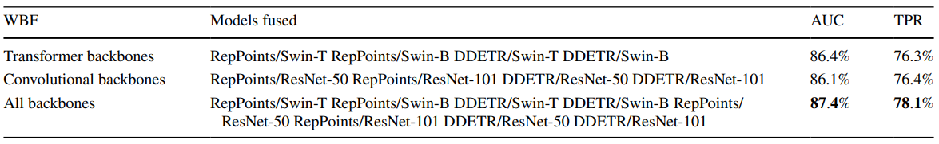
Results - Fusion Models
Transformer and Convolutional fusion outperforms Transformer-only and Convolution-only fusions

Slide 26
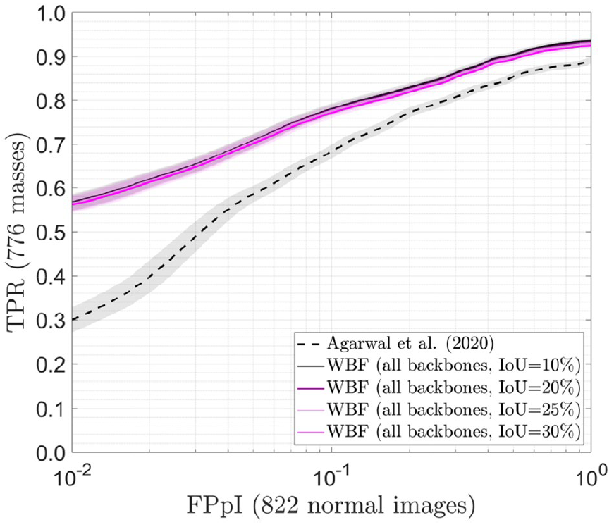
Results - Comparison to Benchmark
WBF models showed very little sensitivity to changes in IoU
Benchmark model used IoU = 10%

Slide 27
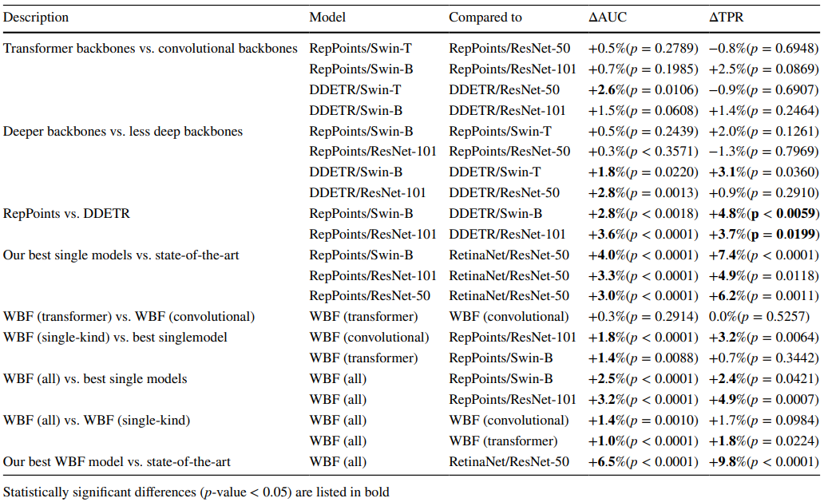
Results
Comparison of models

Slide 28
Conclusion
First model that focuses on the detection of masses on digital mammograms using transformer-based architectures
Transformer-based models can be pretrained on natural images and be successfully fine tuned to detect masses in mammograms.
Model achieved promising results and showed superior performances to their convolutional counterparts, despite having double the computational complexity.

Slide 29
Future Opportunities
Pretraining object-detection heads for transformers
  Convolution backbones benefitted from pretraining
Optimizing Swin Transformer architecture hyperparameters
  Batch size, Patch size, window size, number of layers
Using improved architectures

Slide 30
References
Agarwal R, Díaz O, Yap MH, Llado X, Marti R (2020) Deep learning for mass detection in Full Field Digital Mammograms. Comput Biol Med 121:103774
Aly GH, Marey M, El-Sayed SA, Tolba MF (2021) YOLO based breast masses detection and classification in Full-Field Digital Mammograms. Comput Methods Programs Biomed 200:105823
Balleyguier C, Kinkel K, Fermanian J, Malan S, Djen G, Taourel P, Helenon O (2005) Computer-aided detection (CAD) in mammography: does it help the junior or the senior radiologist? Eur J Radiol 54(1):90–96
Bria A, Karssemeijer N, Tortorella F (2014) Learning from unbalanced data: a cascade-based approach for detecting clustered microcalcifications. Med Image Anal 18(2):241–252
Cao H, Pu S, Tan W, Tong J (2021) Breast mass detection in digital mammography based on anchor-free architecture. Comput Methods Programs Biomed 205:106033
Carion N, Massa F, Synnaeve G, Usunier N, Kirillov A, Zagoruyko S (2020) End-to-end object detection with transformers. In: European conference on computer vision, pp 213–229. Springer
CDC (2022) Breast cancer screening guidelines for women. https://www.cdc.gov/cancer/breast/pdf/breast-cancer-screening-guidelines-508.pdf. Accessed: 2022-05-20
Chen X, Zhang K, Abdoli N, Gilley PW, Wang X, Liu H, Zheng B, Qiu Y (2022) Transformers improve breast cancer diagnosis from unregistered multi-view mammograms. Diagnostics 12(7):1549
Kamran SA, Hossain KF, Tavakkoli A, Bebis G, Baker S (2022) Swin-sftnet: spatial feature expansion and aggregation using swin transformer for whole breast micro-mass segmentation. arXiv preprint arXiv:2211.08717
Liu Z, Lin Y, Cao Y, Hu H, Wei Y, Zhang Z, Lin S, Guo B (2021)
Swin transformer: hierarchical vision transformer using shifted windows. Proceedings of the IEEE/CVF International Conference on Computer Vision, pp 10012–10022
Dosovitskiy A, Beyer L, Kolesnikov A, Weissenborn D, Zhai X, Unterthiner T, Dehghani M, Minderer M, Heigold G, Gelly S et al (2020) An image is worth 16x16 words: transformers for image recognition at scale. arXiv preprint arXiv: 2010. 11929

