Slide 1
A deep learning method for classifying mammographic breast density categories
Team #7
Negar Maghsoudi – Ashkan Reisi
10/11/2023

Slide 2
Purpose
Scattered density
Out of the four BI‐RADS breast density categories, it is fairly easy to distinguish the categories of “almost entirely fatty” and “extremely dense” by visual assessment
Emphasizing on difficulty of distinguishing the two most common and most variably assigned BI‐RADS categories, i.e., “scattered density” and “heterogeneously dense” for radiologists
The aim of this work is to investigate a deep learning‐based breast density classifier to distinguish these two categories
heterogeneously density
1

Slide 3
Dataset
A curated dataset at University of Pittsburgh Cancer Institute
A cohort of 1,427 women
From 2005—2016
One patient may have multiple (in average 4, range 1–7) sequential screening mammogram examinations (each examination has 4 images both MLO and CC views)
Total of 22,000 digital mammogram images (7,925 images of “scattered density” and 14,075 of “heterogeneously dense”)
The collected mammogram images are negative or breast‐cancer free
The ground truth was the assigned BI‐RADS density categories by a group of breast imaging radiologists
2

Slide 4
Method: Preprocessing
The whole‐breast region is first separated automatically from the nonbreast region
Histogram equalization was run to adjust the intensity distribution of all images to the same range
All images were resized to a smaller resolution of 227 × 227 (original resolution: 3518 × 2800)
The mean image of training data was generated and subtracted from each input image
3

Slide 5
Method: Deep learning model
Five convolutional layers
Three max‐pooling layers
Three fully connected layers
A final 2‐way softmax function
AlexNet
Reversing the order of the pooling and normalization layers
Hyperparameters:
Stochastic gradient descent (SGD)
Batch size of 50
Learning rate of 0.001
Training:
6-fold cross validation (5 for training and 1 for validation)
Specifications:
Using the Caffe platform
Intel® Core™ i7‐4790
8 GB RAM
Titan X Pascal Graphics Processing Unit (GPU)
4

Slide 6
Method: Analysis plans
Two sets of data
All collected digital mammograms
Excluding potentionally inaccurately labeled images
Two sets of analysis
The proposed CNN model
Initializing the proposed CNN model with the weights of the pretrained AlexNet model (transfer learning)
Utilizing LIBRA tool to compute the quantitative breast percentage density (PD%)
By definition, generally the PD% in the images of scattered density are lower than the images with heterogeneously density
The “scattered density” images where the PD% was “unexpectedly” greater than the average of the PD% of the “heterogeneously dense” images
The “heterogeneously dense” images were removed where the PD% was “unexpectedly” lower than the average of the “scattered density” images
5

Slide 7
Method: Analysis plans
Train:
To reduce the potential bias in training the CNN model due to unbalanced sample sizes for the two categories:
Used 7,000 “scattered density” images
Used 7,000 “heterogeneously dense” images,
all randomly selected from the entire dataset of each category
Test:
A separate unseen set of 1,850 images (925 with a “scattered density” and 925 with a “heterogeneously dense” category), randomly selected from the remaining
6

Slide 8
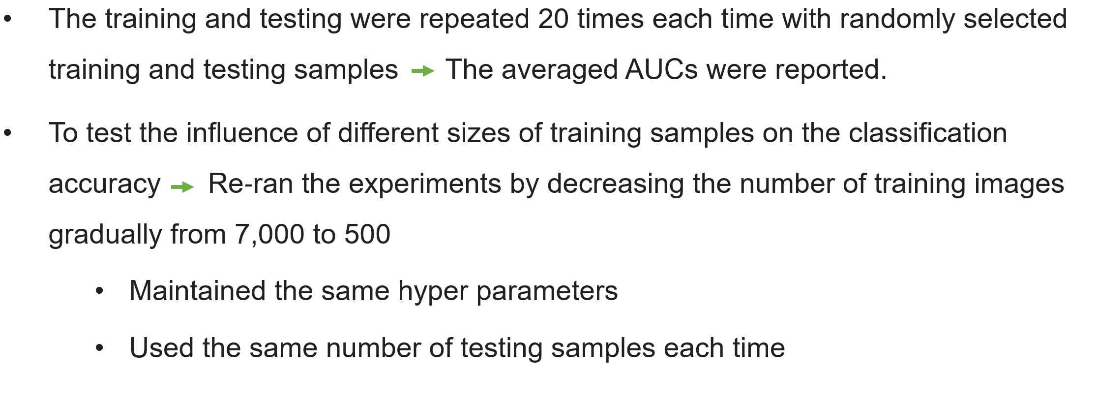
Method: Analysis plans
7

Slide 9
Results: Proposed model on all collected images
8

Slide 10
Results: Transfer learning on all collected images
9

Slide 11
Results: Filtered collection of images
867 images whose PD% was greater than the average PD% of the 14,075 “heterogeneously dense” images; were removed from 7,925 “scattered density” images
2,286 images whose PD% was lower than the average PD% of the 7,925 “scattered density” images, were filtered out from the 14,075 “heterogeneously dense” images
A Total of 18,847 images were left for analysis
10

Slide 12
Discussion
11

Slide 13
Discussion: Strengths
Usage of a large clinical imaging dataset
Test of training from scratch and transfer learning of pretrained deep learning models
Additional analysis to mitigate the influence of noisy or wrongly labeled data
12

Slide 14
Discussion: Limitations
A single center retrospective study
The studied images were read by radiologists no track on interpreter of each image
The lack of ground truth
Only cancer‐free mammogram images not considering bias introduced by tumor
13

Slide 15
Suggestions
The model with transfer learning needs to be fine-tuned probably with different set of hyperparameters which may impact the model’s ability to learn from mammogram images effectively.
The study relies on a single dataset of digital mammogram images collected from one institution. This limits the generalizability of the findings to other healthcare settings or populations.
The result primarily focuses on the model's accuracy (AUC) but does not provide a detailed discussion of false positives and false negatives, which are crucial in clinical applications to understand the potential impact on patient care.
14

Slide 16
Suggestions
Explore more data preprocessing techniques including image enhancement and noise reduction methods to improve the quality of input data.
Consider using ensemble learning techniques to combine the predictions of multiple models or model variations. Ensemble methods can often improve overall classification performance and robustness.
15

