Slide 1
A fully integrated computer-aided diagnosis system for digital X-ray mammograms via deep learning detection, segmentation, and classification
Christopher Collum
Ayesh Meepaganithage

Slide 2
Introduction
This is part 2 of the 3 part framework previously presented
Challenge presented by the issue of quite a few masses having ambiguous boundaries between the mass and background tissue
This paper proposes their own methods for detection, segmentation, and classification

Slide 3
Introduction Cont.
Use an automatic You-Only-Look-Once (YOLO) based detection model.
A newly proposed segmentation model called full resolution convolutional network (FrCN)
segmentation model is compared against other state of the art models
A CNN classifier is used to distinguish benign and malignant

Slide 4
Literature Review
Detection struggles with using appropriate features or automatically generating those features
Segmentation problems include edge boundary detection and input image resolution
Some other works also combine all three systems (detection, segmentation, classification) into an integrated system, but challenges of computational complexity still exist

Slide 5
Model
YOLO for mass detection
FrCN for mass segmentation
CNN for mass classification

Slide 6
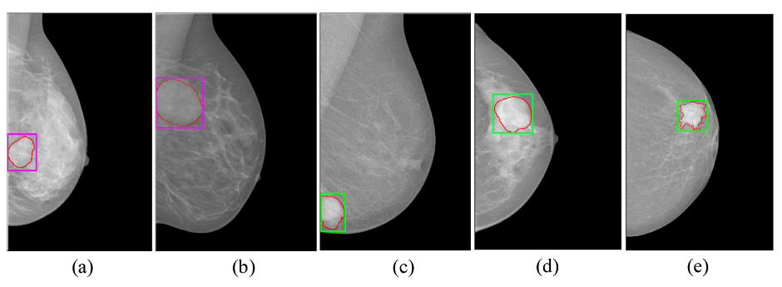
Mass Detection
Notes:
Examples of mass detection utilizing YOLO on the test images of INbreast dataset. (a) and (b) show the detected ROIs (i.e., masses) for benign cases, while (c), (d), and (e) for malignant cases. Detected ROI are superimposed on the original images: benign (magenta), malignant (green), and ground truth (red). (For interpretation of the references to colour in this figure legend, the reader is referred to the web version of this article.).

Slide 7
Dataset
INbreast dataset
410 mammograms of 115 patients
Considered mammograms with masses in both views
112 masses of 107 cases
36 masses with BI-RAD 2,3 categories
76 masses belonging to BI-RAD 4,5,6 categories
896 images after augmentation

Slide 8
Data Augmentation and Transfer Learning
Images augmented 8 times by rotating in 45⁰ angles
Generated 896 total images (112 original * 8)
End up with 288 benign and 608 malignant
transfer learning was used to initialize parameters of all models (used imageNet)

Slide 9
YOLO
Used to detect mass regions from entire mammograms
Regional ROI-based CNN
Bounding boxes more accurately align masses
Low running time
Images resized to 448x448
Normalized to range[0,1]
Mass is considered to be correctly detected when Intersection over Union (IoU) between extracted and annotated (ground truth) bounding boxes exceeds 50%

Slide 10
Mass Segmentation
Pixel-to-pixel segmentation of FCN, SegNet, and U-Net provided better segmentation results than conventional methods.
Multiple max-pooling and subsampling layers in encoder networks affects in the loss in the spatial resolution of the feature maps.
To recover the resolution of the feature maps in the decoder network of these models, the up-sampling and deconvolution layers were utilized.
These deep learning segmentation models suffer from the diminished spatial resolution, loss of details, and increase in computation cost.
Notes:
Based on previous studies,
However, these segmentation models used
………..but these processes increased # of training parameters

Slide 11
Mass Segmentation
FrCN consists of two main consecutive encoder and decoder networks.
The encoder network involves thirteen convolutional layers.
The max-pooling and sub-sampling layers are removed from the encoder network to preserve the full spatial resolution of the original input as well as the details of the objects.
The high-level deep feature maps in each block of the encoder network are generated utilizing only the convolutional process, preserving the full resolution of the input images.
Notes:
Authors proposed a new deep learning model for pixel -to -pixel mass segmentation
3) This is a key modification to avoid any information loss during feature map generation for accurate pixel-to-pixel mass segmentation.
4) By this modification, FrCN is able to maintain the details and edges especially for the tiny objects.

Slide 12
Mass Segmentation
The decoder network of FrCN is built by replacing all three FC layers of VGG-16 with three full convolutional layers.
Because the convolutional layers on the full resolution of the input images without sub-sampling in the encoder network are utilized, up-sampling and deconvolutional layers in the decoder network are not used.

Slide 13
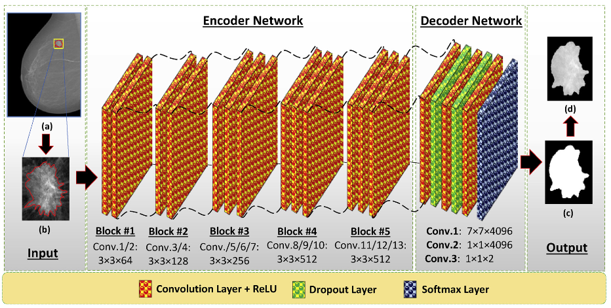
Mass Segmentation
Notes:
There are no maxpooling layers
dropout 0f 0.5

Slide 14
Mass Segmentation
Masses detected in the detection stage are fed directly into the proposed segmentation stage
The falsely detected cases of breast masses over each test fold have been excluded in the segmentation stage.
CLAHE is used as a preprocessing method.
The final output of deep feature maps is directly fed into a Softmax classifier to obtain the probability that each pixel is a mass or non-mass.

Slide 15
Hyperparameters
Optimizer : Adam
Learning rate : 0.0001
Weight decay : 0.0005
Epochs : 100
Batch size : 24
Dropout rate : 0.3

Slide 16
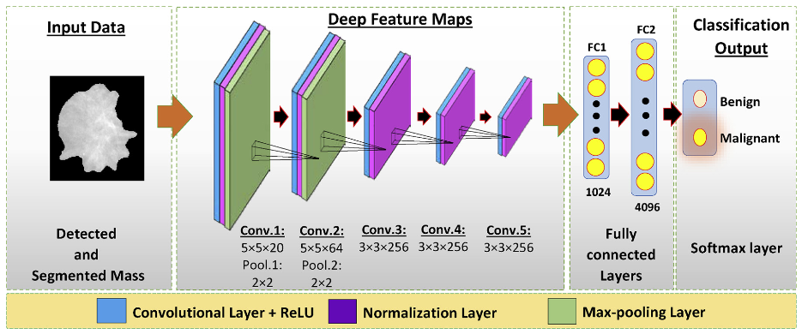
Mass Classification
A simplified version of AlexNet was used.
Notes:
1st and 2nd convolutional layers has 20 and 64 filters with a size of 5 × 5 are used,
3rd, 4th , and 5th convolutional layers has 256 filters with a size of 3 × 3 for each.
max-pooling with a size of 2 × 2 is used to sub-sample the input patch via a factor of 2
two FC layers are used with 1024 and 4096 nodes,
a logistic regression layer (i.e., Softmax) with two nodes are added to represent the benign against malignant classification.

Slide 17
Hyperparameters
Optimizer : Adam
Learning Rate : 0.001
Epochs : 100
Batch size : 20
Loss function : Weighted cross-entropy
Dropout rate : 0.5

Slide 18
Experiment Setting
For each stage,
4-fold cross validation was used
Randomly divided the augmented dataset into,
75% for training (216 benign and 456 malignant)
6.25% for validation (18 benign and 38 malignant)
18.75% or testing (54 benign and 114 malignant)
Notes:
Randomly divided the augmented dataset for both benign and malignant classes into,

Slide 19
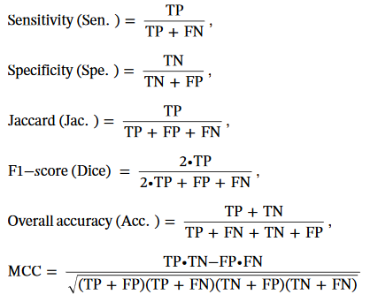
Evaluation Metrices
Matthew Correlation Coefficient (MCC) is used as a balanced measure of the quality of classifications even if the classes are in different sizes, counting in true and false positives and negatives

Slide 20
Results - Mass Detection
The detected regions are considered to be correct when ≥ IoU 50%.
Notes:
consider the masses to be correctly detected if the intersection over union (IoUGround truth Extracted ) between the extracted and annotated (i.e., ground truth) bounding boxes of the mass is greater than or equals 50%

Slide 21
Results - Mass Detection
Ref. | Method | Dataset | Testing time per image (seconds) | Accuracy
[1], [2] | Cascade Deep Learning and Random Forest | INbreast | 39 | 96.00
[3] | Adaptive threshold with some machine learning techniques | INbreast | 108 | 87.00
Proposed | Deep learning | INbreast | 3 | 98.96
References
[1] N. Dhungel, G. Carneiro, A.P. Bradley, A deep learning approach for the analysis of masses in mammograms with minimal user intervention, Med. Image Anal. 37 (no. 1) (2017) 114–128.
[2] G. Carneiro, J. Nascimento, A.P. Bradley, Automated analysis of unregistered multiview mammograms with deep learning, IEEE Trans. Med. Imaging 36 (no. 11) (2017) 2355–2365.
[3] E. Kozegar, M. Soryani, B. Minaei, D. Inês, Assessment of a novel mass detection algorithm in mammograms, J. Cancer Res. Ther. (2013) 592–600.

Slide 22
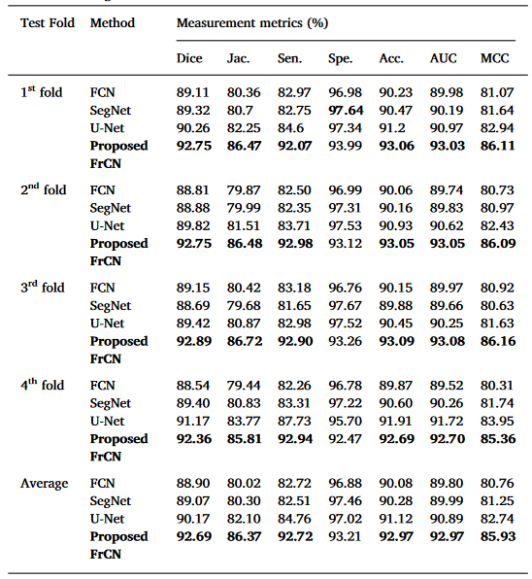
Results - Mass Segmentation

Slide 23
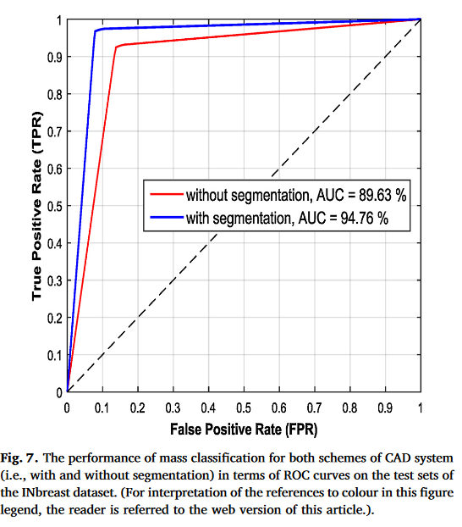
Results - Mass Classification

Slide 24
Discussion
YOLO-based deep learning can detect the masses even if they exist inside dense tissues or over pectoral muscles
The proposed FrCN overcomes the limitations of the latest deep learning segmentation models in terms of preserving high resolution the details
For mass classification via CNN, the proposed CAD system achieves much better results when mass segmentation is utilized

Slide 25
Technical Specifications
PC Specs
Intel ® Core (™) i7-6850K CPU @ 2.26 GHz
16 GB RAM
NVIDIA GeForce GTX 1080 GPU
Software Specs
Python 2.7.14
C++
Ubuntu 16.04
Tensorflow

Slide 26
Thank You!

