Slide 1
Exploiting Patch Sizes and Resolutions for Multi-Scale Deep Learning in Mammogram Image Classification
Gaurav Srikar and Brian Székely

Slide 2
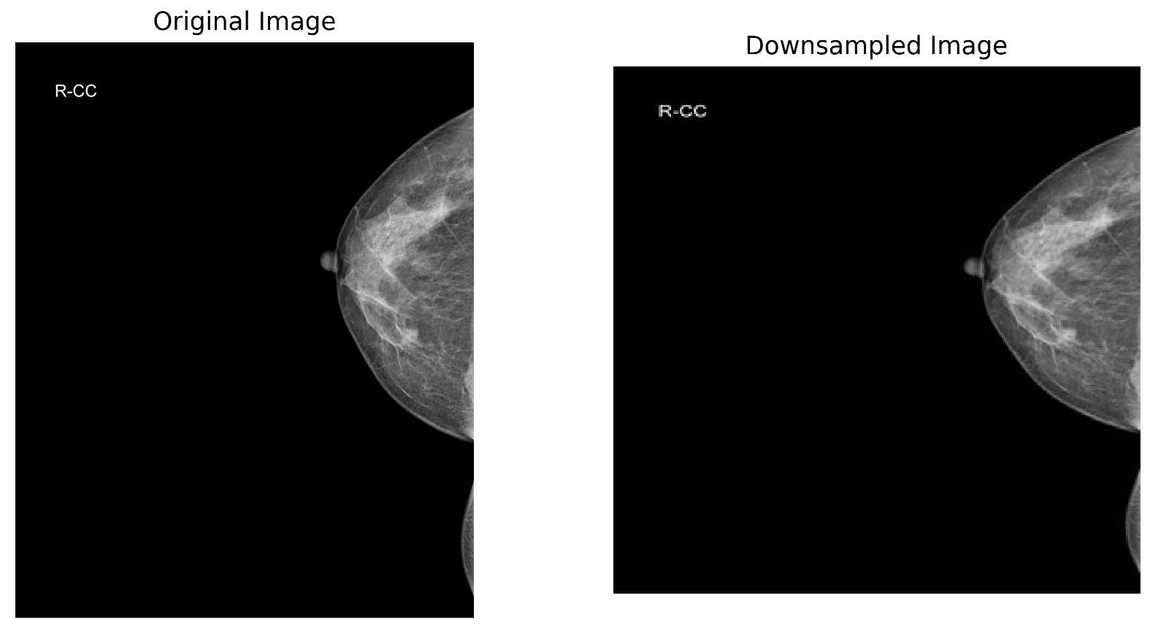
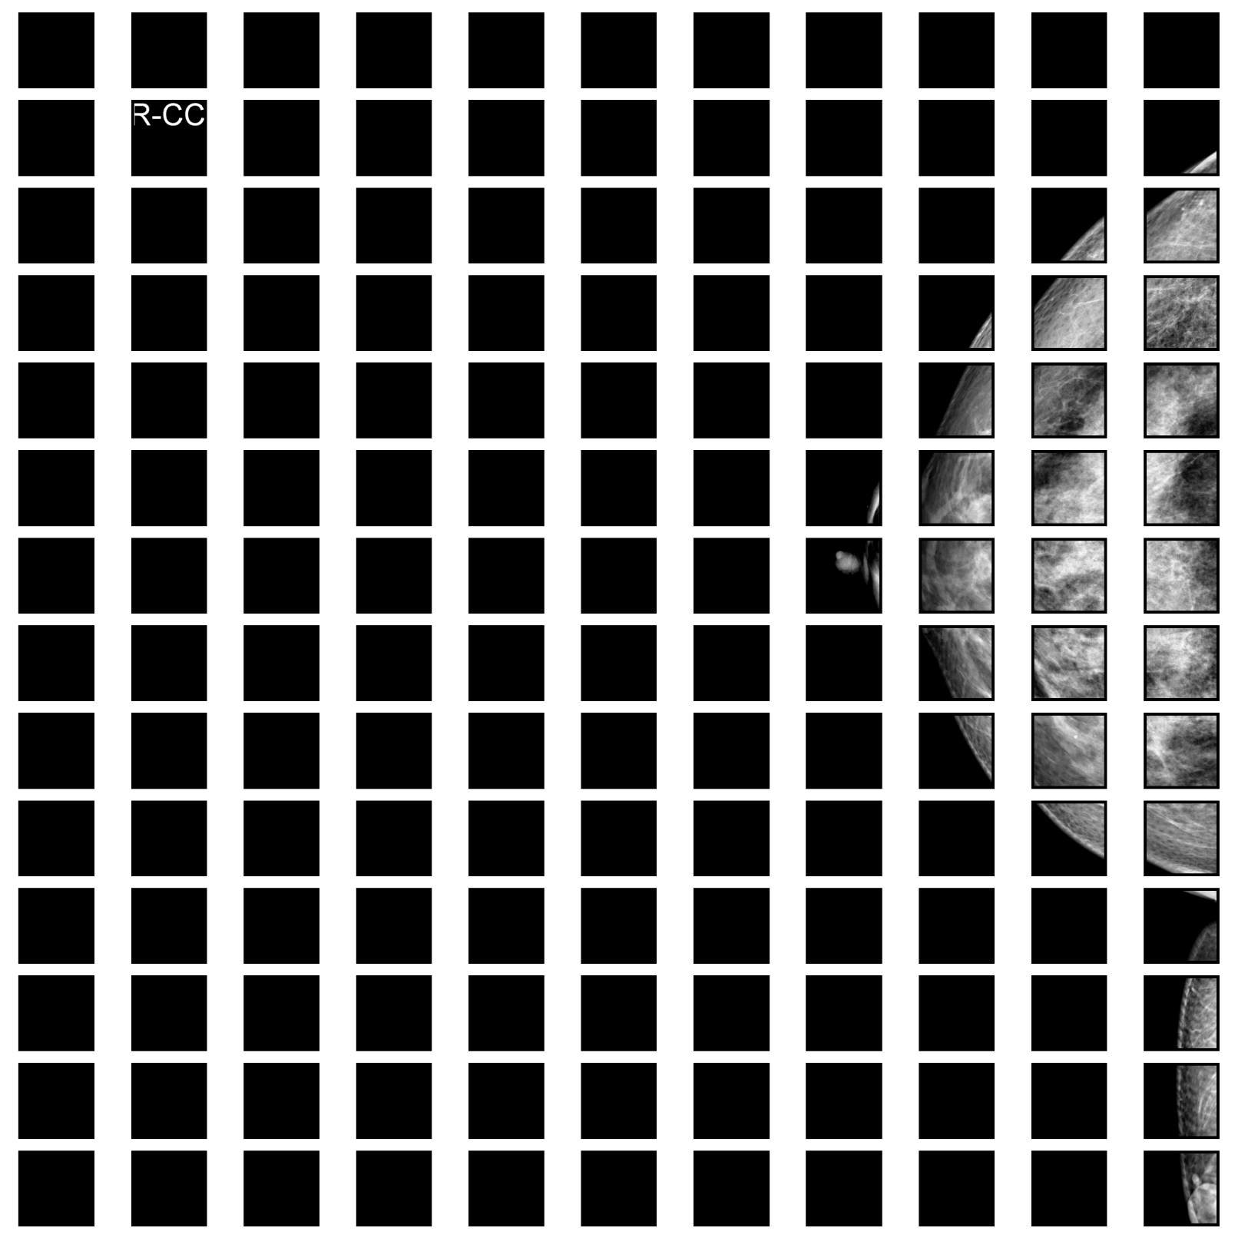
Brief Introduction
Two main approaches for classifying 2D mammograms are fully image-based and patch-based methods
Multi-view classifiers that leverage bilateral asymmetries and multiple views of mammograms are considered state-of-the-art.
Notes:
Questions remain regarding the impact of patch size and spatial resolution in mammogram classification. Multi-scale approaches and resolution reduction effects need further investigation.

Slide 3
Contributions
Investigate the impact of patch size on patch and whole image classifiers, considering lesions of different sizes.
Study the effects of reducing input image resolution on both classifiers and its influence on lesions of varying sizes.
Introduce a multi-patch size and multi-resolution approach for whole image classification, utilizing patch classifiers adapted to lesion sizes.
Demonstrate that multi-scale models outperform single patch-sized and single-resolution classifiers.

Slide 4
Datasets
1566 cases
758 biopsy-proven cancers
The images were downsampled to a resolution of 100 µm/pixel to match the resolution of other dataset images
Contain lesion-level annotations
1293 cases for training and 351 cases for validation
1539 cases
363 are biopsy-proven cancers
351 benign biopsied lesions
747 normal cases
Training (1237 cases), validation (201 cases), and testing (101 cases)
Contain lesion-level annotations

Slide 5
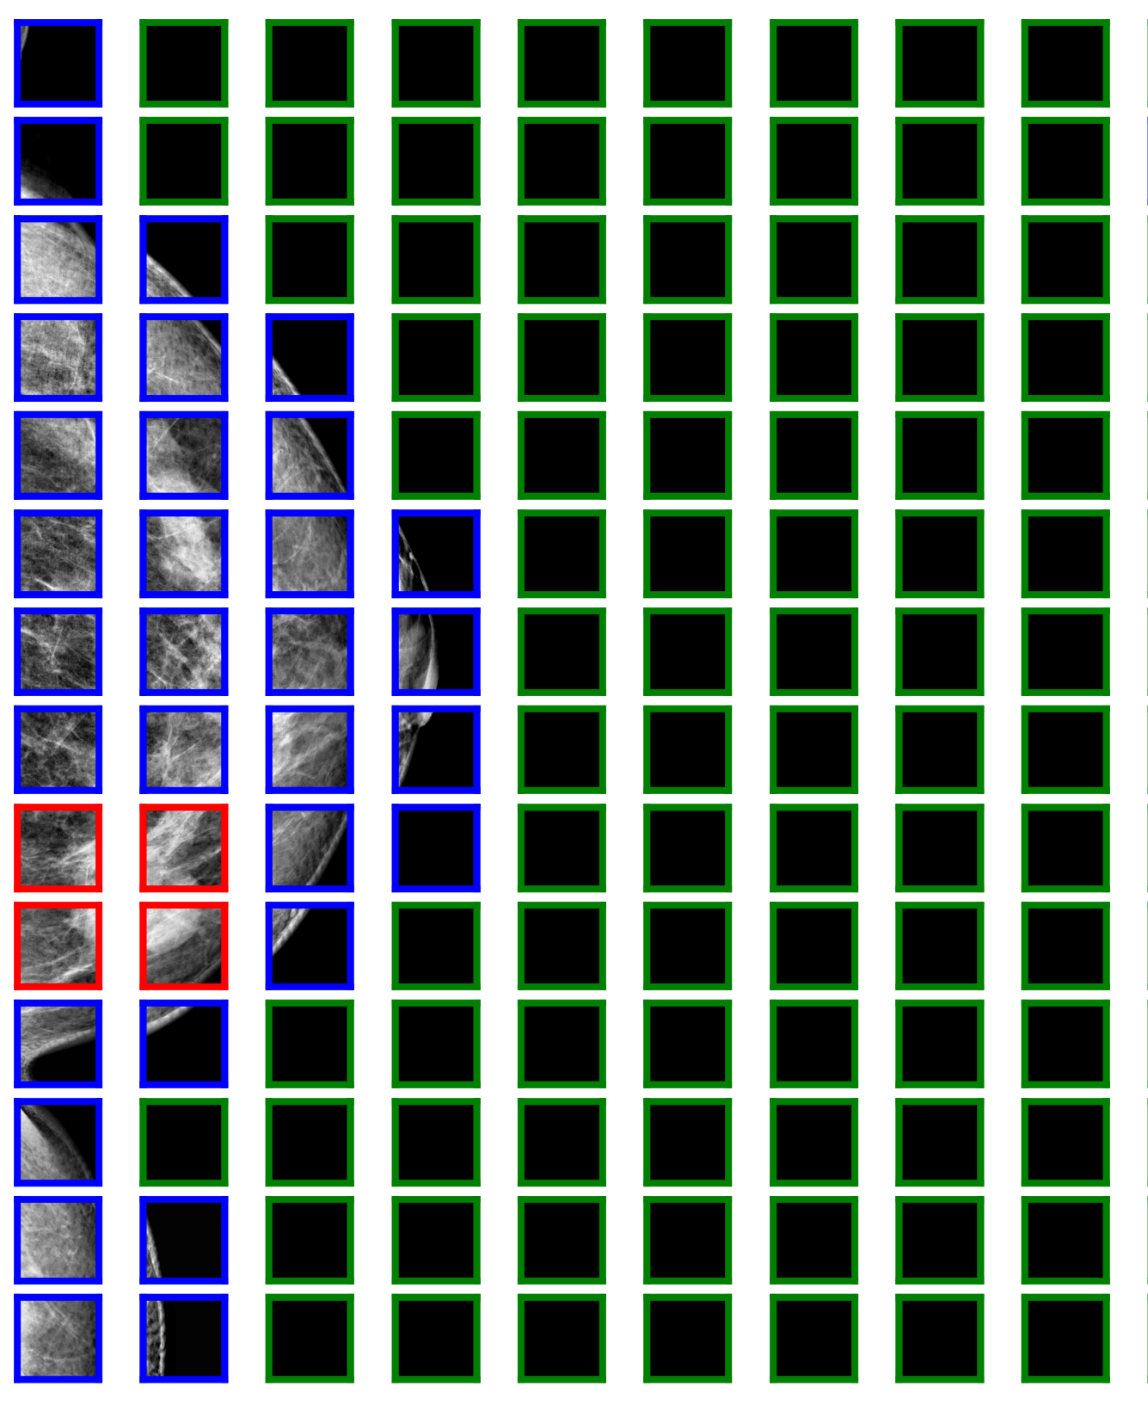
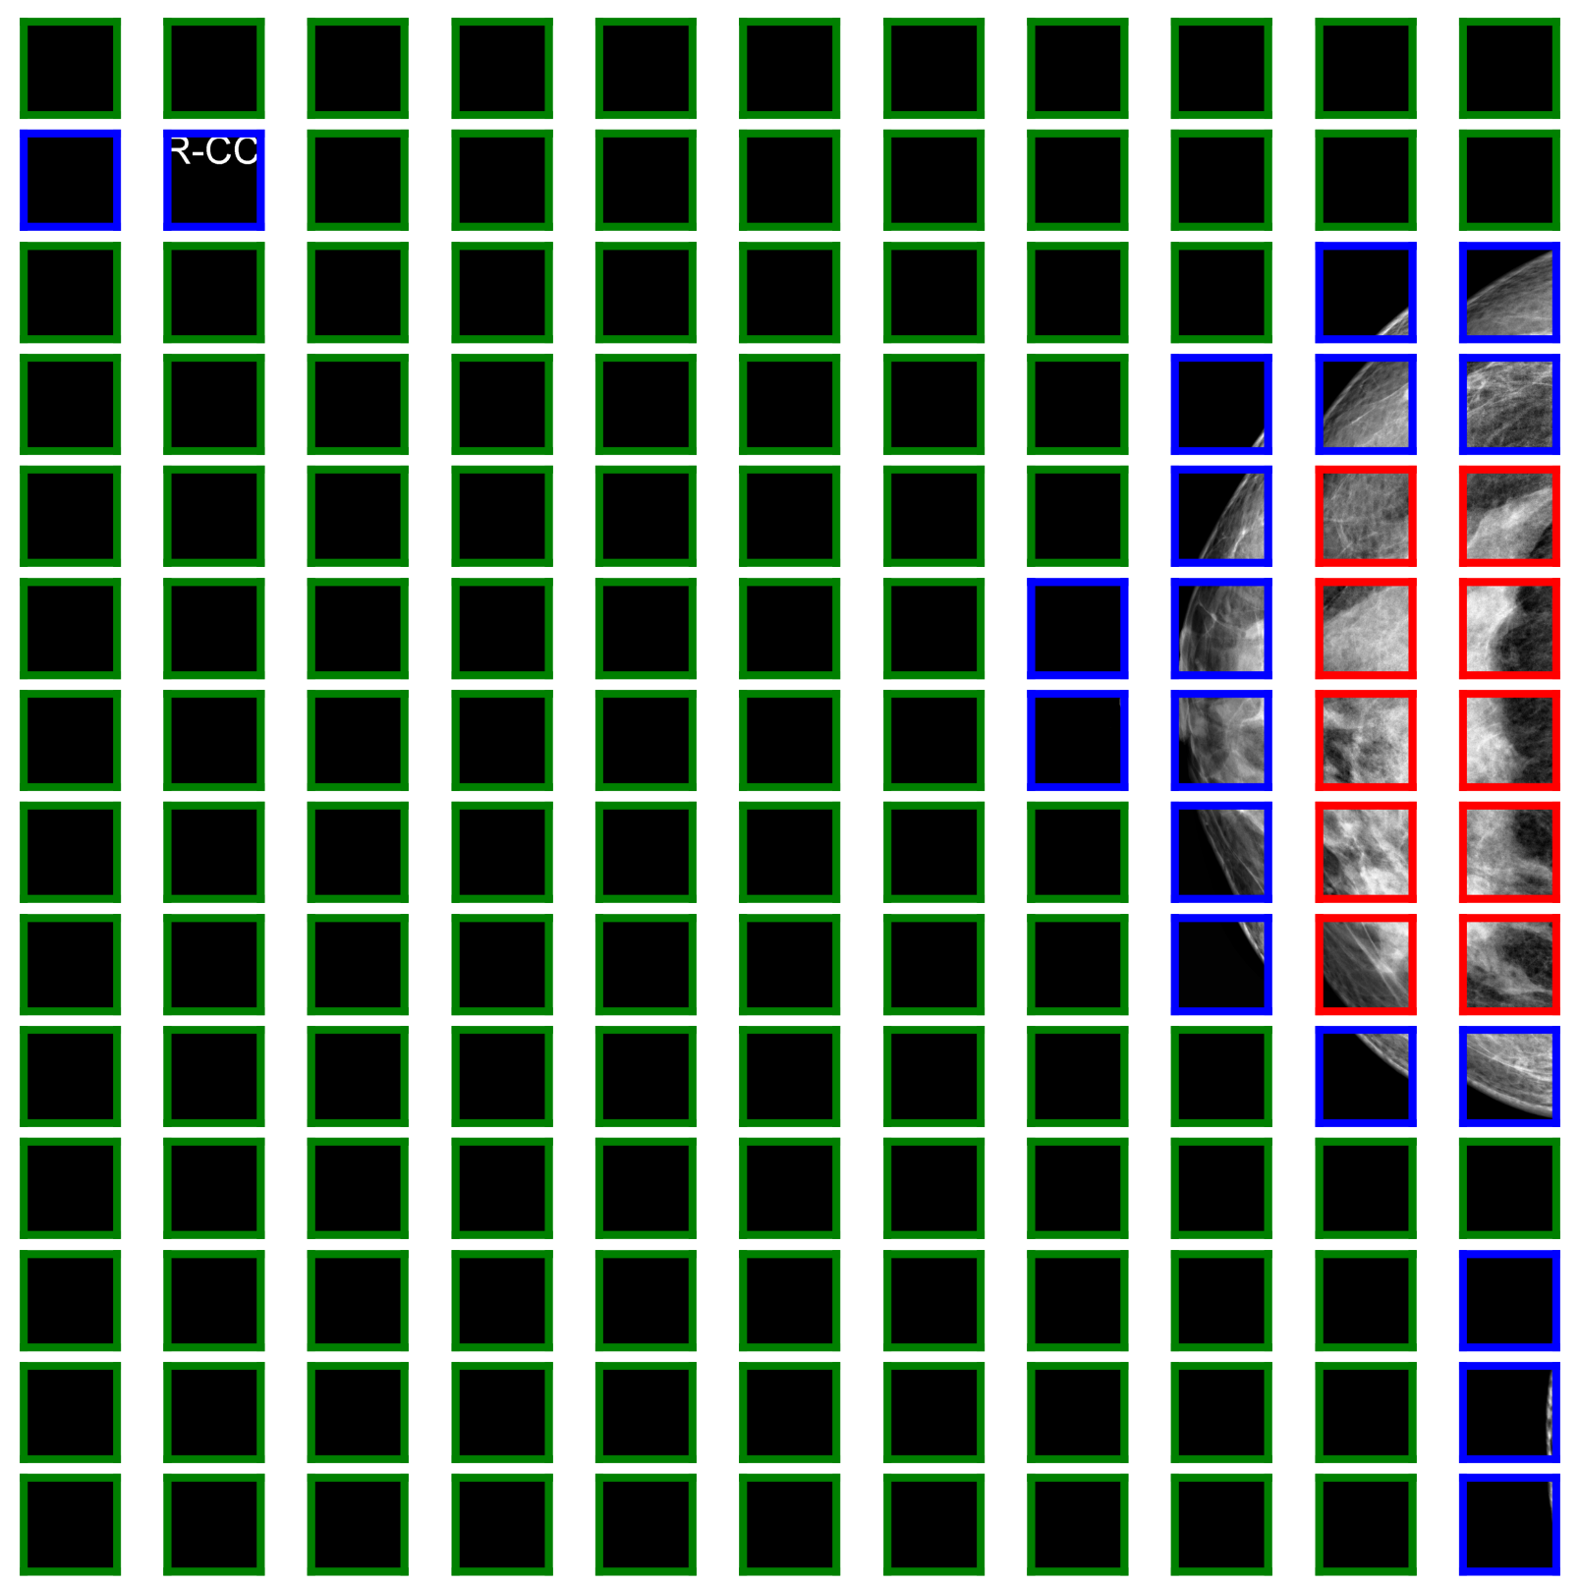
Patch Extraction
Notes:
10 background and 10 lesion patches were selected
Extracted patches from images containing lesions using two strategies: "fixed" and "random" extractions.
In the "fixed" strategy, patches were centered on the lesion, and for large lesions, the space was divided into smaller non-overlapping patches to ensure comprehensive lesion representation.
"Random" lesion patches were included, centered at random positions within the lesion, reducing potential bias in large lesion patches.
Patches were selected to have an intersection over union (IoU) less than 0.5 between each other to maintain diversity.
Noted a strong class imbalance in the patch dataset due to the presence of normal patches in every image, while many images contained only one lesion.

Slide 6
Patch Classifier
DenseNet-121 and ResNet-34
256, 512, and 768 pixel patches at a resolution of 100 µm/pixel
100, 150, and 200 µm/pixel a fixed patch-size of 512 pixels
CBIS-DDSM: Weights were initialized from ImageNet and SGD optimizer
GEHC: weights were initialized from the CBIS-DDSM model with last two dense layers fine-tuned
Data augmentation - flips and rotations
Each model was trained 10 times

Slide 7
3 Lesion Groups
Small (<256 pixels)
Medium (256-512 pixels)
Large (>512 pixels)
Performance
Patch classifier AUC:: normal vs. abnormal
Patch classifier AUC: benign vs. malignant
Notes:
Normal vs. abnormal classifier: Normal vs. abnormal AUC seeks to characterize the ability of the classifier to find or detect a given lesion type and size (e.g., medium mass)
The benign vs. malignant AUC aims to evaluate the ability of the classifier to tell if a lesion of a given size and type is benign or malignant.

Slide 8
Whole Image Classifier
The patch classifier was converted to a whole image classifier
eliminate global average pooling
eliminate connected layers
add a convolutional block
Weights from patch classifier
bottleneck residual block proposed
Residual block skipped connections to avoid vanishing gradients
One whole image classifier was trained for each of the patch classifiers
AUC, SP, ACC, std, t-test
p-values were obtained by comparing each classifier to the best performing base classifier of each experiment
Notes:
The best performing base classifiers used in the t-test were:
resolution 100 µm for the CBIS-DDSM and GEHC datasets in the resolution experiment,
patch size 256 for CBIS-DDSM in the patch size experiment,
and patch size 512 for the GEHC dataset in the patch size experiment

Slide 9
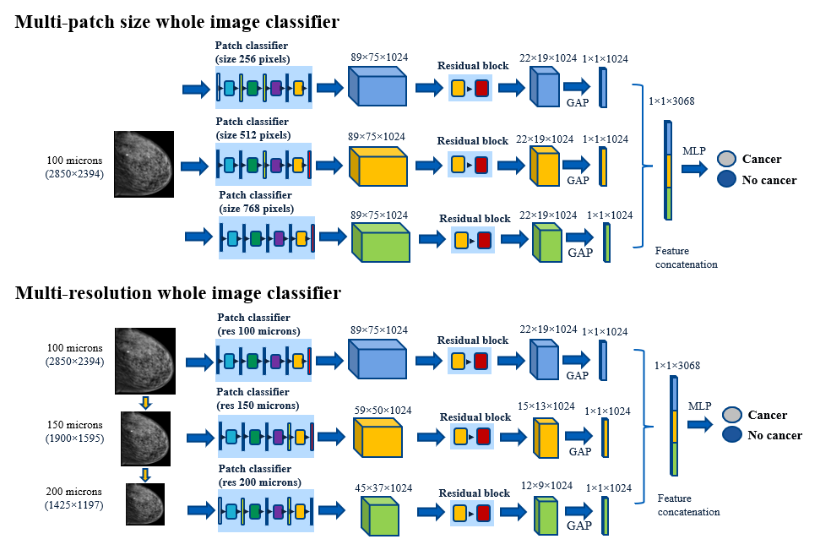
Multi-patch size & Multi-resolution Whole Image Classifier

Slide 10
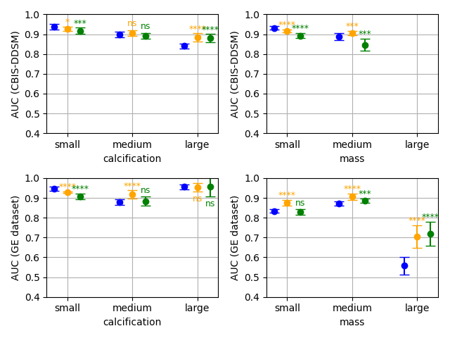
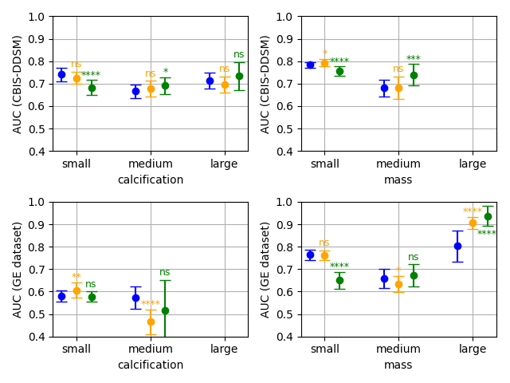
Results
Performance of the patch classifier with different patch sizes.
CBIS-DDMS
CBIS-DDMS
GEHC Dataset
GEHC Dataset
Calcification
Mass
Calcification
Mass
(a) Normal vs. Abnormal AUC
(b) Malignant vs. Benign AUC
Patch size 258
Patch size 512
Patch size 768

Slide 11
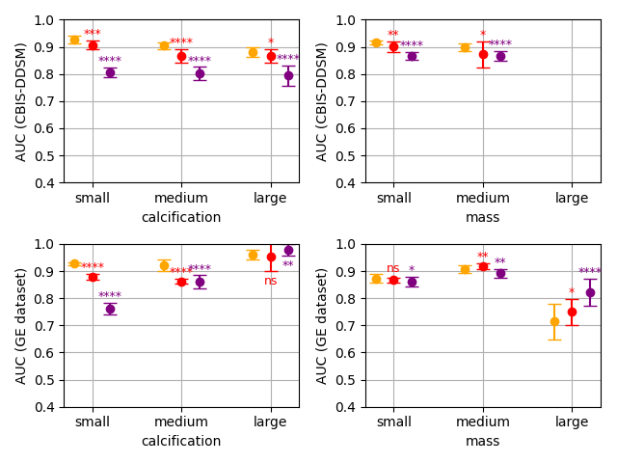
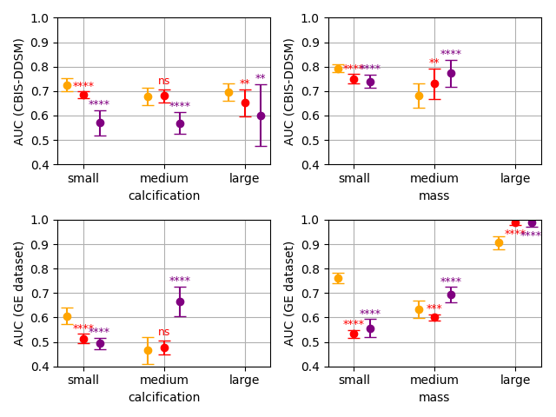
Results
Performance of the patch classifier with different resolutions.
CBIS-DDMS
CBIS-DDMS
GEHC Dataset
GEHC Dataset
Calcification
Mass
Calcification
Mass
(a) Normal vs. Abnormal AUC
(b) Malignant vs. Benign AUC
100 𝝻m
150 𝝻m
200 𝝻m

Slide 12
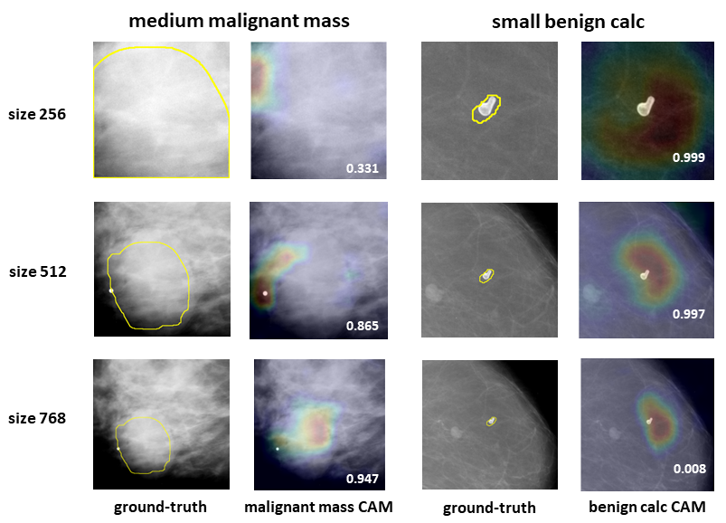
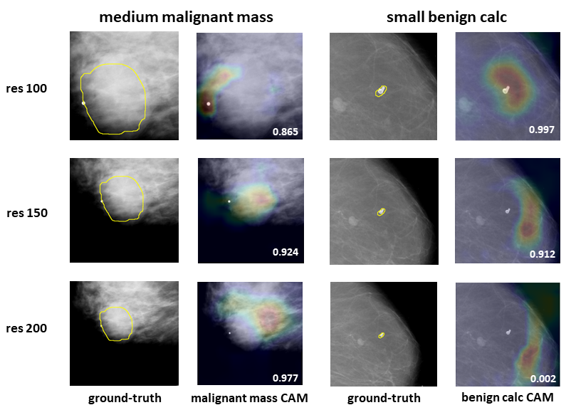
Results
Class Activation Maps
(a) Different Patch Sizes
(b) Different Resolutions

Slide 13
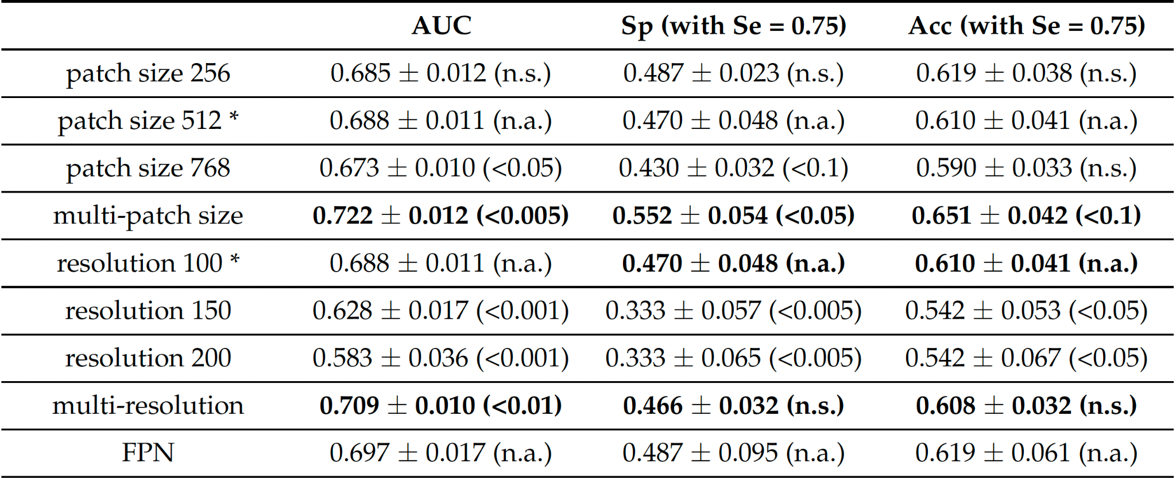
Results
Table1. AUC, specificity (Sp), and accuracy (Acc) of the whole image classifiers in CBIS-DDSM.
Table2. AUC, specificity (Sp), and accuracy (Acc) of the whole image classifiers in the GEHC dataset.

Slide 14
Conclusion
The multi-patch size solution outperformed FPN in the two datasets
The multi-patch size solution compared to the best single patch size baseline classifier.
AUC by 0.025 (+3%) on the public CBIS-DDSM dataset.
AUC by 0.034 (+5%) on the GEHC dataset.
The multi-resolution approach compared to the best single resolution classifier.
AUC by 0.025 (+3%) on CBIS-DDSM
AUC by 0.021 (+3%) on the GEHC data

Slide 15
Limitations
“More research is needed on patch-sampling strategies, transfer learning representations from patch-level to whole image classifier with additional lesion-level annotations images.” - Authors
The result images are very hard to interpret.
There approach is very expensive to implement and takes longer training time.

Slide 16
Thank you. Questions?

