Slide 1
Convolutional Feature Descriptor Selection for Mammogram Classification
Dong Li , Lei Zhang , Jianwei Zhang, and Xingyu Xie
Presented By - Aminul Huq & Mst. Tasnim Pervin

Slide 2
Motivation
Most of the previous approaches require detection or segmentation as prior.
Insufficient attention to lesion areas.
Focus on discriminative features.
Utilize image level classification labels only.
Reduce dependency on mask annotations.

Slide 3
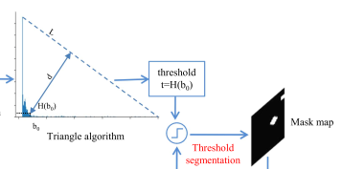
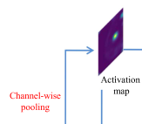
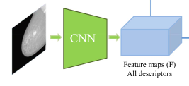
Methodology

Slide 4
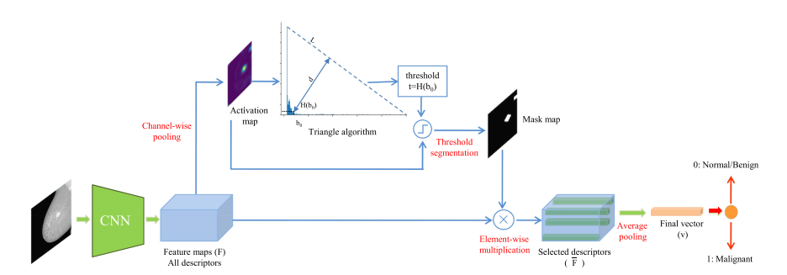
Methodology

Slide 5
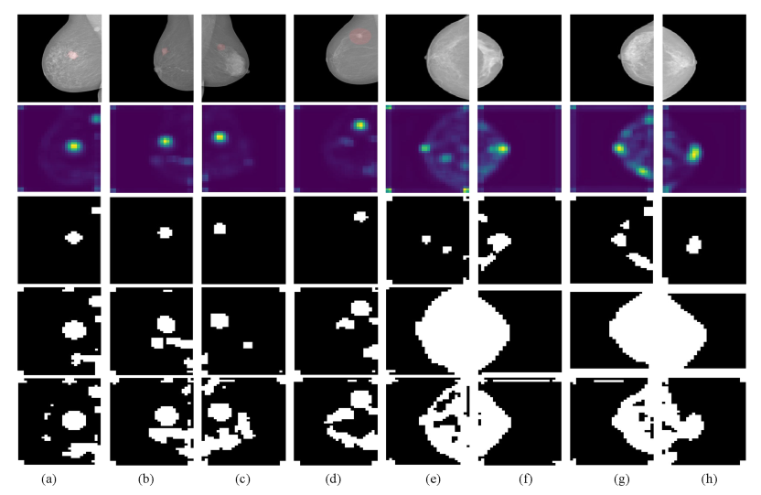
Original image
Activation Maps
(a)-(d) malignant
Isodata thresholding
(e)-(h) benign
Triangle thresholding
Mean thresholding

Slide 6
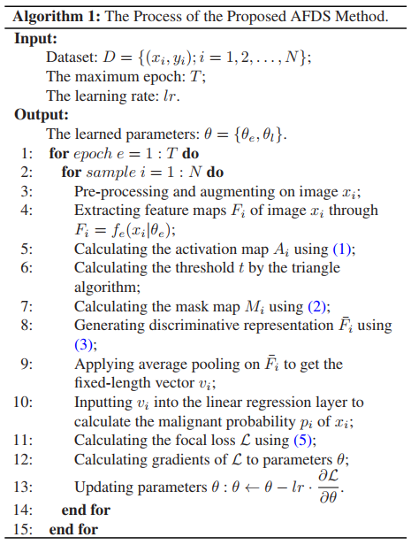
Algorithm

Slide 7
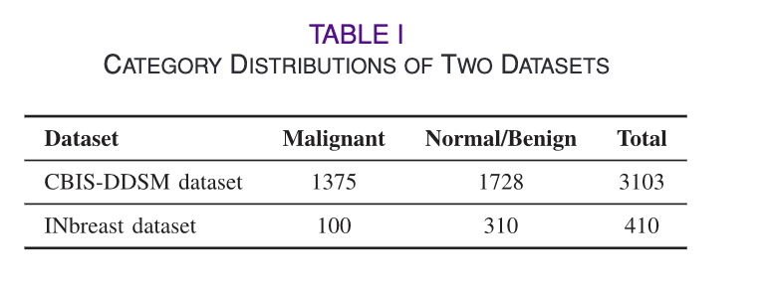
Datasets
Preprocessing:
Resize to 1350 x 950
Random crop to 1280 x 896 (training)
Center crop to 1280 x 896 (testing)
Augmentation:
Horizontal Flip
Vertical Flip
Rotation (-30 degree to +30 degree)
Normalize to [0-1] using mean and variance
Metrics:
Accuracy
AUC
ROC
Sensitivity
Specificity
ECE(Expected Calibration Error)

Slide 8
Hyper-parameters
Feature extractor: DenseNet169 (pretrained)
Epochs: 100
Batch size: 8
Optimizer: ADAM
Learning rate: 0.00005 with decay rate 0.9 (feature extractor layer)
Learning rate: 0.0001 with decay rate 0.85 (logistic regression layer)
Loss function: Focal loss

Slide 9
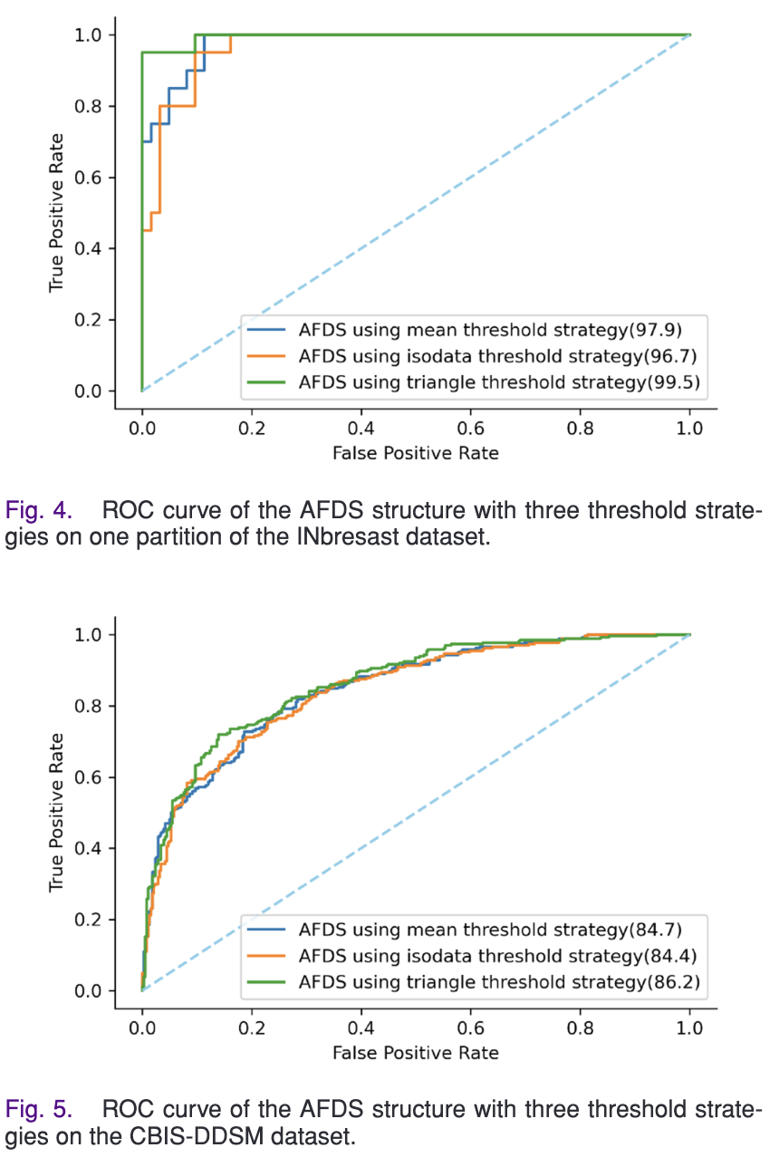

Slide 11
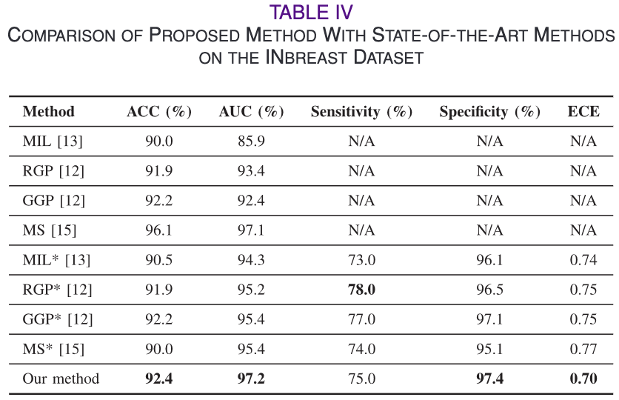
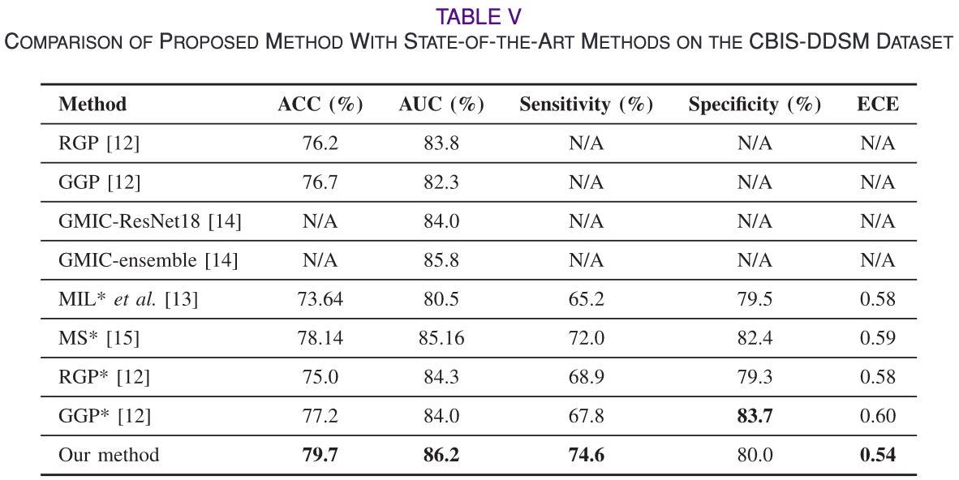

Slide 12
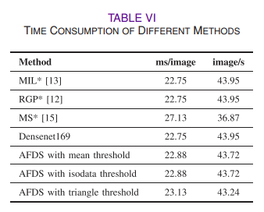

Slide 13
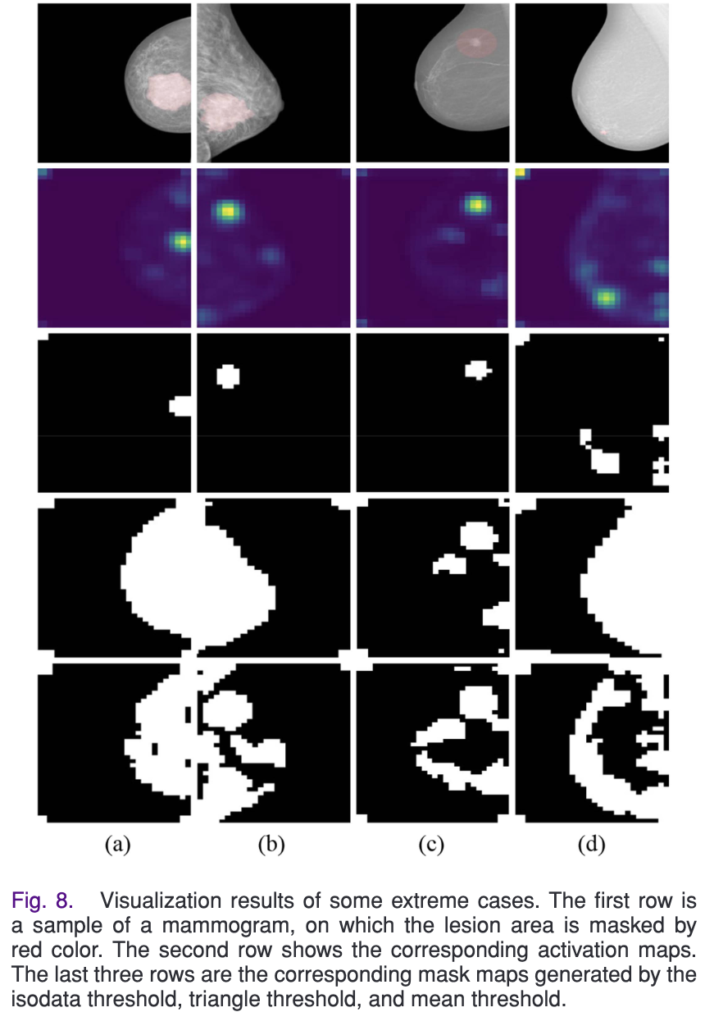
Discussion
Advantages:
Extracts discriminative lesion areas without segmentation/ bounding box detection
Outperforms SOTA mammogram classification methods
Disadvantages:
Produces entire breast mask map for extremely large or small lesions.
Noisy mask for normal sized lesions.
Slight increase in time computation

Slide 14
Thank You !!!

