Slide 1
Hypercomplex Neural Architectures for Multi-View Breast Cancer Classification
Neha Ujjainkar & Abhishek Khandekar

Slide 2
Outline
Introduction
Methods
Data set
Results
Advantages
Disadvantages
Conclusion

Slide 3
Introduction
.
Traditional approach:
Deep learning methods for breast cancer classification perform a single-view analysis.
Proposed a novel approach:
Multi-view breast cancer classification based on a parameterized hypercomplex neural network.

Slide 4
Introduction
.
Issue with multi-path network:
The model can favor one of the two views during learning.
The model might fail in leveraging the correlated views.
Quaternion neural networks (QNNs):
Ability to model interactions between input channels.
Captures internal latent relations within input channels.
Reduces the total number of parameters by almost 75%.

Slide 5
Introduction
.
Parameterized hypercomplex neural networks (PHNNs):
Generalize hypercomplex multiplications as a sum of Kronecker products
Applicable to any n-dimensional input (instead of just 3D/4D as the quaternion domain)
Proposed Method:
Parameterized hypercomplex ResNets (PHResNets):
- Able to process ipsilateral views corresponding to one breast.

Slide 6
Introduction
.
Proposed Method:
PHYBOnet:
- Involving a Bottleneck with n = 4, to process learned features in a joint fashion
- Able to process bilateral views corresponding to both breast
- Perform a patient-level analysis
PHYSEnet:
- Shared Encoder with n = 2, to learn stronger representations of the ipsilateral views
- Shares the weights between bilateral views,
- Perform a breast-level analysis.

Slide 7
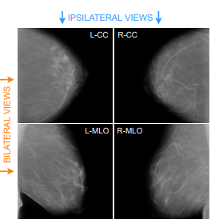
Multi-View Approach
.
Ipsilateral views (CC and MLO views of the same breast)
– Helps detect eventual tumors.
Bilateral views (same view of both breasts)
– Helps locate masses (like asymmetries)
Radiologists employ a multi-view approach leveraging info from both ipsilateral and bilateral views.

Slide 8
Proposed Method
.
Multi-view parameterized hypercomplex ResNet:
Leverages information contained in multiple views through parameterized hypercomplex convolutional (PHC) layers.
ResNets are used which are characterized by residual connections that ensure proper gradient propagation during training.
A ResNets block is typically defined by: y = F(x) + x
When equipped with PHC layers F(x) becomes:
F(x) = BN (PHC(ReLU (BN (PHC(x))))),

Slide 9
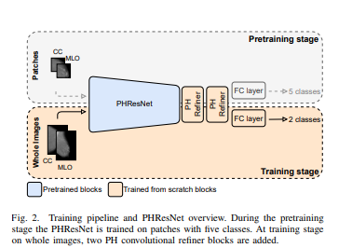
Proposed Method
.
B. Parameterized hypercomplex architectures for two views

Slide 10
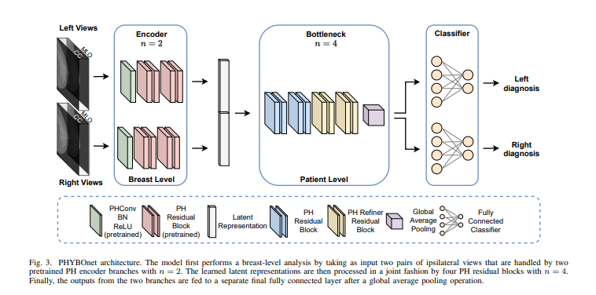
Proposed Method
.
C. Parameterized hypercomplex architectures for four views
1) Parameterized Hypercomplex Bottleneck network (PHYBOnet):

Slide 11
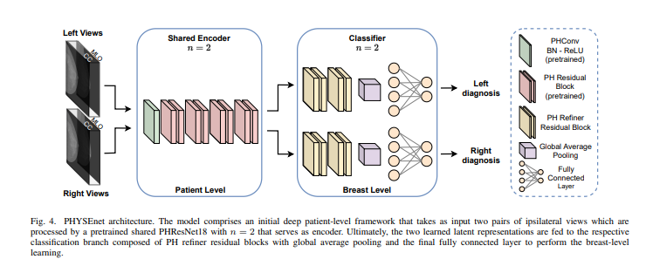
Proposed Method
.
C. Parameterized hypercomplex architectures for four views
2) Parameterized Hypercomplex Shared Encoder network (PHYSEnet):

Slide 12
Dataset
.
CBIS-DDSM:
employed for the training of the patch classifier as well as the whole-image classifier in the two-view scenario.
The images are resized to 600×500
Augmented with a random rotation between −25 and +25 degrees
Performed random horizontal and vertical flips
INbreast:
Consider BI-RADS categories 4, 5, and 6 as positive and 1, 2 as negative
The same preprocessing as CBIS-DDSM is applied

Slide 13
Dataset
.
CheXpert:
Contains 224,316 chest X-rays with both frontal and lateral views
Provides 14 labels for common chest radiographic observations.
Images are resized to 320 × 320 for training
The same augmentation operations as before are applied
BraTS19:
Contains brain MRI scans
For training, volumes are resized to 128 × 128 × 128
Augmented via random scaling between 1 and 1.1 for the task of overall survival prediction

Slide 14
Evaluation metrics
.
AUC (Area Under the ROC Curve):
trade-off between True Positive Rate (TPR) and False Positive Rate (FPR) using different probability thresholds.
Classification accuracy:
To evaluate the model performance.
Dice score:
For the segmentation task, which measures the pixel-wise agreement between a predicted mask and its corresponding ground truth

Slide 15
Training Procedure
.
Training challenges:
Benign or malignant tumors present very few differences distinguishable only by trained and skilled clinicians.
Neural models require huge volumes of data for training.
A lesion occupies only a tremendously small portion of the original image.
Training strategy:
Pretrain the model on patches of mammograms
Initializing the network weights with the patch classifier weights and train on whole images.

Slide 16
Training Details
.
Two-view architectures:
Added 4 refiner residual blocks with the bottleneck design.
The output of such blocks is fed to the final fully connected layer.
The backbone network is initialized with the patch classifier weights.
the refiner blocks and final layer are trained from scratch.

Slide 17
Training Details
.
Four-view architectures:
Parameterized hypercomplex bottleneck network (PHYBOnet):
Divide PHResNet18 blocks in such a way that the first part of the network serves as an encoder for each side and the remaining blocks compose the bottleneck.
the two outputs are fed to the respective fully connected layer
responsible for producing the prediction related to its side.

Slide 18
Training Details
.
Parameterized hypercomplex shared encoder network (PHYSEnet):
presents as a shared encoder model a whole PHResNet18
The two classifier branches are comprised of the 4 refiner blocks with a global average pooling layer and the final classification layer.

Slide 19
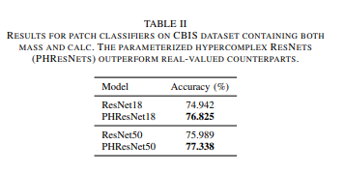
Experimental evaluation
.
Patch classifier:

Slide 20
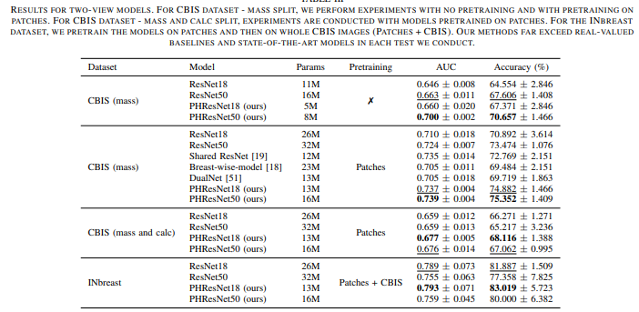
Experimental evaluation
.
Experiments with two views :

Slide 21
Experimental evaluation
.
Experiments with four views :

Slide 22
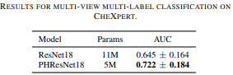
Experimental evaluation
.
Result on CHEXPERT :

Slide 23
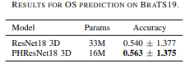
Experimental evaluation
.
Result on BRATS19 :

Slide 24
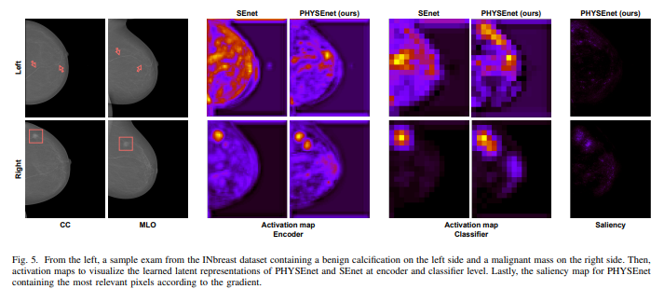
Visualizing Multi-View Learning
.
Visualizing Multi-View Learning:

Slide 25
Advantages
.
Considers ipsilateral views as well as bilateral.
Capability of capturing and truly exploiting correlations between views.
Reduces the number of free parameters to almost half.
The proposed approach is portable and flexible.

Slide 26
Disadvantages
.
Require at least two views. (cannot be used for Single view mammographs)
Accuracy needs to be improved further.

Slide 27
Conclusion
.
The proposed approach handles multi-view mammograms as a radiologist does, thus leveraging information contained in ipsilateral views as well as bilateral.
Leveraging hypercomplex algebra properties, neural models are endowed with the capability of capturing and truly exploiting correlations between views.
This study paves the way for novel methods capable of processing medical imaging exams with techniques closer to radiologists and human understanding.

Slide 28
Future Improvements
.
Utilizing a larger image training data set.
Optimizing hyperparameters—including the batch size and cross-validation.
The model could employ a different base architecture (instead of ResNet18 and ResNet50).
Investigate some other evaluation and visualization metrics.

Slide 29
References
R. L. Siegel, K. D. Miller, H. E. Fuchs, and A. Jemal, “Cancer statistics, 2022,” CA: A Cancer Journal for Clinicians, vol. 72, no. 1, pp. 7–33, 2022.
I. C. Moreira, I. Amaral, I. Domingues, A. Cardoso, M. J. Cardoso, and J. S. Cardoso, “INbreast: Toward a full-field digital mammographic database,” Academic Radiology, vol. 19, no. 2, pp. 236–248, 2012
S. Misra, N. L. Solomon, F. L. Moffat, and L. G. Koniaris, “Screening criteria for breast cancer,” Adv. Surg., vol. 44, pp. 87–100, 2010.
D. Gur, G. S. Abrams, D. M. Chough, M. A. Ganott, C. M. Hakim, R. L. Perrin, G. Y. Rathfon, J. H. Sumkin, M. L. Zuley, and A. I. Bandos, “Digital breast tomosynthesis: Observer performance study,” American Journal of Roentgenology, vol. 193, no. 2, pp. 586–591, 2009.
Y. Liu, F. Zhang, C. Chen, S. Wang, Y. Wang, and Y. Yu, “Act like a radiologist: Towards reliable multi-view correspondence reasoning for mammogram mass detection,” IEEE Trans. Pattern Anal. Mach. Intell., no. 01, pp. 1–1, 2021.
L. Shen, L. Margolies, J. Rothstein, E. Fluder, R. McBride, and W. Sieh, “Deep learning to improve breast cancer detection on screening mammography,” Sci. Rep., vol. 9, 2019.
N. Wu, Z. Huang, Y. Shen, J. Park, J. Phang, T. Makino, S. Kim, K. Cho, L. Heacock, L. Moy, and K. J. Geras, “Reducing false-positive biopsies using deep neural networks that utilize both local and global image context of screening mammograms,” Journal of Digital Imaging, vol. 34, pp. 1414 – 1423, 2021.
G. Murtaza, L. Shuib, A. Wahid, G. Mujtaba, H. Nweke, M. Al-Garadi, F. Zulfiqar, G. Raza, and N. Azmi, “Deep learning-based breast cancer classification through medical imaging modalities: state of the art an
D. Abdelhafiz, C. Yang, R. Ammar, and S. Nabavi, “Deep convolutional neural networks for mammography: advances, challenges and applications,” BMC Bioinformatics, vol. 20, 2019.
S. S. Aboutalib, A. A. Mohamed, W. A. Berg, M. L. Zuley, J. H. Sumkin, and S. Wu, “Deep Learning to Distinguish Recalled but Benign Mammography Images in Breast Cancer Screening,” Clinical Cancer Research, vol. 24, no. 23, pp. 5902–5909, 2018.

Slide 30
.
Thank You

