Slide 1
Deep Multiple Instance Learning for Automatic Breast Cancer Assessment Using Digital Mammography

Slide 2
Overview
Computer-aided detection (CAD) systems have emerged to assist radiologists and improve breast cancer detection rates.
  They are helpful when there is observation lack, or inability for double reading with two or more radiologists
Obstacles yet to be improved:
Precision
Stability

Slide 3
Contributions
Investigate the application of decomposition of images in mammography
Demonstrate the impact of decomposing images on SVMs comparing to traditional techniques
Provide an insight about improving precession of results through applying image decomposition on data
Study the stability and comprehensiveness of the BEMD approach through applying the it on various dataset.

Slide 4
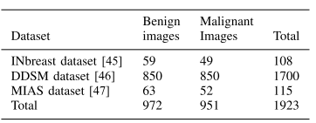
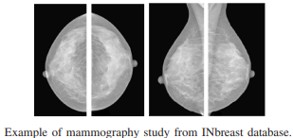
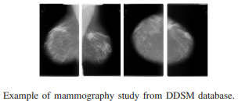
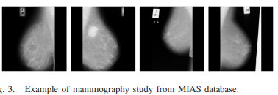
Dataset

Slide 5
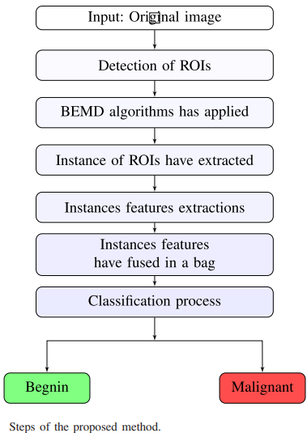
Steps of Proposed Method

Slide 6
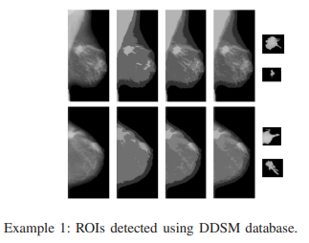
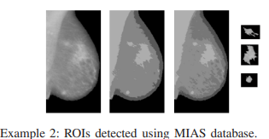
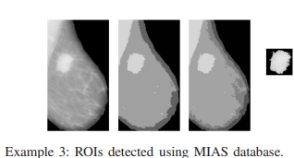
Extracting ROIs and Applying BEMD
Extracting ROIs through K-means algorithm
Decomposing the ROIs into several sublayers based on the BEMD algorithm in order to be able to describe these ROIs as much as possible → Each level of BIMFs contains an additional texture detail of the detected ROI

Slide 7
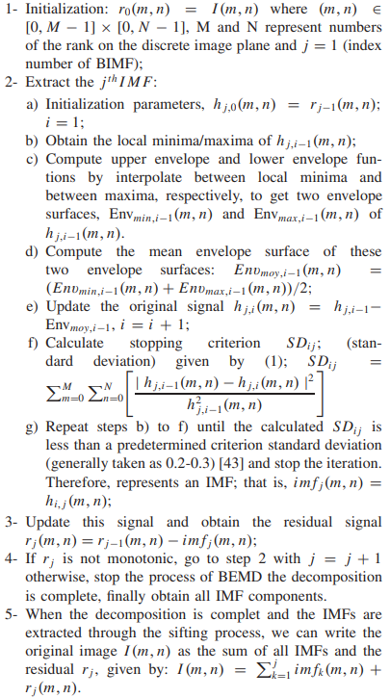
Bidimensional Empirical Mode Decomposition (BEMD)
Empirical mode decomposition (EMD) [26] is an approach adapted to nonstationary time frequency analysis

Slide 8
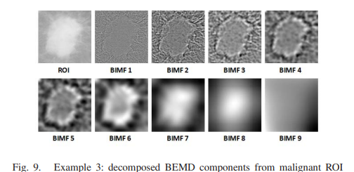
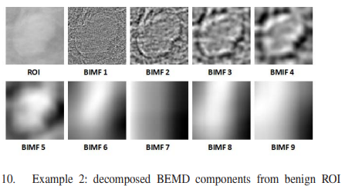
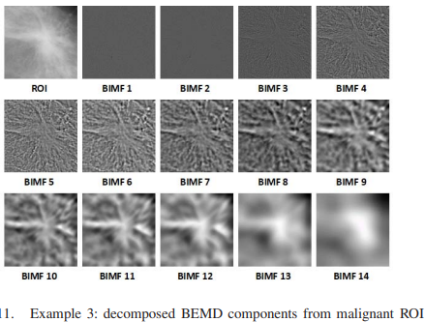
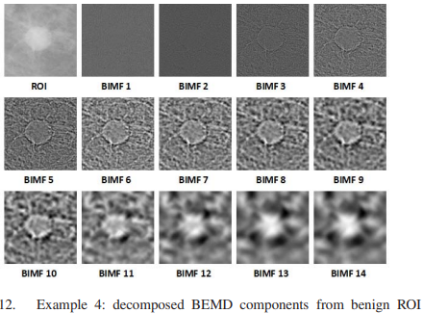
Decomposed BEMD components from ROI

Slide 9
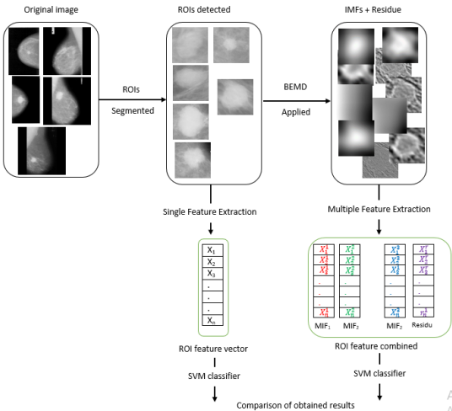
Proposed framework architecture for classifying breast abnormalities
Acquiring several layers out of ROIs (BIMFs); each layer contains specific detail
The combination of features layers in a matrix can improve the description of the region in question

Slide 10
Feature extraction and Classifier implementation
4 methods are applied for feature extraction:
  Haralick
  Gray-Level Cooccurrence Matrices (GLCM)
  Gray-Level Run-Length Matrices (GLRLM)
  Histograms of local binary patterns (LBPH)
The features have been extracted from the layers, each layer represented by a single vector. The vectors of the same ROI have combined in a matrix (V1, V2,..., Vn) corresponding the layers (IMF1, IMF2,..., IMFn, Residue) describing a single ROI.
These matrices are the input parameters of our classifier.
an SVM with a nonlinear kernel (radial basis function (RBF))

Slide 11
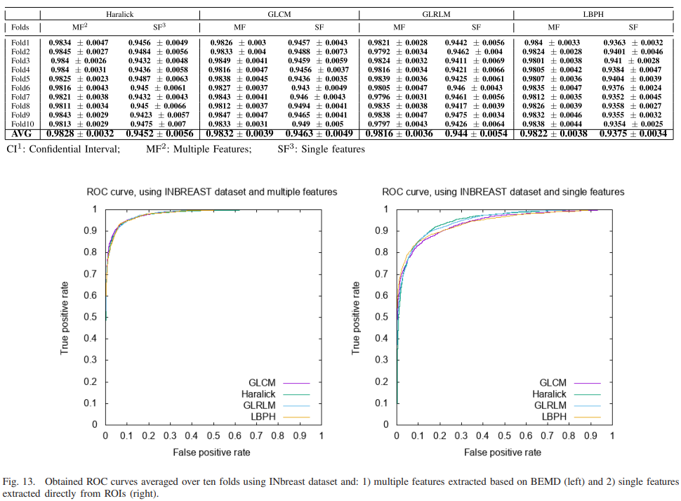
Training Results
3 models are built and trained in three different data bases
Results on INbreast Dataset

Slide 12
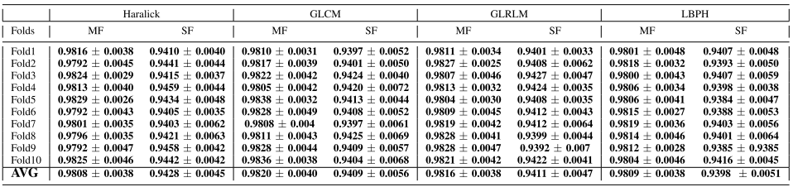
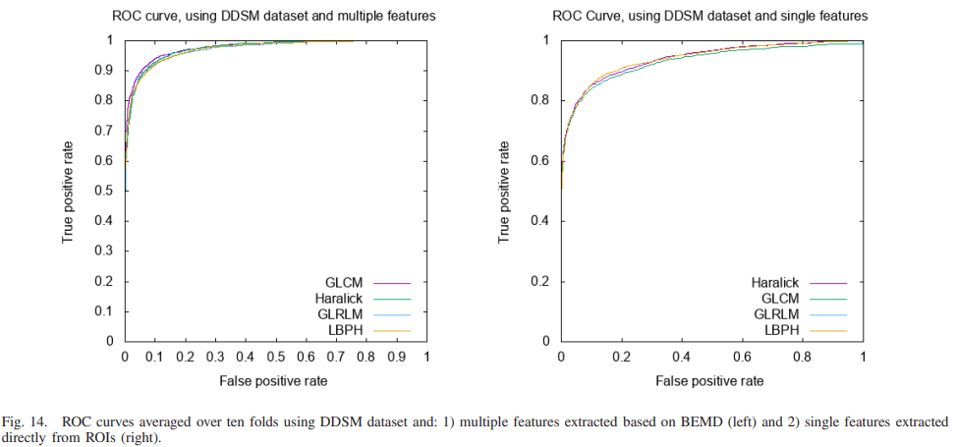
Training Results
Results on DDSM Dataset:

Slide 13
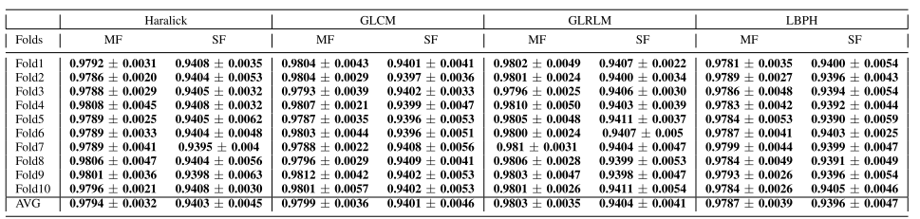
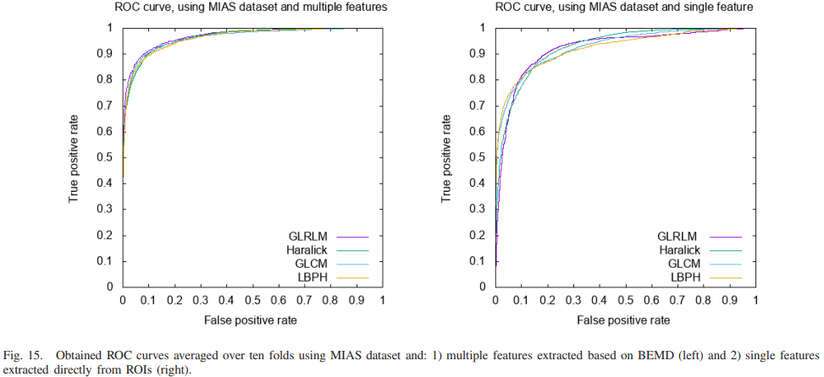
Training Results
Results on MIAS Dataset:

Slide 14
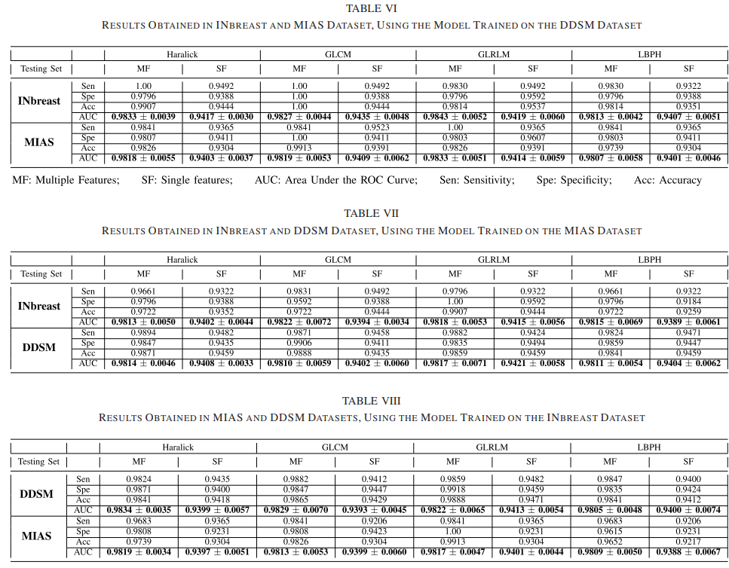
Testing Results

Slide 15
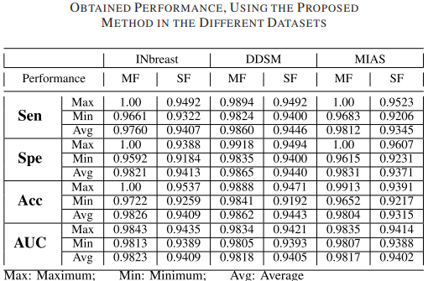
Summary of the obtained performance
Whatever data used for training
Whatever data used for testing
Whatever the technique used (Haralick, GLCM, GLRLM, LBPH) for ROIs feature extraction
BEMD integration has resulted in superior performance

Slide 16
Conclusion
Successfully Derived sublayers from ROIs.
Diversified datasets were used (datasets have been scanned with different scanners
and with different resolutions).
Integration of BEMD and SVM can be promising.
Applying the BEMD algorithm makes it possible to observe several levels of intensity and textures:
  Each level (BIMF) was considered as a layer
  The cooperation of the layers and the study of the dependencies between them allow giving a good description of ROIs.
        Therefore, the classification process can get better results

