Slide 1
Boundary loss for highly unbalanced segmentation
Christopher Collum
Ayesh Meepaganithage

Slide 2
Introduction
Initial deep learning methods on medical images utilized Dice or cross-entropy loss.
Based on regional integrals.
Difficulty for highly unbalanced segmentations.
For example, when size of foreground region is significantly smaller than the background.

Slide 3
Introduction Cont.
Cross-entropy measures affinity between predicted regions and ground-truth.
Assumes equal importance for all samples and classes.
Requires balanced datasets.
If not balanced cross-entropy becomes biased towards the majority class.
Downsampling infrequent labels is one method of mitigating the problem, but this lowers total dataset size.
Could also assign different weights, but this may create an over importance of unwanted noise.

Slide 4
Introduction Cont.
Dice was a general improvement over cross-entropy but also faced challenges.
Struggles with very small structures.
mis-classified pixels lead to large loss decreases
False positives and false negatives are of equal importance, which is mainly appropriate when both types of errors are equally bad.
Focal terms have been introduced to help mitigate class imbalance issues.

Slide 5
Model
Proposal of a boundary-based loss function.
Measures a distance metric on shapes/contours rather than regions.
Traditionally boundary representations are difficult in CNN’s.
Inspired by techniques in discrete (graph-based) optimization for computing gradient flows in curve evolution.
Can be combined with regional losses and implemented with any existing deep learning architecture.

Slide 6
Model
Evaluated on two challenging and highly imbalanced segmentation problems.
Ischemic Stroke Lesion (ISLES)
White Matter Hyperintensities (WMH)

Slide 7
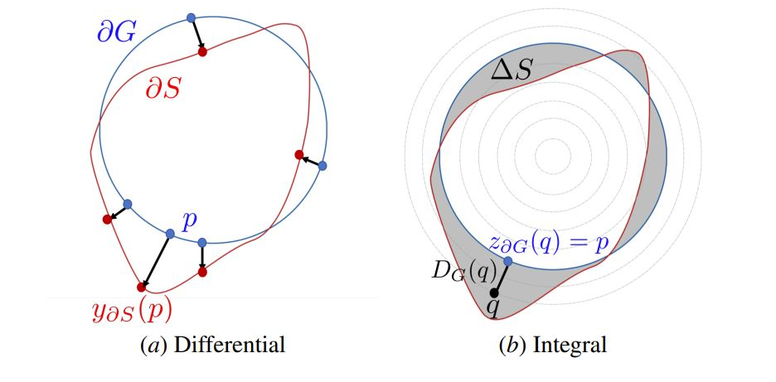
Model

Slide 8
Experiments
Two sets of experiments
Evaluating integrating proposed boundary loss with different regional loss functions
Checking different strategies for selecting and scheduling 𝝰

Slide 9
Datasets
Ischemic Stroke Lesion Segmentation (ISLES) Dataset
94 scans
74 training
20 validation
spatial resolution(mm): 0.8 *0.8 *4 - 1 *1 *12
White Matter Hyperintensities (WMH) Dataset
60 scans
50 training
10 validation
spatial resolution(mm): 0.95 *0.95 *3 - 1.21 *1 *3

Slide 10
Data Preprocessing
Convert 3D scans to a stack of independent 2D images
Normalized between 0-1
Rescaled to 256*256
No data augmentation

Slide 11
Architecture and Hyperparameters
Deep learning model : UNet
Optimizer : Adam
Initial learning rate: 0.001
Halved if not improved after 20 epochs
Batch size: 8
No early stopping

Slide 12
Compared Loss Functions
GDL
Distance weighted cross-entropy
Focal Loss
Hausdorff Loss

Slide 13
Generalized Dice Loss (GDL)
where coefficients,
wG = 1/(∫ _{p∈ Ω}g(p)dp)² and
wB = 1/(∫ (1_{Ω} − g(p))dp)²
are introduced to reduce the correlation between the Dice overlap and region size

Slide 14
Distance weighted cross-entropy
A modified weighted cross-entropy loss.
The weight for each pixel depends both on the class distribution, and its distance to the two cells closest boundaries.
Was proposed as a way to integrate spatial information during the training.
where C is the set of classes and s^{c}_{θ} (p) are the network predictions for class c.
w₀ = 10 and σ = 5 are two hyperparameters.

Slide 15
Focal Loss
Give hard examples more important weight.
with γ = 2 as default hyper-parameter.
Therefore, during training, pixels correctly classified with a high confidence will have little to no influence.

Slide 16
Hausdorff Loss
This closely related loss is also designed to minimize some distance between the two boundaries, but through a different path.
where DS denotes the distance function from predicted boundary S, after thresholding sθ.
β is a hyper-parameter, which the authors of Karimi and Salcudean (2019) set to 2 following a grid search.
The distance needs to be re-computed at each epoch during training, for all the images.
It also requires to store the whole volume in memory

Slide 17
Selection of ⍺
Constant
use a constant throughout the whole training.
Increase
Start with a low ⍺ and increases at the end of each epoch.
The weight of LR remains constant.
At the end , the two losses have the same weight.
Rebalance
Rewrite the combined loss as (1 − α)LR + αLB.
Start with a low ⍺ and increases it over time.
More importance to the regional loss at the beginning, increase the impact of the boundary loss gradually.
At the end , the two losses have the same weight.
Weight for LR never reaches 0.

Slide 18
Evaluation Metrics
Dice Similarity Coefficient (DSC)
Measures of similarity between two sets of data.
Commonly used in medical image segmentation.
The Dice similarity coefficient (DSC) is a measure of overlap between two sets of data.
The DSC ranges from 0 to 1, where 1 indicates perfect overlap and 0 indicates no overlap.
Notes:
Randomly divided the augmented dataset for both benign and malignant classes into,

Slide 19
Evaluation Metrics
Modified Hausdorff Distance (HD95)
Used 95th percentile
A measure of the distance between two sets of data.
Commonly used in medical image segmentation.
A smaller HD indicates that the two sets are closer together, while a larger HD indicates that the two sets are farther apart.
Notes:
Randomly divided the augmented dataset for both benign and malignant classes into,

Slide 20
Quantitative Results
Loss | ISLES |  | WMH
 | DSC | HD95(mm) | DSC | HD95(mm)
L_{B} | NA | NA | NA | NA
L_{HD} | NA | NA | 0.638 (NA) | 4.578 (NA)
GDL | 0.511 (0.016) | 5.320 (1.742) | 0.768 (0.051) | 3.634 (2.570)
GDL + L_{B}(2D) | 0.644 (0.026) | 4.795 (3.712) | 0.793 (0.006) | 2.039 (1.834)
GDL + L_{B}(3D) | 0.659 (0.001) | 2.725 (2.196) | 0.818 (0.003) | 1.702 (1.982)
GDL + L_{HD} | 0.582 (0.015) | 4.126 (1.634) | 0.805 (0.015) | 2.151 (2.100)
UNet cross-entropy | 0.608 (0.025) | 4.572 (0.675) | 0.757 (0.015) | 4.355 (3.388)
UNet cross-entropy + L_{B}(2D) | 0.631 (0.016) | 5.961 (2.291) | 0.756 (0.022) | 2.887 (2.629)
Focal Loss | 0.631 (0.046) | 4.989 (2.775) | 0.808 (0.026) | 1.816 (1.370)
Focal Loss + L_{B}(2D) | 0.650 (0.019) | 1.770 (0.549) | 0.786 (0.031) | 2.258 (2.513)
Notes:
Average DSC and HD95 values (and standard deviation over three independent runs)
HD95 means 95th percentile value
The difference of the improvements the boundary loss brings might be due to the difference in the difficulty of the tackled tasks.
The more difficult the tasks (i.e., when regional terms have difficulty achieving good performances), the larger the gain boundary loss brings.
GDL/ISLES is a noticeable case, where boundary loss corrected substantially the performance of the GDL regional loss, making it the winning competitor (although, without boundary information, it is the worse-performing regional loss).
Computing the distance map from the 3D volume rather than from the 2D slices gives a small boost in performance (about 1% DSC), and is more noticeable on the training curve for WMH
This difference could be explained by the spacing between the slices on the z axis: they are quite close (and correlated) in the case of WMH. However, in the case of ISLES, the big spacing (around 1cm) makes slices quite independent. Adding 3D information in this case is less helpful.
Using the boundary loss alone does not yield the same competitive results as a joint loss (i.e., boundary and region), making the network collapse quickly into empty foreground regions, i.e., softmax predictions close to zero9.

Slide 21
Qualitative Results
Methods based on DSC losses, such as GDL, do not use spatial information and prediction errors are treated equally.
This means that the errors for pixels in an already detected object have the same importance as the errors produced in completely missed objects.
Proposed boundary loss is based on the distance map from the ground-truth boundary, which penalize such cases more, helping to recover small and far regions.
Proposed boundary loss has a better computation complexity.

Slide 22
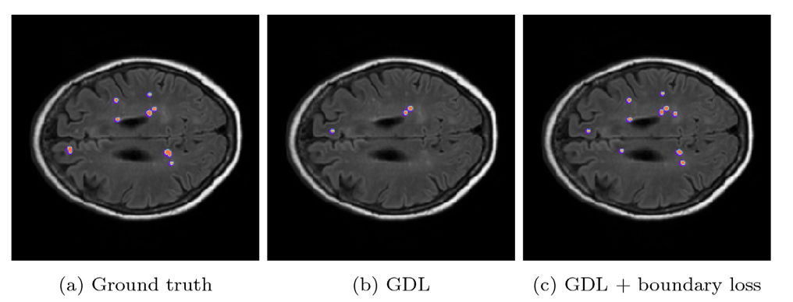
Qualitative Results
Proposed boundary loss helped to recover small regions that were otherwise missed by the model trained with the generalized Dice loss (GDL).

Slide 23
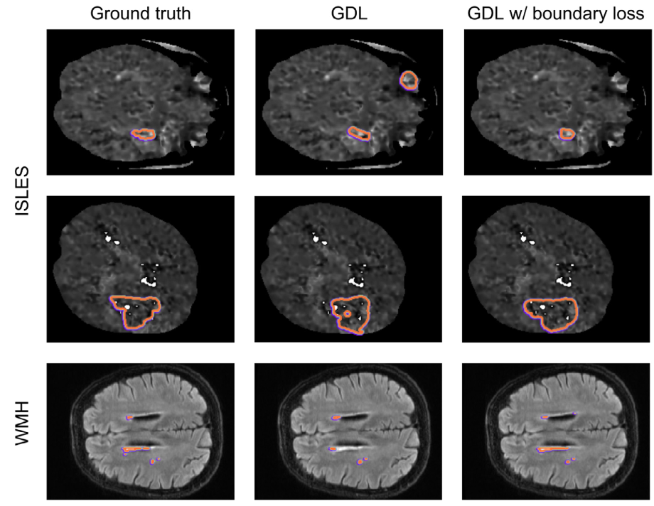
Qualitative Results

Slide 24
Selection of ⍺ - Results
Strategy |  | ISLES
 | DSC | HD95
GDL only |  | 0.511 (0.0160 | 5.320 (1.742)
Constant ⍺ | ⍺ = 0.001 | 0.545 (0.020) | 4.778 (1.546)
 | ⍺ = 0.01 | 0.566 (0.019) | 5.052 (1.395)
 | ⍺ = 0.05 | 0.606 (0.015) | 5.326 (1.712)
 | ⍺ = 0.1 | 0.605 (0.010) | 5.762 (1.782)
 | ⍺ = 0.5 | 0.604 (0.006) | 9.234 (10.463)
 | ⍺ = 1 | 0.628 (0.023) | 2.462 (0.706)
 | ⍺ = 1.5 | 0.565 (0.074) | 3.335 (1.164)
 | ⍺ = 2 | 0.549 (0.084) | 20.275 (16.603)
Increase ⍺ |  | 0.622 (0.004) | 4.952 (1.773)
Rebalance ⍺ |  | 0.644 (0.026) | 4.795 (3.712)
Notes:
While proposed boundary loss can benefit from a tuned balance between the two losses, even a sub-optimal α can already provide improvement over the regional loss alone.

Slide 25
Results
While proposed boundary loss can benefit from a tuned balance between the two losses, even a sub-optimal α can already provide improvement over the regional loss alone.
Using any of the two proposed scheduling strategies (increasing α or re-balancing) yields better results than any constant α.

Slide 26
Selection of ⍺ - Learning Rate Curves
Notes:
The GDL alone and the GDL with a small constant α = 0.001 have a similar training DSC over time, but that their validation DSC are significantly different.
A similar behaviour can be observed by examining the results with constant α = 1 and the rebalanced α

Slide 27
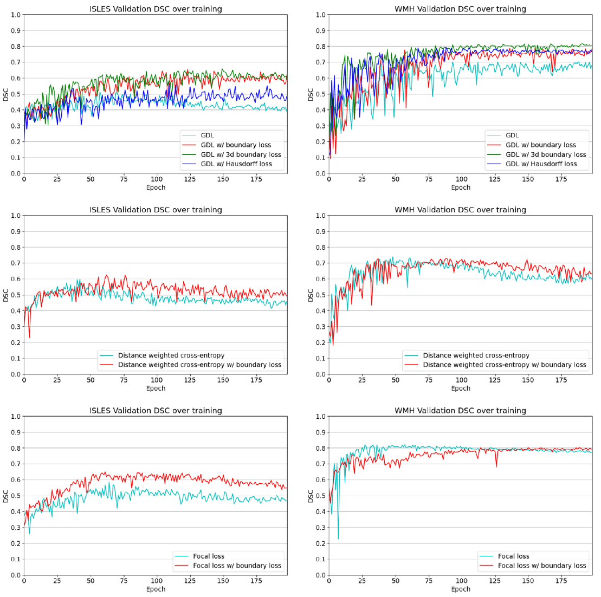
Selection of ⍺ - Learning Rate Curves

Slide 28
Advantages
Ran experiments on a benchmark dataset so should be directly comparable to other loss functions
Code is publicly available
Methodology should be easily transferable to mammography images for testing

Slide 29
Disadvantages
No test test
Not mentioned whether the dataset was split randomly
Equations were not properly explained
Hard to understand tables

Slide 30
Technical Specifications
Pytorch
NVIDIA GTX 1080 Ti

Slide 31
Thank You!

