Slide 1
A deep learning model using data augmentation for detection of architectural distortion in whole and patches of images
Brian Szekely and Gaurav Srikar

Slide 2
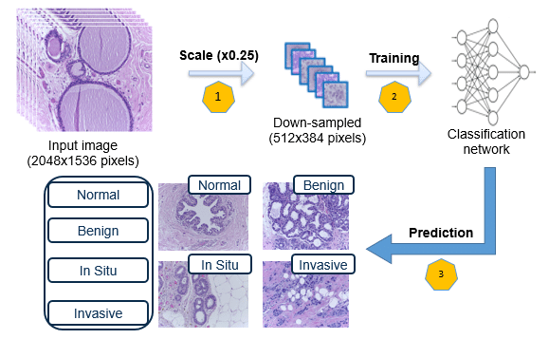
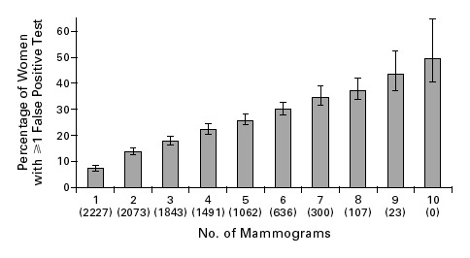
Introduction
Challenges in Deep Learning for Breast Cancer:
Limited data leading to high false positive rates.
Low contrast in mammogram datasets.
Objectives:
Investigation into the performance of CNN models with variable-sized images.
Apply data augmentation to reduce false positive classifications.
Design of a novel CNN-based model for architectural distortion detection.

Slide 3
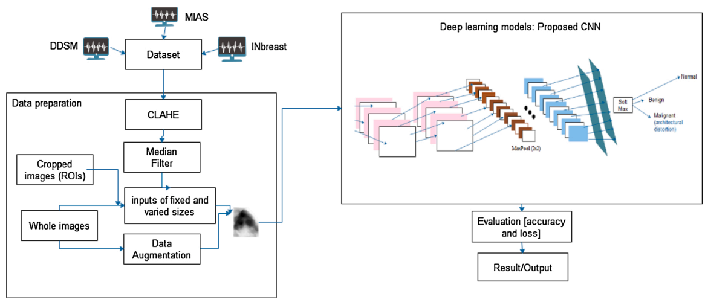
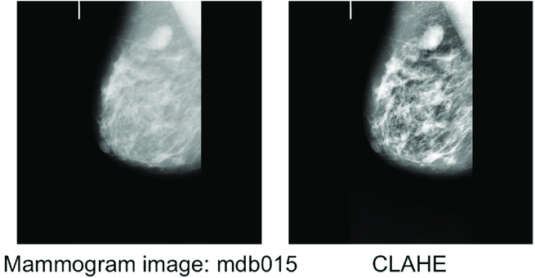
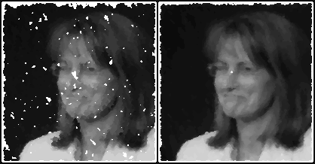
Proposed CADx System
Notes:
MIAS -> 322 (MLO view of images) 1024 × 1024 with radiologist’s ground truth markings
DDSM - > 10,480 (MLO and CC view of images)
INbreast -> 410 Images 3328 × 4048 or 2560 × 3328 pixels.
MIAS and DDSM -> cropped images into 299x299 pix ROIs
multi-sized images (LOVE HOW THEY SAY “Result was not encouraging’)
1024 × 1024 pixels for MIAS
2560 × 3328 pixels for INbreast

Slide 4
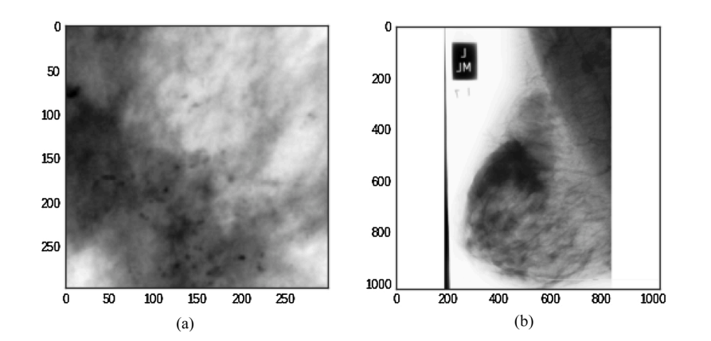
Proposed CADx System

Slide 5
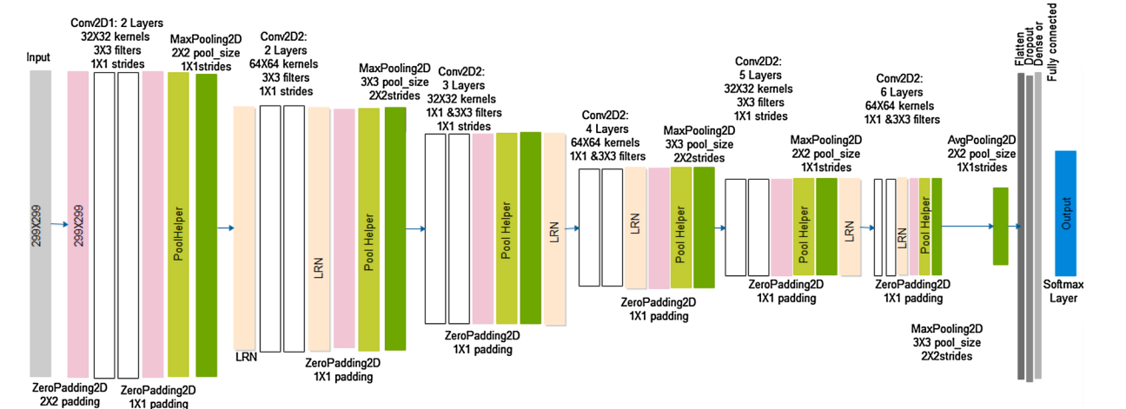
Architecture
24 classes
Notes:
Model has 9,438,208 parameters (Double the number of parameters of GoogleNet)
12 convolutional layers alongside pooling and fully connected layers
concept of Conv-Conv-Pool-Drop architecture.
Adam optimizer
learning rate was 0.001
Regularization Technique: L2 (Weight Decay)
Applied L2 regularization, commonly known as "weight decay."
Aimed at reducing overfitting in the model.
L2 Values:
L2 values range between 0 and 0.1.
Examples include 0.1, 0.001, 0.0001.
Values are in a logarithmic scale.

Slide 6
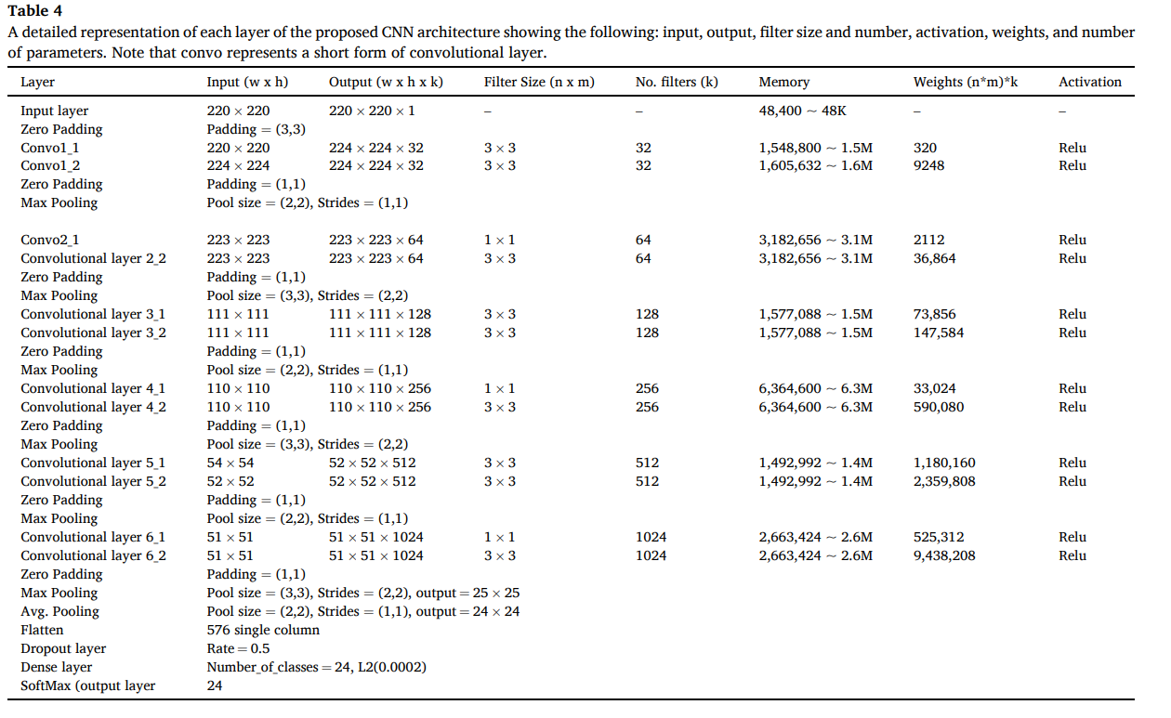
Detailed Architecture
Complexity - evaluated to be O(n)
Using this architecture in our project

Slide 7
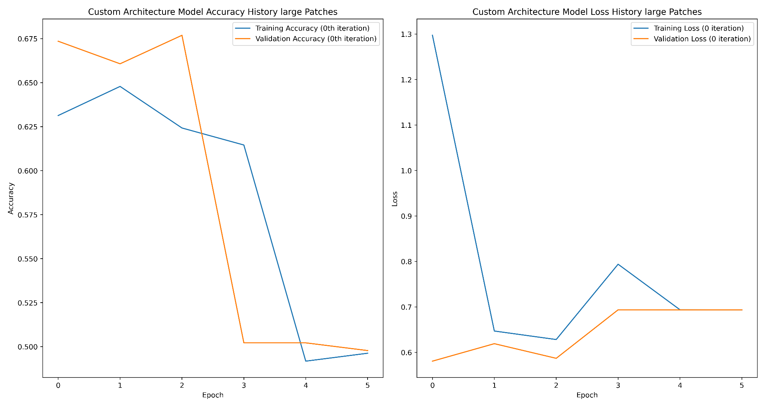
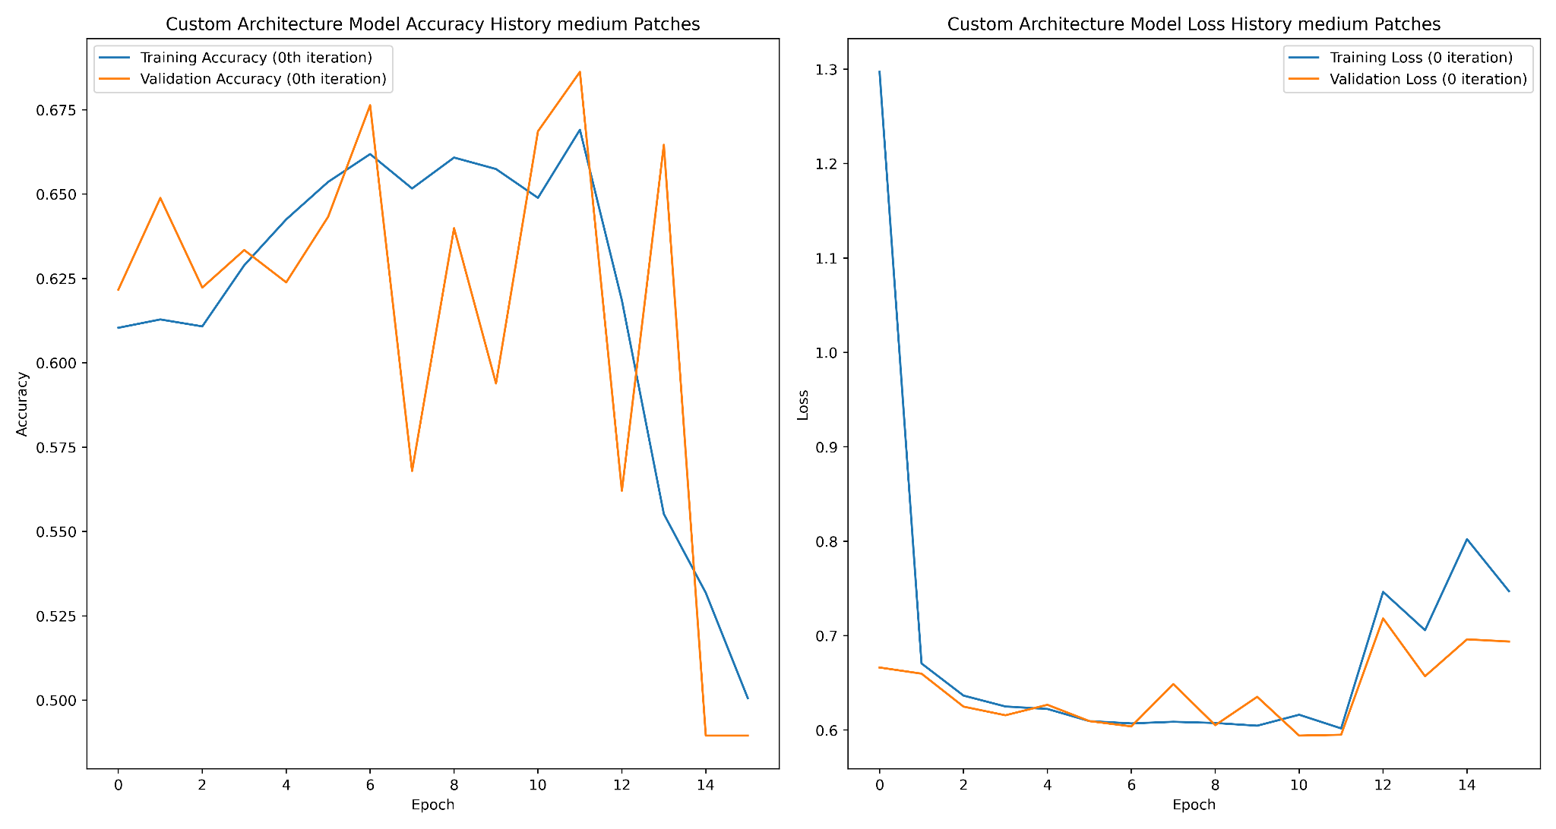
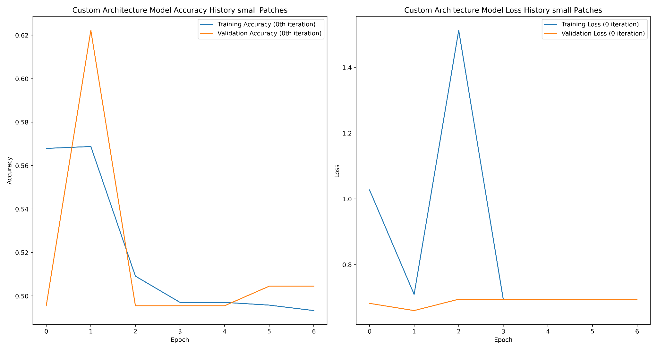
Our implementation
Large patches 522 x 522
Medium patches 344 x 344
Small patches 222 x 222

Slide 8
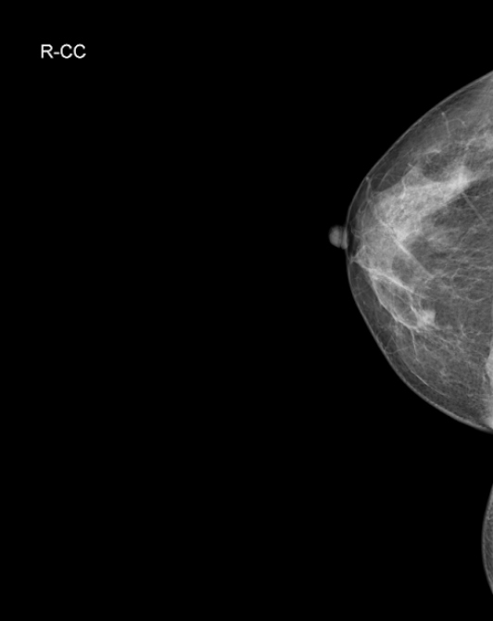
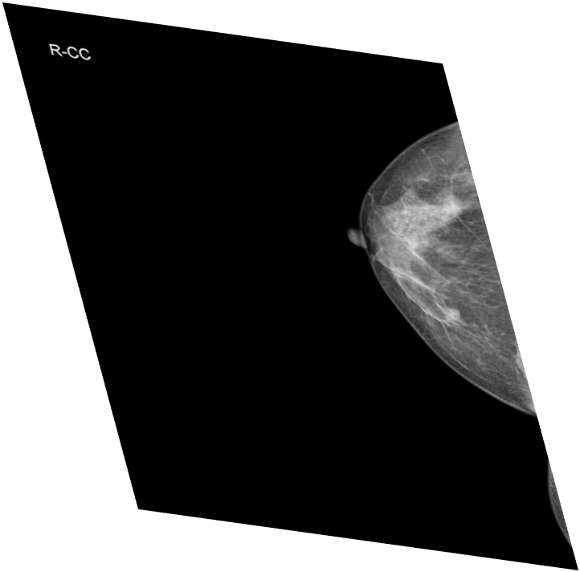
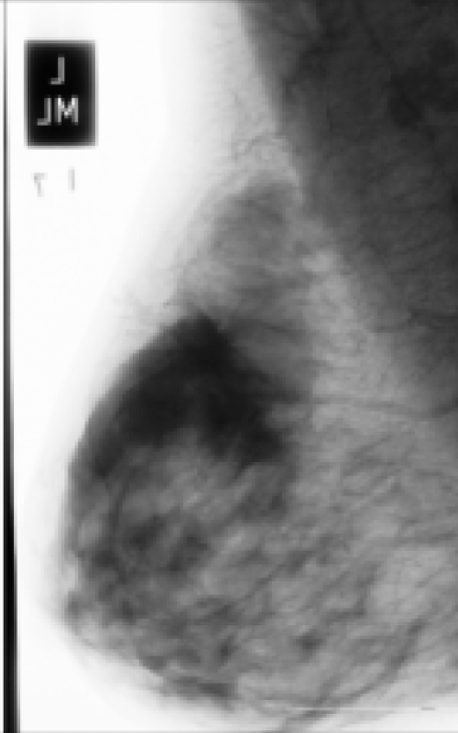
Data Augmentation
Original
Horizontal Flip
Vertical Flip
Rotation 90°
Rotation 180°
Rotation 270°
Width Shift
Height Swift
Shearing
Zoom In
Zoom Out
ZCA Whitening

Slide 9
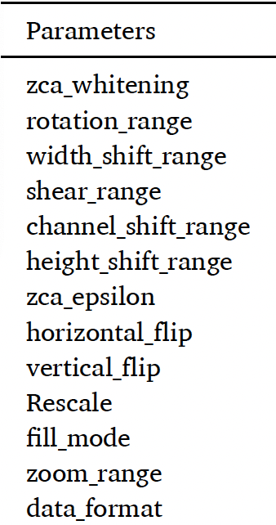
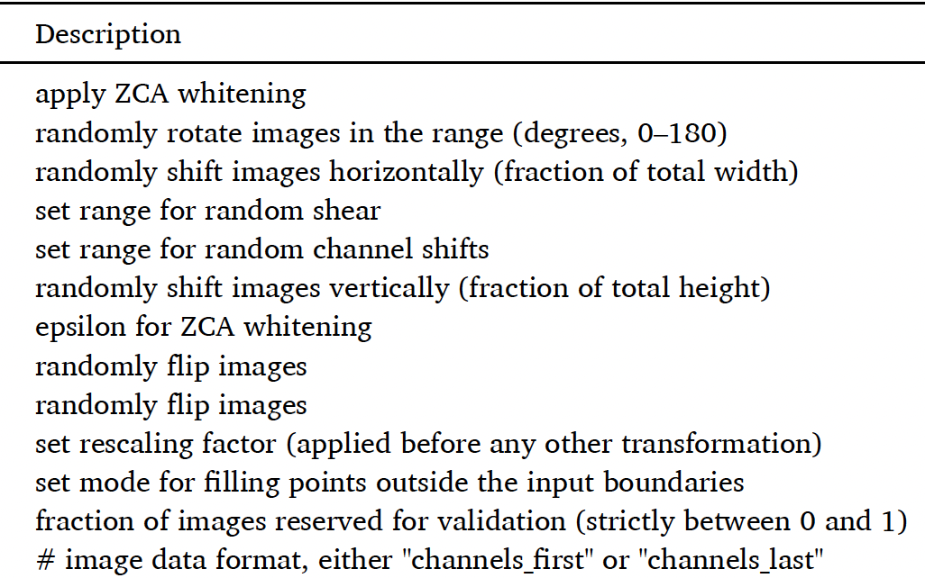
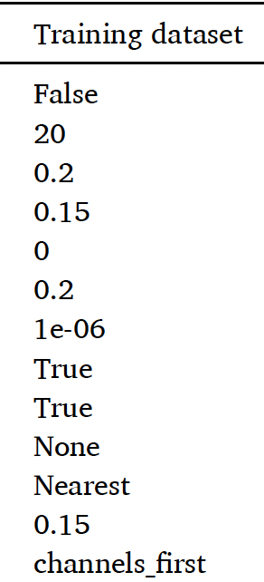
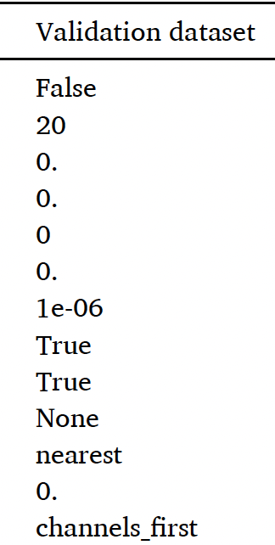
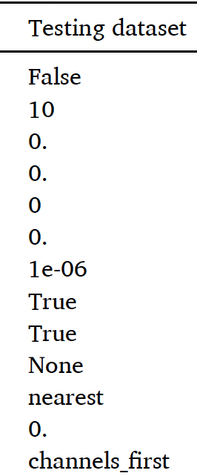
Data Augmentation Parameters and Output

Slide 10
Experiment
Patch / ROI level
MIAS Dataset (299 X 299)
No data augmentation
All data augmentation
Combinations
Vertical flip, horizontal flip, rotation at 90 degrees, and width shift range of 50 %.
Vertical flip, rotation at 180 degrees, height shift range of 50 %, width shift range, the zoom range of 50 %, and applied ZCA whitening.
Horizontal flip, rotation at 270 degrees, both width and height shift range of 50 %, and applied ZCA whitening.
DDMS + CBIS Dataset (299 X 299)
No data augmentation
All data augmentation
Combinations
Vertical and horizontal flip, zoom range of 50 % and rotations at 180 degrees.
Whole image level
MIAS whole image dataset (1024 X 1024)
INbreast whole image dataset (2560 X 3328)

Slide 11
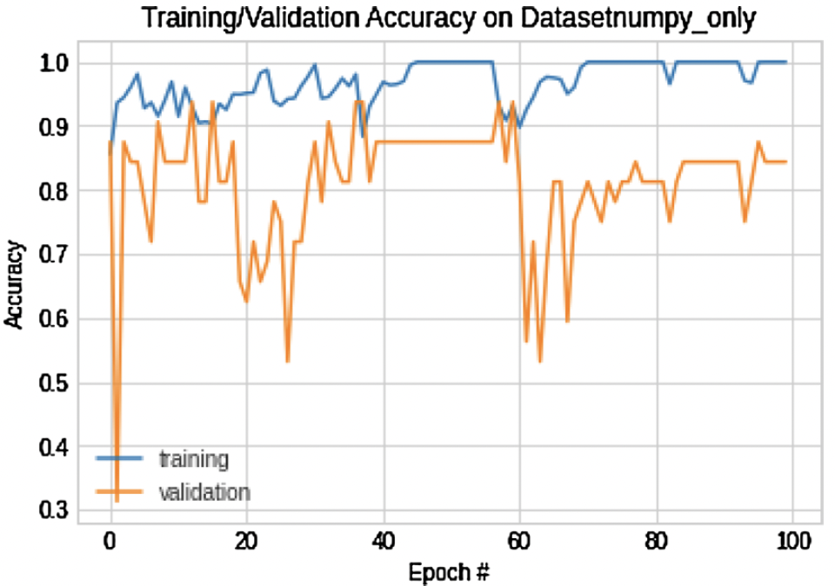
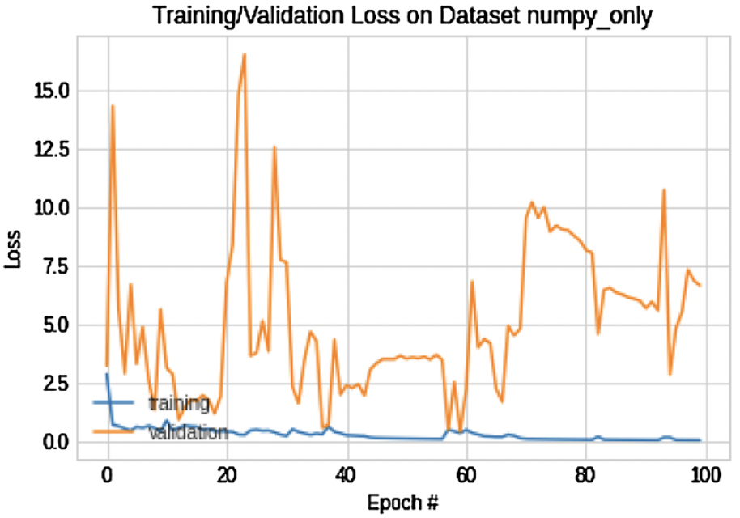
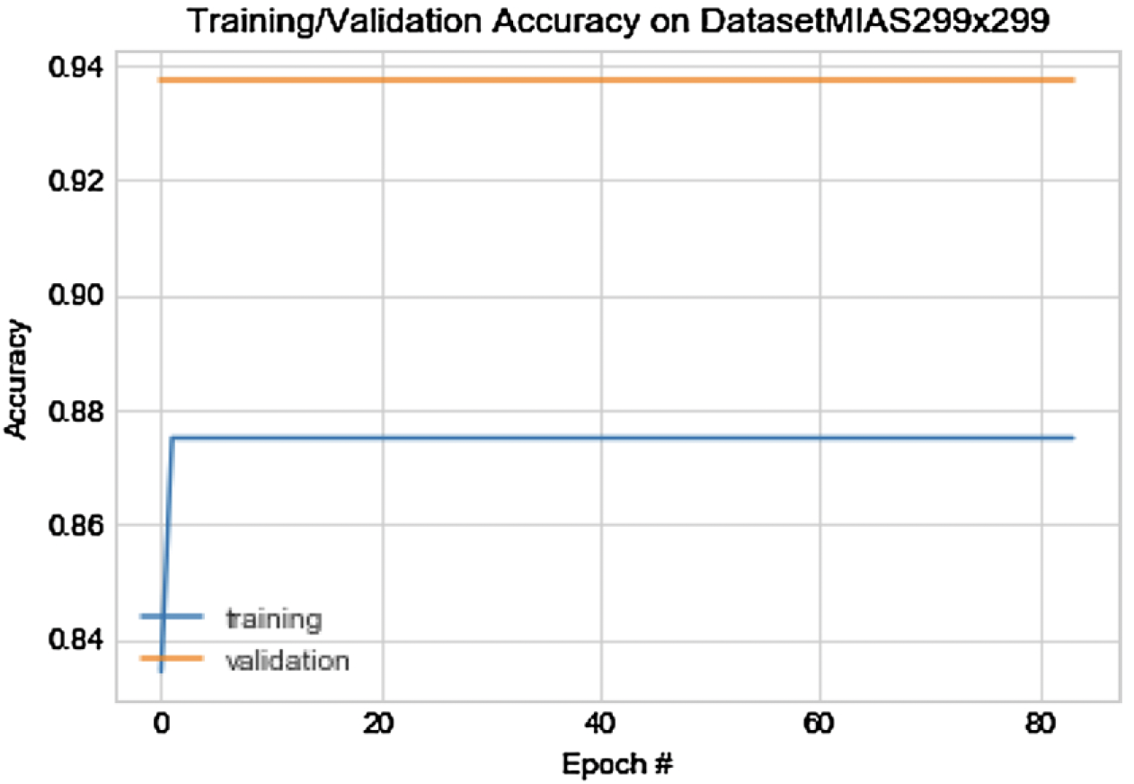
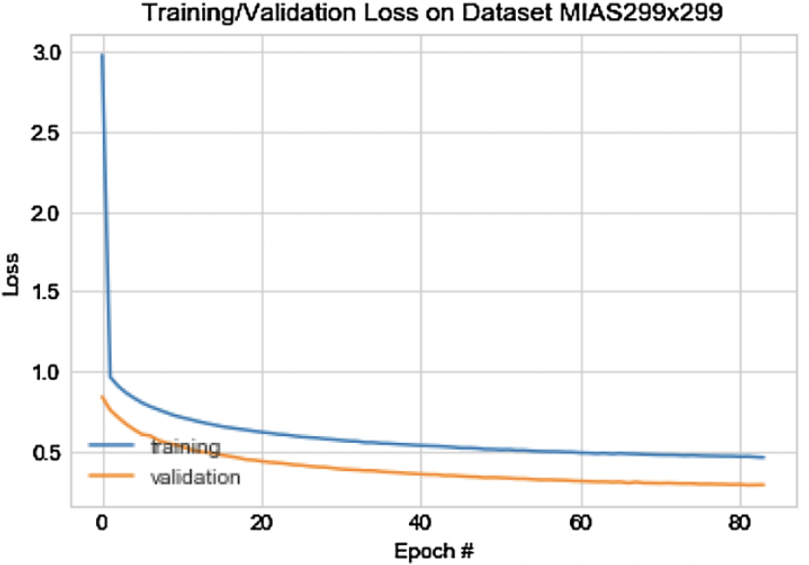
Results and Discussion
Fig. 4. MIAS Dataset without any data augmentation
Fig. 5. MIAS Dataset with all data augmentation techniques

Slide 12
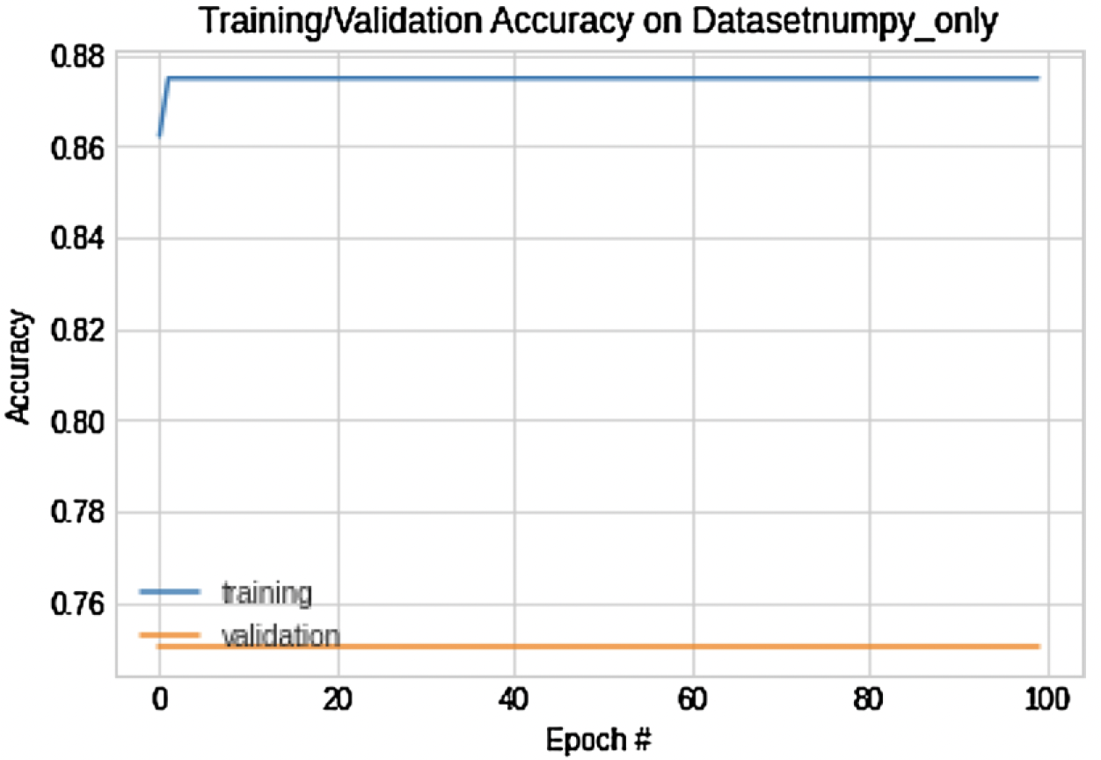
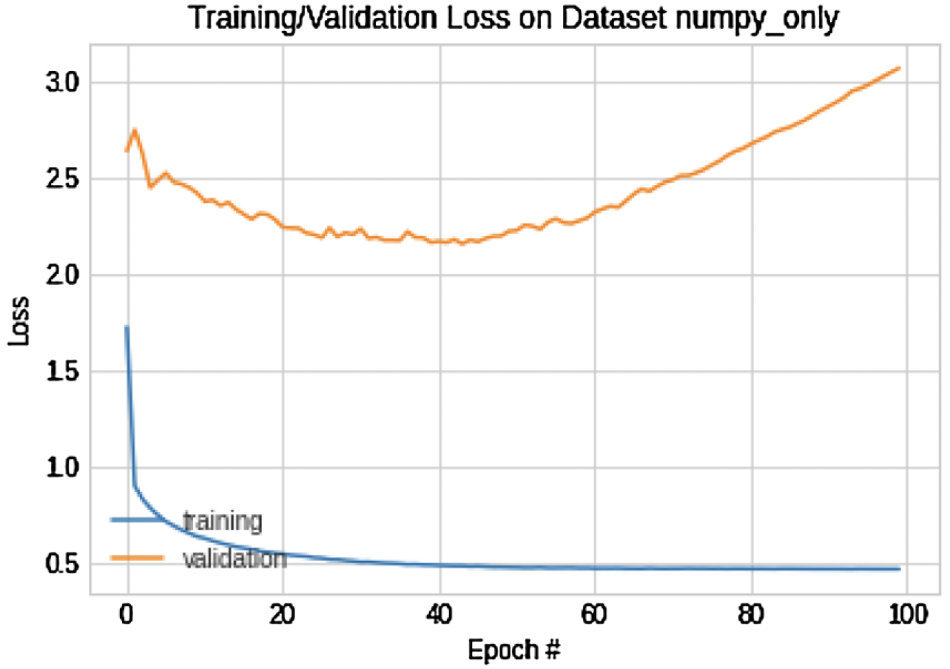
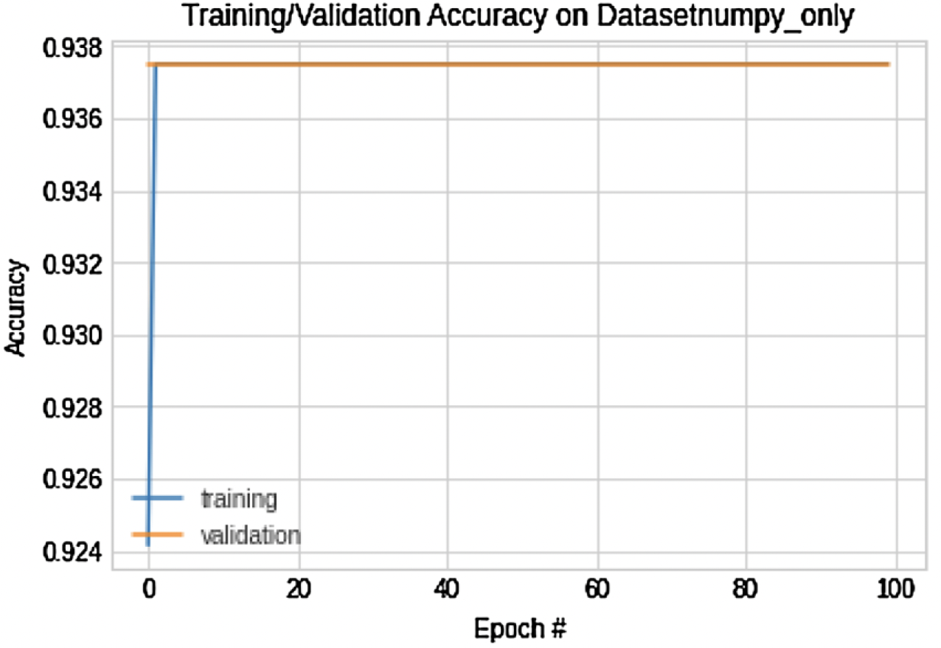
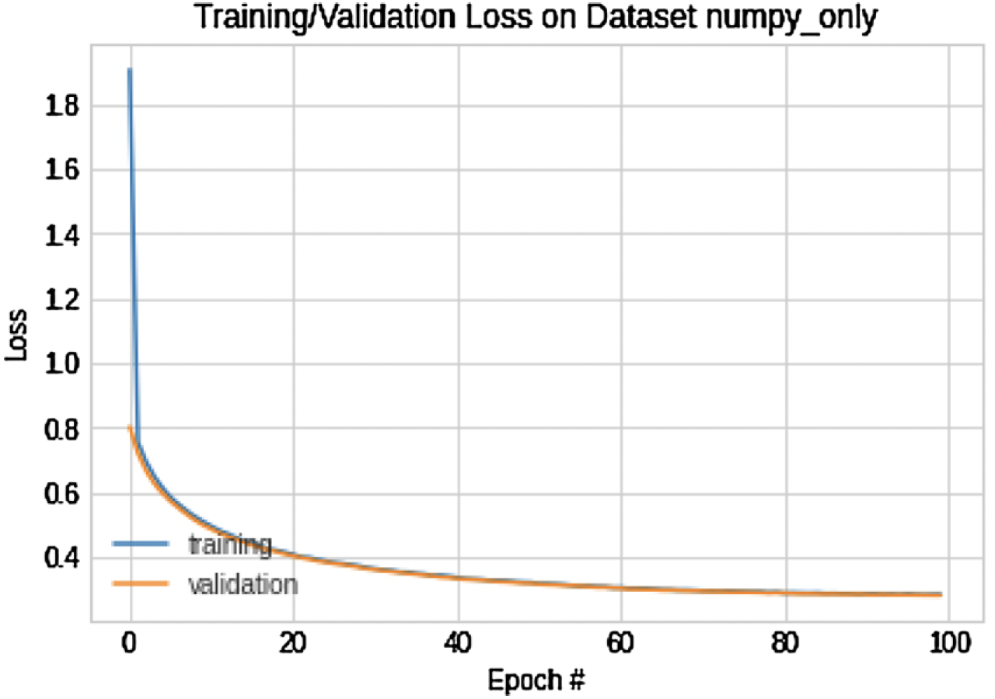
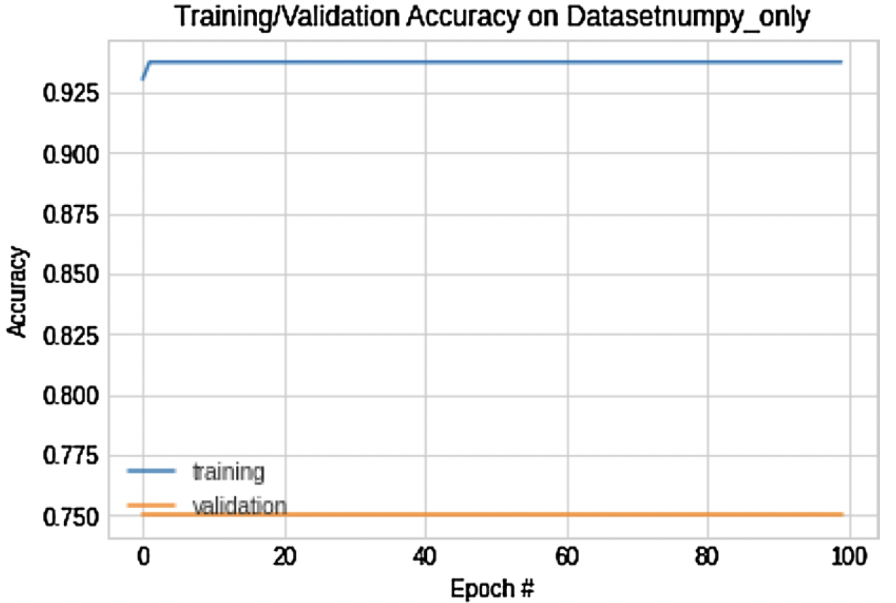
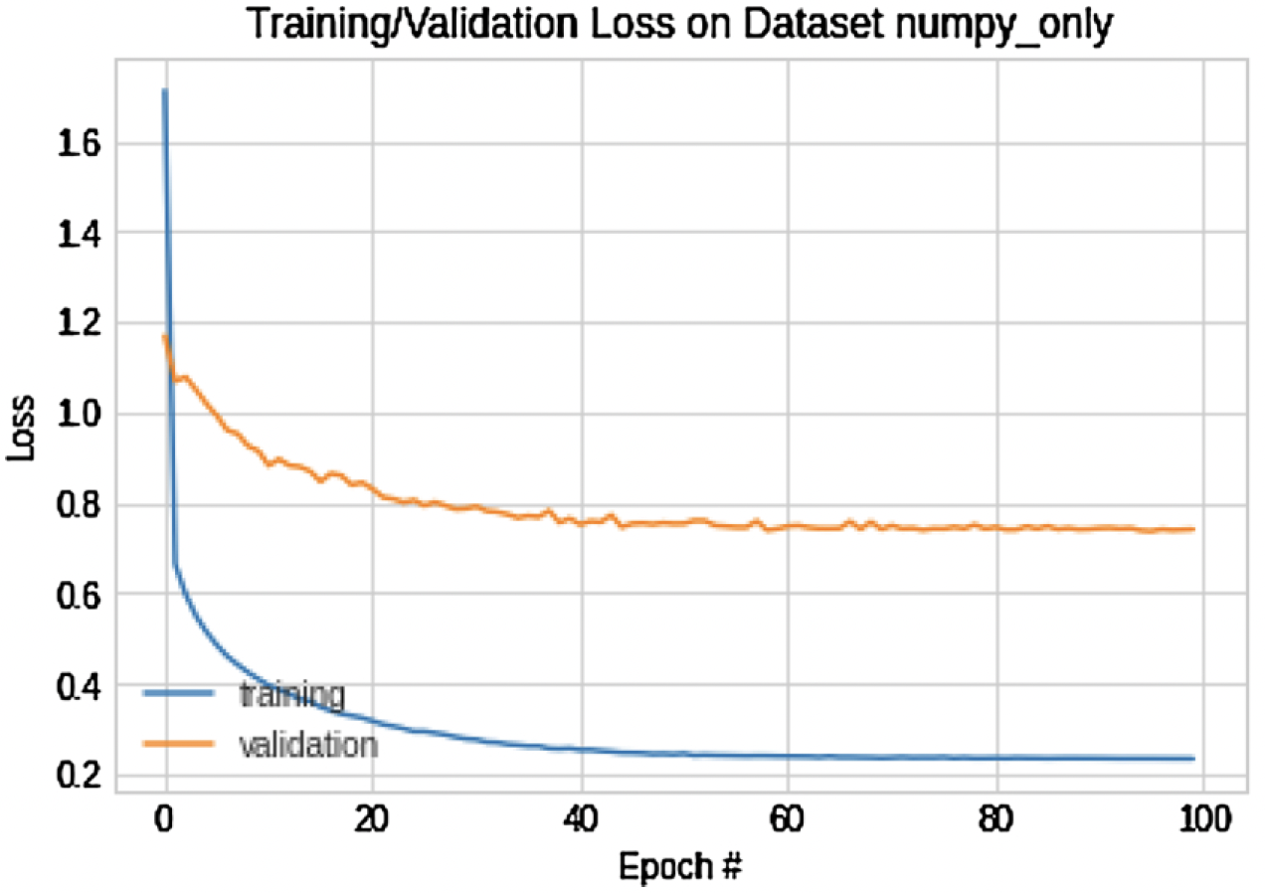
Results and Discussion
Fig. 6. MIAS Dataset with data augmentation described in (i)
Fig. 7. MIAS Dataset with data augmentation described in (ii)
Fig. 8. MIAS Dataset with data augmentation described in (iii)

Slide 13
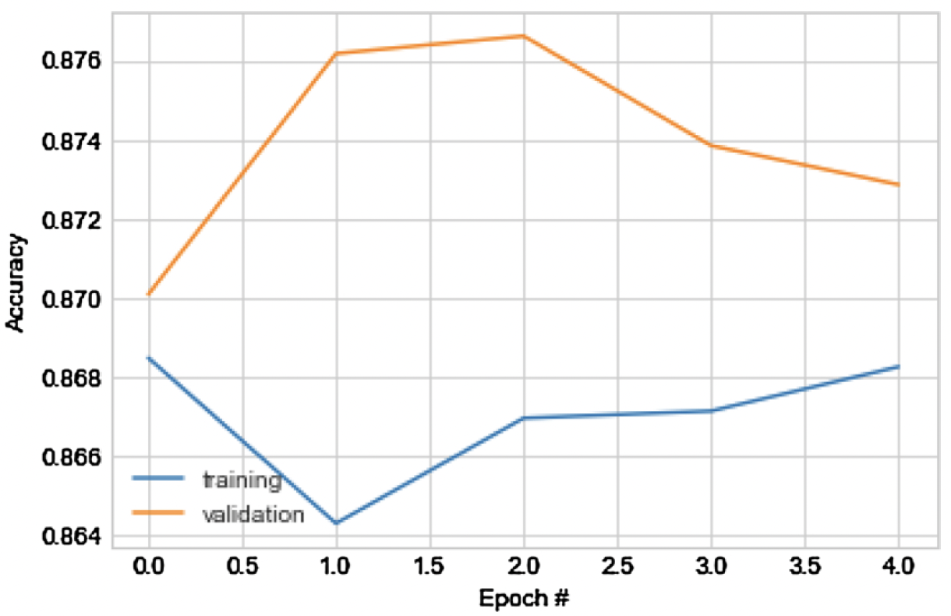
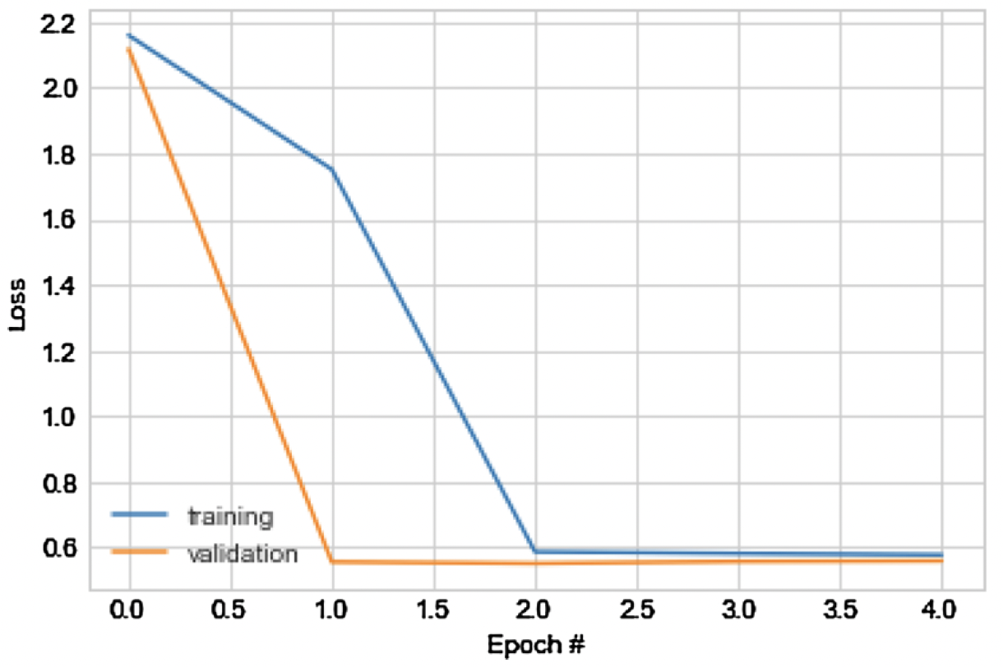
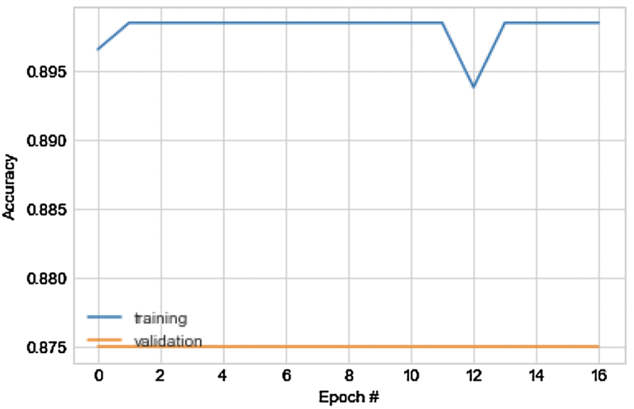
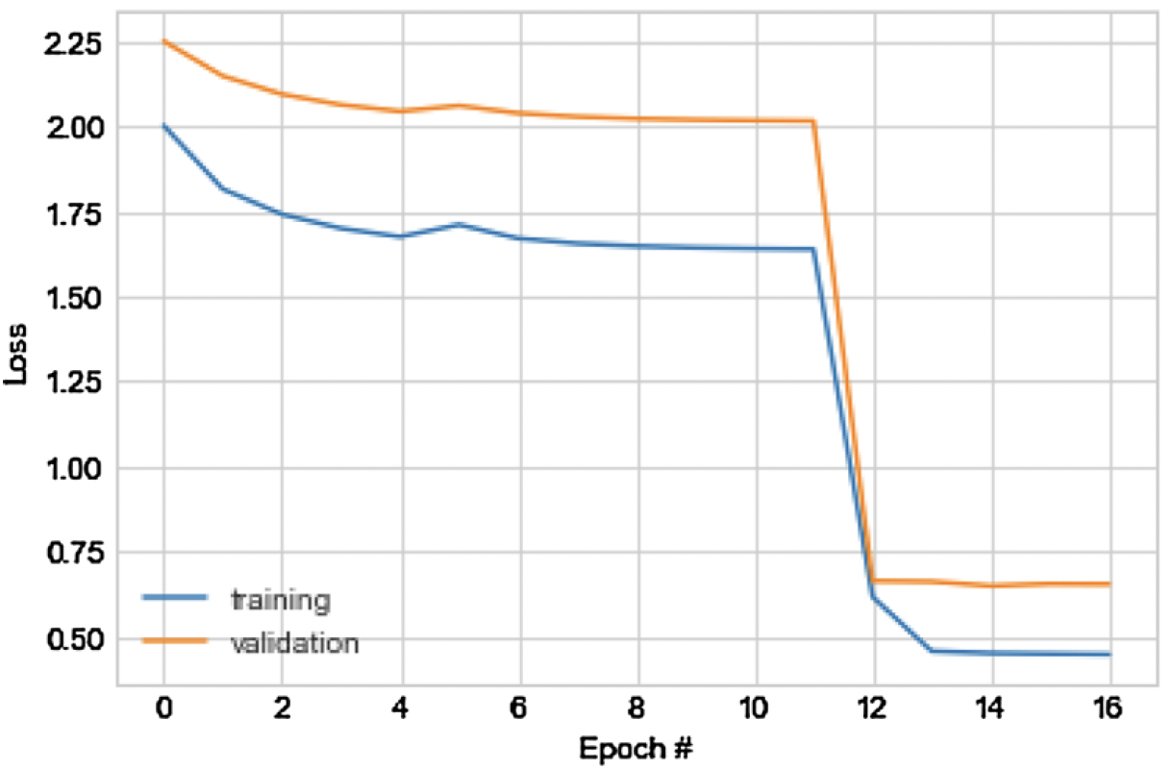
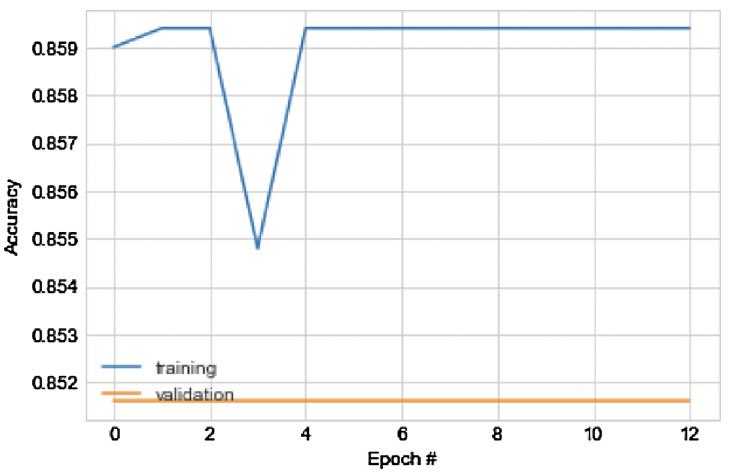
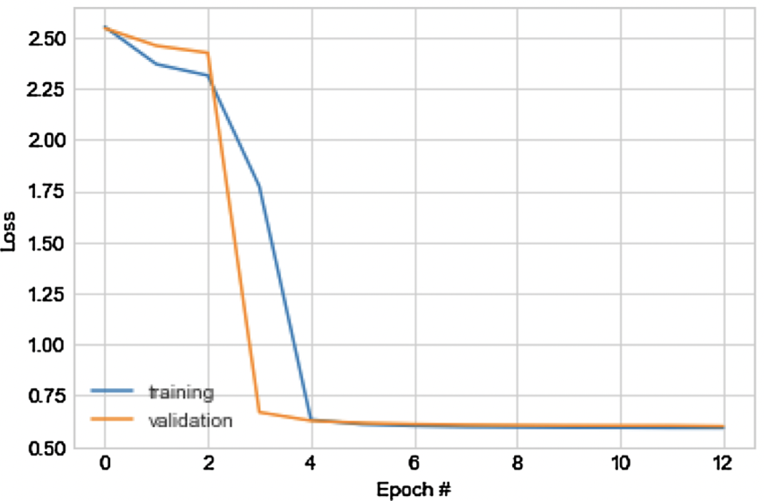
Results and Discussion
Fig. 9. DDSM + CBIS Dataset without any data augmentation
Fig. 10. DDSM + CBIS Dataset with all data augmentation techniques
Fig. 11. DDSM + CBIS Dataset with data augmentation described in (i)

Slide 14
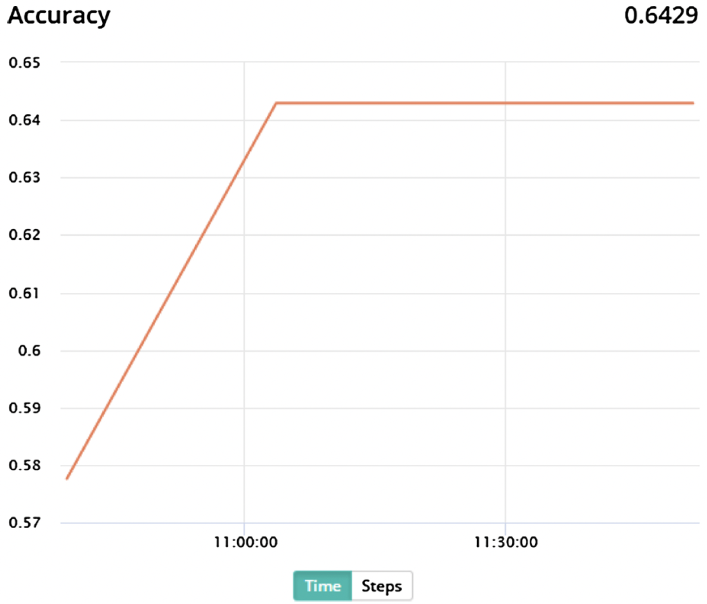
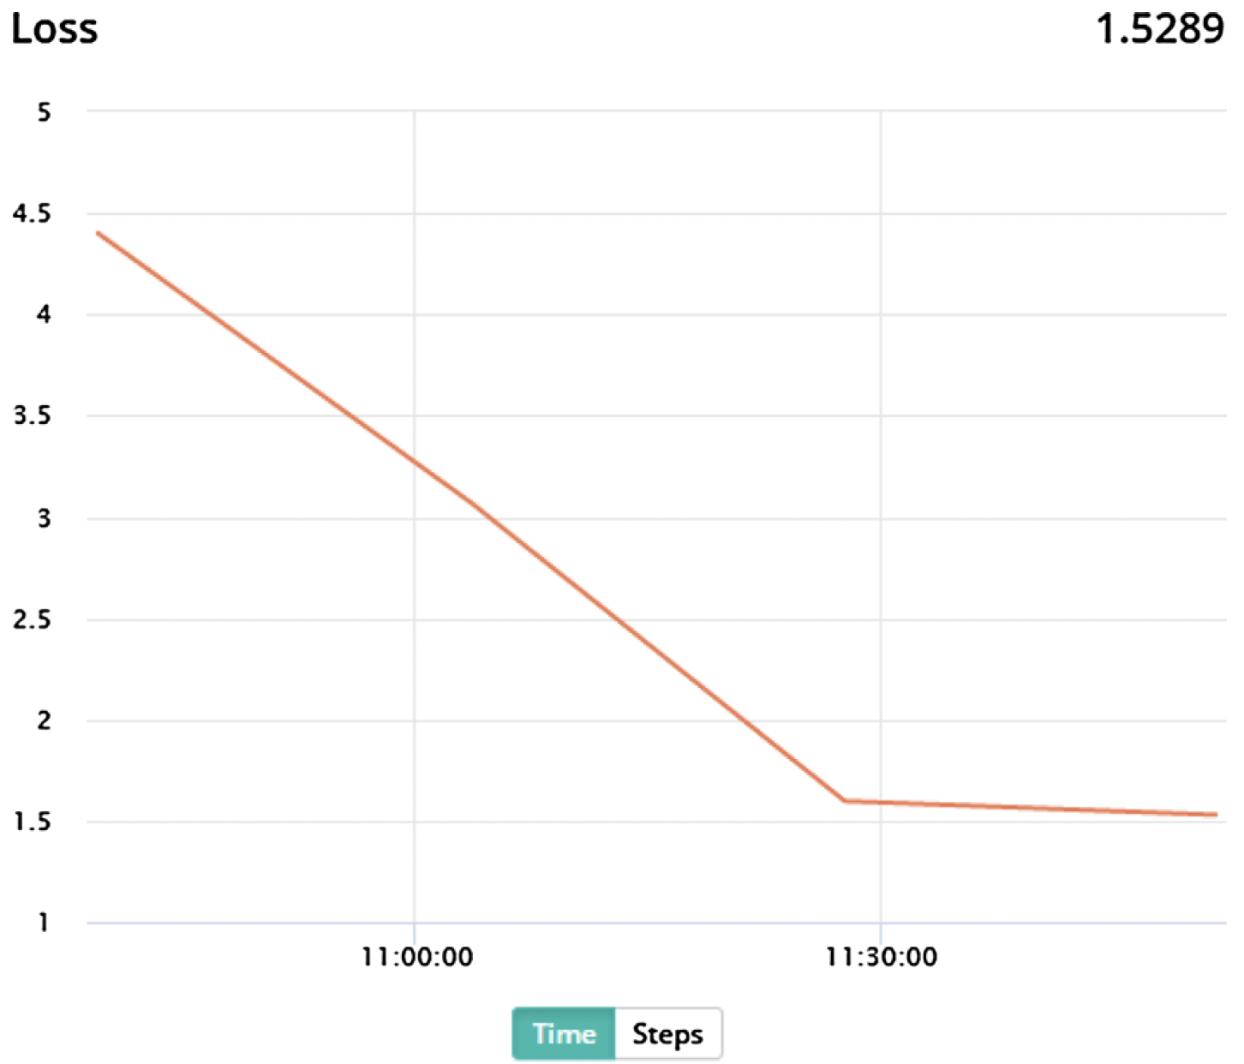
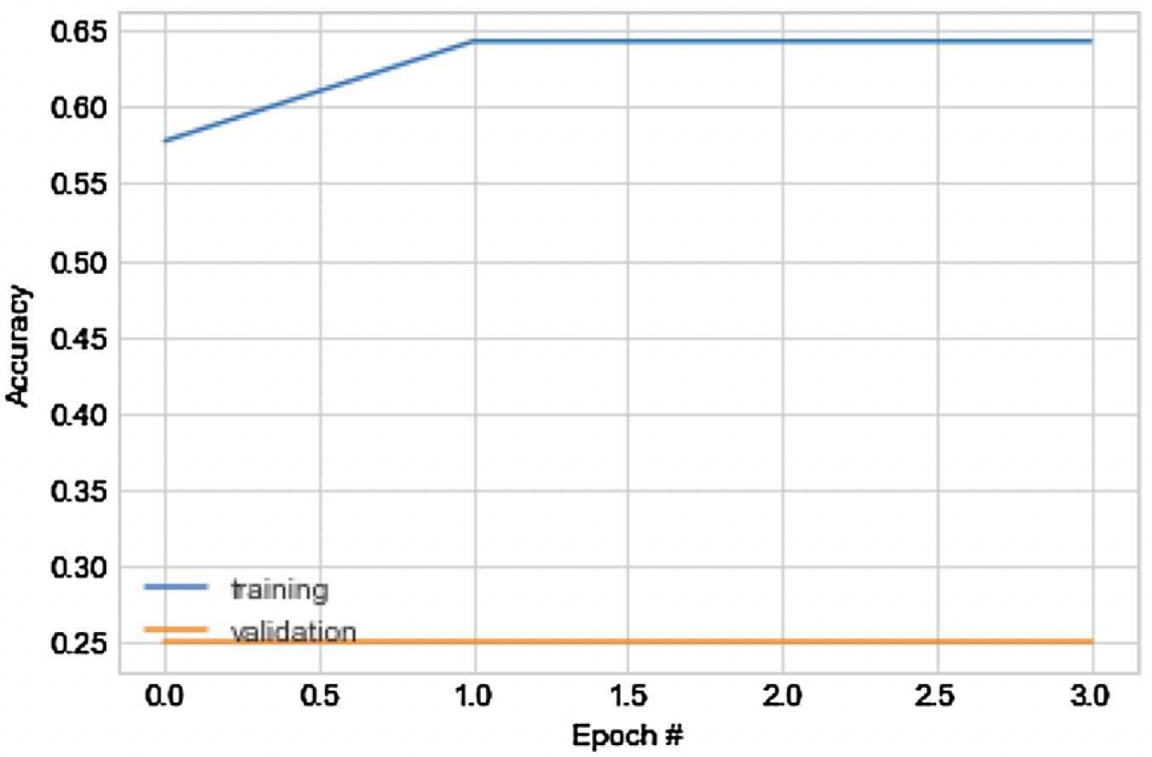
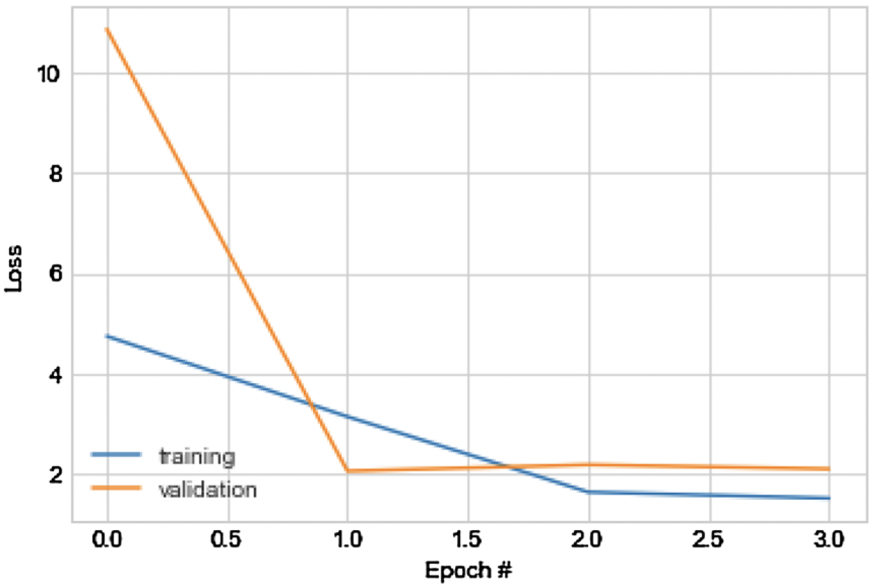
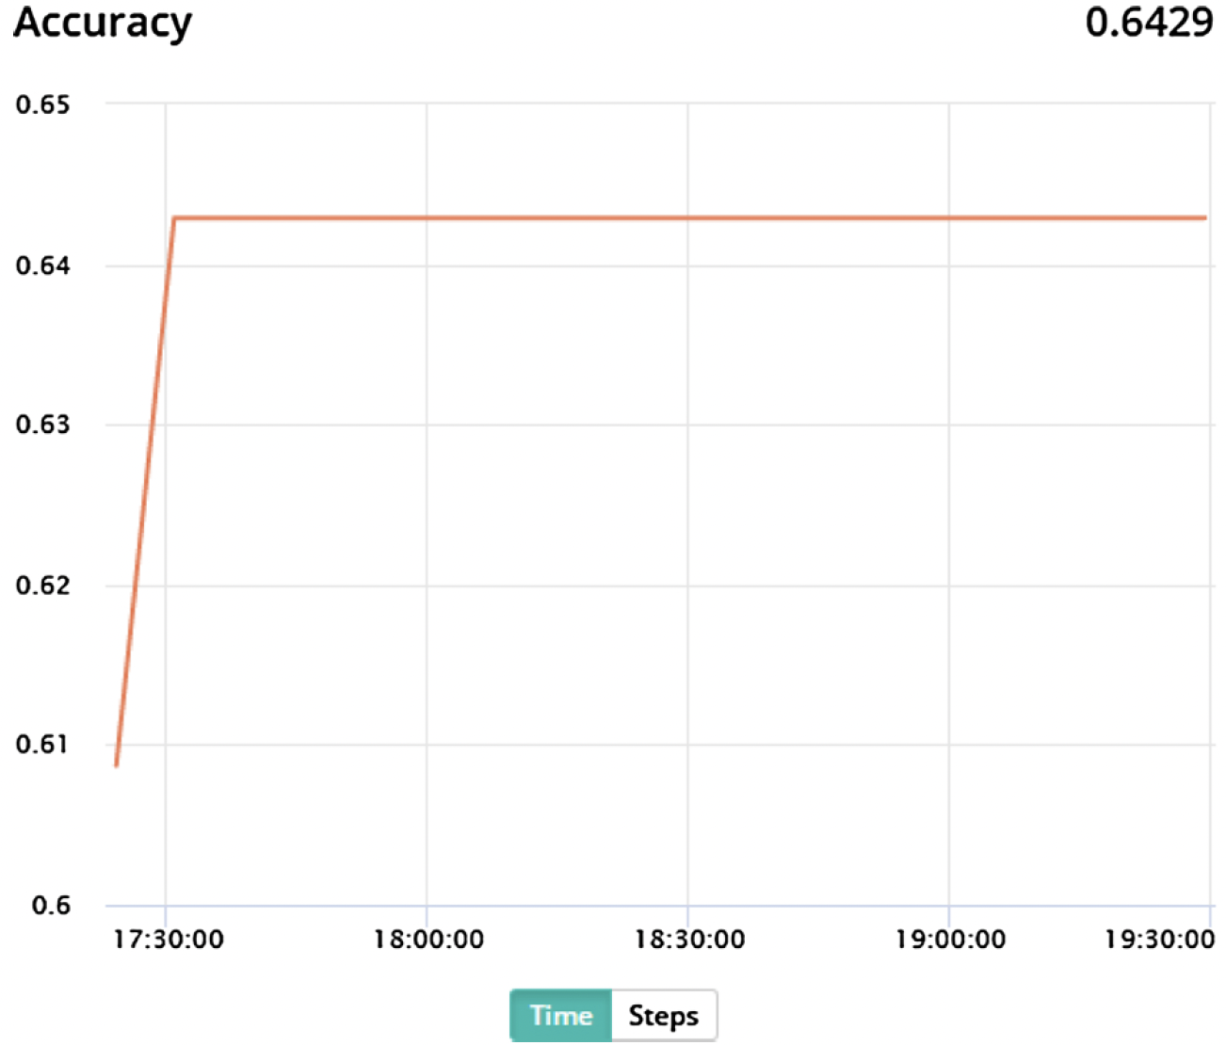
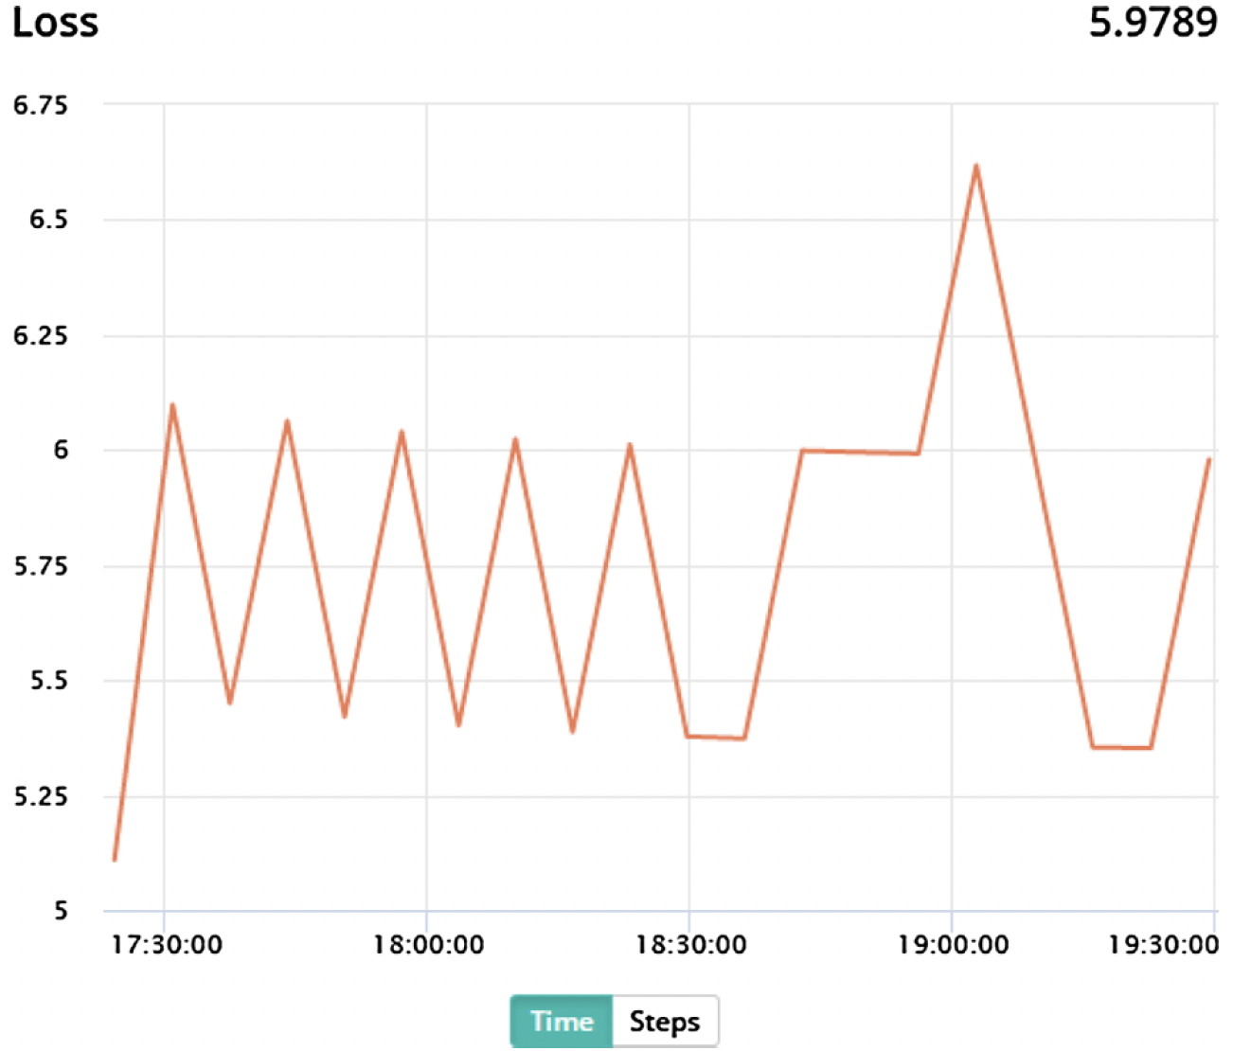
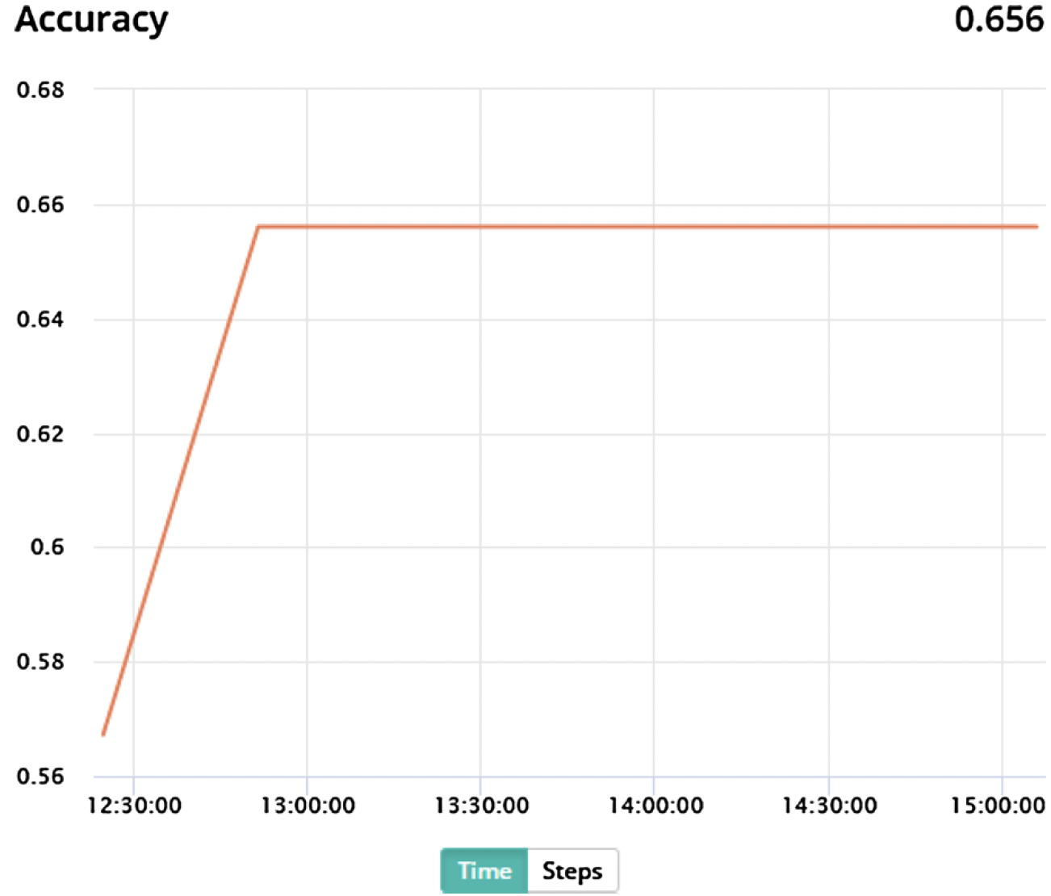
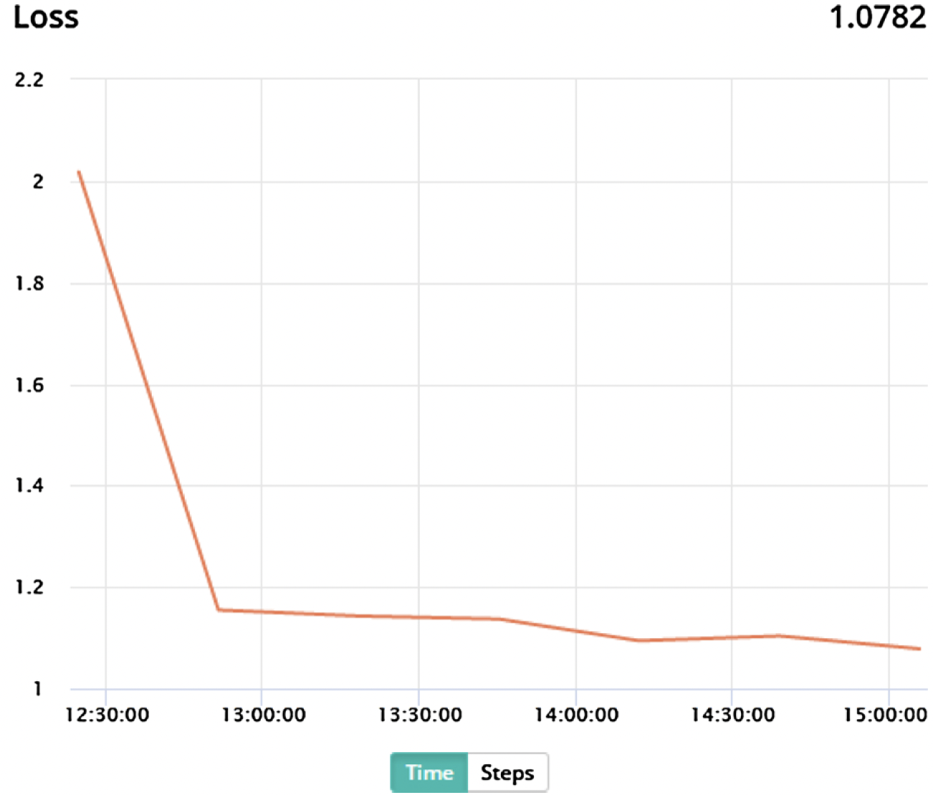
Results and Discussion
Fig. 12. MIAS whole image dataset (1024 × 1024) dataset with data augmentation.
Fig. 13. INbreast whole image dataset (2560 × 3328) dataset with data augmentation.
Fig. 14. MIAS whole image dataset (1024 × 1024) using a CNN model with higher depth.
Fig. 15. INbreast whole image dataset (2560 × 3328) using a CNN model with higher depth.

Slide 15
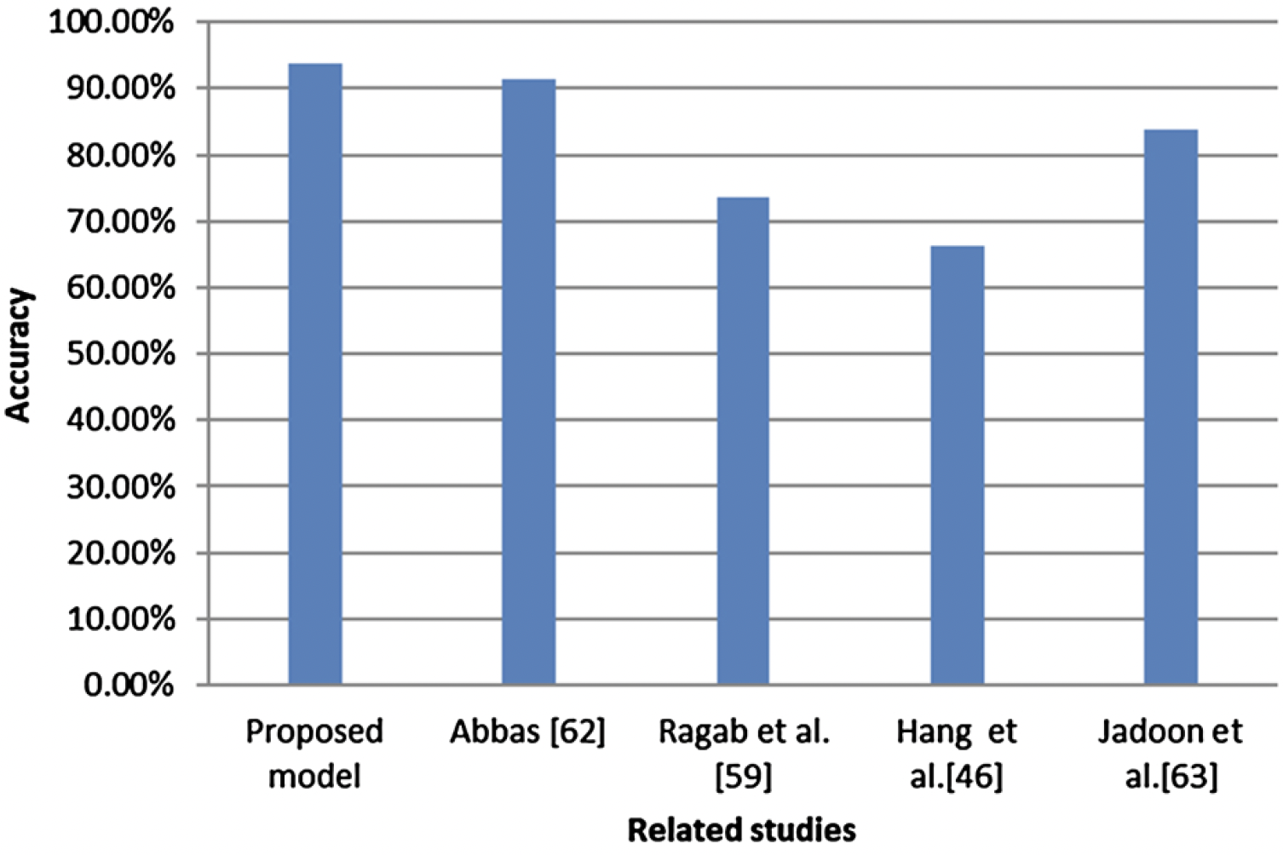
Results, Discussion and Conclusion
Proposed architectural distortion-based CNN with data augmentation.
Model Description | Dataset | Accuracy
Proposed CNN model | MIAS 299X299 dataset | 84.30 %
 | DDSM + CBIS dataset | 87.38 %
Proposed CNN model + data augmentation | MIAS 299X299 dataset | 93.75 %
 | DDSM + CBIS dataset | 89.50 %
 | INbreast dataset 2560X3328 | 64.29 %
 | MIAS 1024X1024 | 64.29 %
Comparative analysis of the proposed architectural distortion CNN with popular CNN architectures.
CNN | # Weights | Batch Size | Learning Rate (FT, SC) | Best Model Iterations (Fine Tuning, from scratch) | Accuracy
Proposed CNN model | 668,837 | 32 | 0.001 | 8, 20 | 87.29 %
GoogLeNet | 10,299,840 | 32 | 10⁻⁵, 10⁻⁵ | 12, 12 | 59.80 %
AlexNet | 56,866,848 | 32 | 10⁻⁵, 10⁻⁵ | 665 | 65.60 %
ResNet-50 | 23,512,128 | 32 | 10⁻⁵, 10⁻⁴ | 4104 | 62.70 %
VGG-16 | 134,256,320 | 32 | 10⁻⁵, 10⁻⁵ | 9, 58 | 58.00 %

Slide 16
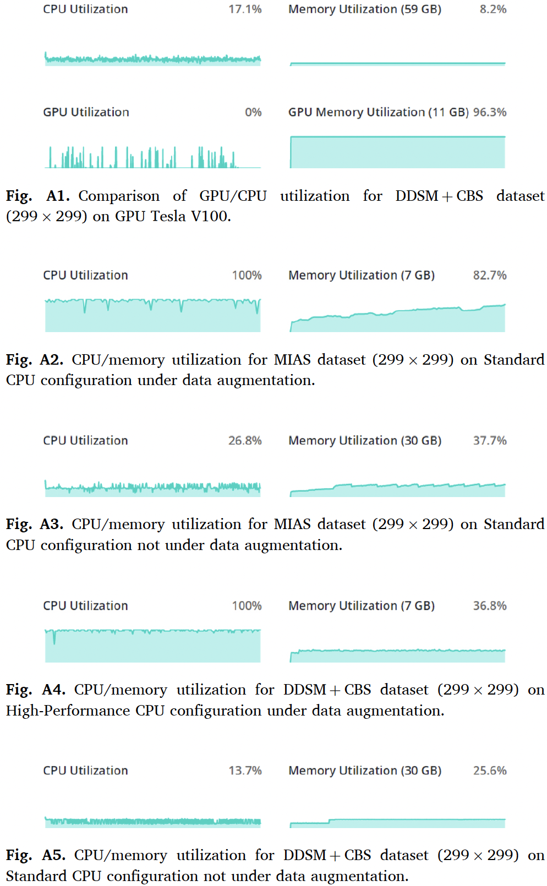
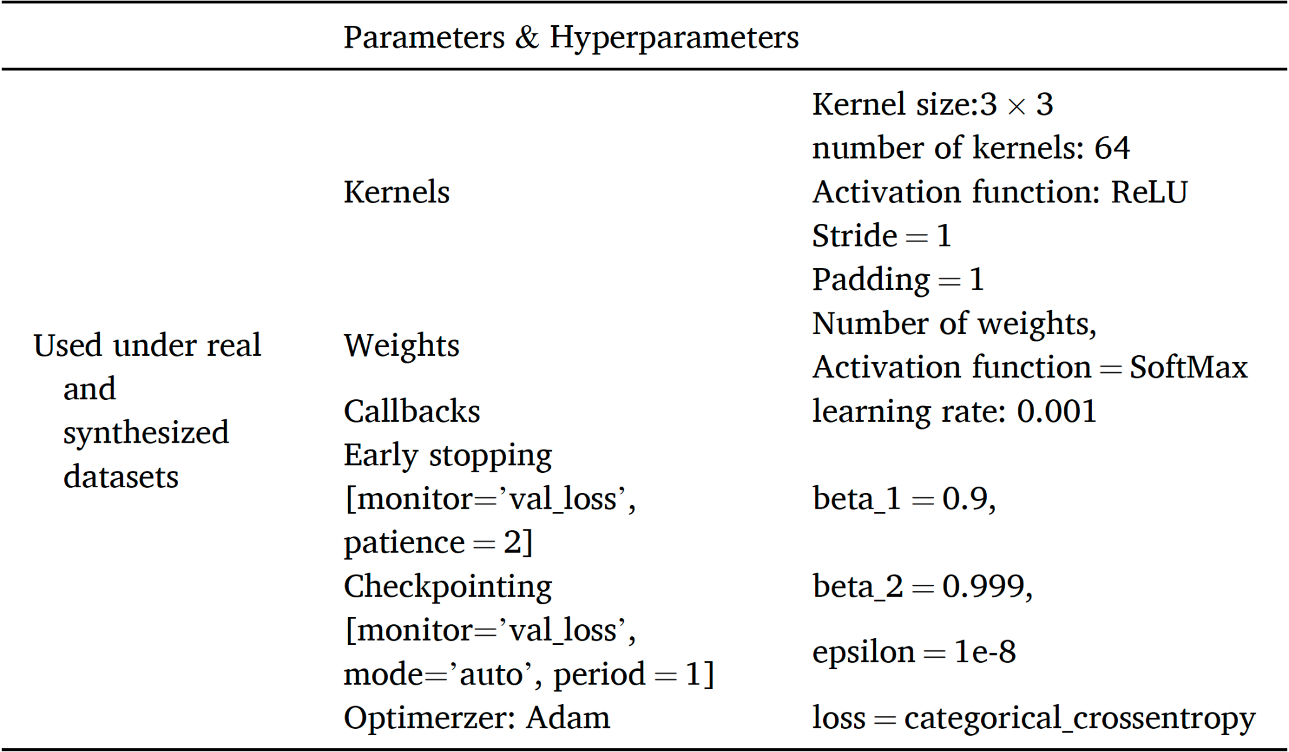
Experimental Setup
Used Keras with Tensorflow
Floyd Server
High Performance GPU
Tesla V100
16 GB Memory
61 GB RAM and 100 GB SSD
Standard GPU
Tesla K80
12 GB Memory
61 GB RAM and 100 GB SSD
CPU only
High Performance CPU
Intel Xeon with 8 Cores
32 GB RAM and 100 GB SSD
Standard CPU
Intel Xeon with 2 Cores
8 GB RAM and 100 GB SSD

Slide 17
Strengths
Proposing a novel CNN-based model which works good with patches.
The various techniques of data augmentation were used with multiple datasets at different scale.
Very brief introduction
This paper presented most details required - Easy to re-implement.
Various comparisons made - Popular CNN architectures and similar approaches.

Slide 18
Weaknesses
The enhancement of the proposed CNN model was not described
Reduction of false positive rates - No proof
Testing data was never used
Hard to interpret architecture and tables
Motivation behind designing their CNN was unclear
No other augmentation combinations with DDMS + CBIS dataset
Last couple of graph’s X-axis units were different
Inconsistency with training iterations

Slide 19
Thank you. Questions?

