Slide 1
An interpretable classifier for high-resolution breast cancer screening images utilizing weakly supervised localization
Presented By
Aminul Huq and Mst Tasnim Pervin

Slide 2
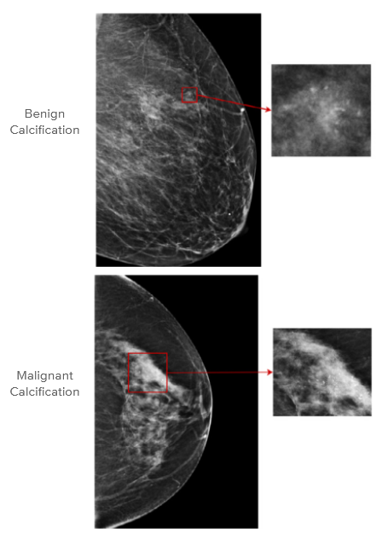
Introduction
regions of interest (ROI) in mammography images, such as masses, asymmetries, and microcalcifications, are often smaller in comparison to the salient objects in natural images.
both the local details, such as lesion shape, and global structure, such as overall breast fibroglandular tissue density and pattern, are essential for accurate diagnosis.

Slide 3
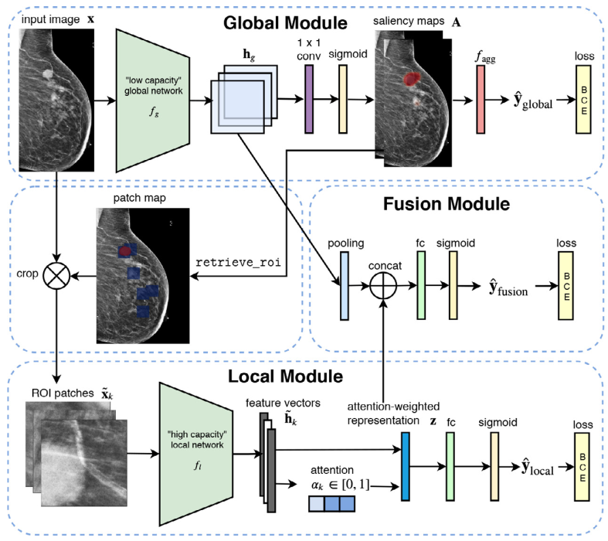
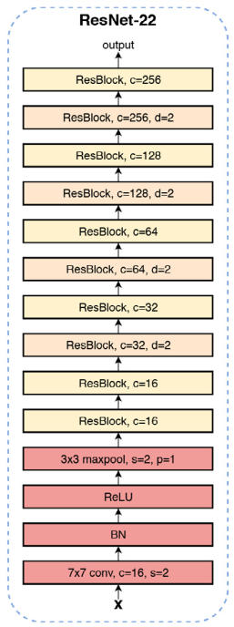
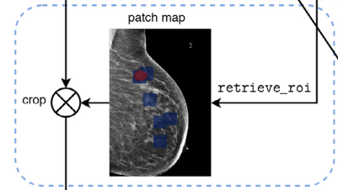

Slide 4
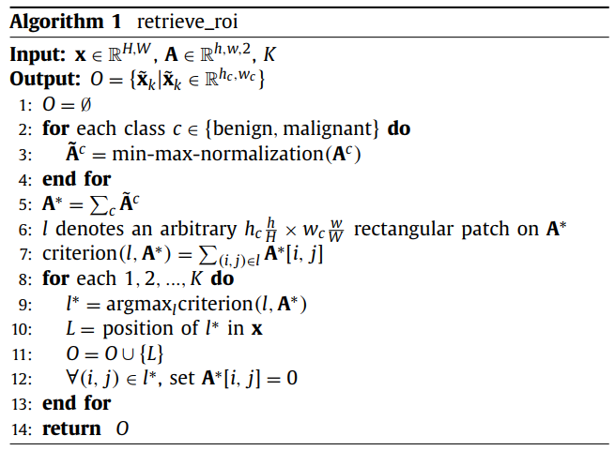
Methodology
ROI retrieval
Top t% pooling
Gated Attention

Slide 5
Dataset
NYU Breast Cancer Screening Dataset
Training, Validation, Testing - 80:10:10
229,426 exams. At Least 4 images from each exam
Malignant 0.21% & Benign 1.22%
2944 x 1920 dimension
Random cropping, resizing and Noise removal (Whole Image Augmentation)
Average prediction over 10 random augmentation for testing.
{0,90,180,270} degree rotation (ROI Image Augmentation)
CBIS-DDSM Dataset
Training & Testing - 85:15
Training & Validation - 80:20
2944 x 1920 dimension
Erosion and dilation to enhance breast margin
Re-align the breast to the left margin
Augmentation
Horizontal Flipping
Random Rotation
Random Translation
Random Shearing
Pixel wise Gaussian Noise

Slide 6
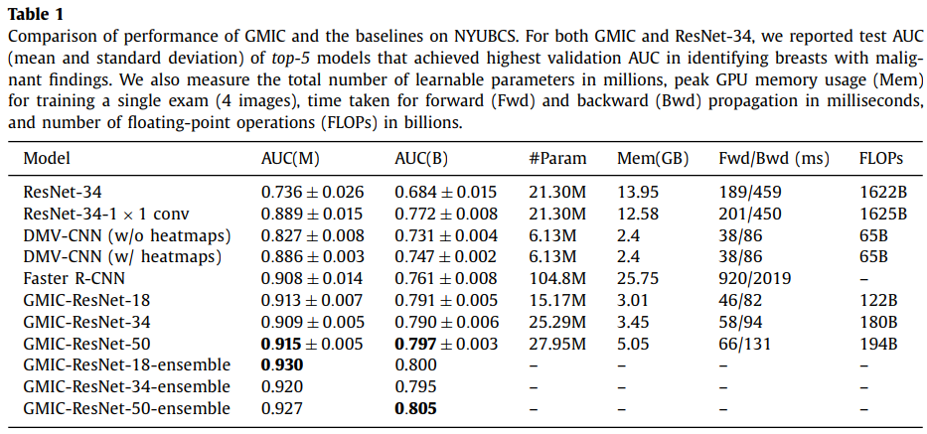
Experimental Results

Slide 7
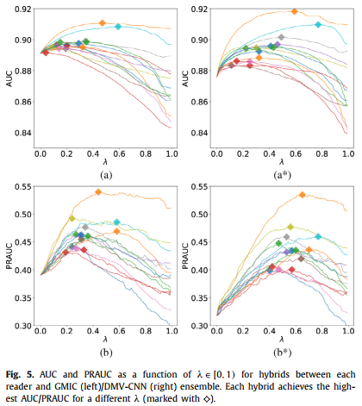
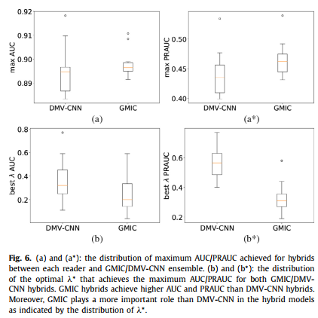

Slide 8
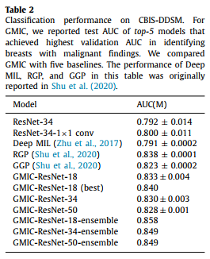
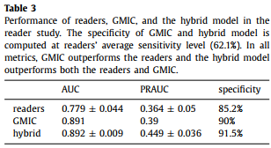
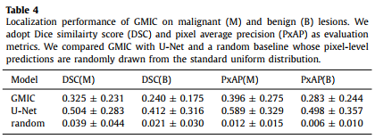
Performance Comparison

Slide 9
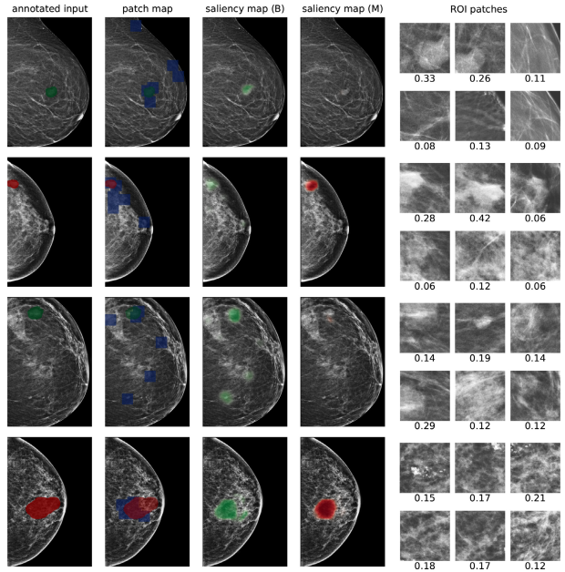

Slide 10
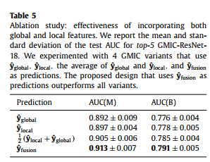
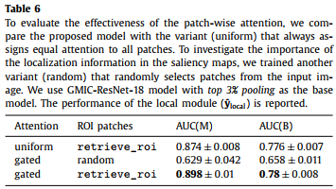
Ablation Study

Slide 11
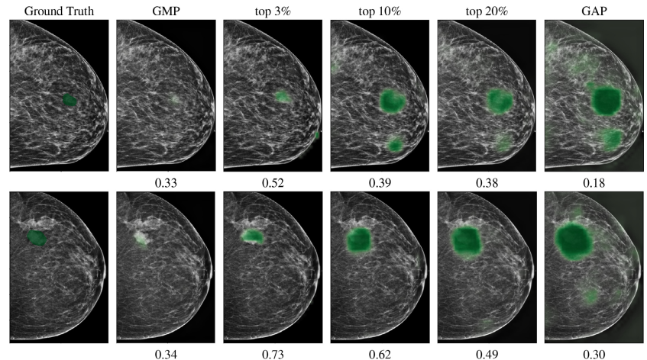
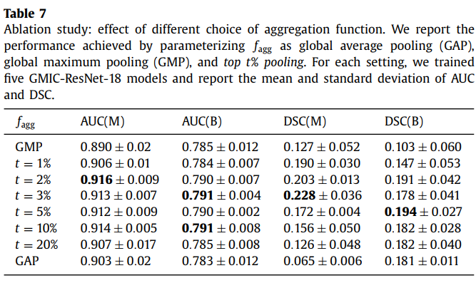
Top t% pooling

Slide 12
Discussions
Advantages:
Focuses on both local features and global context
Introduces top t% pooling
Expert medical staff on board
Code available for verification
Disadvantages:
NYU dataset doesn’t have a fix testset. CBIS-DDSM has a fix test set
There is scope for weight assignment & tuning in the loss function

Slide 13
Thank You!
Any Questions

