Slide 1
Review of High-Resolution Mammogram Synthesis using Progressive Generative Adversarial Networks
Neha Ujjainkar & Abhishek Khandekar

Slide 2
Goal of the study
.
The goal of this paper is to demonstrate the applicability of GANs in generating synthetic Full Field Digital Mammograms. (FFDM)
Demonstrate progressive training and various stabilization methods that can be employed for the synthesis of high-resolution mammograms.

Slide 3
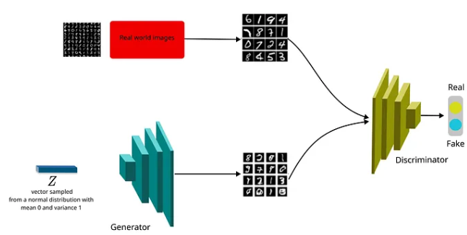
Introduction
.
The generation of synthetic medical images is of increasing interest to both image analysis and machine learning communities for several reasons.
Data augmentation
Domain transfer
Image-to-Image translation
In semi-supervised learning, leverage unlabeled alongside labeled data in order to improve classification or detection performance.

Slide 4
Issues with other Generative models
.
Auto Regressive Model:
Generate image pixels one at a time, conditioned on all previously generated pixels.
Issues:
Have not been able to scale to high image resolutions.
The computational cost of generating a single image does not scale favorably with its resolution.

Slide 5
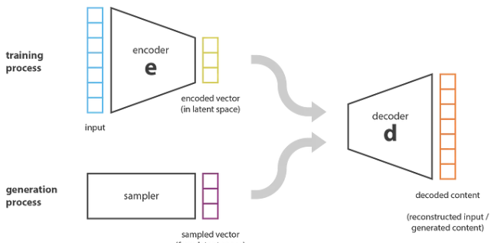
Issues with other Generative models
.
Variational Auto-encoders:
It captures the underlying probability distribution of a given dataset and generates novel samples using an encoder-decoder structure.
Issues:
Restrictions on the prior and posterior distributions limit the quality of the drawn samples.
Training with pixel losses exhibits an averaging effect across multiple possible solutions in pixel space, which manifests itself as blurriness.

Slide 6
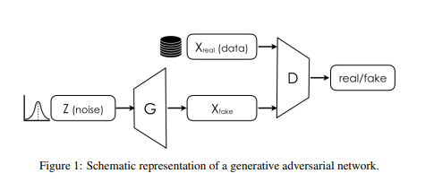
GAN
.
Generative Adversarial Networks :
Issues:
Training can be unstable.
Susceptible to mode collapse.
Gradient saturations.

Slide 7
GAN
.
Generative Adversarial Networks :
Both the generator and discriminators are trained using cost functions directly opposing each other.
The discriminator binary cross entropy is as follows:

Slide 8
Wasserstein GAN
.
Wasserstein GAN :
The difference between the real and generated data distribution in terms of how much work is required to transform one distribution into another.
WGAN aims to minimize the difference between the real and generated data distribution.

Slide 9
Wasserstein GAN
.
Wasserstein Loss :
The difference between the real and generated data distribution in terms of how much work is required to transform one distribution into another.
Lipschitz continuity :
Penalty is calculated by using Lipschitz continuity.
Gradients are penalized by using Lipschitz continuity.
Change in output with respect to input using L2 normalization and bound it to not go beyond 1.

Slide 10
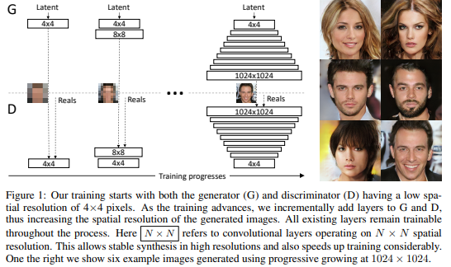
Progressive GAN
.
PG-GAN:
Generates high-resolution images at 1024 X 1024.
Grow both the generator and discriminator progressively.

Slide 11
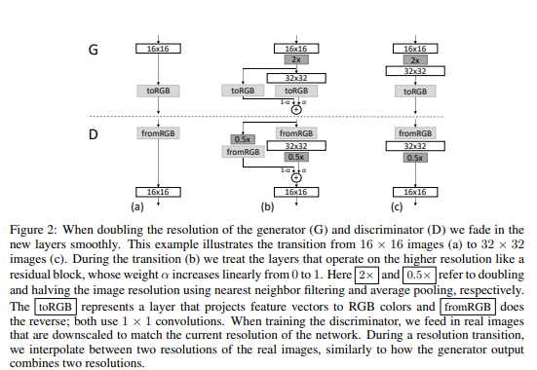
Progressive GAN
.
PG-GAN:
Methodology is similar to Resnet.
Uses skip connections.

Slide 12
Progressive GAN
.
PG-GAN: A further important contribution
Minibatch Standard Deviation:
To improve the diversity of generated images, PG-GANs incorporate a minibatch standard deviation.
Equalized learning rates:
Used to increase stability and speed up convergence during training.
Wasserstein Distance:
The difference between the real and generated data distribution in terms of how much work is required to transform one distribution into another.

Slide 13
Dataset
.
Proprietary dataset :
Number of images (>1,000,000)

Slide 14
Training
.
Down-sampled the training images by the largest factor to match one of the desired dimensions and padded the other dimension with zeros.
Initially trained until the network was presented with 15 million images (33 epochs) which took about 52 hours.
Later performed additional training on 5 million images and selected the best network checkpoint based on the Sliced Wasserstein Distance.
The final output image size is 1280x1024 pixels.

Slide 15
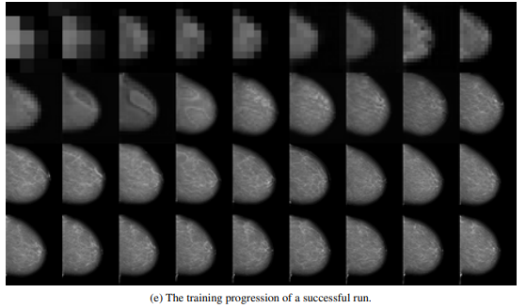
Training
.

Slide 16
Training Challenges
.
Increased the number of images used for training, from an initial 150k to 450k. - This helped introduce more variation. (also introduced some noise)
Added some supervised information by conditioning on the view, namely CC and MLO. - This step was highly relevant as it had a significant impact on the visual appearance of the images.
Decreased the learning rate from 0.002 to 0.0015 and gradually increased the discriminator iterations from 1 to a maximum of 5 discriminator updates for each generator update.

Slide 17
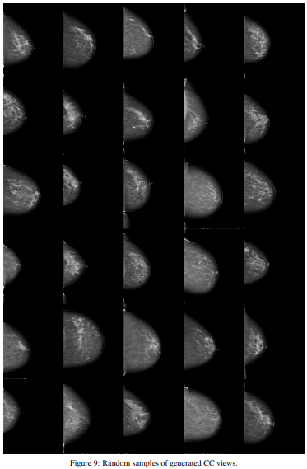
Result
.
6x5 grids of randomly selected
generations from CC views.

Slide 18
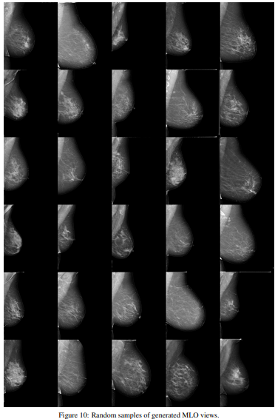
Result
.
6x5 grids of randomly
selected generations
from MLO views.

Slide 19
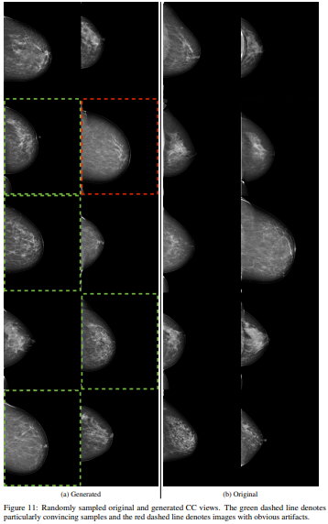
Result
.
Randomly sampled original and
generated CC views. The green
dashed line denotes particularly
convincing samples and the red
dashed line denotes images with obvious artifacts.

Slide 20
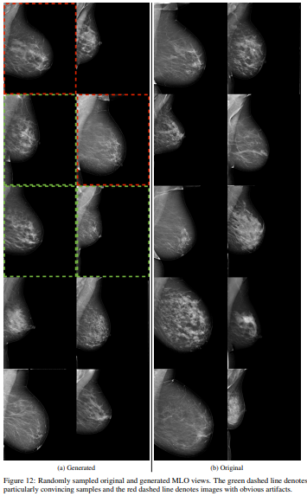
Result
.
Randomly sampled original and generated MLO views. The green dashed line denotes particularly convincing samples and the red dashed line denotes images with obvious artifacts.

Slide 21
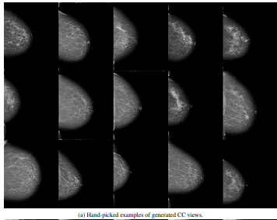
Result
.
3x5 grids of handpicked convincing results from CC views.

Slide 22
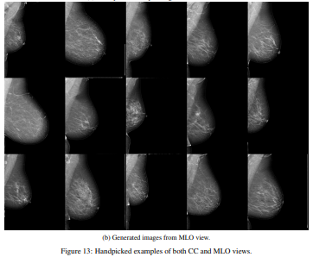
Result
.
3x5 grids of handpicked convincing results from MLO views.

Slide 23
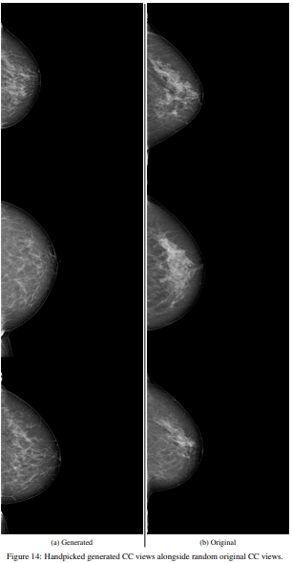
Result
.
1x3 grids of handpicked convincing results, alongside the real image.(CC)

Slide 24
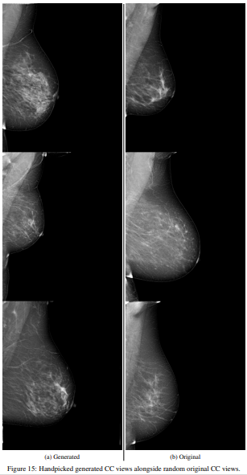
Result
.
1x3 grids of handpicked convincing results, alongside the real image.(MLO)

Slide 25
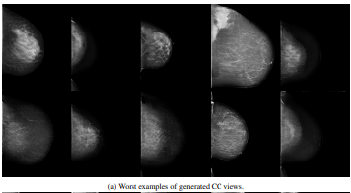
Failure Results
.
2x5 grids where we present examples of failures from CC and MLO views, along with images with artifacts from the training set

Slide 26
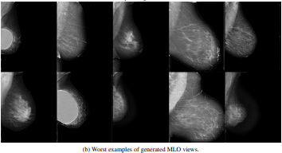
Failure Results
.
2x5 grids where we present examples of failures from CC and MLO views, along with images with artifacts from the training set

Slide 27
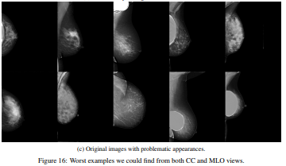
Failure Results
.
2x5 grids where we present examples of failures from CC and MLO views, along with images with artifacts from the training set

Slide 28
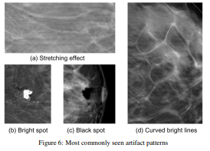
Failure Results
.
Network failures, which indicate that not all possible latent vectors correspond to valid images in pixel space. Others can be attributed to problems in the training set

Slide 29
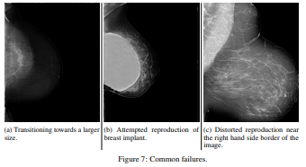
Failure Results
.
Network failures, which indicate that not all possible latent vectors correspond to valid images in pixel space. Others can be attributed to problems in the training set

Slide 30
Advantages
.
This study was the first to show that the generation of realistic synthetic medical images was feasible at up to 1280x1024 pixels, the highest resolution achieved for medical image synthesis then.
This study managed to overcome the underlying instabilities inherent in training such adversarial models and was able to generate images of higher resolution.

Slide 31
Disadvantages
.
The MLO view was harder to model for this approach as it exhibited the highest variation and contained the most anatomical information.
Several types of failures in the generated images were observed. Some of them were network failures that indicated that not all possible latent vectors correspond to valid images in pixel space.

Slide 32
Conclusion
.
The proposed approach was successful in generating highly realistic, high-resolution synthetic mammograms using a progressively trained generative adversarial network.
This study managed to overcome the underlying instabilities inherent in training such adversarial models and was able to generate images of higher resolution. (1280x1024 pixels)

Slide 33
References
https://www.georgeho.org/deep-autoregressive-models/
https://arxiv.org/pdf/2010.10258.pdf
Understanding Variational Autoencoders (VAEs) | by Joseph Rocca | Towards Data Science
Goodfellow, I., Pouget-Abadie, J., Mirza, M., Xu, B., Warde-Farley, D., Ozair, S., Courville, A., and Bengio, Y. (2014). Generative adversarial nets. In Advances in neural information processing systems, pages 2672–2680.
Karras, T., Aila, T., Laine, S., and Lehtinen, J. (2018). Progressive growing of gans for improved quality, stability, and variation. In Proceedings of the International Conference on Learning Representations.
Gulrajani, I., Ahmed, F., Arjovsky, M., Dumoulin, V., and Courville, A. C. (2017). Improved training of Wasserstein gans. In Advances in Neural Information Processing Systems, pages 5767–5777.
Arjovsky, M., Chintala, S., and Bottou, L. (2017). Wasserstein GAN. arXiv preprint arXiv:1701.07875 (2017).
Costa, P., Galdran, A., Meyer, M. I., Niemeijer, M., Abràmoff, M., Mendonça, A. M., and Campilho, A. (2017). End-to-end adversarial retinal image synthesis. IEEE transactions on medical imaging, 37(3):781–791.

Slide 34
.
Thank You

