Slide 1
Pre-training in Medical Data: A Survey
Qiu, Y., Lin, F., Chen, W. et al. Pre-training in Medical Data: A Survey. Mach. Intell. Res. 20, 147–179 (2023). https://doi.org/10.1007/s11633-022-1382-8
Augustine Ofoegbu, Dan Eassa

Slide 2
Overview
Background
Medical imaging tasks
Classification
Segmentation
Survival Prediction
Other data types
Bio-Signal data
Electronic Health Records
Multi-modal medical tasks
Challenges and future direction
Conclusion

Slide 3
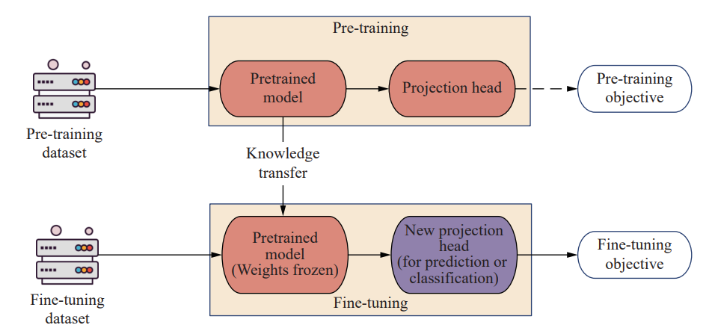
Why pretraining?
Allows use a small labelled data to train an effective model
Pre training was invented from the lack of data information
Lack of labels and data volume
Through pre-training, clusters or features in the data are extracted by the model
Improves generalization ability for specific content
Notes:
Pre-training is a process of learning universal feature representations and then using the pre-trained model in the downstream tasks
i.e. limited data due to a rare disease

Slide 4
Why pretraining?
Accelerate convergence process on downstream tasks
particularly where computational resources are constrained
Ever increasing amount of data generation across all industries
High cost of manual annotation
Leverages abundant non-labelled data
Alleviate the effect of training on data with imbalanced labels
Notes:
Self-supervised pre-training leverages abundant non-labelled data, getting a good initialization before the downstream tasks

Slide 5
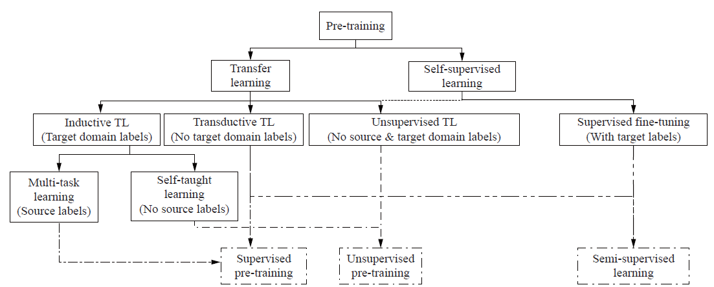
Pre Training Techniques
Notes:
Transfer Learning
Learns the related knowledge in the target domain by transferring information from the same or related domain
Involves two steps - pretraining and fine tuning
Self-Supervised learning
A pre training approach that involves extracting abundant knowledge from unlabelled data
Enables the production of the supervision information by itself instead of manual annotations
the loss function is minimized in the space where the representations live: the feature space

Slide 6
Self Supervised Learning
Find unlabeled data, usually from the same domain (distribution)
Decide on the representation learning objective (pretext task), or the method that you want to try
Choose augmentations and train for several epochs
Take the pre-trained feature extractor and fine-tune it with an MLP on top. MLP usually stands for 2 linear layers with ReLU activations in-between.
Train on the downstream task
You can fine-tune the pre-trained network or keep its weights frozen
Compare with baseline
Notes:
if no baseline, compare with the architecture without self-supervised pre-training

Slide 7
Contrastive Self Supervised Learning
Refers to any training method wherein a classifier distinguishes between “similar” (positive) and “dissimilar” (negative) input pairs
Contrastive learning aims to align positive feature vectors while pushing away negative ones
Relies heavily on augmentations
Self-supervised learning needs heavy regularization as the space of possible solutions is extremely big and there are a lot of chances of overfitting
Notes:
Since we do not have labels, it is very common to distinguish data by comparison
To make a positive pair, we apply 2 different stochastic transformations in the same image
To make a negative pair, we apply 2 different stochastic transformations in a different image
Augmentations should make sense in terms of the downstream task
Augmentation must maintain the image semantics (meaning)
Augmentation must give the model a hard time
Finally, augmentations are dependent on the dataset’s diversity and size.
A heavily used standardization layer before feeding the output to the loss functions is the softmax with temperature
We teach the model what a fake image (negative sample) is compared to a real one (positive sample)
Regularizations - L2 weight regularization (weight decay), LARS optimizer, learning rate warmup, learning rate decay, as well as batch normalization.
In the simplest case we have 2 views of an image
Loss functions: the core idea behind SSL

Slide 8
Momentum Contrast for Unsupervised Visual Representation Learning (MOCO)
A contrastive learning approach using dictionary look-up via a dynamic dictionary with a queue and moving-averaged encoder
MoCo learns the robust representation via performing dictionary look-up by making the query embeddings closed and its matching key embedding far away
Notes:
There are two necessities to build such a reasonable dictionary:
The dictionary should be large enough
The representation should be consistent
MoCo mechanism achieves the first necessity through a dynamic memory bank, where the oldest mini-batch will be progressively replaced by a new one. At the same time, a momentum update method is introduced to address the key representations′ consistency
The representation should be consistent (the key requires to be encoded using a similar or identical encoder to be meaningful of the similarity metric between query and key in the dictionary).

Slide 9
Swapping Assignments between Multiple Views (SwAV)
Cluster assignment-based contrastive learning paradigm
SwAV does not calculate view-pair comparison, instead comparing the cluster assignments of the different views
Requires less computation resources
Notes:
SwAV introduces online clust
Proposes a multi-crop augmentation strategy aiming to increase the number of image views while not burdening with extra memory and computation cost ering, which maps the features (Z = z1, z2, z3,..., zB ) to a set of vectors ( Q = q1, q2, q3,..., qB ) by the prototype ( C = c1, c2, c3,..., cB ). Then, the newly defined loss is to minimize the similarity with a setup of swapped prediction

Slide 10
Simple framework for contrastive learning of visual representations (SimCLR)
Learns representation on an unlabelled dataset by maximizing agreement between random conducting augmentation methods for the same data sample via a contrastive loss
Data is augmented with randomly selected methods producing two views. These two views are are a positive pair, while all other samples are negative
Notes:
Augmented views pass through the backbone, typically a large-scale neural network, producing the embeddings that are the features of the data we want to get via the pre-training settings
The dimensionality of trained embeddings is reduced through a multi-layer non-linear projection head. The losses are calculated by conducting the loss function for a positive pair and its corresponding negative samples in a mini-batch

Slide 11
Bidirectional Encoder Representations from Transformers (BERT)
Transformer is an attention mechanism that uses the structure of the encoder and decoder to calculate the relationship between input information
After the input is passed through the encoder, the contribution of an input element to the total input can be calculated
In natural language processing (NLP), this attention score is used as the weight of other words for that word to compute a weighted representation of a given word
The influence representation of a given word can be obtained by feeding a weighted average of all word representations into a fully connected network
When passing through the decoder, only a one-word representation can be decoded in one direction at a time, and each decoding step will consider the previous decoding results
Notes:
BERT profoundly affects the processing and generation of EHRs data and textual medical data in the medical field
Adopts the main structure of the bidirectional deep Transformer

Slide 12
BERT
After pre-training, BERT can obtain robust parameters for downstream tasks.
By modifying inputs and outputs with data from downstream tasks, BERT can be fine-tuned for any NLP task
Notes:
For input, its pattern is two sentences connected by a particular token [SEP], which can represent
1) Sentence pairs in paraphrasing;
2) Hypothesis-premise pairs in implication;
3) Questions in question answering-paragraph pairs;
4) Single sentences for text classification or sequence tagging
For output, BERT will generate a token-level representation for each token, which can be used to process sequence labelling or question answering, and unique tokens [CLS] can be fed into an additional layer for classification
. BERT can handle these applications efficiently by inputting a single sentence or sentence pair.

Slide 13
Medical Images in Pre-training
Three main areas of interest
Diagnosis (classification)
Segmentation
Survival prediction / survival analysis
Image data modalities include CT, MRI, X-ray, Ultrasound, Dermoscopy, Ophthalmology, whole slide tissue images (WSI), etc
A pre-trained model used in medical imaging tasks not only reduces the labour cost of data processing but also improves the efficiency of the model learning process
Solves the problem of image labelling and the problem of fewer data in pre-training
Notes:
Small-scale image datasets are common, several investigations have used pre-trained methods to mitigate the influences of the insufficient scale of image data
The application of pre-training on images greatly improves the function of auxiliary medical detection, reduces the workload of doctors, and improves the reliability of diagnosis.
results on this are state-of-the-art on a small scale of data
Applied in Diagnosis experiments on several medical image datasets including CT/MRI, mammograms, ultrasound image classification, X-rays, etc
For segmentation, pre-trained deep learning models show comparative advantage results compared to other methods in Image segmentation tasks
For 3D segmentation, both the convergence speed results of the pre-trained transfer learning is significantly higher than that of the ordinary model.
pre-trained encoder can accurately learn the features of the picture

Slide 14
Survival Prediction
Survival prediction (survival analysis or prognosis) is a medical task to predict the expected duration of time until events happen (e.g., death),
There are very few large, labelled, and public datasets. It may be possible to overcome the challenge of limited data by pre-training on a large dataset from another domain
Time Series Data
The images captured from the same area at different times
Outperforms other advanced clinical prediction methods
eg. gradual deterioration of brain structure and function caused by ageing
Notes:
Survival
Some works have utilised deep learning methods to achieve state-of-the-art survival prediction results
However, the requirement for large amounts of well-phenotyped training data has still been one of the significant challenges for introducing deep learning into survival prediction
Time Series
For instance, the CT images of the same body area scan at 1, 3 and 6 months, respectively. The set of images can be regarded as time-series images data that contain abundant temporal relevant diagnostic information.

Slide 15
Bio Signal Data
Examples include electrocardiograms, stress level detection, personality analysis, emotion recognition
Unsupervised or self-supervised pre-training yielded a lower performance than supervised pre-training
Still feasible from a practical perspective as fewer annotations required
Models pre trained on both real and synthetic data have been used to efficiently remove noise from and pretrain Bio signal data
Pre-trained models enable enhanced performance in emotion detection and sleep stage detection
Notes:
Large number exist and contain a large volume of physiological information
Electroencephalograms (EEG), electrocardiograms (ECG), heart rate variability (HRV), electromyograms (EMG), electrodermal activity (EDA) and photoplethysmography (PPG)
DL-based advances in bio-signals enable the processing of signals
signal segmentation, wave detection, and noise removal
enable creation of high-quality feature representations to be used in clinical applications
signal de-noising, disease diagnosis, emotion recognition, genetic mutation detection
These studies have all shown the pre-training techniques to succeed in specific scenarios
Performance isn’t always improved by pretraining but still practical as it reduces training time and speeds up convergence process
No large-scale dataset supports pre-training a generalized and high-quality representation of features. Therefore, for bio-signals, a specific pre-training framework is required to explore to get further improvements in the performance
Some experiments showed that self-supervised learning can alleviate the class imbalance problem

Slide 16
Electronic Health Records
EHRs related tasks include prediction, information extraction from clinic notes, the international classification of disease (ICD) coding, medication recommendation, etc
In conditions where there is a lack of data, it is possible to enhance the performance of the model with pretraining
Transformer-based models, such as BERT, are the mainstream for EHR data pre-training-related works.
Med-BERT achieved promising performance on disease prediction tasks with small fine-tuning datasets
Notes:
AI-aided prediction is critical in clinical practice, automatically analysing patients′ conditions and providing suggestions to doctors for saving more lives. The primary purpose of prediction in EHRs is to predict the progression of the disease, such as mortality, the next visit, etc
In comparison with pre-training in other areas, there are fewer exploration opportunities for EHR data
Med-BERT to predict heart failure among patients with diabetes and the onset of pancreatic cancer
The development of a privacy-related pre-training framework seems to be a promising topic in EHR studies
Med-BERT to predict heart failure among patients with diabetes and the onset of pancreatic cancer
However, if the pre-trained model consists of abundant auxiliary tasks and has a complex relationship to the target task, using the pre-trained model becomes inefficient and subnormal
Information Extraction
As EHR data contains valuable information which can assist doctors in diagnosing and making the treatment scheme.
Recent studies have introduced pre-training in processing EHR data with improved results

Slide 17
Medication recommendation
Aims to recommend a set of medicines according to the patient's symptoms, which would play a critical role in assisting doctors in making decisions
Could be a potential strategy to mitigate the doctor shortage problem in some countries
ICD coding
ICD coding is the task of predicting and coding all doctors′ diagnoses with clinical test notes containing patients′ symptoms and diagnostic procedures in an unstructured text format
Notes:
Some recent studies utilised GNN as pre-training to improve performance and interpretability.

Slide 18
Multi-Modality Data
Most publicly available healthcare datasets consist of multiple modalities.
Advances in uni-modal representation learning provide a firm foundation for improving performance in downstream tasks.
To date, most multi-modal pretrained models are based on visual and textual modalities.
Experiments showed the advantages of multi-modal pre-training over text-only embedding
Notes:
It is a part of nature, since the information that people are exposed to is always multimodal.
People see the colour, hear the sound, feel the texture and smell the odour. Humans leverage different senses to better understand the information they receive. A significant reason to learn from multi-modal data is the assumption that the complementary nature of the different modalities can effectively improve performance. This assumption also applies to the medical domain.
The most common modalities in uni-modal pre-training are vision and language.
Multi-modal pre-training tasks in the medical domain
Almost all the multi-modal pre-training in the medical domain is based on V+L modalities. Therefore, most downstream tasks focus on medical images and clinical reports, such as radiology image interpretation and medical visual question answering (VQA).
Introducing AI technology to generate diagnosis reports is crucial for radiology examinations, where a model is used to describe a medical image. Recent research has mainly focused on disease diagnosis and the generation of preliminary diagnosis reports.
Most challenging application of pre training so far
Many researchers have tried to introduce pre-training to process the multimodality data. However, most of the current research only focuses on generating clinical reports and tries to use the model to interpret the radiological examination, and the main reason is that there are many large datasets for this task. In contrast, the lack of task-related datasets limits the progress of research on multi-modality pretraining. Furthermore, there are currently few works on applying pre-training for bio-signal data to make survival predictions. Since bio-signal alone may not provide sufficient information for survival prediction, we see the potential of combining multi-modality data for this critical task and have included a discussion on this interesting future research direction.

Slide 19
Challenges and Future Direction
For basic pre-training techniques
improvement of computation efficiency both in the model pre-training and downstream tasks
developing a non specific task models.
Data scarcity remains one of the most significant barriers to training a high-performance model for medical tasks.
pretrain a general-purpose model on limited data.
pre-training techniques combined with machine learning research relating to privacy
Class imbalance is a common challenge in machine learning and deep learning
Notes:
Future research directions could be explored to maximise pre-training benefits in the medical domain
Although hospitals and other institutions can produce much healthcare data daily, those data cannot be available due to the increasingly strict data privacy clauses.
Many datasets have been published for research, however, the quantity of the data is still short for pre-training a general-purpose model, especially for bio-signal, EHR and multimodality related tasks. Therefore, it is a future direction to pretrain a general-purpose model on limited data.
Privacy concerns about healthcare data require urgent attention due to the strict data privacy clauses.
Specifically, the question of whether personal healthcare information can be recovered via malicious attacks from the pre-trained feature representation has yet to be thoroughly investigated.
This problem would influence whether or not pre-training techniques could be widely applied in real-world applications.
Many privacy-related tasks in ML and DL have become hot topics, such as federated learning and differential privacy learning.
It is expected that pre-training techniques combined with machine learning research relating to privacy will be a promising field for future research in the upcoming years. Many recent works have started to research this medical data privacy field, and this topic would be well worth studying.
If a deep learning model has been trained on a class-imbalanced dataset, the model will bias toward the majority category.

Slide 20
Contributions of the paper
First systematically summarized the pre-training techniques that are used for medical and clinical scenarios
Summarized the medical pre-training models used on four main data types: medical images, bio-signal data, EHR data, and multi-modality. Authors claim to be the first to do a survey so comprehensively
Summarized the benchmark dataset of medical images, bio-signal and EHRs
Discuss the challenges of the pre-training model in the medical domain and look to the topics for future research
Notes:
Searched keywords related to pre-training in the medical domain

Slide 21
Conclusion
Pre-training techniques are hot research topics in ML and DL. It has attracted much attention in medical domain due to the challenges posed by medical data, such as the data scarcity and lack of annotation.
Wanna know more about an area of research?
Start by reading a review paper on that area!
Collection of paper
Bibliography websites,
including Google scholar,
DBLP,
ACM digital library and
Web of Science

