Slide 1
Feature extraction based on empirical mode decomposition for automatic mass classification of mammogram images
Negar Maghsoudi – Ashkan Reisi

Slide 2
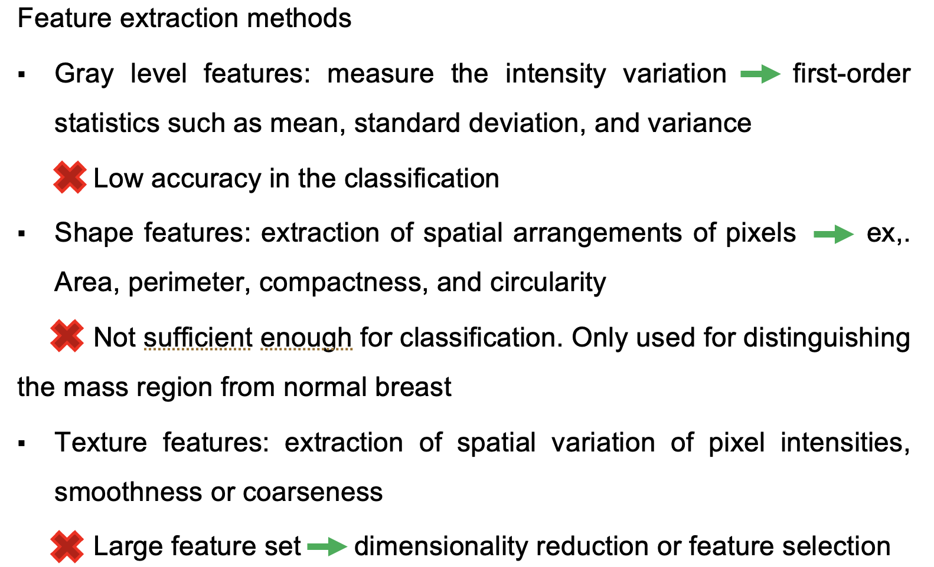
Introduction

Slide 3
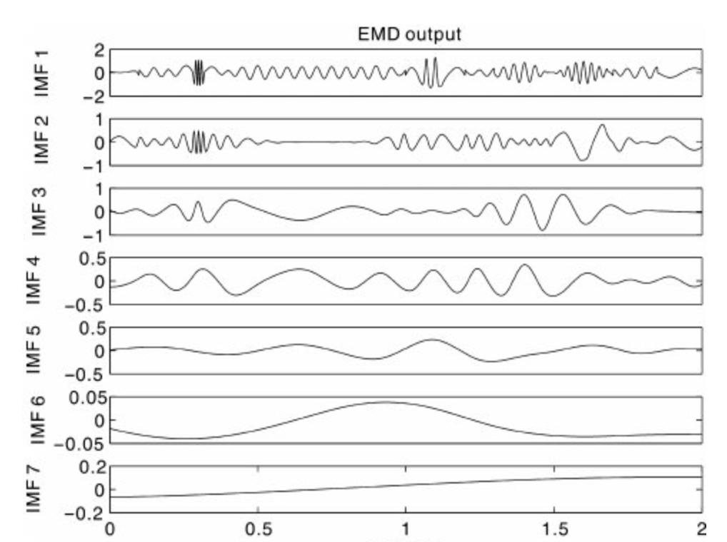
Introduction-Cont.
To address these issues incorporate BEMD technique to extract texture features
The extracted BIMFs are strong characteristics of the texture features
BEMD has the mode mixing problem

Slide 4
BEEMD (Ensemble BEMD)
Incomplete decomposition
Each f^{i}(m,n) is decomposed independently
Leading to reconstruction error

Slide 5
MBEMD (Modified BEMD)
1. The first mode, BIMF1 is obtained in the same way
2. The first residue is calculated as
3. Decompose the residue by adding I realizations of white noise

Slide 6
MBEMD (Modified BEMD)-Cont.
4. The residues and BIMFs are obtained as
5. The reconstructed image is obtained by
Complete decomposition
Negligible reconstruction error
Better separation of modes no mode mixing problem
Reducing the number of sifting iterations less computational complexity

Slide 7
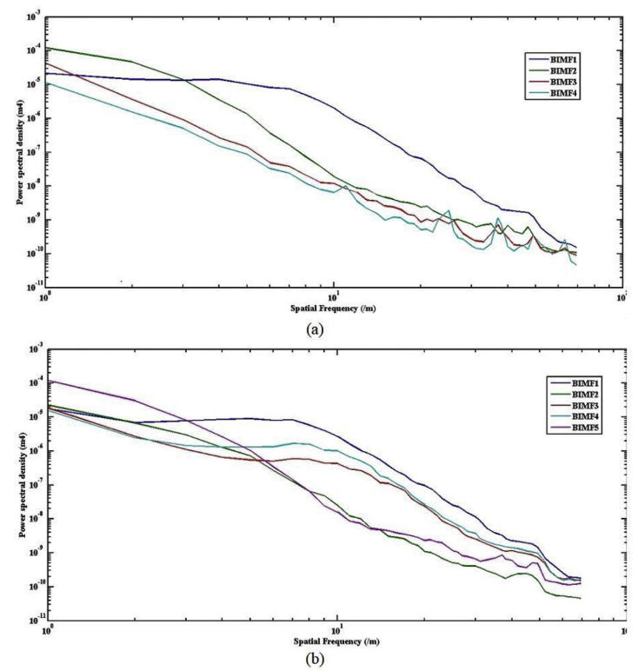
Mode Mixing Problem

Slide 8
Datasets & Environment
Three datasets:
MIAS:
Resizing images to 1024 * 1024
Out of 322 MLO view images, picked 39 with malignant and 53 with benign type of mass.
DDSM
2500 patients (both breasts + MLO and CC) took 60 images with benign and 60 with malignant masses
Mahatma Gandhi Memorial Hospital (MGM)
176 images (MLO and CC)
Resizing 1954 * 2410
Environment:
MATLAB
Intel Core i3 processor
2.10 GHz CPU
4 GB RAM

Slide 9
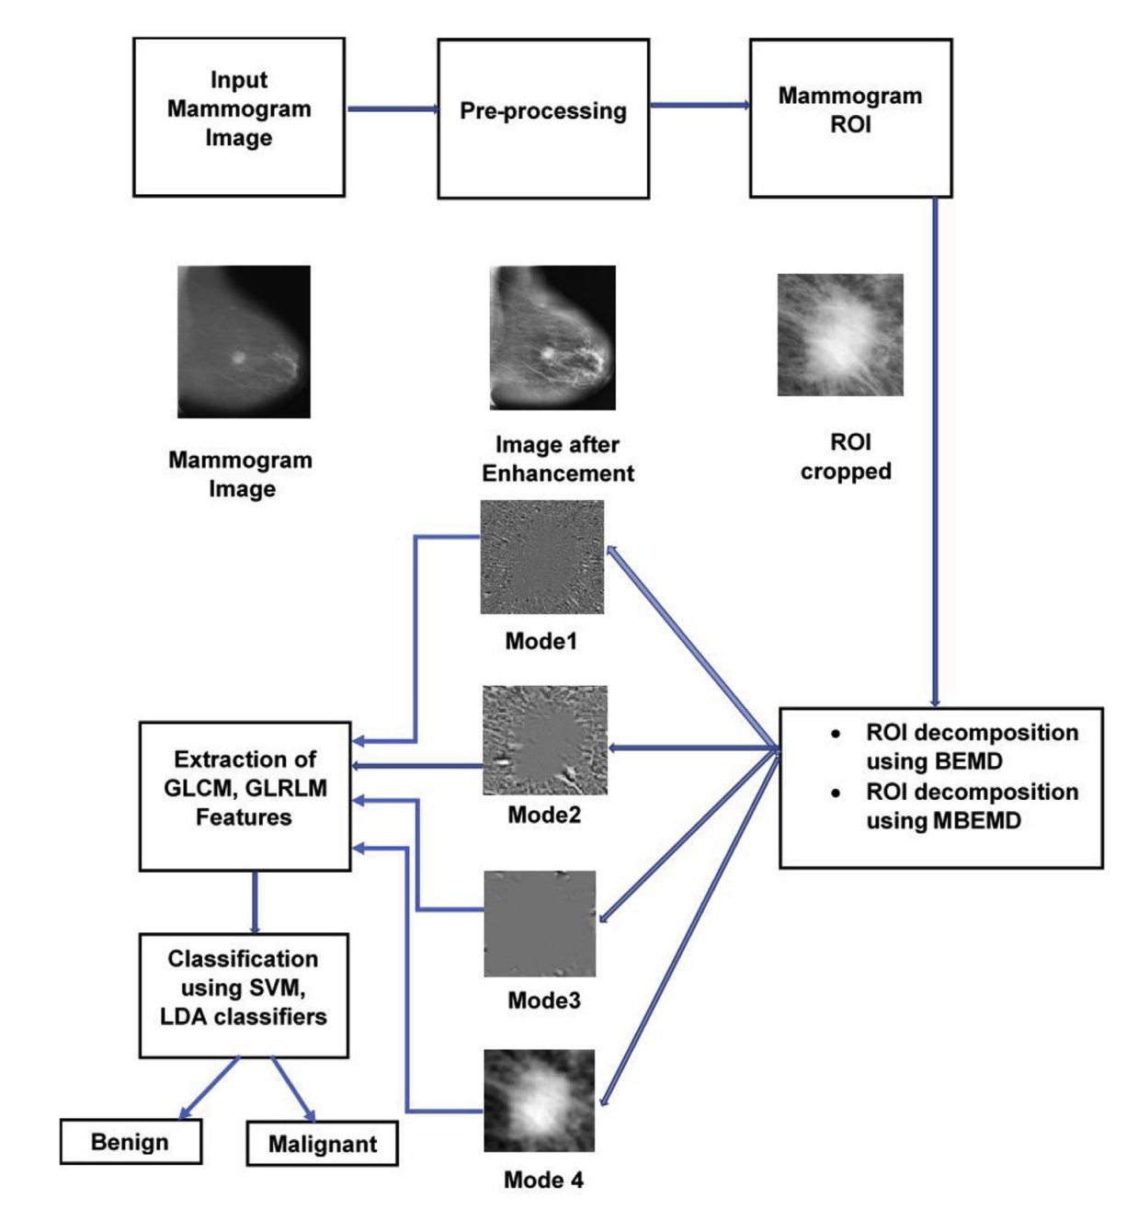
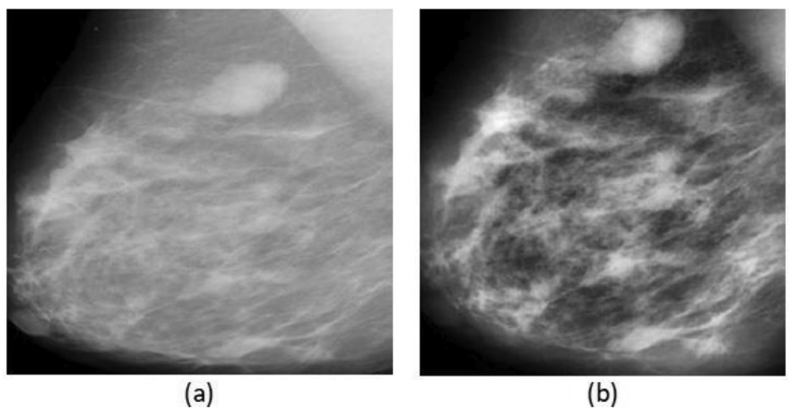
Proposed Pipeline
Steps:
1. Pre-processing
CLAHE
Gaussian smoothing
2. ROI extraction
Manual cropping
3. Decomposition (4 IMFs)
BEMD
MBEMD

Slide 10
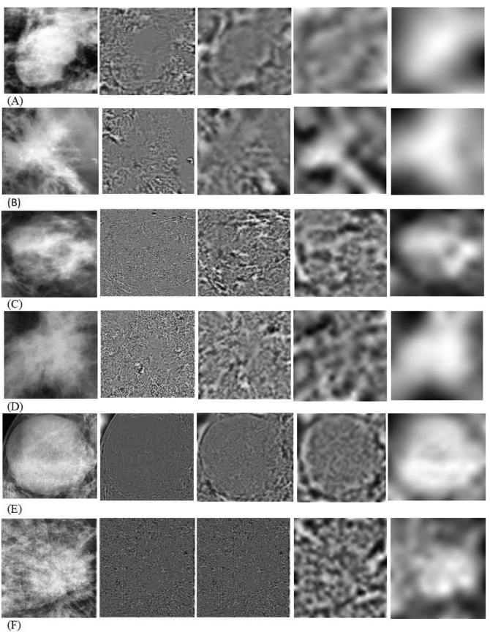
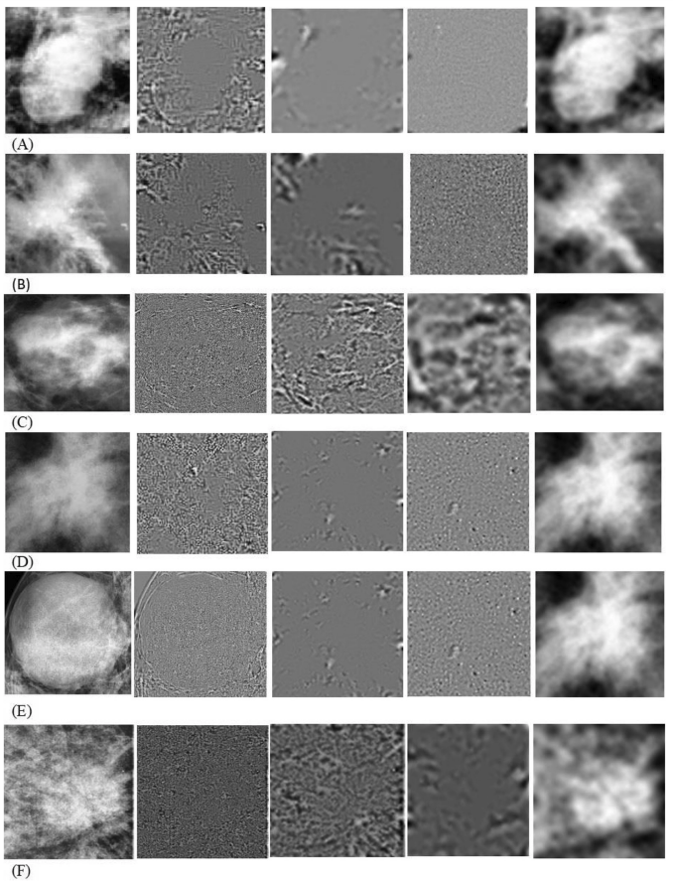
Proposed Pipeline

Slide 11
Proposed Pipeline-Cont.
Steps:
4. Feature extraction
Five GLCM
Seven GLRM
5. Classification
SVM
LDA
6. Performance evaluation
OI
MSE
PSNR
Frequencies of variation of pixel intensity
Energy
Contrast
Entropy
Maximum Probability (Max. Prob)
Inverse Difference moment (Inv. Diff)
The number of adjacent pixels with the same intensity in a particular direction
Short Run Emphasis (SRE)
Long Run Emphasis (LRE)
Gray Level Non-uniformity (GLN)
Run Percent (RP)
Run Length Non-uniformity (RLN)
Low Gray level Run Emphasis (LGRE)
High Gray level Run Emphasis (HGRE)

Slide 12
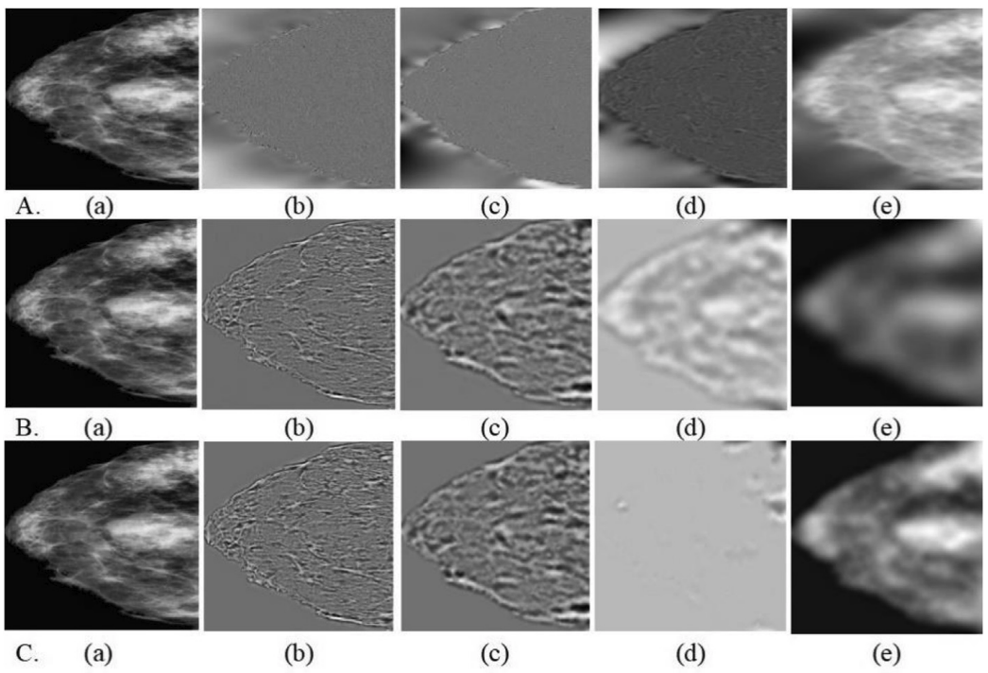
Comparison of EMD algorithms
Decomposition of DDSM image B_3101_1. RIGHT_CC into its BIMFs. A. Decomposition by BEMD B. Decomposition by BEEMD C. Decomposition by the proposed MBEMD. (a) Input image (b) Mode 1: BIMF1 (c) Mode 2: BIMF 2 (d) Mode 3: BIMF3 (e) Mode 4: BIMF4

Slide 13
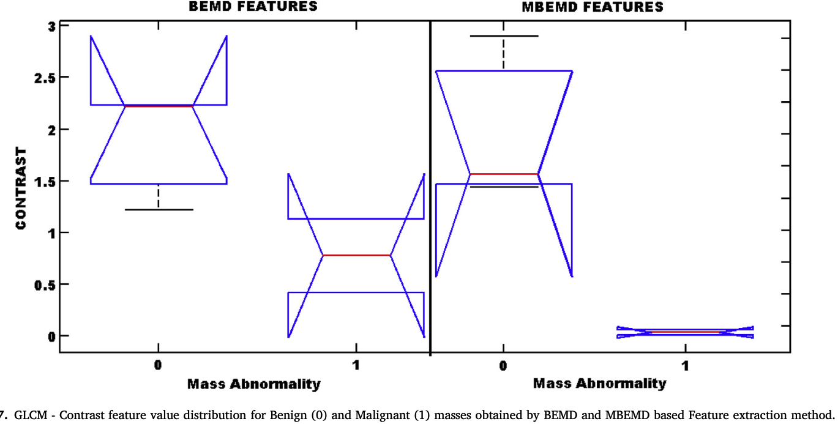
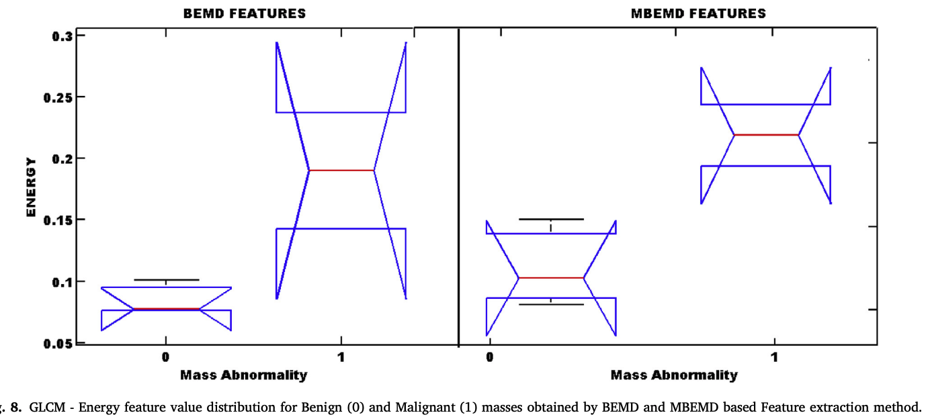
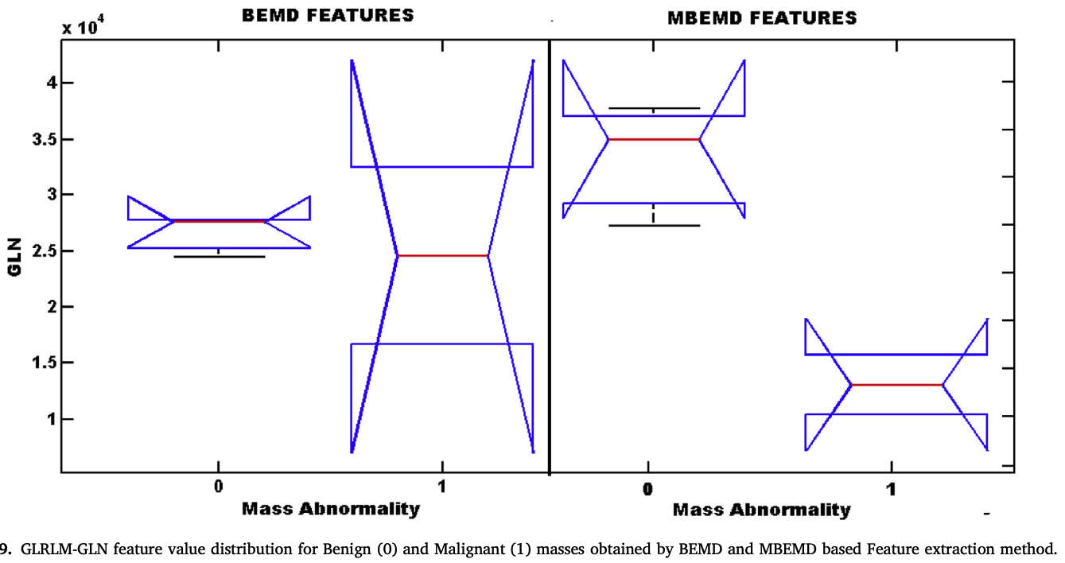
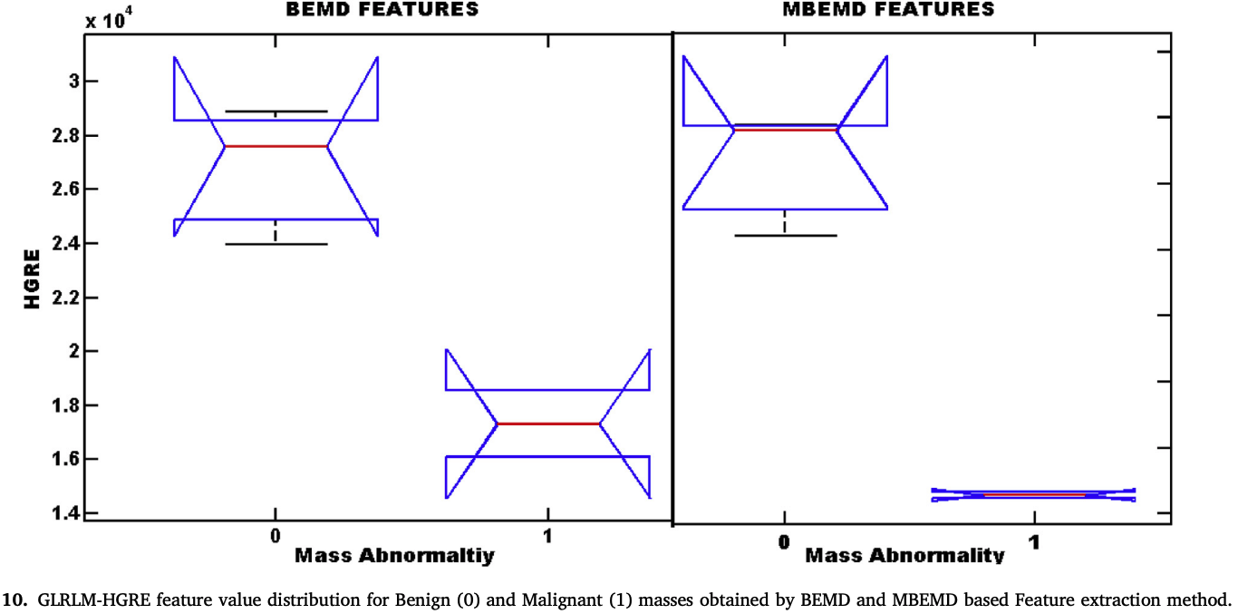
Comparison of EMD algorithms/Feature Extraction

Slide 14
Evaluation Metrics
Orthogonality Index (OI): evaluation of orthogonality of decomposed IMFs The lower OI the less leakage between the IMFs
Mean Square Error (MSE):
Peak Signal to Noise Ratio (PSNR):

Slide 15
Performance Comparison
Lower OI in MBEMD addresses mode mixing problem
Lower MSE in MBEMD and higher PSNR show the completeness
Notes:
MSE is less to show the completeness of BEMD algorithm

Slide 16
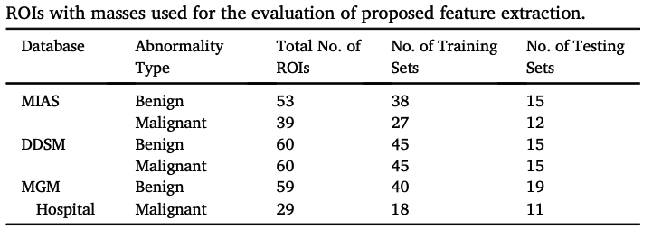
Experimental Results
Datasets
Performing ten-fold cross validation

Slide 17
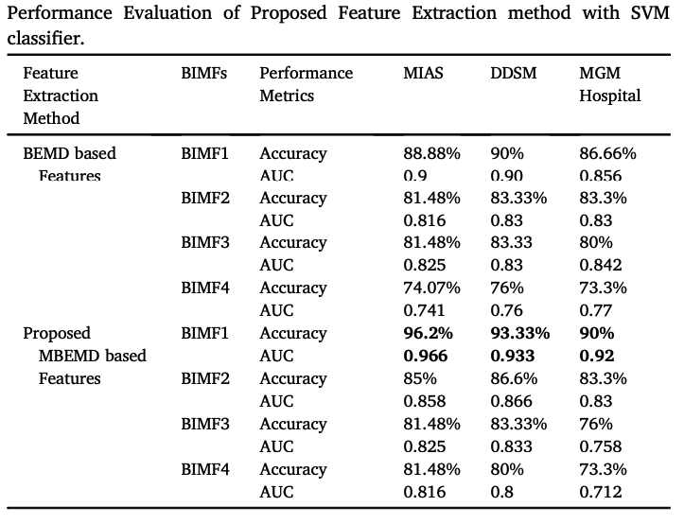
Experimental Results/SVM

Slide 18
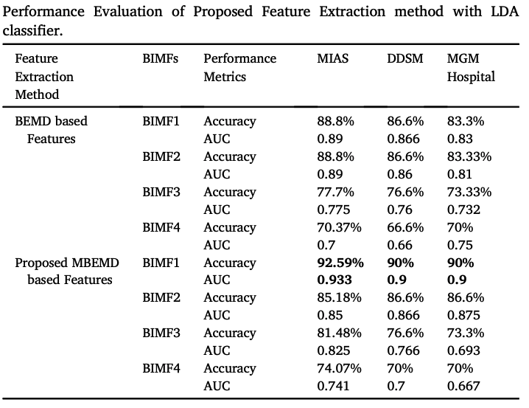
Experimental Results/LDA

Slide 19
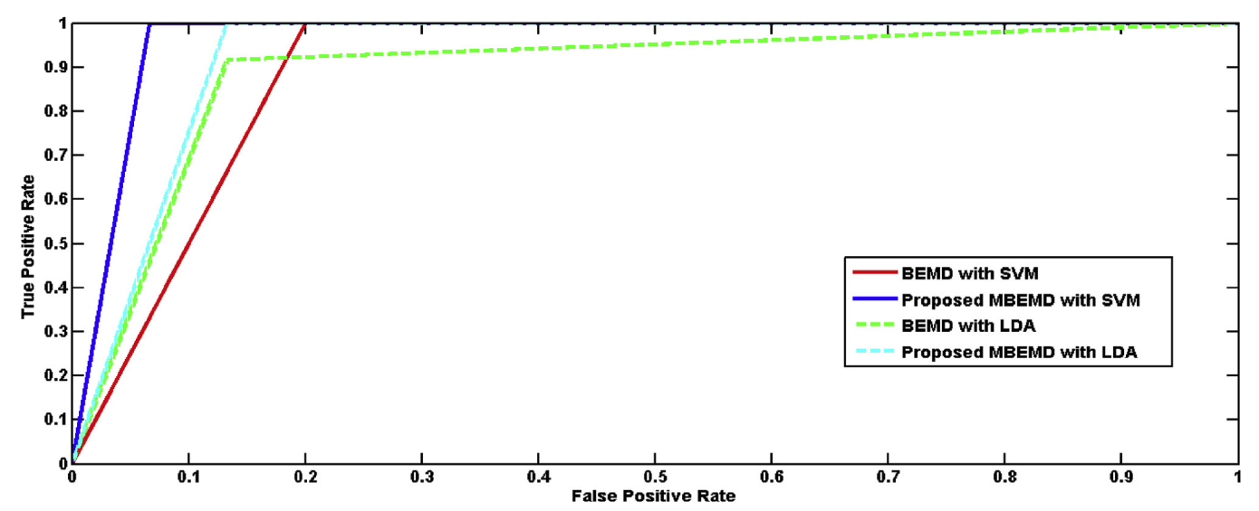
Experimental Results-MIAS

Slide 20
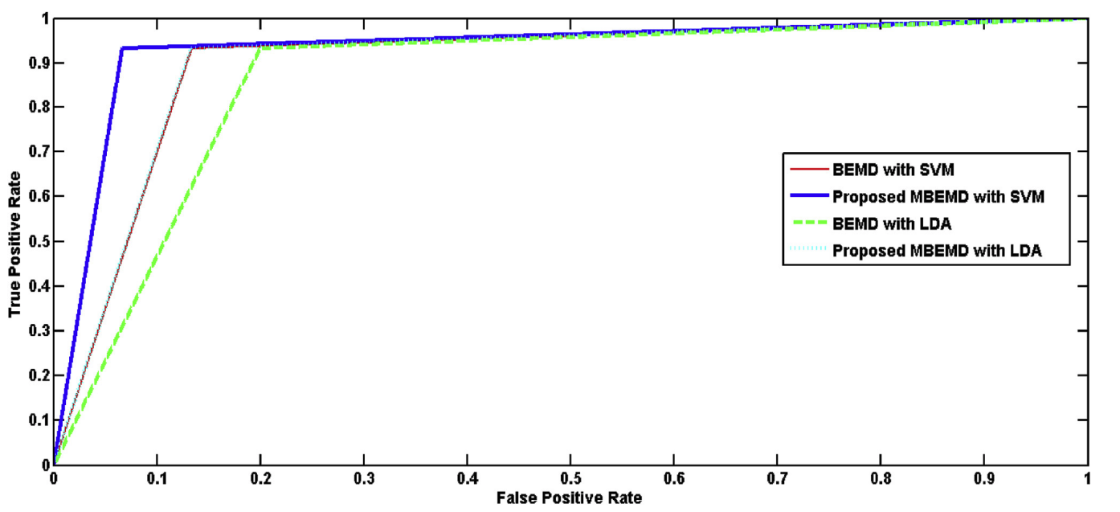
Experimental Results-DDSM

Slide 21
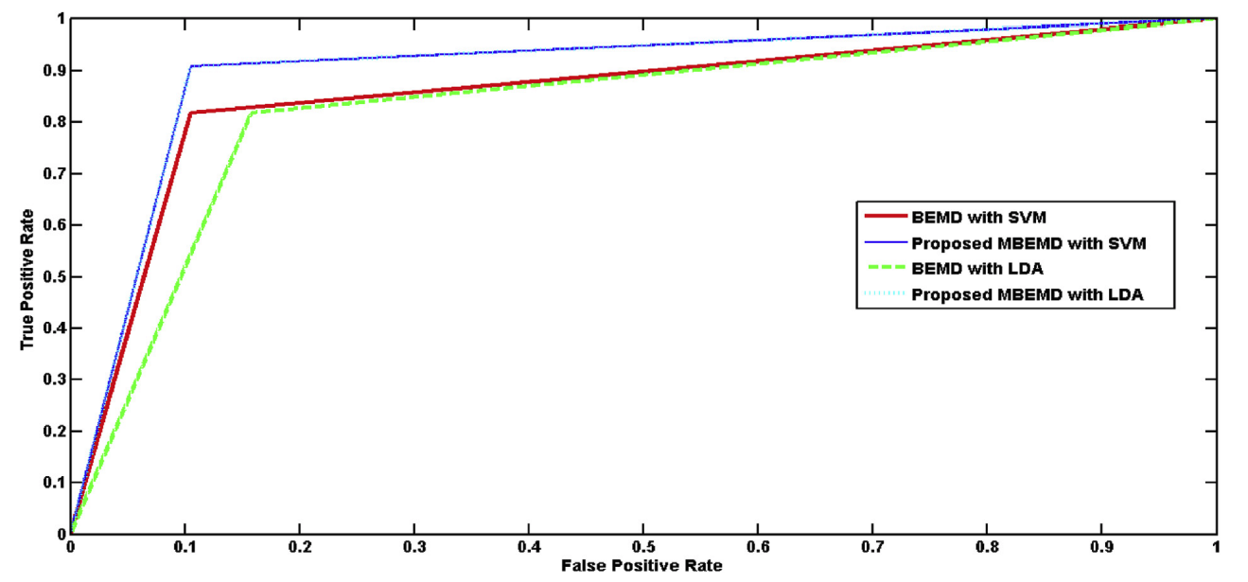
Experimental Results-MGM

Slide 22
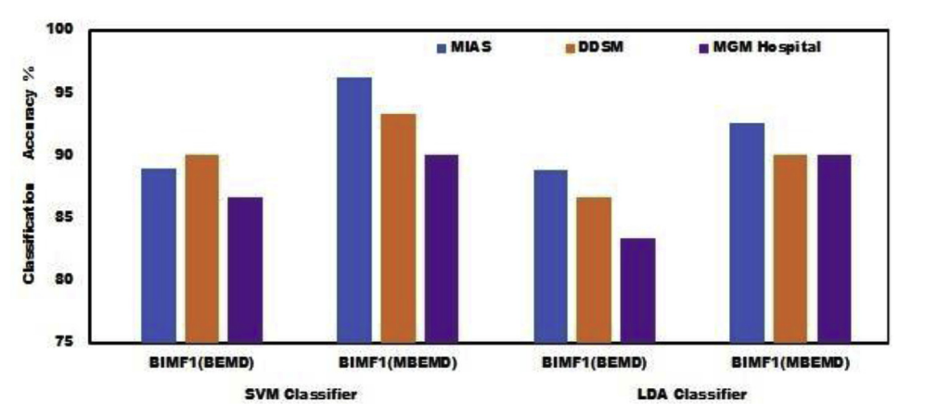
Experimental Results-Accuracy

Slide 23
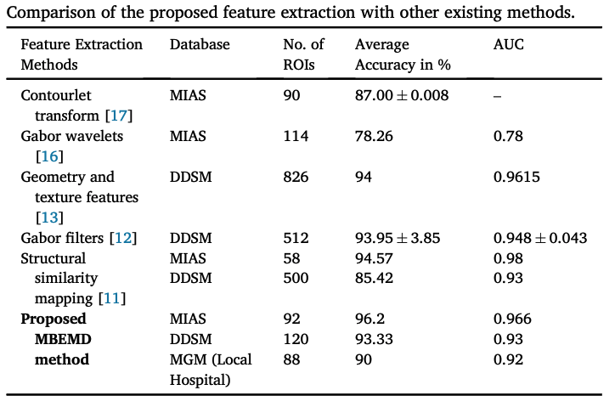
Comparison with Other Methods

Slide 24
Strengths
Extensive comparison between different EMD-based decomposition methods
Utilizing three different datasets for evaluation
Proposing the new decomposition method which provides complete decomposition

Slide 25
Limitations
Wrong method in applying cross-fold validation
Not providing enough detail in their proposed method
Small sample sizes in each dataset
Selective comparison with BEEMD in evaluations
Mostly focusing on the first BIMF in the comparisons (no aggregated result)

